Slide 1
Organizational Behavior
15th Ed
Chapter 11
Robbins and Judge
Communication

Slide 2
Chapter 11 Learning Objectives
After studying this chapter you should be able to:
Identify the main functions of communication.
Describe the communication process and distinguish between formal and informal communication.
Contrast downward, upward, and lateral communication, and provide examples of each.
Contrast oral, written, and nonverbal communication.
Analyze the advantages and challenges of electronic communication.
Show how channel richness underlies the choice of communication channel.
Differentiate between automatic and controlled processing of persuasive messages.
Identify common barriers to effective communication.
Show how to overcome the potential problems in cross-cultural communication.

Slide 3
Identify the main functions of communication
LO 1
Functions of Communication
  Control
  Motivation
  Emotional Expression
  Information

Slide 4
Identify the main functions of communication
LO 1
Control - Organizations have authority hierarchies and formal guidelines that employees are required to follow.
  Informal communication also controls behavior.
    When work groups tease or harass a member who produces too much, they are informally communicating with, and controlling, the member’s behavior.

Slide 5
Identify the main functions of communication
LO 1
Motivation
  Clarifies to employees what is to be done, how well they are doing, and what can be done to improve performance.
  The formation of specific goals, feedback on progress toward the goals, and reinforcement of desired behavior all stimulate motivation and require communication.

Slide 6
Identify the main functions of communication
LO 1
Emotional Expression
  Provides a release for the emotional expression of feelings and for fulfillment of social needs.
  For many employees, their work group is a primary source for social interaction.

Slide 7
Identify the main functions of communication
LO 1
Information
  Communication facilitates decision-making.
  It provides information by transmitting the data to identify and evaluate optional choices.

Slide 8
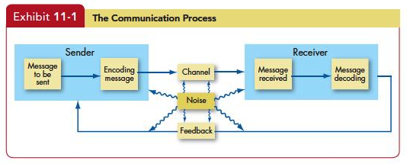
Describe the communication process and distinguish between formal and informal communication
LO 2

Slide 9
Contrast downward, upward, and lateral communication, and provide examples of each
LO 3
Downward Communication
  Flows from one level to a lower level.
  Purpose is to assign goals, provide instructions, communicate policies and procedures, provide feedback.
  Downward communication must explain the reasons why a decision was made.
  It has a one-way nature.

Slide 10
Contrast downward, upward, and lateral communication, and provide examples of each
LO 3
Upward Communication
  Flows to a higher level.
  Provide feedback to higher-ups, inform them of progress, and relay current problems.
  To engage in effective upward communication.
    Try to reduce distractions.
    Communicate in headlines not paragraphs.
    Prepare an agenda to make sure you use your boss’s attention well.

Slide 11
Contrast downward, upward, and lateral communication, and provide examples of each
LO 3
Lateral Communication
  When communication takes place among members of the same work group, among members of work groups at the same level, among managers at the same level, or among any horizontally equivalent personnel, horizontal communications are often necessary to save time and facilitate coordination.

Slide 12
Contrast oral, written, and nonverbal communication
LO 4
Oral Communication
  The chief means of conveying messages. Speeches, formal one-on-one and group discussions, and informal rumor mill or grapevine are popular forms of oral communication.
  Advantages are speed and feedback.
  A disadvantage arises when the message must be passed through a number of people producing distortion.

Slide 13
Contrast oral, written, and nonverbal communication
LO 4
Written Communication
  Include memos, letters, electronic mail, faxes, periodicals, bulletin boards.
  Advantages include that they are tangible and verifiable.
  Drawbacks include: time-consuming, lack of feedback, and no guarantee of receipt.

Slide 14
Contrast oral, written, and nonverbal communication
LO 4
Nonverbal Communication
  It is impossible to not communicate nonverbally
  It includes body movements, the intonations or emphasis we give to words, facial expressions, and the physical distance between the sender and receiver.

Slide 15
Contrast oral, written, and nonverbal communication
LO 4
Every body movement has meaning, and no movement is accidental.
We act out our state of being with body language.
Most important messages body language are:
  the extent to which we like another and are interested in his or her views.
  the perceived status between a sender and receiver.

Slide 16
Contrast oral, written, and nonverbal communication
LO 4
We’re more likely to position ourselves closer to people we like and touch them more often.
A body position or movement can communicate something of the emotion behind a message, but when it is linked with spoken language, it gives fuller meaning to a sender’s message.
There is no record of nonverbal communication.

Slide 17
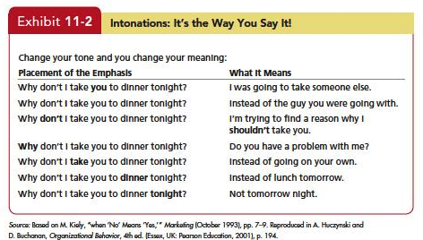
Contrast oral, written, and nonverbal communication
LO 4

Slide 18
Contrast oral, written, and nonverbal communication
LO 4
Physical distance also has meaning.
  What is considered proper spacing between people largely depends on cultural norms.
  A businesslike distance in some European countries feels intimate in many parts of North America.
  Distance may indicate aggressiveness or sexual interest or it may signal disinterest or displeasure with what is being said.

Slide 19
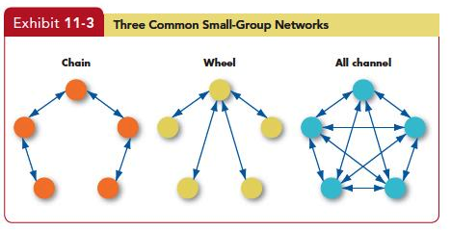
Contrast oral, written, and nonverbal communication
LO 5

Slide 20
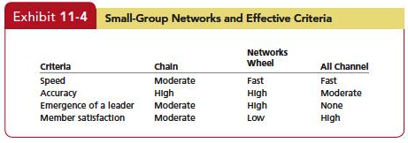
Contrast oral, written, and nonverbal communication
LO 5

Slide 21
Contrast oral, written, and nonverbal communication
LO 5
The Grapevine
  A recent survey found that 75 percent of employees hear about matters first through rumors on the grapevine.
  A recent report shows that grapevine or word-of-mouth information from peers about a company has important effects on whether job applicants join an organization.

Slide 22
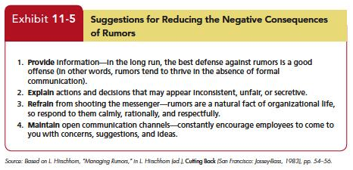
Contrast oral, written, and nonverbal communication
LO 5

Slide 23
Analyze the advantages and challenges of electronic communication
LO 5
Electronic Communication
  An indispensible–and in about 71 percent of cases, the primary–medium of communication.
  Includes e-mail, text messaging, networking software, bogs, and video conferencing.

Slide 24
Analyze the advantages and challenges of electronic communication
LO 5
E-mail
  Transmits and receives text and documents.
  Growth has been significant.
  Advantages to e-mail usage.
    Quickly written, edited, and stored.
    Distributed to one person or thousands.
    Recipients can read them at their own convenience.
    Cost is a fraction of other methods.

Slide 25
Analyze the advantages and challenges of electronic communication
LO 5
Drawbacks to e-mail usage.
  Misinterpreting the message.
  Communicating negative messages.
  Time-consuming nature of e-mail.
  Limited expression of emotions.
  Privacy concerns.

Slide 26
Analyze the advantages and challenges of electronic communication
LO 5
Instant Messaging and Text Messaging
  Like e-mail, instant messaging (IM) and text messaging (TM) use electronic media.
  Unlike e-mail, though, IM and TM either occur in real time (IM) or use portable communication devices (TM).
  The growth of TM has been spectacular.
  Despite their advantages, IM and TM aren’t going to replace e-mail.

Slide 27
Analyze the advantages and challenges of electronic communication
LO 5
Social Networking
  Nowhere has communication been more transformed than in networking.
  More than 600 million users have created accounts at Facebook.
  The research and advisory firm Gartner Inc. estimates that social networking will soon replace e-mail as the primary form of business communication for 20 percent or more of business users.

Slide 28
Analyze the advantages and challenges of electronic communication
LO 5
Blogs
  A blog (Web log) is a Web site about a single person or company.
  Twitter is a hybrid social networking service that allows users to post “microblog” entries to their subscribers about any topic, including work.

Slide 29
Analyze the advantages and challenges of electronic communication
LO 5
Video Conferencing
  Video conferencing permits employees in an organization to have meetings with people at different locations.
  Video conferencing technology, in effect, allows employees to conduct interactive meetings without the necessity of being physically in the same location.
  Information Overload a condition in which information inflow exceeds an individual’s processing capacity.

Slide 30
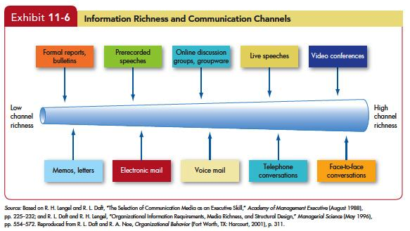
Show how channel richness underlies the choice of communication channel
LO 6

Slide 31
Differentiate between automatic and controlled processing of persuasive messages
LO 6
Automatic processing
    A relatively superficial consideration of evidence and information.
    Advantage
    - It takes little time and low effort.
    Disadvantage
      It lets us be easily fooled by a variety of tricks, like a cute jingle or glamorous photo.

Slide 32
Differentiate between automatic and controlled processing of persuasive messages
LO 6
Controlled processing
  You do independent research among experts who know something about the subject, gather information about prices from a variety of sources, and consider the costs and benefits of renting versus buying.
  Controlled processing requires effort and energy, but it’s harder to fool someone who has taken the time and effort to engage in it.

Slide 33
Identify common barriers to effective communication
LO 8
Barriers to Effective Communication
  Filtering
  Selective Perception
  Information Overload
  Filtering
  Selective Perception
  Information Overload
  Communication Apprehension
  Lying

Slide 34
Show how to overcome the potential problems in cross-cultural communication
LO 9
Cultural Barriers caused by:
  Semantics- words mean different things to different people. Some words do not translate between cultures.
  Word connotations- words imply different things in different languages.
  Tone differences.
  Differences in tolerance for conflict and methods for resolving conflicts.

Slide 35
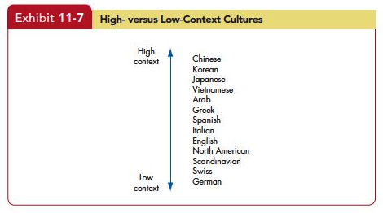
Show how to overcome the potential problems in cross-cultural communication
LO 9

Slide 36
Show how to overcome the potential problems in cross-cultural communication
LO 9
A Cultural Guide
  Assume differences until similarity is proven.
  Emphasize description rather than interpretation or evaluation.
  Practice empathy. Put yourself in the recipient’s shoes.
  Treat your interpretations as a working hypothesis.

Slide 37
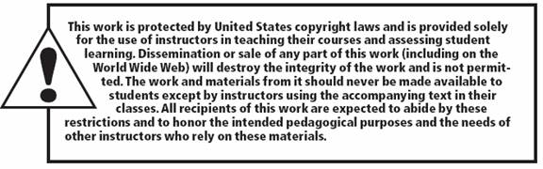
All rights reserved. No part of this publication may be reproduced, stored in a retrieval system, or transmitted, in any form or by any means, electronic, mechanical, photocopying, recording, or otherwise, without the prior written permission of the publisher. Printed in the United States of America.
Copyright © 2013 Pearson Education, Inc.
publishing as Prentice Hall
Notes:
All rights reserved. No part of this publication may be reproduced, stored in a retrieval system, or transmitted, in any form or by any means, electronic, mechanical, photocopying, recording, or otherwise, without the prior written permission of the publisher. Printed in the United States of America.

