Slide 1
Relational Algebra
Chapter 4

Slide 2
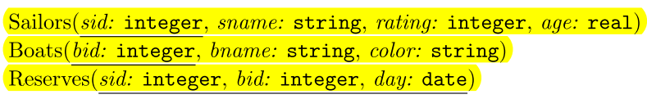
Introduction and Schemas
Most important thing to understand is that the input and output of Query are relations

Slide 3
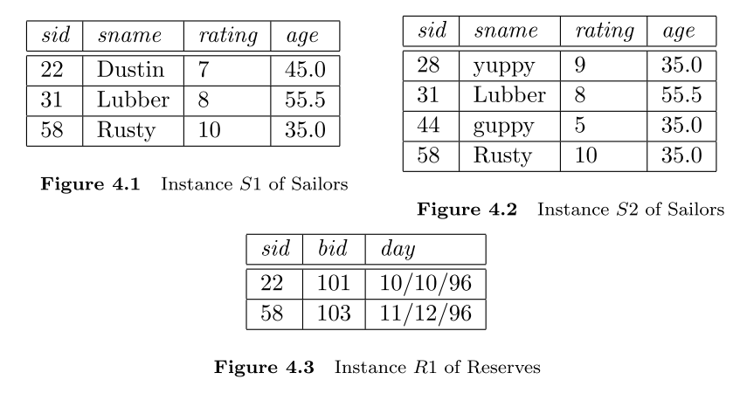
Instance Example

Slide 4


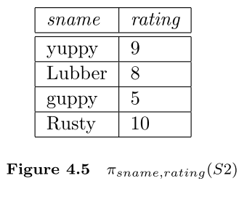
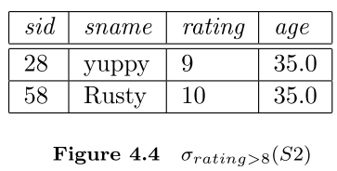
Selection and Projection

Slide 5

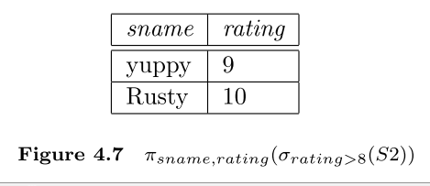
Compose Expressions

Slide 6
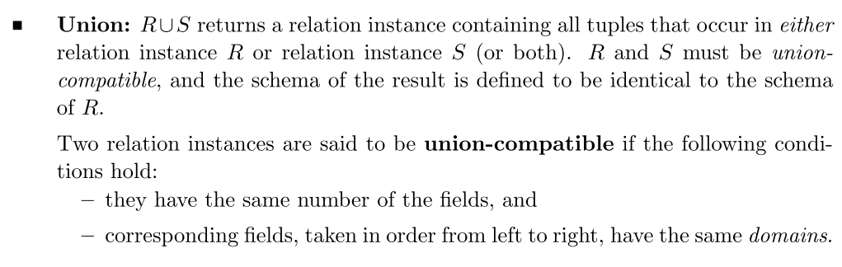
Set Operations: Union

Slide 7
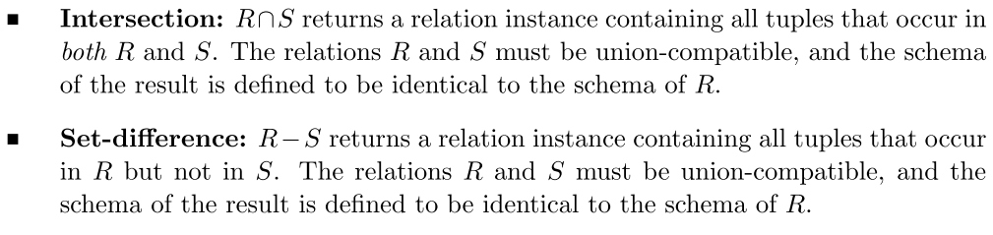
Set Operations: Intersection and Set Difference

Slide 8
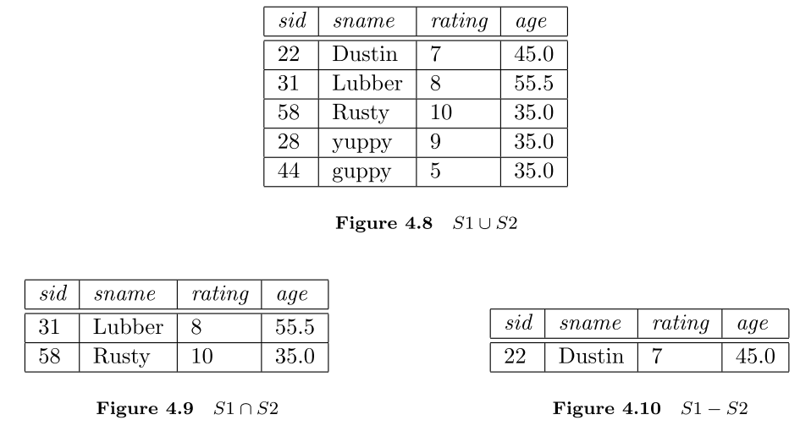
Example:

Slide 9
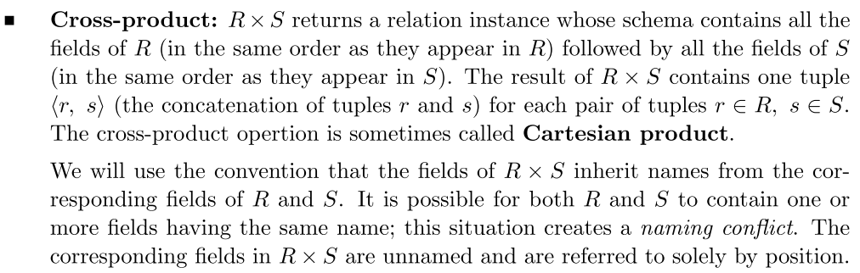
Cross Product:

Slide 10
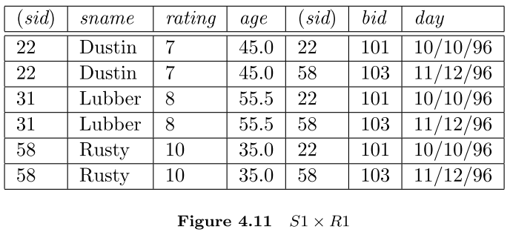
Example:

Slide 11

Condition Join
The most general version of the join operation accepts a join condition c and a pair of relation instances as arguments, and returns a relation instance

Slide 12

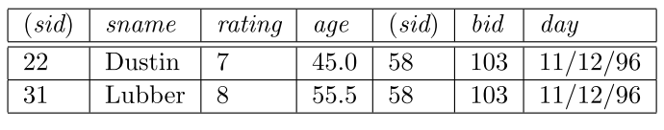
Condition Join Example

Slide 13
Equijoin
A common special case of the join operation R S is when the join condition consists solely of equalities of the form R.name1 = S.name2, that is, equalities between two ﬁelds in R and S.
The schema of the result of an equijoin contains the ﬁelds of R (with the same names and domains as in R) followed by the ﬁelds of S that do not appear in the join conditions.

Slide 14
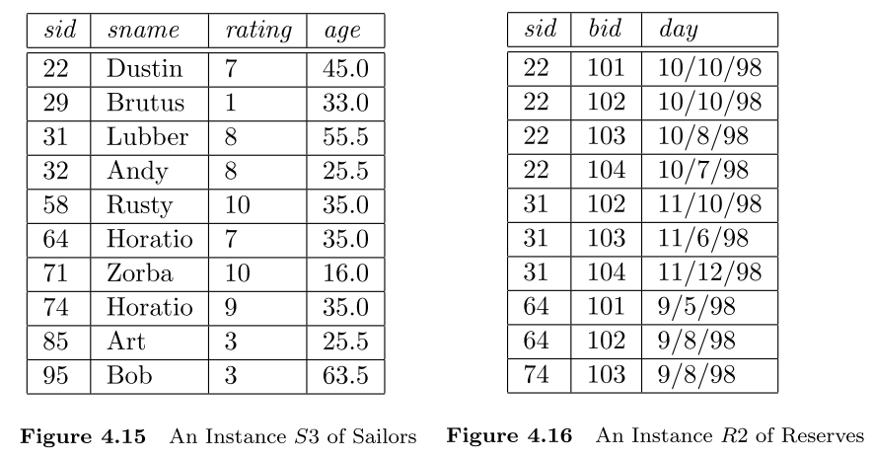
More Examples:

Slide 15
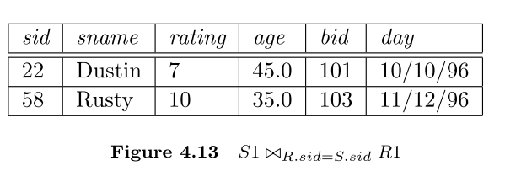
Equijoin Example

Slide 16

Natural Join
A further special case of the join operation R S is an equijoin in which equalities are speciﬁed on all ﬁelds having the same name in R and S.
In this case, we can simply omit the join condition.

Slide 17
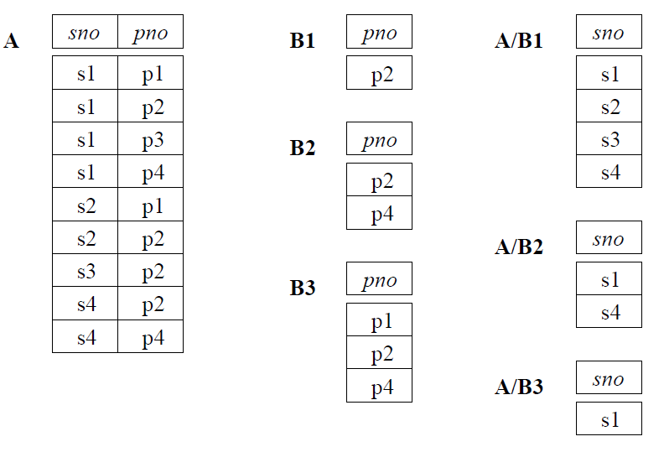
Division

Slide 18
