Slide 1
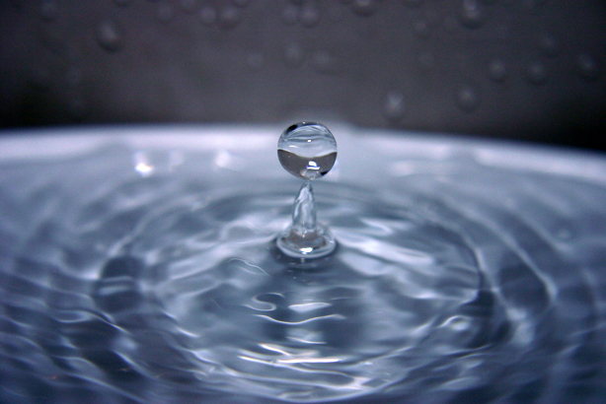
Interfacial Phenomena
Chapter 15
1

Slide 2

Interfaces
When phases exist together, the boundary between two of them is known as an interface
The properties of the molecules forming the interface are often sufficiently different from those in the bulk of each phase.
The term surface is used when referring to either a gas–solid or a gas–liquid interface.

Slide 3
Importance
Emulsion formation and stabilization
dispersion of insoluble particles in liquid media to form suspensions
Pulmonary surfactant is a mixture of lipids and proteins which is secreted into the alveolar
The main function of surfactant is to lower the surface tension at the air/liquid interface within the alveoli of the lung. (easier breathing)
Prevent alveolar colapse due to surface tensiom

Slide 4
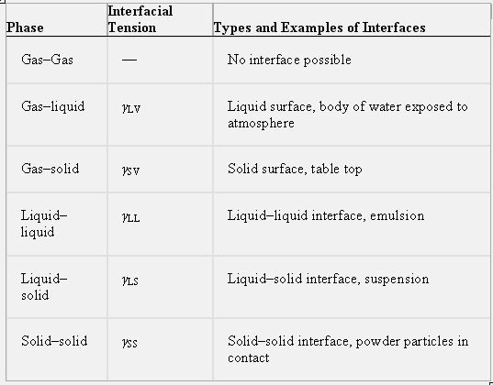
Types of interface
The term surface is customarily used when referring to either a gas–solid or a gas–liquid interface

Slide 5
Liquid Interfaces
Surface and Interfacial Tensions
molecules in the bulk liquid are surrounded in all directions by other molecules for which they have an equal attraction.
molecules at the surface (i.e., at the liquid–air interface) can only develop attractive cohesive forces with other liquid molecules that are situated below and adjacent to them. They can also develop adhesive forces of attraction with the molecules constituting the other phase involved in the interface, although, in the case of the liquid–gas interface, this adhesive force of attraction is small.

Slide 6
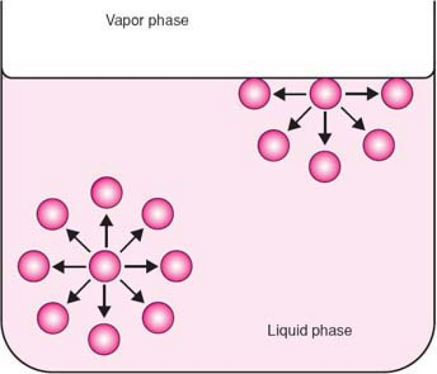
unequal attractive forces acting on molecules at the
surface of a liquid as compared with molecular forces in the bulk of the liquid

Slide 7
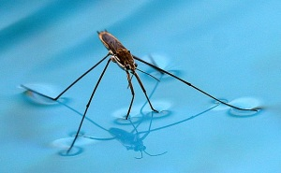
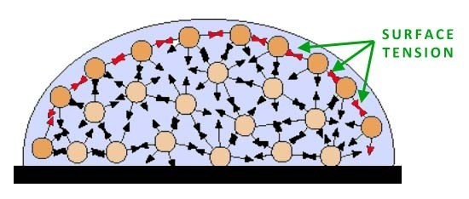
The net effect is that the molecules at the surface of the liquid experience an inward force toward the bulk.
Such a force pulls the molecules of the interface together and, as a result, contracts the surface, resulting in a surface tension.

Slide 8
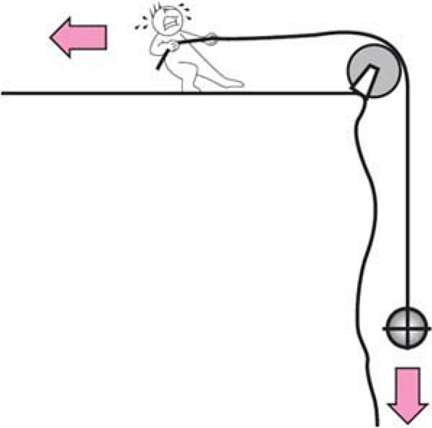
https://www.youtube.com/watch?v=HNnFqve-Wgk
Surface tension: It is similar to the situation that exists when an object dangling over the edge of a cliff on a length of rope is pulled upward by a man holding the rope and walking away from the edge of the top of the cliff

Slide 9
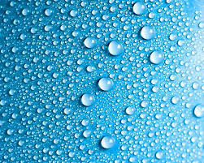
Definitions
This “tension” in the surface is the force per unit length that must be applied parallel to the surface so as to counterbalance the net inward pull.
Interfacial tension is the force per unit length existing at the interface between two immiscible liquid phases and.
the surface and interfacial tensions, have the units of dynes/cm or N/m.

Slide 10
Surface tension as a force per unit length can also be illustrated by means of a three-sided wire frame across which a movable bar is placed
https://www.youtube.com/watch?v=nKKS3qQGR8w
Wire frame is put in soap solution
A soap film is formed over the area ABCD and can be
stretched by applying a force f (such as a hanging mass) to the movable bar, length L, which acts against the surface tension of the soap film
When the mass is removed, the film will contract owing to its surface tension.
The surface tension, γ, of the solution forming the film is then a function of the force
that must be applied to break the film over the length of the movable bar in contact with the film.

Slide 11
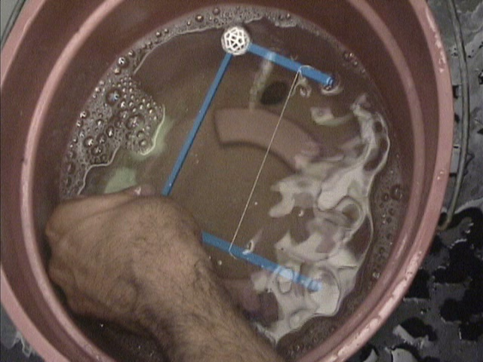

Slide 12
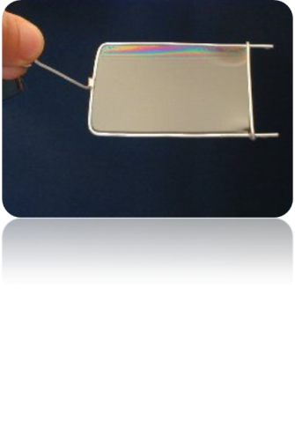
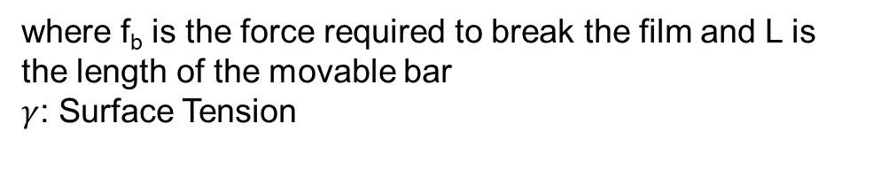
Surface tension as a force per unit length can also be illustrated by means of a three-sided wire frame across which a movable bar is placed
Because the soap film has two liquid–gas interfaces (one above and one below the plane of the paper), the total length of contact is in fact is equal to twice the length of the bar.
where f_{b} is the force required to break the film and L is the length of the movable bar
$γ$: Surface Tension

Slide 13
Question?
A wire frame was used to calculate the surface tension of a soap solution. If the length of the bar, L, is 5 cm and the mass required to break a soap film is 0.50 g, what is the surface tension of the soap solution?
Notes:
Recall that the downward force is equal to the mass multiplied by the acceleration due to gravity.

Slide 14
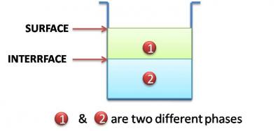
Surface and Interfacial Tension
in the general sense, all tensions may be referred to as interfacial tensions
interfacial tensions is most often used for the attractive force between immiscible liquids., γLL, γSS, and at γLS.
The term surface tension is reserved for γLV, γSV, tensions.

Slide 15
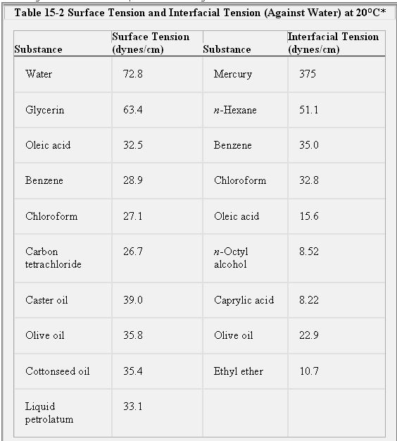

Slide 16
Effect of Temp on surface tension
The surface tensions of most liquids decrease almost linearly with an increase in temperature, that is, with an increase in the kinetic energy of the molecules.
The surface tension of water at at 20°C it is 72.8, and at 75°C it is 63.5 dynes/cm.
Notes:
because cohesive forces decrease

Slide 17
Notes
Ordinarily, interfacial tensions are less than surface tensions because the adhesive forces between two liquid phases forming an interface are greater than when a liquid and a gas phase exist together.
if two liquids are completely miscible, no interfacial tension exists between them.

Slide 18
Surface Free Energy and Surface Tension
each molecule near the surface of liquid possesses a certain excess of potential energy as compared to the molecules in the bulk of the liquid. (due to surface tension)
The larger the surface of the liquid, the more molecules have this excessive potential energy
Therefore, if the surface of the liquid increases (e.g., when water is broken into a fine spray), the energy of the liquid also increases
Because this energy is proportional to the size of the free surface, it is called a surface free energy
Notes:
To move a molecule from the inner layers to the surface, work needs to be done against the force of
surface tension

Slide 19
Surface Free Energy and Surface Tension
liquid takes form with minimal free surface and with minimal surface energy
For example, liquid droplets tend to assume a spherical shape because a sphere has the smallest surface area per unit volume.
To increase the surface of the liquid without any additional changes in the liquid state, in particular without changes in liquid temperature, work must be done against the surface tension

Slide 20
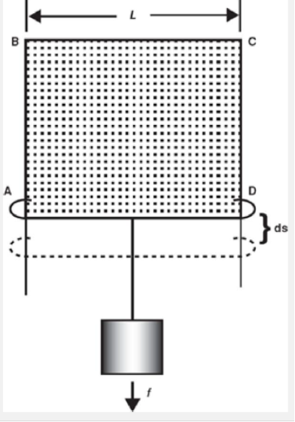
To evaluate the amount of work in increasing the surface area, we can write equation γ × 2L = f.
When the bar is at a position AD and a mass is added to extend the surface by a distance ds,

Slide 21


work dW (force multiplied by distance) is
because 2L × ds is equal to the increase in surface area, dA, produced by extending the soap film
For a finite change
W is the work done, or surface free energy increase, expressed in ergs,
γ is the surface tension in dynes/cm,
ΔA is the increase in area in cm2
erg = dyne . cm
Surface tension can be defined as the surface free energy
change per unit area increase

Slide 22
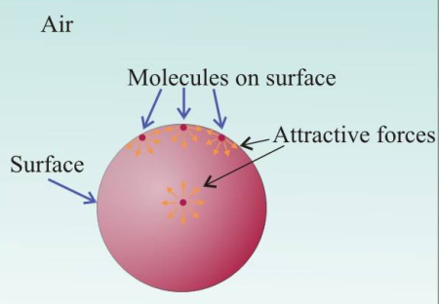
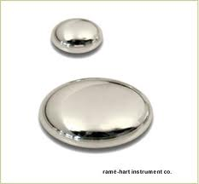
W = γ ∆ A
erg = dyne . cm
For equilibrium, the surface free energy
of a system must be at a minimum.
Thus Liquid droplets tend to assume a spherical shape since a sphere has the smallest surface area per unit volume.

Slide 23
Calculation of Work against Surface Tension
W = γ ∆ A
A wire frame was used to calculate the surface tension of a soap solution. If the length of the bar, L, is 5 cm and the mass required to break a soap film is 0.50 g, what is the surface tension of the soap solution?
What is the work required in pull the wire down 1 cm

Slide 24
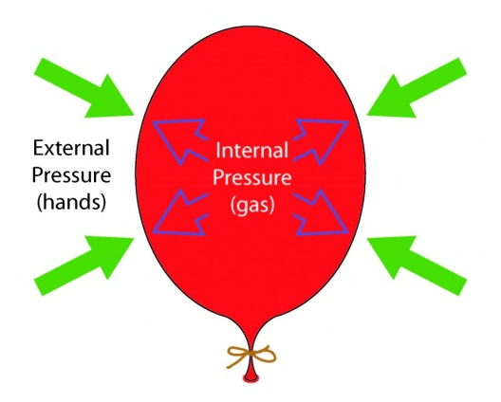
Pressure Differences Across Curved Interfaces
Another way of expressing surface tension is in terms of the pressure difference that exists across a curved interface.
Anyone who has blown up a balloon has probably noticed that the air pressure inside the balloon is greater than on the outside

Slide 25
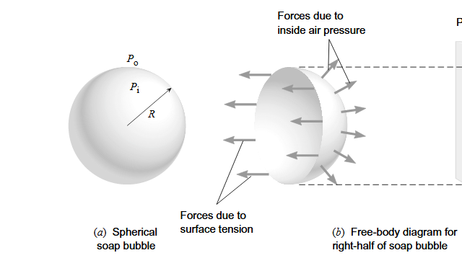
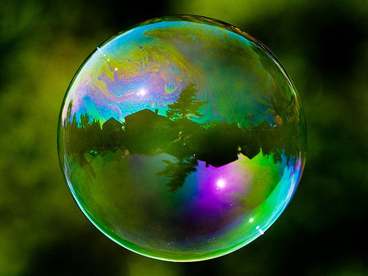
A soap bubble. Like a balloon, the pressure inside a soap bubble is greater than that on the outside
this difference in pressure depends on the surface tension γ of the liquid and the radius R of the bubble.

Slide 26
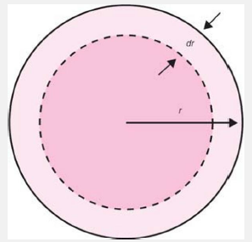
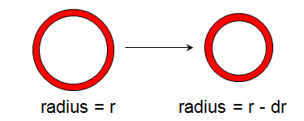
Pressure Differences Across Curved Interfaces
Phenomena at Curved Surfaces:
As a consequence of interfacial tension, there is a balancing pressure across any curved surface.
Assume we deform a soap bubble by a very small amount by applying a pressure (decrease volume):
dr
r
ΔA = (4πr² – 4π(r-dr)²)
ΔA = (4πr² – 4π(r²+dr²-2rdr))
ΔA = -8πrdr
the term containing (dr)² in equation can be disregarded
(- Shrink in volume)

Slide 27
Pressure Differences Across Curved Interfaces
Surface Energy Work
ΔA = -8πrdr
W_{s} = -γ8πrdr
Surface Tension
Change in surface area
W_{s}
_{Work due to surface tension}

Slide 28
https://www.youtube.com/watch?v=ZRVxr4-gls8
Because pressure is a force per unit area,
the work change brought about by change pressure
W_{P}= ΔP x 4πr²dr
W_{s} = -γ8πrdr
When the two are equal we get for the pressure across the curved surface (equilibrium reached)
ΔP x 4πr²dr = 8πγrdr
ΔP=
Therefore, as the radius of a bubble decreases, the pressure of the air inside increases relative to that
outside. (laplace equation)
Notes:
Because pressure is a force per unit area
At equilibrium, this must equal the change in surface free energy
Young laplace equation

Slide 29
Measurement of Surface and Interfacial Tensions
Capillary Rise Method.
The DuNoüy Ring Method
https://www.youtube.com/watch?v=yw3KsRRbIf4

Slide 30
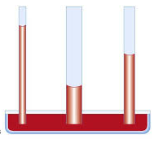
Capillary Rise Method
When a capillary tube is placed in a liquid contained in a beaker, the liquid generally rises up the tube a certain distance.
By measuring this rise in a capillary, it is possible to determine the surface tension of the liquid
Only for surface tension not for interfacial tension

Slide 31
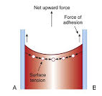
Because the force of adhesion between the liquid molecules and the capillary wall is greater than the cohesion between the liquid molecules, the liquid is said to wet the capillary wall, spreading over it and rising in the tube (Capillarity)
water shows a strong tendency to spread out over a polar surface such as clean glass
cohesive forces
Notes:
Meniscus

Slide 32
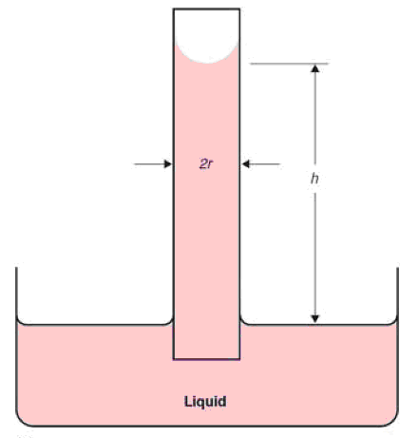
Consider a capillary tube with an inside radius r immersed in a liquid that because of the weight of the liquid, the upward movement is just balanced by the downward force of gravity.
The water column is held together by the surface film

Slide 33
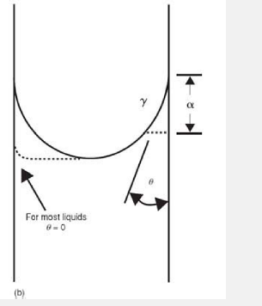
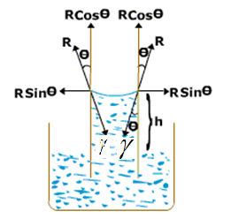
The upward vertical component of the force resulting from the surface tension of the liquid at any point on the circumference is given
The total upward force around the inside circumference of the tube is
where θ is the contact angle between the surface of the liquid and the capillary wall and 2πr is the inside circumference of the capillary

Slide 34

For water and other commonly used liquids, the angle θ is insignificant,
that is, the liquid wets the capillary wall so that cos is taken as unity for practical purposes (1)
The total upward force around the inside circumference of the tube is

Slide 35
The counteracting force of gravity (mass × acceleration) is given by the product of the cross-sectional area, πr ², the height, h, of the liquid column to the lowest point of the meniscus, the density of the liquid, ρ, and the acceleration of gravity g
πr ² h(ρ )g + w.
w, is added to account
for the weight of liquid
above h in the meniscus

Slide 37


When the liquid has risen to its maximum height, which can be read from the calibrations on the capillary tube, the opposing forces are in equilibrium, and accordingly the surface tension can be calculated
the contact angle, and (w) can usually be disregarded

Slide 38

Example:
A sample of chloroform rose to a height of 3.67 cm at 20°C in a capillary tube having an inside radius of 0.01 cm. What is the surface tension of chloroform at this temperature? The density of chloroform is 1.476 g/cm³.

Slide 39
The DuNoüy Ring Method
The DuNoüy tensiometer is widely used for measuring surface and interfacial tensions.
Principle: the force necessary to detach a platinum–iridium ring immersed at the surface or interface is proportional to the surface or interfacial tension.
The force required to detach the ring in this manner is recorded in dynes on a calibrated dial.
https://www.youtube.com/watch?v=cntqd0CRE8w I

Slide 40
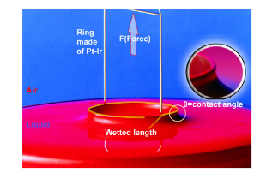
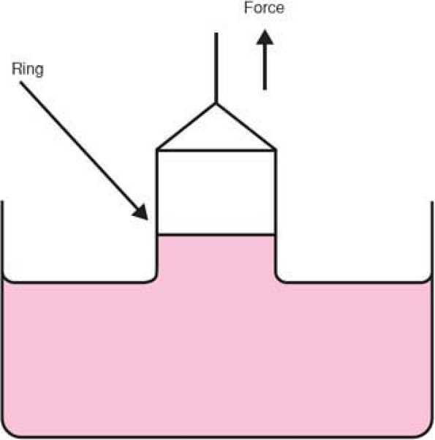
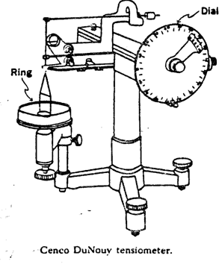

Slide 41


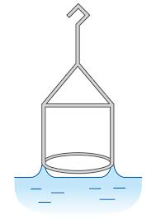
F= force to detach ring
C=2πr
A correction factor is necessary because the simple theory does not take into account certain variables such as the radius of the wire used to form the ring, and the volume of liquid raised out of the surface.,
Errors as large as 25% may occur if the correction factor is not calculated and applied.
Reduced to 0.25% error

Slide 42
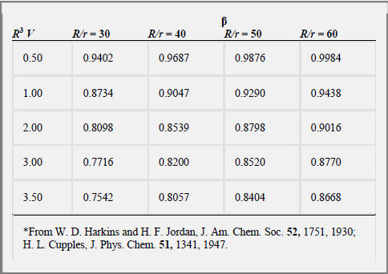
/
R: The ring of the tensiometer radius
r, radius of the wire that forms the ring
V: The volume of water lifted above the free surface of water
F: from the dial reading (dynes)
F=ma
V=g/d (d= density)

Slide 43
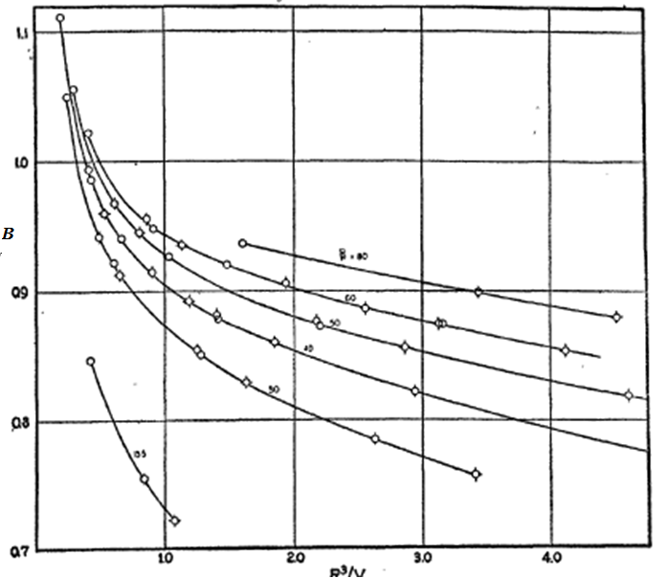
R^{3/}/V

Slide 44
Adsorption at Liquid Interfaces
Generally moving molecules from bulk to surface needs energy due to higher surface free energy
Certain molecules and ions, when dispersed in the liquid, move of their own accord to the interface.
Their concentration at the interface then exceeds their concentration in the bulk of the liquid (reduce surface energy)

Slide 45
Adsorption at Liquid Interfaces
Such a phenomenon, where the added molecules are partitioned in favor of the interface, is termed adsorption,.
Molecules and ions that are adsorbed at interfaces are termed surface-active agents or surfactants. An alternative term is amphiphile, (surfactants, emulsifiying agents) (reduce surface tension)

Slide 46
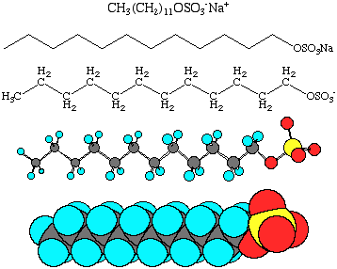
Surface Active Agents
A surfactant molecule is depicted schematically as a cylinder representing the hydrocarbon (hydrophobic) portion with a sphere representing the polar (hydrophilic) group attached at one end.
Sodium Lauryl
Sulfate molecule

Slide 47
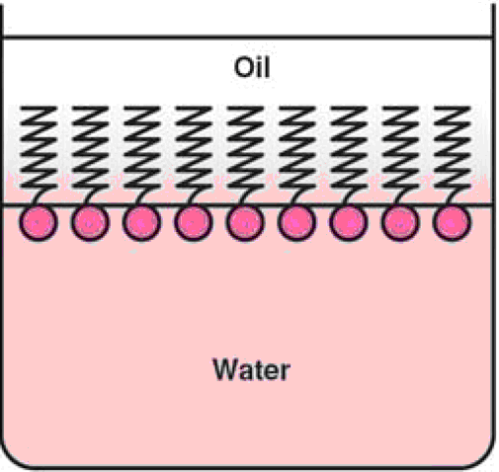
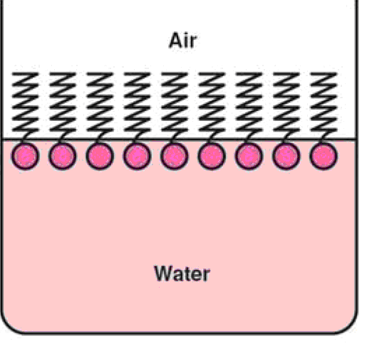
The situation for a fatty acid at the air–water and oil–water interface:
At the oil–water interface, the lipophilic chains are directed upward into the air;
at the air–oil interface, they are associated with the oil phase.

Slide 48
Surfactants (Balance)
For the amphiphile to be concentrated at the interface, it must be balanced with the proper amount of water- and oil-soluble groups.
If the molecule is too hydrophilic, it remains within the body of the aqueous phase and exerts no effect at the interface.
if it is too lipophilic, it dissolves completely in the oil phase and little appears at the interface
Their must be a balance between hydrophilic and lipophilic properties

Slide 49
Systems of Hydrophile–Lipophile Classification
HLB: hydrophilic–lipophilic balance: is an expression for the relationship of the hydrophilic ("water-loving") and hydrophobic ("water-hating") groups of a surfactant
The higher the HLB of an agent, the more hydrophilic it is.
The Spans, sorbitan esters , are lipophilic and have low HLB values (1.8–8.6); (w/o mostly)
The Tweens, polyoxyethylene derivatives of the Spans, are hydrophilic and have high HLB values (9.6–16.7).
(O/W) mostly

Slide 50
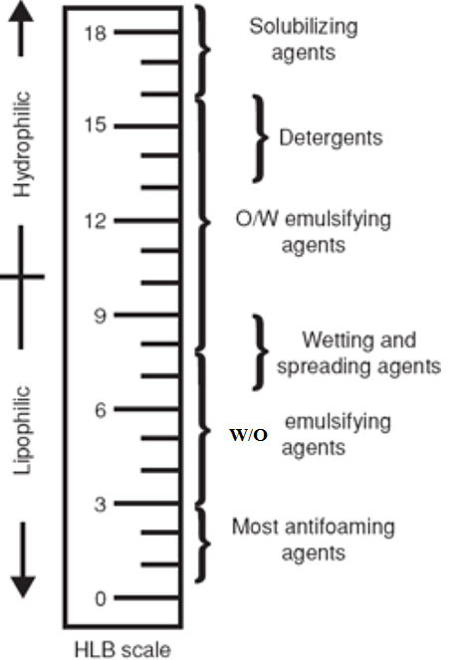

Slide 51
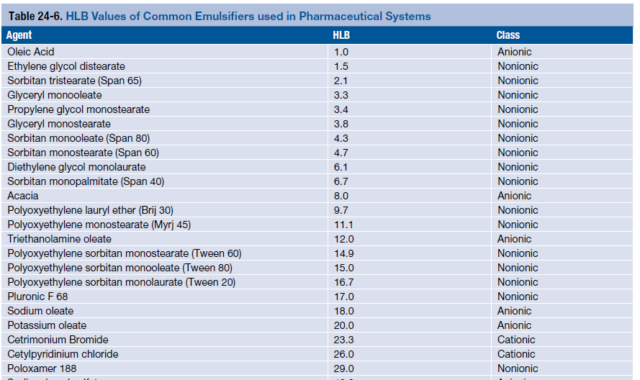

Slide 52
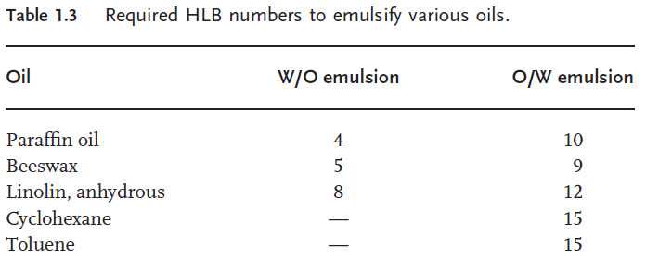
RHLB
required hydrophile– lipophile balance (RHLB): it is the required HLB of emulsification of an oil

Slide 53
HLB mixtures
The relative importance of the hydrophilic and lipophilic groups was first recognized when using mixtures of surfactants containing varying proportions of a low and high HLB number
The average HLB number may be calculated from additivity
HLB = x1HLB1 + x2HLB2
where x1 and x2 are the weigh fractions of the two surfactants with HLB1 and HLB2.

Slide 54
HLB Mix
When two or more emulsifiers are blended, the
resulting HLB of the blend is easily calculated. For example,
suppose you want to determine the HLB value of a blend comprising 70% of TWEEN 80 (HLB = 15) and 30% Of SPAN 80 (HLB = 4.3).
The calculation would be:
TWEEN 80 70% X 15.0 = 10.5
SPAN 80 30% X 4.3 = 1.3
HLB of blend = 11.8

Slide 55
Mixing HLB
One may take any pair of emulsifying agents, which fall at opposite ends of the HLB scale, for example, Tween 80 (HLB = 15) and Span 80 (sorbitan monooleate, HLB = 5) using them in various proportions to cover a wide range of HLB numbers

Slide 56

Here's an easy way to calculate how much of any emulsifier (A) to blend with any other emulsifier (B), to reach an HLB of X.

Slide 57
Required HLB for Oil mixtures
For example, suppose you are making an O/W emulsion The product might be
30% mineral spirits, Req HLB 14
50% cottonseed oil : Req HLB 6
20% chlorinated paraffin to be emulsified in water. Req HLB 14
The required HLB of the combination can be calculated
as follows:
Mineral Spirits ..........30% X Req. HLB 14 = 4.2
Cottonseed Oil ..........50% X Req. HLB 6 = 3.0
Chlorinated Paraffin . . 20% X Req. HLB 14 = 2.8
_______
Estimated HLB for emulsifier system ..........10.0

Slide 58
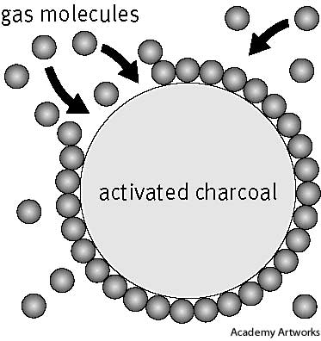
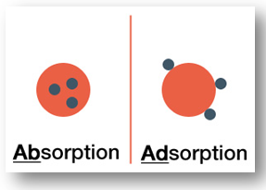
Adsorption at Solid Interfaces
Adsorption (general) is the adhesion of atoms, ions, or molecules from a gas, liquid, or dissolved solid to a surface. This process creates a film on surface
solid–gas adsorption:
the removal of objectionable odors from rooms and food,
the operation of gas masks,

Slide 59
The Solid–Gas Interface
the adsorbent : the material used to adsorb the gas)
the adsorbate: the substance being adsorbed
types of adsorption:
physical adsorption:
associated with van der Waals forces
reversible
A physically adsorbed gas can be desorbed from a solid by increasing the temperature and reducing the pressure.
the removal of the adsorbate from the adsorbent being known as desorption.

Slide 60
2. chemical adsorption or chemisorption
the adsorbate is attached to the adsorbent by primary chemical bonds,
irreversible unless the bonds are broken.

Slide 61
Factors affecting Solid-gas adsorption
The degree of adsorption of a gas by a solid depends on:
the chemical nature of the adsorbent and the adsorbate
the surface area of the adsorbent,
the temperature,
the partial pressure of the adsorbed gas.

Slide 62
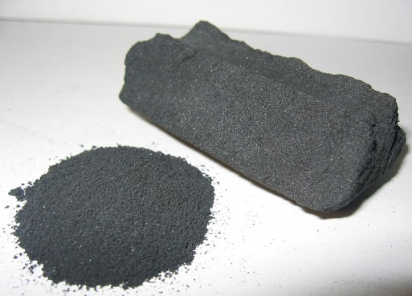
Activated charcoal
An example of a substance that can adsorb enormous amounts of gases or liquids
form of carbon processed to have small, low-volume pores that increase the surface area available for adsorption

Slide 63
Activated charcol
Due to its high degree of microporosity, just one gram of activated carbon has a surface area in excess of 3,000 m2
Activated carbon is used to treat poisonings and overdoses following oral ingestion. Tablets or capsules of activated carbon are used in many countries as an over-the-counter drug to treat diarrhea, indigestion, and flatulence.
Drinking water filtration, Air purification

Slide 64
Activated charcoal is made from material burnt in a superheated high-oxygen atmosphere, creating small holes in the range of 100 to 800 Å in diameter throughout the grain of the charcoal

Slide 65
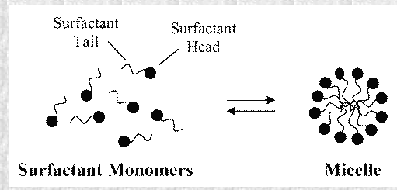
Critical micelle concentration
Another energetically favorable form for the surfactant molecules in water solution are micelles where the hydrophobic tails are protected by the hydrophilic head groups
.

Slide 66
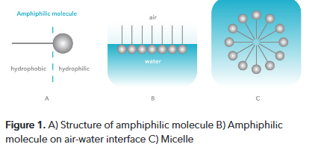
In colloidal and surface chemistry, the critical micelle concentra - tion (CMC) is defined as the concentration above which micelles form

Slide 67
At low surfactant concentration the surfactant molecules arrange on the surface.
When more surfactant is added the surface tension of the solution starts to rapidly decrease since more and more surfactant molecules will be on the surface.
When the surface becomes saturated, the addition of the surfactant molecules will lead to formation of micelles.
This concentration point is called critical micelle concentration.

Slide 68
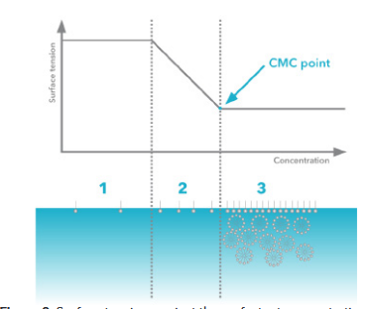
1- At very low surfactant concentration only slight change in surface tension is detected.
2- Addition of surfactant decreases the surface tension drastically
3- At CMC point, surface becomes saturated and the addition of surfactant molecules do not effect on the surface tension.

Slide 69
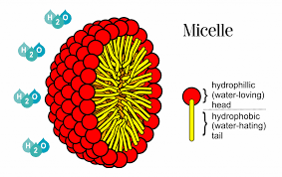
Micellar solubilization
An important property of micelles that has particular significance in pharmacy is their ability to increase the solubility of sparingly soluble substances in water.

Slide 70
Applications of Surface-Active Agents
emulsifying agents, soaps, wetting agents, and solubilizing agents
aids to the absorption of drugs in the body.
A surfactant may affect the activity of a drug or may itself exert drug action.
As an example of the first case, the penetration of hexylresorcinol into Ascaris, is increased by the presence of a low concentration of surfactant. This potentiation of activity is due to a reduction in interfacial tension between the liquid phase and the cell wall of the organism
As a result, the adsorption and spreading of hexylresorcinol over the surface of the organism is facilitated

Slide 71
Quaternary ammonium compounds are examples of surface-active agents that in themselves possess antibacterial activity
agents are adsorbed on the cell surface and supposedly bring about destruction by increasing the permeability or ―leakiness of the lipid cell membrane
Surfactants may alter membrane properties and affect drug absorption

Slide 72
Electric Properties of Interfaces
Particles dispersed in liquid media may become charged mainly in one of two ways:
the selective adsorption of a particular ionic species present in solution.
This may be an ion added to the solution or, in the case of pure water, it may be the hydronium or hydroxyl ion.
2. charges on particles arise from ionization of groups (such as COOH) that may be situated at the surface of the particle. In these cases, the charge is a function of pK and pH.

Slide 73
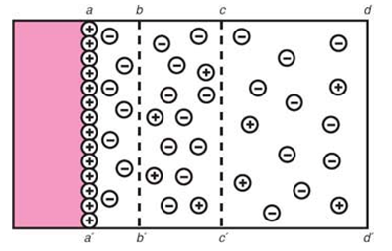
The Electric Double Layer
Consider a solid surface in contact with a polar solution containing ions, for example, an aqueous solution of an electrolyte.
suppose that some of the cations are adsorbed onto the surface, giving it a positive charge.
Remaining in solution are the rest of the cations plus the total number of anions added.

Slide 74
These anions are attracted to the positively charged surface by electric forces that also serve to repel the approach of any further cations once the initial adsorption is complete.

Slide 75
A situation is set up in which some of the excess anions approach the surface, whereas the remainder are distributed in decreasing amounts as one proceeds away from the charged surface.
At a particular distance from the surface, the concentrations of anions and cations are equal, that is, conditions of electric neutrality prevail.

Slide 76
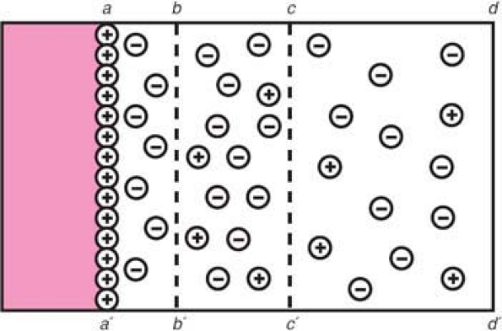
aa′ is the surface of the solid.
The adsorbed ions that give the surface its positive charge are referred to as the potential-determining ions.
Immediately adjacent to this surface layer is a region of tightly bound solvent molecules, together with some negative ions, also tightly bound to the surface.
The limit of this region is given by the line bb′ .
These ions, having a charge opposite to that of the potential-determining ions, are known as counterions or gegenions.

Slide 77
In the region bounded by the lines bb′ and cc′, there is an excess of negative ions.
Beyond cc′, the distribution of ions is uniform and electric neutrality is obtained.

Slide 78
Nernst and Zeta Potentials
The changes in potential with distance from the surface for the various situations:
The potential at the solid surface aa′ due to the potential-determining ion is the electrothermodynamic (Nernst) potential, E,
defined as the difference in potential between the actual surface and the electroneutral region of the solution.

Slide 79
The potential located at the shear plane bb′ is known as the electrokinetic, or zeta, potential, ζ.
The zeta potential is defined as the difference in potential between the surface of the tightly bound layer (shear plane) and the electroneutral region of the solution.

Slide 80
The zeta potential has practical application in the stability of systems containing dispersed particles because this potential governs the degree of repulsion between adjacent, similarly charged, dispersed particles.
If the zeta potential is reduced below a certain value (which depends on the particular system being used), the attractive forces exceed the repulsive forces, and the particles come together. This phenomenon is known as flocculation

Slide 81
Thank You

