Slide 1
Amino Acids and Peptides

Slide 2
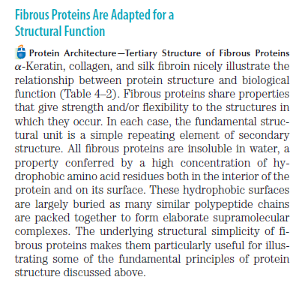

Slide 3
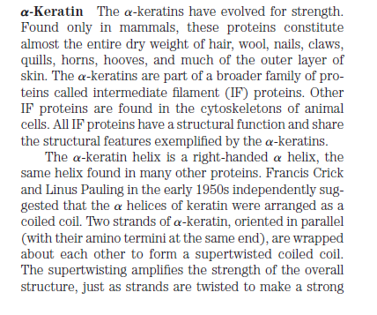

Slide 4
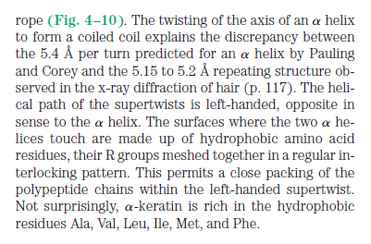

Slide 5
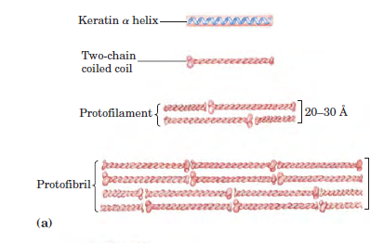

Slide 6
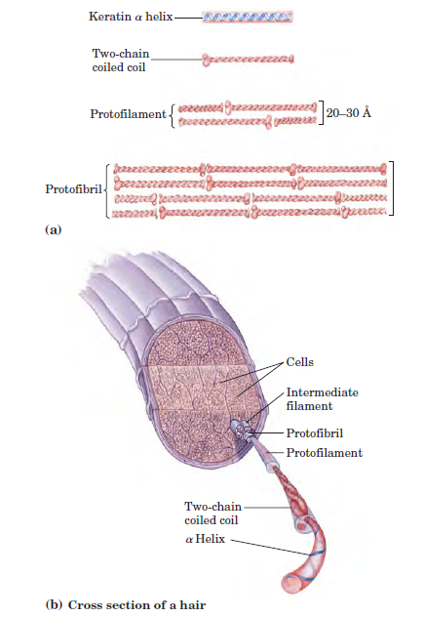

Slide 7
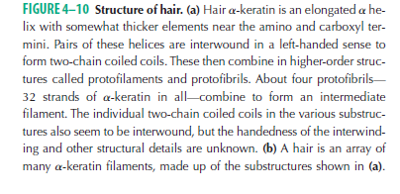

Slide 8
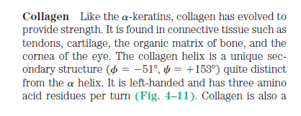
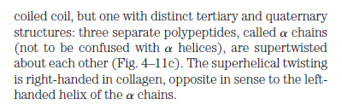

Slide 9
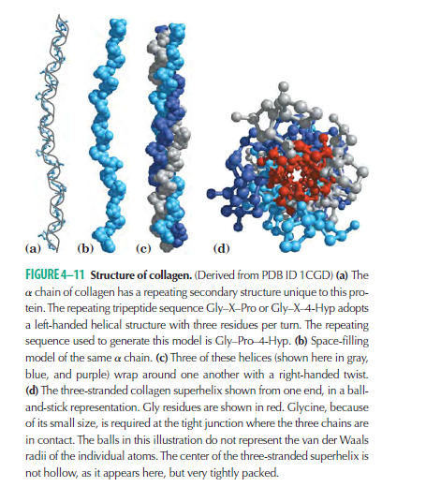

Slide 10
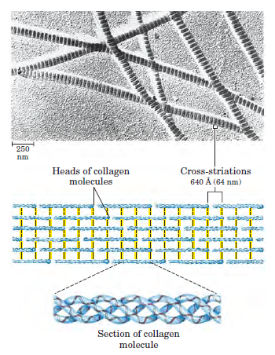

Slide 11
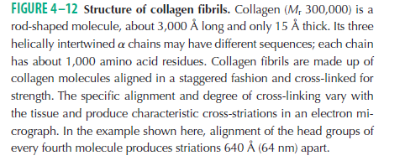

Slide 12
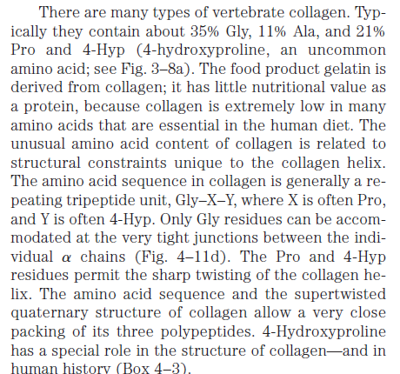

Slide 13
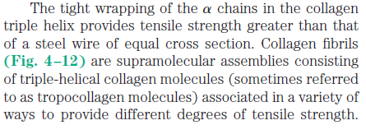
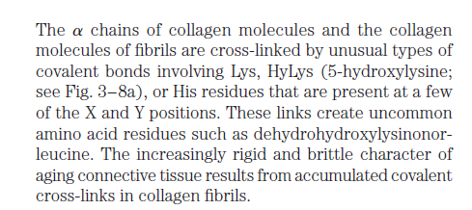

Slide 14
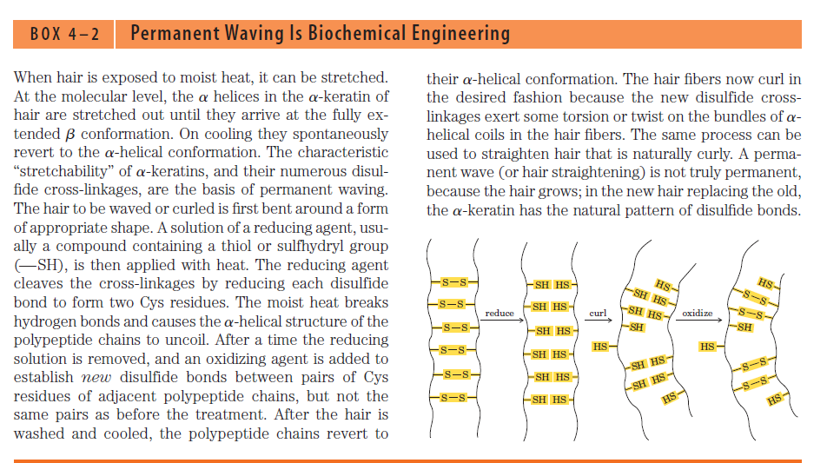

Slide 15
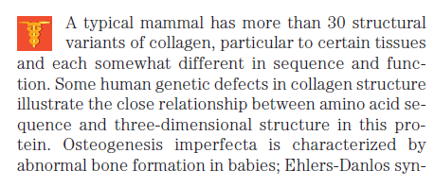
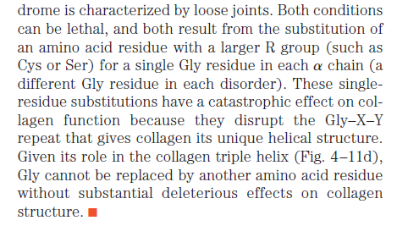

Slide 16
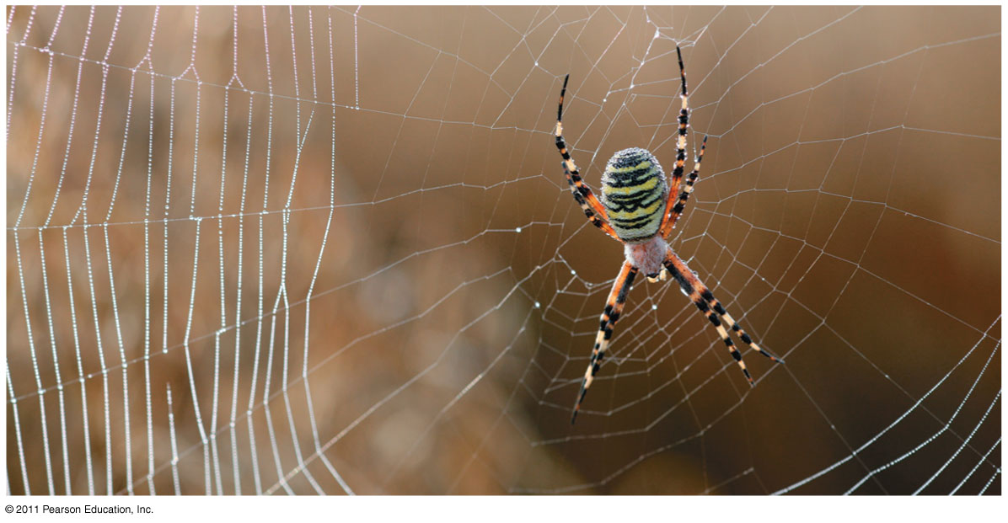
What do we have here ?
Notes:
Figure 5.20 Exploring: Levels of Protein Structure

Slide 17
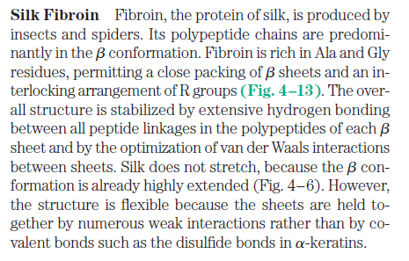

Slide 18
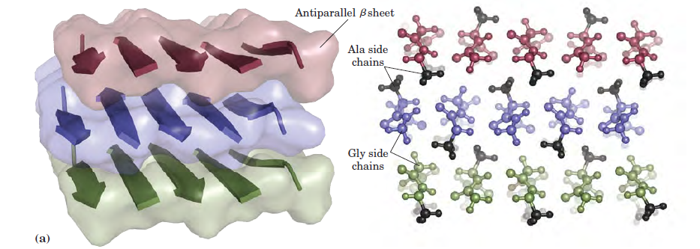
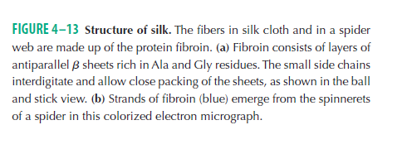

Slide 19
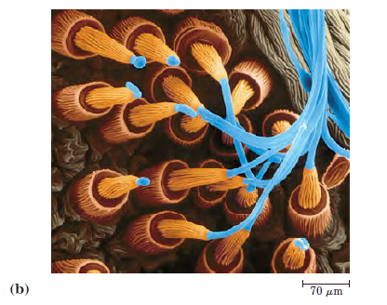

Slide 20
Linus Pauling HOW TO LIVE LONGER AND FEEL BETTER (1986) Pages 89-91
"We have come upon reasons why we require for good health so much larger amounts of vitamin C than are present in the plants we use as food... It has recently been shown by Myllyla and his colleagues that, one molecule of vitamin C is destroyed for each H (hydrogen atom) replaced by OH (during the formation of collagen)... Vitamin C, in the critical reactions that assemble collagen in the tissues, does not serve merely as a catalyst but is destroyed."
Linus Pauling

Slide 21
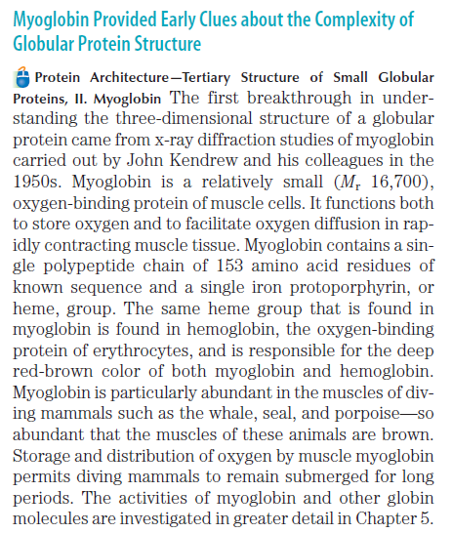

Slide 22
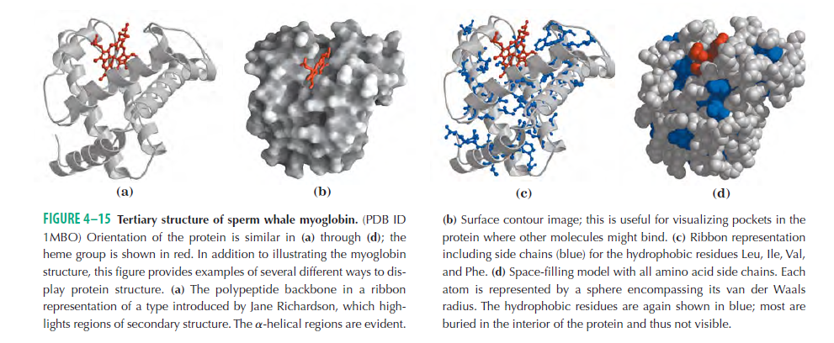

Slide 23
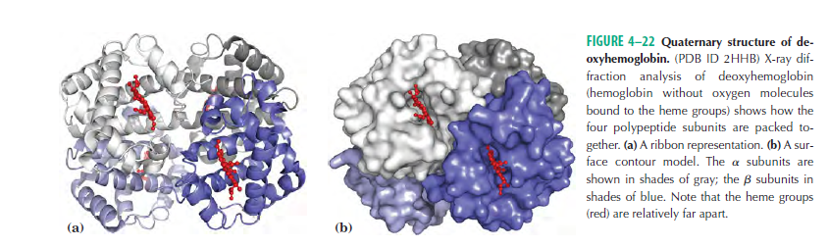

Slide 24
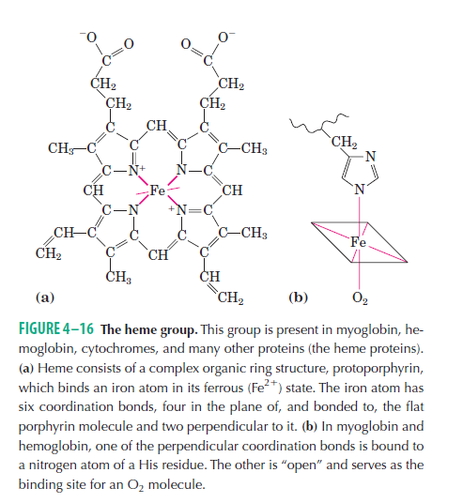

Slide 25
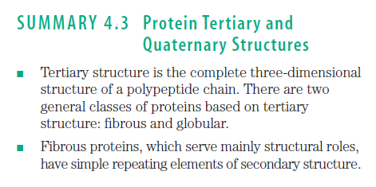
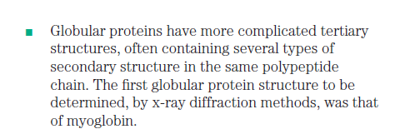

Slide 26
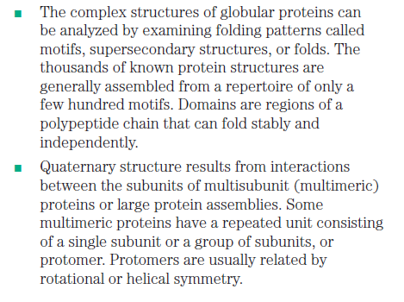

Slide 27
Classes of proteins
Functional definition:
Enzymes: Accelerate biochemical reactions
Structural: Form biological structures
Transport: Carry biochemically important substances
Defense: Protect the body from foreign invaders
Structural definition:
Globular: Complex folds, irregularly shaped tertiary structures
Fibrous: Extended, simple folds -- generally structural proteins
Cellular localization definition:
Membrane: In direct physical contact with a membrane; generally water insoluble.
Soluble: Water soluble; can be anywhere in the cell.

Slide 28
Protein Function
Catalysis – enzymes
Structural – keratin
Transport – hemoglobin
Trans-membrane transport – Na+/K+ ATPases
Toxins – rattle snake venom, ricin
Contractile function – actin, myosin
Hormones – insulin
Storage Proteins – seeds and eggs
Defensive proteins – antibodies

Slide 29
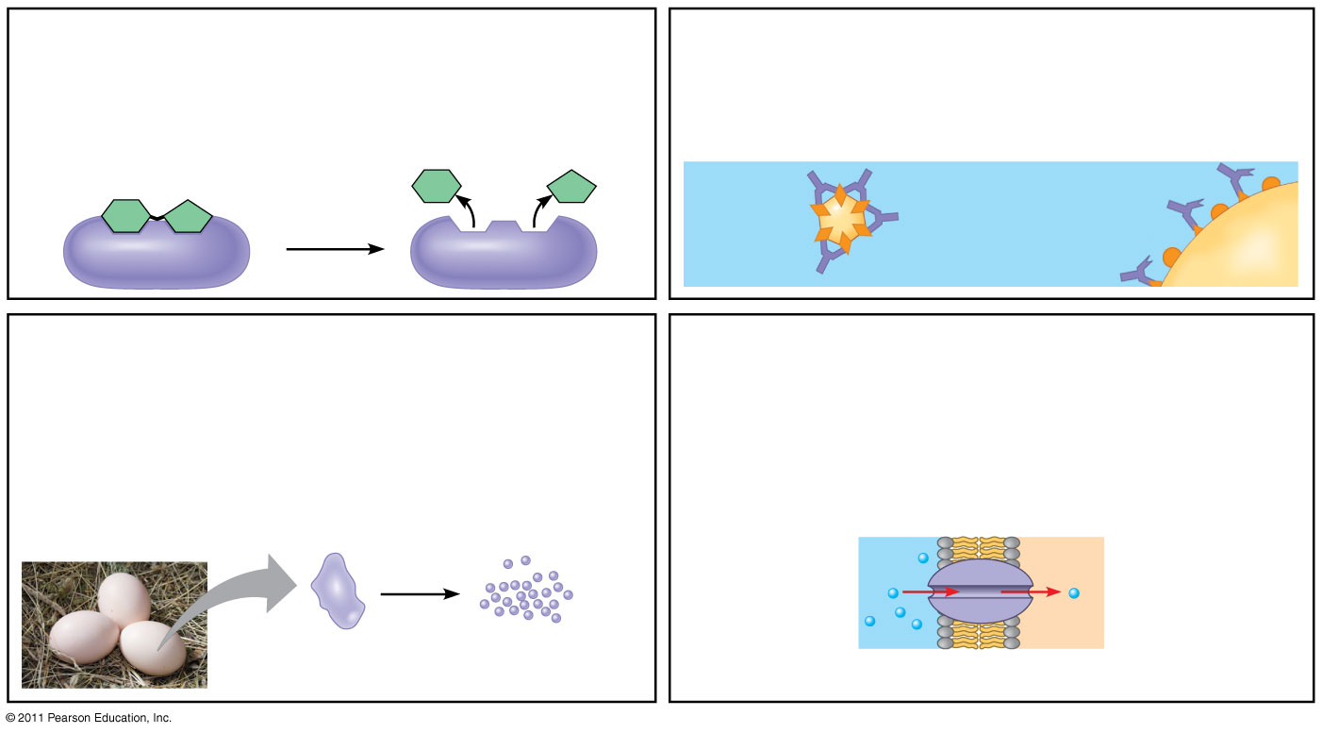
Figure 5.15-a
Enzymatic proteins
Defensive proteins
Function: Selective acceleration of chemical reactions
Function: Protection against disease
Example: Digestive enzymes catalyze the hydrolysis
of bonds in food molecules.
Example: Antibodies inactivate and help destroy
viruses and bacteria.
Antibodies
Enzyme
Virus
Bacterium
Storage proteins
Transport proteins
Function: Storage of amino acids
Function: Transport of substances
Examples: Casein, the protein of milk, is the major
source of amino acids for baby mammals. Plants have
storage proteins in their seeds. Ovalbumin is the
protein of egg white, used as an amino acid source
for the developing embryo.
Examples: Hemoglobin, the iron-containing protein of
vertebrate blood, transports oxygen from the lungs to
other parts of the body. Other proteins transport
molecules across cell membranes.
Transport
protein
Ovalbumin
Amino acids
for embryo
Cell membrane
Notes:
Figure 5.15 An overview of protein functions.

Slide 30
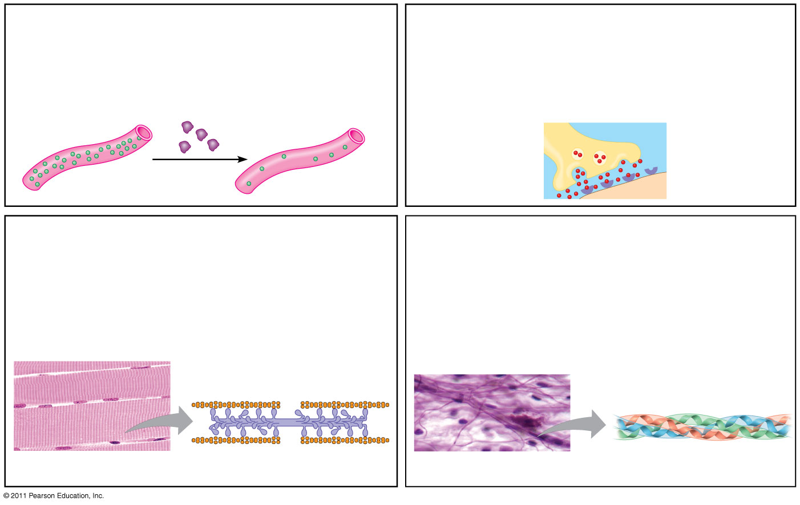
Figure 5.15-b
Hormonal proteins
Receptor proteins
Function: Coordination of an organism’s activities
Function: Response of cell to chemical stimuli
Example: Insulin, a hormone secreted by the
pancreas, causes other tissues to take up glucose,
thus regulating blood sugar concentration
Example: Receptors built into the membrane of a
nerve cell detect signaling molecules released by
other nerve cells.
Receptor
protein
High
blood sugar
Insulin
secreted
Normal
blood sugar
Signaling
molecules
Contractile and motor proteins
Structural proteins
Function: Movement
Function: Support
Examples: Motor proteins are responsible for the
undulations of cilia and flagella. Actin and myosin
proteins are responsible for the contraction of
muscles.
Examples: Keratin is the protein of hair, horns,
feathers, and other skin appendages. Insects and
spiders use silk fibers to make their cocoons and webs,
respectively. Collagen and elastin proteins provide a
fibrous framework in animal connective tissues.
Actin
Myosin
Collagen
Muscle tissue
100 μm
Connective
tissue
60 μm
Notes:
Figure 5.15 An overview of protein functions.

Slide 31
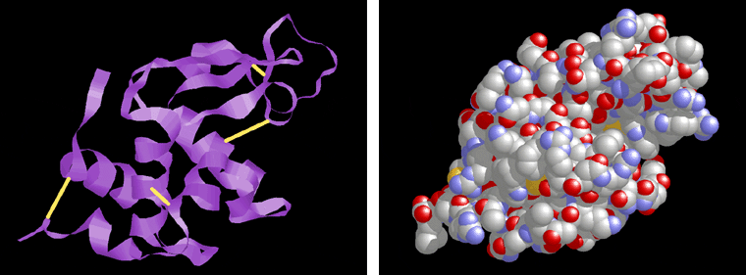
Conformation – spatial arrangement of atoms in a protein
Native conformation – conformation of functional protein
High orders of Protein structure
  A functional protein is not just a polypeptide chain, but one or more polypeptides precisely twisted, folded and coiled into a molecule of unique shape (conformation). This conformation is essential for some protein function e.g. Enables a protein to recognize and bind specifically to another molecule e.g. hormone/receptor; enzyme/substrate and antibody/antigen.

Slide 32
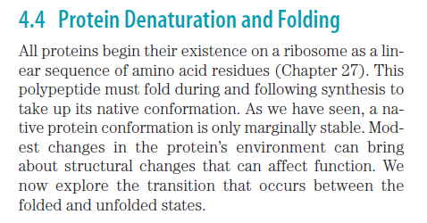

Slide 33
What Determines Protein Structure?
In addition to primary structure, physical and chemical conditions can affect structure
Alterations in pH, salt concentration, temperature, or other environmental factors can cause a protein to unravel
This loss of a protein’s native structure is called denaturation
A denatured protein is biologically inactive

Slide 34
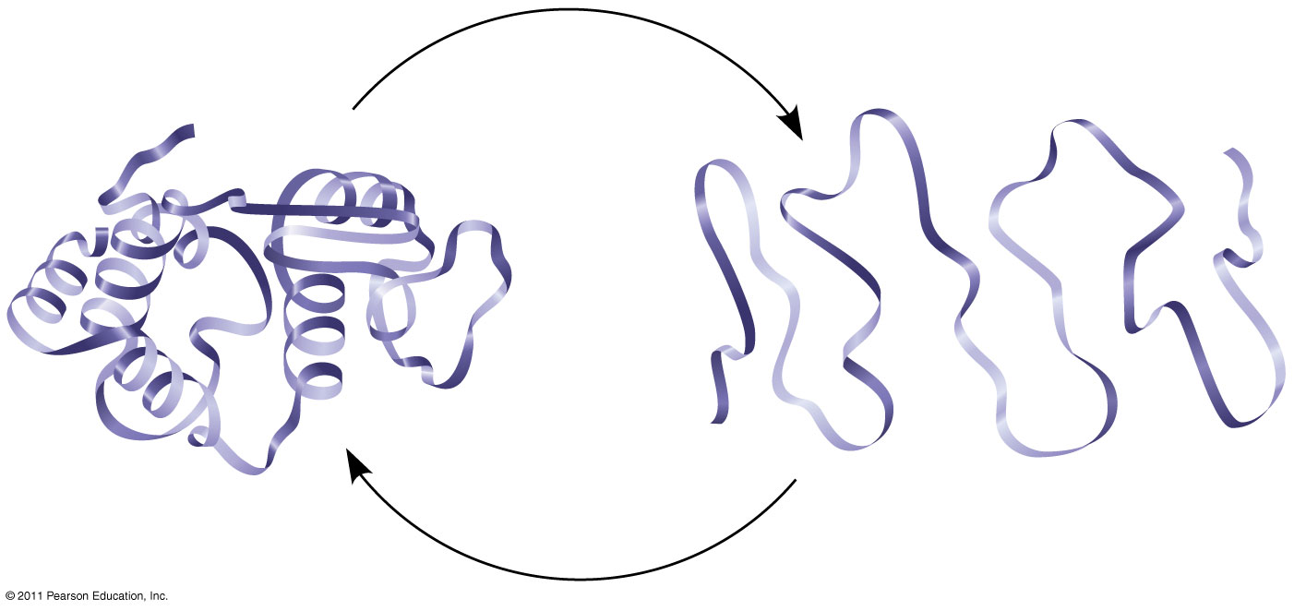
Figure 5.22
De
n
a
tu
r
a
t
i
on
Normal protein
Re
n
i
on
Denatured protein
a
t
u
r
a
t
Notes:
Figure 5.22 Denaturation and renaturation of a protein.

Slide 35
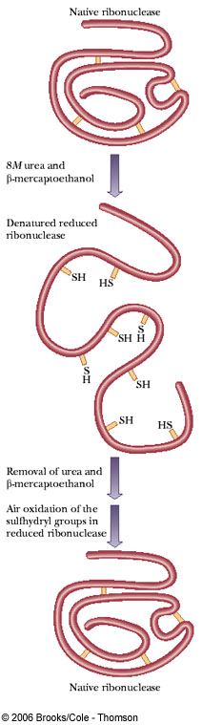
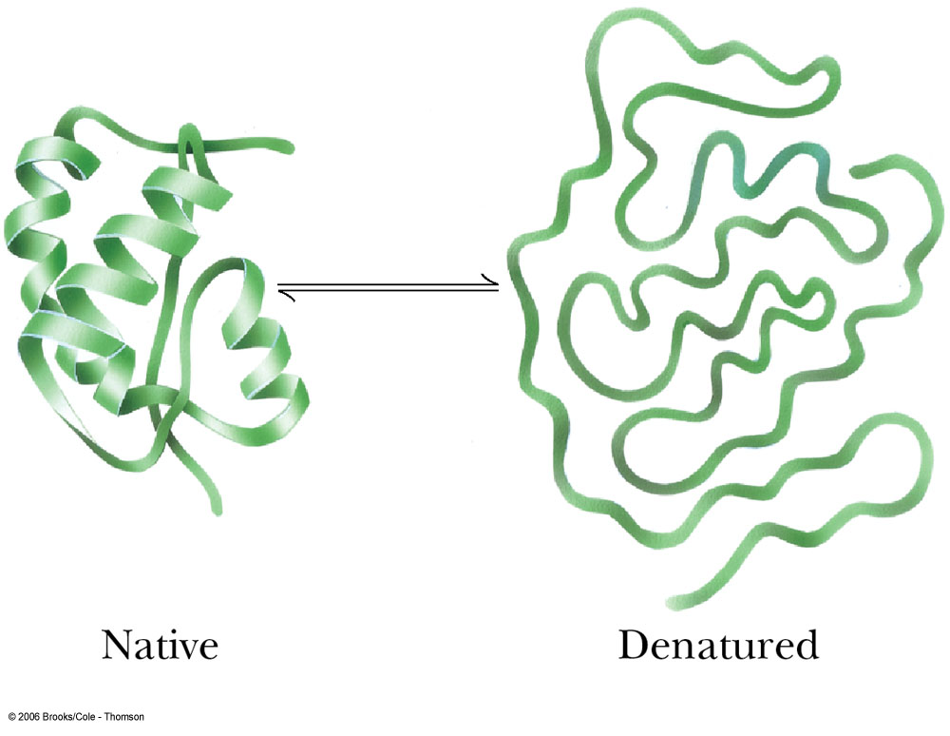
Denaturation and Refolding:
Proteins can be denatured by Heat, extremes pH, and chemicals such as:
1- SDS: Disrupted Electrostatic Interaction.
2- Urea and Guanidine Hydrochloride: form H-bond with protein and disrupted the Hydrophobic interaction.
3- β-marcaptoethanol: reduce the Disulfide Bridges (-S-S- to 2 SH)
Some denatured protein can be recovered, while others are permanent.

Slide 36
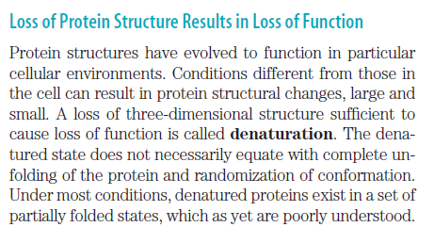

Slide 37
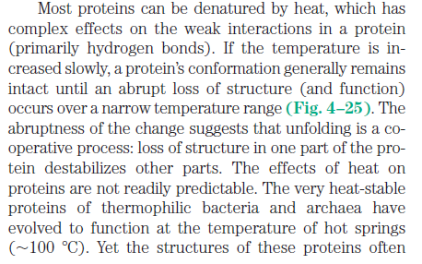

Slide 38
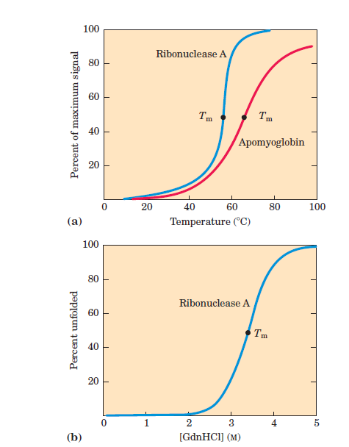

Slide 39
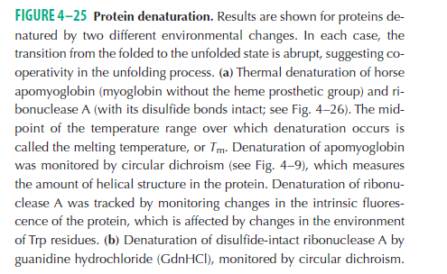

Slide 40
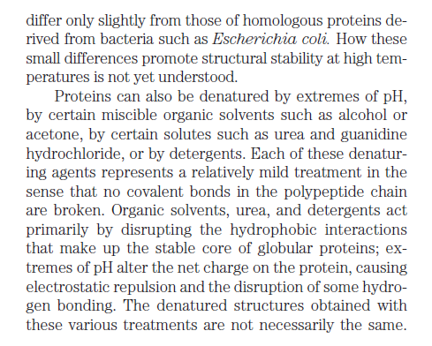

Slide 41
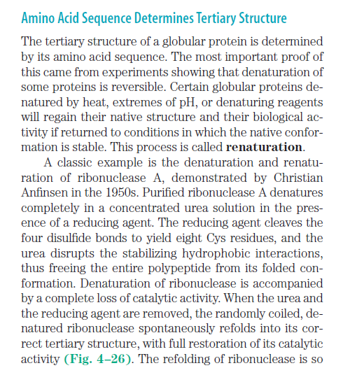

Slide 42
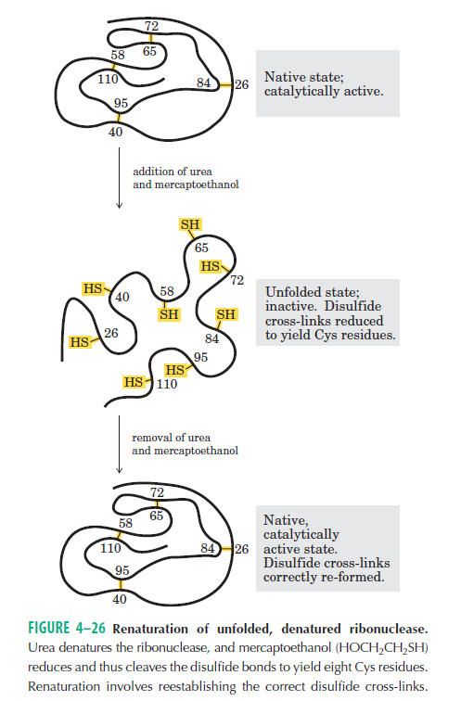

Slide 43
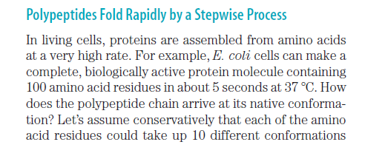

Slide 44
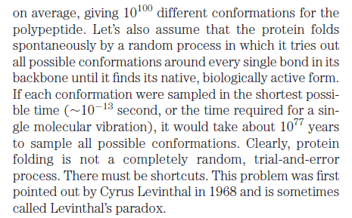

Slide 45
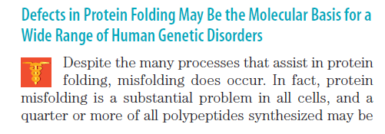
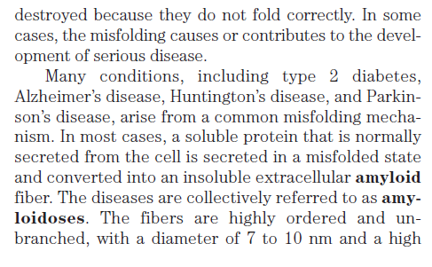


Slide 46
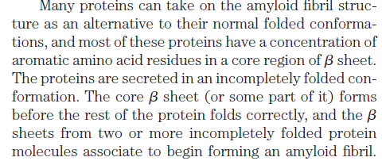
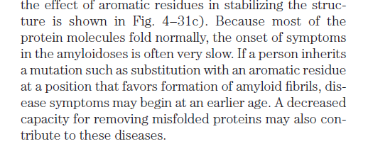

Slide 47
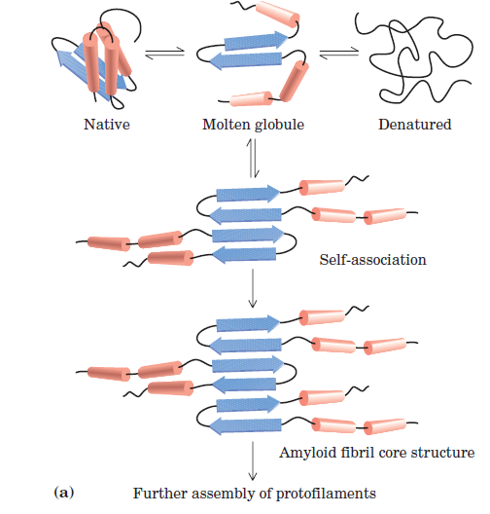

Slide 48



Slide 49


Slide 50


Slide 51
Scientists use X-ray crystallography to determine a protein’s structure
Another method is nuclear magnetic resonance (NMR) spectroscopy, which does not require protein crystallization
Bioinformatics uses computer programs to predict protein structure from amino acid sequences

Slide 52

Diffracted
X-rays
X-ray
source
X-ray
beam
Crystal
Digital detector
X-ray diffraction
pattern
DNA
RNA
polymerase II

Slide 53




Slide 54



The tertiary structure of α-Lactalbumin
X-Ray Crystallography

Slide 55


