Slide 1
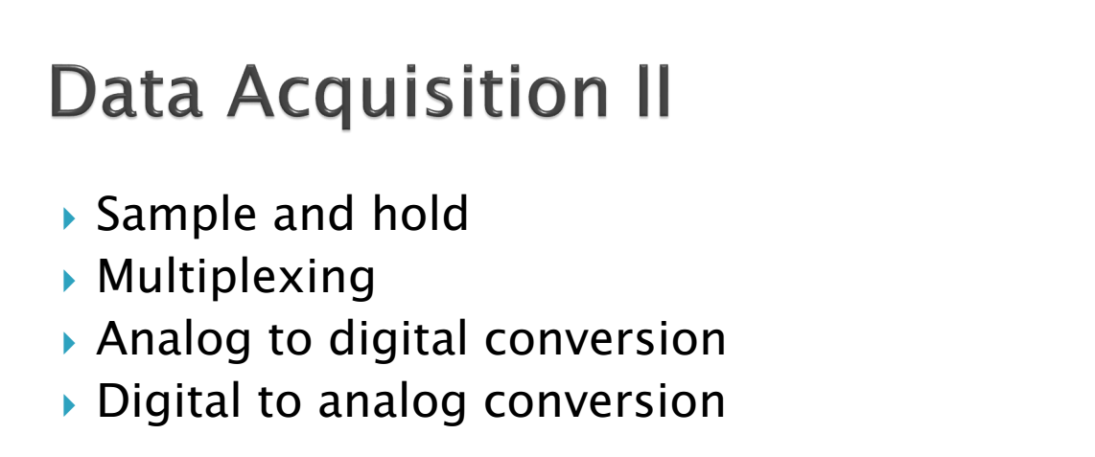

Slide 2
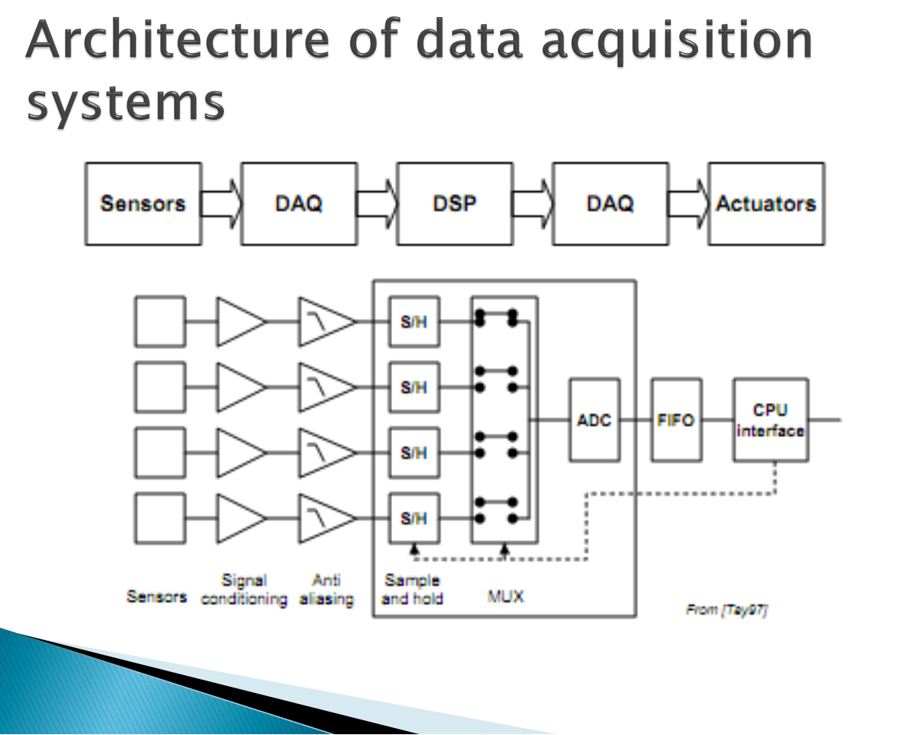

Slide 3
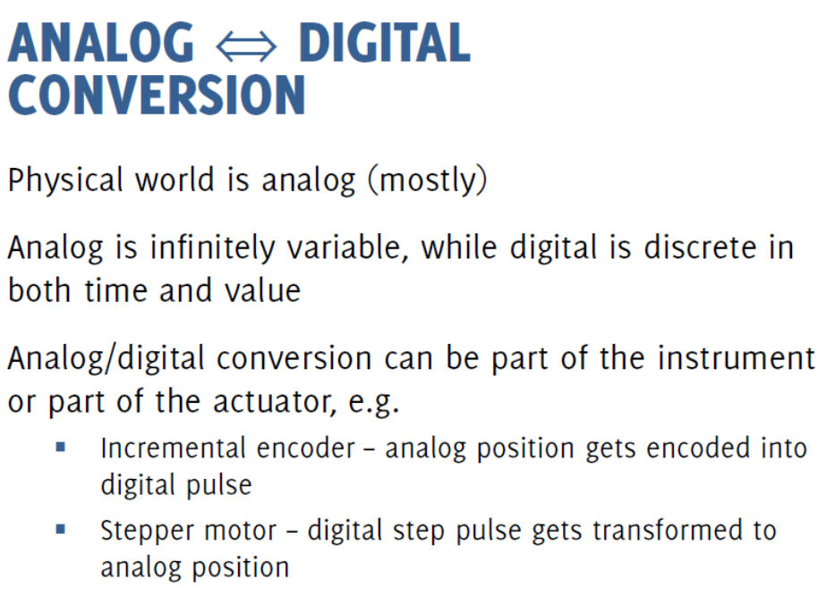

Slide 4
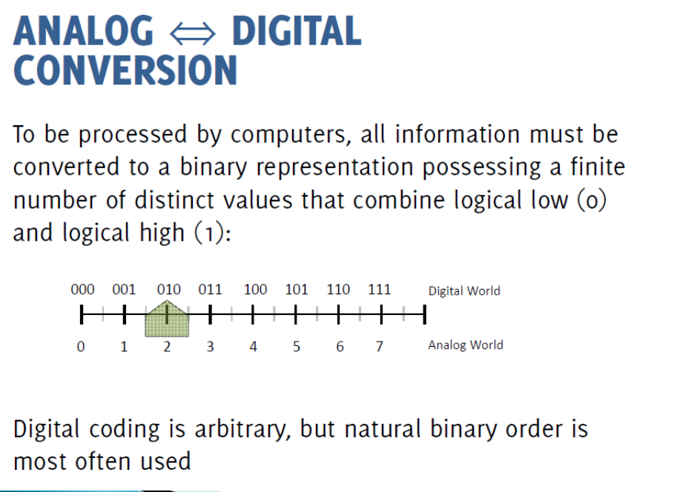

Slide 5
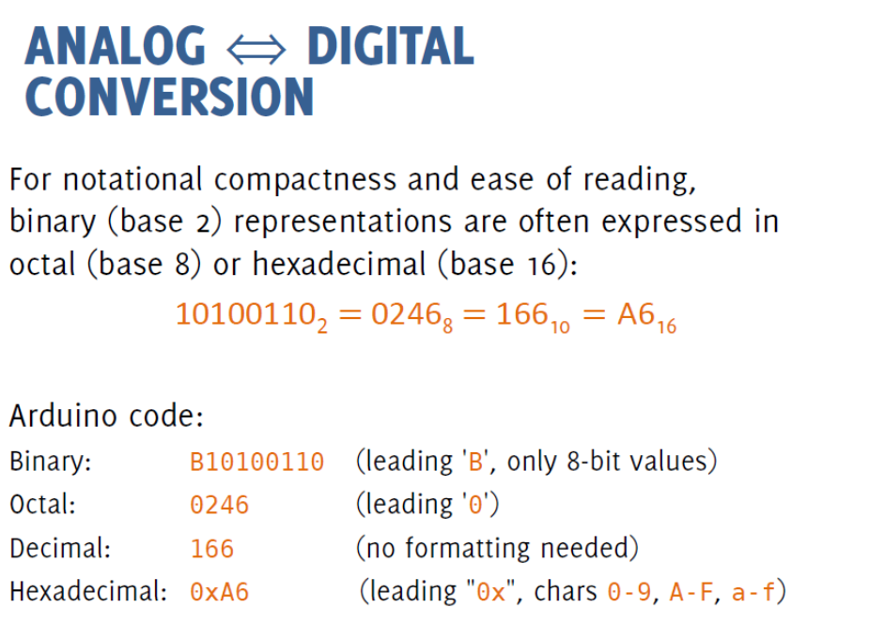

Slide 6
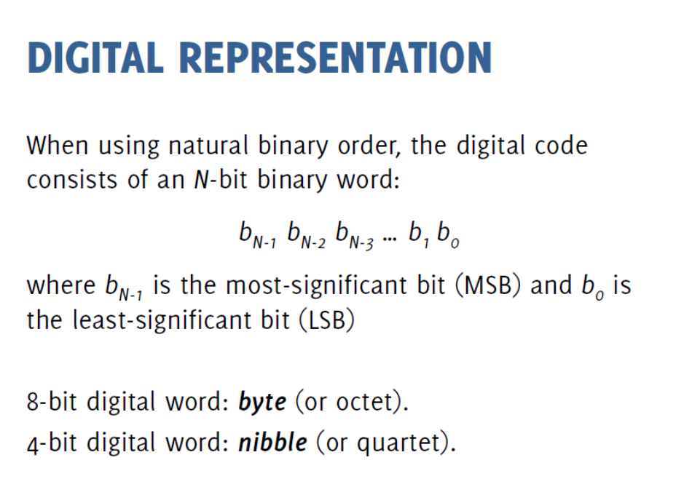

Slide 7
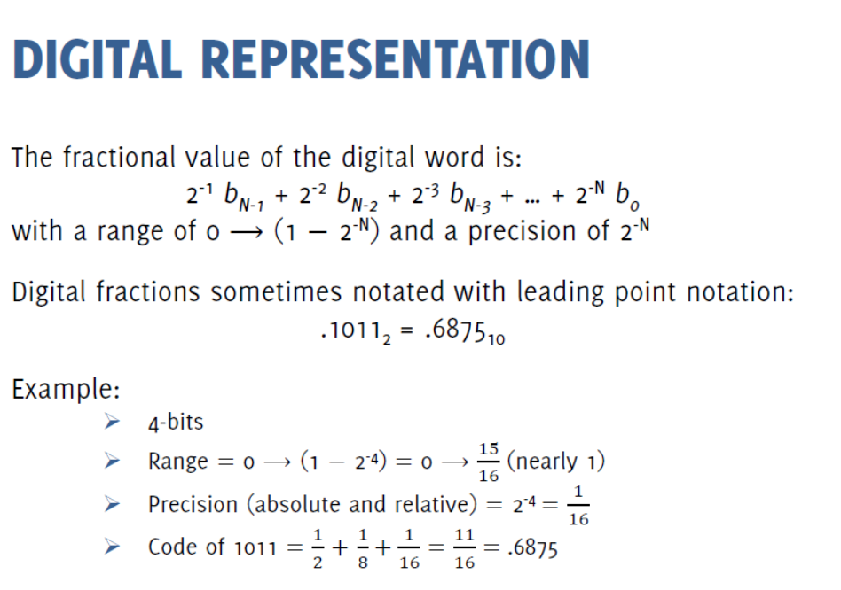

Slide 9
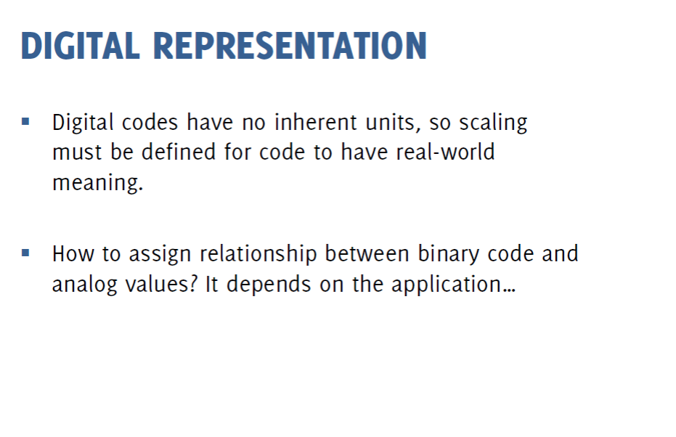

Slide 10
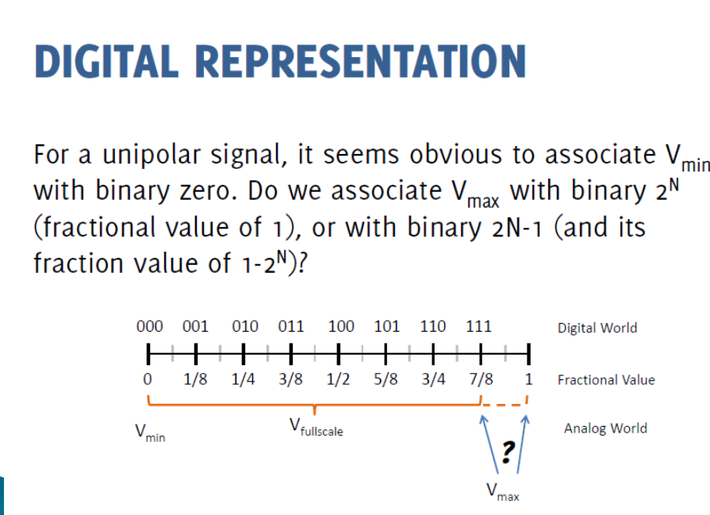

Slide 11
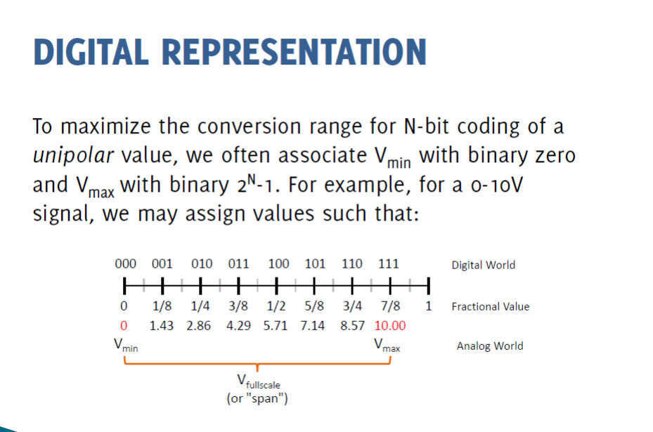

Slide 12
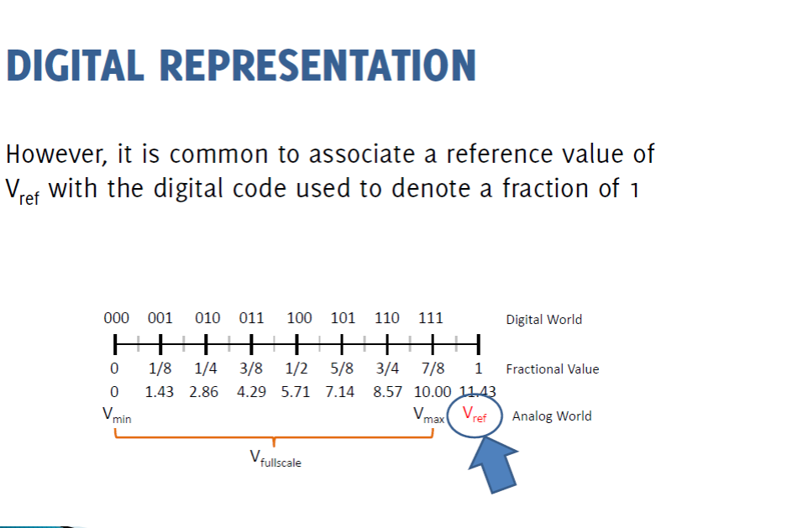

Slide 13
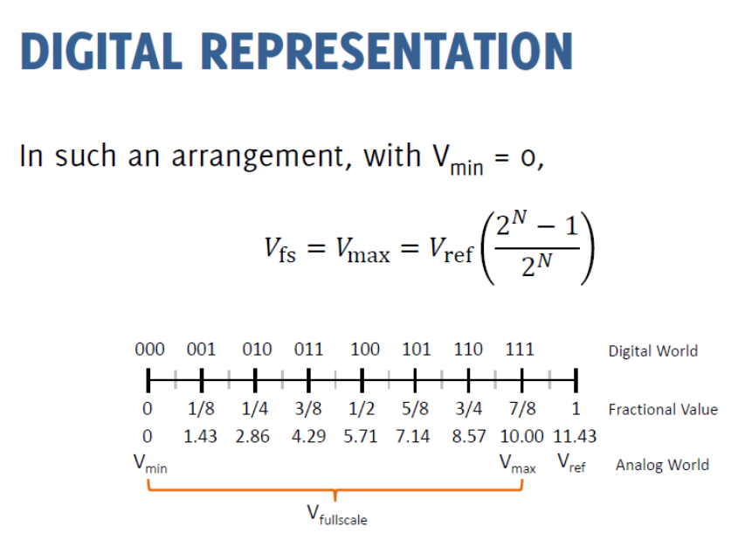

Slide 14
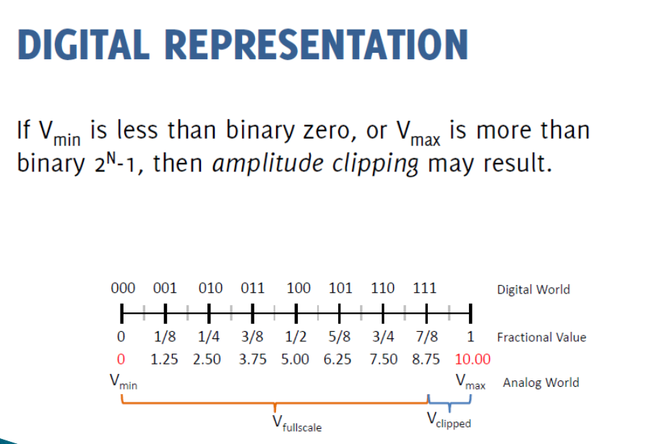

Slide 15
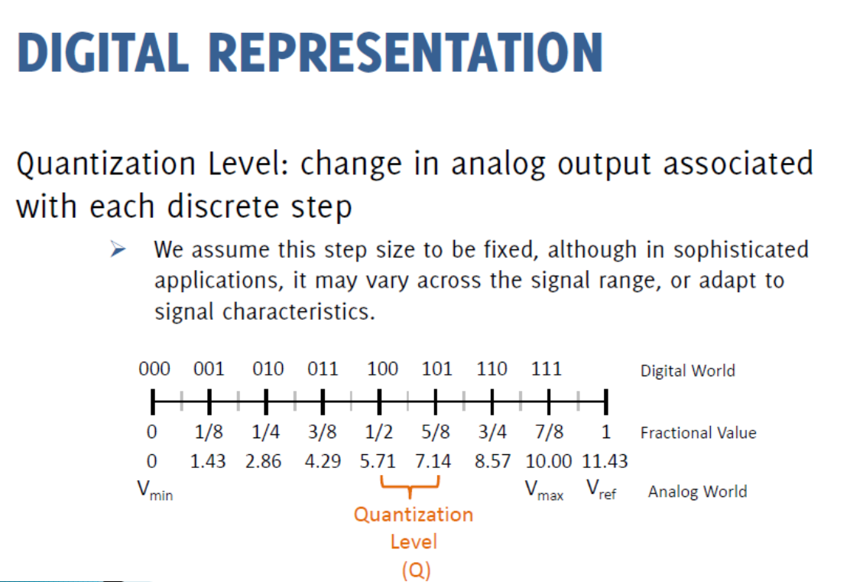

Slide 16
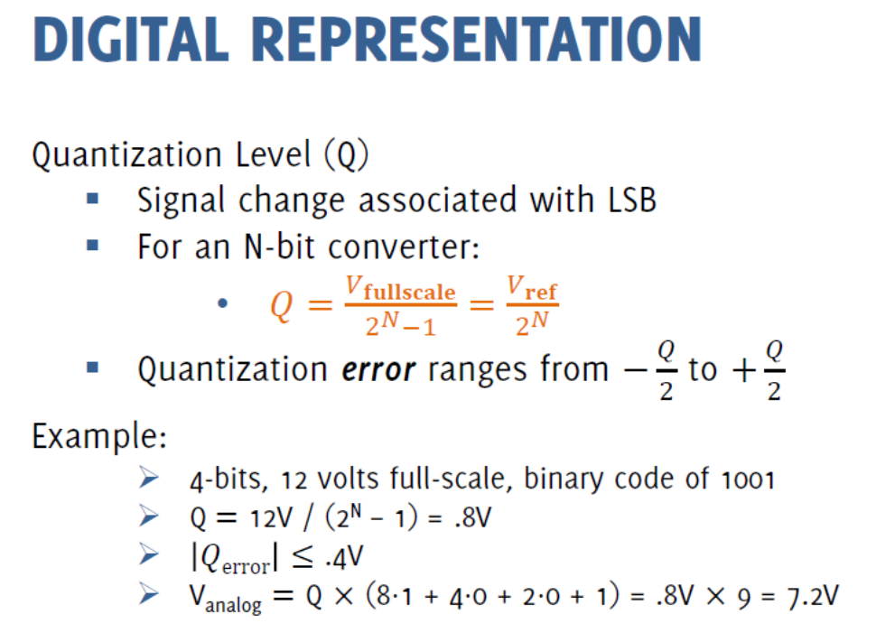

Slide 17
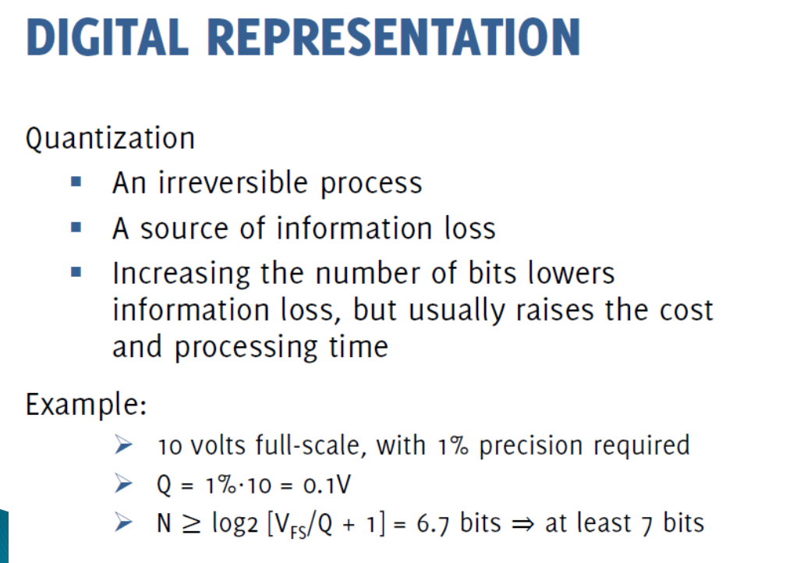

Slide 18
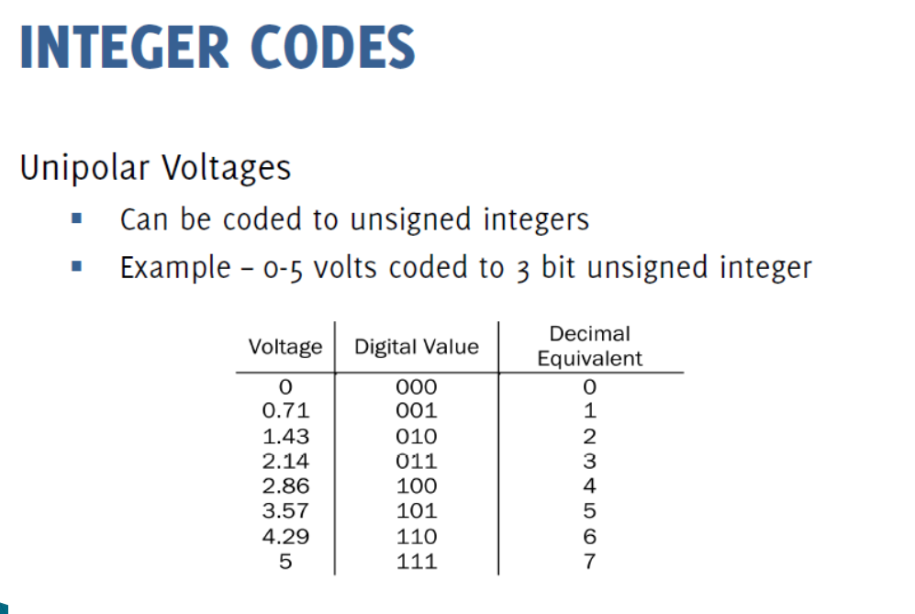

Slide 19
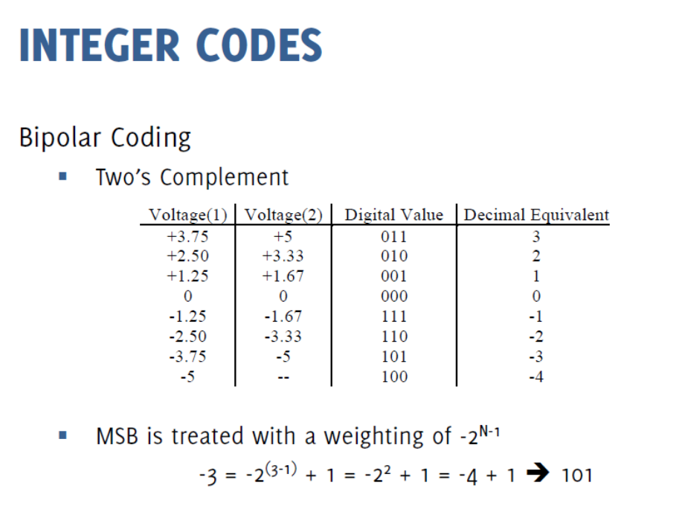

Slide 20
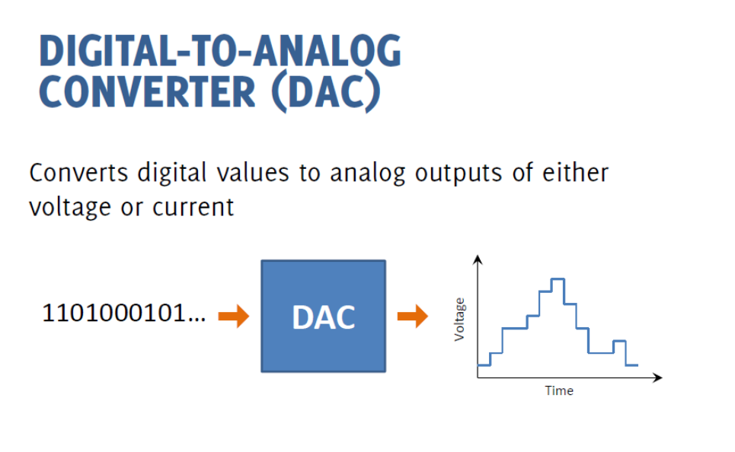

Slide 21
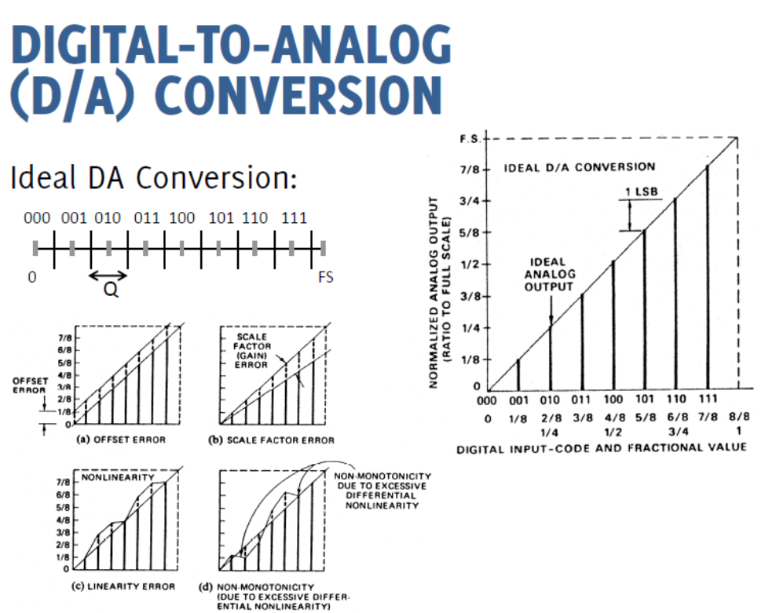

Slide 22
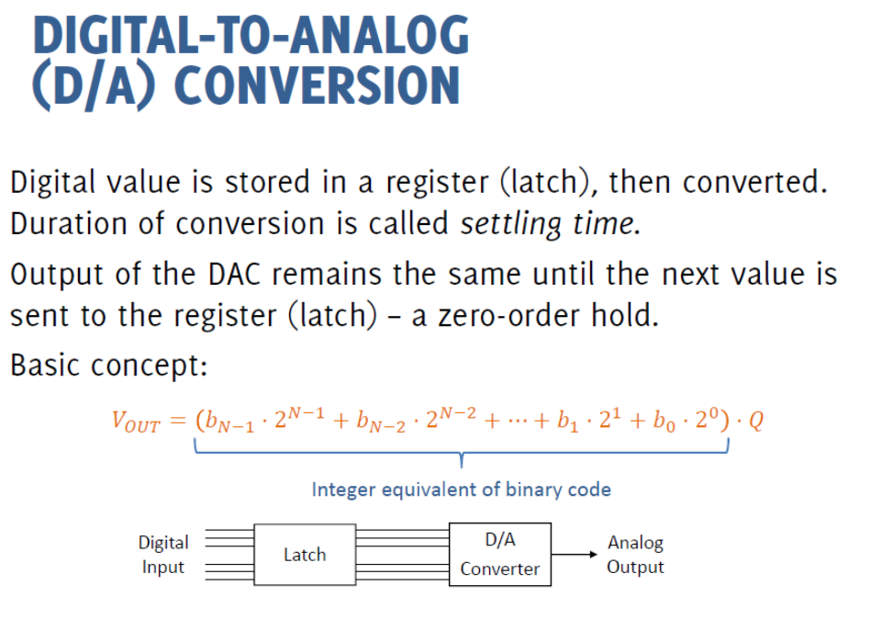

Slide 23
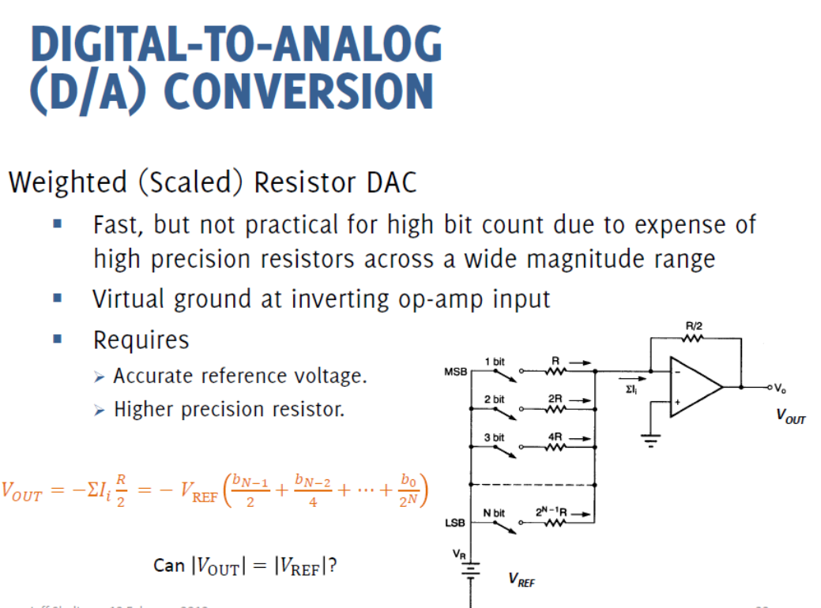
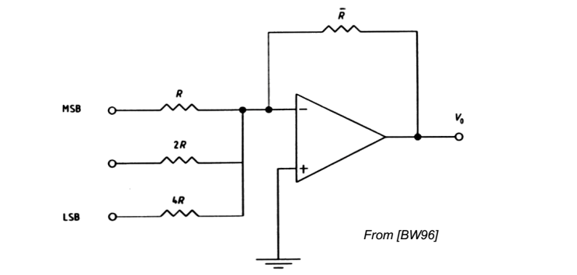

Slide 24

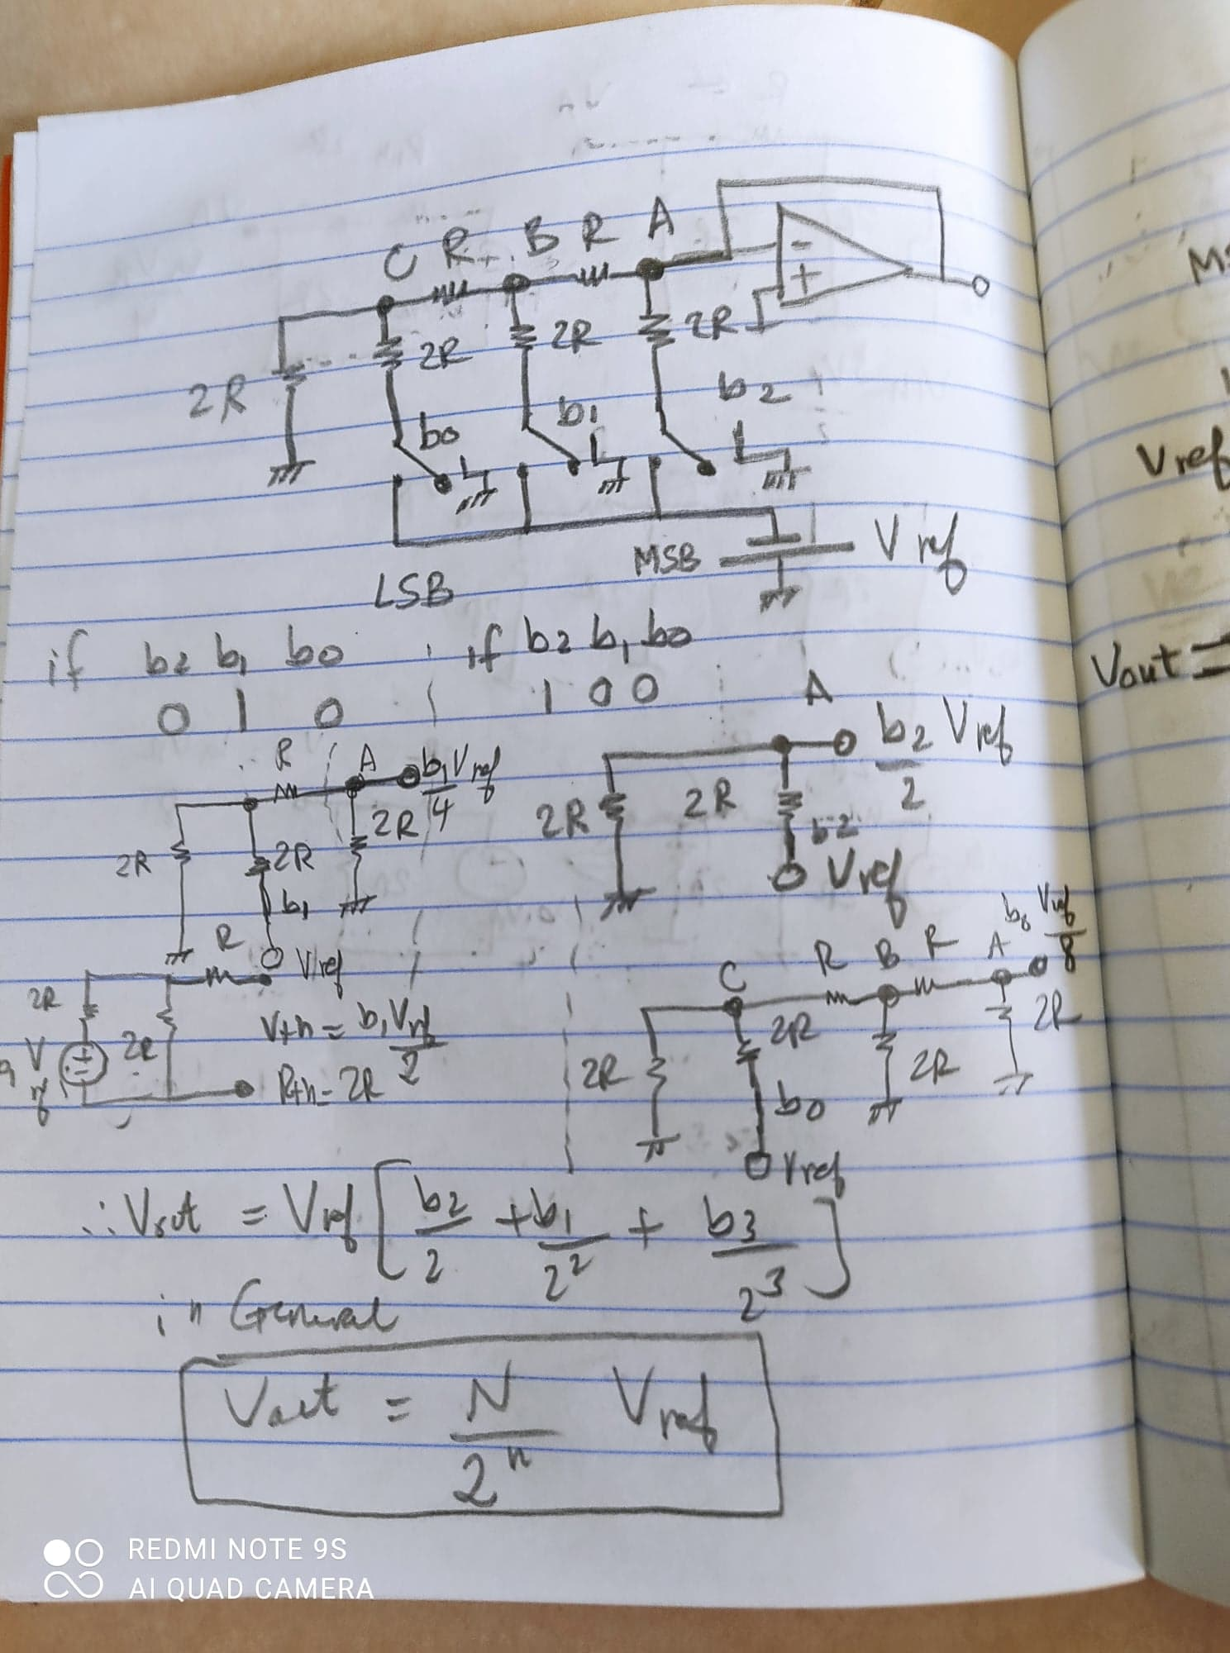
Weighted Resistor DAC
Notes:
Weighted Resistor DAC

Slide 25
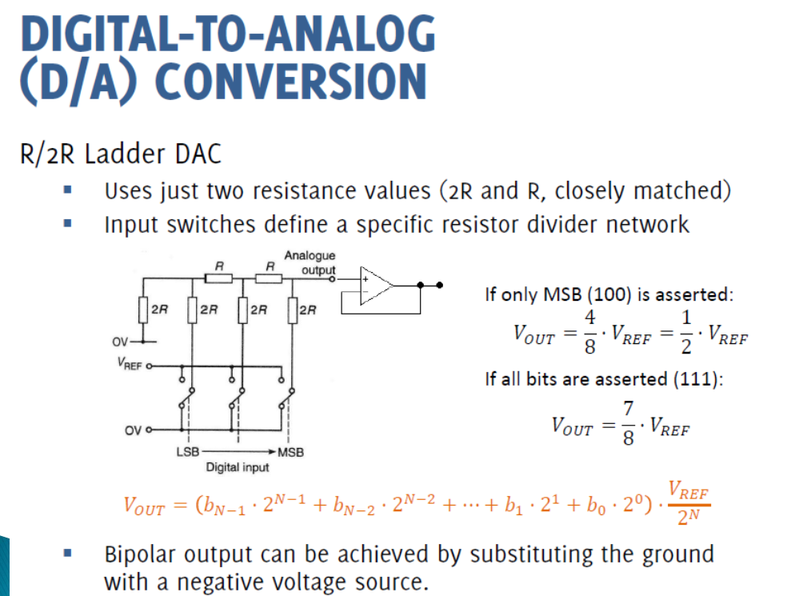

Slide 26
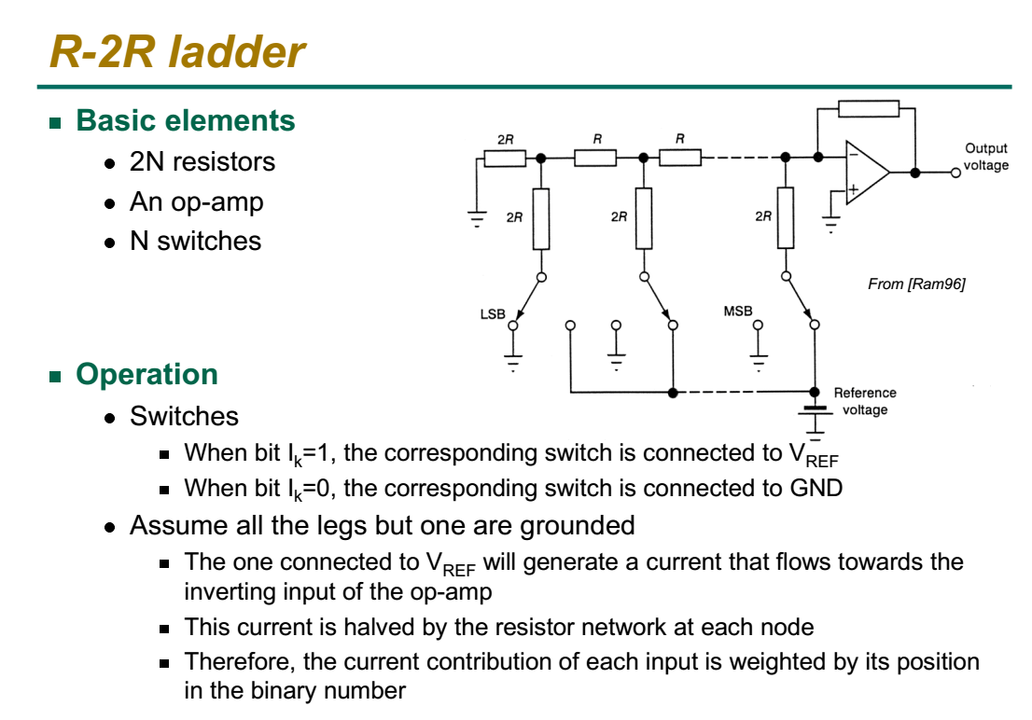

Slide 27
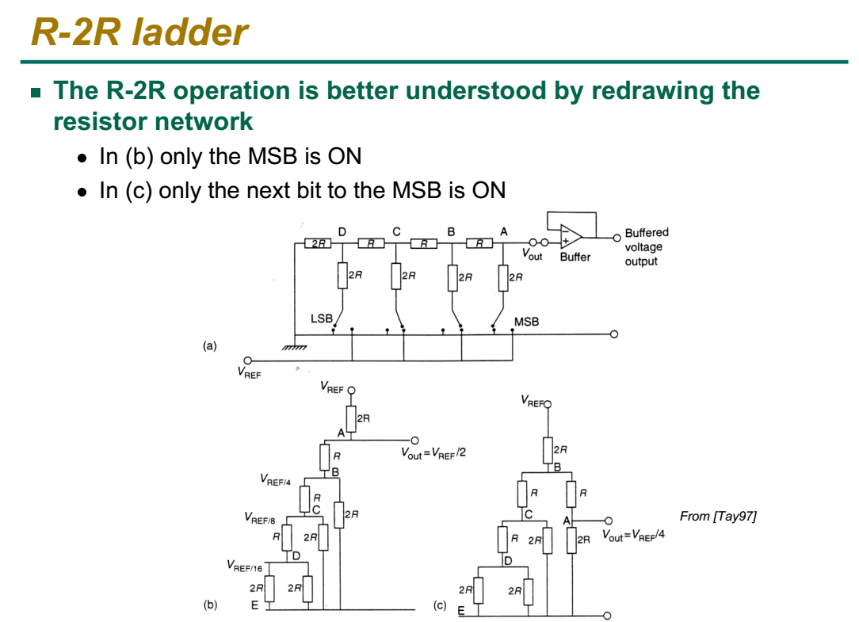

Slide 28
Ladder Network DAC
Notes:
Weighted Resistor DAC

Slide 29
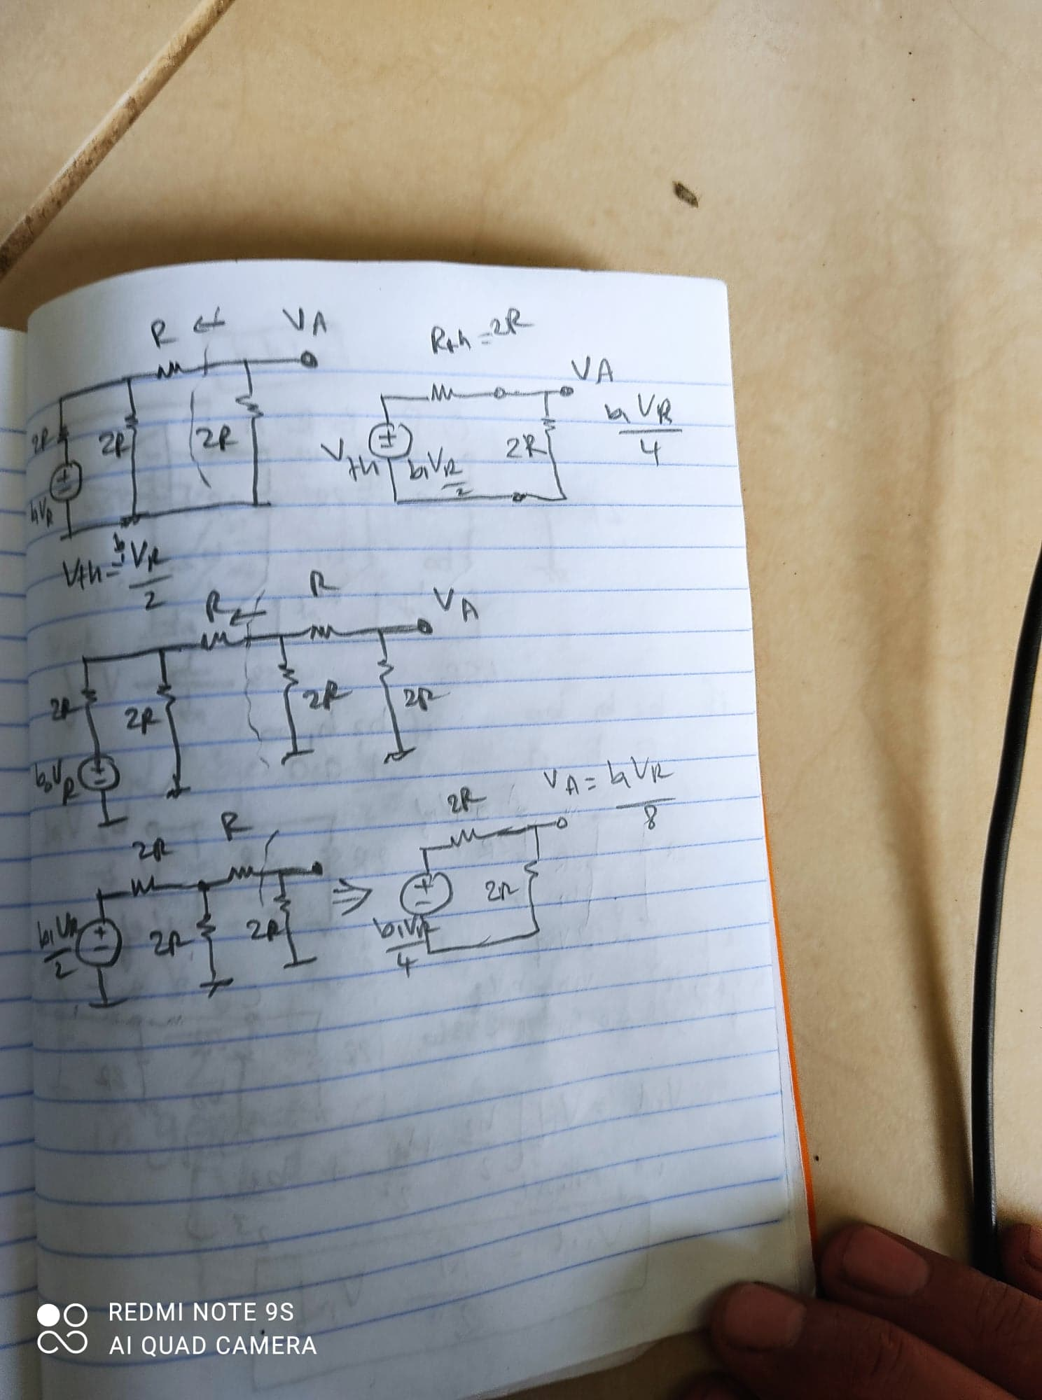
To determine the voltage for every case:
Notes:
To determine the voltage for every case:

Slide 30
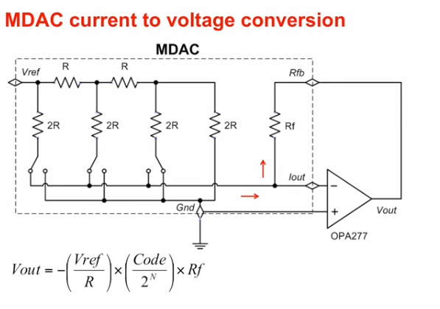
Multiplying DAC
50 cent 8 bit DAC

Slide 31
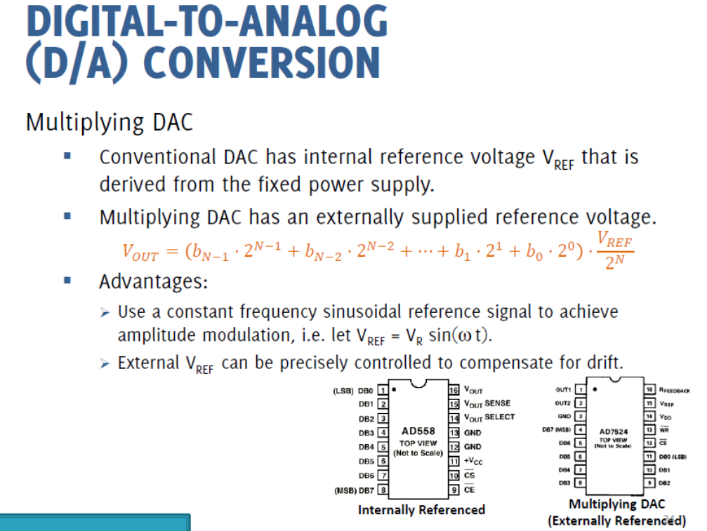

Slide 32
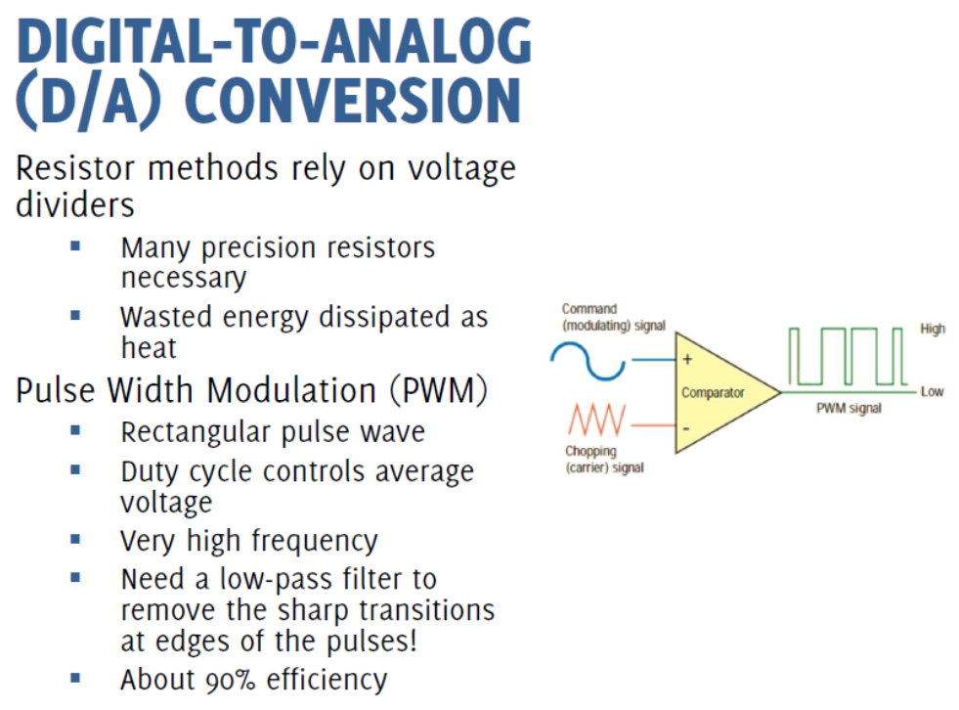

Slide 33
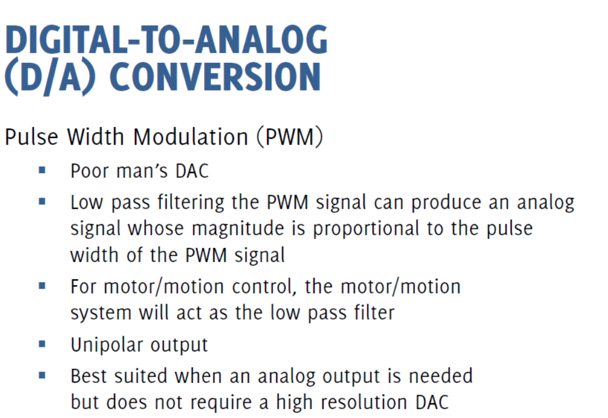

Slide 34
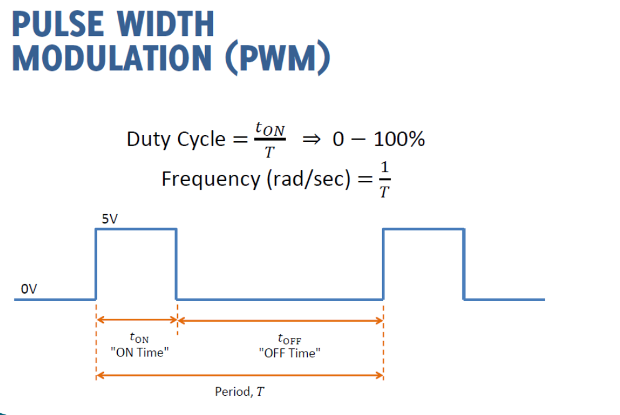

Slide 35
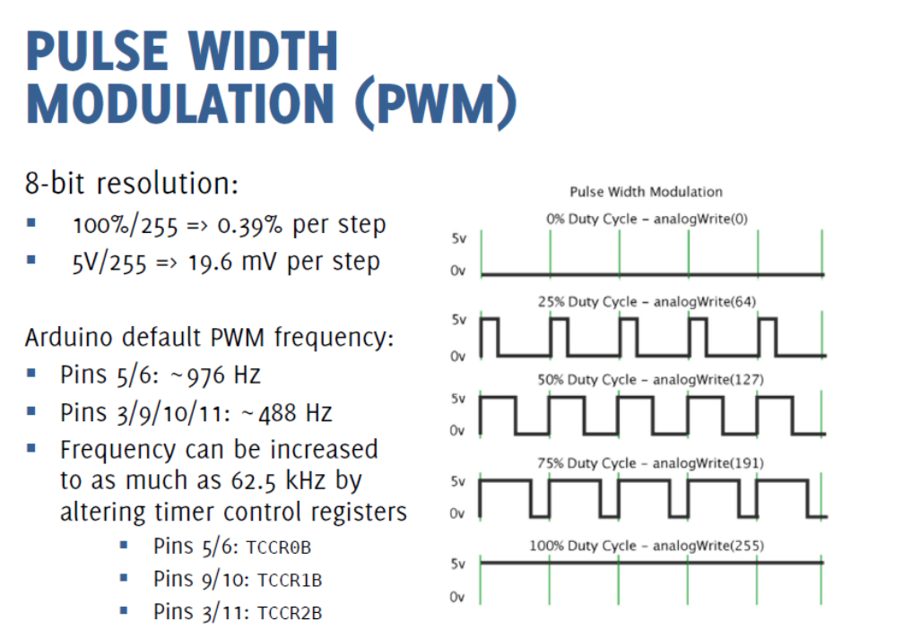
https://circuitdigest.com/microcontroller-projects/arduino-timer-tutorial
https://prototyperobotics.com/steps/2

Slide 36
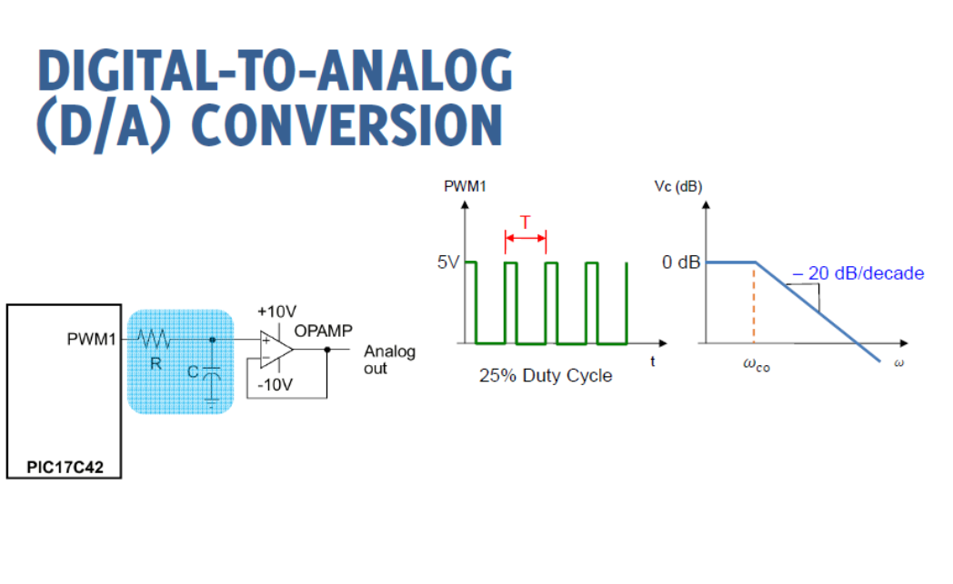

Slide 37
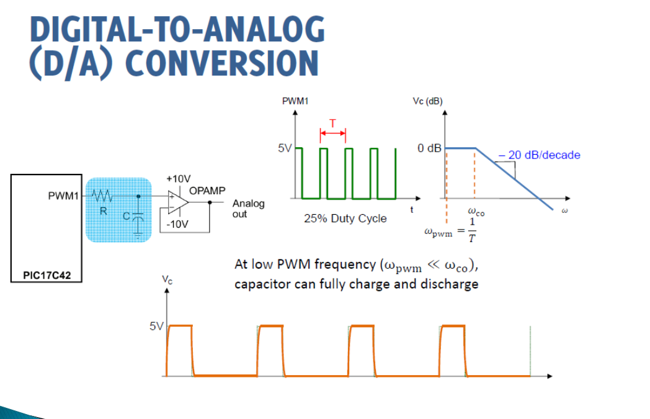

Slide 38
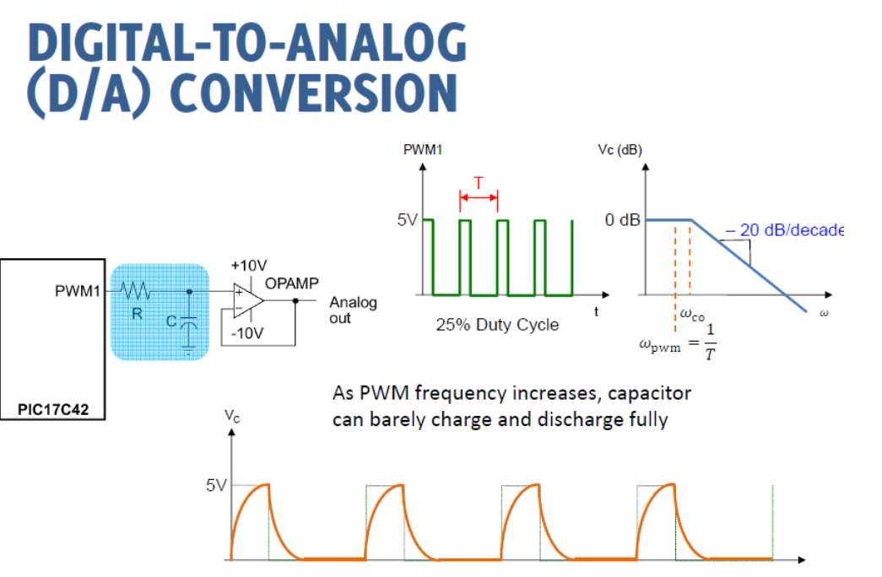

Slide 39
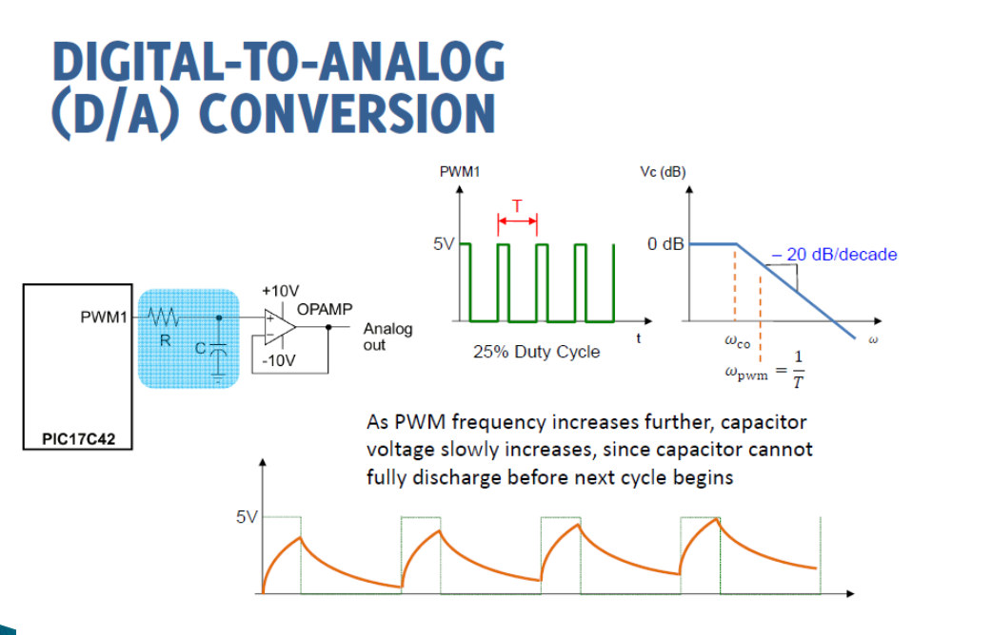

Slide 40
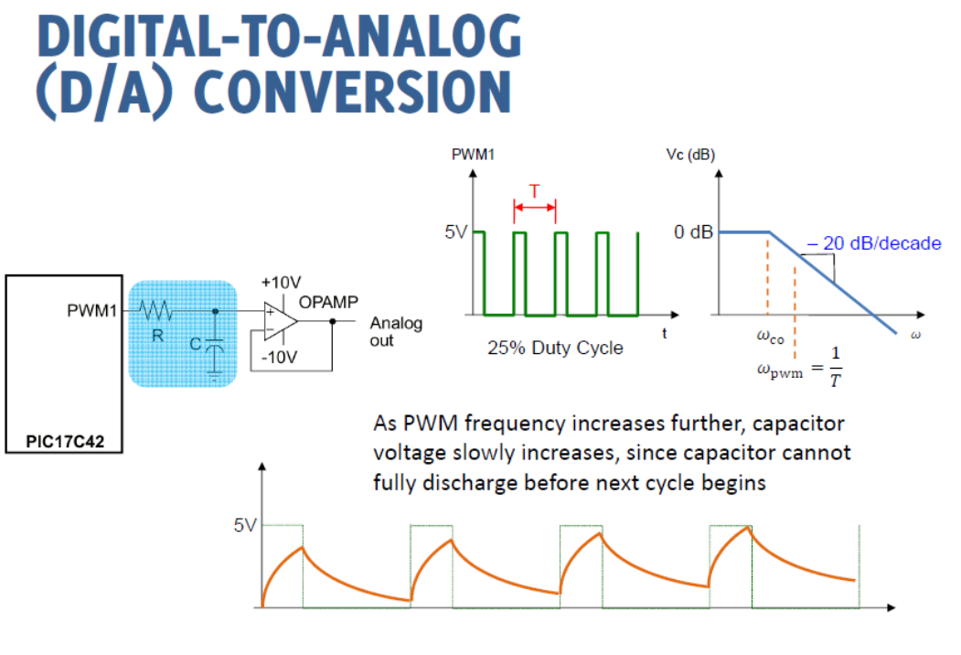

Slide 41
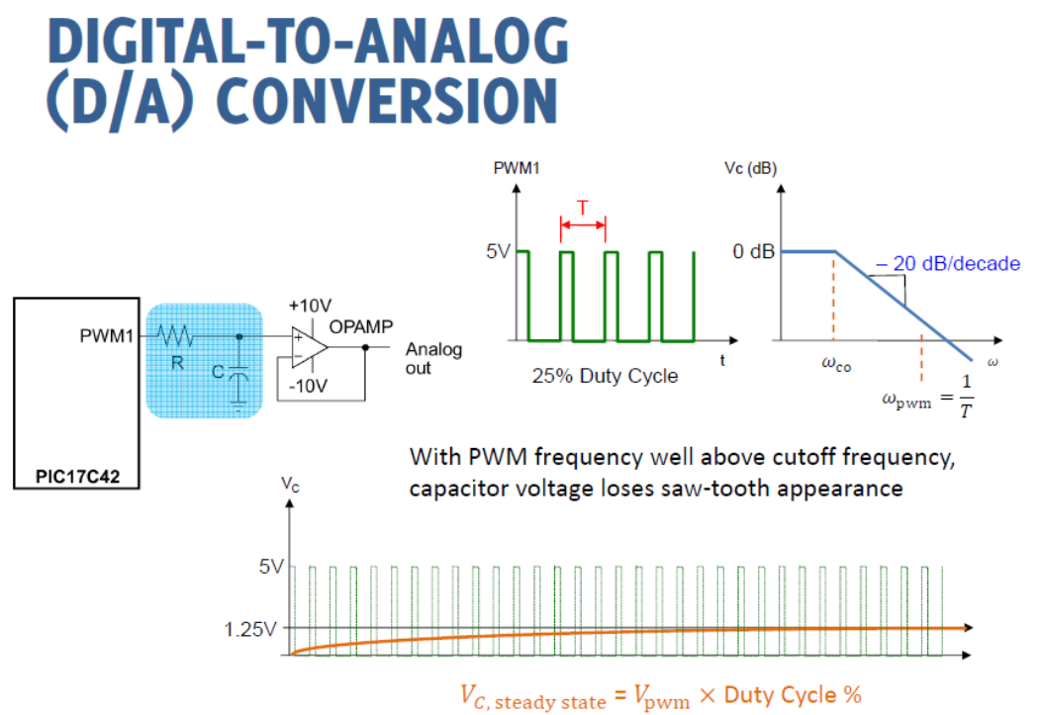

Slide 42
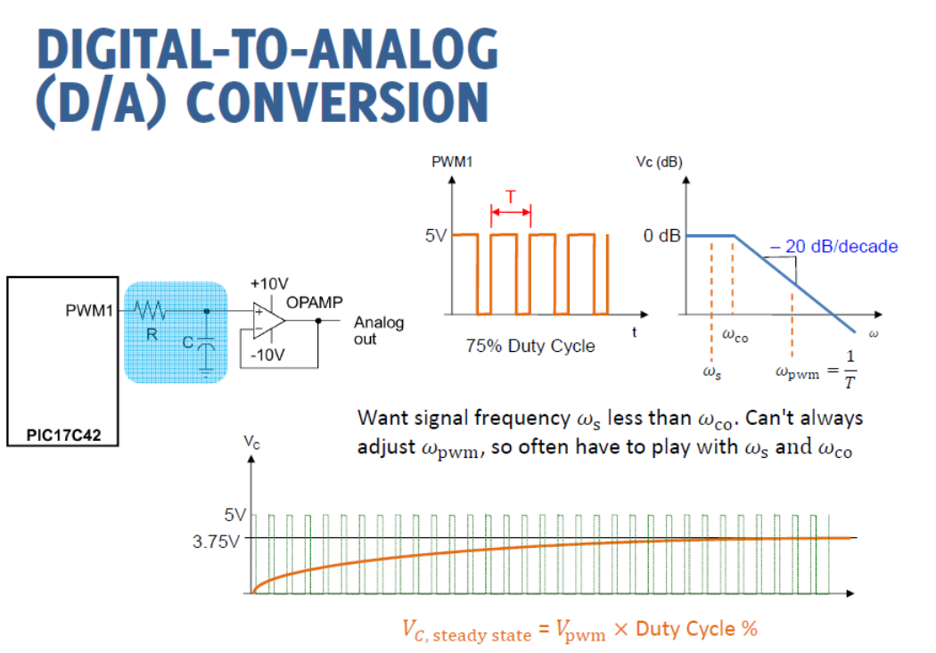

Slide 43
RC Low-pass Filter Design for PWM
Calculated peak-to-peak ripple voltage and settling time at a given PWM frequency and cut-off frequency or values of R and C.
http://sim.okawa-denshi.jp/en/PWMtool.php
https://www.allaboutcircuits.com/technical-articles/low-pass-filter-a-pwm-signal-into-an-analog-voltage/

Slide 44
How to adjust Arduino PWM frequencies
Pins 5 and 6: controlled by Timer 0 in fast PWM mode (cycle length = 256)
Setting Divisor Frequency
0x01 1 62500
0x02 8 7812.5
0x03 64 976.5625 <--DEFAULT
0x04 256 244.140625
0x05 1024 61.03515625
TCCR0B = (TCCR0B & 0b11111000) | <setting>;

Slide 45
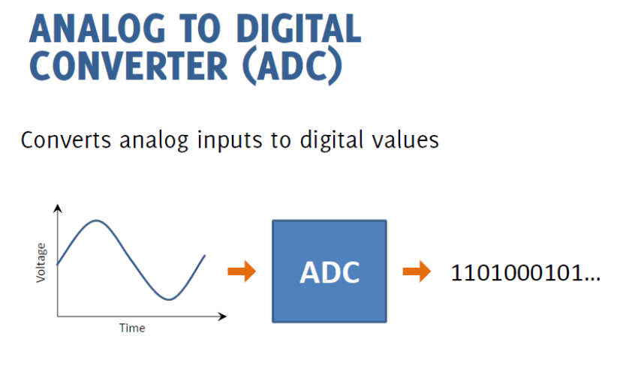

Slide 46
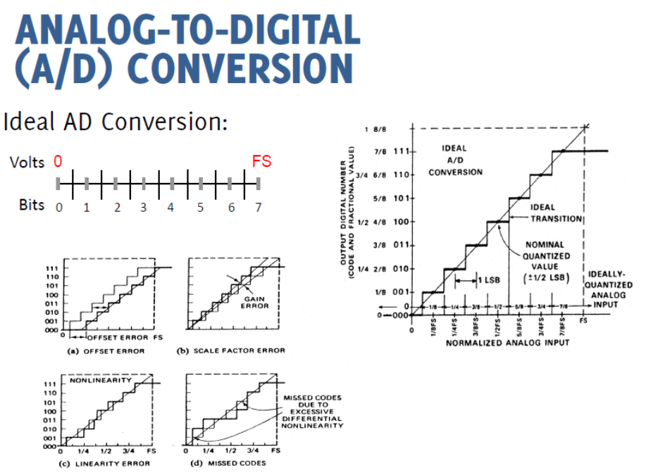

Slide 47
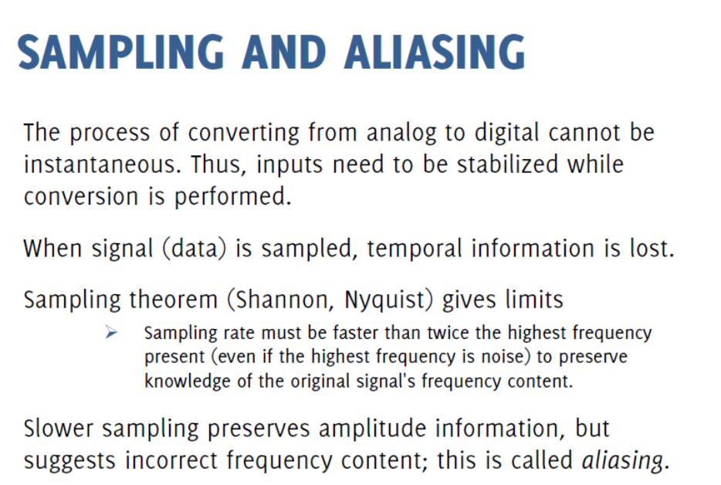

Slide 48
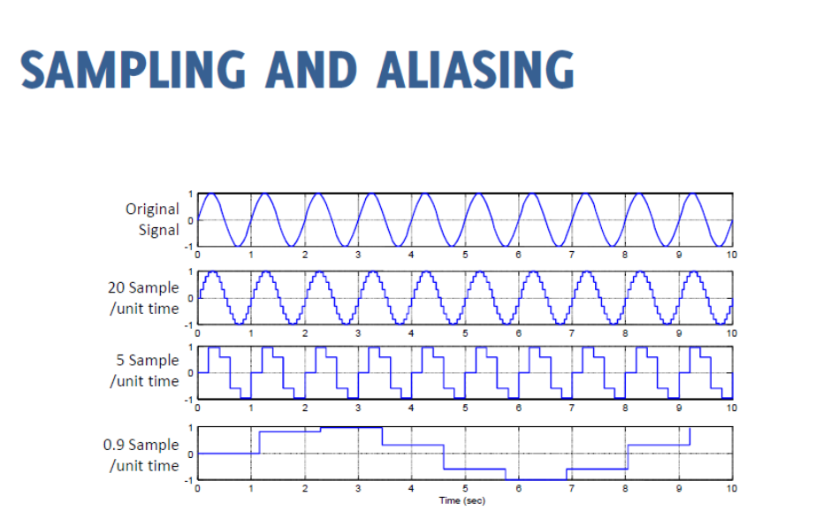

Slide 49
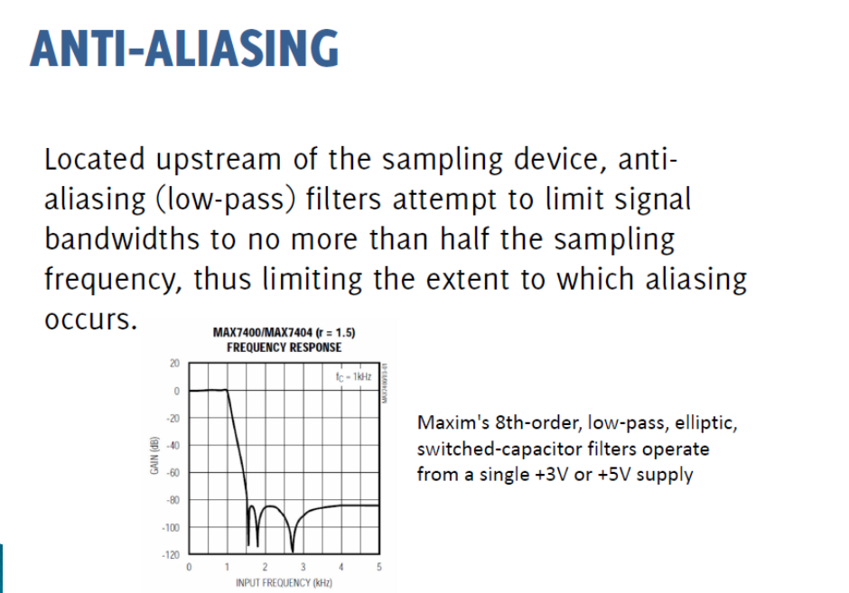

Slide 50
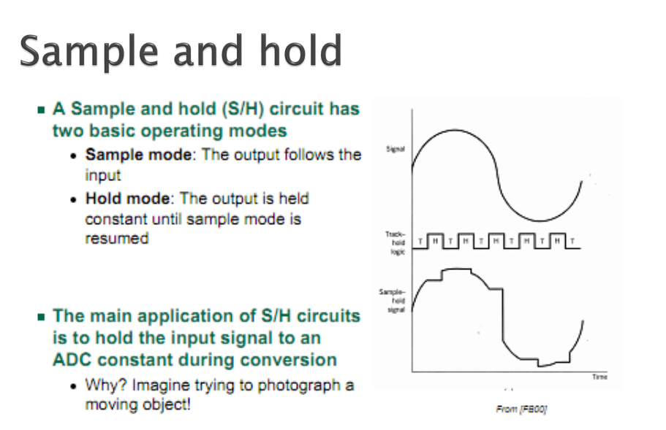

Slide 51
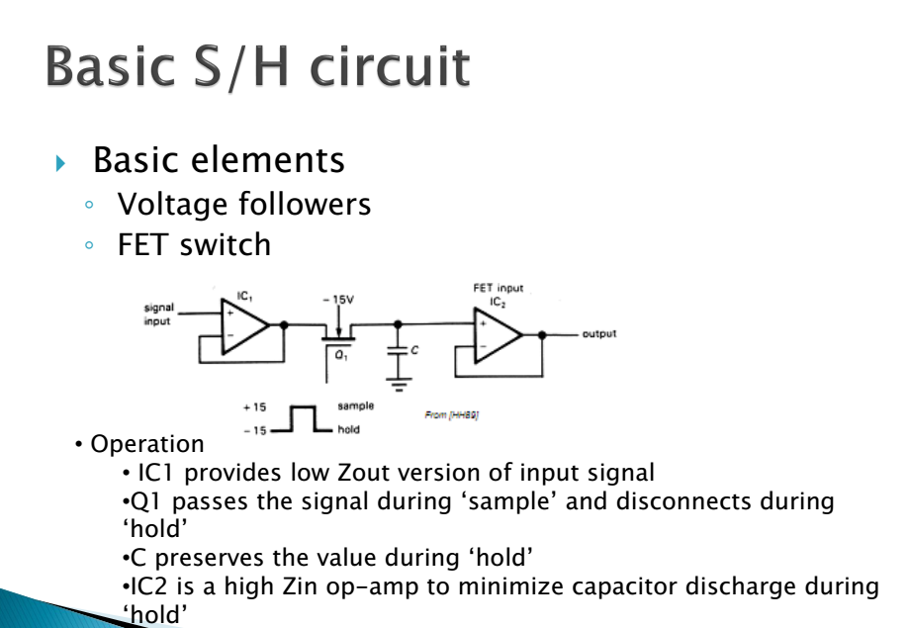

Slide 59
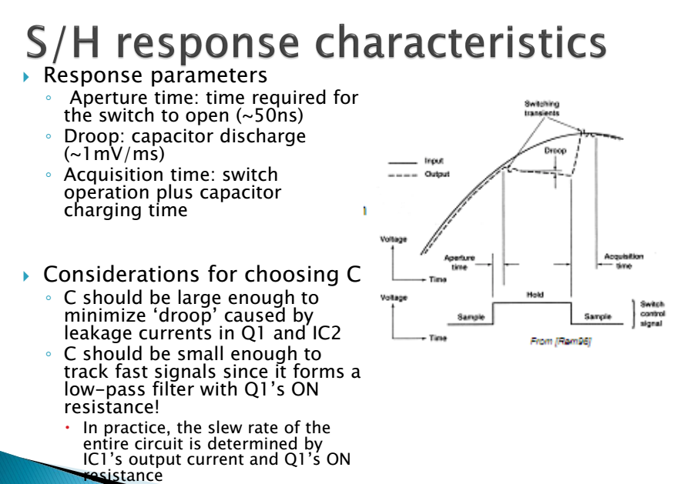

Slide 60
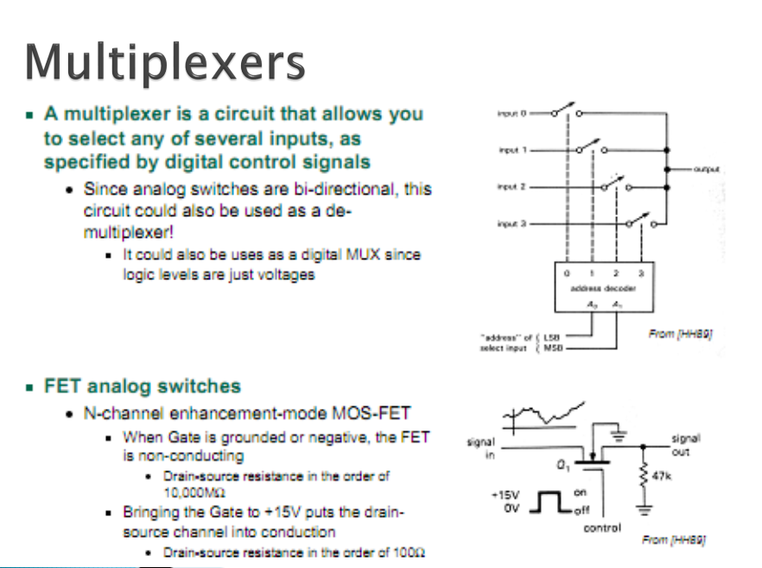

Slide 61


Slide 62



Slide 63


Slide 64


Slide 65


Slide 66


Slide 67



Slide 68


Slide 69


Slide 72


Slide 73


Slide 75
The leftmost op-amp is the (summing) integrator. The next op-amp the integrator feeds into is the comparator, or 1-bit ADC. Next comes the D-type flip-flop, which latches the comparator’s output at every clock pulse, sending either a “high” or “low” signal to the next comparator at the top of the circuit.

Slide 76



If the analog input is zero volts, the integrator will have no tendency to ramp either positive or negative, except in response to the feedback voltage.
In this scenario, the flip-flop output will continually oscillate between “high” and “low,” as the feedback system “hunts” back and forth, trying to maintain the integrator output at zero volts
If, however, we apply a negative analog input voltage, the integrator will have a tendency to ramp its output in a positive direction. Feedback can only add to the integrator’s ramping by a fixed voltage over a fixed time, and so the bit stream output by the flip-flop will not be quite the same:

Slide 77


By applying a larger (negative) analog input signal to the integrator, we force its output to ramp more steeply in a positive direction. Thus, the feedback system has to output more 1’s than before to bring the integrator output back to zero volt
As the analog input signal increases in magnitude, so does the occurrence of 1’s in the digital output of the flip-flop:
A parallel binary number output is obtained from this circuit by averaging the serial stream of bits together. For example, a counter circuit could be designed to collect the total number of 1’s output by the flip-flop in a given number of clock pulses. This count would then be indicative of the analog input voltage.

Slide 80
Example on Bipolar ADC

Slide 82
Conversion Time Consequences, Why S/H?
τc is conversion time
Notes:
τχ is conversion time

