Slide 1
ENGL337
Predicates and Arguments

Slide 2
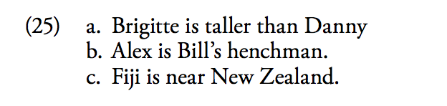
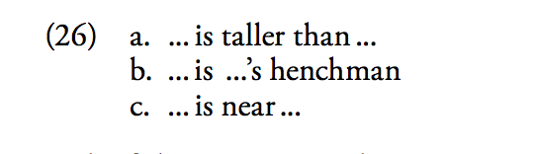
Atomic Propositions
Atomic propositions are the simplest kind of proposition. They consist of a predicate and argument/arguments.

Slide 3
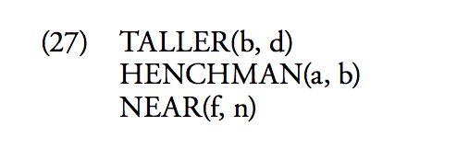
In each of these sequences there is one main word which on its own indicates the nature of the relationship, or the content of the predicate. In the notation to be used here the symbol for the predicate is based on the main word, omitting tense, copula be, and some prepositions. The entities bound in a relationship by the predicate are its arguments, referred to in these examples by names.
By convention, names are represented by lowercase letters. The formulae for the sentences in (25) are:

Slide 4
Some of the main points about predicates:
1- Predicates are semantically ‘incomplete’ if considered in isolation. It isn’t possible to paraphrase or explain the meaning of one of these predicates without including the notion of there being two entities involved in any situation where the predicate applies.

Slide 5
2- Each predicate has a fixed number of arguments.
The predicates we discussed must have exactly two arguments to form a coherent proposition – no more and no fewer – hence they are two-place predicates. The argument ‘slots’ are part of the predicate’s meaning.

Slide 6
Ellipsis
Predicates are commonly used elliptically in natural language, with one of the arguments not explicitly mentioned. For example, one might say simply ‘Brigitte is taller’ or ‘Alex is a faithful henchman’. But the second, unmentioned argument in elliptical utterances like these is still understood in the expressed proposition. If Danny is a subject of conversation, ‘Brigitte is taller’ can be interpreted to mean ‘Brigitte is taller than Danny’. In another context, it may be interpreted to mean that Brigitte is taller than she used to be. It isn’t possible to be taller in isolation without being taller than some comparison standard, and it isn’t possible (in modern English) to be a henchman without being some- one’s henchman. The second argument is still understood to be present in the proposition expressed.

Slide 7
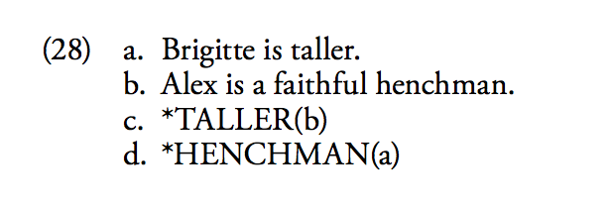
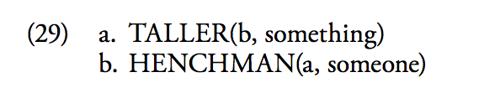
Ellipsis

Slide 8
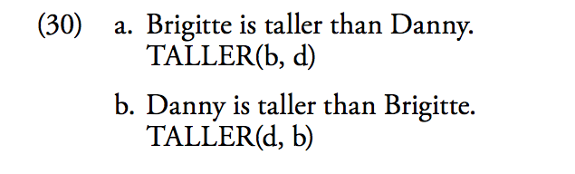
3- The order of the arguments in the formula is significant.
Generally (but not always) the order of arguments in a logical representation is taken from the order of the corresponding expressions in the sentence.

