Slide 1
The swallowing examination of a patient with tracheostomy

Slide 2
Tracheostomy tubes, Intubation, and mechanical ventilation
Tracheostomy tubes are normally placed in cases of
Upper airway obstruction at or above the level of the true vocal folds
Potential upper airway obstruction (edema, surgeries)
Provision of respiratory care

Slide 3
Trachestomy tube
General have three parts:
Outer cannula (stay in place to hold tracheostomy sute open).
Inner cannula (remains in the tube except for cleaning)
Obturator (provide a smooth ,rounded tip for initial insertion of the tracheostomy)

Slide 5
Trachestomy tube
Two important variations in tracheostomy tubes
Cuffed or uncuffed “respiration”
Fenestrated or unfenestrated (speech)

Slide 6

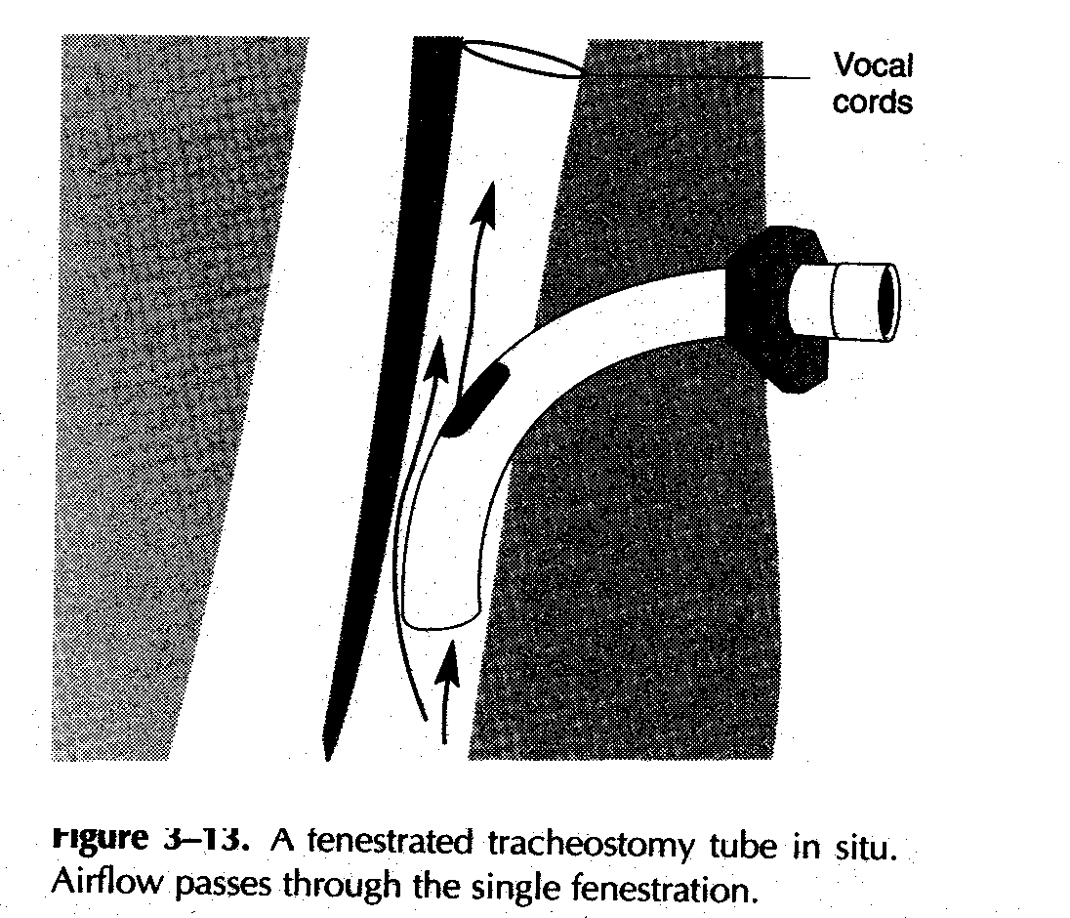

Slide 7

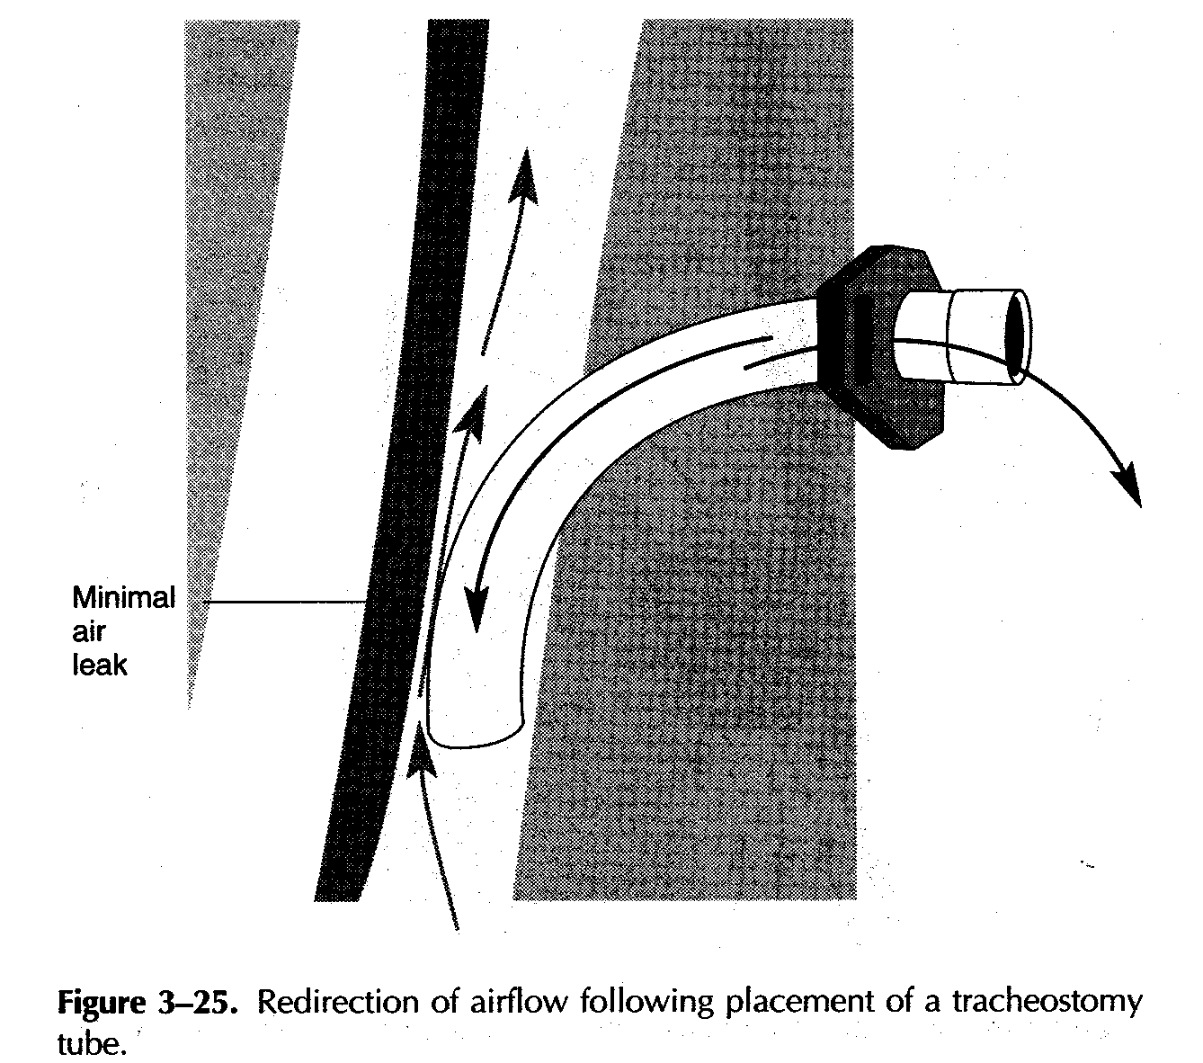

Slide 8
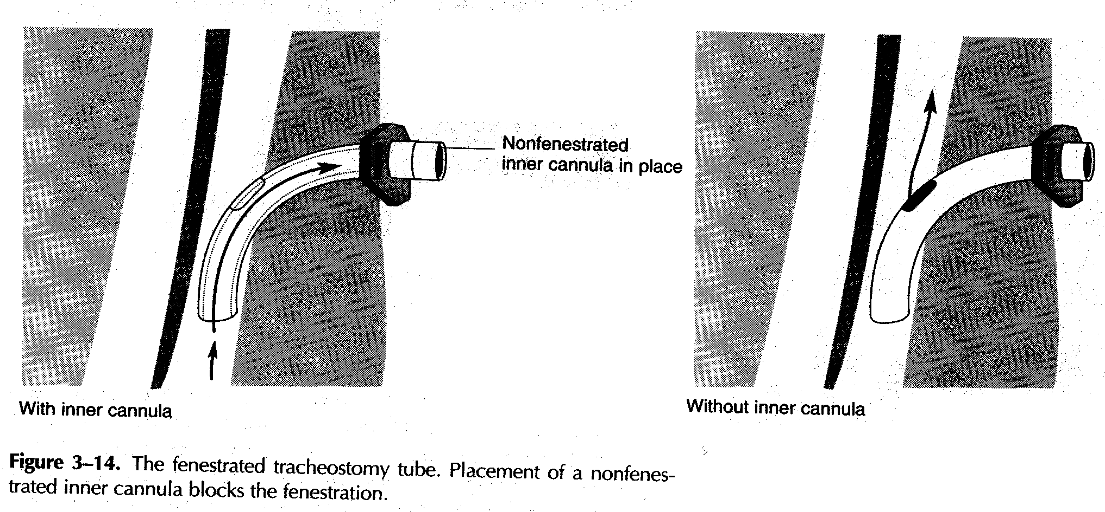

Slide 9
Deflated cuff: space between trachea and cuff is open→ air can pass
Inflated cuff: no material above the cuff can pass below (pts who aspirate their saliva, need respiratory training→ suctioning necessary
If cuff inflated too long → tracheal irritation

Slide 10
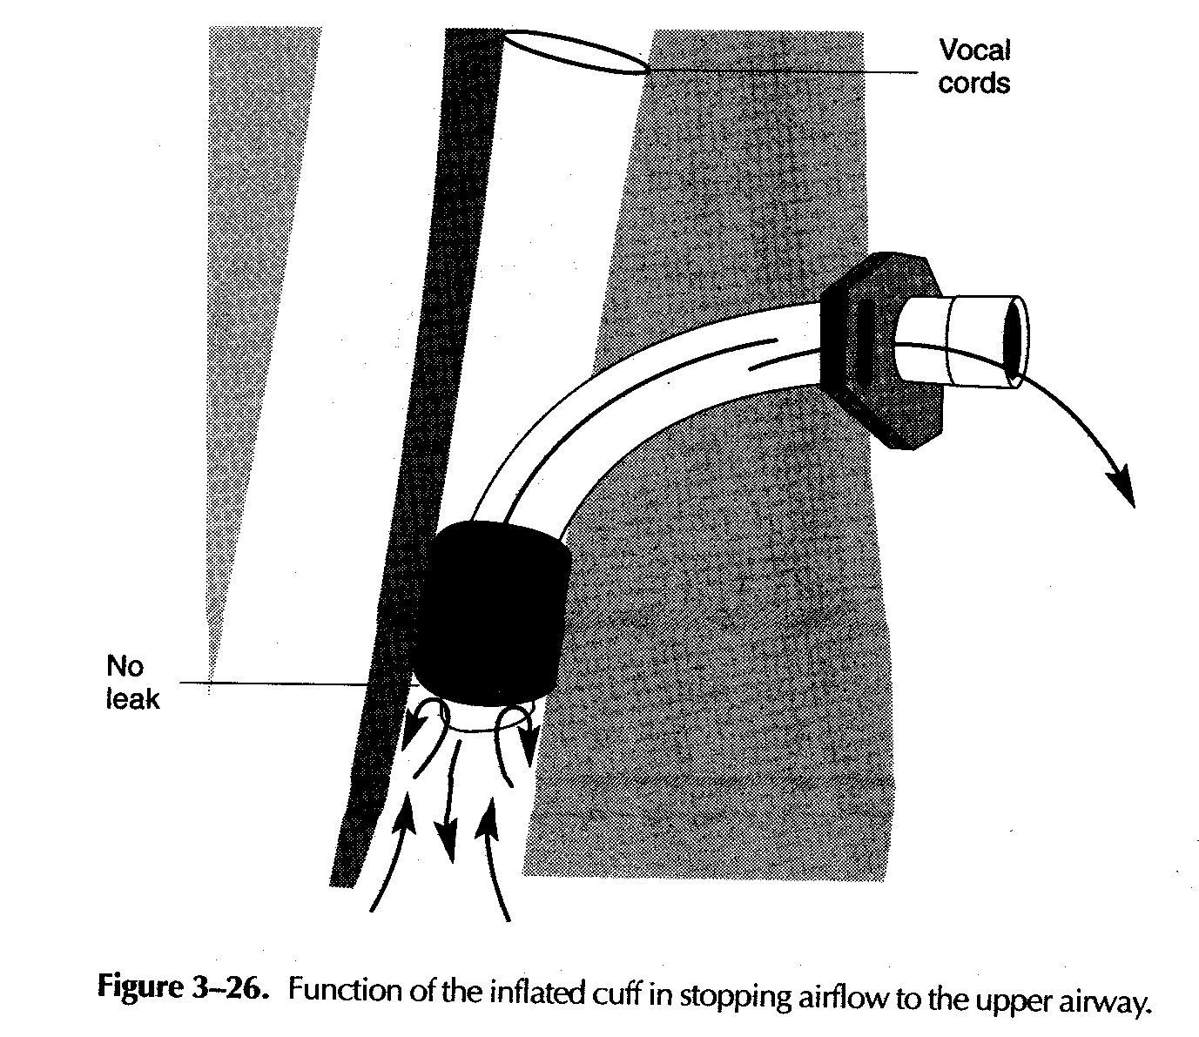


Slide 11
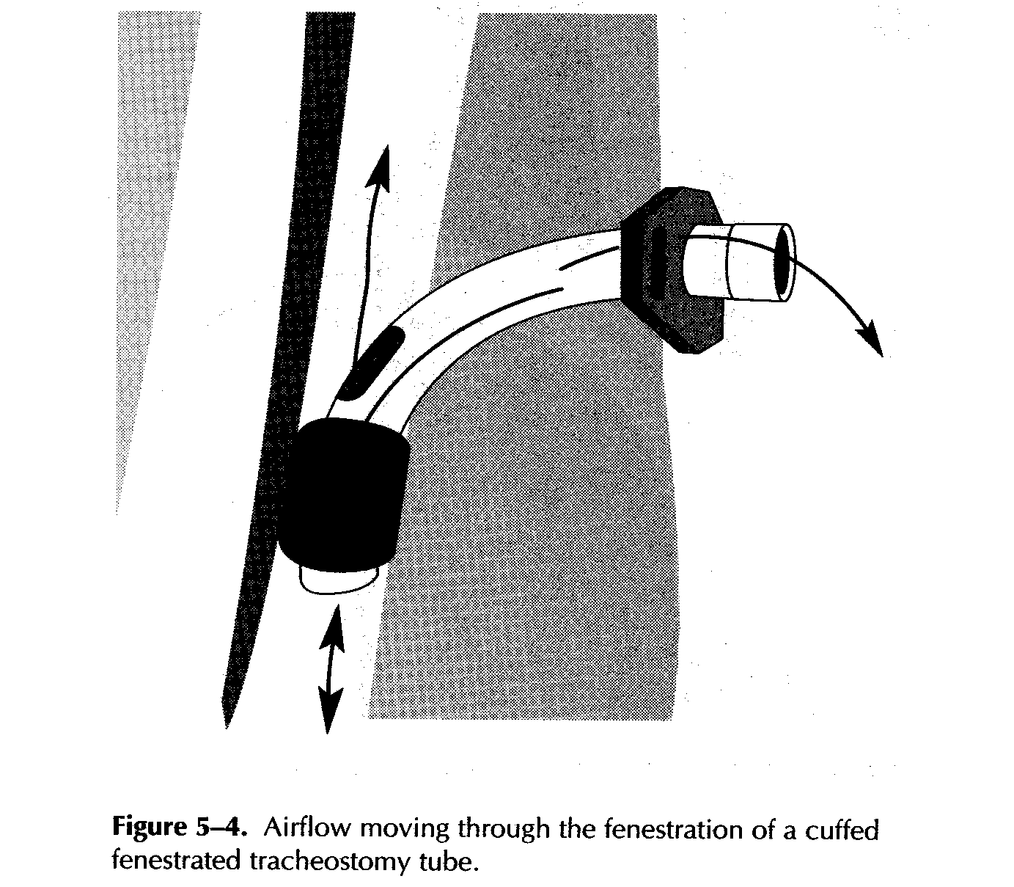


Slide 12
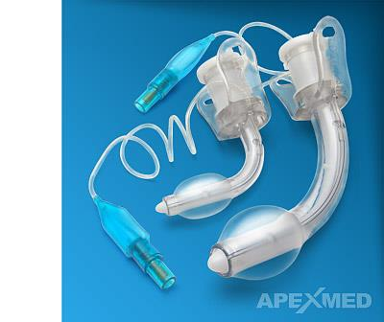

Slide 13
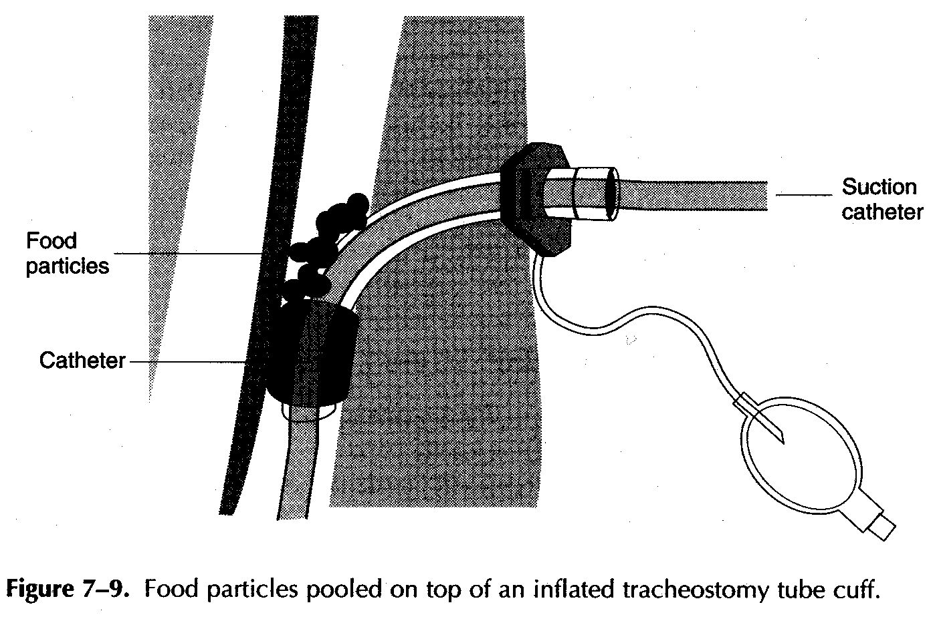

Slide 14
Management of the tracheostomized pt. During swallowing assessment treatment
Should examine the tracheostomy tube to determine:
Presence of a cuff
Status of the cuff (inflated, or deflated)
Size of the tube
Presence of fenestration
The period

Slide 15
Length of time it has been in place:
More than 6 months
Scar tissue formed restrict laryngeal elevation.
Reduced airflow
Reduced sensory stimulation
Reduced vf closure for swallowing and vocalization.

Slide 16
Management of the tracheostomized pt. During swallowing assessment treatment
A recent study has found that the tube occlusion digitally doesn’t negatively effect swallowing and may result in improvements in laryngeal elevation.
Use of valve may helpful in place of light digital occlusion if pt’s respiratory status is stable and tolerate the valve comfortably, and it opens during breathing and closes during exhalatory pressure to increase sufficiently for speech.

Slide 17
Management of the tracheostomy tube:
It is generally best to deflate the tracheostomy cuff prior to attempting any swallows.
An inflated cuff may irritate the trachea as the larynx elevates during swallowing, or it may restrict laryngeal elevation.

Slide 18
Its important to check with the pt’s physician & obtain his advisability of deflating the cuff, as well as the pt’s tolerance for possible aspiration.
**it is extra important to:
Suction the pt well both orally & via the tracheostomy to assure a clear oral cavity and airway prior to beginning therapy.
Suction the pt well immediately after the cuff is deflated so that any secretion sitting above the cuff will be cleared away as they drain around the tube and into the trachea.

Slide 19
During each swallow the pt should gently occlude his or her tracheostomy tube with the gloved finger or gauze pad to establish as near-normal tracheal pressure during swallowing as possible.

Slide 20
One of the advantages in initiating swallowing therapy with a tracheostomy tube in place is that: The swallowing therapist can observe aspiration by examining any expectoration through the tube.
Several authors have reported specific but not infrequent occurring problems related to the presence of tracheostomy tubes during swallowing therapy.

Slide 21
Some of these problems are:
Restriction or limited upward laryngeal movement to protect the airway, causing the formation of scar tissue, thus increasing the chances of aspiration.
Compression of the esophagus by the tube pushing posteriorly on the common wall between the trachea and the esophagus
The change in intratracheal pressure because of the presence of the tube.

Slide 22
Speech valves

Slide 23
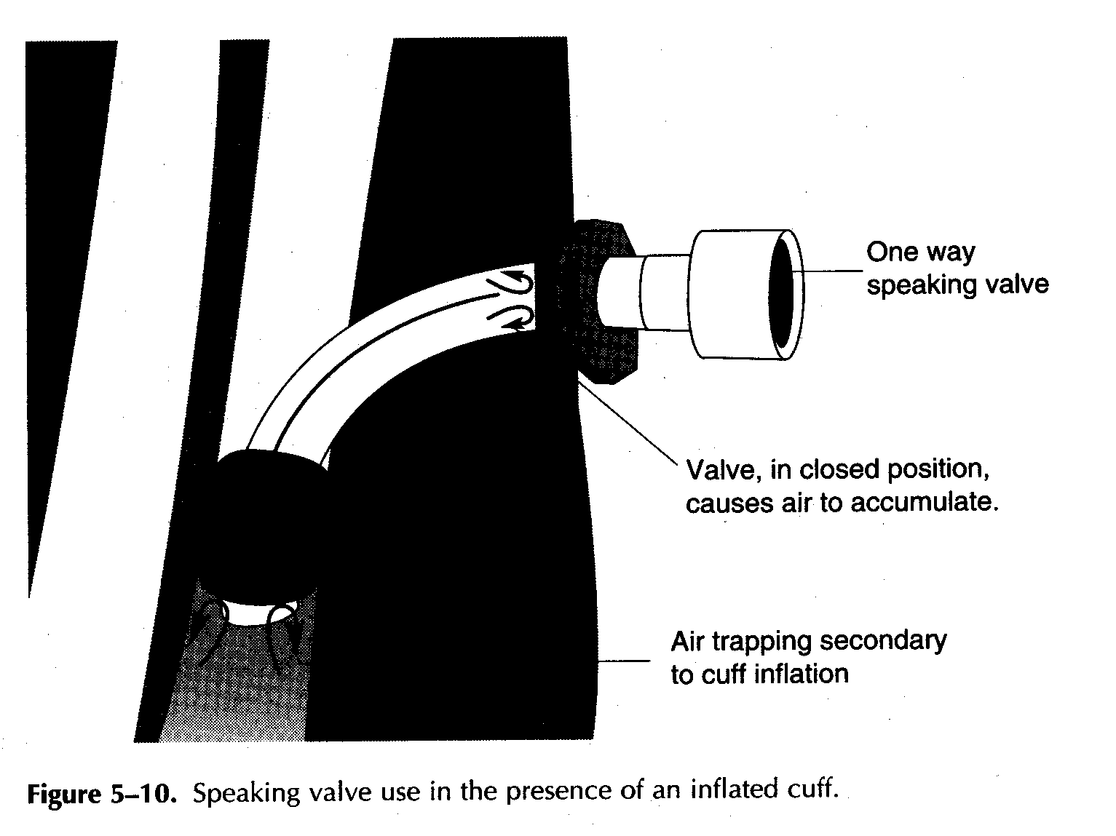

Slide 24
Ventilator-dependent patients
Pt. With Ventilator → their swallowing worsened
Swallowing and respiration are reciprocal , why?
Because the ventilator controls respiratory cycle, the pt’s can’t lengthen the exhalation to allow for the swallow.

Slide 25
https://www.youtube.com/watch?v=UCYBGRj4Teo

Slide 26
Intubation
Placing a tube through the mouth or nose through the pharynx to the lower trachea for more stable airway.
Laryngeal tissue damage if the tube place for days or weeks which affected laryngeal closure during swallowing may result in redness, edema, nodule or polyp.
No swallowing therapy done until intubation is removed (what do you think??)

Slide 28
Decision on potentially Best Posture (cont.)
Poor tongue control.
Difficulty maneuvering the bolus in the mouth.
Bolus trickling over the base of the tongue &into the pharynx before the voluntary swallow is initiated .
Tilt the head downward and then throw the head backward.

Slide 29
Decision on potentially Best Posture
If the pt. has had a hemilaryngectomy.
Any reason for a delay in triggering of the pharyngeal swallow.
Tilt the head downward so that the vallecular space is widened, the airway entrance is narrowed, & the epiglottis is positioned more posteriorly.

Slide 30
Inadequate laryngeal closure
Forward tilting of the head may result in greater protection of the airway by the overhanging epiglottis

Slide 31
Decision on potentially Best Posture
Unilateral pharyngeal paralysis
Turn the pt.’s head toward the affected side to close the pyriform sinus on that side, directing the material down the more functional side.

Slide 32
Decision on potentially Best Posture
Lingual hemiparesis or reduction in oral function on one side.
Tilting the head toward the stronger side may result in directing the material down that side.

Slide 33
Selection of Optimal Food position in the mouth
Food > side of best function & best sensitivity
Liquid > posteriorly in the oral cavity (straw/syringe)

Slide 34
Selection of possible best food consistency
Selection of food depends on:
Info. collected in the history.
Data on oral control.
Info. on pharyngeal & laryngeal control.

Slide 35
Pts with:
Poor oral control
Thickened liquid first, then moving toward materials of thin consistencies.
Delayed pharyngeal swallow or reduced closure of laryngeal entrance
Materials of thicker consistency as applesauce or mashed potatoes.
Reduced tongue base or pharyngeal wall contraction, reduced laryngeal elevation, reduced esophageal sphincter opening
liquids

Slide 36
Combination of disorders, make selection of consistencies more difficult.

Slide 37
Selection of optimum swallowing instruction
The sequence of swallowing instruction should be based on information collected in the preparatory examination
Posture or sequence of postures should be carefully noted, as should the need for voluntary protection of the airway during the swallow.

Slide 38
An Example :
A pt. with slightly reduced tongue control & reduced laryngeal control may need to begin by tilting his or her head downward while putting food in the mouth, then tip his or her head backward when going to swallow, hold the breath during the swallow to voluntarily protect the airway.

Slide 39
Order of Interventions Introduced
The rationale for this sequencing of interventions is based on:
The muscles effort required by pts
The ease of application
Learning of the various procedures.

Slide 40
In order:
Postural techniques.
Increase oral sensation.
Swallowing maneuvers.
Diet (food consistency).

Slide 41
Postural techniques
Postural techniques are easily used by a wide range of pts
Reduced cognition , children, and pts with some degree of restricted physical mobility.
effectively eliminate aspiration on liquids and other foods in a wide range of pt’s.
Postural Techniques: See table 5.2 p.181.

Slide 42
Techniques To improve Oral Sensory Awareness
Used in:
Pts with swallow apraxia.
Delayed onset of the oral swallow.
Delayed triggering of the pharyngeal swallow.
Allowing the clinician / cooperation.

Slide 43
Sensory techniques include:
Increasing downward pressure of the spoon against the tongue in presenting food in the mouth.
Presentation of a sour bolus.
Presentation of a cold bolus.
Presentation of a bolus requiring chewing.

Slide 44
Techniques To improve Oral Sensory Awareness
Thermal tactile stimulation:
It was designed to heighten oral awareness, and provide an alerting sensory stimulus to the cortex & brainstem, when the pt initiates the oral stage of swallow, the pharyngeal swallow will trigger more rapidly.
https://www.youtube.com/watch?v=ukfdL7FNxJo

Slide 45
Techniques To improve Oral Sensory Awareness
This technique has been demonstrated to facilitate faster triggering of the pharyngeal swallow after the stimulation, and reducing the delay for several swallows thereafter.
Measures of the effectiveness of these procedures to increase oral sensory input include:
Duration of time from command to swallow until initiation of the oral stage of swallow.
Oral transit time.
Pharyngeal delay time.

Slide 46
Swallow Maneuvers
The supraglottic swallow:
Designed to close the airway at the level of the true VFs before, and during the swallow.
https://www.youtube.com/watch?v=Ga5ijAKn9SI
The super-supraglottic swallow:
Designed to close the airway entrance before, and during the swallow.
https://www.youtube.com/watch?v=C2HIepSWG84

Slide 47
The effortful swallow:
Designed to increase tongue base posterior motion during the pharyngeal swallow & thus improve bolus clearance from the valleculae
https://www.youtube.com/watch?v=wKmJdCe7aKs
Mendelson maneuver:
Designed to increase the laryngeal elevation .Also it improve the overall coordination of the swallow
Improve the overall coordination of the swallow.
https://www.youtube.com/watch?v=NHZ5g8roe_A

Slide 48
Swallow Maneuvers
These requires:
Careful direction following ability, and are not feasible in pts who have cognitive or significant language impairment.
Increased muscular effort, and are not appropriate in pts who fatigue easily.

Slide 49
Food Consistency(Diet)Changes
Elimination of certain food consistencies from the diet should be the last strategy examined.
This should be done only if other therapy strategies are not feasible, as in a pt with a movement disorder whose posture changes continuously, who cannot follow directions, and use swallow maneuvers, for whom oral sensory procedures are inappropriate.
In some cases, introduction of therapy procedures into the diagnostic procedure immediately enable the pt. to begin eating.

Slide 50
Oral Versus Non-oral Feeding
There are no guidelines the clinician can use to make the decision whether the pt. should continue to be fed orally, or on a nasogastric tube or given some type of gastrostomy.
When it takes a long time to eat a particular food consistency (more than 10 secs.), most pt’s will not continue eating that consistency of food or may not eat a sufficient amount of food.
Time taken to swallow a bolus is an important element in nutritional management.

Slide 51
Radiographic studies indicate that if the pt. takes more than 10 secs. for oral and pharyngeal transit time combined to swallow every bolus without being aspirated, the pt may feed by mouth but will need a Non-oral feeding to supplement oral feedings and to provide adequate nutrition and hydration.
Gastrostomy may be used if the pt. progress in therapy is slow (if it takes more than 3-4 weeks).
It is better not to leave a nasogastric tube for a long period of time (for more than 3-4 weeks). / Pt may be taught to manage the nasogastric tube.

Slide 52
Gastrostomy (through the abdomen into the stomach)

Slide 53
Nasogastric tube
Through the nares to pass through the posterior oropharynx, down the esophagus, and into the stomach.

Slide 54
Techniques for Non-oral Feeding

Slide 55
There are different types of non-oral tubes.
GERD.
Temporarily.

Slide 56
1- Nasogastric Feeding
A tube placed through the nose, pharynx, and esophagus into the stomach.
Narrow tube → minimal irritation
Food is passed through the tube into the stomach.
The number of feedings per day and the amount of food given per feeding vary.
Water for cleaning.
Upright position 1 hour after a meal, why?

Slide 57
Temporarily → replaced with other after 3 to 4 months (some pts. may have it for 5 or 6 month).
The patients and their family may be taught to place the nasogastric tube for each meal and to remove it after feeding.

Slide 58
Limitations:
GERD
Irritation
Prepared liquid diets → expensive

Slide 60
2- Pharyngostomy
Hole from the skin into the pharynx → esophagus → stomach.
Elimination of the tube through the nose (advantage over the nasogastric tube).
Irritating.
Less acceptable socially.
Disadvantage:
Creating a hole.
Pharyngeal scarring.
Patients:
Some head and neck cancer patients.

Slide 62
3- Esophagostomy
From the skin into the esophagus → stomach
Advantages and Disadvantages.

Slide 63
4- Gastrostomy
General surgical procedure with general anesthetic or under local anesthetic.
External opening in the abdomen leading into the stomach.
Long term solution to a severe swallowing disorders.
Advantage:
Removes the risk of nasal and pharyngeal irritation.
Disadvantage:
The stoma can leak.
Become infected.
Uncomfortable.

Slide 64
Criteria for implementation the Non-oral feeding procedure
Aspirating more than 10% of all food consistencies.
Longer than 10 seconds to swallow a single bolus.
If the swallowing disorder is anticipated to be:
Short term (1 month or less) → nasogastric tube
More than one month → gastrostomy (unless the pt. can use the nasogastric tube appropriately)
Sometimes PEG is used as short term dysphagic patients.

Slide 65
Factors Used To Determine The Type Of Non-oral Feeding:
The pt’s. gastrointestinal history.
The cost of feeding and insurance coverage.
The patient’s behavior.
The patient’s preference.
The patient’s medical diagnosis.
If the pt’s swallowing function is borderline (approx. 10 secs. for oral & pharyngeal transit times), the dietitian may provide the patient with diet supplements for the content of the food eaten orally.

Slide 66
If pts. Aspirates more than 10% of each bolus and are aware of that aspiration, the food consistency will be eliminated from their diet. If pts are unable to swallow any food consistency with less than 10% aspiration, he/she will stop eating because of the discomfort of frequent coughing.
Pts who are unaware of having swallowing disorders, or do not cough when aspirating, will preserve in attempting to feed by mouth despite aspiration of excessive amounts.
Swallowing therapist should inform the pt’s managing physician about the gross percentage of each bolus consistency that is aspirated despite of all therapy attempts (posture change….etc…)
Patient who is aspirated more than 10% of every bolus, regardless of consistency of food, should not be feeding orally.

Slide 67
Compensatory Treatment Procedures (CTPs)
CTPs are introduced first in the diagnostic procedure.
CTPs control the flow of food and eliminate the patient’s symptoms, such as aspiration, but do not necessarily change the physiology of the patient’s swallow.
These procedures involve less muscle effort and do not fatigue the patient as quickly as some swallow exercises.
they are under the control of the caregiver and/or the clinician.

Slide 68
Compensatory Treatment Procedures include:
Postural changes, which potentially change the dimensions of the pharynx and the direction of food flow without increasing the patients work or effort.
Increasing sensory input.
Modifying volume and speed of food presentation.
Changing food consistency or viscosity.
Introducing intraoral prosthetic.

Slide 69
Postural techniques:
First the swallowing therapist must correctly diagnose the physiologic or anatomic disorder in the patient’s deglutition then identify the posture that will facilitate swallowing.
Some patients are unable to use postural strategy because of head stabilization devices or other physical constrains.
During radiographic procedures, the clinician cannot introduce all of the postures to assess their individual effects.
Postural technique redirect food flow and change pharyngeal dimensions in systematic ways.
Table 6.1 / page 198.

Slide 70
Postural techniques:
Lying Down: it is used when there is reduced pharyngeal contraction or reduced laryngeal elevation, resulting residue in the pharynx that is aspirated after swallow.
- Gravity
- liquids ------ straw
- Pt’s with reflux.
- pt should cough to clear any residue.

Slide 71
Techniques To Improve Oral Sensory Awareness
It is used with patients with swallow apraxia, tactile agnosia for food, delayed onset of the oral swallow, reduced oral sensation, or delayed triggering of the pharyngeal swallow.

Slide 72
Sensory enhancement techniques include:
Increasing downward pressure of the spoon against the tongue when presenting food in the mouth.
Presenting a sour bolus (50:50 lemon juice+ barium)
Presenting a cold bolus.
Presenting a bolus requiring a chewing.
Presenting a larger volume bolus.
Thermal-tactile stimulation

Slide 73
An exaggerated suck-swallow:
facilitates triggering of the pharyngeal swallow.
Increased tongue-jaw sucking movements with lips closed.
This is also helpful to the patients with poor saliva control.

Slide 74
Modifying Volume and Speed of Food Presentation
Taking smaller boluses at slower rate may eliminate any risk of aspiration in patients.
In patients with a delay in pharyngeal triggering, a larger bolus may facilitate in triggering.
In patients with a weakened pharyngeal swallow that requires 2 or 3 swallows per bolus.
Too much food + Too rapid = severe collection of food in the pharynx and aspiration.

Slide 75
Food Consistency (Diet) Changes
Eliminating food consistencies from the diet should be done only if other compensatory or therapy strategies are not feasible.
Swallowing therapists must work with facility dietitians to define specific foods prepared that fit into each category.
(Table 6.2/ p 203).

Slide 76
Intraoral Prosthetic
An important compensatory procedure to improve swallowing in oral cancer pts with significant loss of oral tongue tissue (25% or more) or tongue movement, neurologic pts with hypoglossal paralysis, and pts with velopharyngeal deficits.
Without prosthesis, the patient has a larger oral cavity and a very small tongue that is incapable of controlling food in the mouth for chewing or swallowing.

Slide 77
Palatal lift prothesis

Slide 78
Therapy Procedures by Category
Therapy procedures are designed to change swallow physiology in contrast to compensatory strategies, which are designed to eliminate symptoms.
To improve range of motion of oral or pharyngeal structure.
To improve sensory input prior to the swallow.
To take voluntary control over the timing or coordination of selected of oropharyngeal movements during swallow.

Slide 79
Direct vs Indirect therapy
Indirect therapy :
Involves exercise programs or swallow of saliva, but no food or liquids is given.
It is used in patients who aspirate on all food viscosities and volumes. (they are unsafe for any oral intake), for example?
Swallow maneuvers can be practiced with saliva only.

Slide 80
Direct vs Indirect therapy
Direct therapy:
Involves presenting food or liquid to the patient, and asking him to swallow it while following specified instructions.
Exercises involve positioning the head or body in a particular way so aspiration is eliminated.
The patient should be given written instructions describing the appropriate steps to follow.
Patient should be given samples to practice dry swallow before proceeding to swallows food or liquids. Small amounts of food provided for practice should be given.
cough

Slide 81
Types of Therapy Techniques
Oral control and oral and pharyngeal and rang of motion exercise.
Range-of-motion exercises.
Improving the extent of movement of the lips, jaws, oral tongue, tongue base, larynx and VF.
Bolus control and chewing exercises can be used to improve fine motor control of the tongue.
Oral motor control exercises. ( tongue control during swallowing):
Lateralization of the tongue during chewing.
Elevating of the tongue to the hard palate.
Cupping of the tongue around the bolus to hold it n a cohesive manner with the sides of the tongue sealed .
The exercises should be written down for the pt or caregiver & completed without the therapist presence.

Slide 82
Types of Therapy Techniques
Range-of-motion tongue exercise:
Increasing the range of the tongue motion, including tongue elevation and lateralization, should improve the oral transit.
Resistance Exercises:
Pushing the tongue against a tongue blade, popsicle, sucker.
Bolus control Exercises:
Improving lingual control of the bolus without asking the patient to swallow.

Slide 83
Types of Therapy Techniques
Exercises to Improve Gross Manipulation of Material.
Pt is given something large to manipulate in the mouth, such as a rolled (4×4) gauze pad.
Pt grasp it between the tongue and palate, move it from side to side, backward and forward. Then back to the middle of the mouth and back to the teeth on one side. (tongue manipulates food during chewing).

Slide 84
Types of Therapy Techniques
Exercises To Hold A Cohesive Bolus:
After doing exercise to Improve Gross Manipulation of Material, the patient places the bolus (paste-consistency, approx. one third teaspoon) moving it around the mouth without loosing the material or letting it spread out around the mouth. Patient cup the tongue around the bolus.
Then liquid

Slide 85
Types of Therapy Techniques
Bolus Propulsion Exercise:
Using 4 long, narrow roll gauze soaked in cranberry or orange juice. With the clinician holding the front of the gauze (so it can’t be swallowed), the patient is asked to push upward and backward against he gauze with the tongue, squeezing liquid out of it and pushing the liquid backward at the same time.

Slide 86
Range Of Motion Exercises For Pharyngeal Structures
Airway Entrance. The patient should be seated and told to hold breath and to bear down for a second, then to let go. Pt may do this by pushing down or pulling up on the chair with both hands for several seconds. Patient with blood pressure should not do this exercise (bearing down increase blood pressure).
Vocal Fold Adduction. (Pt with poor vocal fold adduction).
Bear down against a chair with only one hand and to produce a clear voice (repeated exercise 5 times). Each time the patient repeat “ah” 5 times with hard glottal attack. This increases muscle activity in the larynx and is basic to good laryngeal closure during swallowing.

Slide 87
Range Of Motion Exercises For Pharyngeal Structures
Another exercise is to ask the patient to practice, supraglottic swallow (take a breath ,hold it, then cough as strong as possible).
Tongue Base Exercise.
Pull tongue straight in the mouth as far as possible.
Pull back and pretend to gargle as hard as possible and then release.
Pretend to yawn, which pulls the tongue base back.

Slide 88
Range Of Motion Exercises For Pharyngeal Structures
Laryngeal Elevation Exercise - the falsetto exercise.
Pt is asked to slide up the pitch scale as high as possible to a high squeaky voice. When reaching the top scale, the patient holds the high note for several seconds with as much effort as possible.
During the production of the falsetto the larynx elevates almost as much as it does during swallow.

Slide 89
Sensory Motor Integration Procedures. Swallow Maneuvers

Slide 90
Therapy and Management For specific Swallowing disorders

Slide 91
Disorders affecting the oral preparatory phase
The patient must be able to manipulate food in mouth while maintaining complete closure of the lips, and controlling the bolus, so nothing spills into pharynx.
The clinician should be sure that the patients maintain comfortable nasal breathing from the time that food is placed in the mouth until pharyngeal swallow is completed.

Slide 92
Reduced labial closure.
Reduced range of tongue movement laterally during mastication.
Reduced buccal tension , buccal scarring (facial exercises).
Reduced tongue movement to form the bolus.
Reduced ability to hold the bolus in normal position.
Reduced oral sensitivity.

Slide 93
Disorders affecting the oral phase of the swallow:
-
Reduced tongue elevation.
Reduced anterior-posterior tongue movement.
Disorganized patterns of anterior-posterior tongue movement.
Reduced tongue strength.
Swallowing Apraxia.
Delayed or Absent triggering of the pharyngeal swallow.

Slide 94
Disorders Affecting the Pharyngeal Stage of the Shallow:
Compensatory Techniques Include:
1. Alternating liquid and semisolid or solid swallows, so the liquid washes the material of thicker consistency through the pharynx.
2. Limiting the diet to liquids or thin paste material requiring less pressure to clear the pharynx.
3. Following each swallow of food or liquid with several repetitive dry swallows.

Slide 95
Reduced Laryngeal Elevation:
Mandelsohn maneuver.
Supraglottic swallow.
Falsetto exercise.
Light pressure upward on the thyroid cartilage.

Slide 96
Reduced Laryngeal Closure at the Airway Entrance:
Super-supra glottic swallow.

Slide 97
Reduced Laryngeal Closure at the V.F:
Supraglottic swallow.

Slide 98
Reduced Laryngeal Closure at the V.F:
Head rotation and chin-down are the best way to best airway closure.

Slide 99
Disorders Affecting the Esophageal Phase of the Swallow:
This disorders handled with medication or surgery and diagnosed radiographic by swallowing therapist and radiologist.

Slide 100
Other Issues in Swallowing Therapy:
Combining postures and swallow maneuvers :
Some patients need the both techniques to attain a safe and efficient swallow . Such as patient with poor tongue base.
Chin down posture and effortful swallow
The posture and maneuver should be examined separately during the modified barium swallow and the combination of the two assessed.

Slide 101
Biofeedback as an Assist to Swallowing Therapy
Some of the instrumental procedures:
1. Surface Electromyography :
Amount of effort utilized in attempts at lip closure.
Under the chin- Degree of muscle effort used during the effortful swallow maneuver or mandelsohn maneuver.
Electrical activity Laryngeal elevators during the maneuver.
2. Ultrasound :
Patient observe tongue motion over time while practicing the upward and backward movement of the tongue to propel the bolus through the oral cavity.

Slide 102
Biofeedback as an Assist to Swallowing Therapy
3. Video Endoscopy:
Closure of the true vocal folds before a swallow attempt.
If patient has difficulty in attaining vocal fold or air way entrance closure he could observe the movement during various breath hold maneuvers.
4. Video Fluoroscopy:
Understand the goals of the therapy.

Slide 103
When To Begin Swallowing Therapy:
Medically stable (dysphagic)→ Videofluoroscopy → Therapy plan.
Patient seen daily in the hospital and weekly.
Surgically treated head and neck cancer, as soon as healing has progressed enough to allow them to try swallow (7 to 14 days post surgery with no healing complications).
Undergoing radiation therapy (the time there is complain) .
A stroke patient when they are awake or alert (2 or 3 days).
Outpatient → videofluoroscopy + intensive therapy.

Slide 104
Pt’s who receive therapy months or years after the onset of their problem are still capable of achieving oral intake.
Therapy is usually daily for inpatients and weekly for outpatients.
Tracheostomy tubes and non-oral feeding tubes are left in place during swallowing assessment and therapy.

Slide 105
Maintenance Program
Maintenance programs are the applications of therapy strategies in a continuous way which assist patients to maintain their function for a period of time.
Programs are needed in patients who are unable to monitor their own performance. For example whom?
Maintain compensatory strategies.
Patients who are unable to monitor their own performance such as patients with cognitive deficits.
Maintain compensatory function as long as possible.

Slide 106
Incorporating Swallowing Therapy into Eating
First goal with a dysphagic patient should be; to identify the safest way for the patient to eat, and the most efficient, and quickest way for the him/her to swallow.
This means using compensatory strategies in the beginning.
Not working remain non-oral with swallowing therapy.
Compensatory strategies work but swallowing therapy may take place in order not to use the compensatory strategies forever.
Pt can’t use therapy compensatory strategy but the clinician believes swallowing therapy is appropriate, then therapy should take place

Slide 107
Once the patient has the ability to eat safely, nevertheless under what circumstances then the task monitoring is turned over to a caregiver as a maintenance task.

Slide 108
Group Therapy
Group therapy may be appropriate if several patients are in the facility, at the same time who are working on the same therapy procedures. so patients may be brought together to reinforce each others use of particular procedures .

Slide 109
Cultural Difference in Dysphagia's Management
Meals are a social events where a great deal of communication takes place, How?

Slide 110
Meals Management:
Meal times should be as pleasant as possible by given the easiest food for swallow and the best taste.
Therapist also should:
Warn the family to not encourage patient to talk after swallowing because of the increased risk of aspiration.
Providing patient with food that can be swallowed easily (include the pt at the mealtime).

Slide 111
Medication to Improve Swallowing Disorders
Use of atropine to reduce drooling .

Slide 112
Surgical Interventions:
Surgical interventions to improve oropharygeal swallowing should not be until the therapy has had at least a 6 months trial.
Oropharygeal surgical is a sensitive and may create more damage through scar tissues.

Slide 113
Issues in the Management of Dysphagia in Various Settings
Acute Care Hospital :
The pressure is on the speech-Language pathologist or swallowing therapist to identify dysphagic patients, define their swallow physiology, and outline a treatment plan as quickly as possible.
.

Slide 114
2. Schools :
If there is any question about a child aspirating during feeding experiences in school, it's suggested that the caregiver in the school refrain from further oral feeding of the child until the diagnostic studies are completed.
If parents insist that the child should be fed orally, it's suggested that the school offer the parent's the opportunity to come and feed the child.

Slide 115
Nursing home setting:
Assessment methods.
Feeding staff should follow the directions of the swallowing therapist in terms of the type of food to be fed to the patient, the timing and length of feedings, the way in which food is placed in the mouth , and the observations to be made with each patient prior to placing another food serving into the patient’s mouth.

Slide 116
Nursing home setting:
The feeding staff should also pay attention to the patient’s behavior and reaction to the placement of food in the mouth .
Any changes in the patient’s respiratory rate , voice quality or general alertness throughout a meal should be noted.
The feeding staff should report to swallowing therapist any changes in the patient’s function during a meal and discontinue feeding until the swallowing therapist has assessed the situation.

Slide 117
Home:
In home care, the family can be engaged in providing the appropriate feeding after or by the swallowing therapist and can continue home practice with the patient between the swallowing therapist’s visits.
It is critical that the swallowing therapist provide the patient and the family with tools needed to practice exercises correctly.

Slide 118
Etiology
Neurological disorders:
Dysphagia may be the predominant symptom in a number of neuromuscular diseases. A focal stroke in the brainstem may produce acute Dysphagia. Other neurological diseases such as MS may involve the pharynx and result in Dysphagia. In addition, some medications prescribed for the treatment of neuromuscular disorders can depress the swallowing reflex.
Difficulty swallowing caused by a neurologic disorder
By impairing motor and sensory functions of oral and pharyngeal phases of swallowing
Esophageal relatively spared
Oral/pharyngeal dysphagia may result from structural problems including tumors
Material may
Be delayed or retained along the way
Go out of bounds into the nasopharynx or larynx
Result in morbidity or mortality from neurogenic dysphagia

Slide 119
ALS
MS
CVA
2. Autoimmune diseases.
3. Muscular diseases :
Muscle weakness
Polio

