Slide 1


Slide 2
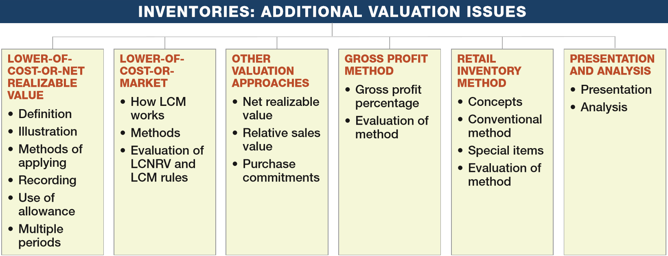
PREVIEW OF CHAPTER 9
Intermediate Accounting
16th Edition
Kieso ● Weygandt ● Warfield

Slide 3
LEARNING OBJECTIVES
9
Inventories: Additional Valuation Issues
After studying this chapter, you should be able to:
Understand and apply the lower-of-cost-or-net realizable value rule.
Understand and apply the lower-of-cost-or-market rule.
Understand other inventory valuation issues.
Determine ending inventory by applying the gross profit method.
Determine ending inventory by applying the retail inventory method.
Explain how to report and analyze inventory.
LO 1

Slide 4
LOWER-OF-COST-OR-NET REALIZABLE VALUE
A company abandons the historical cost principle when the future utility (revenue-producing ability) of the asset drops below its original cost.
Deﬁnition of Net Realizable Value
Net realizable value (NRV) is the estimated selling price in the ordinary course of business, less reasonably predictable costs of completion, disposal, and transportation.
LO 1

Slide 5
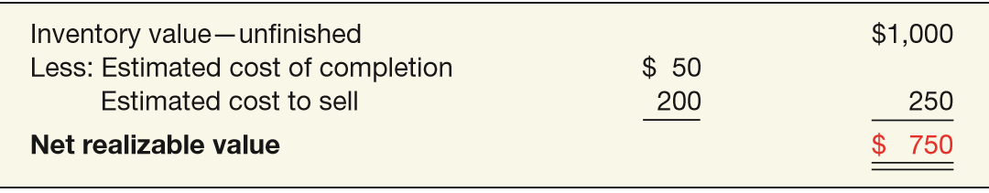
Deﬁnition of Net Realizable Value
Illustration: Assume that Mander Corp. has unfinished inventory with a cost of $950, a sales value of $1,000, estimated cost of completion of $50, and estimated selling costs of $200. Mander’s net realizable value is computed as follows.
ILLUSTRATION 9-1
Computation of Net Realizable Value
LO 1

Slide 6
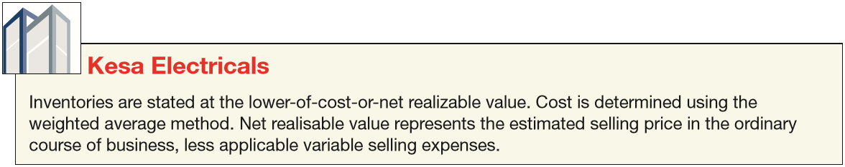
Deﬁnition of Net Realizable Value
ILLUSTRATION 9-1
Mander reports inventory on its balance sheet at $750.
In its income statement, Mander reports a Loss Due to Decline of Inventory to NRV of $200 ($950 − $750).
ILLUSTRATION 9-2
LCNRV Disclosures
LO 1

Slide 7
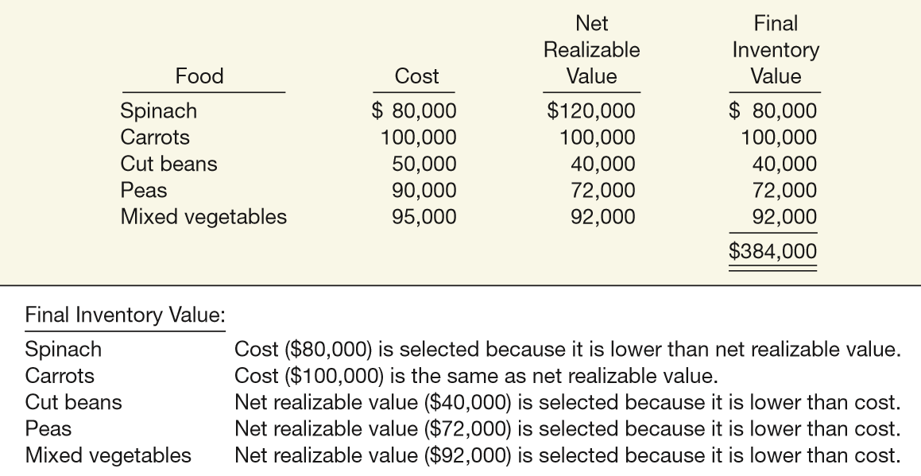
Illustration of LCNRV
Regner Foods computes its inventory at LCNRV, as shown in Illustration 9-3 (amounts in thousands).
ILLUSTRATION 9-3
Determining Final Inventory Value
LO 1

Slide 8
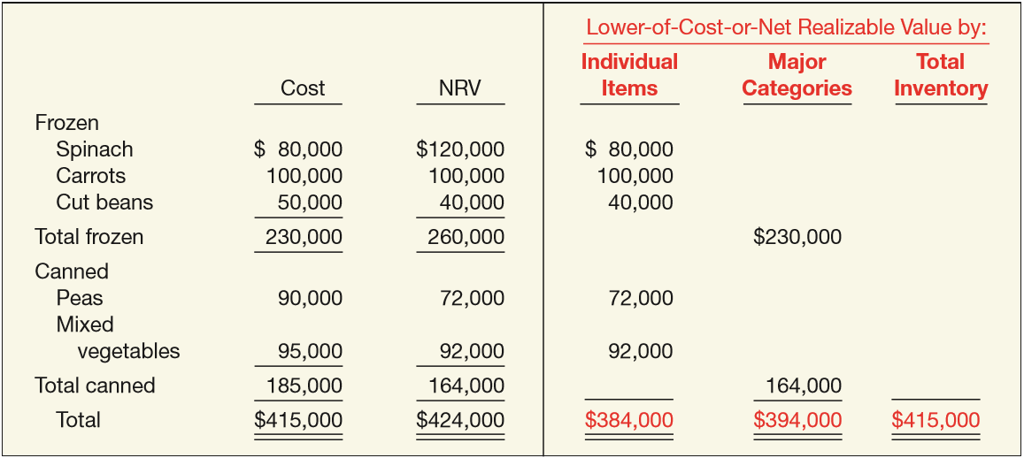
Methods of Applying LCNRV
ILLUSTRATION 9-4
Alternative Applications of LCNRV
Companies usually price inventory on an item-by-item basis.
LO 1

Slide 9
Recording NRV Instead of Cost
The following inventory data is for Ricardo Company.
Ending inventory (cost) $ 82,000
Ending inventory (at NRV) 70,000
Adjustment to LCNRV $ 12,000
Loss Method
Loss Due to Decline in Inventory 12,000
Inventory 12,000
COGS
Method
Cost of Goods Sold 12,000
Inventory 12,000
LO 1

Slide 10
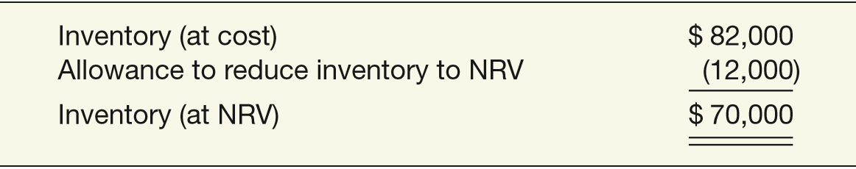
Use of an Allowance
Instead of crediting the Inventory account for market adjustments, companies generally use an allowance account, often referred to as Allowance to Reduce Inventory to NRV.
Using an allowance account under the loss method, Ricardo Company makes the following entry to record the inventory write-down to NRV.
Loss Due to Decline of Inventory to NRV 12,000
Allowance to Reduce Inventory to NRV 12,000
ILLUSTRATION 9-7
Presentation of Inventory Using an Allowance Account

Slide 11
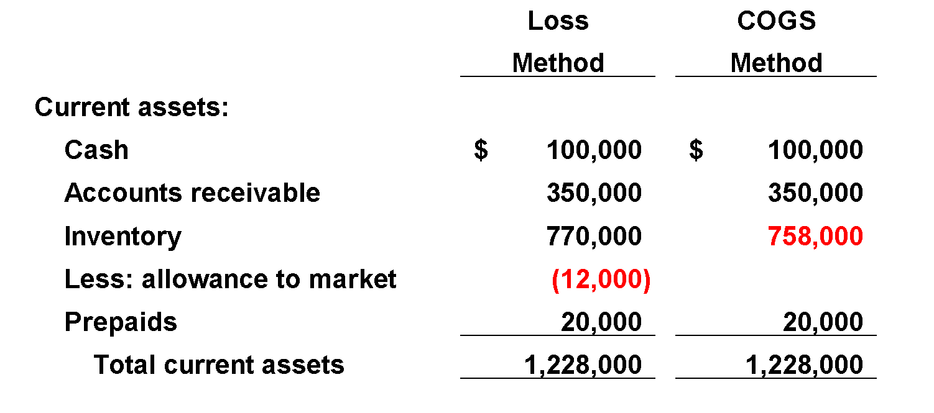
Recording NRV Instead of Cost
Balance Sheet
LO 1

Slide 12
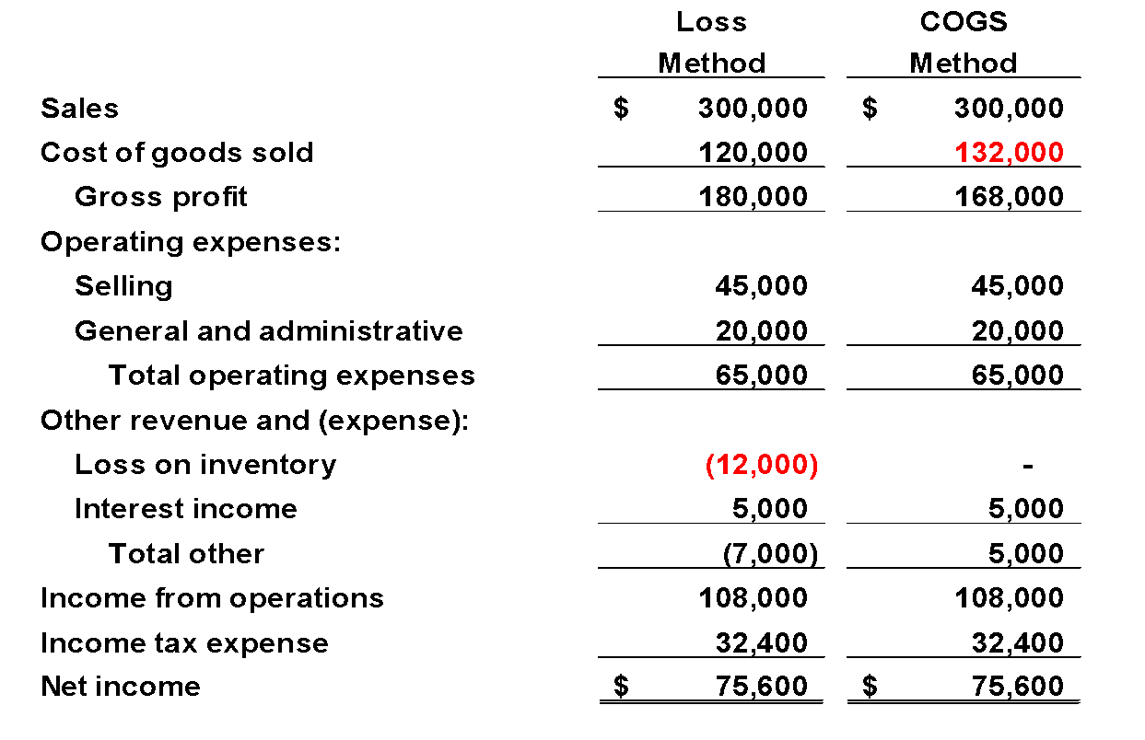
Recording NRV Instead of Cost
Income Statement
LO 1

Slide 13
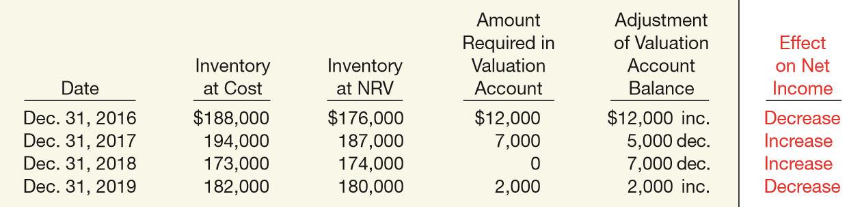
Use of an Allowance—Multiple Periods
In general, accountants adjust the allowance account balance at the next year-end to agree with the discrepancy between cost and the LCNRV at that balance sheet date.
ILLUSTRATION 9-8
Effect on Net Income of Reducing Inventory to NRV

Slide 14
LEARNING OBJECTIVES
9
Inventories: Additional Valuation Issues
After studying this chapter, you should be able to:
Understand and apply the lower-of-cost-or-net realizable value rule.
Understand and apply the lower-of-cost-or-market rule.
Understand other inventory valuation issues.
Determine ending inventory by applying the gross profit method.
Determine ending inventory by applying the retail inventory method.
Explain how to report and analyze inventory.
LO 2

Slide 15
LOWER-OF-COST-OR-MARKET
The use of the lower-of-cost-or-net realizable value method works well to measure the decline in value of a company’s inventory for most companies.
The FASB decided to grant an exception to the LCNRV approach for companies that use the LIFO or retail inventory methods.
Rather than comparing cost to net realizable value, under the alternative approach, companies compare a “designated market value” of the inventory to cost.
The approach is commonly referred to as lower-of-cost-or-market (LCM).
LO 2

Slide 16
LOWER-OF-COST-OR-MARKET
This approach begins with replacement cost, then applies two additional limitations to value ending inventory.
Net realizable value (ceiling) and
net realizable value less a normal profit margin (floor).
Net realizable value (NRV) is the estimated selling price in the ordinary course of business, less reasonably predictable costs of completion and disposal.
A company values inventory at the lower-of-cost-or-market, with market limited to an amount that is not more than net realizable value or less than net realizable value less a normal profit margin.
LO 2

Slide 17
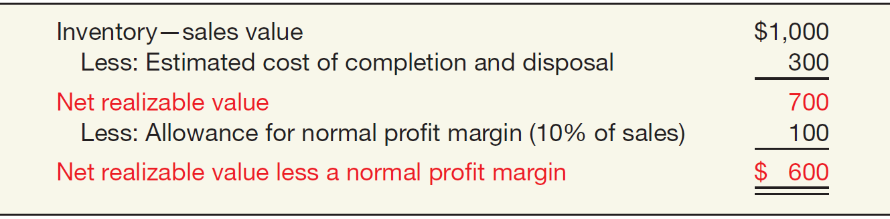
LOWER-OF-COST-OR-MARKET
Illustration: Assume that Parker Corp. has unfinished inventory with a sales value of $1,000, estimated cost of completion and disposal of $300, and a normal profit margin of 10 percent of sales. Parker determines the following net realizable value.
ILLUSTRATION 9-9
Computation of Net Realizable Value
LO 2

Slide 18
LOWER-OF-COST-OR-MARKET
ILLUSTRATION 9-10
Inventory Valuation— Lower-of-Cost-or-Market
What is the rationale for the Ceiling and Floor limitations?
Ceiling = NRV
Not
>
Replacement
Cost
Cost
Market
Not
<
Floor =
NRV less Normal
Profit Margin
GAAP
LCM
LO 2

Slide 19
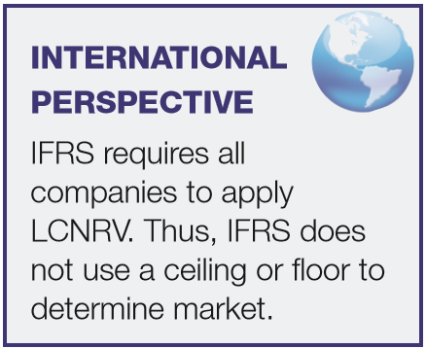
LOWER-OF-COST-OR-MARKET
What is the rationale for the Ceiling and Floor limitations?
Ceiling – prevents overstatement of the value of obsolete, damaged, or shopworn inventories.
Floor – deters understatement of inventory and overstatement of the loss in the current period.
LO 2

Slide 20
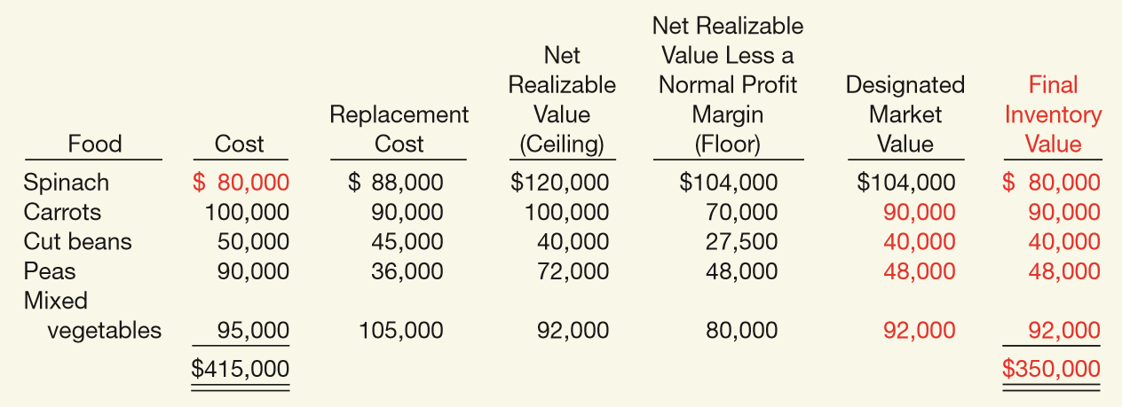

How Lower-of-Cost-or-Market Works
ILLUSTRATION 9-12
Determining Final Inventory Value
$65,000
Regner makes the following entry (using the loss method) to record the decline in value.
Loss Due to Decline of Inventory to Market 65,000
Allowance to Reduce Inventory to Market 65,000
LO 2

Slide 21
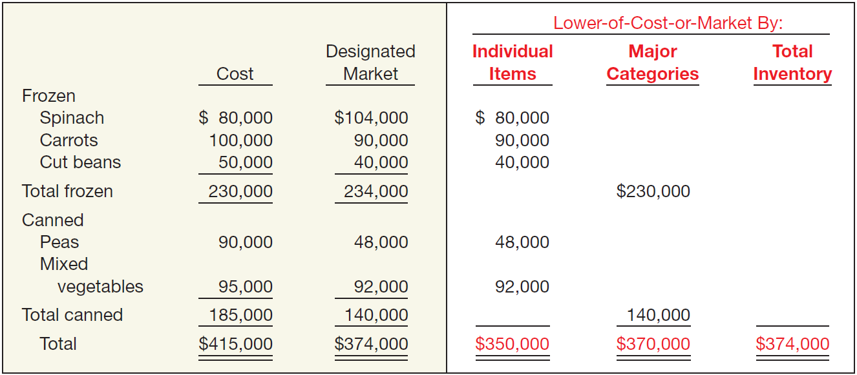
Methods of Applying Lower-of-Cost-or-Market
ILLUSTRATION 9-13
Alternative Applications of Lower-of-Cost-or-Market
LO 2

Slide 22
WHAT DO THE NUMBERS MEAN? “PUT IT IN REVERSE”
WHAT’S YOUR PRINCIPLE
The lower-of-cost-or-net-realizable value (market) rule is designed to provide timely information about the decline in the value of inventory. When the value of inventory declines, income takes a hit in the period of the write-down. What happens in the periods after the write-down? For some companies, gross margins and bottom lines get a boost when they sell inventory that had been written down in a previous period. For example, as the table below shows, Vishay Intertechnology, Transwitch, and Cisco Systems reported gains from selling inventory that had previously been written down. The table also evaluates how clearly these companies disclosed the effects of the reversal of inventory write-downs. For Transwitch, the reversal of fortunes amounted to 23 percent of net income. The problem is that the $600,000 credit had little to do with the company’s ongoing operations, and the company did not do a good job disclosing the effect of the reversal on current-year proﬁtability. Even when companies do disclose a reversal, it is sometimes hard to determine the impact on income. For example, Intel disclosed that it had sold inventory that had been written down in prior periods but did not specify how much reserved inventory was sold. Transparency of ﬁnancial reporting should be a top priority.
(continued)
LO 2

Slide 23
WHAT DO THE NUMBERS MEAN? “PUT IT IN REVERSE”
WHAT’S YOUR PRINCIPLE
With better disclosure of the reversals that boost proﬁts in the current period, ﬁnancial transparency would also get a boost.
Company
Gain from Reversal
Disclosure
Vishay Intertechnology
Transwitch
Cisco Systems
Not available
$600,000
$525 million
Poor—The semiconductor company did not mention the gain in its earnings announcement. Two weeks later in an SEC ﬁling, Vishay disclosed the gain on the inventory that it had written down.
Poor—The company did not mention the gain in its earnings announcement. Three weeks later in an SEC ﬁling, the company disclosed the gain on the inventory that it had written down.
Good—The networking giant detailed in its earnings release and in SEC ﬁlings the gains from selling inventory it had previously written off.
Source: S. E. Ante, “The Secret Behind Those Profit Jumps,” BusinessWeek Online (December 8, 2003).
LO 2

Slide 24
LOWER-OF-COST-OR-MARKET
Evaluation of LCNRV and Lower-of-Cost-or-Market Rule
Conceptual deficiencies:
Expense recorded when loss in utility occurs. Profit on sale recognized at the point of sale.
Inventory valued at cost in one year and at market in the next year.
Net income in year of loss is lower. Net income in subsequent period may be higher than normal if expected reductions in sales price do not materialize.
Application of these rules uses a “normal profit” in determining inventory values, which is a subjective measure.
LO 2

Slide 25
LEARNING OBJECTIVES
9
Inventories: Additional Valuation Issues
After studying this chapter, you should be able to:
Understand and apply the lower-of-cost-or-net realizable value rule.
Understand and apply the lower-of-cost-or-market rule.
Understand other inventory valuation issues.
Determine ending inventory by applying the gross profit method.
Determine ending inventory by applying the retail inventory method.
Explain how to report and analyze inventory.
LO 3

Slide 26

OTHER VALUATION APPOACHES
Valuation at Net Realizable Value
Permitted by GAAP under the following conditions:
a controlled market with a quoted price applicable to all quantities, and
no significant costs of disposal
or
too difficult to obtain cost figures.
LO 3

Slide 27
OTHER VALUATION APPOACHES
Valuation Using Relative Sales Value
Used when buying varying units in a single lump-sum purchase.
Illustration: Woodland Developers purchases land for $1 million that it will subdivide into 400 lots. These lots are of different sizes and shapes but can be roughly sorted into three groups graded A, B, and C. As Woodland sells the lots, it apportions the purchase cost of $1 million among the lots sold and the lots remaining on hand. Calculate the cost of lots sold and gross profit.
LO 3

Slide 28
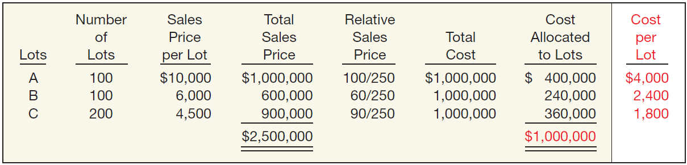
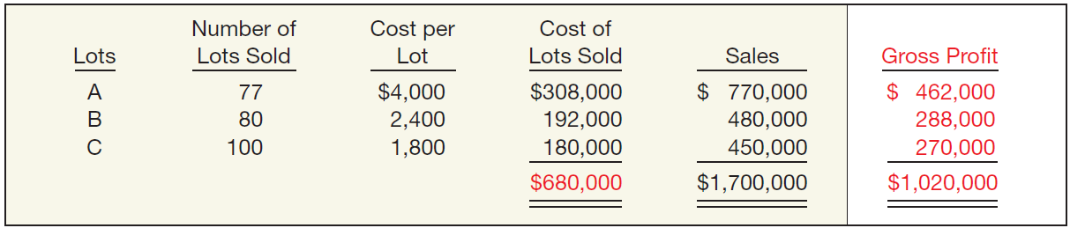
OTHER VALUATION APPOACHES
ILLUSTRATION 9-14
Allocation of Costs, Using Relative Sales Value
ILLUSTRATION 9-15
Determination of Gross Profit, Using Relative Sales Value
LO 3

Slide 29
OTHER VALUATION APPOACHES
Purchase Commitments—A Special Problem
Generally seller retains title to the merchandise.
Buyer recognizes no asset or liability.
If material, the buyer should disclose contract details in note in the financial statements.
If the contract price is greater than the market price, and the buyer expects that losses will occur when the purchase is effected, the buyer should recognize losses in the period during which such declines in market prices take place.
LO 3

Slide 30
OTHER VALUATION APPOACHES
Illustration: St. Regis Paper Co. signed timber-cutting contracts to be executed in 2018 at a price of $10,000,000. Assume further that the market price of the timber cutting rights on December 31, 2017, dropped to $7,000,000. St. Regis would make the following entry on December 31, 2017.
Unrealized Holding Gain or Loss—Income 3,000,000
Estimated Liability on Purchase Commitment 3,000,000
Other expenses and losses in the Income statement.
Current liabilities on the balance sheet.
LO 3

Slide 31
OTHER VALUATION APPOACHES
Illustration: When St. Regis cuts the timber at a cost of $10 million, it would make the following entry.
Purchases (Inventory) 7,000,000
Est. Liability on Purchase Commitment 3,000,000
Cash 10,000,000
Assume the Congress permitted St. Regis to reduce its contract price and therefore its commitment by $1,000,000.
Est. Liability on Purchase Commitment 1,000,000
Unrealized Holding Gain or Loss—Income 1,000,000
LO 3

Slide 32
LEARNING OBJECTIVES
9
Inventories: Additional Valuation Issues
After studying this chapter, you should be able to:
Understand and apply the lower-of-cost-or-net realizable value rule.
Understand and apply the lower-of-cost-or-market rule.
Understand other inventory valuation issues.
Determine ending inventory by applying the gross profit method.
Determine ending inventory by applying the retail inventory method.
Explain how to report and analyze inventory.
LO 4

Slide 33
GROSS PROFIT METHOD OF ESTIMATING INVENTORY
Substitute Measure to Approximate Inventory
Beginning inventory plus purchases equal total goods to be accounted for.
Goods not sold must be on hand.
The sales, reduced to cost, deducted from the sum of the opening inventory plus purchases, equal ending inventory.
LO 4

Slide 34
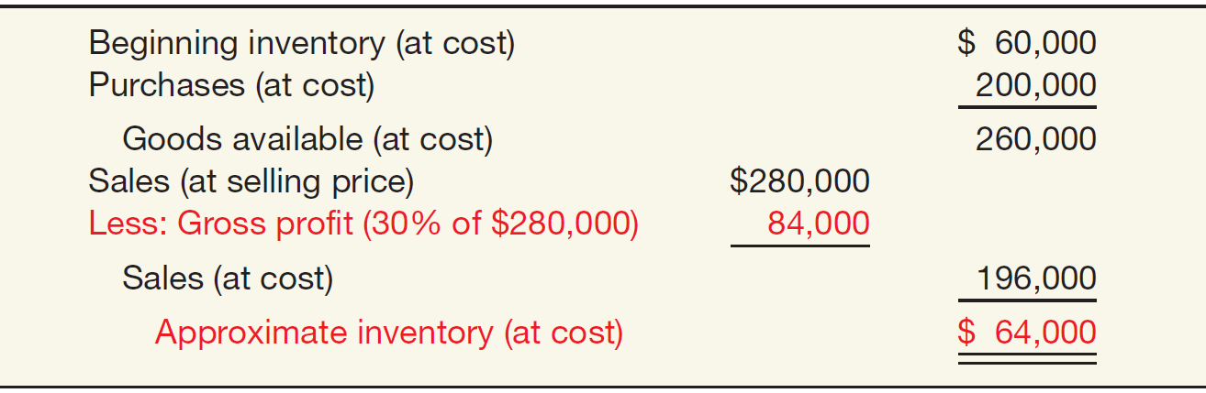
GROSS PROFIT METHOD
Illustration: Cetus Corp. has a beginning inventory of $60,000 and purchases of $200,000, both at cost. Sales at selling price amount to $280,000. The gross profit on selling price is 30 percent. Cetus applies the gross margin method as follows.
ILLUSTRATION 9-17
Application of Gross Proﬁt Method
LO 4

Slide 35
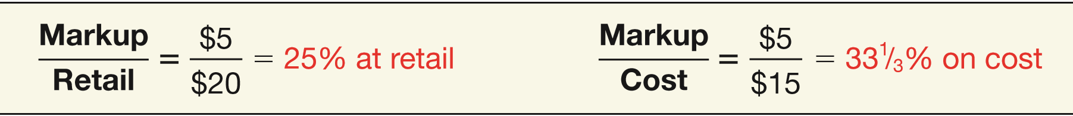
GROSS PROFIT METHOD
Computation of Gross Profit Percentage
Illustration: In Illustration 9-17, the gross profit was a given. But how did Cetus derive that figure? To see how to compute a gross profit percentage, assume that an article cost $15 and sells for $20, a gross profit of $5.
ILLUSTRATION 9-18
Computation of Gross Proﬁt Percentage
LO 4

Slide 36
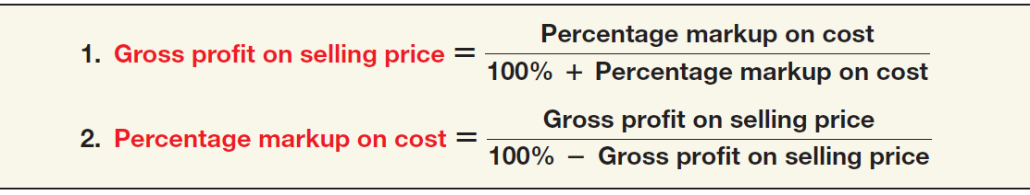
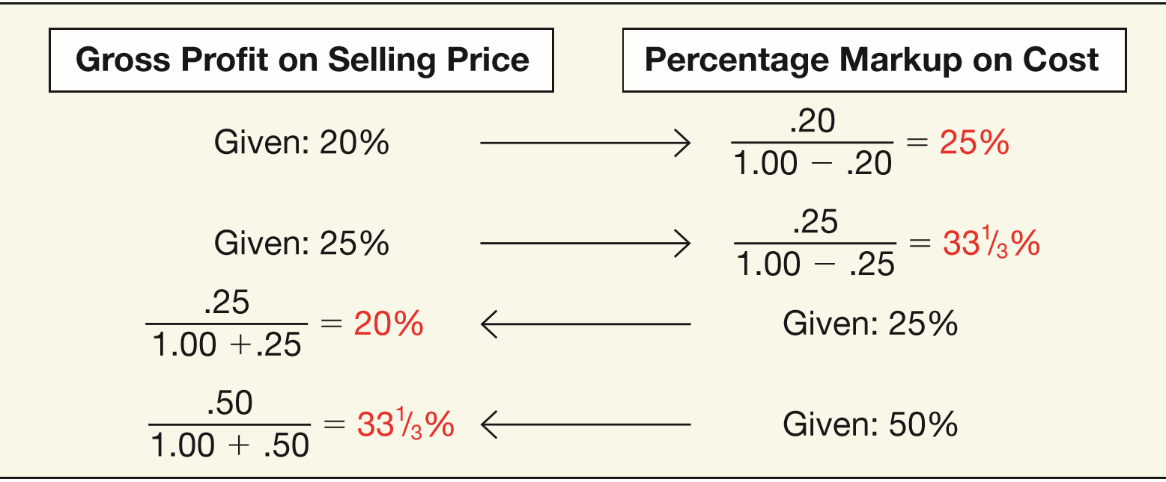
GROSS PROFIT METHOD
ILLUSTRATION 9-19 Formulas Relating to Gross Profit
ILLUSTRATION 9-20
Application of Gross Profit Formulas
LO 4

Slide 37
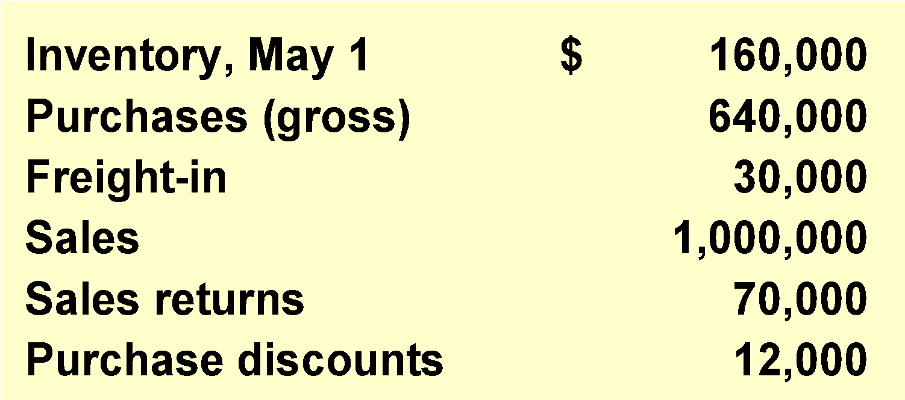
GROSS PROFIT METHOD
Illustration: Astaire Company uses the gross profit method to estimate inventory for monthly reporting purposes. Presented below is information for the month of May.
Instructions:
(a) Compute the estimated inventory at May 31, assuming that the gross profit is 25% of sales.
(b) Compute the estimated inventory at May 31, assuming that the gross profit is 25% of cost.
LO 4

Slide 38
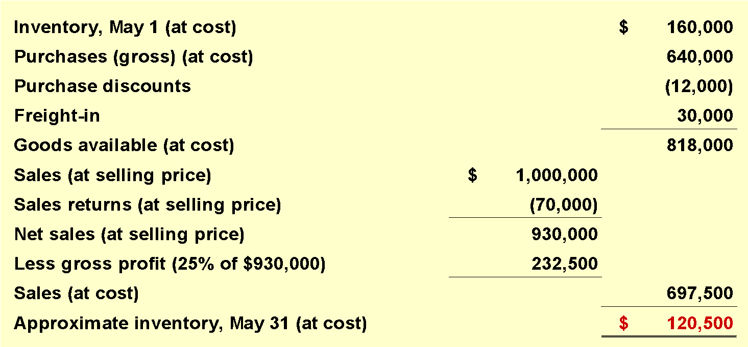
GROSS PROFIT METHOD
(a) Compute the estimated inventory at May 31, assuming that the gross profit is 25% of sales.
LO 4

Slide 39
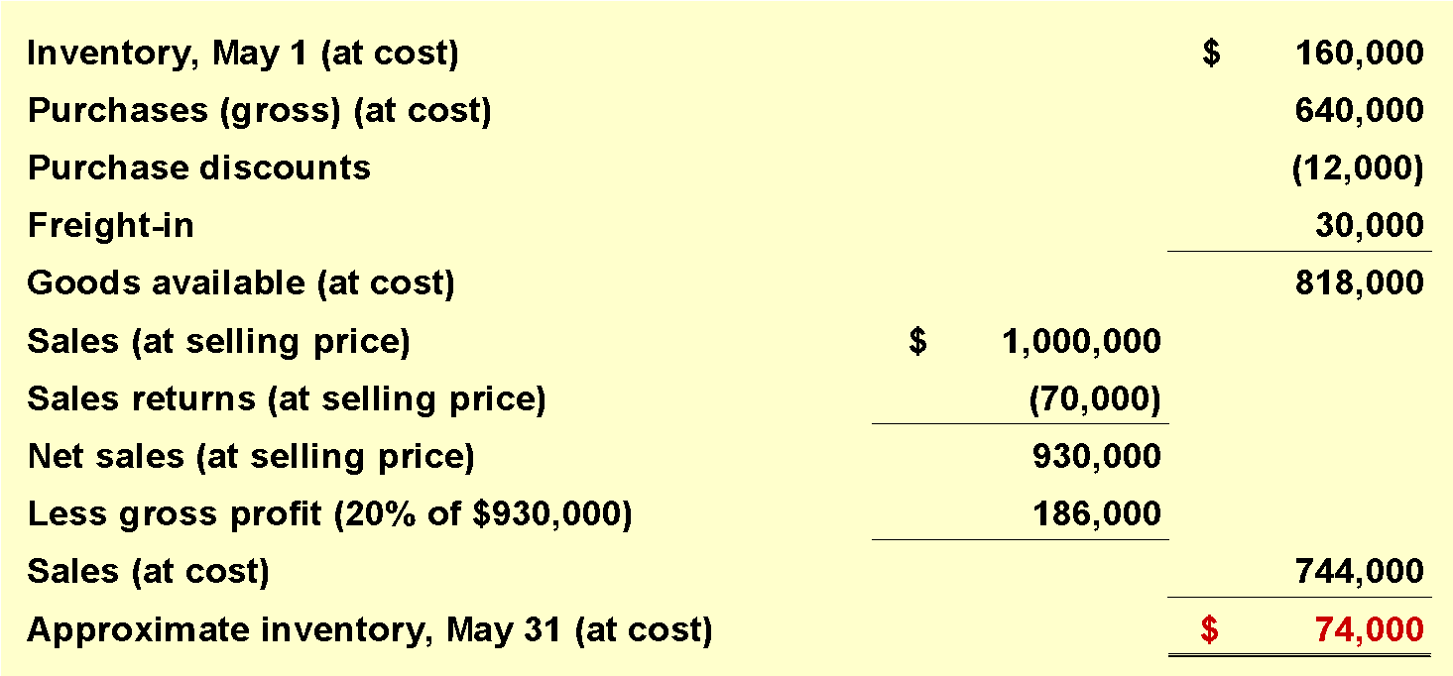
GROSS PROFIT METHOD
(b) Compute the estimated inventory at May 31, assuming that the gross profit is 25% of cost.
25%
100% + 25%
= 20% of sales
LO 4

Slide 40
GROSS PROFIT METHOD
Evaluation of Gross Profit Method
Disadvantages:
It is an estimate.
It generally relies on past percentages in determining the markup.
Care must be exercised when applying a blanket gross profit rate when there are varying gross profits.
Normally unacceptable for financial reporting purposes. GAAP requires a physical inventory as additional verification.
LO 4

Slide 41
WHAT DO THE NUMBERS MEAN? THE SQUEEZE
WHAT’S YOUR PRINCIPLE
Managers and analysts closely follow gross proﬁts. A small change in the gross proﬁt rate can signiﬁcantly affect the bottom line. At one time, Apple suffered a textbook case of shrinking gross proﬁts. In response to pricing wars in the personal computer market, Apple had to reduce prices more quickly than it could reduce its costs. As a result, gross proﬁt declined and so did its stock price. However, times are now changing. Apple’s stock price is increasing, and one of the key drivers behind the high stock valuations is Apple’s improved gross proﬁt. Perhaps this is not so surprising when you consider the success of its iPhone 6, its upgrades, and now the Apple watch! Here are two other examples of how gross proﬁt and stock price are very much correlated. Nike—the largest global manufacturer of athletic footwear—at one time reported earnings that indicated falling gross proﬁt, leading market analysts to adjust Nike’s stock price downward. The cause—continuing downward pressure on its gross proﬁt. On the positive side, an increase in the gross proﬁt rate provides a positive signal to the market. For example, just a 1 percent boost in Dr. Pepper’s gross proﬁt rate cheered the market, indicating the company was able to avoid the squeeze of increased commodity costs by raising its prices.
Sources: Trefis, “Nike’s Earnings Reiterate Gross Margin Pressure,” http://seekingalpha.com (March 23, 2011); D. Kardous, “Higher Pricing Helps Boost Dr. Pepper Snapple’s Net,” Wall Street Journal Online (June 5, 2008); and D. Sparks, “Will Apple Inc.’s Profit Margin Continue Upward?” The Motley Fool (December 4, 2014).

Slide 42
LEARNING OBJECTIVES
9
Inventories: Additional Valuation Issues
After studying this chapter, you should be able to:
Understand and apply the lower-of-cost-or-net realizable value rule.
Understand and apply the lower-of-cost-or-market rule.
Understand other inventory valuation issues.
Determine ending inventory by applying the gross profit method.
Determine ending inventory by applying the retail inventory method.
Explain how to report and analyze inventory.
LO 5

Slide 43
RETAIL INVENTORY METHOD
A method used by retailers, to value inventory without a physical count, by converting retail prices to cost.
Requires retailers to keep:
Total cost and retail value of goods purchased.
Total cost and retail value of the goods available for sale.
Sales for the period.
Methods
Conventional
Cost
LIFO Retail
Dollar-value LIFO
LO 5

Slide 44
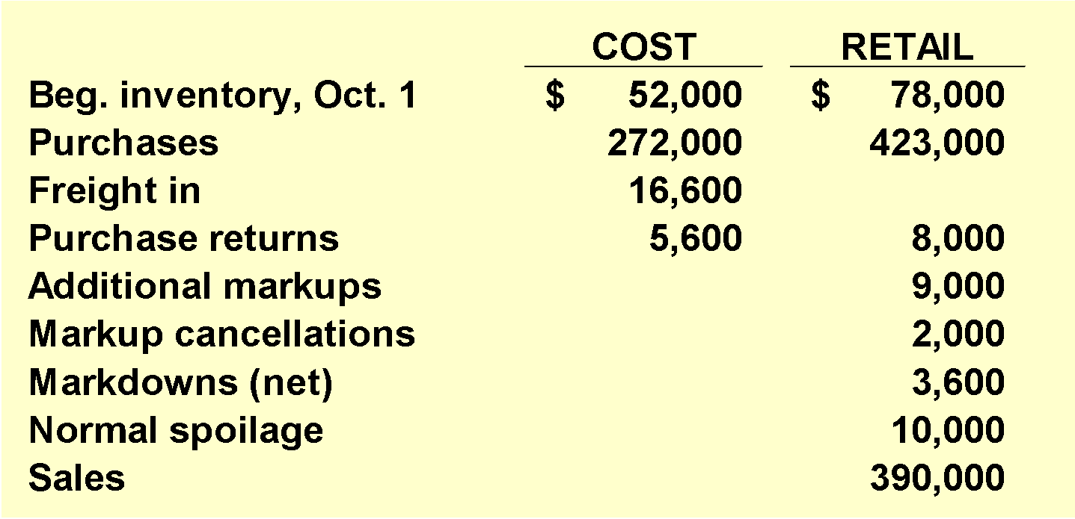
RETAIL INVENTORY METHOD
Illustration: Fuque Inc. uses the retail inventory method to estimate ending inventory for its monthly financial statements. The following data pertain to a single department for the month of October.
Instructions:
Prepare a schedule computing retail inventory using the following methods:
(1) Conventional (LCM)
(2) Cost
LO 5

Slide 45
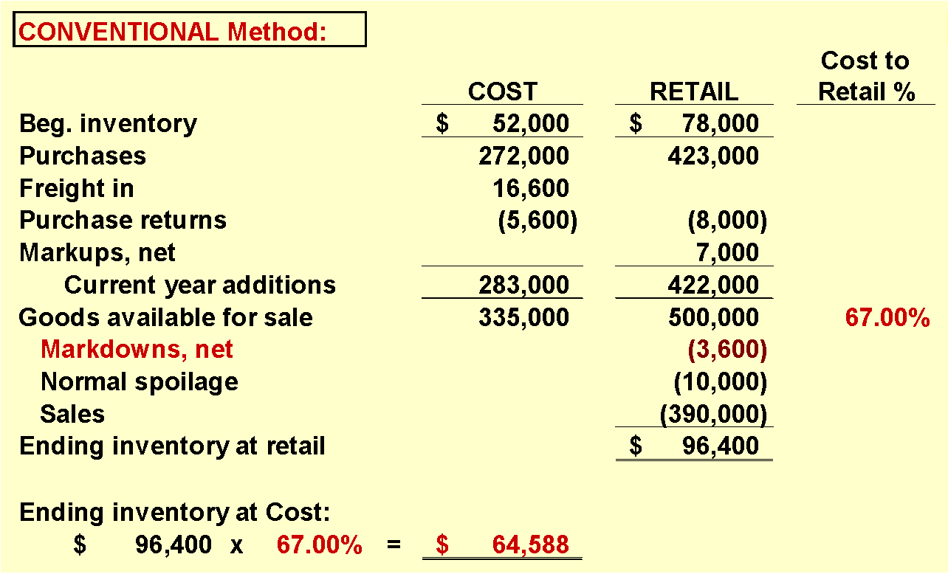
RETAIL INVENTORY METHOD
LO 5

Slide 46
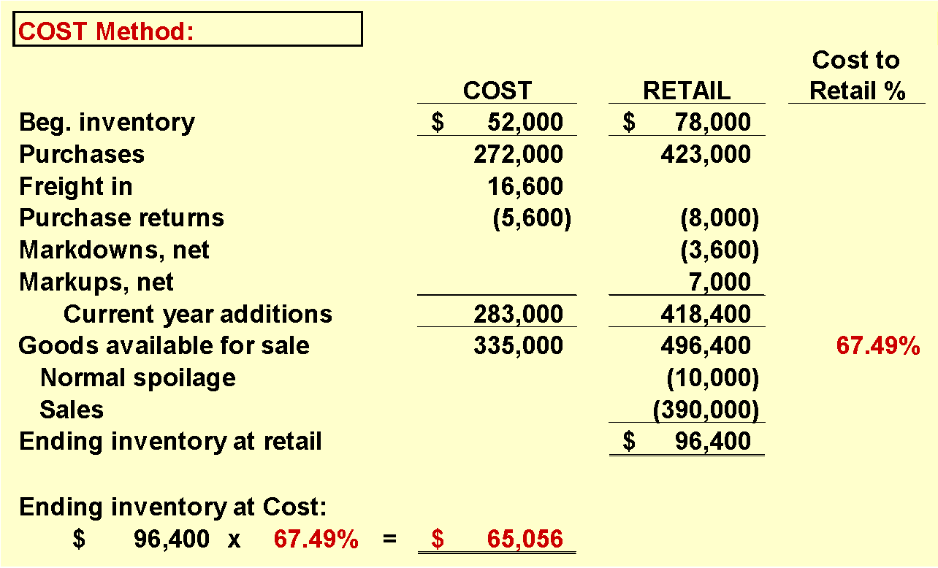
RETAIL INVENTORY METHOD
LO 5

Slide 47
WHAT DO THE NUMBERS MEAN? PRICE FIXING
WHAT’S YOUR PRINCIPLE
Markups, markdowns, cancellations… how can retailers keep up? Well, it can be pretty tough, but it may be getting more manageable with some innovative technology. It used to be that a company like Nebraska Furniture Mart would have to dispatch an army of employees each morning to update printed price labels throughout its stores, to maintain its pledge to offer the lowest prices on televisions, dishwashers, sofas, and ﬂooring. But after a major investment in digital price displays, a single worker can now quickly update the prices for thousands of products at multiple locations. This helps Nebraska match price changes at competitors, like Home Depot and Sears. At present, Nebraska resets prices at the beginning of each day, so the investment in inventory technology may not be as effective in competing with online retailers, such as eBay and Amazon.com, which commonly change prices throughout the day (Nebraska does not want the price of a product to change as a customer is walking up to the checkout). Nonetheless, digital price displays help Nebraska (and other brick-and-mortar retailers) stay competitive and should reduce the cost of implementing the retail inventory method in its accounting system.
Source: Anonymous, “Stores Try Fixed Prices That Aren’t So Fixed,” Businessweek (August 2, 2015), p. 22.
LO 5

Slide 48
RETAIL INVENTORY METHOD
Special Items Relating to Retail Method
Freight costs
Purchase returns
Purchase discounts and allowances
Transfers-in
Normal shortages
Abnormal shortages
Employee discounts
When sales are recorded gross, companies do not recognize sales discounts.
LO 5

Slide 49
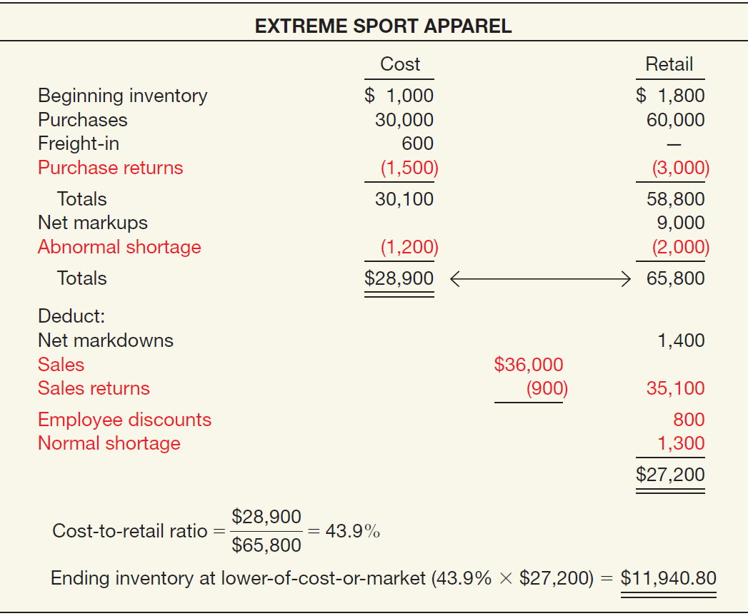
ILLUSTRATION 9-27
Conventional Retail Inventory Method— Special Items Included

Slide 50
RETAIL INVENTORY METHOD
Evaluation of Retail Inventory Method
Used for the following reasons:
To permit the computation of net income without a physical count of inventory.
Control measure in determining inventory shortages.
Regulating quantities of merchandise on hand.
Insurance information.
Some companies refine the retail method by computing inventory separately by departments or class of merchandise with similar gross profits.
LO 5

Slide 51
LEARNING OBJECTIVES
9
Inventories: Additional Valuation Issues
After studying this chapter, you should be able to:
Understand and apply the lower-of-cost-or-net realizable value rule.
Understand and apply the lower-of-cost-or-market rule.
Understand other inventory valuation issues.
Determine ending inventory by applying the gross profit method.
Determine ending inventory by applying the retail inventory method.
Explain how to report and analyze inventory.
LO 6

Slide 52
PRESENTATION AND ANALYSIS
Presentation of Inventories
Accounting standards require disclosure of:
Composition of the inventory, inventory financing arrangements, and the inventory costing methods employed.
Consistent application of costing methods from one period to another.
Inventory composition either in the balance sheet or in a separate schedule in the notes.
LO 6

Slide 53
PRESENTATION AND ANALYSIS
Presentation of Inventories
Accounting standards require disclosure of:
Significant or unusual financing arrangements relating to inventories.
Inventories pledged as collateral for a loan in the current assets section rather than as an offset to the liability.
Basis on which it states inventory amounts (lower of-cost-or-market) and the method used in determining cost (LIFO, FIFO, average cost, etc.).
LO 6

Slide 54
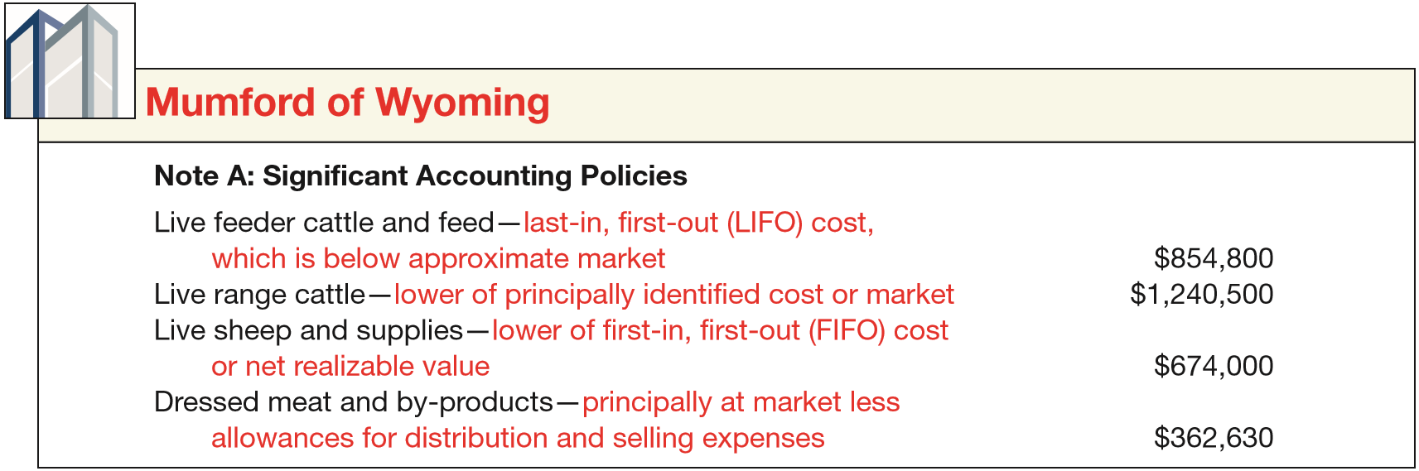
PRESENTATION AND ANALYSIS
Presentation of Inventories
ILLUSTRATION 9-28
Disclosure of Inventory Methods
LO 6

Slide 55
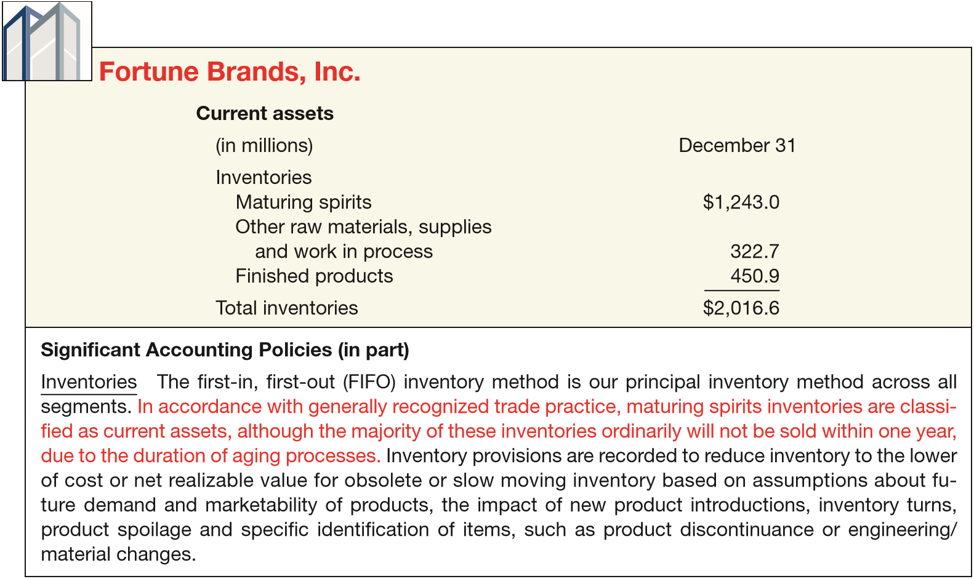

PRESENTATION AND ANALYSIS
Presentation of Inventories
ILLUSTRATION 9-29
Disclosure of Trade Practice in Valuing Inventories
LO 6

Slide 56
PRESENTATION AND ANALYSIS
Analysis of Inventories
Common ratios used in the management and evaluation of inventory levels are inventory turnover and average days to sell the inventory.
LO 6

Slide 57
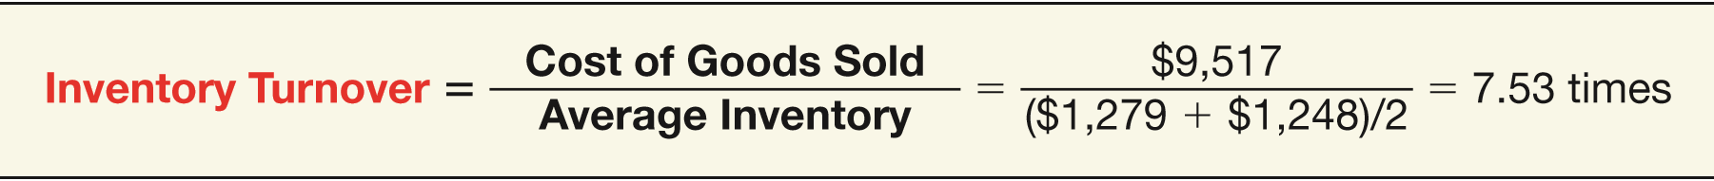
PRESENTATION AND ANALYSIS
Inventory Turnover
Measures the number of times on average a company sells the inventory during the period.
Illustration: In its 2014 annual report Kellogg Company reported a beginning inventory of $1,248 million, an ending inventory of $1,279 million, and cost of goods sold of $9,517 million for the year.
ILLUSTRATION 9-30
Inventory Turnover
LO 6

Slide 58
PRESENTATION AND ANALYSIS
Average Days to Sell Inventory
Measure represents the average number of days’ sales for which a company has inventory on hand.
ILLUSTRATION 9-30
Average Days to Sell
365 days / 7.53 times = every 48.5 days
LO 6

Slide 59
APPENDIX 9A
LIFO RETAIL METHODS
Primary reason to use LIFO
Tax advantages.
Results in a better matching of costs and revenues.
The use of LIFO retail is made under two assumptions:
stable prices and
fluctuating prices.
LO 7 Determine ending inventory by applying the LIFO retail methods.

Slide 60
APPENDIX 9A
LIFO RETAIL METHODS
STABLE PRICES—LIFO RETAIL METHOD
A major assumption of the LIFO retail method is that the markups and markdowns apply only to the goods purchased during the current period and not to the beginning inventory.
LO 7

Slide 61
APPENDIX 9A
LIFO RETAIL METHODS
Illustration: Fuque Inc. uses the retail inventory method to estimate ending inventory for its monthly financial statements. The following data pertain to a single department for the month of October.
Instructions:
Prepare a schedule computing estimate retail inventory using the LIFO Retail method.
LO 7

Slide 62
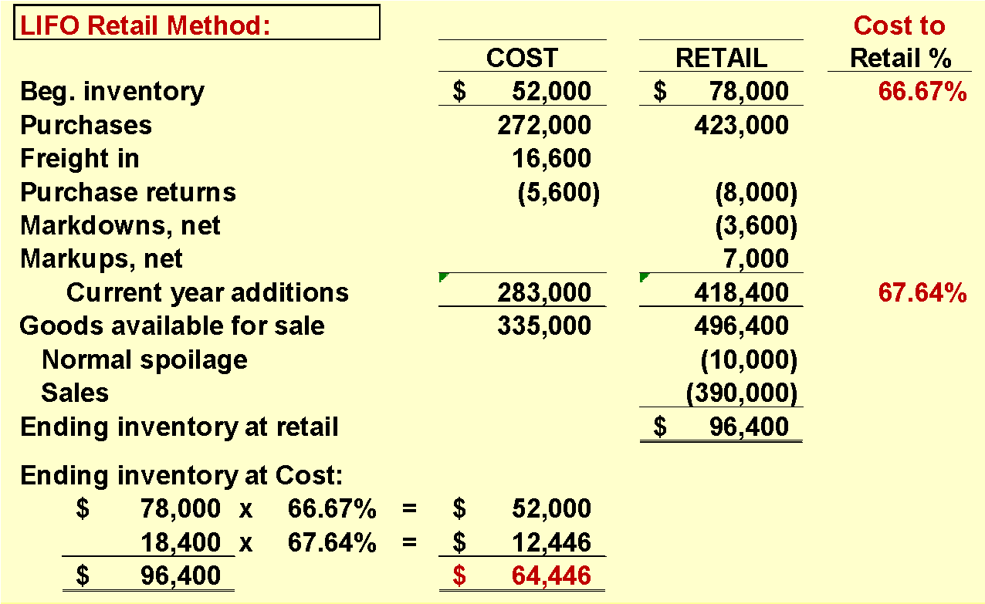
APPENDIX 9A
LIFO RETAIL METHODS
LO 7

Slide 63
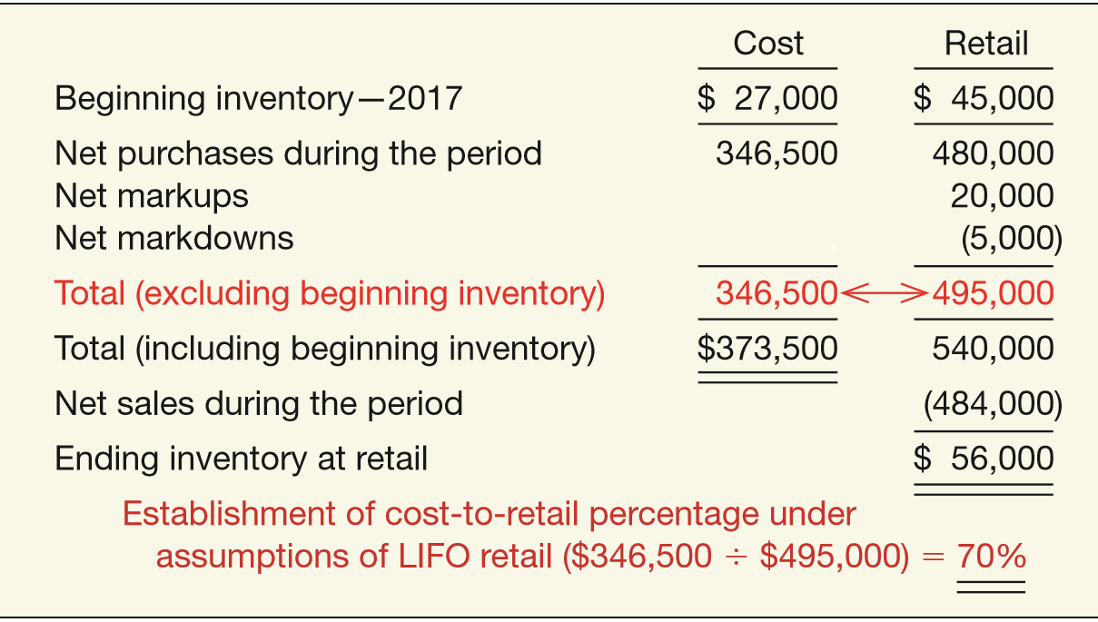
APPENDIX 9A
LIFO RETAIL METHODS
2014
ILLUSTRATION 9A-1
LIFO Retail Method—Stable Prices
LO 7

Slide 64
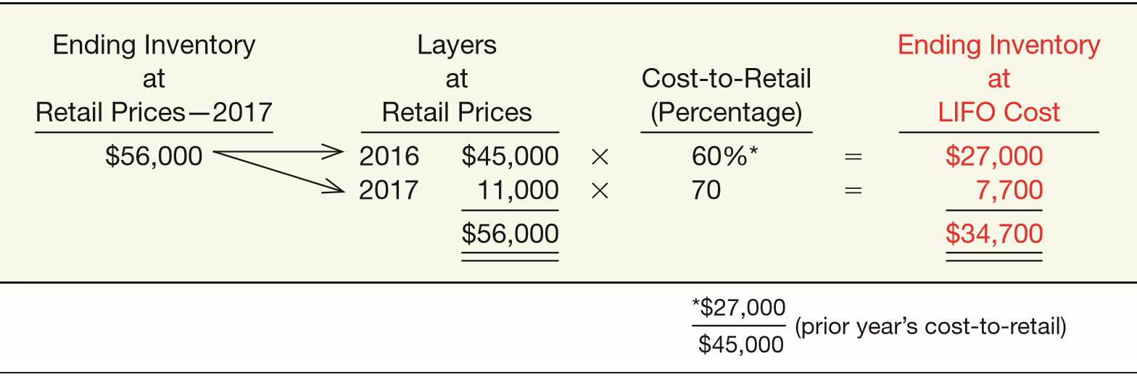
APPENDIX 9A
LIFO RETAIL METHODS
ILLUSTRATION 9A-2
Ending Inventory at LIFO Cost, 2017—Stable Prices
Inventory is composed of two layers.
LO 7

Slide 65
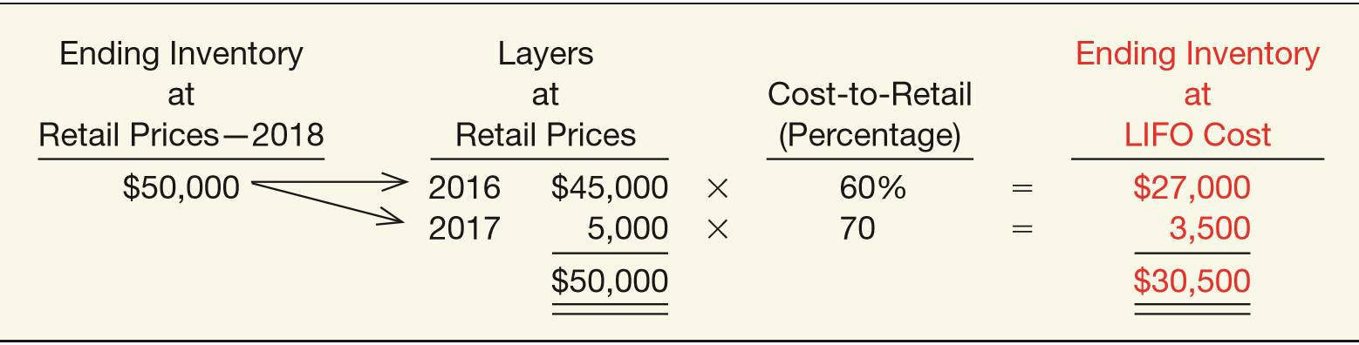
APPENDIX 9A
LIFO RETAIL METHODS
ILLUSTRATION 9A-3
Ending Inventory at LIFO Cost, 2018—Stable Prices
Notice that the 2017 layer is reduced from $11,000 to $5,000.
LO 7

Slide 66
APPENDIX 9A
LIFO RETAIL METHODS
FLUCTUATING PRICES—DOLLAR-VALUE LIFO RETAIL
If the price level does change, the company must eliminate the price change so as to measure the real increase in inventory, not the dollar increase.
LO 7

Slide 67
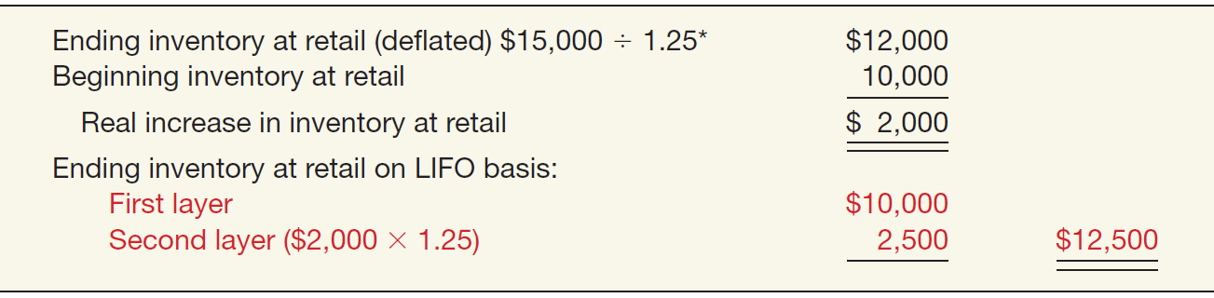
APPENDIX 9A
LIFO RETAIL METHODS
Illustration: Assume that the beginning inventory had a retail market value of $10,000 and the ending inventory had a retail market value of $15,000. Assume further that the price level has risen from 100 to 125. It is inappropriate to suggest that a real increase in inventory of $5,000 has occurred. Instead, the company must deflate the ending inventory at retail.
*1.25 = 125 ÷ 100
ILLUSTRATION 9A-4
Ending Inventory at Retail— Deﬂated and Restated
LO 7

Slide 68
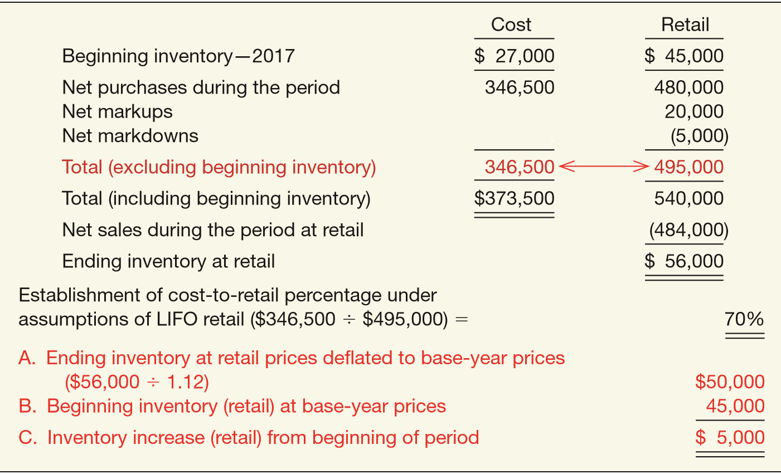
APPENDIX 9A
LIFO RETAIL METHODS
Illustration: Assume that the current 2017 price index is 112
(prior year = 100) and that the inventory ($56,000) has remained unchanged.
ILLUSTRATION 9A-5
Dollar-Value LIFO Retail Method—Fluctuating
Prices
LO 7

Slide 69
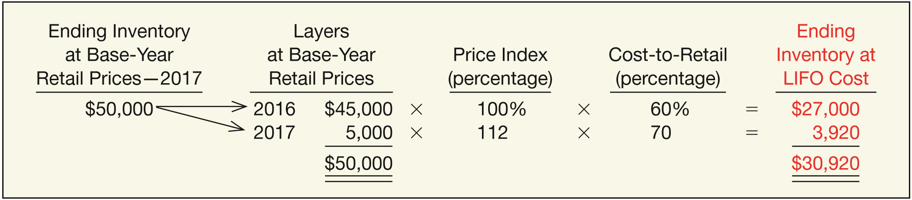
APPENDIX 9A
LIFO RETAIL METHODS
Illustration: From this information, we compute the inventory amount at cost:
ILLUSTRATION 9A-6
Ending Inventory at LIFO Cost, 2017—Fluctuating Prices
Hernandez must restate layers of a particular year to the prices in effect in the year when the layer was added.
LO 7

Slide 70
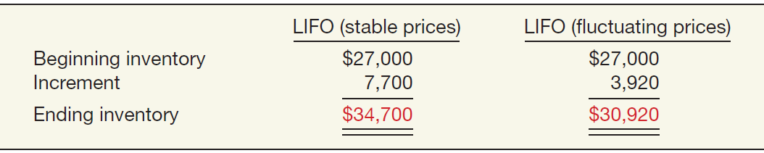
APPENDIX 9A
LIFO RETAIL METHODS
Difference between the LIFO approach (stable prices) and the dollar-value LIFO method.
ILLUSTRATION 9A-7 Comparison of Effect of Price Assumptions
The difference of $3,780 results from an increase in the price of goods, not from an increase in the quantity of goods.
LO 7

Slide 71
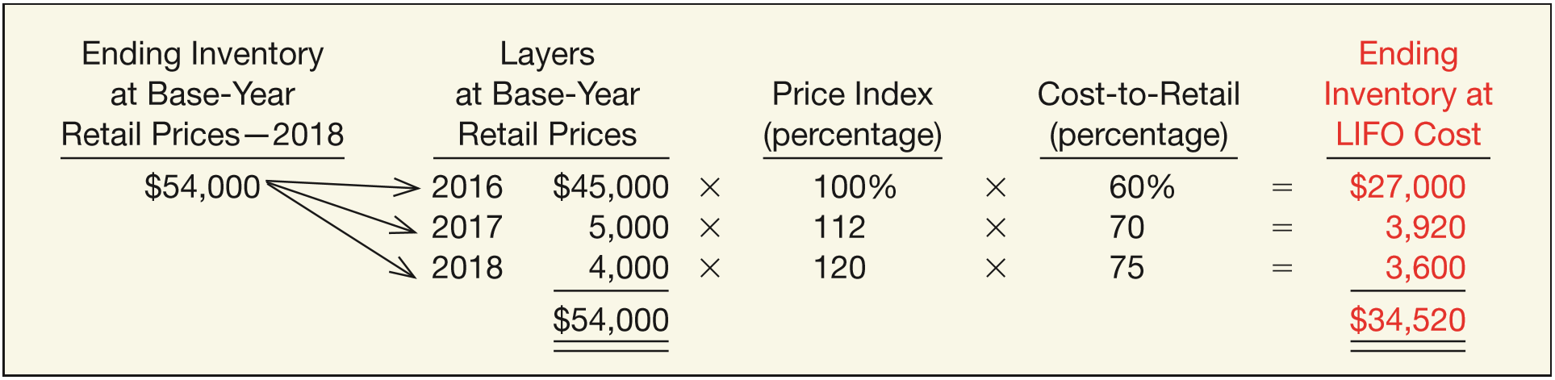
APPENDIX 9A
LIFO RETAIL METHODS
SUBSEQUENT ADJUSTMENTS UNDER DOLLAR-VALUE LIFO RETAIL
Illustration: Using the data from the previous example, assume that the retail value of the 2018 ending inventory at current prices is $64,800, the 2018 price index is 120 percent of base-year, and the cost-to-retail percentage is 75 percent.
ILLUSTRATION 9A-8
Ending Inventory at LIFO Cost, 2018—Fluctuating Prices
LO 7

Slide 72
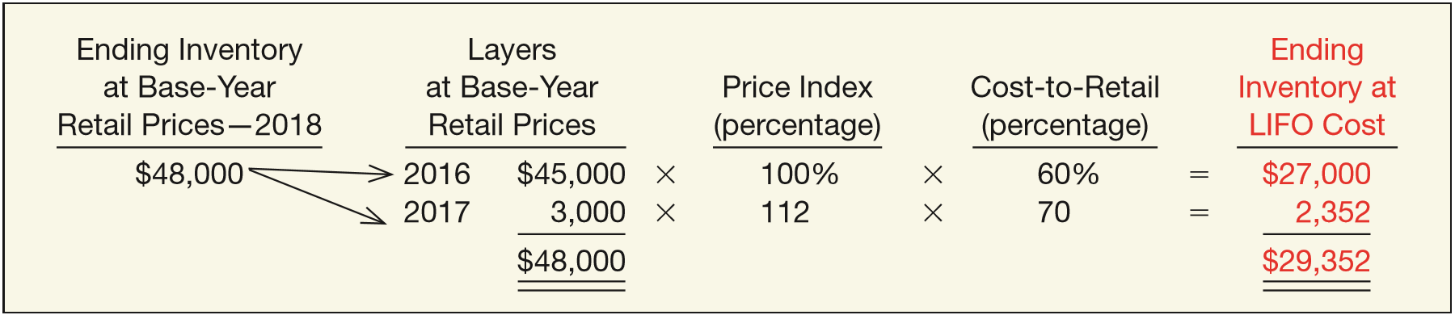
APPENDIX 9A
LIFO RETAIL METHODS
SUBSEQUENT ADJUSTMENTS UNDER DOLLAR-VALUE LIFO RETAIL
Illustration: Conversely assume that in 2018 the ending inventory in base-year prices is $48,000. Compute the ending inventory at LIFO cost.
ILLUSTRATION 9A-9
Ending Inventory at LIFO Cost, 2018—Fluctuating Prices
LO 7

Slide 73
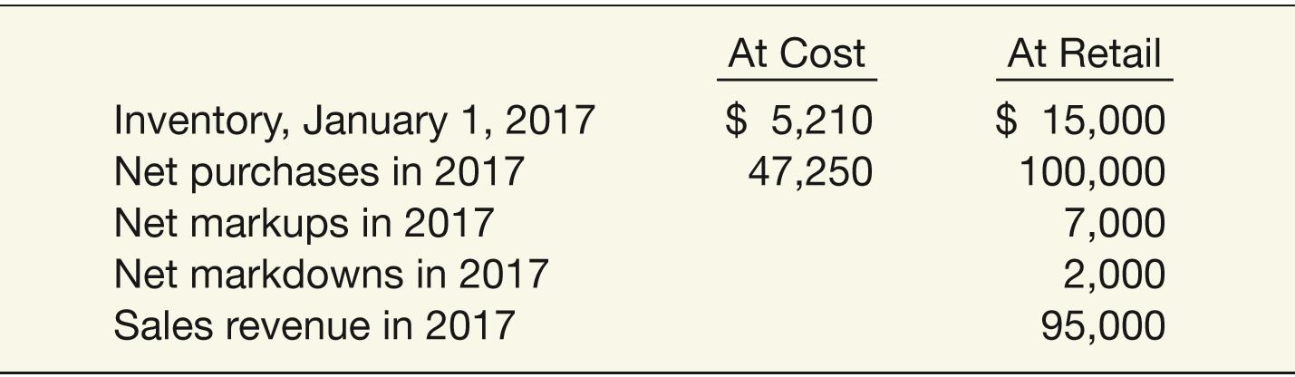
APPENDIX 9A
LIFO RETAIL METHODS
CHANGING FROM CONVENTIONAL RETAIL TO LIFO
Illustration: Hackman Clothing Store employs the conventional retail method but wishes to change to the LIFO retail method beginning in 2018. The amounts shown by the firm’s books are as follows.
LO 7

Slide 74
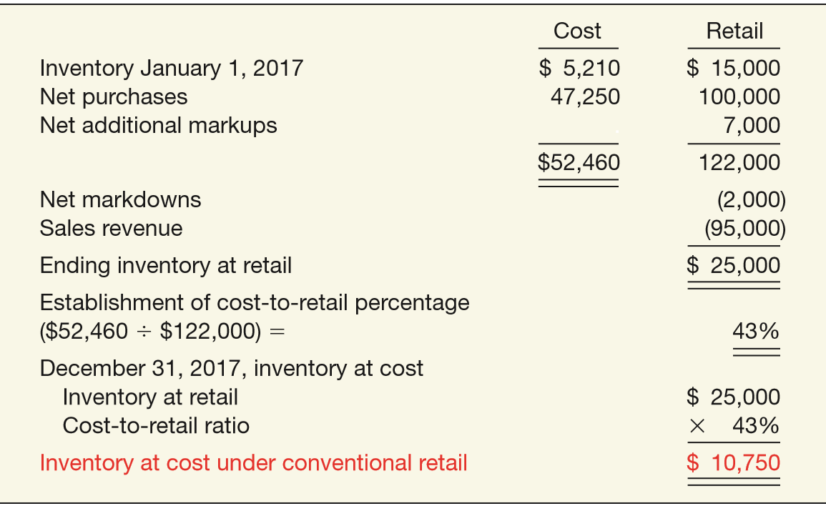
APPENDIX 9A
LIFO RETAIL METHODS
Conventional Retail Inventory Method
ILLUSTRATION 9A-10
Conventional Retail Inventory Method
LO 7

Slide 75
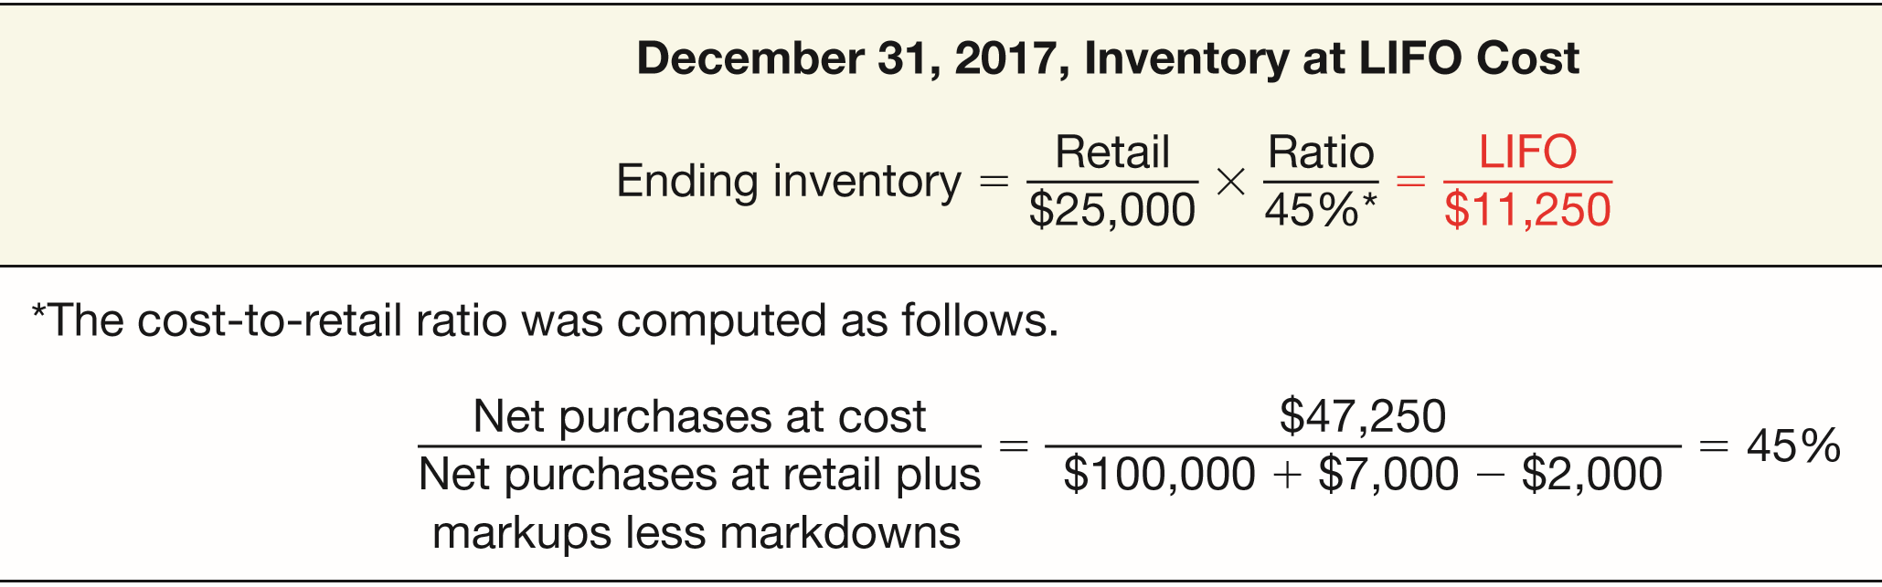
APPENDIX 9A
LIFO RETAIL METHODS
Hakeman Clothing can then quickly approximate the ending inventory for 2017 under the LIFO retail method.
ILLUSTRATION 9A-11
Conventional to LIFO Retail Inventory Method
The difference of $500 ($11,250 - $10,750) between the LIFO retail method and the conventional retail method is the amount by which the company must adjust beginning inventory for 2018.
LO 7

Slide 76
RELEVANT FACTS - Similarities
IFRS and GAAP account for inventory acquisitions at historical cost and evaluate inventory for LCNRV subsequent to acquisition.
Who owns the goods—goods in transit, consigned goods, special sales agreements—as well as the costs to include in inventory are essentially accounted for the same under IFRS and GAAP.
LO 8 Compare the accounting procedures related to valuation of inventories under GAAP and IFRS.

Slide 77
RELEVANT FACTS - Differences
The requirements for accounting for and reporting inventories are more principles-based under IFRS. That is, GAAP provides more detailed guidelines in inventory accounting.
A major difference between IFRS and GAAP relates to the LIFO cost flow assumption. GAAP permits the use of LIFO for inventory valuation. IFRS prohibits its use. FIFO and average-cost are the only two acceptable cost flow assumptions permitted under IFRS. Both sets of standards permit specific identification where appropriate.
IFRS does not have an exception to the LCNRV rule for the LIFO/retail inventory methods (IFRS does not allow LIFO). GAAP, on the other hand, for LIFO/retail inventory method companies, defines market as replacement cost subject to the constraints of net realizable value (the ceiling) and net realizable value less a normal markup (the floor). IFRS does not use a ceiling or a floor to determine lower-of-cost-or-market.

Slide 78
RELEVANT FACTS - Differences
Under GAAP, if inventory is written down under the LCNRV or lower-of-cost-or-market valuation, the new basis is now considered its cost. As a result, the inventory may not be written back up to its original cost in a subsequent period. Under IFRS, the write-down may be reversed in a subsequent period up to the amount of the previous write-down. Both the write-down and any subsequent reversal should be reported on the income statement.
IFRS requires both biological assets and agricultural produce at the point of harvest to be reported at net realizable value. GAAP does not require companies to account for all biological assets in the same way. Furthermore, these assets generally are not reported at net realizable value. Disclosure requirements also differ between the two sets of standards.

Slide 79
ON THE HORIZON
One issue that will be difficult to resolve relates to the use of the LIFO cost flow assumption. As indicated, IFRS specifically prohibits its use. Conversely, the LIFO cost flow assumption is widely used in the United States because of its favorable tax advantages. In addition, many argue that LIFO from a financial reporting point of view provides a better matching of current costs against revenue and therefore enables companies to compute a more realistic income.

Slide 80
IFRS SELF-TEST QUESTION
All of the following are key similarities between GAAP and IFRS with respect to accounting for inventories except:
costs to include in inventories are similar.
LIFO cost flow assumption where appropriate is used by both sets of standards.
fair value valuation of inventories is prohibited by both sets of standards.
guidelines on ownership of goods are similar.

Slide 81
IFRS SELF-TEST QUESTION
All of the following are key differences between GAAP and IFRS with respect to accounting for inventories except the:
definition of the lower-of-cost-or-market test for inventory valuation differs between GAAP and IFRS.
average cost method is prohibited under IFRS.
inventory basis determination for write-downs differs between GAAP and IFRS.
guidelines are more principles based under IFRS than they are under GAAP.

Slide 82
IFRS SELF-TEST QUESTION
Under IFRS, agricultural activity results in which of the following types of assets?
I. Agricultural produce
II. Biological assets
I only.
II only.
I and II.
Neither I nor II.

Slide 83
COPYRIGHT
“Copyright © 2016 John Wiley & Sons, Inc. All rights reserved. Reproduction or translation of this work beyond that permitted in Section 117 of the 1976 United States Copyright Act without the express written permission of the copyright owner is unlawful. Request for further information should be addressed to the Permissions Department, John Wiley & Sons, Inc. The purchaser may make back-up copies for his/her own use only and not for distribution or resale. The Publisher assumes no responsibility for errors, omissions, or damages, caused by the use of these programs or from the use of the information contained herein.”

