Slide 1
ENCS5321
Advanced Computer Networks
Link Layer

Slide 2
Error Control

Slide 3
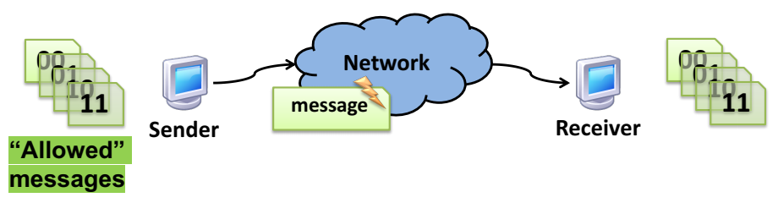
Error control: Motivation
A priori, any string of bits is an “allowed” message
  Hence any changes to the bits (bit errors) the sender transmits produce “allowed” messages
Therefore without error control, receiver wouldn’t know errors happened!

Slide 4
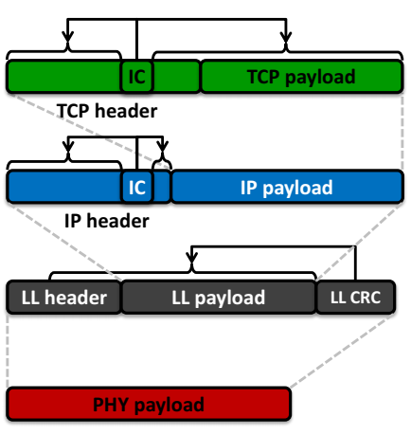
Error control in the Internet stack
Transport layer
  Internet Checksum (IC) over TCP/UDP header, data
Network layer (L3)
  IC over IP header only
Link layer (L2)
  Cyclic Redundancy Check (CRC)
Physical layer (PHY)
  Error Control Coding (ECC),or
  Forward Error Correction (FEC)

Slide 5
Error control: Key Ideas
Reduce the set of “allowed” messages
  Not every string of bits is an “allowed” message
  Receipt of a disallowed string of bits means that the message was garbled in transit over the network
We call an allowable message (of n bits) a codeword
  Not all n-bit strings are codewords!
  The remaining n-bit strings are “space” between codewords
Plan: Receiver will use that space to both detect and correct errors in transmitted messages

Slide 6
Encoding and decoding
Problem: Not every string of bits is “allowed”
  But we want to be able to send any message!
  How can we send a “disallowed” message?
Answer: Codes, as a sender-receiver protocol
  The sender must encode its messages ➜ codewords
  The receiver then decodes received bits ➜ messages
The relationship between messages and codewords isn’t always obvious!

Slide 7
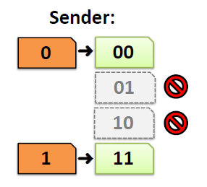
A simple error-detecting code
Let’s start simple: suppose messages are one bit long
Take the message bit, and repeat it once
  This is called a two-repetition code

Slide 8
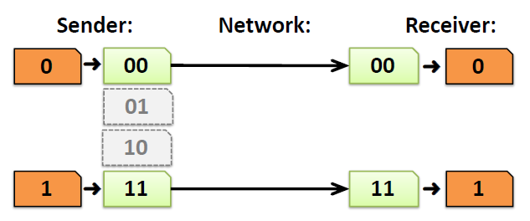
Receiving the two-repetition code
Suppose the network causes no bit error
Receiver removes repetition to correctly decode the message bits

Slide 9
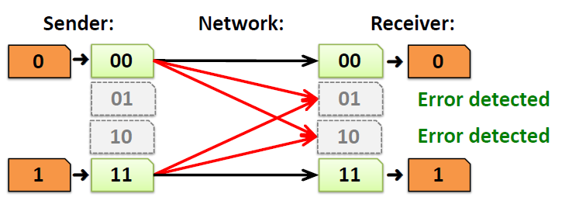
Detecting one bit error
Suppose the network causes up to one bit error
The receiver can detect the error:
  It received a non-codeword
Can the receiver correct the error?
  No! The other codeword could have been sent as well

Slide 10
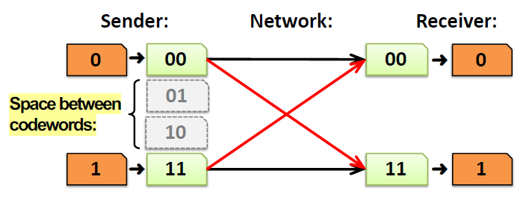
Reception with two bit errors
Can receiver detect presence of two bit errors?
  No: It has no way of telling which codeword was sent!
    Enough bit errors that the sent codeword “jumped over” the space between codewords

Slide 11

Hamming distance
Measures the number of bit flips to change one codeword into another
Hamming distance between two messages m1, m2: The number of bit flips needed to change m1 into m2
Example: Two bit flips needed to change codeword 00 to codeword 11, so they are Hamming distance of two apart

Slide 12
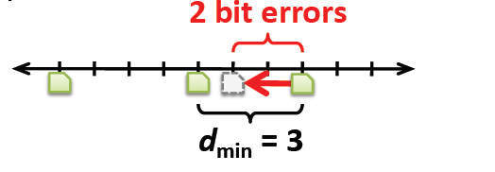
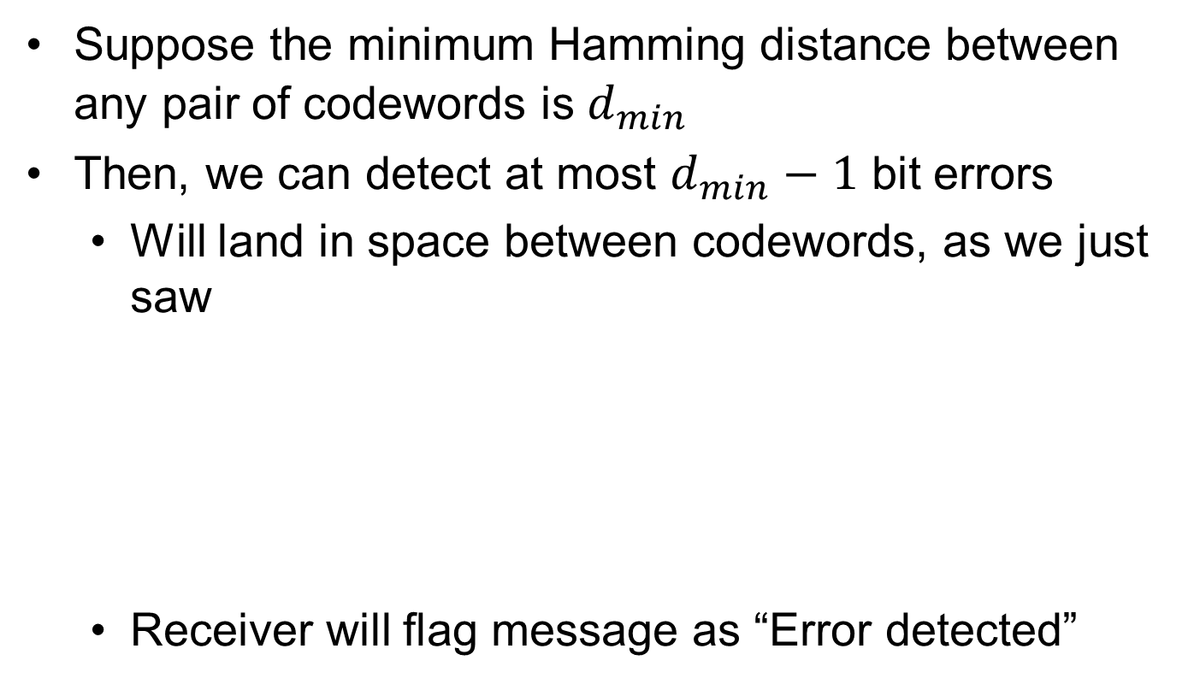
How many bit errors can we detect?
Suppose the minimum Hamming distance between any pair of codewords is $d_{min}$
Then, we can detect at most $d_{min}−1$ bit errors
  Will land in space between codewords, as we just saw
  Receiver will flag message as “Error detected”

Slide 13
Decoding error detecting codes
The receiver decodes in a two-step process:
  Map received bits → codeword
    Decoding rule: Consider all codewords
      Choose the one that exactly matches the received bits
      Return “error detected” if none match
  Map codeword → source bits and “error detected”
    Use the reverse map of the sender

Slide 14
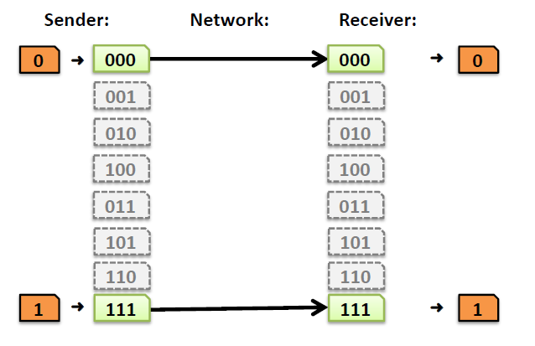
A simple error-correcting code
Let’s look at a three-repetition code
If no errors, it works like the two-repetition code:

Slide 15
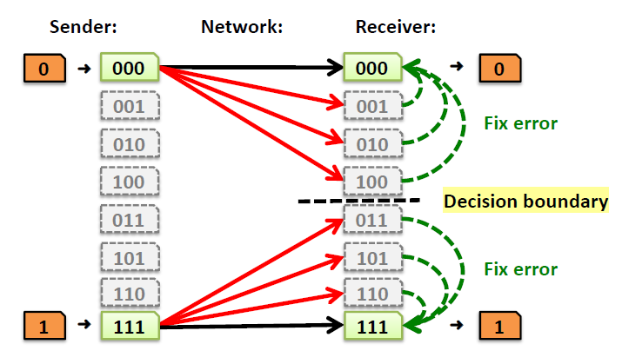
Correcting one bit error
Receiver chooses the closest codeword (measured by Hamming distance) to the received bits
  A decision boundary exists halfway between codewords

Slide 16
Decoding error correcting codes
The receiver decodes in a two-step process:
  Map received bits → codeword
    Decoding rule: Consider all codewords
      Choose one with the minimum Hamming distance to the received bits
  Map codeword → source bits
    Use the reverse map of the sender

Slide 17
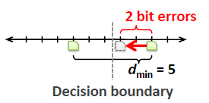
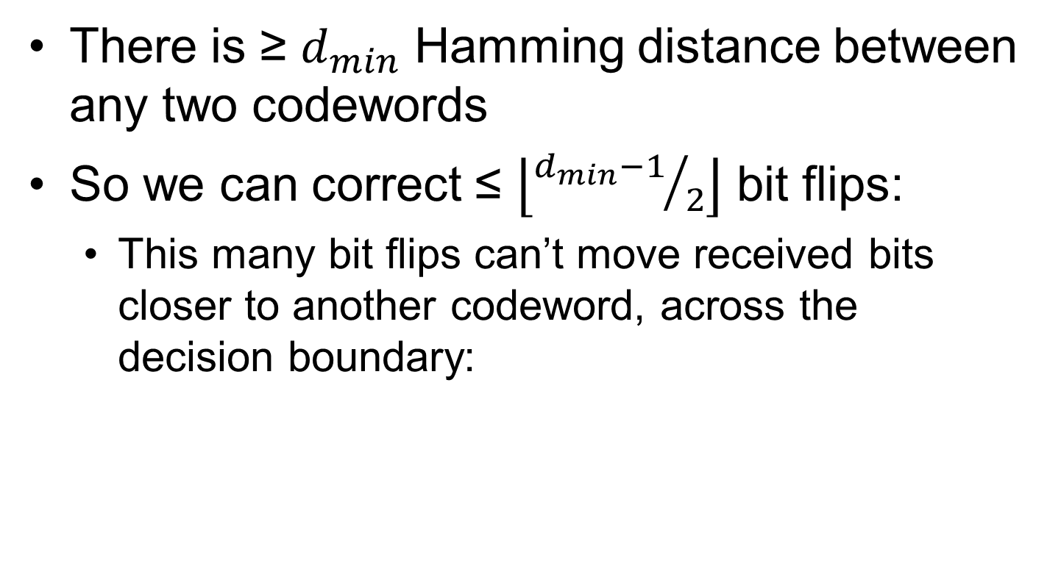
How many bit errors can we correct?
There is ≥ $d_{min}$ Hamming distance between any two codewords
So we can correct ≤ $\left\lfloor {d_{min}−1}/2\right\rfloor$ bit flips:
  This many bit flips can’t move received bits closer to another codeword, across the decision boundary:

Slide 18
Code rate
Suppose codewords of length n, messages length k (k < n)
The code rate R = k/n is a fraction between 0 and 1
So, we have a tradeoff:
  High-rate codes (R approaching one) generally correct fewer errors, but add less overhead
  Low-rate codes (R close to zero) generally correct more errors, but add more overhead

Slide 19

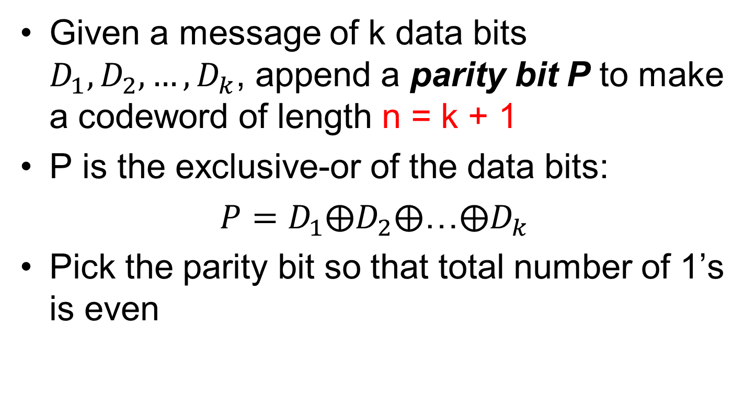
Parity bit
Given a message of k data bits $D_{1},D_{2},…,D_{k}$, append a parity bit P to make a codeword of length n = k + 1
P is the exclusive-or of the data bits:
$P=D_{1}⨁D_{2}⨁$…$⨁D_{k}$
Pick the parity bit so that total number of 1’s is even

Slide 20
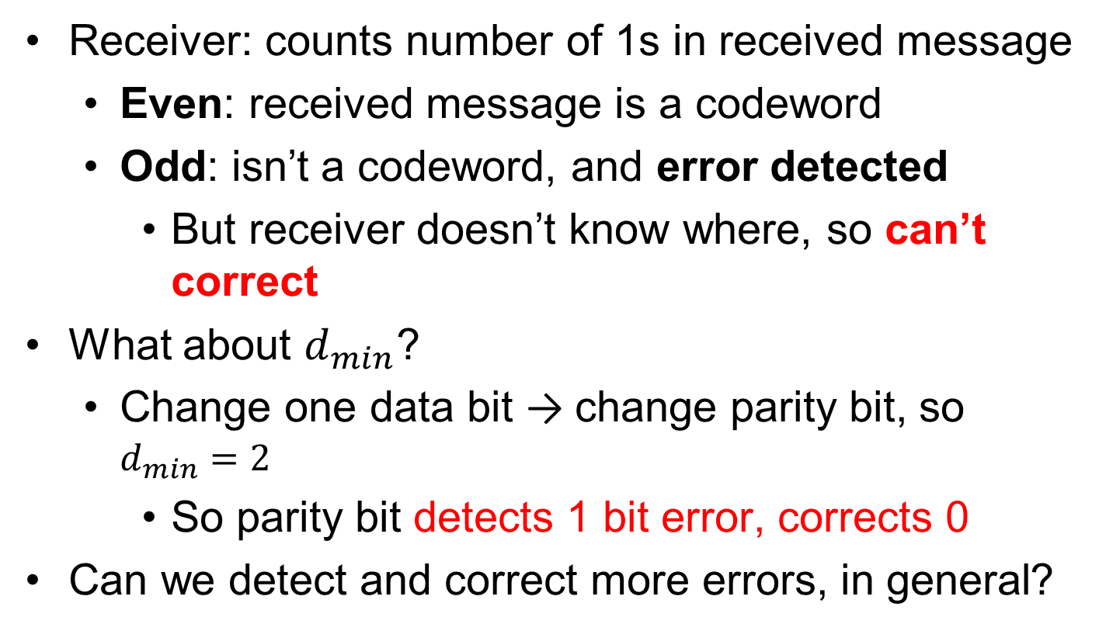
Checking the parity bit
Receiver: counts number of 1s in received message
  Even: received message is a codeword
  Odd: isn’t a codeword, and error detected
    But receiver doesn’t know where, so can’t correct
What about $d_{min}$?
  Change one data bit → change parity bit, so $d_{min}=2$
    So parity bit detects 1 bit error, corrects 0
Can we detect and correct more errors, in general?

Slide 21
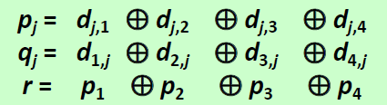
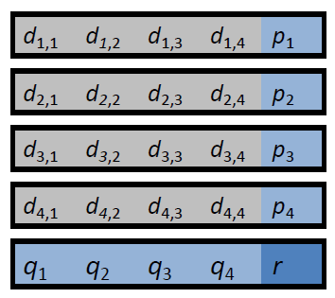
Two-dimensional parity
Break up data into multiple rows
  Parity bit across each row (pi)
  Parity bit down each column (qi)
  Add a parity bit r covering row parities
  This example has rate 16/25:

Slide 22
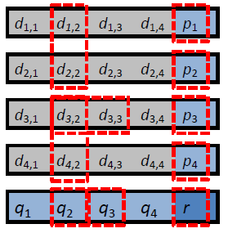
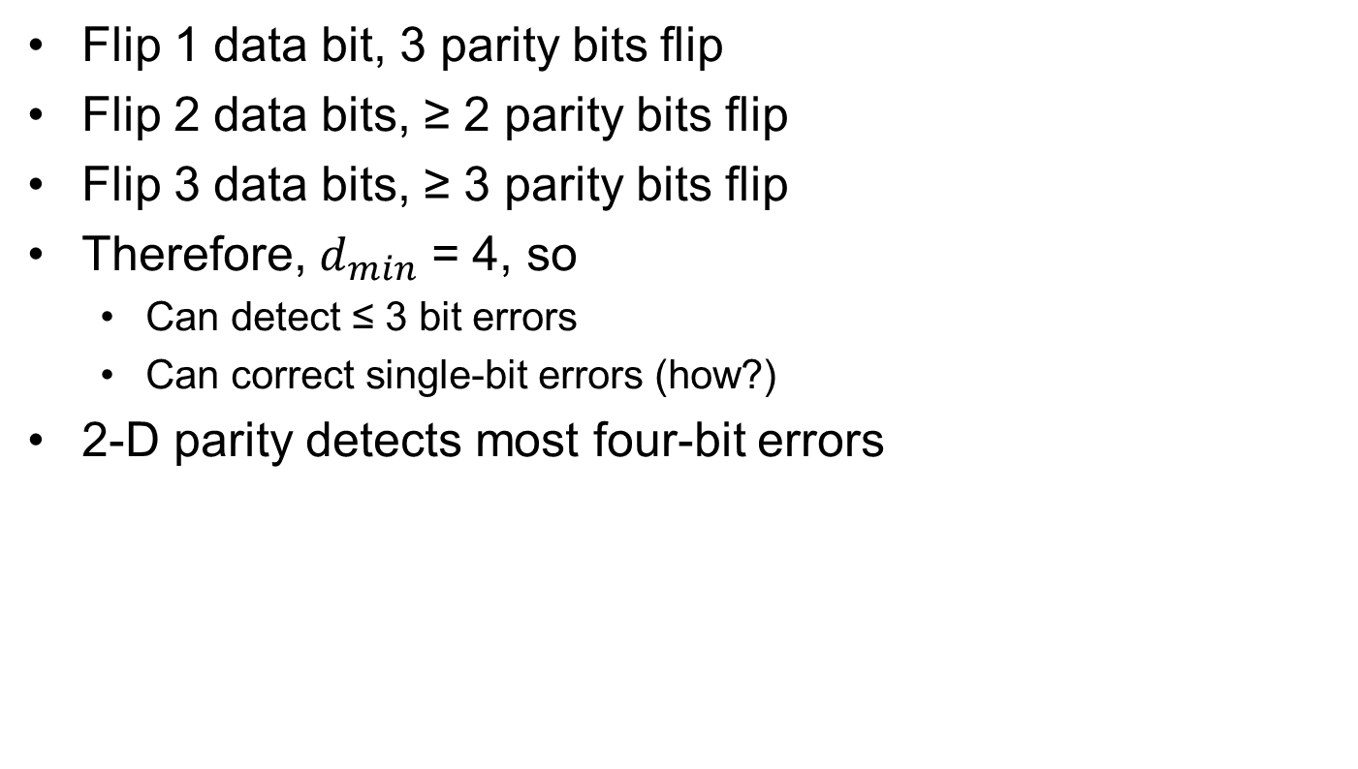
Two-dimensional parity
Flip 1 data bit, 3 parity bits flip
Flip 2 data bits, ≥ 2 parity bits flip
Flip 3 data bits, ≥ 3 parity bits flip
Therefore, $d_{min}$ = 4, so
  Can detect ≤ 3 bit errors
  Can correct single-bit errors (how?)
2-D parity detects most four-bit errors

