Slide 1
Chapter Seven
DC Machinery Fundamentals
aabdo@birzeit.edu Electrical Machine & Power Electronics ENEE 4301

Slide 2
Introduction
Most electric machines operate on the basis of interaction between current carrying conductors and electromagnetic fields.
In particular: generator action is based on Faraday’s law of electromagnetic induction, which implies that a current carrying conductor moving in a region having flux lines at right angles to the conductor will have emf induced in it
e_{ind} = (v x B) l
aabdo@birzeit.edu Electrical Machine & Power Electronics ENEE 4301

Slide 3
Motor Action
Motor action is based on
The linear dc machine behavior studied earlier resembles the behavior of real dc generators and motors
However, real machines rotate and do not move in straight lines as linear dc machines
aabdo@birzeit.edu Electrical Machine & Power Electronics ENEE 4301

Slide 4
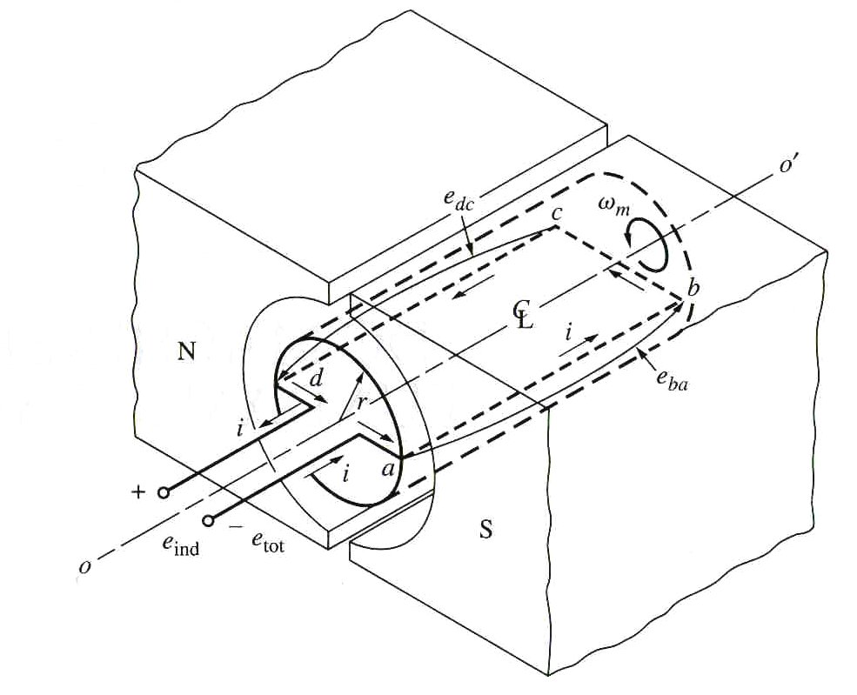
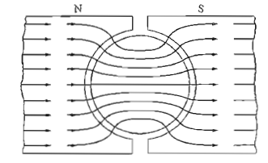
Rotating Loop Between Curved Pole Faces
The simplest rotating dc machine is shown below.
It consists of:
A rotating single loop of wire in a slot carved in a cylindrical ferromagnetic core – rotor
A pair of stationary magnetic poles (north and south) – stator
aabdo@birzeit.edu Electrical Machine & Power Electronics ENEE 4301

Slide 5
Rotating Loop Between Curved Pole Faces
The magnetic field is supplied by the stator.
The air gap between the rotor and stator is of constant width (i.e. is the same everywhere under the pole faces).
➔ magnetic flux density is equal everywhere under the pole surface.
From Chapter 1, we know that the reluctance of the air is much higher than that of the core material, ➔ magnetic flux takes shortest possible path through the air gap (i.e. perpendicular to the rotor surface).
aabdo@birzeit.edu Electrical Machine & Power Electronics ENEE 4301

Slide 6
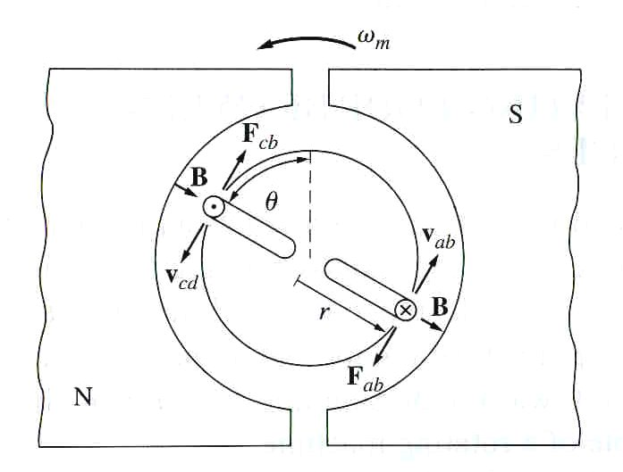
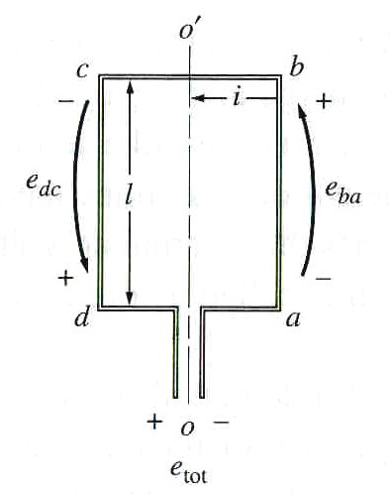
Voltage Induced in a Rotating Loop
If the rotor is rotated, a voltage will be induced in the wire loop. (Note: No voltage source applied to the rotor terminals.)
To determine the total voltage e_{tot} on the loop, each segment of the loop (as shown in the figure below) has to be examined separately and the resulting voltages summed up
aabdo@birzeit.edu Electrical Machine & Power Electronics ENEE 4301

Slide 7
Voltage Induced in a Rotating Loop
To determine the total voltage e_{tot} on the loop, examine each segment of the loop separately and sum all the resulting voltages. The voltage on each segment is given by e_{ind} = (v x B) ⋅ l
Note that B is 0 beyond the edges of the pole face
Thus, the total induced voltage on the loop is:
Calculation for each section is shown next
aabdo@birzeit.edu Electrical Machine & Power Electronics ENEE 4301

Slide 8
Voltage Induced in a Rotating Loop
Segment ab:
Velocity v_{ab} tangential to rotation path
Segment bc:
direction of either into or out of page
-
-
aabdo@birzeit.edu Electrical Machine & Power Electronics ENEE 4301

Slide 9
Voltage Induced in a Rotating Loop
Segment cd:
Velocity v_{cd} tangential to rotation path
Segment da:
-
-
aabdo@birzeit.edu Electrical Machine & Power Electronics ENEE 4301

Slide 10
Voltage Induced in a Rotating Loop
Thus, the total induced voltage on the loop is:
e_{ba}= e_{dc}= vBl (since v x B is parallel to l)
e_{cb}=e_{ad}=0 (since v x B is perpendicular to l)
Final result:
aabdo@birzeit.edu Electrical Machine & Power Electronics ENEE 4301

Slide 11
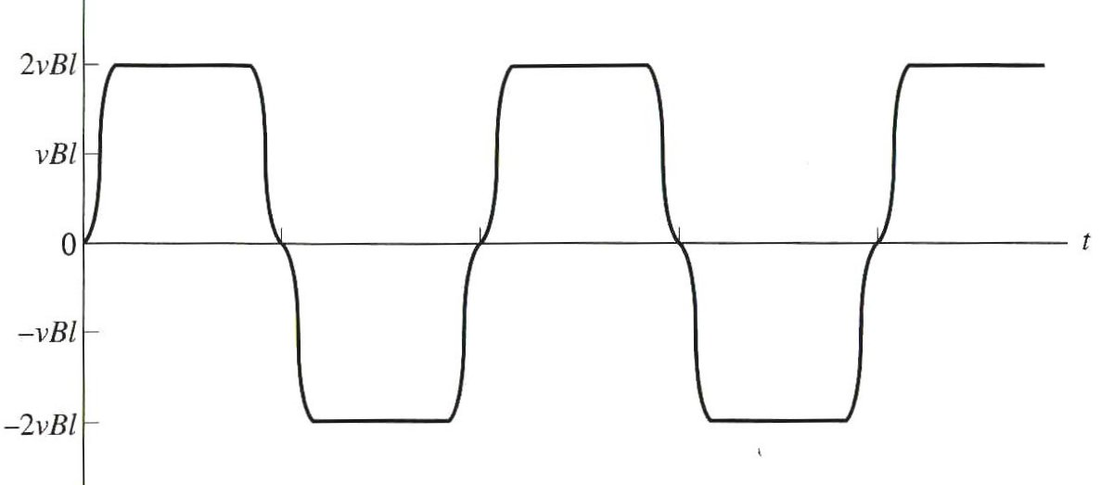
Voltage Induced in a Rotating Loop
When the loop rotates through 180°, segment ab is under the north pole face instead of the south pole face. At that time, the direction of the voltage on the segment reverses, but its magnitude remains constant.
The resulting voltage e_{tot}
aabdo@birzeit.edu Electrical Machine & Power Electronics ENEE 4301

Slide 12
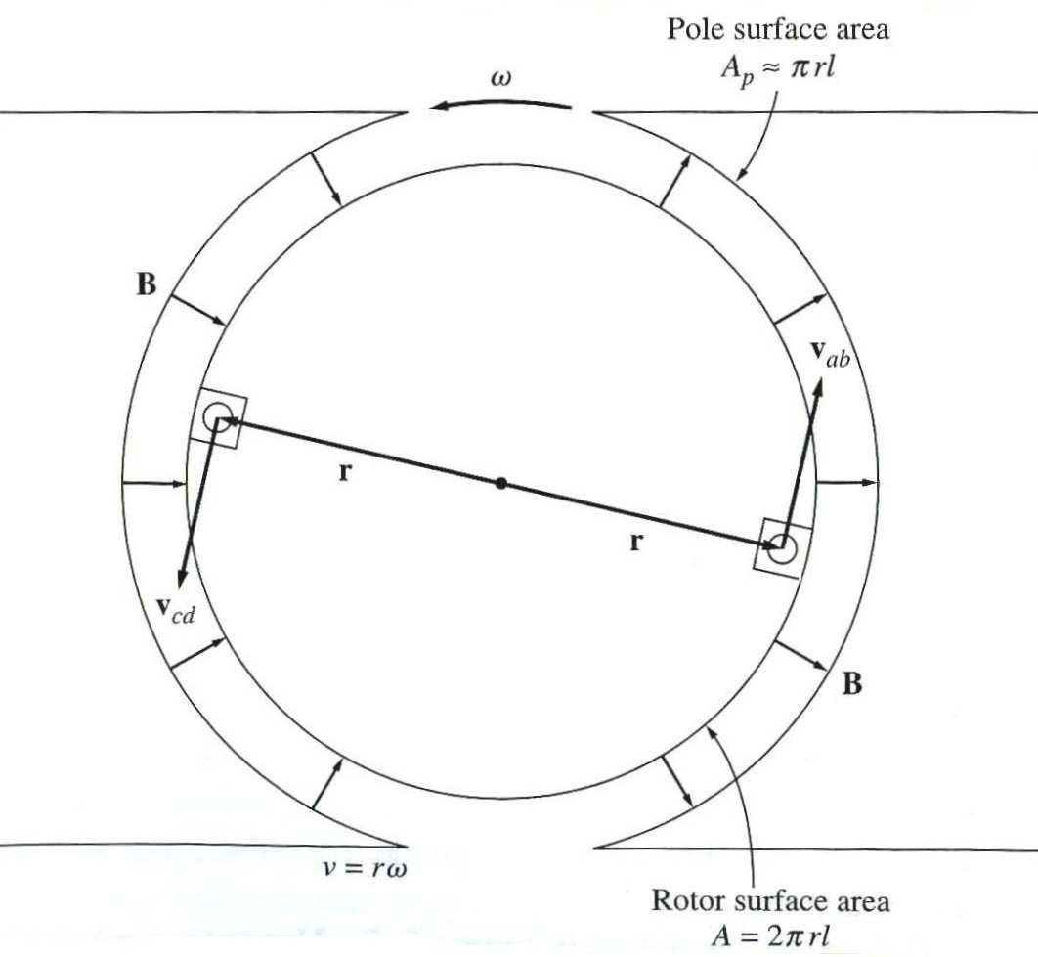
Voltage Induced in a Rotating Loop
An alternative expression for e_{ind} that relates the behaviour of the single loop to the behaviour of larger, real dc machines can be obtained by examining the figure below:
The tangential velocity v of the
loop edges can be expressed
as v = rω. Therefore,
aabdo@birzeit.edu Electrical Machine & Power Electronics ENEE 4301

Slide 13
Voltage Induced in a Rotating Loop
For a 2-pole machine, if we assume that the gap between the poles is negligible (the gaps at the top and bottom of the diagram) then the surface area of the pole can be written as (area of cylinder /2) :
Therefore,
aabdo@birzeit.edu Electrical Machine & Power Electronics ENEE 4301

Slide 14
Voltage Induced in a Rotating Loop
Since the air gap flux density B is constant everywhere under the pole faces, the total flux under each pole is:
Thus, the final form of the voltage equation is:
In general, the voltage in any real machine will depend on the same three factors:
1) The flux in the machine
2) the speed of rotation
3) a constant representing the machine construction
aabdo@birzeit.edu Electrical Machine & Power Electronics ENEE 4301

Slide 15
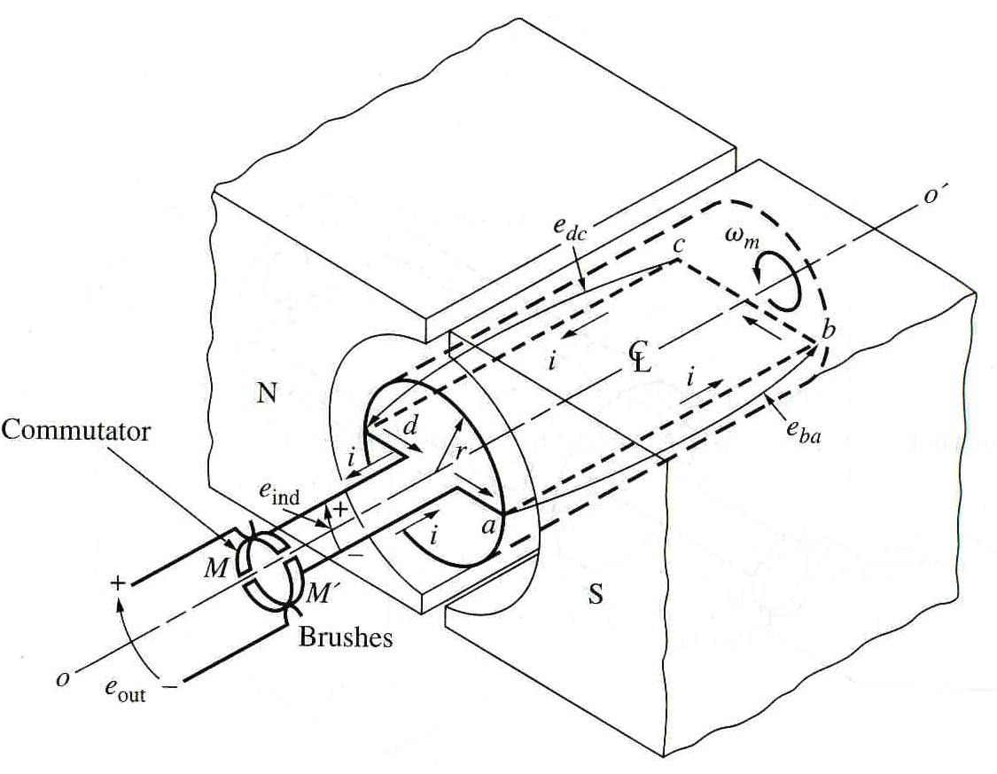
Getting DC voltage out of the rotating loop
The voltage out of the loop is alternating between a constant positive value and a constant negative value, i.e. ac voltage.
How can this machine be modified to produce a dc voltage?
Answer: By using a mechanism called commutator and brushes.
aabdo@birzeit.edu Electrical Machine & Power Electronics ENEE 4301

Slide 16
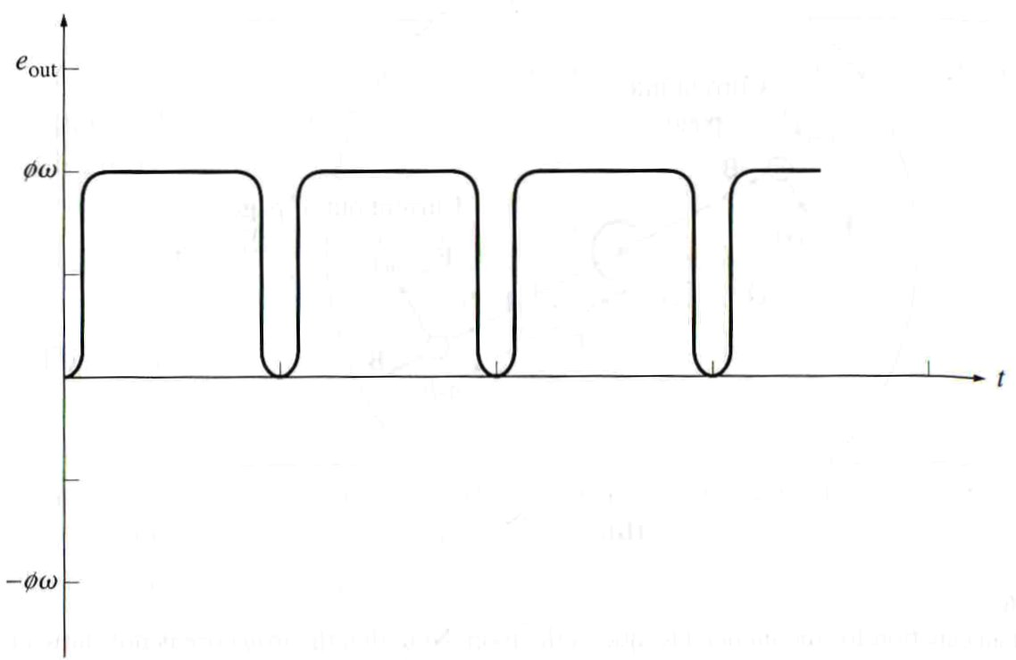
Commutation
Two semicircular conducting segments (commutator segments) are added to the end of the loop.
Two fixed contacts (brushes) are placed at an angle such that at the instant the voltage in the loop is zero, the contacts short-circuit the two segments.
Every time voltage of the loop changes direction, the contacts also switch connections and the output of the contacts is always built up in the same way (as shown next).
This connection-switching process is known as commutation process
➔
Output voltage of a dc machine without
commutator and brushes.
Output voltage of a dc machine with
commutator and brushes.
aabdo@birzeit.edu Electrical Machine & Power Electronics ENEE 4301

Slide 17
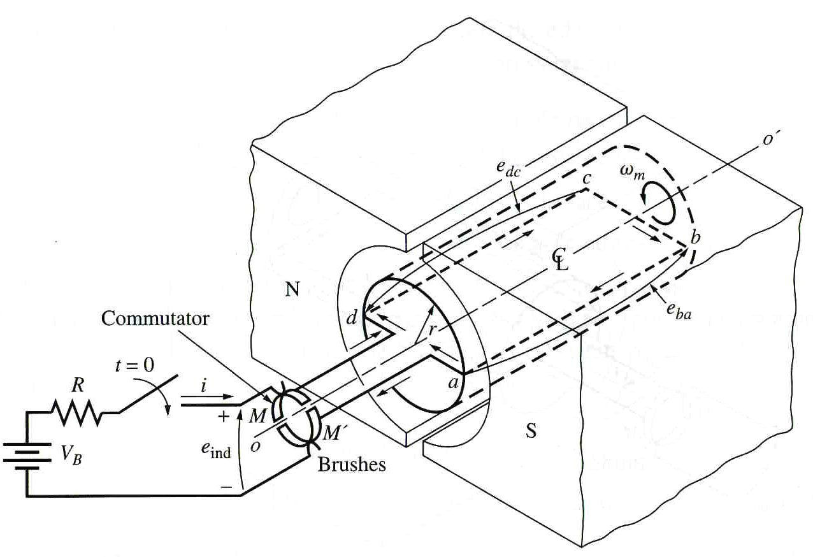
Torque Induced in a Rotating Loop
If the simple machine is connected to a battery, as shown below, how much torque will be produced in the stationary loop when the switch is closed and current is allowed to flow?
aabdo@birzeit.edu Electrical Machine & Power Electronics ENEE 4301

Slide 18
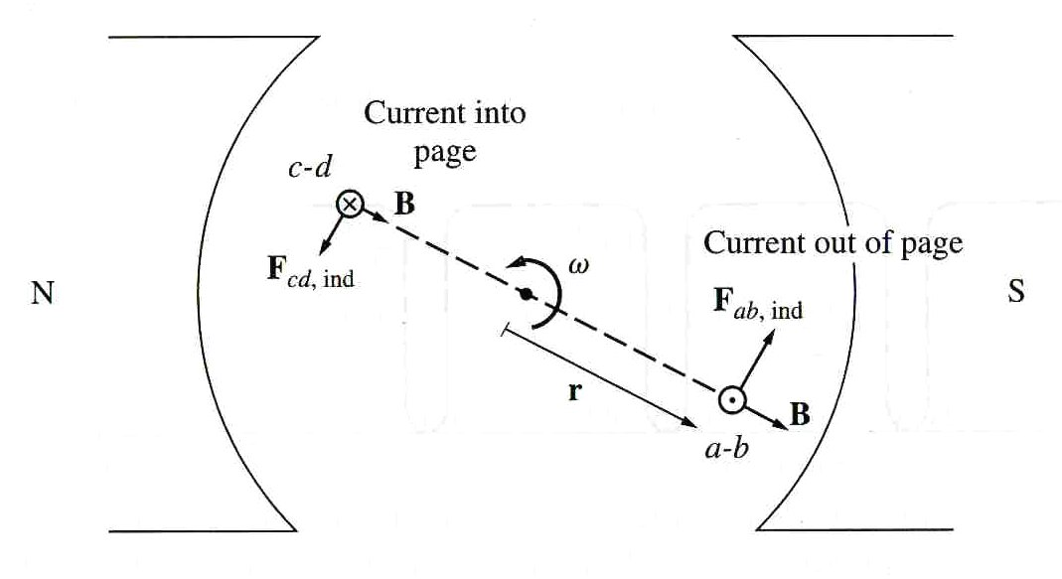
Torque Induced in a Rotating Loop
As before, the approach is to examine each segment of the loop and then sum the effects of all segments.
The force on each segment is given by
aabdo@birzeit.edu Electrical Machine & Power Electronics ENEE 4301

Slide 19
Torque Induced in a Rotating Loop
And the torque on the segment is given by :
where θ is the angle between r and F.
When the loop is beyond the pole edges, τ = 0 (since B = 0).
aabdo@birzeit.edu Electrical Machine & Power Electronics ENEE 4301

Slide 20
Torque Induced in a Rotating Loop
Segment ab:
Current directed out of the page
aabdo@birzeit.edu Electrical Machine & Power Electronics ENEE 4301

Slide 21
Torque Induced in a Rotating Loop
aabdo@birzeit.edu Electrical Machine & Power Electronics ENEE 4301

Slide 22
Torque Induced in a Rotating Loop
Note that
F_{ab}= F_{cd}= ilB and t_{ab}=t_{cd}=rFsinq=rilB CCW
(since q=90 deg) And
F_{bc}=F_{da}=0 (since l is parallel to B )
t_{bc}=t_{da}=0
Hence, the total induced torque in the loop is:
aabdo@birzeit.edu Electrical Machine & Power Electronics ENEE 4301

Slide 23
Torque Induced in a Rotating Loop
By employing the facts that and , the torque expression can be reduced to:
In general, the torque in any real machine will depend on the same three factors:
1) the flux in the machine
2) the current in the machine
3) a constant representing the machine construction
aabdo@birzeit.edu Electrical Machine & Power Electronics ENEE 4301

Slide 24
Example 7-1
A simple rotating loop between curved pole faces connected to a battery and a resistor through a switch. The physical dimensions and characteristics of the machine are:
r=0.5m; l=1m; R=0.3 ohm; B=0.25T; V_{B}=120V
What happens when switch is closed?
What is the machine’s maximum starting current? What is the steady-state angular velocity at no load?
Suppose load torque=10 N.m, what is the new steady-state speed? How much power is supplied to the shaft? How much power is being supplied by the battery? is the machine a motor or a generator?
Suppose the machine is unloaded again, and a torque =7.5 N.m is applied to the shaft in the direction of motion. What is the new steady-state speed? Is the machine acting as a motor or generator?
Suppose the machine is running unloaded, what would be the final steady-state speed of the rotor be if the flux density were reduced to 0.2 T?
aabdo@birzeit.edu Electrical Machine & Power Electronics ENEE 4301

Slide 25
Example 7-1
aabdo@birzeit.edu Electrical Machine & Power Electronics ENEE 4301

Slide 26
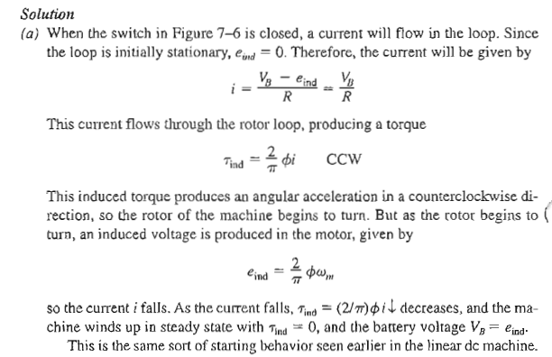
Example 7-1
aabdo@birzeit.edu Electrical Machine & Power Electronics ENEE 4301

Slide 27
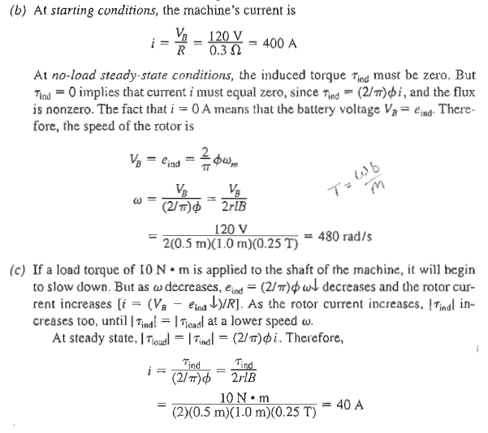
Example 7-1
aabdo@birzeit.edu Electrical Machine & Power Electronics ENEE 4301

Slide 28
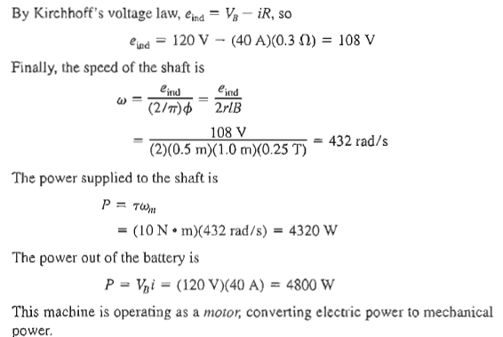
Example 7-1
aabdo@birzeit.edu Electrical Machine & Power Electronics ENEE 4301

Slide 29
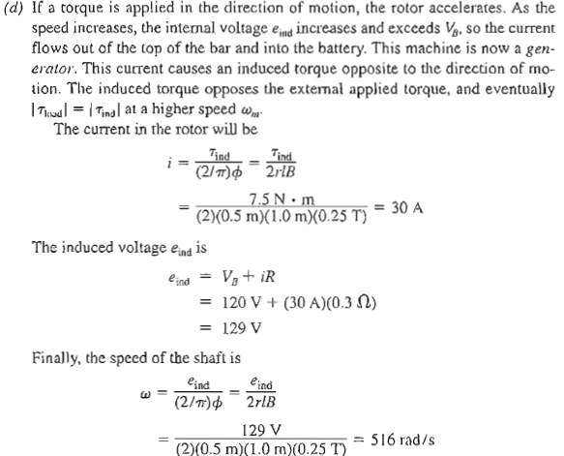
Example 7-1
aabdo@birzeit.edu Electrical Machine & Power Electronics ENEE 4301

Slide 30
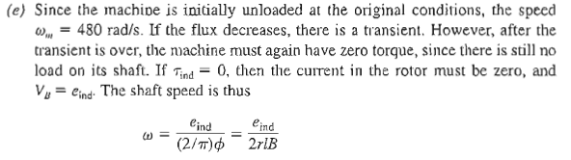
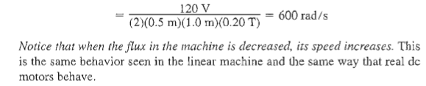
Example 7-1
aabdo@birzeit.edu Electrical Machine & Power Electronics ENEE 4301

