Slide 1
Argumentation
Adapted from They Say, I Say: The Moves That Matter in Academic Writing

Slide 2
Preface
In research, we do not only summarize what “they say,” when using secondary references, but we also quote exact words.
Quoting someone else’s words gives a tremendous amount of credibility to your summary and helps ensure that it is fair and accurate.
In a sense, then, quotations function as a kind of proof of evidence, saying to readers: “Look, I’m not just making this up. She makes this claim and here it is in her exact words.”

Slide 3
Quotation major pitfall
The main problem with quoting arises when writers assume that quotations speak for themselves. Because the meaning of a quotation is obvious to them, many writers assume that this meaning will also be obvious to their readers, when often it is not.

Slide 4
Quotation major pitfall
In a way, quotations are orphans: words that have been taken from their original contexts and that need to be integrated into their new textual surroundings.

Slide 5
So? INTEGRATE
There are two key ways to produce quote integration:
  (1) by choosing quotations wisely, with an eye to how well they support a particular part of your text,
  and (2) by surrounding every major quotation with a frame explaining whose words they are, what the quotation means, and how the quotation relates to your own text.
THEREFORE, quoting what “they say” must always be connected with what you say.

Slide 6
Choosing quotations wisely
Do not to select quotations just for the sake of demonstrating that you’ve read the author’s work; you need to make sure they support your own argument.
Not every quote you wrote in your note file is going to be used, and sometimes you need to refer back to the secondary reference again to look for better quotes as your thesis or approach may change.

Slide 7
Surrounding every quotation with a frame
Since quotations do not speak for themselves, you need to build a frame around them in which you do that speaking for them.

Slide 8
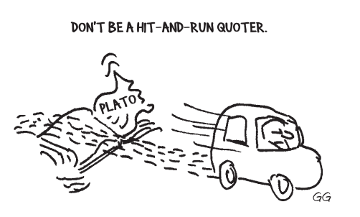

Slide 9
Example:
Susan Bordo writes about women and dieting. “Fiji is just one example. Until television was introduced in 1995, the islands had no reported cases of eating disorders. In 1998, three years after programs from the United States and Britain began broadcasting there, 62 percent of the girls surveyed reported dieting.”
I think Bordo is right. Another point Bordo makes is that. . . .

Slide 10
The writer fails to introduce the quotation adequately or explain why he finds it worth quoting
Neglecting to say who Bordo is or even that the quoted words are hers, the writer does not explain how her words connect with anything he is saying or even what she says that he thinks is so “right.”
He simply abandons the quotation in his haste to zoom on to another point.

Slide 11
The Sandwich!
To adequately frame a quotation, you need to insert it into a “quotation sandwich”
  the statement introducing it serving as the top slice of bread
  the explanation following it serving as the bottom slice.
  The introductory or lead-in claims should explain who is speaking and set up what the quotation says; the follow-up statements should explain why you consider the quotation to be important and what you take it to say.

Slide 12
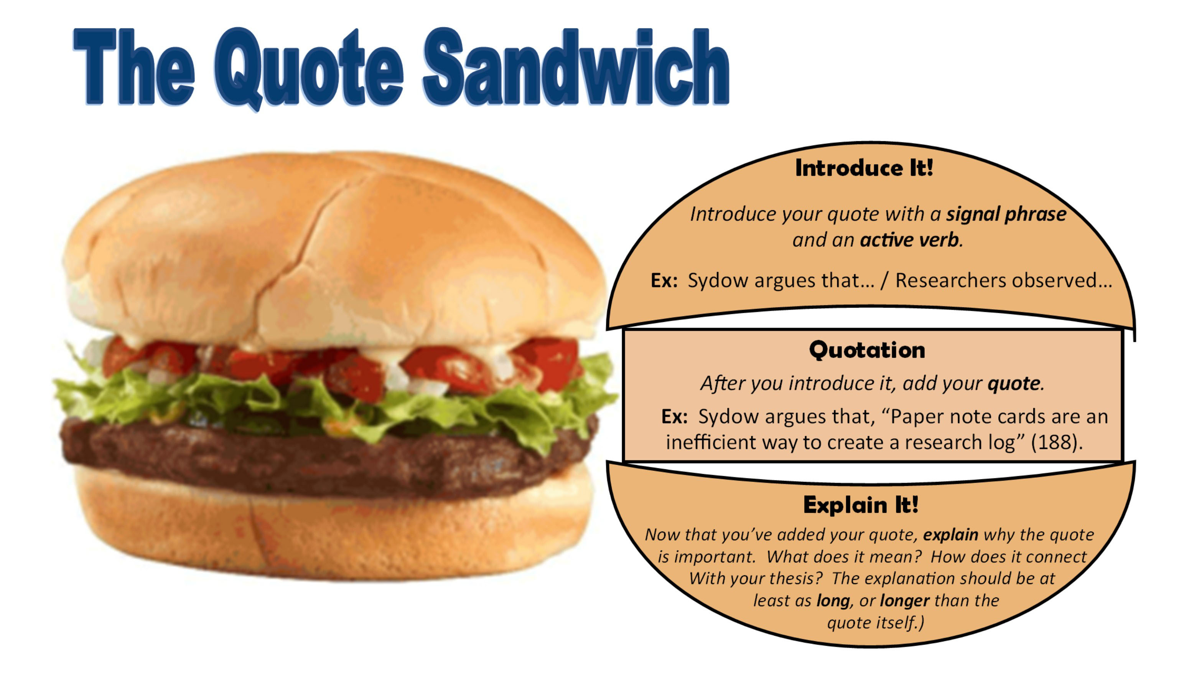

Slide 13
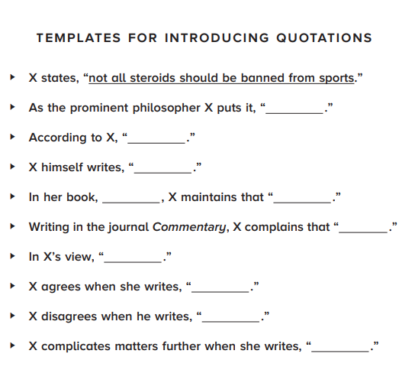

Slide 14

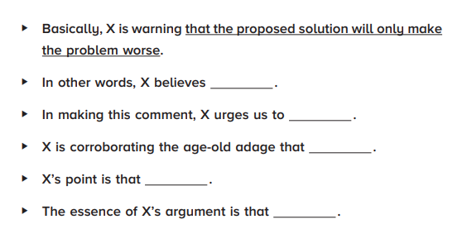

Slide 15
Correction to the previous example:
The feminist philosopher Susan Bordo deplores Western media’s obsession with female thinness and dieting. Her basic complaint is that increasing numbers of women across the globe are being led to see themselves as fat and in need of a diet. Citing the islands of Fiji as a case in point, Bordo notes that “until television was introduced in 1995, the islands had no reported cases of eating disorders. In 1998, three years after programs from the United States and Britain began broadcasting there, 62 percent of the girls surveyed reported dieting” (149–50). Bordo’s point is that the Western cult of dieting is spreading even to remote places across the globe. Ultimately, Bordo complains, the culture of dieting will find you, regardless of where you live.
Bordo’s observations ring true because. . . .

Slide 16
This framing of the quotation integrates Bordo’s words into the writer’s text and serves to demonstrate the writer’s interpretation of what Bordo is saying.
“the feminist philosopher” and “Bordo notes” provide information that readers need to know.
The sentences that follow the quotation build a bridge between Bordo’s words and those of the writer.
The reference to 62 percent of Fijian girls dieting is no longer an inert statistic but a quantitative example of how “the Western cult of dieting is spreading . . . across the globe.”
Thus, it is clear that the quotation is being used purposefully to set up the writer’s own argument and has not been stuck in just for padding the essay or the works-cited list.

