Slide 1
Lower Gastrointestinal Disorders

Slide 2
The lower GI
1. Involves the small intestine (duodenum, jejunum, and ileum) -The digestion and absorption of nutrients occur primarily in the small intestine.
2. Large intestine (colon, rectum, and anal canal)
The large intestine reabsorbs water and facilitates the elimination of waste material.
pancreas and gallbladder support digestion by delivering digestive secretions to the duodenum

Slide 3
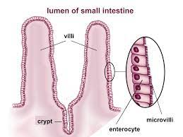
Tissue of the small intestine is circularly folded into what are referred to as the folds of Kerckring. Rising from the mucosal surface are finger-like projections called villi. On the surface of villi are fine hair-like projections called microvilli. This area is often referred to as the “brush border.”
Increase the surface area of the small intestine to such an extent that it is 600 times greater than it would be if the intestine were a straight, flat tube
The spaces between villi are called crypts. These crypts (location of stem cells) from which specialized epithelial cells (enterocytes) for the small intestine develop.
Rapid turnover
Malnutrition and disease reduce the ability of these cells to regenerate
Microbiota of intestinal tract and may contribute to changes in immune function and to the onset of disease
The small intestine is very adaptive
Stem cells provide new cells for the body as it grows, and replace specialised cells that are damaged or lost. They have two unique properties that enable them to do this: They can divide over and over again to produce new cells. As they divide, they can change into the other types of cell that make up the body
Notes:
The immune system plays a vital role in keeping the body healthy by providing a fine balance between the elimination of invading pathogens and the maintenance of tolerance to healthy self-tissue

Slide 4
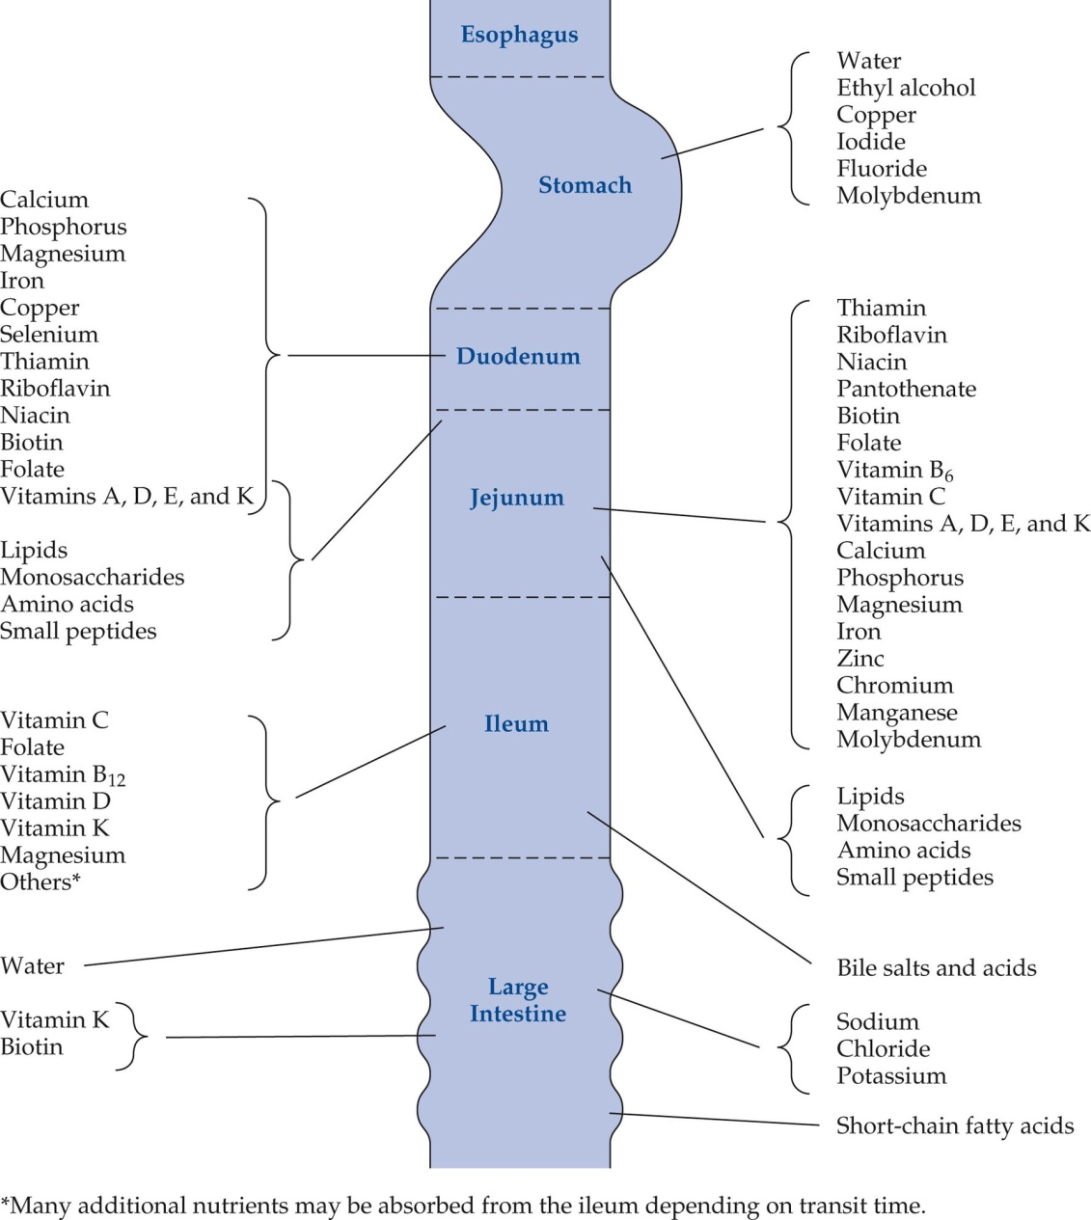
The ileum primary site for reabsorption of bile acids
bile acids are exclusively produced in the body, these substances need to be recirculated back to the liver in order to maintain an adequate body pool
What if we can’t reabsorb bile?
Bile acids are potent “digestive surfactants” that promote absorption of lipids (including fat-soluble vitamins), acting as emulsifiers (1,2). Bile acids represent the primary pathway for cholesterol catabolism and account for ∼50% of the daily turnover of cholesterol

Slide 5
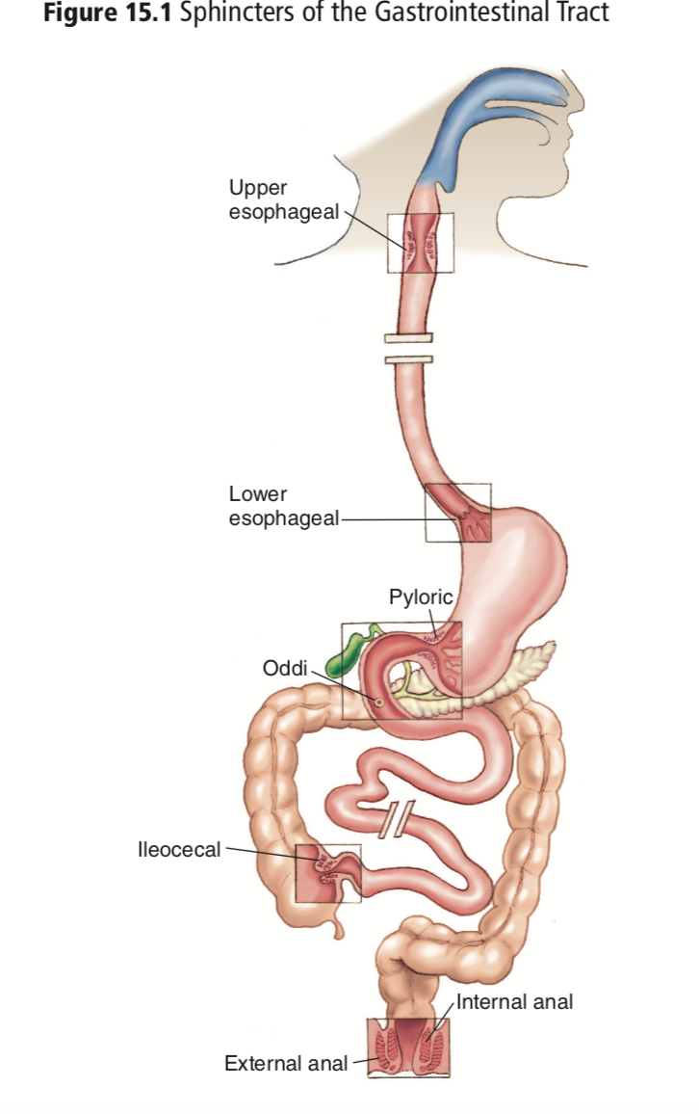
The ileocecal sphincter (valve) protects the small intestine from bacteria translocation from the large intestine by remaining closed except during the digestive process
Notes:
When stimulated by either increasing pressure, such as that exerted by fluid, or by chemical irritation, the ileocecal sphincter relaxes

Slide 6
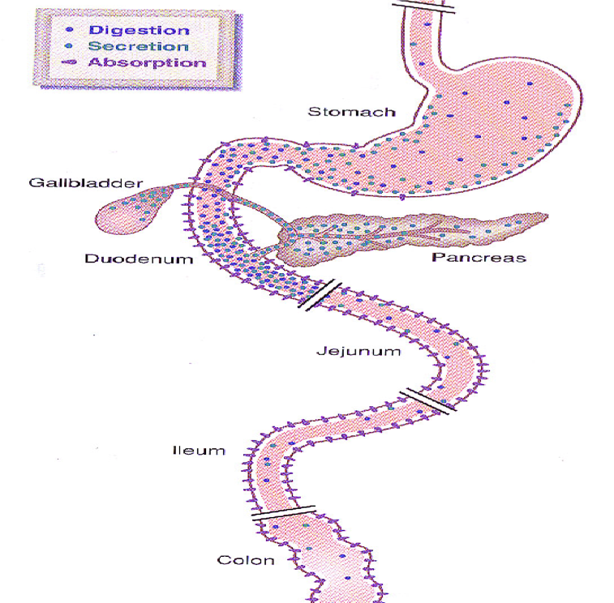
Motility of the small intestine is controlled by the enteric nervous system and influenced by a variety of hormones, peptides, and neurotransmitters.
identifying target receptors for control of motility may assist in the treatment of disease- Conditions that are effected by motility in Small intestine
The small intestine produces its own secretions and also receives secretions from ancillary organs of digestion, including the pancreas and gallbladder.

Slide 7
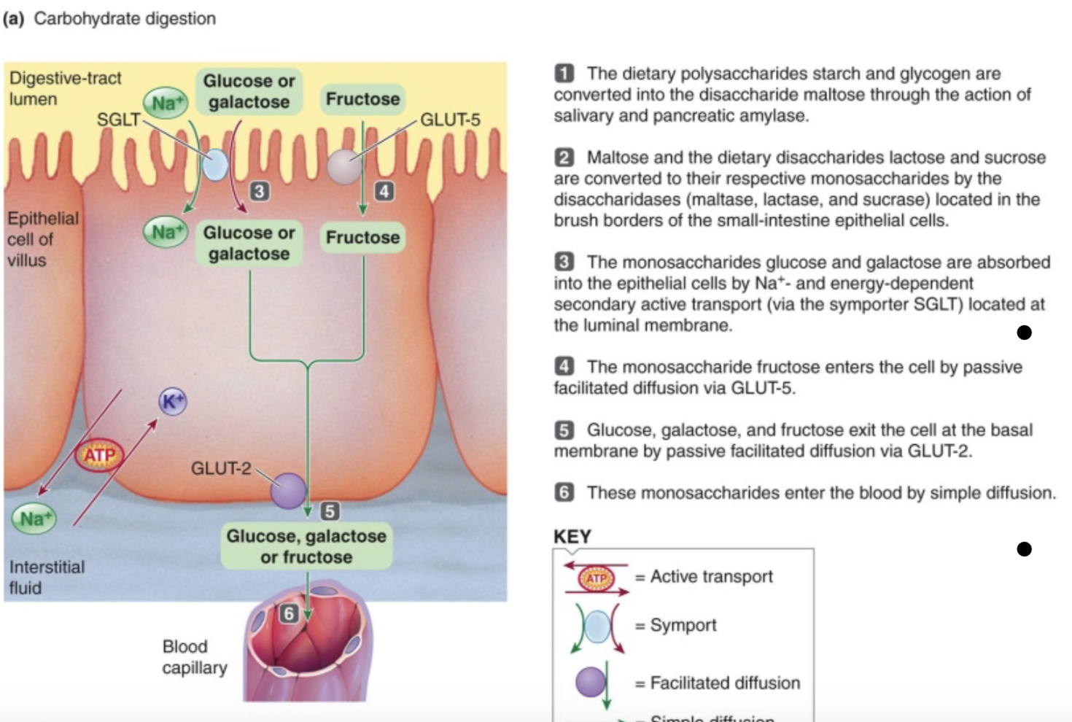
Dietary starches/polysaccharides are broken down by amylases to maltose (2 glucose molecules)
• Disaccharides broken down by their respective enzymes in brush border
• Lactose (glucose+galactose): lactase
Maltose: maltase
Sucrose (glucose + fructose): sucrase
Monosaccharides absorbed at apical membrane of epithelial cells by active transport

Slide 8
Dietary fat emulsified by bile salts into smaller fat droplets to facilitate lipase action
Lipase hydrolyzes the triglycerides into monoglycerides and free fatty acids
These water-insoluble products are carried to the luminal surface of the small-intestine epithelial cells within water-soluble micelles, which are formed by bile salts and other bile constituents.
When a micelle approaches the absorptive epithelial surface, the monoglycerides and fatty acids leave the micelle and passively diffuse through the lipid bilayer of the luminal membranes.

Slide 9
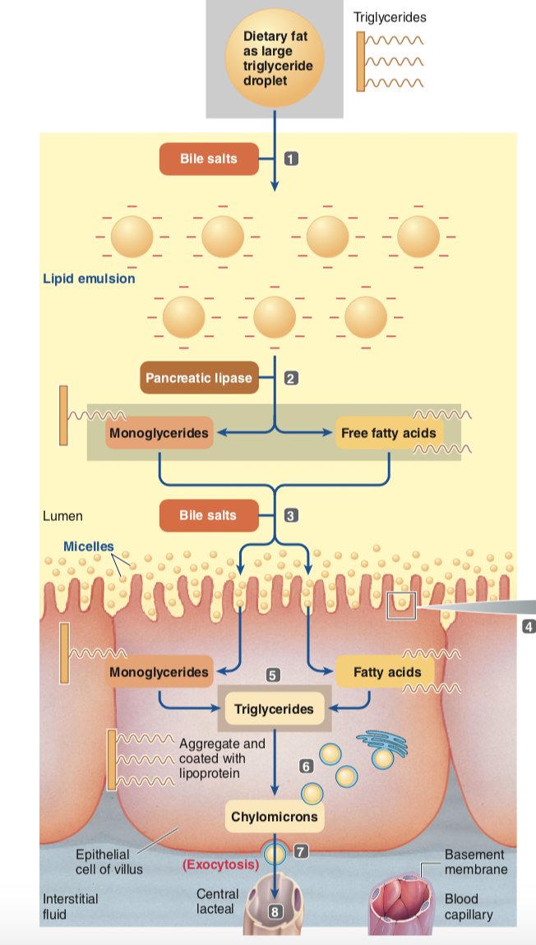

Slide 10
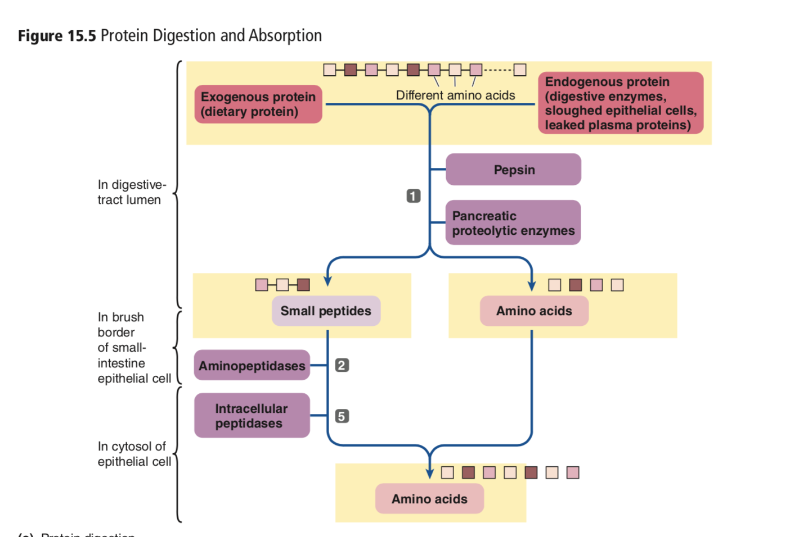
Dietary and endogenous proteins are hydrolyzed into their constituent amino acids and a few small peptide fragments by gastric pepsin and the pancreatic proteolytic enzymes.

Slide 11
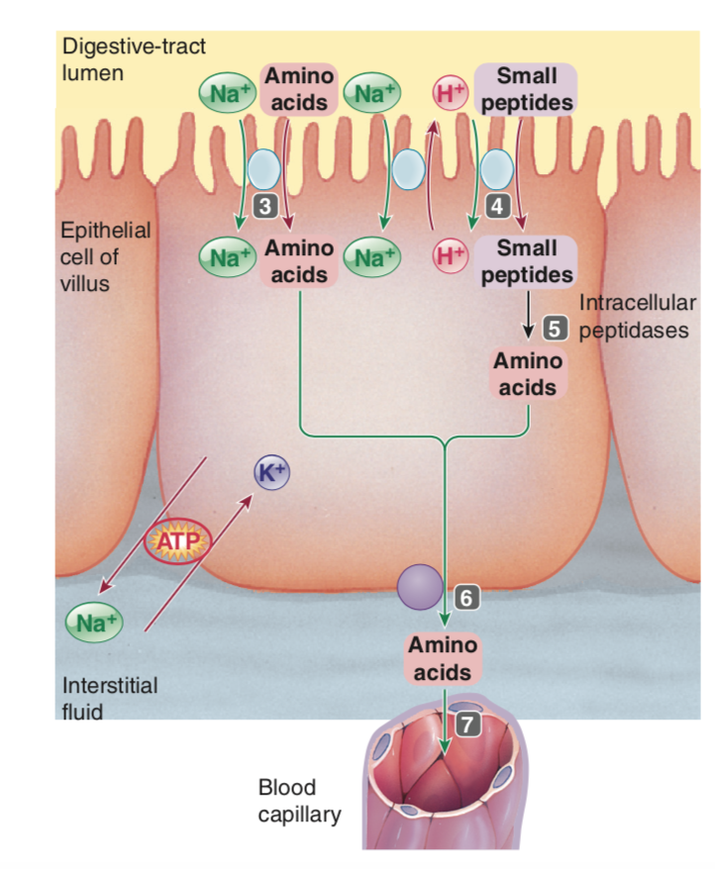
Amino acids are absorbed into the epithelial cells by means of Na+- and energy-dependent secondary active transport via a symporter. Various amino acids are transported by carriers specific for them.
Some small peptides are absorbed by a different type of symporter driven by H+, Na+

Slide 12
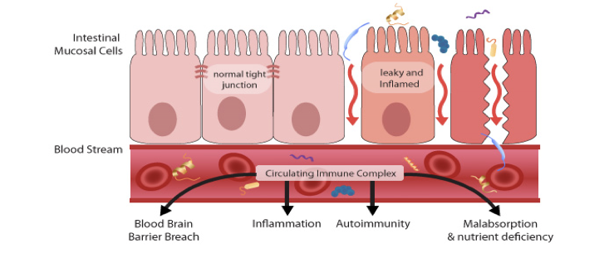

Slide 13
Malabsorption
Malabsorption is common:
– Primary cause can be impaired digestion(maldigestion)followed by malabsorption
– or primary cause can be an absorption problem alone
Symptom:
– Diarrhea (usually related to CHO, possibly Protein) – Steatorrhea (related to FAT)

Slide 14
Diarrhea
bowel movement is the last stop in the movement of food through your digestive tract
Increase in frequency of bowel movements and/or an increase in water content of stools
Acute diarrhea is short term (less than 2 weeks)
Persistent diarrhea lasts 2–4 weeks
Chronic diarrhea that lasts longer than 4 weeks
Concerns: Electrolyte imbalances, malabsorption, dehydration, and malnutrition.
Large-volume losses can quickly lead to dehydration and electrolyte and acid-base imbalances. Hyponatremia ( low sodium) and hypokalemia are both common with diarrhea.

Slide 15
Normal osmolality of the gastrointestinal tract is approximately 300 mOsm/L. When the number of osmotically active particles in the intestine increases, the body responds by pulling water into the lumen in an attempt to normalize osmolality. When this occurs, increased water efflux results in what we refer to as osmotic diarrhea.
The term osmolarity refers to the number of particles of solute per liter of solution

Slide 16
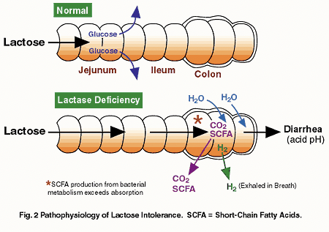
Osmotic diarrhea
unabsorbed nutrients or other substances attract water to the colon and increase fecal water content; common causes include high intakes of poorly absorbed sugars (such as sorbitol, mannitol, or fructose), lactase deficiency (which causes lactose malabsorption), and ingestion of laxatives that contain magnesium or phosphates
Rapid transit of intestinal contents through the small intestine
Treatment:
Modify diet to minimize osmotic load
Fasting
medications

Slide 17
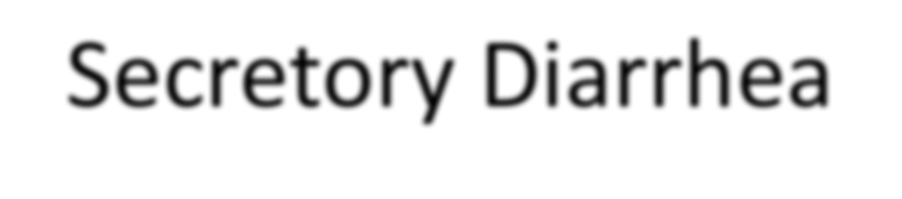
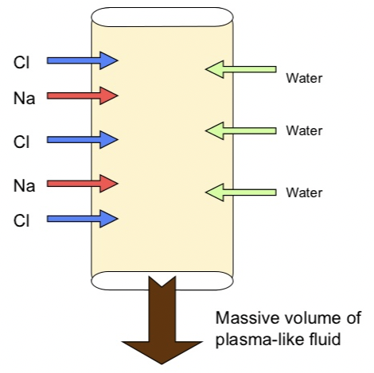
Secretory Diarrhea
Excessive fluid and electrolyte secretions into the intestine.
underlying disease is what causes excessive secretions, not the hyperosmolality. Thus, secretory diarrhea does not resolve when the patient is made NPO
Bacterial and virus infections
antibiotics and other medications. These medications generally cause diarrhea either by increasing GI motility or by altering the normal flora of the colon.
Chronic ethanol and other drugs and toxins
Mucosal damage & inflammation – Active secretion of electrolytes and water by the intestinal epithelium
  Ion channels in epithelial cells of SI are disturbed (Stay open)

Slide 18
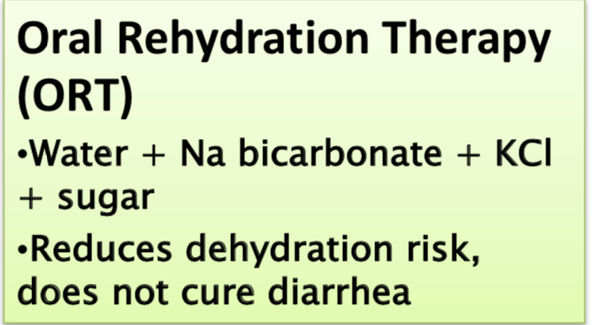
Correcting the underlying medical problem is the first step in treating diarrhea
If Medications? Antibiotics?- find alternatives
Modifying diet to remove unabsorbed agent
Antidiarrheal drugs may be prescribed to slow GI motility or reduce intestinal secretions.
Probiotics may be beneficial for treating certain types of diarrhea—especially infectious diarrhea ?
Oral Rehydration Therapy: Severe diarrhea requires the replacement of lost fluid and electrolytes.
  Oral rehydration solutions can be purchased or easily mixed using water, salts, and a source of glucose
Notes:
the presence of glucose in the solution enhances sodium and water absorption
research has suggested that probiotics and prebiotics may improve the mucosal defense in the GI tract and may also reduce the growth of harmful bacteria

Slide 19
Dietary Management
Goal: Restore normal fluid, electrolyte, and acid-base balance; decrease gastrointestinal motility; thicken the consistency of the stool; restore normal flora; and gradually introduce foods that allow the patient to return to a normal diet
  SCFA promote water and electrolyte absorption in the colon, which reduces the incidence of diarrhea. Other research has suggested that probiotics and prebiotics may improve the mucosal defense in the GI tract and may also reduce the growth of harmful bacteria.
Soft, regular and small, digestible meals
avoiding high-sugar beverages and foods high in simple carbohydrates/sugar alcohols
Avoid Gas-producing foods
Fat has no osmotic effect so no need to restrict fat unless fat malabsorption
Medium chain triglycerides (MCT) may help some cases of fat malabsorption

Slide 20
Lipid Malabsorption
(Steatorrhea)
Malabsorption→ Fat in the stool
Digestion and absorption of fat require adequate pancreatic lipase, adequate bile from the liver and gallbladder, and adequate secretion through the common bile duct and pancreatic duct
Liver & gall bladder disease → lack of bile
  Biliary tract obstruction by stones or tumors
  low bile salts --> micelles don't form --> fecal fat
  Ileal dysfunction → lowers bile salt concentrations
Bacterial overgrowth →Damage the intestinal mucosa
Pancreatic diseases → lack of lipases
Motility disorders that accelerate gastric emptying or intestinal transit can cause fat malabsorption because they prevent the normal mixing of dietary fat with lipase and bile
Fat-soluble vitamins are malabsorbed as well.

Slide 21
Diagnosis
Patient goes on a high fat diet
100 g fat/d for 3 days → Collect stool→ Excretion of 7 -8 percent or more of the fat intake generally indicates steatorrhea
Normal excretion = 3 - 5 g/d

Slide 22
Nutritional Management of Steatorrhea
Increase kcal to meet needs, especially protein and carbohydrate
Control fat level to amount tolerated
Vitamin and mineral supplements:
Use MCT oil to meet kcal needs
  8 to 10 carbons long
  Bile not needed for absorption
  Delivered to liver via portal venous blood NOT chylomicrons

Slide 23
Consequences of Fat Malabsorption
losses of food energy, essential fatty acids, fat-soluble vitamins, and some minerals
Weight loss
Minerals (calcium, magnesium, and zinc) deficiencies occur because the minerals form soap with the unabsorbed fatty acids and bile acids
Calcium deficiency→ risk of developing bone disease
Calcium deficiency → increased risk of developing kidney stones
kidney stones ( calcium oxalate)
The oxalates in foods bind to calcium in the small intestine →eliminated in the stool.
If calcium decreases, oxalates are free to be absorbed into the blood and are ultimately excreted in the urine.

Slide 24
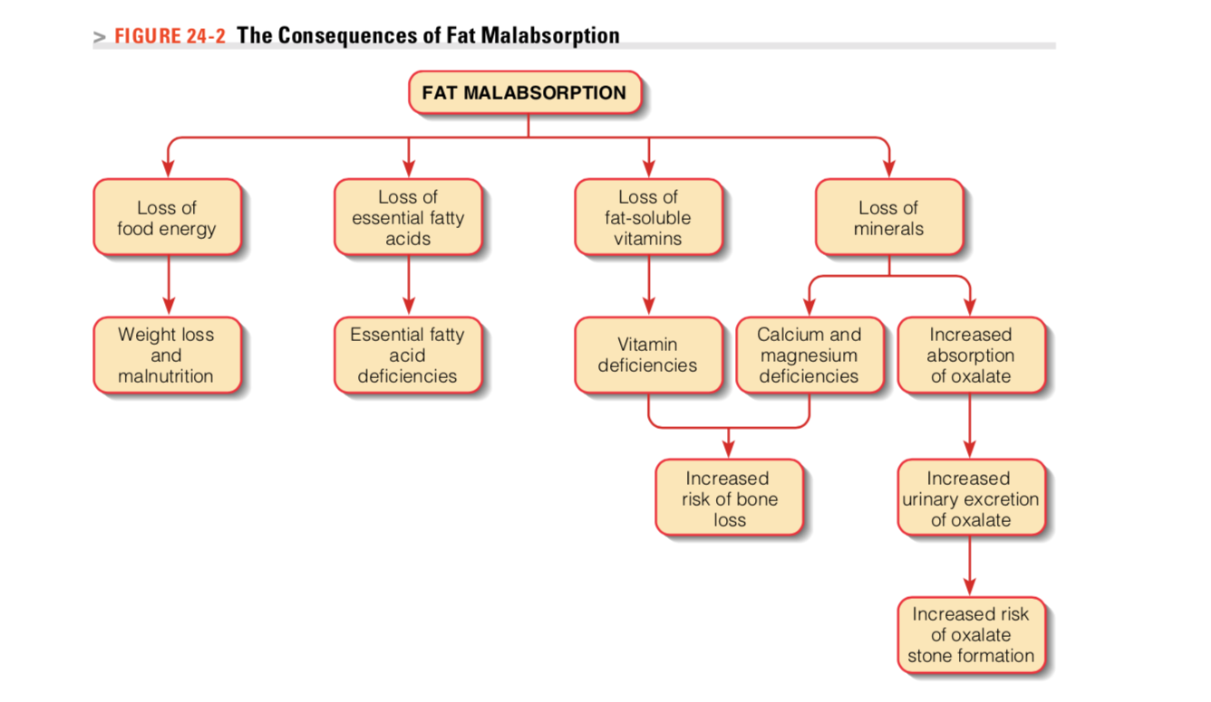

Slide 25
Carbohydrate Malabsorption
Pancreatic insufficiency
No pancreatic amylase →poor starch and fat absorption
Intestinal problem
  Insufficient mucosal enzymes (such as Lactase, etc.)
  Damaged cells
Lactose malabsorption
  Most common CHO intolerance
  Primary deficiency of enzyme lactase
  Secondary deficiency due to G.I. damage
  Symptoms: cramping, gas, diarrhea

Slide 26
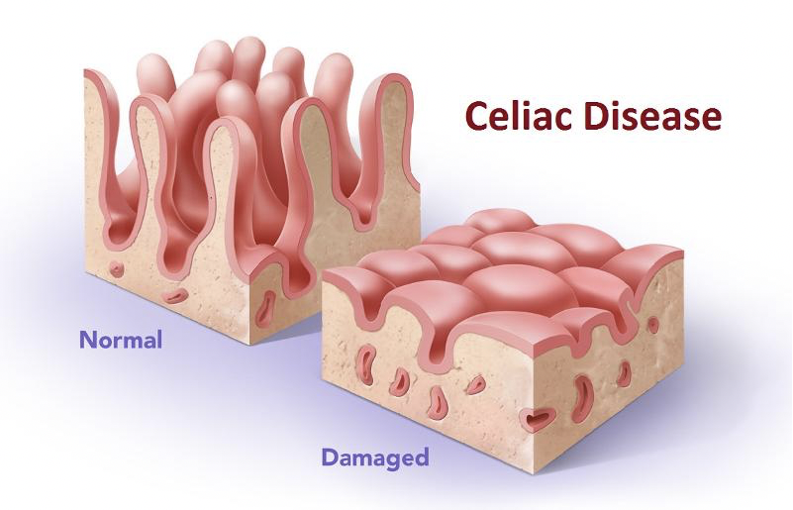
Celiac Disease
Autoimmune disease in genetically susceptible individuals caused by the immunological reaction to gluten.
Damage to the intestinal mucosa observed in CD when the small intestine is exposed to the protein Gliadin which is part of GLUTEN.
protein components of gluten.
In affected areas, the villi may be shortened or absent, resulting in a significant reduction in mucosal surface area (and, therefore, in the number of cells that digest and absorb nutrients)

Slide 27
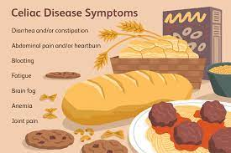
Gluten is found in wheat, rye, malt, and barley.
Exposure to the gliadin component of gluten results in a T-cell- mediated inflammatory response ( T –cell produce pro-inflammatory cytokines) that damage the intestinal mucosa and + infiltration of white blood cells into the mucosa.
The damage to the enterocytes results in a reduced absorptive surface area and loss of digestive enzymes (Villi lack the disaccharidases & peptidases needed for digestion )
As a result of nutrient malabsorption, children with celiac disease often exhibit poor growth, low body weight, muscle wasting, and anemia. Adults may develop anemia, bone disorders
Higher risk of developing DM1, inflammatory bowel diseases, and intestinal cancers.

Slide 28
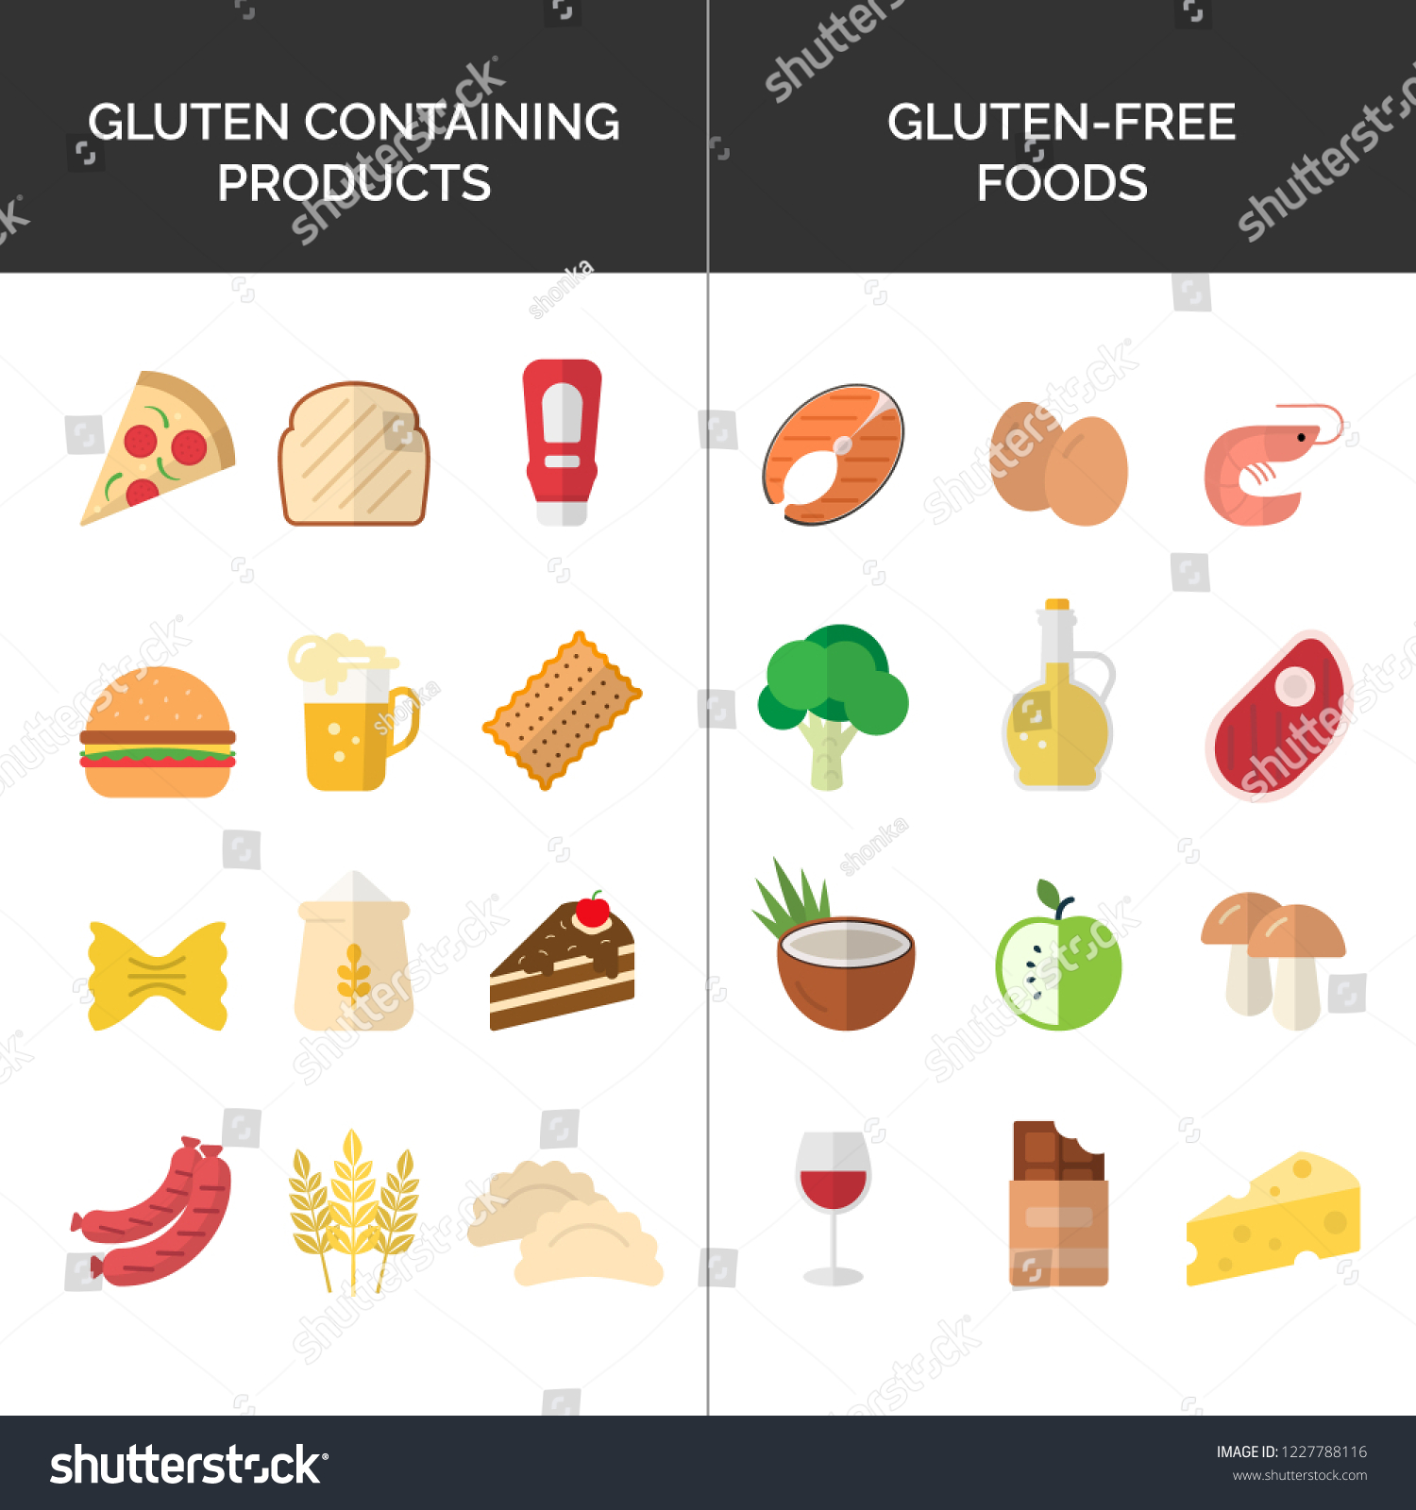
Dietary Treatment
Nutrition therapy and education will center on Gluten- Free Diets
Address secondary malabsorption (such as lactose) until the intestine has healed
As villi are regenerated and absorptive capability returns
Avoid all foods and other products that contain wheat, rye, barley, and malt ( Life-long)
Vitamin & mineral supplements (esp. Ca, Fe, fat soluble vitamins, folate)
Be cautious of hidden sources of gluten ( salad dressings, soy sauce etc.)

Slide 29
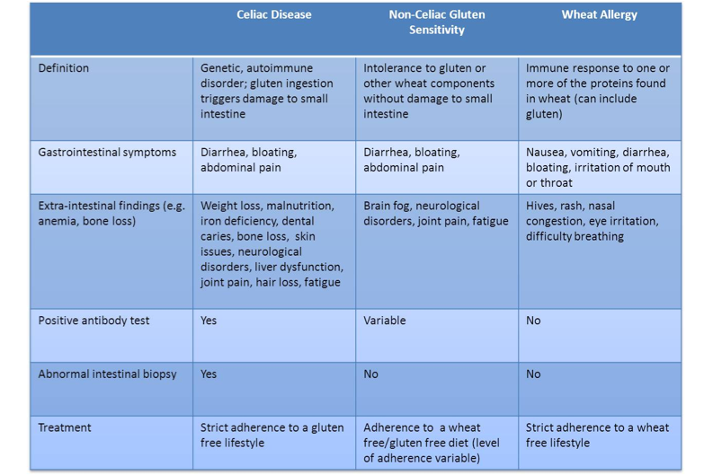

Slide 30
Irritable Bowel Syndrome
Abdominal pain or discomfort that occurs in association with altered bowel habits over a period of at least 3 months (diarrhea and/or constipation)
Three subtypes of IBS
IBS-D (diarrhea predominant)
IBS-C (constipation predominant)
IBS-M (mixed diarrhea and constipation)

Slide 31
The specific cause of IBS is unknown, but current research is focused on multiple factors
Contributing Factors:
  Stress
  Excessive use of medications or laxatives
  Antibiotics
  Food poisoning can trigger IBS-D
  Dysbiosis of gut microbiota can be causal in IBS-C
  Genetic predisposition

Slide 32
Abnormal motility is considered to be a major factor contributing to symptoms of abdominal pain and altered bowel habits.
Increased sensitivity of the enteric nervous system that causes abnormal motility and pain
  IBS-C (constipation) may be related to slowed intestinal transit likely due to the overgrowth of methanogenic bacteria (methane delays intestinal transit, possibly acting as a neuromuscular transmitter)
  IBS-D (diarrhea) and IBS-M (mixed C&S) may be auto-immune disease secondary to acute gastroenteritis
  Primary neurotransmitters involved in transmission of impulse -DEFECT
Individuals with IBS have an increased sensitivity to stimulation of the gastrointestinal tract. This means that, when exposed to the same stimuli, most individuals do not develop the symptoms that IBS patients experience
The methanogenic bacteria are anaerobic organisms that convert CO2 to methane via a sequence of reactions that utilizes several unusual cofactors.
Notes:
Altered GI mucosal permeability has been documented in IBS and Camilleri et al. suggest that many of the previ- ously discussed factors are actually triggers leading to this increased permeability. The increased permeability of the mucosa then leads to inflammation and altered perception of pain.

Slide 33
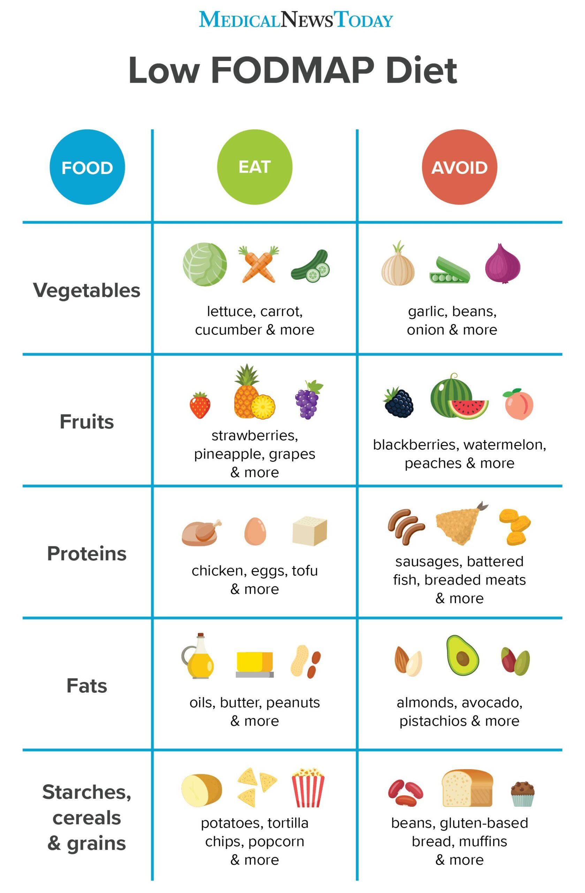
Nutrition Therapy for Irritable Bowel Syndrome
Identify food intolerances that worsen symptoms
Avoid problem foods
high-fiber diets are often recommended for individuals with irritable bowel syndrome/ or fiber supplements
Reduce stress
Medications to help with symptoms
FODMAP diets- diet low in certain sugars that may cause intestinal distress.
(fermentable oligosaccharides, disaccharides, monosaccharides and polyols, which are short-chain carbohydrates (sugars) that the small intestine absorbs poorly
Traditional exclusion diet
Notes:
use of a traditional exclusion diet. This approach eliminates all possible foods related to the patient’s symptoms. Then each food is added back within a specific time period. If the patient does not experience any symptoms when the food is added back to the diet, that food is considered to be tolerated and allowed to be included in the regular diet.

Slide 34
Constipation
Infrequent or difficult passage of feces
Can be precipitated by drugs, medications or medical conditions
Slowed colonic transit
rectal outlet obstruction
storage of fecal contents in the rectum for long periods of time

Slide 35
Constipation
Treatment:
High fiber (>25 g/d)
Whole grains, fruits, vegetables; psyllium (Metamucil)
Prunes
Adequate fluid
If needed:
Laxatives
  Bulk-forming = increase moisture content of stool to stimulate peristalsis (example: Metamucil)
  Stimulant: Irritate intestinal mucosa or directly stimulate submucosal and myenteric plexus - increase motor activity and peristalsis
  Saline or osmotic laxatives = high osmolality salts (Milk of Mg), KCL also prunes/sorbitol work the same way

Slide 36
Prebiotics
Non-digestible but fermentable substances in foods that stimulate the growth & activity of beneficial microbiota of the large intestine
Food for the beneficial microbes
Ex: Inulin; galactooligosaccharides, fructooligosaccharides, Resistant starch; Soluble fiber; oligosaccharides in breast milk

Slide 37
Inflammatory Bowel Diseases ( IBD)
An autoimmune, chronic inflammatory condition of the gastrointestinal tract. IBD is actually the general term for either of two diagnoses:
Ulcerative colitis (UC)
Crohn’s disease

Slide 38
Interaction of both environmental and clinical factors that cause an inappropriate immune response in genetically predisposed Individuals
Environmental factors: Smoking, infectious agents, intestinal flora, diet, and physiological changes in the small intestine from which an abnormal inflammatory response is triggered.
Strong genetic association for IBD as evidenced by positive family history in approximately 5%–15% of patients.
immune response results in release of cytokines that direct an excessive and abnormal inflammatory reaction that ultimately destroys the intestinal mucosa.

Slide 39
Nutritional Consequences:
Low food intake - pain, anorexia, nausea
Malabsorption
High enteric losses of many macro and micronutrients (protein, iron, zinc etc. )
High energy requirements if fever

Slide 40
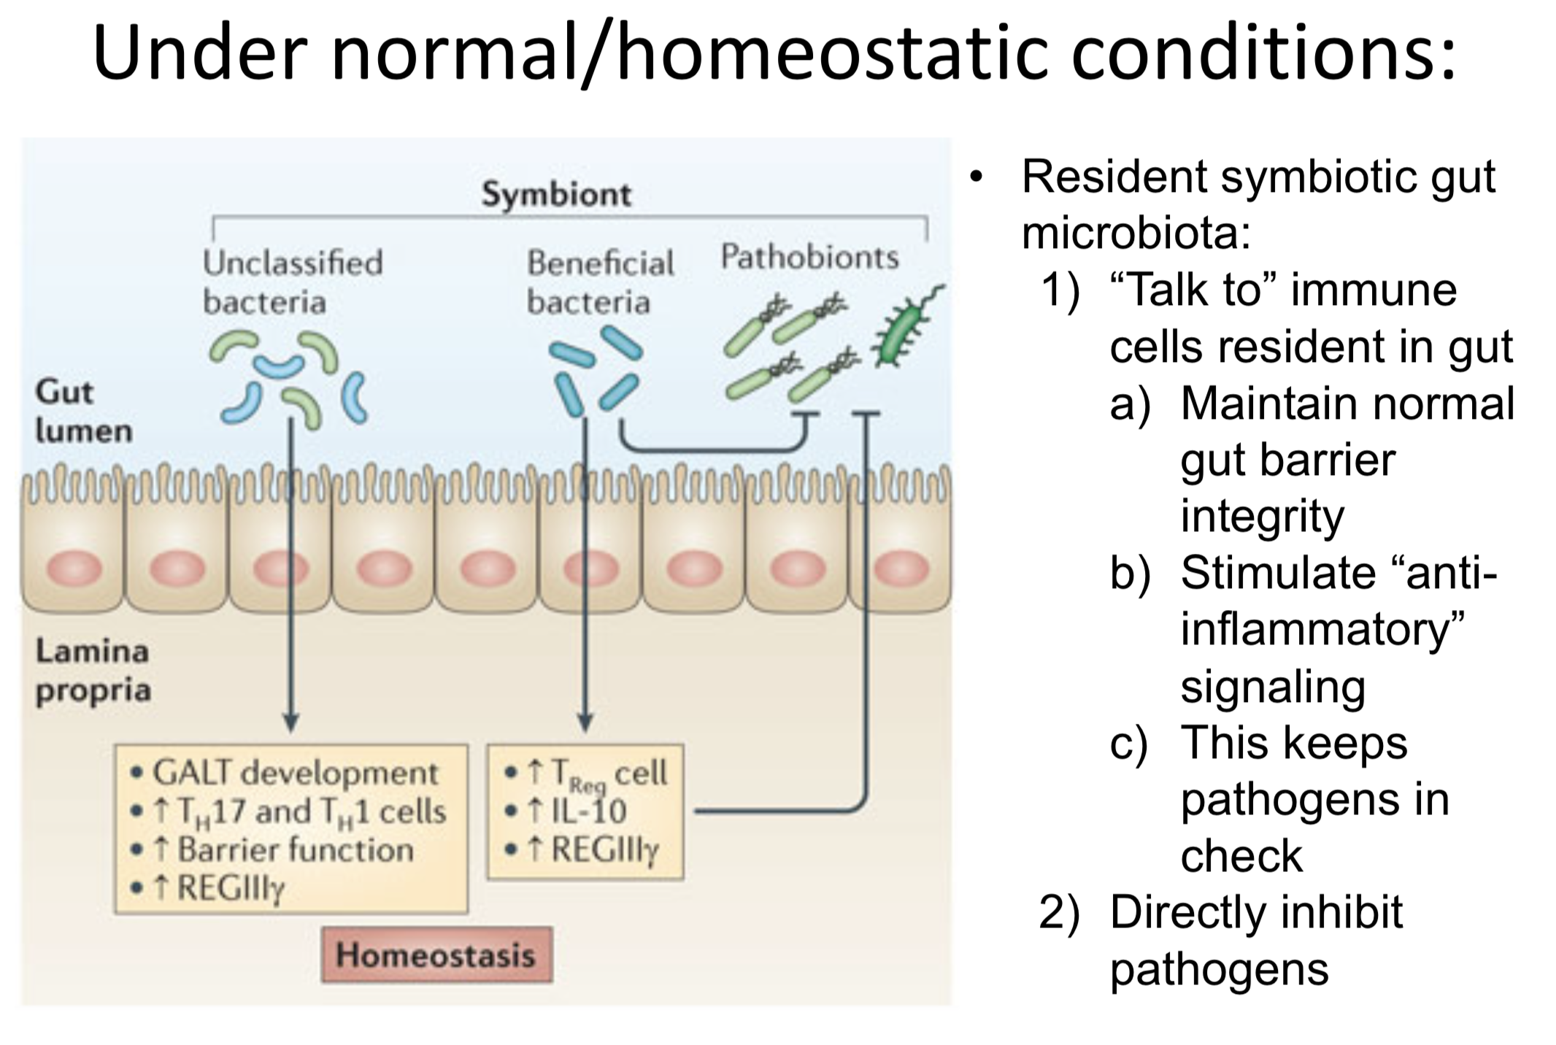

Slide 41
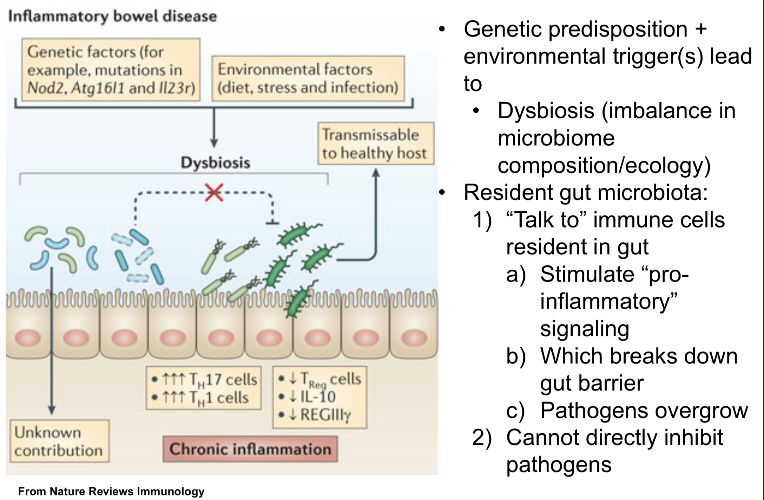

Slide 42
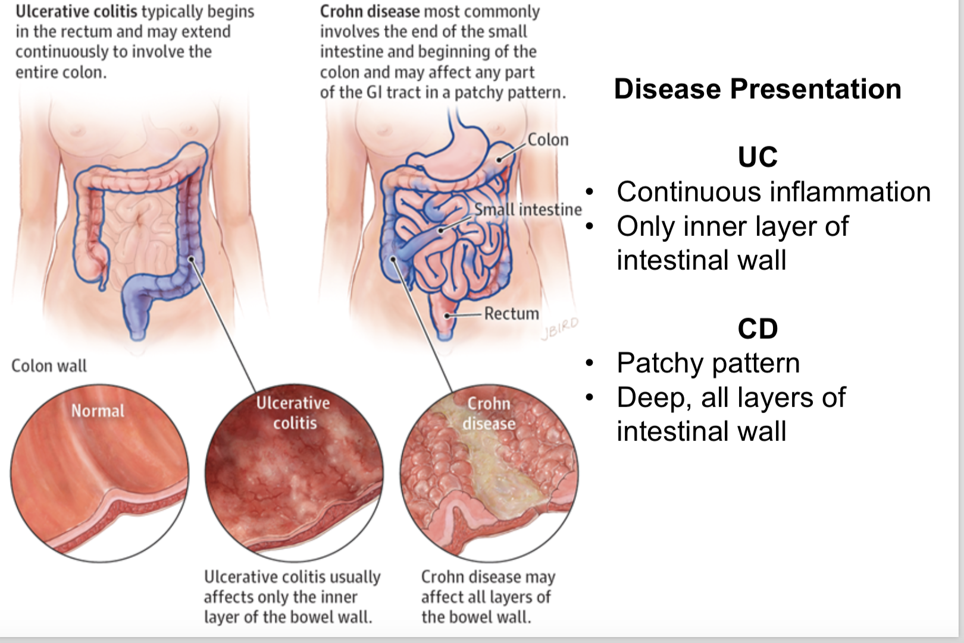

Slide 43
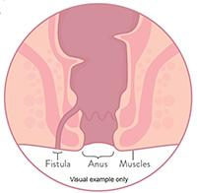
Crohn’s Disease
Lesions may develop in different areas in the intestine\
Affects small intestine in 75% of cases (lower ileum), but can involve any part of GI tract
Chronic inflammation of affected areas
Discontinuous (patches)
All layers of intestinal wall are affected
Wall can get thickened and scarred, obstructions
fistulas (abnormal passages between tissues)
50-70% need surgery (resections) – but get remissions
Increased risk for developing cancer
May lead to more nutrient malabsorption than UC because affects small intestine
Weight loss, muscle wasting, and malnutrition can be common in Crohn’s
Notes:
Ulcers that form on the inside wall of the intestine or nearby organs. Those ulcers can extend through the entire thickness of the bowel wall, creating a tunnel to drain the pus from the infected area.

Slide 44
Ulcerative Colitis
Involves the rectum and usually extends into the colon
Tissue inflammation is continuous along the length of intestine affected, ending abruptly at the area where healthy tissue be- gins.
Mucosa and submucosa only
Usually normal small intestine
Fistulas are rare
Sympt: Bloody diarrhea , rectal bleeding, constipation, anemia (related to blood loss) abdominal pain

Slide 45
Treatment
Anti-inflammatory medications, antibiotics, immuno- suppressive medications, immunomodulators, and biologic therapies as well as surgical intervention
Intervention
Maintain or improve nutritional status (kcal, protein, micronutrients)
Induce or maintain remission – reduce irritation by low fiber, low lactose, low fat, etc. Liberal diet during remission
Education for lifetime
Find ways to reduce overall life stresses
Identify trigger foods and avoid (

Slide 46
Nutrition Therapy for IBD
Food avoidance is common because of abdominal discomfort, diarrhea, and anorexia-→ requires more aggressive nutrition intervention to prevent protein-energy malnutrition, nutrient deficiencies, and growth failure in children.
High cal, high-protein diets
Vitamin and mineral supplements (iron, zinc, magnesium, calcium, vitamin D, folate, and vitamin B12)
During disease exacerbations
  Low-fiber, low-fat diet provided
  Small, frequent feedings can minimize stool output and reduce symptoms of malabsorption
If diarrhea or flatulence is present, a restricted intake of lactose, fructose, and sorbitol may improve symptoms
  Adequate fluids
Tube feedings are used if necessary

Slide 47
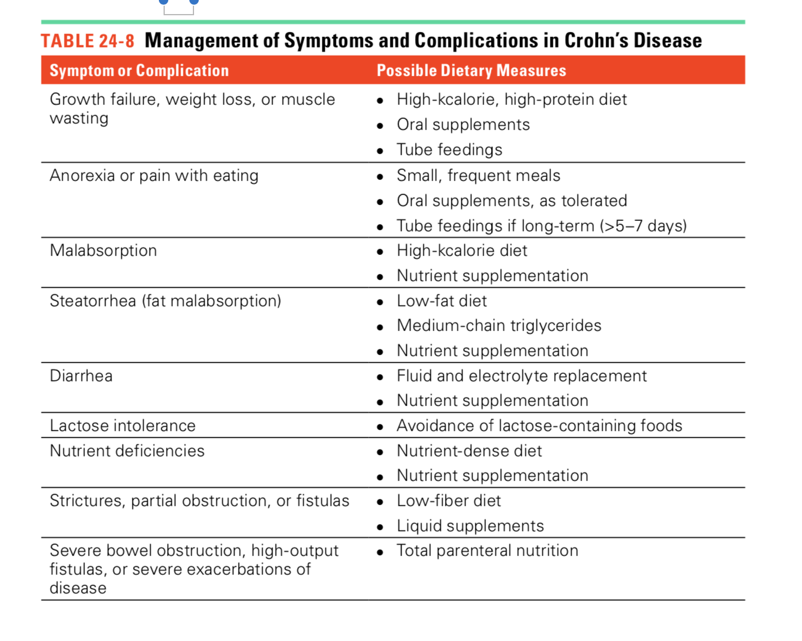

Slide 48

Intestinal Surgeries
The most common procedure in UC is a total colectomy (removal of the rectum )
Crohn’s disease, the ileostomy (removal of the colon and rectum)
When a certain part of the intestinal tract is removed, normal physiology and function of that portion is lost
changes in motility, in absorption, and in how waste products are handled—
Resections of the terminal ileum and loss of the ileocecal valve tend to result in significant fluid, electrolyte, vitamin, and mineral deficiencies + motility is much faster

Slide 49
Short Bowel Syndrome
Due to surgical intersection
SBS : The malabsorption syndrome that results when the absorptive capacity of the remaining intestine is insufficient for meeting nutritional needs.
Up to 50 percent of the small intestine can be resected without serious nutritional consequences

Slide 50
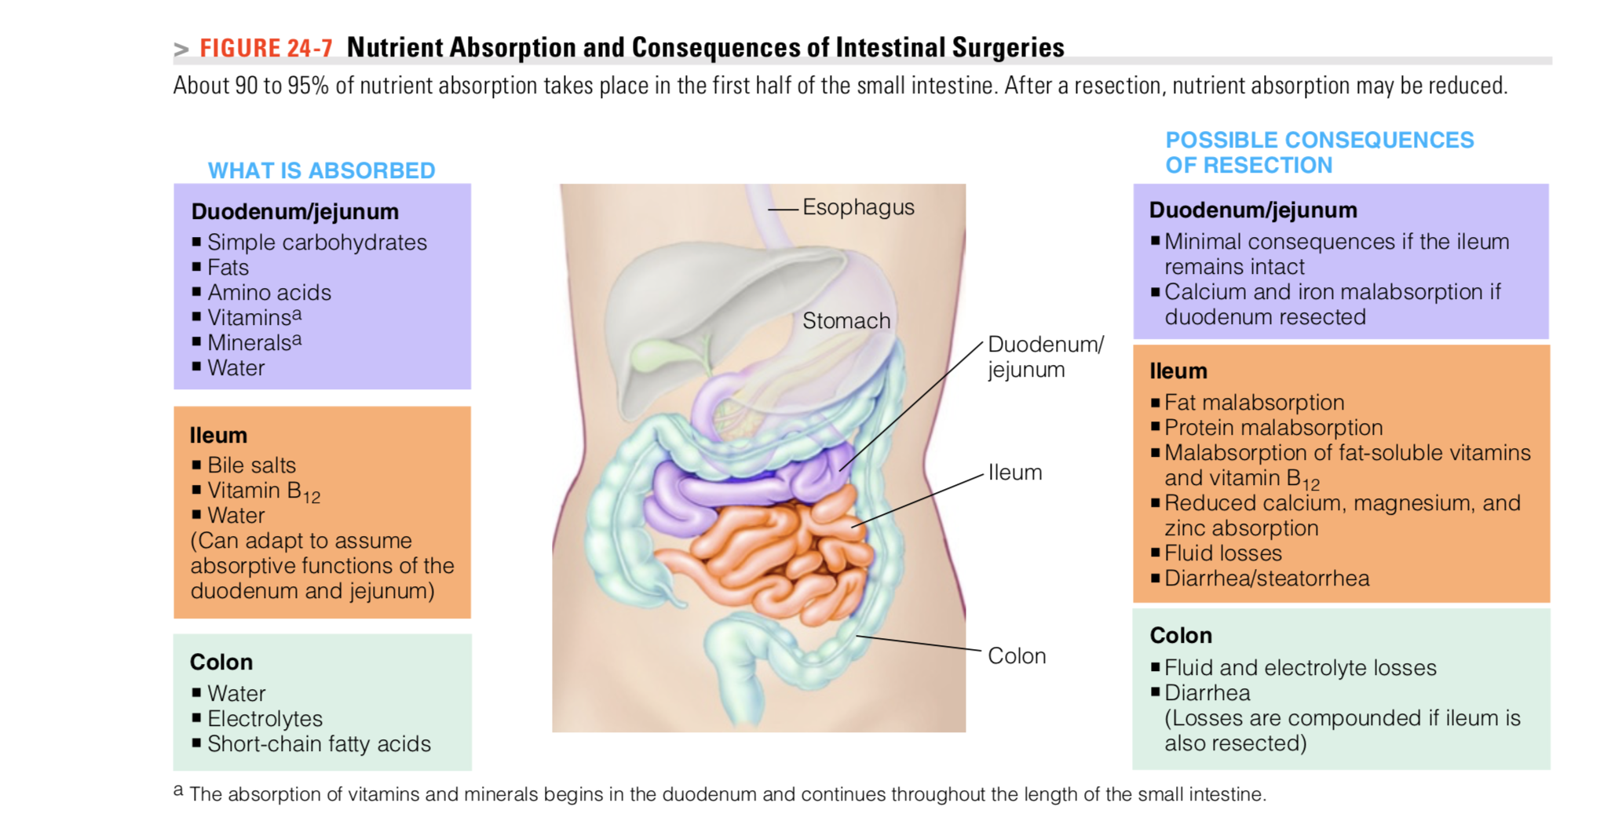

Slide 51
In Extensive Surgeries: Patients may need lifelong parenteral nutrition to supplement oral intakes
Intestinal Adaptation: Occurs after surgery- improves intestine’s absorptive capacity- tube and oral feedings when they begin ASAP post surgery can stimulate the growth of intestinal tissue.
Specific Consequences of ileal resection:
Malabsorption of bile salts, fat, Ca, Mg, B12 (if no distal ileum)
Renal oxalate stones develop in 75% cases
Gallstones, because less bile salts in bile
Rapid transport of intestinal contents, diarrhea o Reduced area for fluid absorption
Notes:
he remaining section of intestine develops taller villi and deeper crypts and also grows in length and diameter; these changes dramatically increase the absorptive surface area of the remaining intestine.

Slide 52
Nutrition Therapy for Short Bowel Syndrome
MNT Treatment: Diarrhea control is primary aim
Many patients require combinations of parenteral, enteral, and oral nutrition support in order to accommodate degrees of malabsorption and patient requirements for nutrition and fluids.
TPN after surgery and gradually move to tube feedings and/or oral feedings
Initial oral intake may consist of sips of clear, sugar-free liquids, progressing to larger amounts of liquid formulas and then to solid foods, as tolerated.
Very small, frequent feedings
high-fat, low-carbohydrate diet (high energy) vs. high-complex-carbohydrate, low-fat diet if intact colon, because the colon bacteria can metabolize the unabsorbed carbohydrate and produce short-chain fatty acids
Avoid large amounts lactose, concentrated sweets, fiber, caffeine
Multivitamins

Slide 53
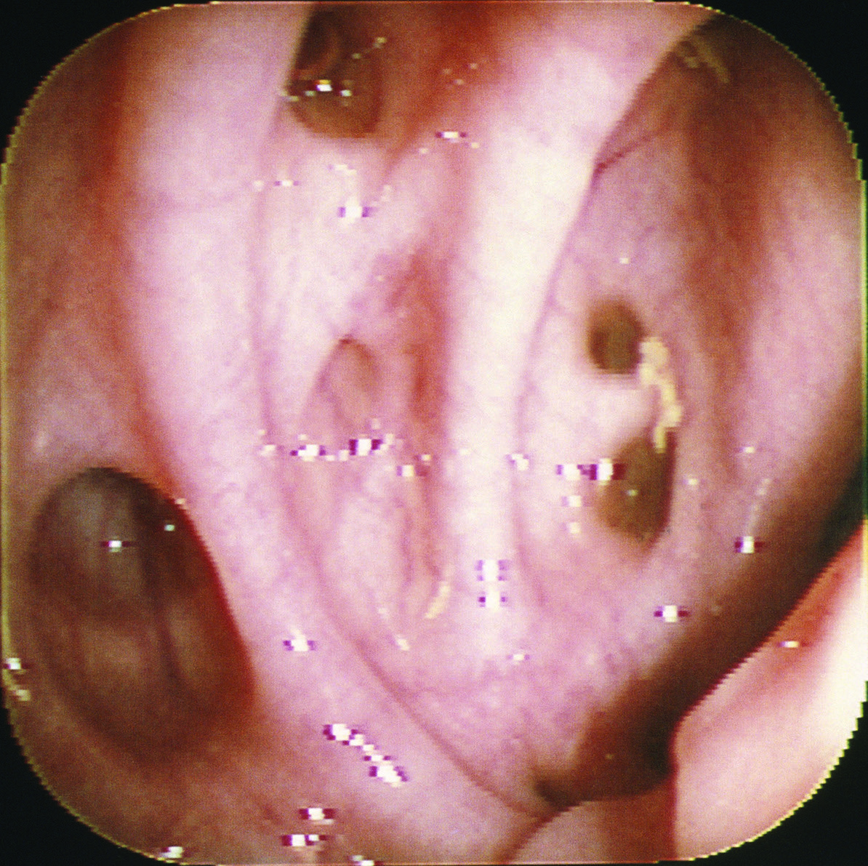
Diverticulosis
Diverticulosis is defined as the abnormal presence of outpockets, pouches, or sacs on the surface of the small intestine or colon.
occur in the small intestine but are most common in the colon
Fecal matter becomes trapped and exerts excessive pressure against the wall of the colon. This pressure causes development of small pouches on the wall of the colon, which are referred to as diverticula
Diverticulitis is acute inflammation of the diverticula. Foodstuffs and bacteria can collect in diverticula and the mucosa can become infected.

Slide 54
Treatment
High fiber diets→ for constipation
Antibiotics to treat infections
In severe cases, oral fluids and food are withheld and fluids are provided intravenously. After pain and diarrhea have resolved, an oral diet is reintroduced, beginning with clear liquids and progressing to a low-fiber diet
Once inflammation has subsided, fiber intakes should be increased by about 5 grams each week until recommended intakes (about 25 to 35 grams per day) are achieved.
If necessary--> surgery to remove the affected portion of the colon.

