Slide 1
Phonological and Articulation disorders
SPAU 131
Thair Odeh

Slide 2
Speech sound disorders is an umbrella term referring to any difficulty or combination of difficulties with perception, motor production, or phonological representation of speech sounds and speech segments—including phonotactic rules governing permissible speech sound sequences in a language
Speech sound disorders can be organic or functional in nature. Organic speech sound disorders result from an underlying motor/neurological, structural, or sensory/perceptual cause. Functional speech sound disorders are idiopathic—they have no known cause. See figure below

Slide 3
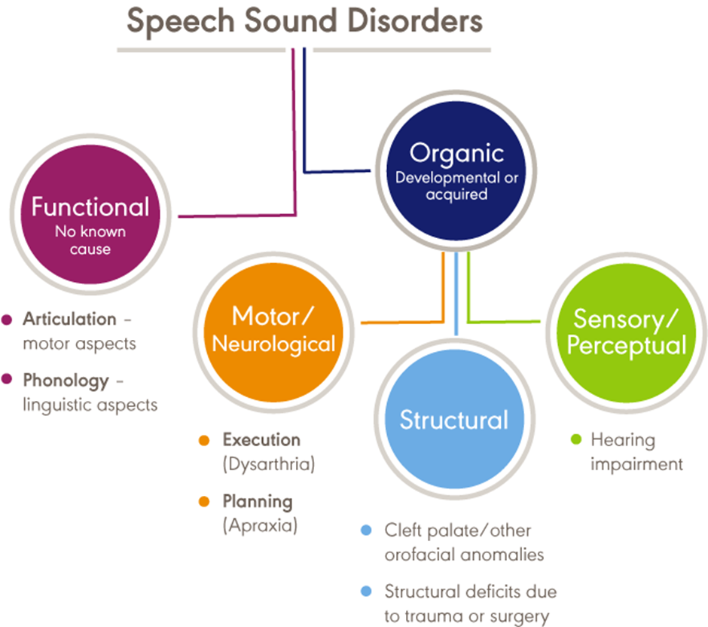

Slide 4
Incidence and Prevalence
Overall, 2.3% to 24.6% of school-aged children were estimated to have speech delay or speech sound disorders
A 2012 survey from the National Center for Health Statistics estimated that, among children with a communication disorder, 48.1% of 3- to 10-year old children and 24.4% of 11- to 17-year old children had speech sound problems only.
Residual or persistent speech errors were estimated to occur in 1% to 2% of older children and adults (Flipsen, 2015).
Reports estimated that speech sound disorders are more prevalent in boys than in girls, with a ratio ranging from 1.5:1.0 to 1.8:1.0 (Shriberg et al., 1999; Wren et al., 2016).
Reports estimated that 11% to 40% of children with speech sound disorders had concomitant language impairment (Eadie et al., 2015; Shriberg et al., 1999).
Poor speech sound production skills in kindergarten children have been associated with lower literacy outcomes (Overby, Trainin, Smit, Bernthal, & Nelson, 2012).

Slide 5
Signs and symptoms may occur as independent articulation errors or as phonological (rule-based error patterns )
Assimilation (Consonant Harmony)One sound becomes the same or similar to another sound in the word
Process | Description | Example | Likely Age of Elimination**
Velar Assimilation | non-velar sound changes to a velar sound due to the presence of a neighboring velar sound | kack for tack; guck for duck | 3
Nasal Assimilation | non-nasal sound changes to a nasal sound due to the presence of a neighboring nasal sound | money for funny; nunny for bunny | 3

Slide 6
SubstitutionOne sound is substituted for another sound in a systematic way
Process | Description | Example | Likely Age of Elimination**
Fronting | sound made in the back of the mouth (velar) is replaced with a sound made in the front of the mouth (e.g., alveolar) | tar for car; date for gate | 4
Stopping | fricative and/or affricate is replaced with a stop sound | pun for fun; tee for see doo for zoo; berry for very top for shop; top for chop; dump for jump; dat for that | /f, s/ — 3 /z, v/ — 4 sh, ch, j, th — 5
Gliding | liquid (/r/, /l/) is replaced with a glide (/w/, /j/) | wabbit for rabbit; weg for leg | 6–7
Deaffrication | affricate is replaced with a fricative | ship for chip; zhob for job | 4

Slide 7
Syllable StructureSound changes that affect the syllable structure of a word
Process | Description | Example | Likely Age of Elimination**
Cluster Reduction | consonant cluster is simplified into a single consonant | top for stop keen for clean | with /s/ — 5 without /s/ — 4
Weak Syllable Deletion | unstressed or weak syllable in a word is deleted | nana for banana; tato for potato | 4
Final Consonant Deletion | deletion of the final consonant of a word | bu for bus; no for nose; tree for treat | 3

Slide 8
Signs and symptoms of functional speech sound disorders include the following:
omissions/deletions—certain sounds are omitted or deleted (e.g., "cu" for "cup" and "poon" for "spoon")
substitutions—one or more sounds are substituted, which may result in loss of phonemic contrast (e.g., "thing" for "sing" and "wabbit" for "rabbit")
additions—one or more extra sounds are added or inserted into a word (e.g., "buhlack" for "black")
distortions—sounds are altered or changed (e.g., a lateral "s")

Slide 9
Influence of Accent
An accent is the unique way that speech is pronounced by a group of people speaking the same language and is a natural part of spoken language.
Accents may be regional; for example, someone from New York may sound different than someone from South Carolina.
Foreign accents occur when a set of phonetic traits of one language are carried over when a person learns a new language.
The first language acquired by a bilingual or multilingual individual can influence the pronunciation of speech sounds and the acquisition of phonotactic rules in subsequently acquired languages

Slide 10
Influence of Dialect
dialect (a rule-governed language system that reflects the regional and social background of its speakers).
Dialectal variations of a language may cross all linguistic parameters, including phonology, morphology, syntax, semantics, and pragmatics. An example of a dialectal variation in phonology occurs with speakers of African American English (AAE) when a "d" sound is used for a "th" sound (e.g., "dis" for "this").
This variation is not evidence of a speech sound disorder but, rather, one of the phonological features

Slide 11
Speech-language pathologists (SLPs) must distinguish between dialectal differences and communicative disorders and must
Speech-language pathologists (SLPs) must distinguish between dialectal differences and communicative disorders and must
recognize all dialects as being rule-governed linguistic systems;
understand the rules and linguistic features of dialects represented by their clientele; and
be familiar with nondiscriminatory testing and dynamic assessment procedures, such as identifying potential sources of test bias, administering and scoring standardized tests using alternative methods, and analyzing test results in light of existing information regarding dialect use (see, e.g., McLeod, Verdon, & The International Expert Panel on Multilingual Children's Speech, 2017).

Slide 12
Causes
Gender—the incidence of speech sound disorders is higher in males than in females (e.g., Everhart, 1960; Morley, 1952; Shriberg et al., 1999).
Pre- and perinatal problems—factors such as maternal stress or infections during pregnancy, complications during delivery, preterm delivery, and low birthweight were found to be associated with delay in speech sound acquisition and with speech sound disorders (e.g., Byers Brown, Bendersky, & Chapman, 1986; Fox, Dodd, & Howard, 2002).
Family history—children who have family members (parents or siblings) with speech and/or language difficulties were more likely to have a speech disorder (e.g., Campbell et al., 2003; Felsenfeld, McGue, & Broen, 1995; Fox et al., 2002; Shriberg & Kwiatkowski, 1994).
Persistent otitis media with effusion—persistent otitis media with effusion (often associated with hearing loss) has been associated with impaired speech development (Fox et al., 2002; Silva, Chalmers, & Stewart, 1986; Teele, K

Slide 13
Roles and responsibilities
• Providing prevention information to individuals and groups known to be at risk for speech sound disorders, as well as to individuals working with those at risk
• Educating other professionals on the needs of persons with speech sound disorders and the role of SLPs in diagnosing and managing speech sound disorders
• Screening individuals who present with speech sound difficulties and determining the need for further assessment and/or referral for other services
• Recognizing that students with speech sound disorders have heightened risks for later language and literacy problems

Slide 14
Roles and responsibilities
• Conducting a culturally and linguistically relevant comprehensive assessment of speech, language, and communication
• Taking into consideration the rules of a spoken accent or dialect, typical dual-language acquisition from birth, and sequential second-language acquisition to distinguish difference from disorder
• Diagnosing the presence or absence of a speech sound disorder
• Referring to and collaborating with other professionals to rule out other conditions, determine etiology, and facilitate access to comprehensive services
• Making decisions about the management of speech sound disorders
• Making decisions about eligibility for services, based on the presence of a speech sound disorder

Slide 15
Roles and responsibilities
• Developing treatment plans, providing intervention and support services, documenting progress, and determining appropriate service delivery approaches and dismissal criteria
• Counseling persons with speech sound disorders and their families/caregivers regarding communication-related issues and providing education aimed at preventing further complications related to speech sound disorders
• Serving as an integral member of an interdisciplinary team working with individuals with speech sound disorders and their families/caregivers

