Slide 1
Evaluation of swallowing disorders II
Juhayna Taha, MSc.
Fall 19/20

Slide 2
Management information to be collected from the laryngeal examination
Assess laryngeal function in swallowing disorders
if laryngeal function appeared to be broderline, the clinician should teach the pt. the supraglottic or super-supraglottic swallow to increases the pt’s. airway protection period to initiate any swallowing
https://www.youtube.com/watch?v=C2HIepSWG84

Slide 3
Pulmonary function testing
Determine whether the pt. can tolerate any amount of aspiration.
Patients who are observed to aspirate on a radiographic study have been found at high risk for developing pneumonia in the next 6 months than pts. who exhibit no aspiration
https://www.youtube.com/watch?v=cKdxSVe6pyM

Slide 4
Information collected from the preparatory examination
Based on the preparatory examination, the clinician should determine:
The posture that may result in best swallowing
The best position of the food in the mouth
The best food consistency
Some indication about the nature of the problem

Slide 5
Should Trial swallows at the bed side evaluation be attempted?
We need to consider the risk-benefit ratio
If the patient is orally-fed, the clinician can observe the following:
The patient’s reaction to food
Oral movements in chewing
Any coughing, throat clearing or changes in breathing
changes in secretion levels
Coordination of breathing and swallowing

Slide 6
Decisions on the best posture
Making changes to posture, can assess in the management of swallowing disorders.
What changes can we make when noting the following symptoms:
poor tongue control ( premature loss) ?
Delay in the triggering of pharyngeal swallow?
Unilaterla pharagyneal paralysis ?

Slide 7
Selection of optimal food position in the mouth
This is based on the results from oral sensitivity examination
The food should be placed in the side of best function/ sensitivity

Slide 8
Selection of best food consistency
How do we determine the best consistency?
Which food consistency works with the following:
    Delayed pharyngeal swallow?
    Reduced tongue base / pharyngeal all contraction?
    Reduced closure of laryngeal opening ?

Slide 9
Utensils to be used in initial swallowing evaluation
Size 0 or 00 laryngeal mirror
A tongue blade
A cup
A spoon
A straw

Slide 10
The swallowing Examination

Slide 11
Management of Tracheostomy patient
Its best to deflate the Trachestomy cuff before attempting any swallow, why?
https://www.youtube.com/watch?v=AZSmiBPZnCY
Suctioning orally and via the tracheostomy
https://www.youtube.com/watch?v=J18h_wqH5XI
During swallow, ask patient to occlude tracheostomy opening
Give patient chance to practice instructions through dry swallows

Slide 12
Observation during trail swallows
It is useful for the clinician to places his fingers under the patient’s chin, with fingers spread to cover the laryngeal area. Why?
This can help in estimating the oral transit time and pharyngeal delay time
Assessment of aspiration:
    Ask patient to phonate /a/
    Ask the patient to pant, then phonate/a/ again, why?
    ask patient to rotate head to either side and vocalize
    Ask patient to chin up, then vocalize again
https://www.youtube.com/watch?v=x_sssJErd6U
https://www.youtube.com/watch?v=NVAGon9R1i0

Slide 13
Videoflurouscopic procedure

Slide 14
Purpose of the Videoflurouscopy examination
Define abnormalities in anatomy and physiology causing the patients symptoms
Identify and evaluate treatment strategies that may immediately aid the patient in swallowing in a more efficient manner

Slide 15
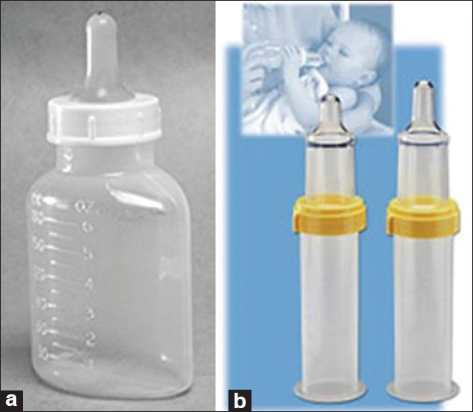
Placement of the food in the mouth
A disposable spoon should be used. Unless the patient has a bite reflex, what do we use then?
For infants, food presented through a bottle with a nipple:

Slide 16
Types and amounts of materials used
All food consistencies are examined ( think liquid, barium paste and solid food)
At least two swallows should be examined for the following
    1ml, 3ml, 5ml, 10ml and cup drinking of thin liquid
    1/3 teaspoon of pudding
    ¼ bite of a cookie
  We should allow the patient to feed himself, why?

Slide 17
Types and amounts of materials used
Vollumes of liquids are increased until or unless the patient aspirates. Why owe vary volumes of liquids but not pudding or solid food?
Once the cause of aspiration is determined, intervention strategies should be tried, there include:
    postural changes
    Changing sensory input
    Swallowing manuvers

Slide 18
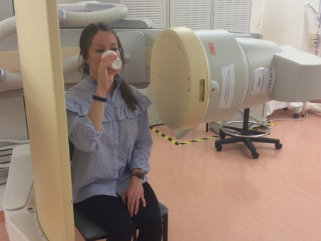
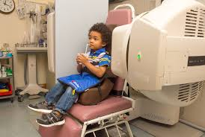
Positioning of the patient

Slide 19
Focus of the Flurouscopic image
https://www.youtube.com/watch?v=grIPYEwbCy4

Slide 20
Measures to be made: lateral view
Oral transit time
Pharyngeal transit time
Pharyngeal delay
Location of bolus movement
Patterns of lingual movement
Amount and location of residue
The anatomic or physiologic reason for aspiration

Slide 21
Measures to be made: anterior-Posterior view
Symmetry of function
Only examine materials that caused aspiration during lateral view testing

Slide 22
Instructions to the patient
Basically explain what is the patient required to do

Slide 23
Procedures to be followed with various materials to be swallowed
Should start with liquids. And present different volumes.
Ask the patient to keep the liquid in their mouth until asked to swallow.
Once the volume of liquid that causes aspiration is identified, we try intervention strategies on this volume.
Second thicker material should be used, if aspiration happens, we try intervention strategies.
Third, solid food is tried. For the last two materials, we ask the patient to chew and swallow when ready. What do we do if the patient cannot follow directions?

Slide 24
Trial therapy
Do you remember what are the things we can do ?

Slide 25
Guidelines for referral to VF
Any patient who is suspected to aspirate
When swallowing disorder is suspected to have pharyngeal involvement
We need to determine the cause of aspiration

Slide 26
Who should do the VF study ?

Slide 27
Order of intervention introduced
First : postural techniques
Second: sensory stimulation
Third: swallow maneuvers
Fourth: diet changes

Slide 28
Postural techinuqes
Specific postures are used to compensate for particular types of dysphagia by changing the way that the food moves through the pharynx.
It is a good idea to have the patient try using these postures during the VFFS/MBS; this way you can get an idea of how well or what will really work or not work for that patient.

Slide 29
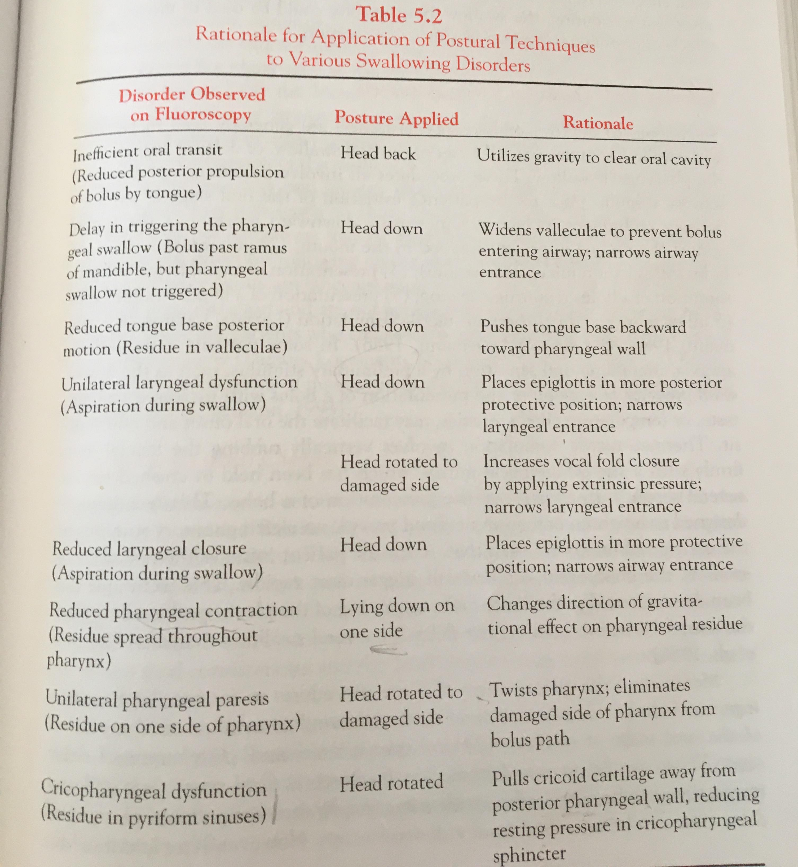

Slide 30
Improving oral sensory awareness
When do we use these?
Usually we introduce a sensory stimuli before the initiation of the oral stage of swallow
      increasing downward pressure of spoon on the tongue when presenting he food
      Presentation fo souer bolus ( 50% lemon juice, 50% barium)
      Presenting a cold bolus
      Presenting a bolus that requires chewing
      Larger volumes
      Thermal-tactile stimulation
    How we measure the effectiveness?

Slide 31
Swallow manuvers
Super-glottic swallow ( closes airway at the level of VF)
Super supra-glottis swallow (close of airway before and during swallow)
Effortful swallow (increases tongue base posterior movement)
Mendelson maneuver (increases the extend and duration of laryngeal elevation)

Slide 32
Diet changes
This should be the last option, if none of the above procedures work.

Slide 33
