Slide 1
Capacitive Sensors

Slide 2

Capacitive Sensors

Slide 3

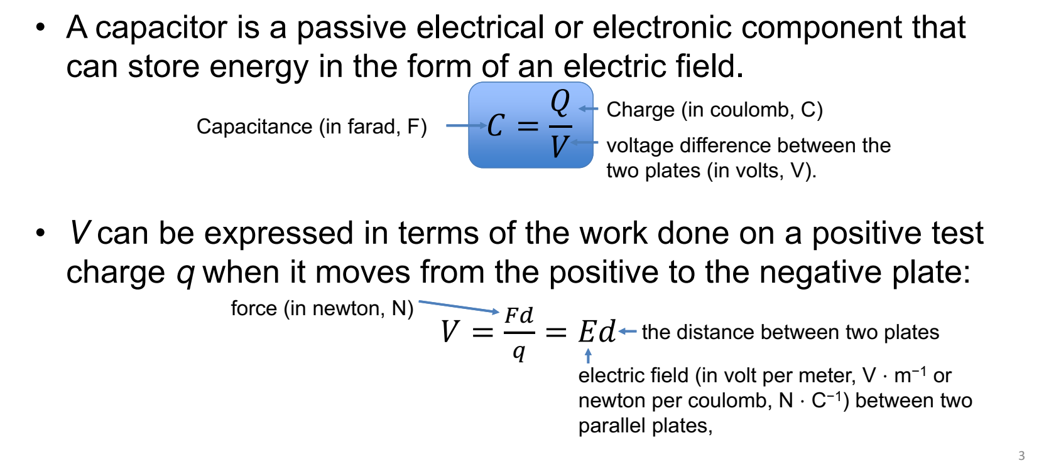

Slide 4

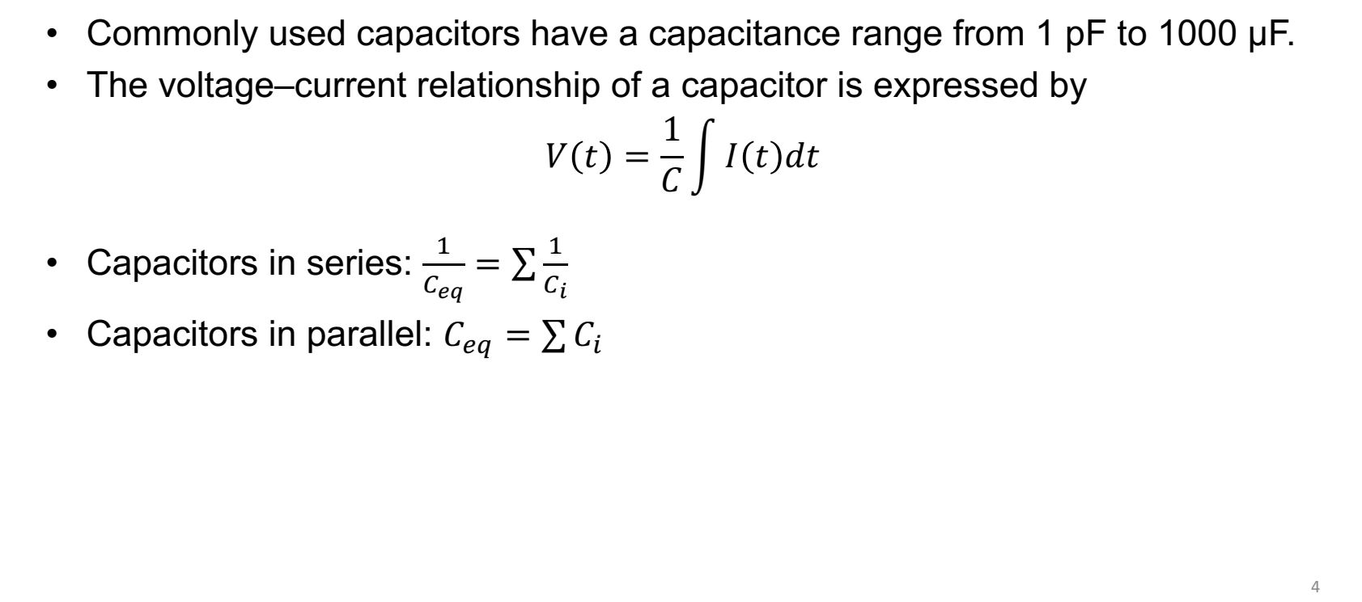

Slide 5

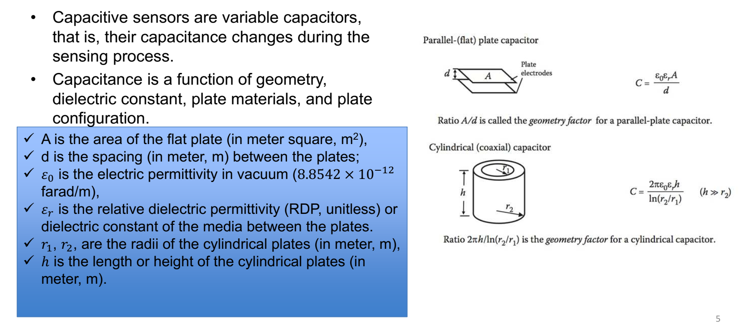

Slide 6

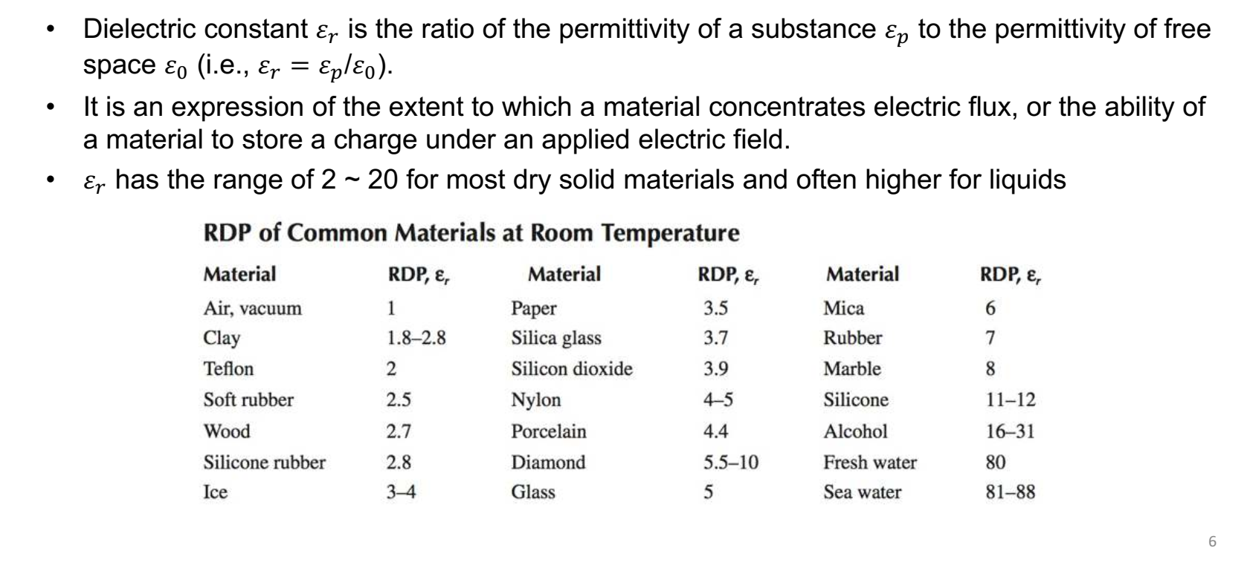

Slide 7


Slide 8

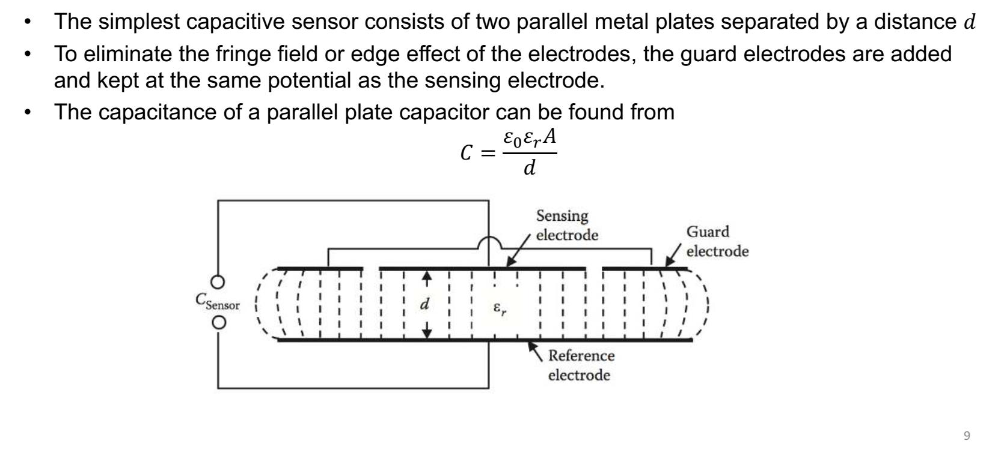

Slide 9

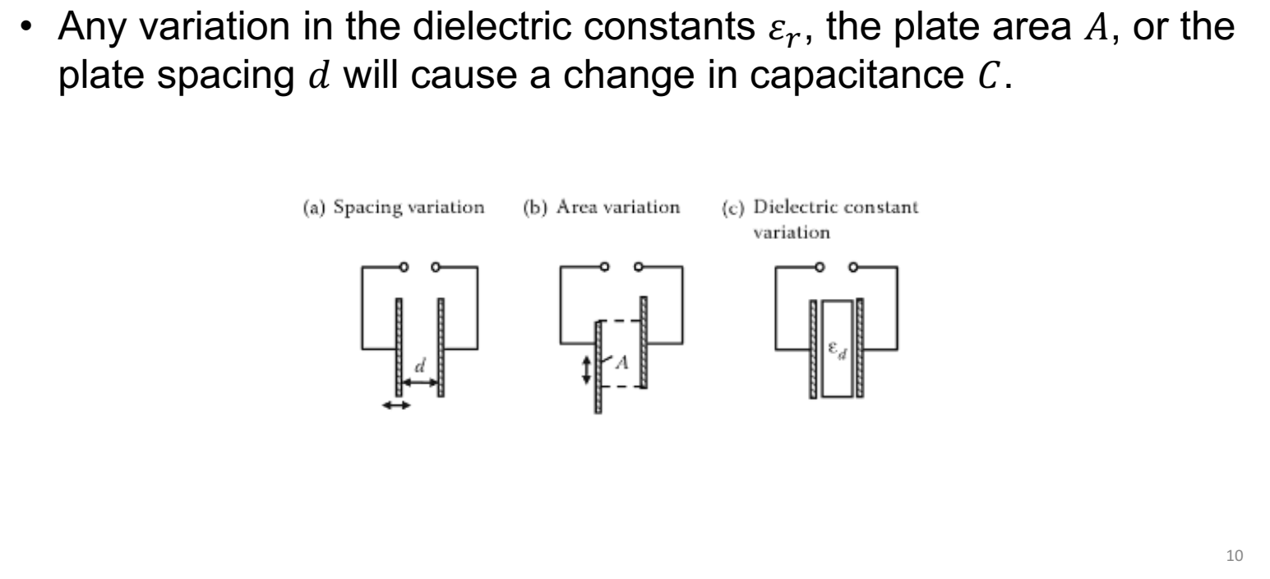

Slide 10
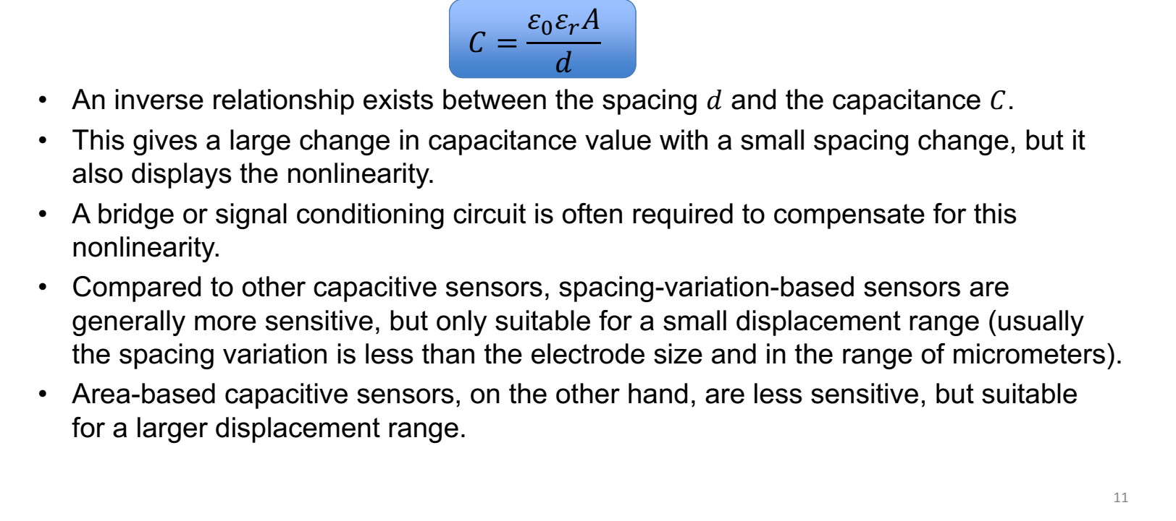

Slide 11

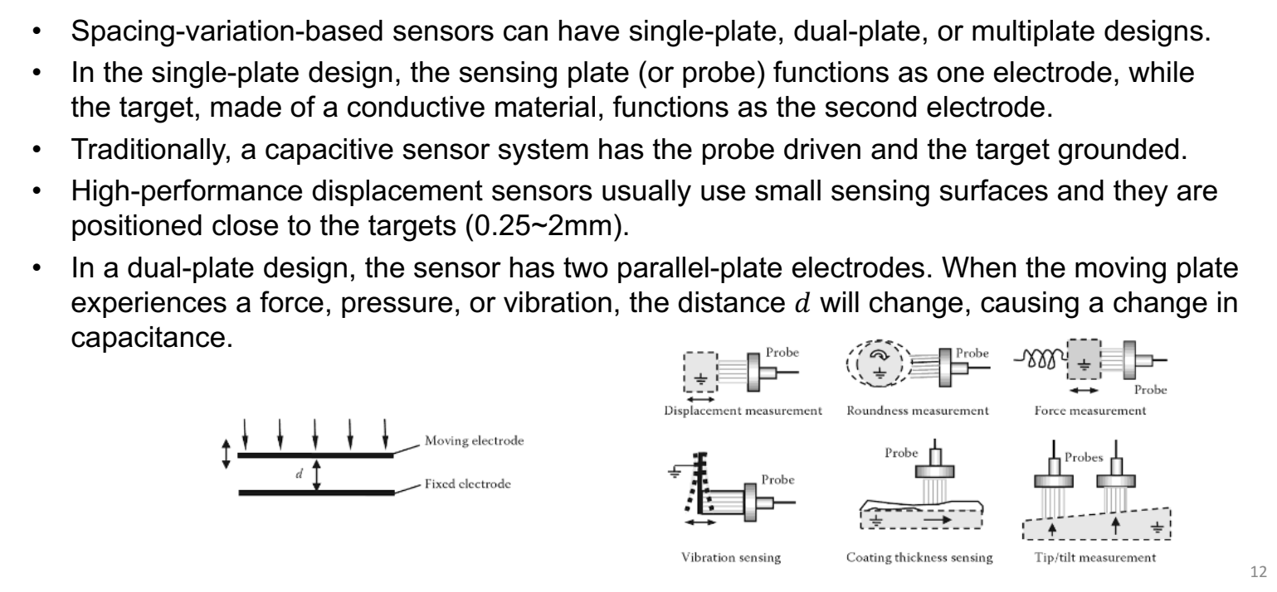

Slide 12

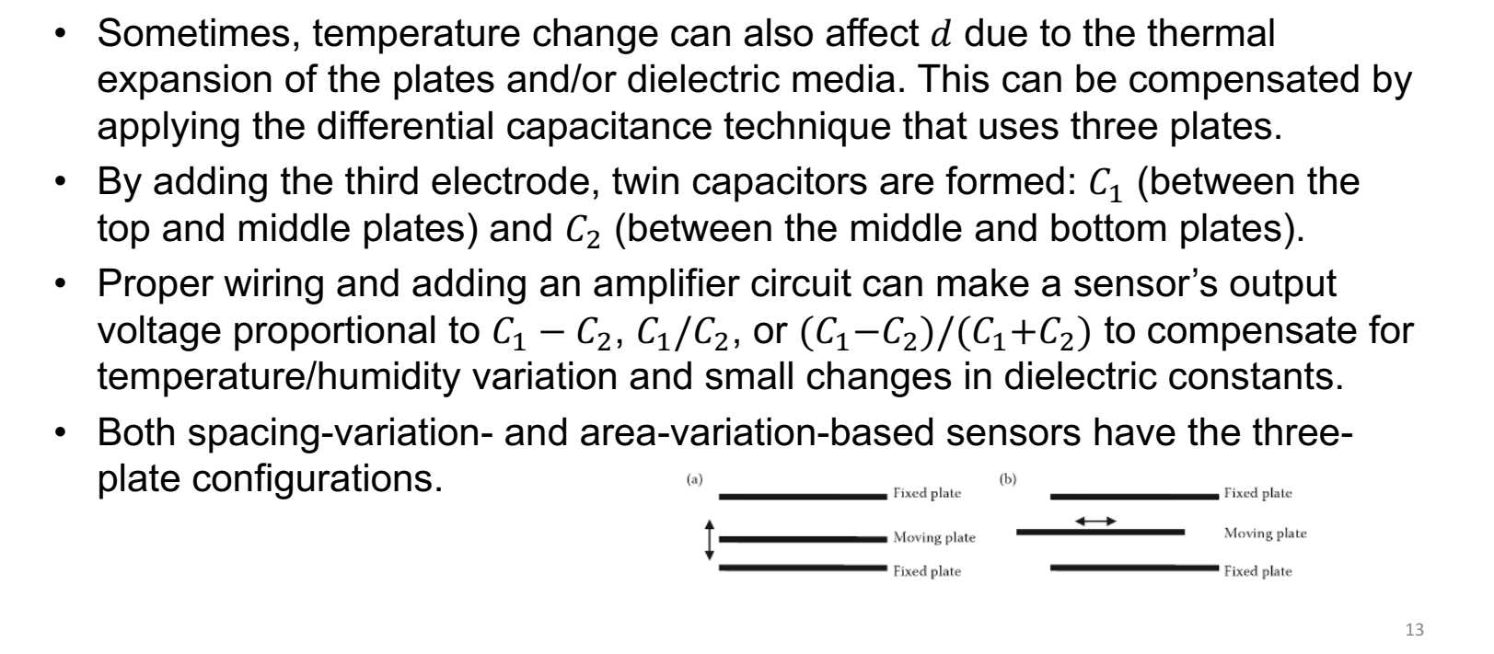

Slide 13

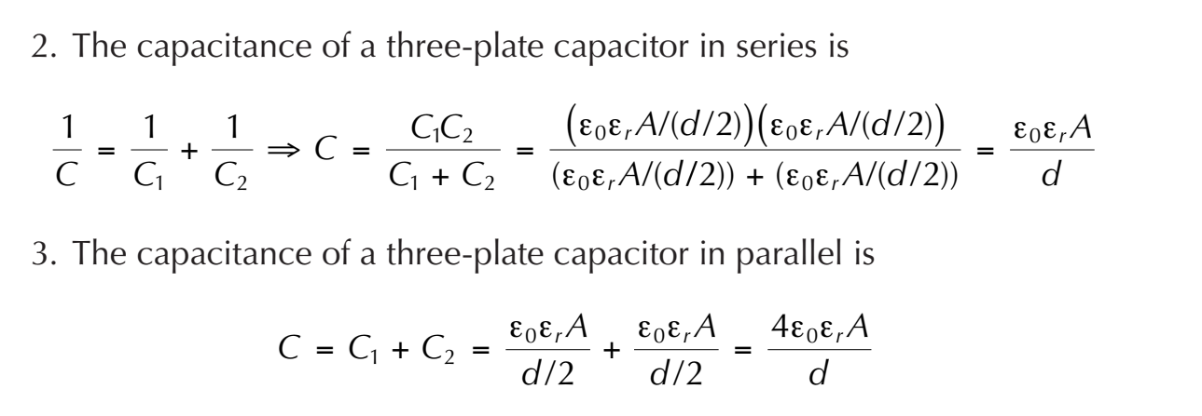

Slide 14

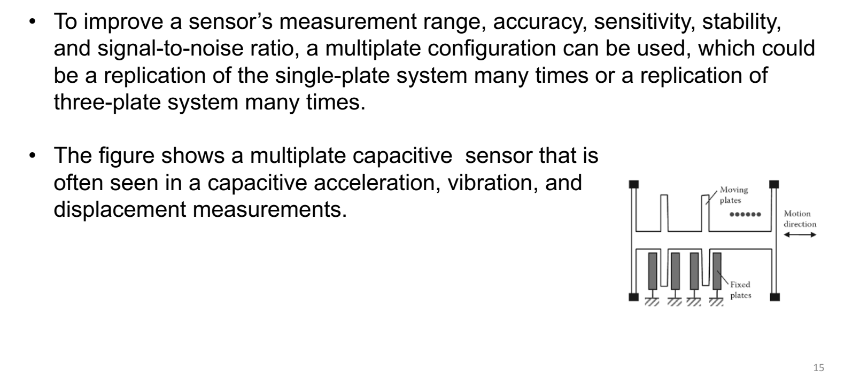

Slide 15
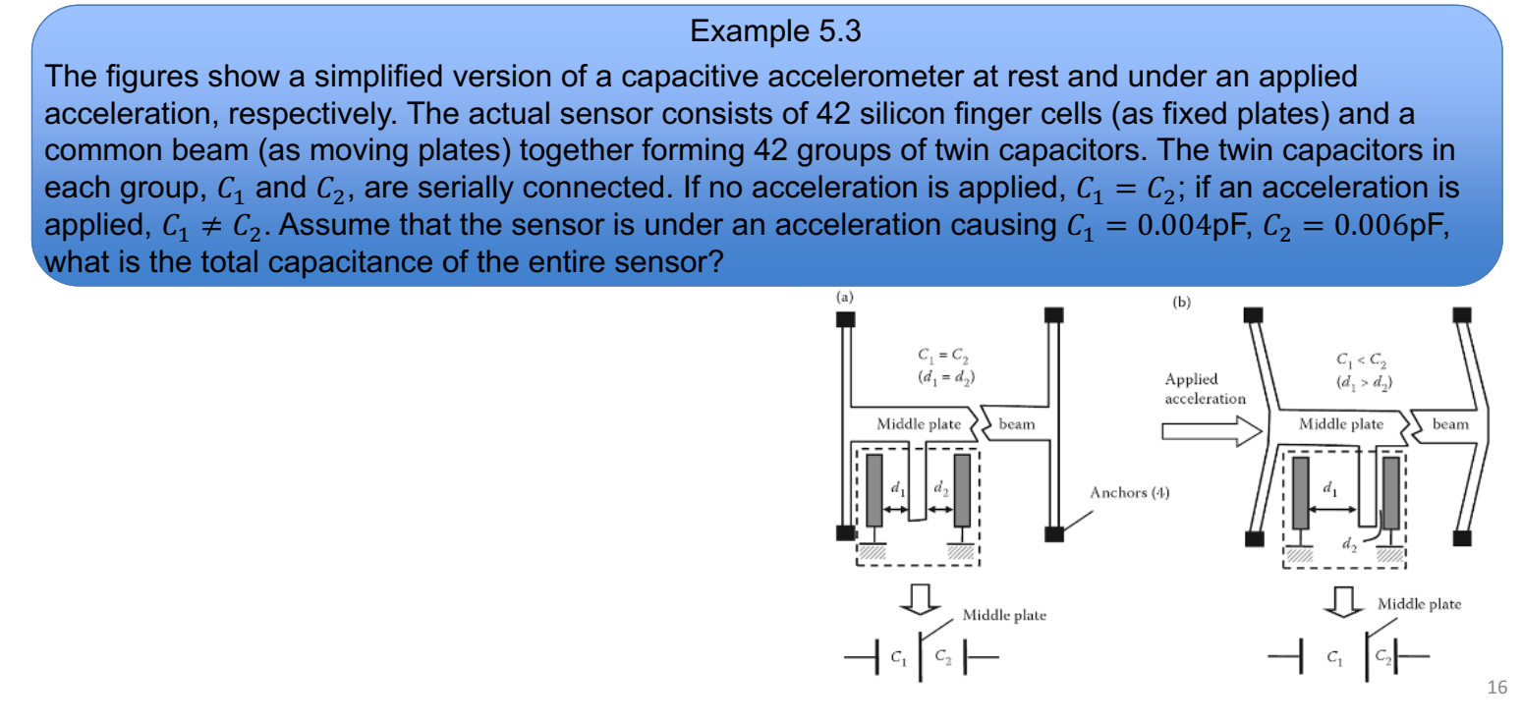


Slide 16

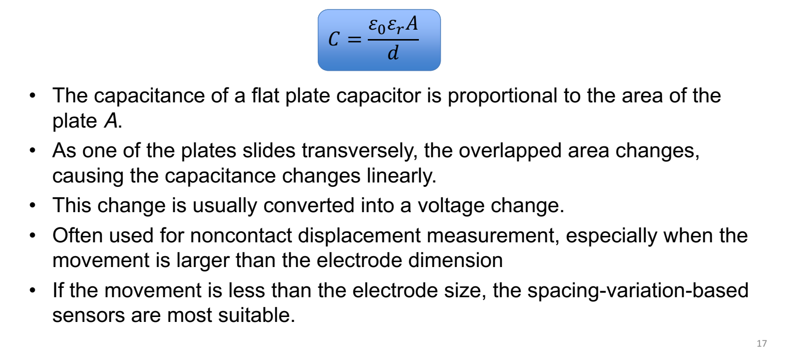

Slide 17

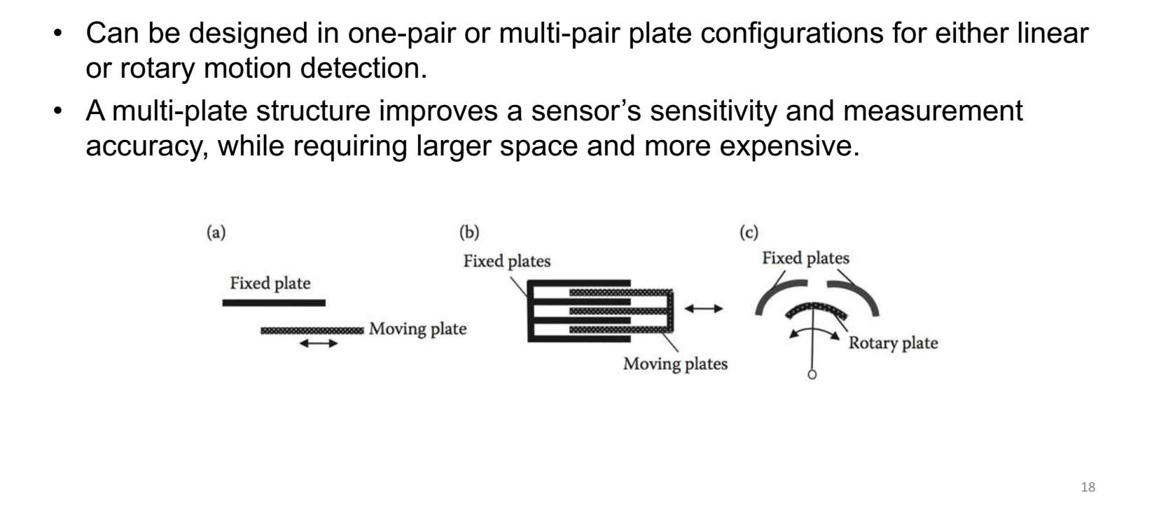

Slide 18
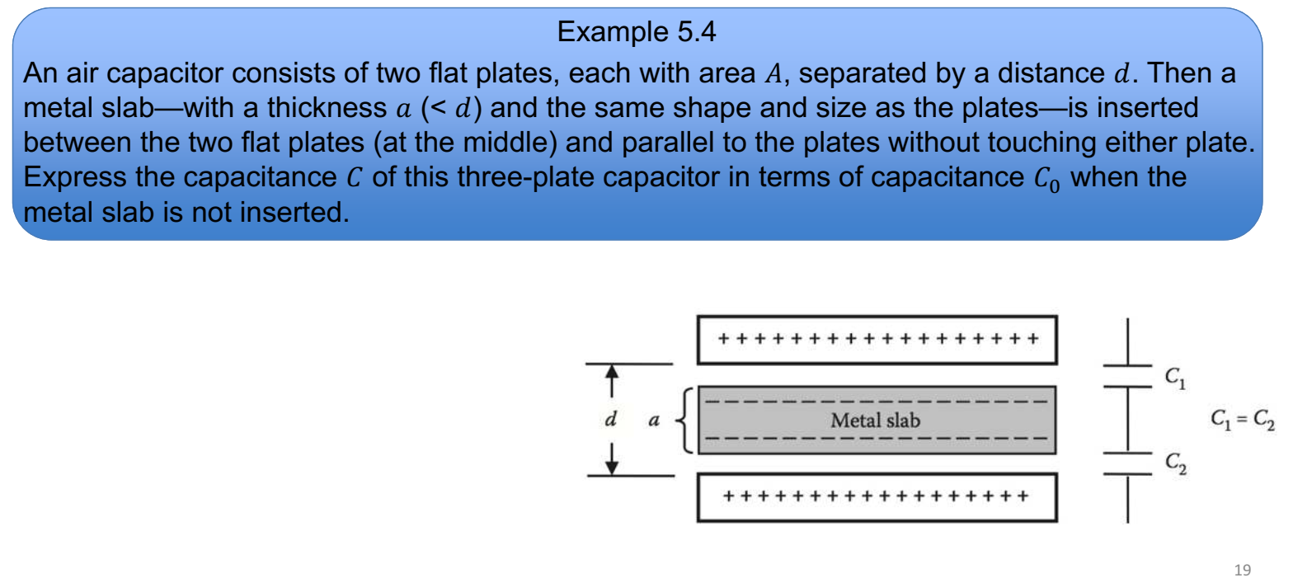

Slide 19
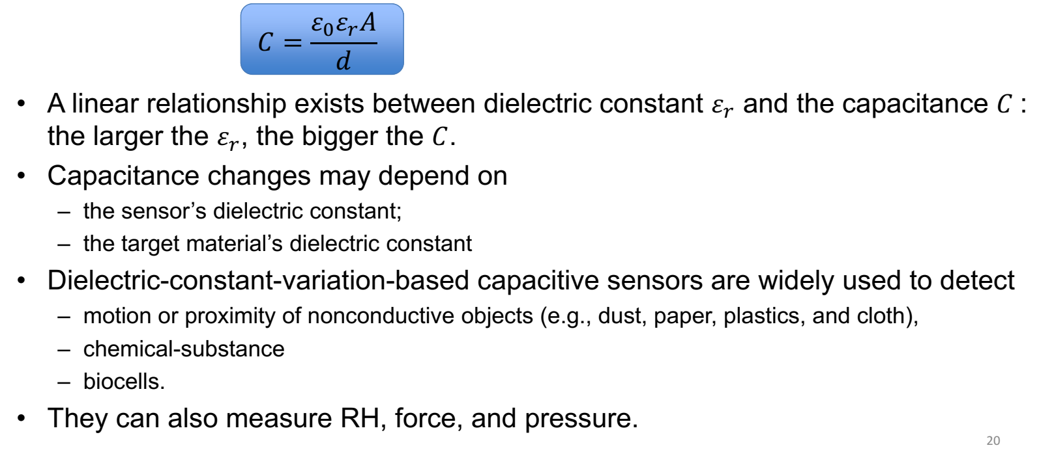
Dielectric Constant Variation Based Sensors

Slide 20
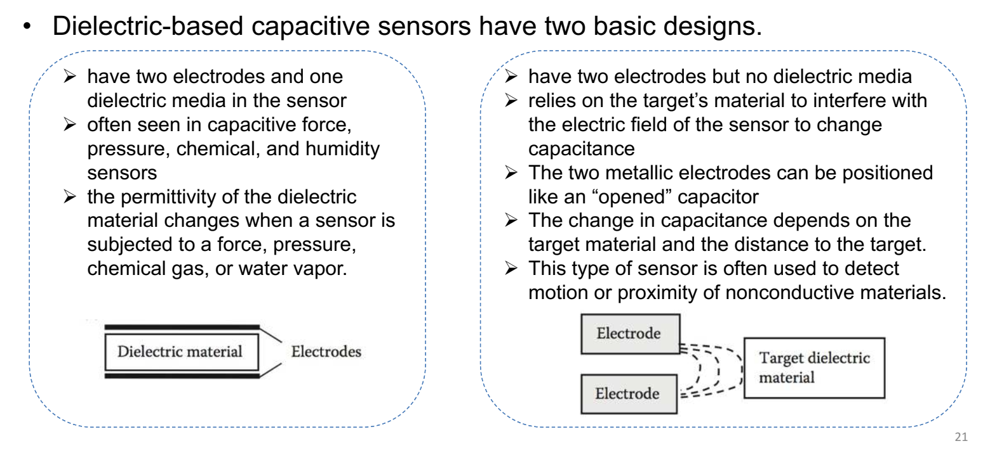
Dielectric Constant Variation Based Sensors

Slide 21
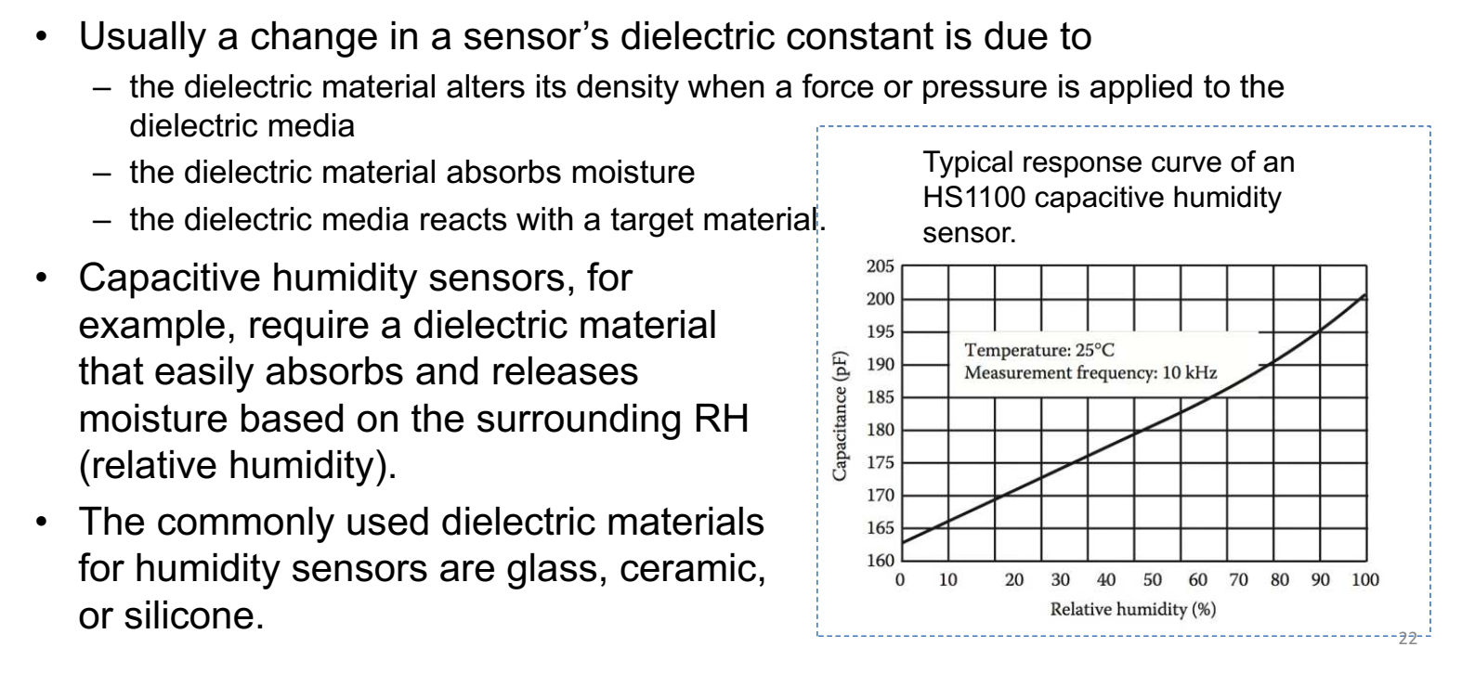
Dielectric Constant Variation Based Sensors

Slide 22

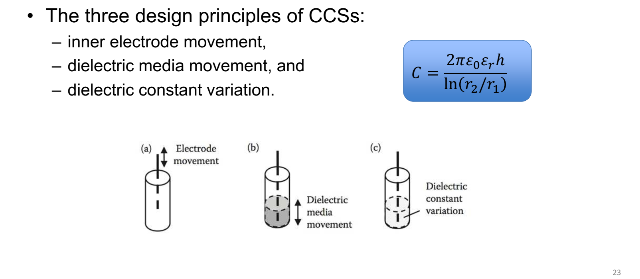

Slide 23

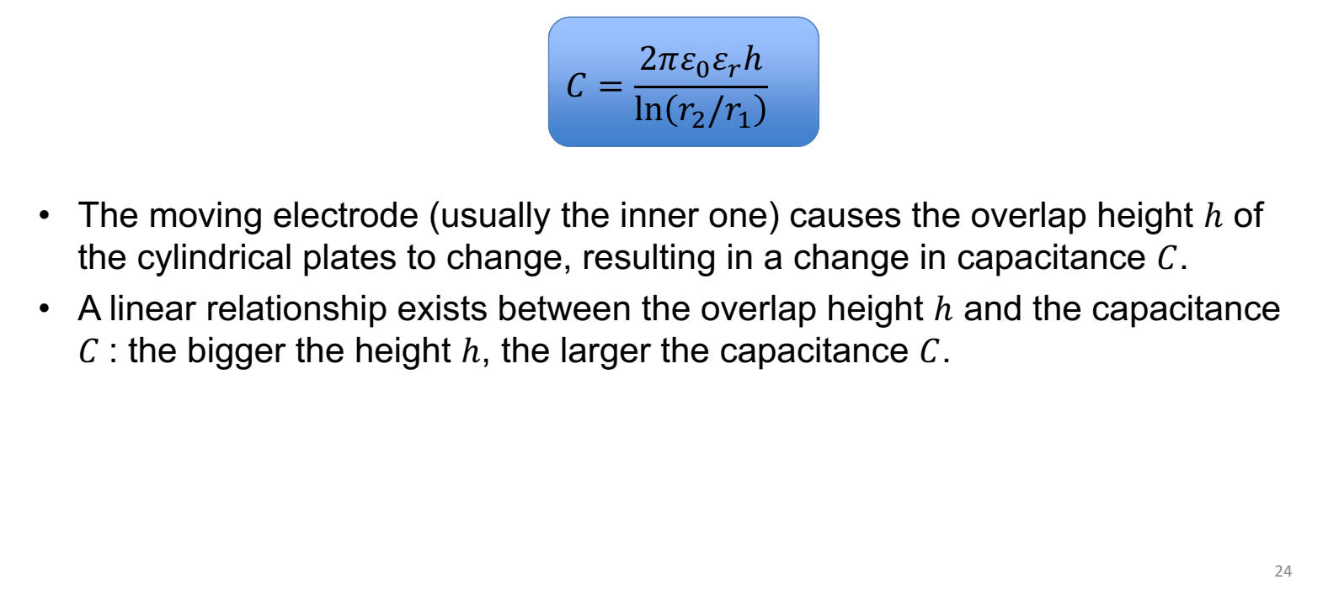

Slide 24

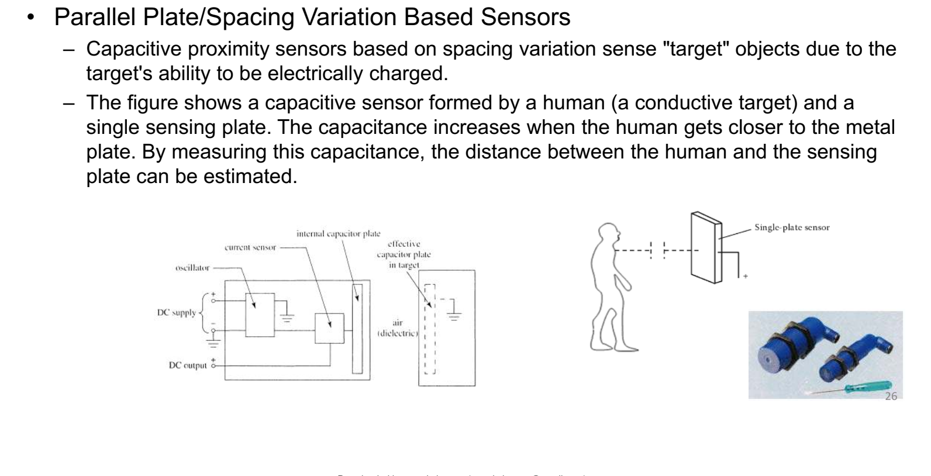

Slide 25
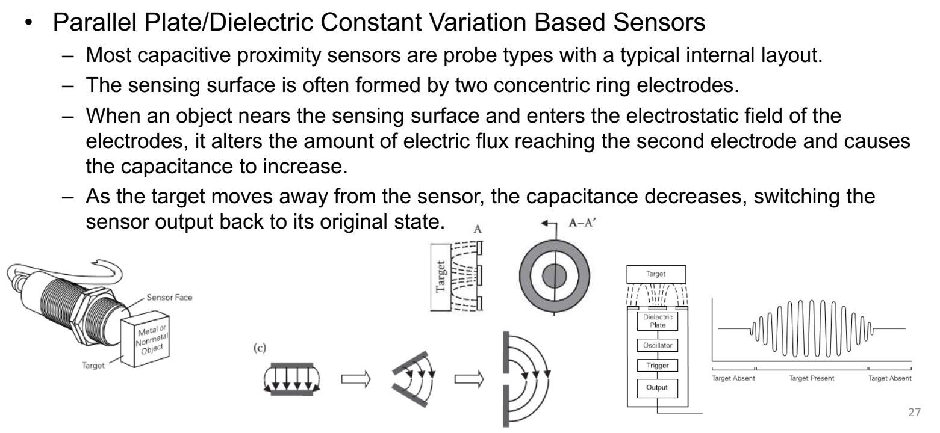

Slide 26



Slide 27

From Tables marble has a dielectric constant of 8, which corresponds to ~50%
of the rated distance according to Figure ; thus, the effective sensing distance
for marble is (9 mm) × 50% = 4.5 mm.

Slide 28

From Figure , εr = 20 corresponds to 82% normal sensing range; εr = 10 corresponds to 60% normal sensing range.
Since Sn = 20 mm, the effect sensing distance for glass is (20 mm) × 60% =
12 mm, and the effect sensing distance for ammonia behind the glass is (12 mm) ×
82% = 9.84 mm. The glass is only 3 mm thick, which results in 6.84 mm operating margin. Thus, the sensor is able to sense the ammonia behind the 3-mm-thick
glass panel.

Slide 29

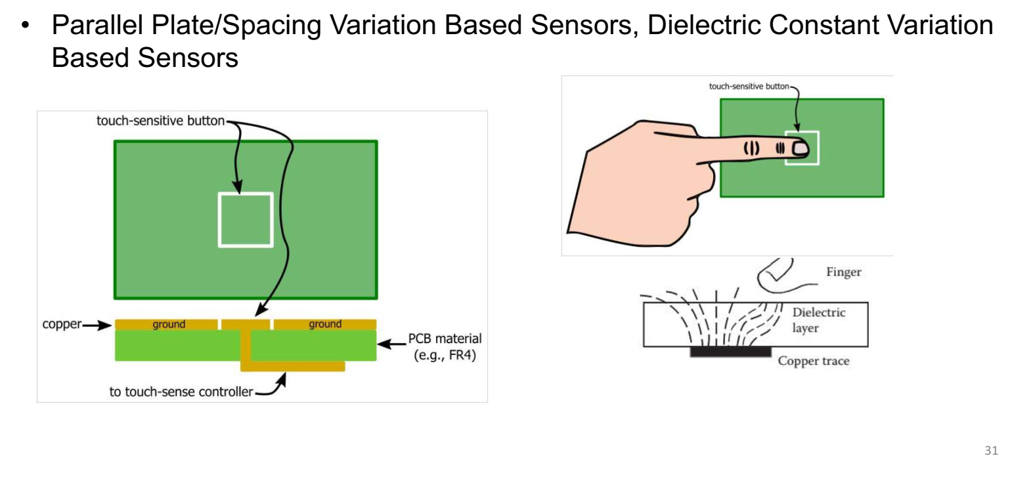

Slide 30
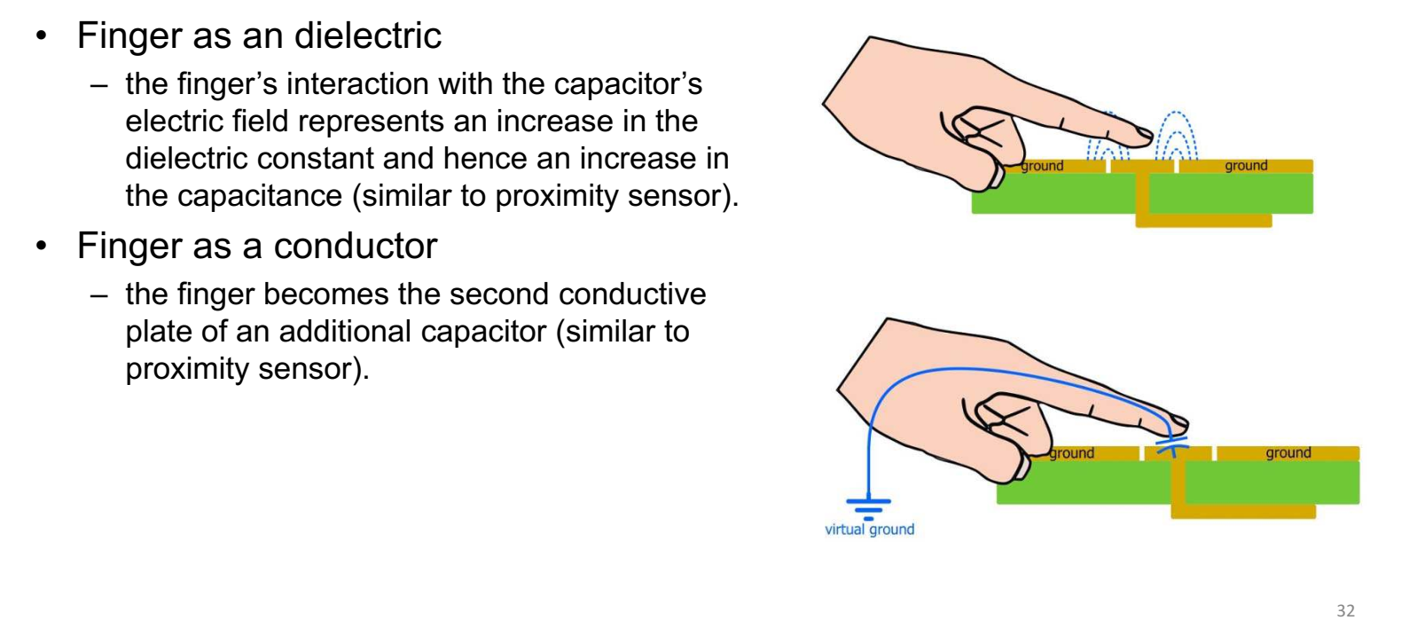

Slide 31

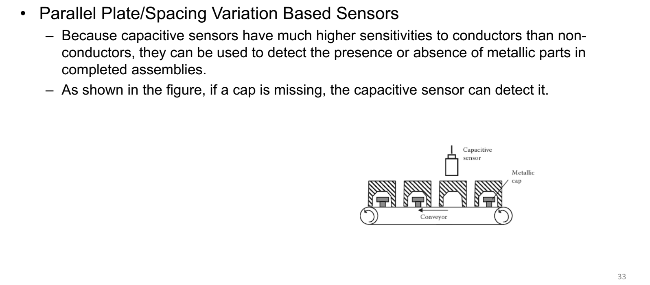

Slide 32

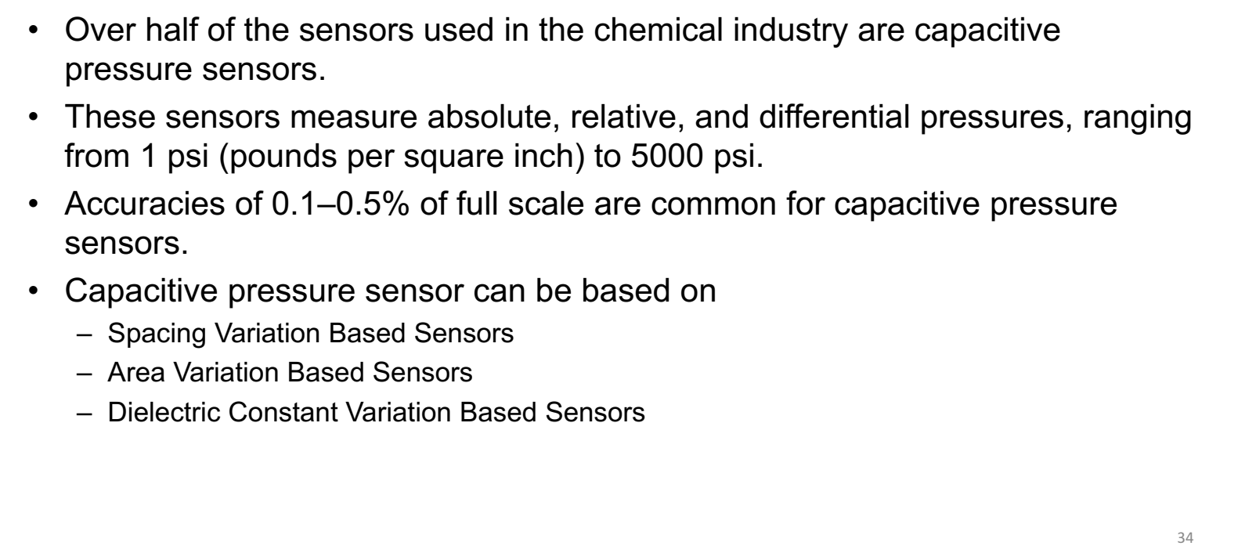

Slide 33


Slide 34
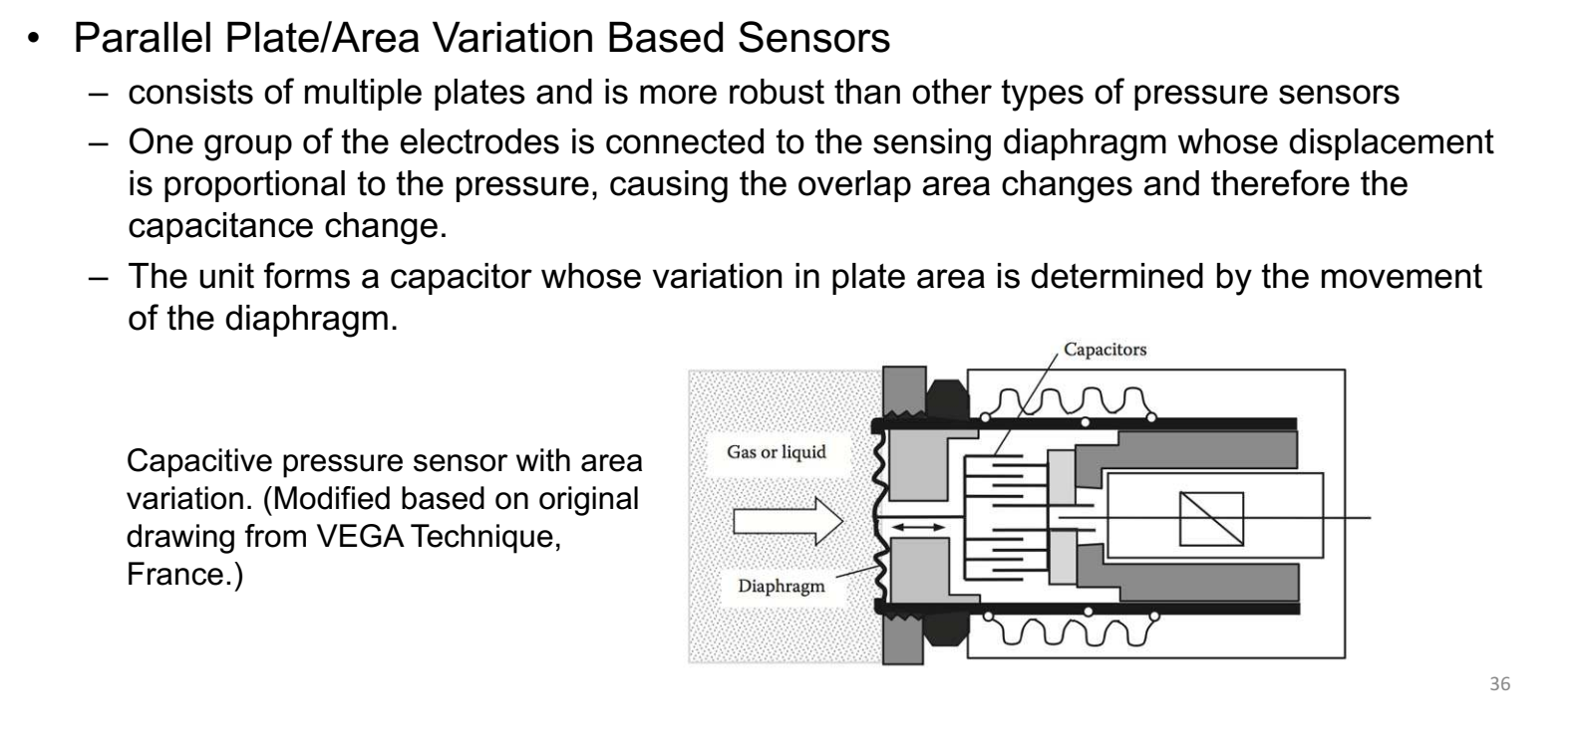

Slide 35
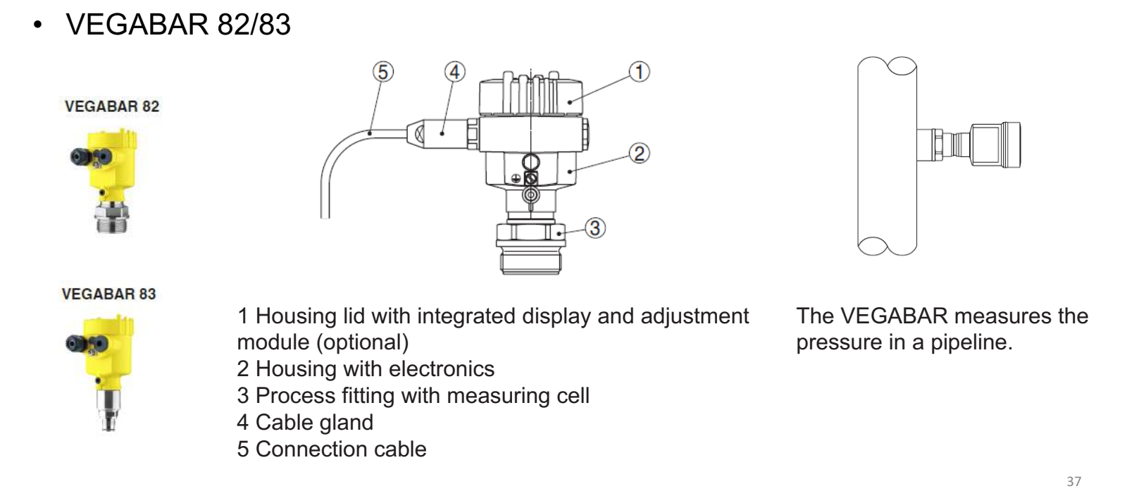

Slide 36
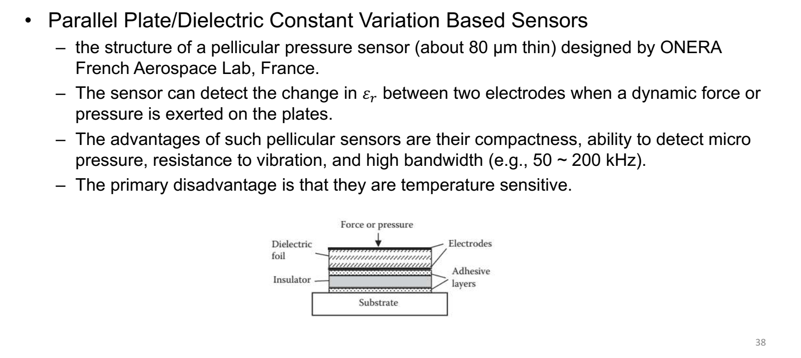

Slide 37

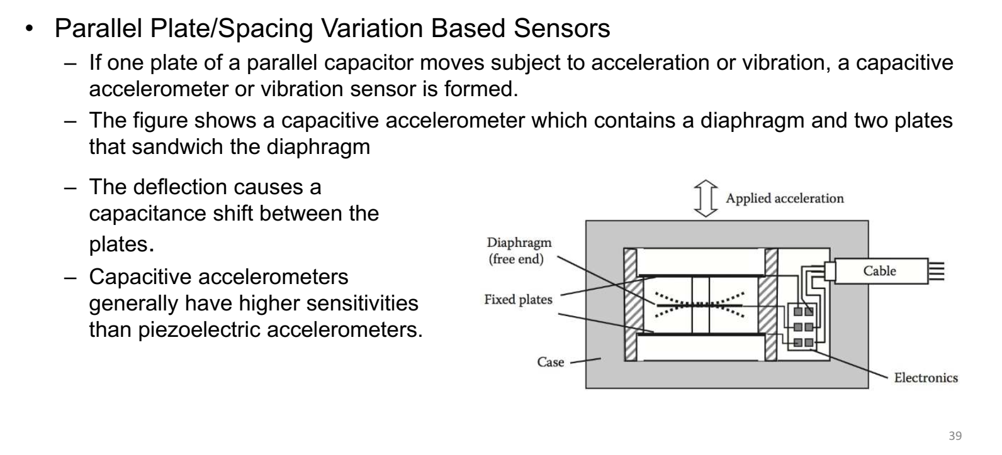

Slide 38
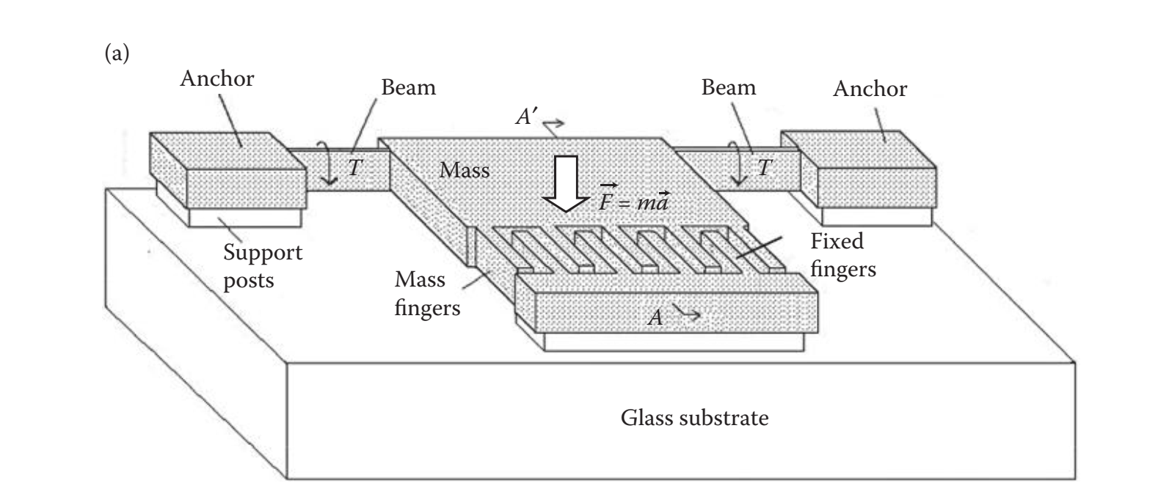
Accelerometer

Slide 39

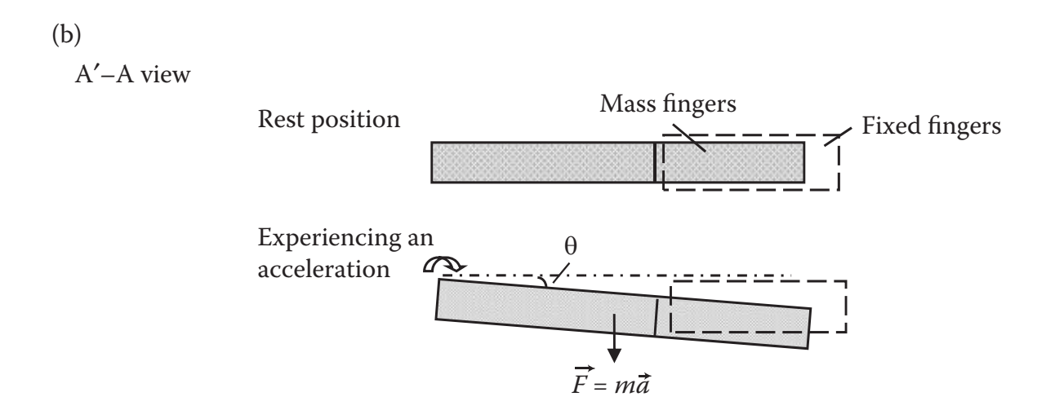

Accelerometer

Slide 40

Accelerometer
Find the capacitance change ΔC using the parameters listed in Table, given
θ = 1.6°, εr = 1

Slide 41

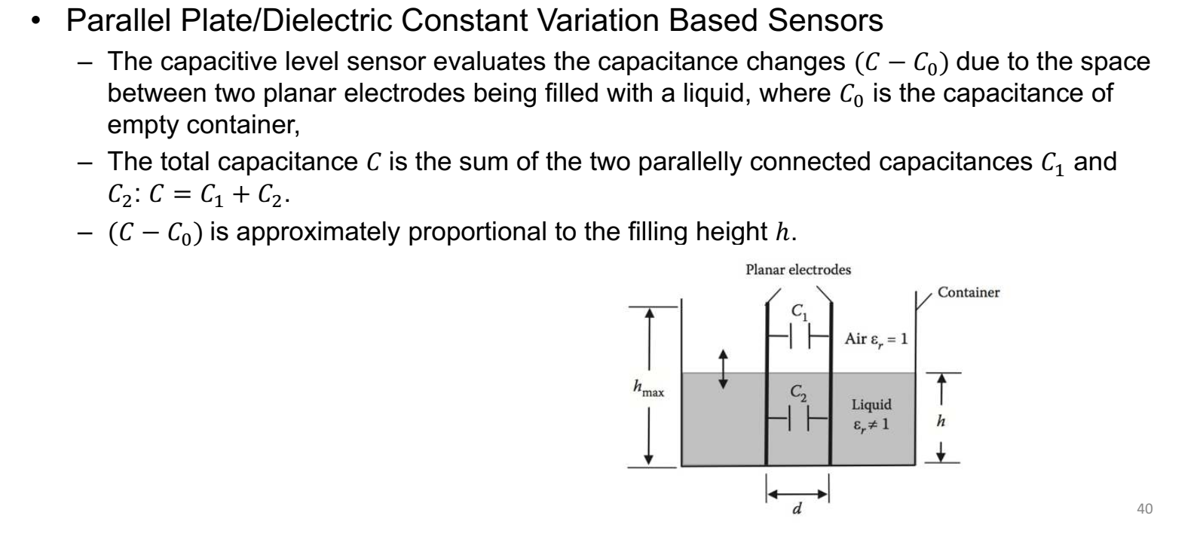

Slide 42
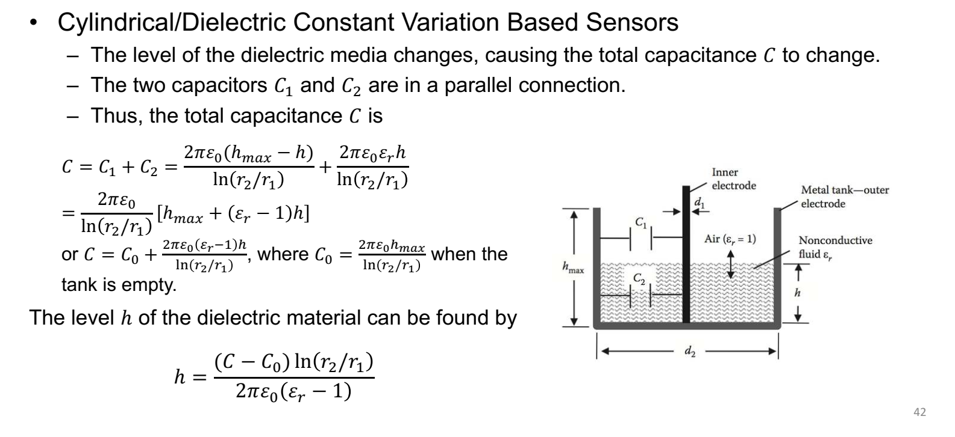

Slide 43
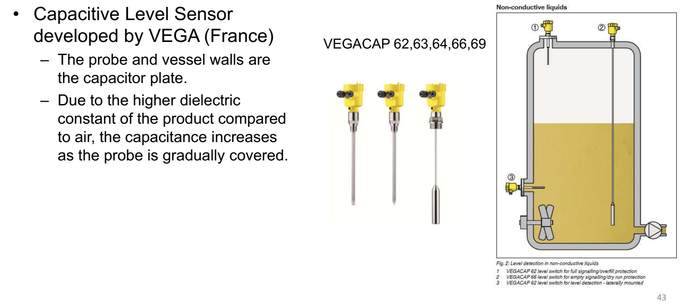

Slide 44




Slide 45

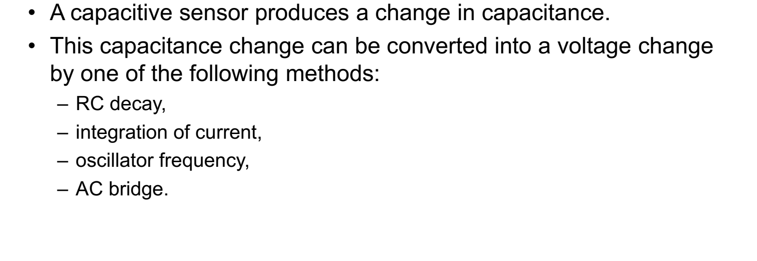

Slide 46

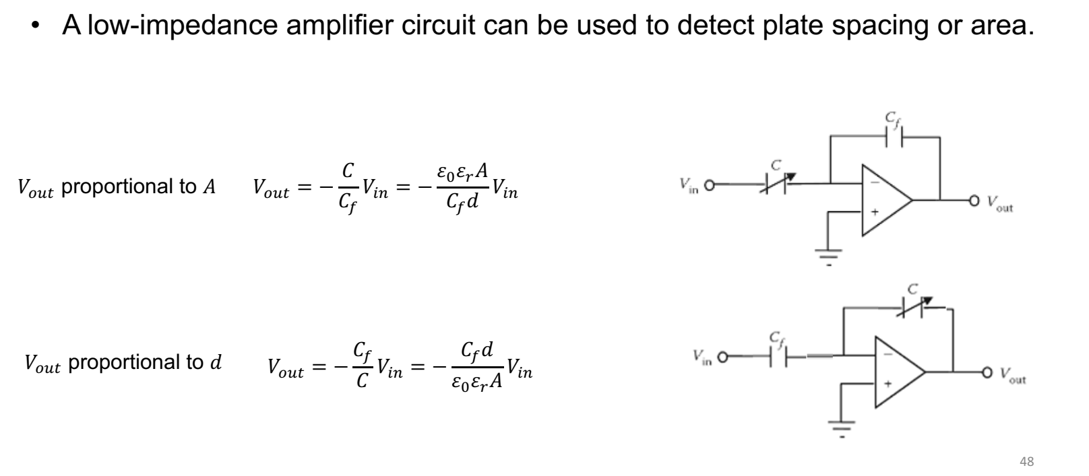

Slide 47

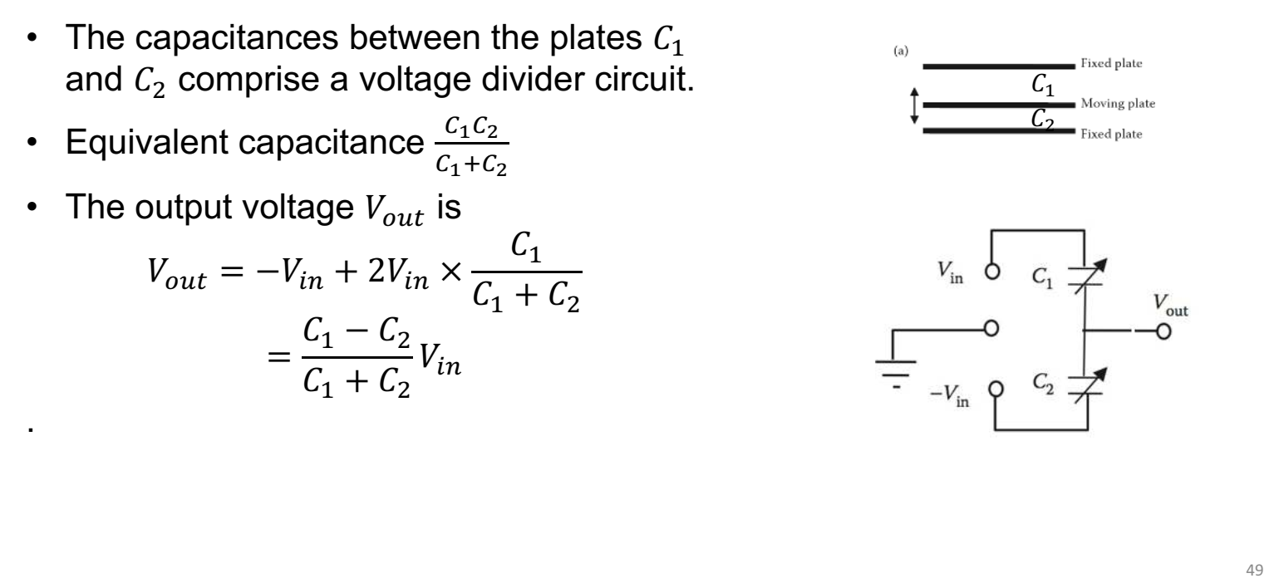

Slide 48


Slide 49
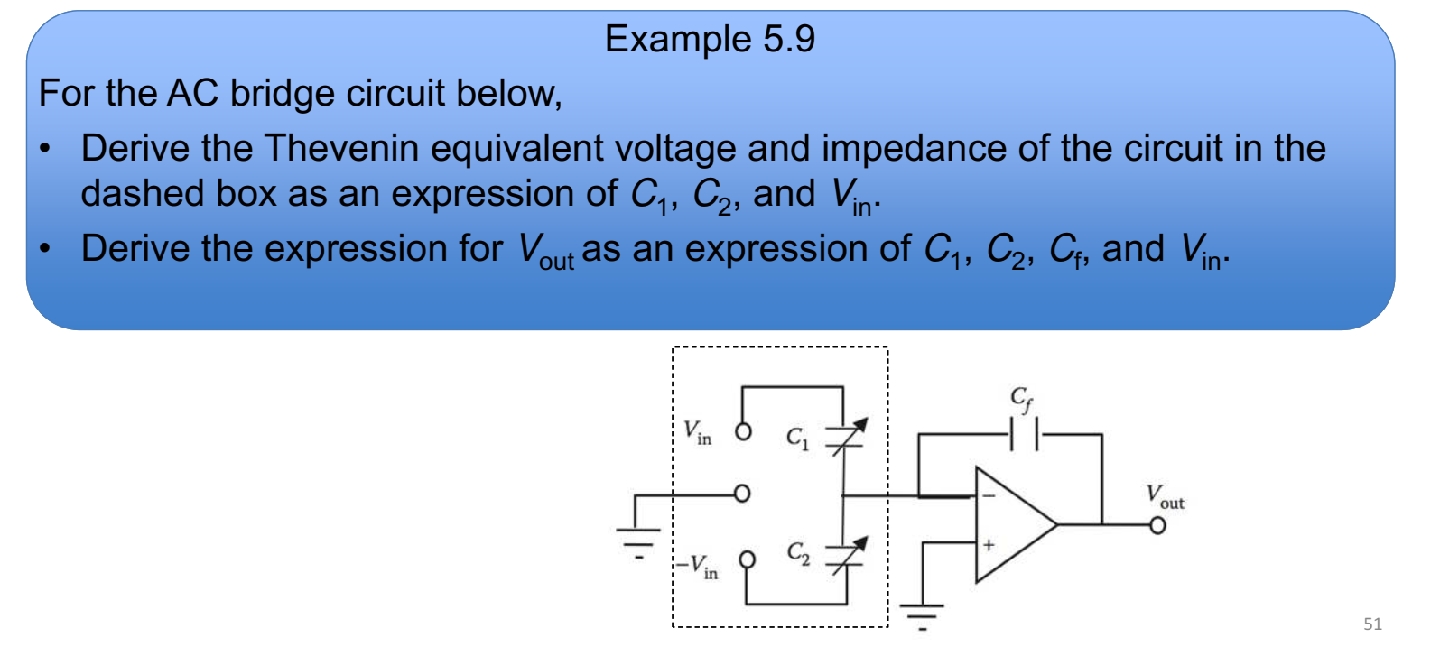

Slide 50

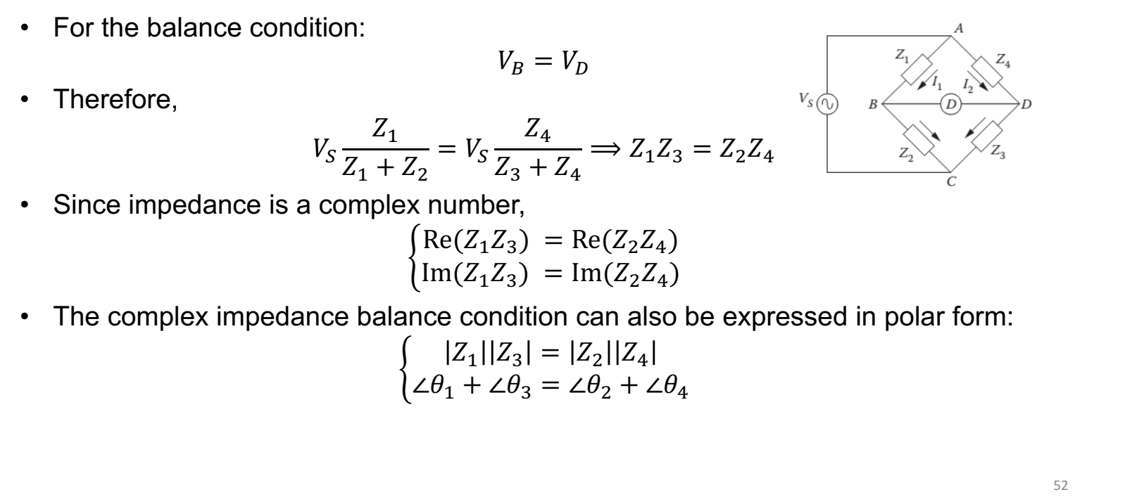

Slide 51


Slide 52

