Slide 1



Slide 2
 The pancreas is both:
Exocrine gland that produces digestive enzymes
Endocrine gland that produces peptide hormones: insulin, glucagon, and somatostatin
The peptide hormones are secreted from cells located in the islets of Langerhans
  β cells produce insulin
  α cells produce glucagon
  δ cells produce somatostatin بتأثر بالجلوكوز بعمليات الأيض
These hormones play an important role in regulating the metabolic activities of the body particularly the homeostasis of blood glucose

Slide 3
Hyperinsulinemia (due for example, to an insulinoma) can cause severe hypoglycemia
The inadequate release of insulin is commonly aggravated by an excess of glucagon
A relative or absolute lack of insulin, such as in diabetes mellitus, can cause serious hyperglycemia
If diabetes is left untreated, retinopathy, nephropathy, neuropathy, and cardiovascular complications may result
Administration of insulin preparations or other injectable or oral glucose lowering agents can prevent morbidity and reduce mortality associated with diabetes في انسولين للاستنشاق ولكن ما شفناه مطبق عندنا
type 1 ما بكون في انسولين بالمرة

Slide 4
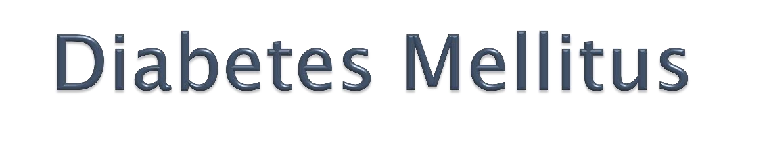
Diabetes is heterogeneous group of syndromes characterized by an elevation of blood glucose caused by relative or absolute deficiency of insulin
There are four clinical classifications of diabetes:
Type 1 diabetes (insulin dependent diabetes mellitus)
Type 2 diabetes (non-insulin dependent diabetes mellitus)
Gestational diabetes NIDDM تسمية رموز قديمة
Diabetes due to other causes (genetic defects or medications, etc)

Slide 5
 Gestational diabetes is defined as carbohydrate intolerance with onset or first recognition during pregnancy
It is important to maintain adequate glycemic control during pregnancy
Uncontrolled gestational diabetes can lead to fetal macrosomia (abnormally large body), shoulder dystocia (difficult delivery), and neonatal hypoglycemia
Diet, exercise, and or insulin administration are effective in this condition
Glibenclamide (glyburide US) and metformin may be safe alternatives to insulin therapy for gestational diabetes
المنظم او الحبة الكبيرة Metformin اول دواء دائماً
ومرات حتى للتضعيف
تكيس المبايض مرتبط بالانسولين لذلك نعطي ميتفورمين للعلاج وايضاً السمنة ممكن تكون تكيس المبايضPolycystic ovary syndrome

Slide 6
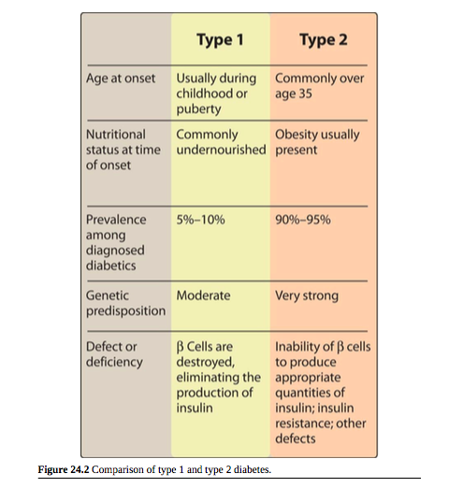

Slide 7

 Most commonly affects individuals in puberty or early adulthood
 Some latent forms can occur later in life
Type 1.5 LADA latent autoimune diabetes in adults

Slide 8
Absolute deficiency of insulin caused by massive β-cell necrosis
Loss of β-cell function is usually ascribed to autoimmune- mediated processes against the β cell
May be triggered by an invasion of viruses or the action of chemical toxins
Due to β-cell destruction pancreas fails to respond to glucose

Slide 9

Shows classic symptoms of insulin deficiency (polydipsia, polyphagia, polyuria, and weight loss)
Require exogenous (injected) insulin to control hyperglycemia and maintain blood glucose concentrations as close to normal as possible
Treatment helps in avoiding the catabolic state that results from Type II diabetes which is characterized by hyperglycemia and life-threatening ketoacidosis

Slide 10
In a normal post-absorptive period, low basal levels of circulating insulin are maintained through constant β-cell secretion which suppresses lipolysis, proteolysis, and glycogenolysis
A burst of insulin secretion occurs within 2 minutes after a meal, in response to transient increases in circulating glucose and amino acids
This lasts for up to 15 minutes and is followed by the postprandial secretion of insulin

Slide 11

Having non-functional β cells in T1DM can neither maintain a basal secretion level of insulin nor respond to variations in circulating fuels
The development and progression of neuropathy, nephropathy, and retinopathy are directly related to the extent of glycemic control (measured as blood levels of glucose and/or HbA1c)

Slide 12

Most diabetic cases
Influenced by genetic factors, aging, obesity, and peripheral insulin resistance, rather than autoimmune processes or viruses
The metabolic alterations observed are milder than those described for type 1
The long-term clinical consequences can be as devastating
The pancreas retains some β-cell function, but variable insulin secretion is insufficient to maintain glucose homeostasis
Frequently accompanied by the lack of sensitivity of target organs to either endogenous or exogenous insulin

Slide 13
The pancreas retains some β-cell function, but variable insulin secretion is insufficient to maintain glucose homeostasis
The β-cell mass may become gradually reduced in type 2 diabetes
In contrast to patients with type 1, type 2 diabetes are often obese
Frequently accompanied by the lack of sensitivity of target organs to either endogenous or exogenous insulin

Slide 14

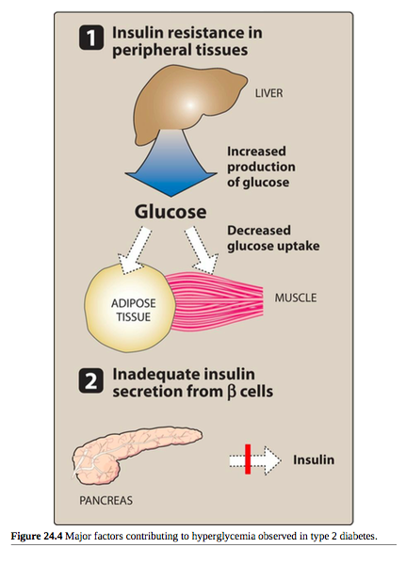

Slide 15

 Treatment:
The goal in treating T2DM is to maintain blood glucose concentrations within normal limits and to prevent the development of long-term complications of the disease
Weight reduction, exercise, and dietary modification decrease insulin resistance and correct the hyperglycemia of type 2 diabetes in some patients
Most patients are dependent on pharmacologic intervention with oral glucose-lowering agents
As the disease progresses, β-cell function declines and insulin therapy is often required
مريض السكر بكون متعطش للسكر لان الخلايا ما فيها سكر، والانسلولين هو يلي بدخل السكر
السكر عالي بالدم ولكن ما بدخلوا الخلية وهذه مشكلة تؤثر على الدايت بعض الشيء

Slide 16

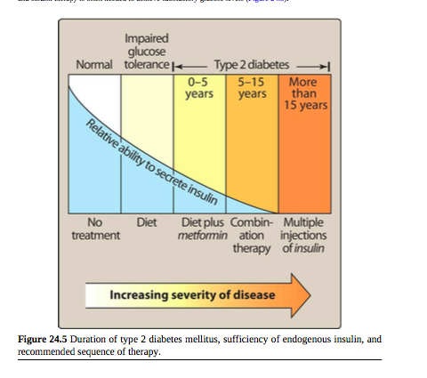

Slide 17

 Insulin is a storage hormone:
it promotes anabolism
inhibits catabolism of carbohydrates, fatty acids and protein
بمنع تكسير الجلايكوجين Glycogenisis
اذا ما في انسلوين بكون ما في مستقبلات حتى فالبروتين بتكسر ليعمل طاقة فبصير في كيتونبدي
In the absence of insulin:
  most tissues cannot use glucose
  fats/proteins are broken down to provide energy
  نفسه مثل الاسيتون او الكحول
  1 ما في عنده انسولين
  2 في عنده ولكن قليل

Slide 18

Mechanism of action :
 Insulin binds to insulin receptors on the plasma membrane and activates tyrosine kinase – primarily in adipose tissue, liver and skeletal muscle
1 بكون احتمالية اكثر لعمل كيتون بدي
2 اما هذا بكون أقل لانه بكون في انسولين قليل
Ketonebody
Ketoacidosis electrolyte imbalances
, hyperglycemia

Slide 19

 Insulin increase the storage of glucose as glycogen in the liver
Liver :
It inserts the GLUT-2 glucose transport molecule in the cell membrane
It inhibits gluconeogenesis – thus significantly ↓
glucose output by the liver
It decreases the protein catabolism تكسير

Slide 20

Muscle :
 Insulin stimulates glycogen synthesis and protein synthesis
Glucose transport into the cells is facilitated by GLUT-4 into the cell membrane
 Insulin inhibits the protein catabolism

Slide 21

Adipose tissue :
 Insulin facilitates the storage of triglyceride by:
Activating plasma lipoprotein lipase
Inhibiting intracellular lipolysis
 It increases the glucose uptake by GLUT-4 insertion into the cell membrane

Slide 22

Insulin is a polypeptide hormone consisting of two peptide chains connected by disulfide bonds
Synthesized as a precursor (proinsulin ) that undergoes proteolytic cleavage to form insulin and C-peptide
Undergoes significant hepatic extraction
Measurement of circulating C-peptide provides a better index of insulin levels
Proinsulinانزيم غير فعال = Insulin + C-peptide فقط وظيفته ينفصل عن الانسولين ليصير فعال فأحياناً منفحصه للتشخيص
للتمييز بين 1 و2 ننظر على مستويات الانسولين

Slide 23

Insulin secretion is regulated by blood glucose levels, certain amino acids, other hormones, and autonomic mediators
Secretion is most commonly triggered by high blood glucose
In the pancreas, glucose is phosphorylated by glucokinase
The products of glucose metabolism enter the mitochondrial respiratory chain and generate ATP
The rise in ATP levels بعد الاكلcauses a block of K+ c₂h₊annels, leading to membrane depolarization and Ca influx
The increase in intracellular Ca²⁺ causes pulsatile insulin exocytosis

Slide 24

 Sulfonylureasحبة صغيرة and glinides act by inhibition of K⁺ channels
Metformin affect sensitivity

Slide 25
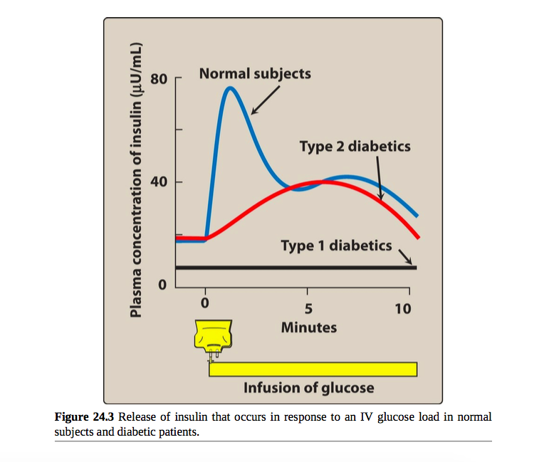

Slide 26
Glucose given by injection has a weaker effect on insulin secretion than oral glucose
When given orally, glucose stimulates production of incretin hormones by the gut, which, in turn, stimulate insulin secretion by the pancreas بنفعش ل 1
في منها ابر وفي منها فموي
وحتى الابر ممكن ما تنفع لل 1

Slide 27

Human insulin is produced by recombinant DNA technology using E. coli or yeast altered genetically to contain the human insulin gene
Modifications of the amino acid sequence of human insulin have produced insulins with different PK properties
The 3 insulins lispro, aspart, and glulisine have a faster onset and shorter duration of action than regular insulin
Insulins glargine and detemir and degludec are long-acting and show prolonged flat levels following injection مديد لانثس
Basal يلي بضل او متبقي بعد الوجبات
والمفروض يوخذ اثنين
Protamine antidote for heparin

Slide 28

Insulin is degraded in the GIT if taken orally اذا انصنع هذا رح يكون مُربح جداً
Insulin is administered by subcutaneous injection
In a hyperglycemic emergency, regular insulin is injected IV
Continuous subcutaneous insulin infusion (insulin pump) does not require multiple daily injections منيحة للاطفال وللتيب 1

Slide 29
Insulin preparations vary in their onset of activity and in duration of activity due to differences in their amino acids
Dose, site of injection, blood supply, temperature, and physical activity can affect the duration of action of the various preparations
Insulin is inactivated by insulin-degrading enzyme which is found mainly in the liver and kidney
Sliding Scale المريض المفروض يقيس الانسولين وبناءً عليه بعطي الجرعة
لازم ينوع بالمكان يلي بعطيه فيه الحقنة
والانسولين هو انابولك هرمون وهذا يؤدي الى تراكم الدهون وبالتالي تبعجات بالبطن

Slide 30

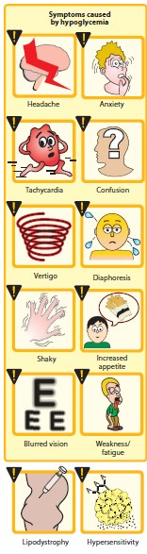
Symptoms of hypoglycemia in excessive dose
Weight gain
Lipodystrophy
Allergic reactions
Local injection site reactions
Diabetics with renal insufficiency may require adjustment of the insulin dose
Hypoglycemia unawareness ببطل يحسب انه في مشكلة وهذه مشكلة

Slide 31
 Caution should be paid when making any change in insulin treatment and dose
B blocker مشكلة ما منحب نعطيها مع مرضى السكرية

Slide 32

Rapid acting and short acting insulin مع الوجبات او حالات الطوارئ
Intermediate acting insulin
Long acting insulin
Insulin combinations

Slide 33

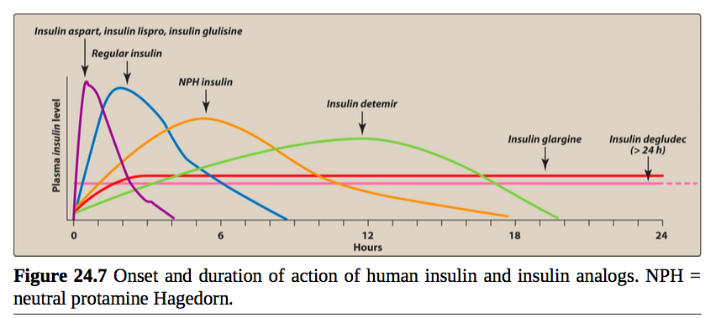

Slide 34

 Include 4 preparations:
Regular insulin
Insulin lispro
Insulin aspart
Insulin glulisine
Depended on Amino acid
Long and Short
Intermediate and Short
in regimen not in the same syringe
حسب وضع المريض نختار الجرعة والدواء المناسب

Slide 35
 Lispro, aspart and glulisine forms are classified as rapid-acting insulins because of their rapid onset and short duration of action الاختلاف بالأحماض الأمينية بعطيهم صفة السرعة
 Rapid acting insulins offer more flexible treatment regimens and may lower the risk of hypoglycemia

Slide 36
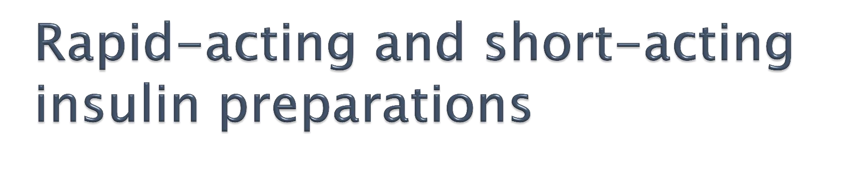
 Regular insulin, insulin lispro, and insulin aspart are pregnancy category B
 Insulin glulisine is pregnancy category C

Slide 37
 Peak levels of insulin lispro are seen at 30 to 90 minutes after injection, as compared with 50 to 120 minutes for regular insulin
 Insulin lispro also has a shorter duration of activity than regular insulin

Slide 38

A short-acting, soluble, crystalline zinc insulin
Given subcutaneously
Given IV in emergencies
Rapidly lowers blood glucose
Long + Short بنفس الابرة صعب 4

Slide 39
Insulin lispro is more rapidly absorbed after subcutaneous injection than regular insulin
Insulin aspart and insulin glulisine have pharmacokinetic and pharmacodynamic properties similar to those of insulin lispro
Administered to mimic the prandial release مع الوجبات
Usually not used alone but with a longer-acting insulin to ensure proper glucose control
Administered SC

Slide 40
Insulin lispro is usually administered 15 minutes prior to a meal or immediately following a meal
رؤية أخصائيي تغذية مهم لحساب كمية الطعام بالنسبة للجرعة
Insulin glulisine can be taken either 15 minutes before a meal or within 20 minutes after starting a meal
Insulin aspart should be administered just prior to the meal or up to 15 minutes following the meal
Taste Buds بتتغير بالفم كل فترة وفترة

Slide 41
 All of the rapid-acting formulations are suitable for IV administration, although regular insulin is most commonly used when the IV route is needed
 Insulin lispro, insulin aspart, and insulin glulisine may also be used in external insulin pumps

Slide 42

Neutral protamine Hagedorn (NPH) insulin suspension of crystalline zinc insulin combined at neutral pH with the positively charged polypeptide protamine- Antidonte for heparin
Insulin NPH is also called insulin isophane
Its duration of action is intermediate
NPH insulin should only be given subcutaneously (never IV) بالاختبار

Slide 43
Useful in treating all forms of diabetes except diabetic ketoacidosis and emergency hyperglycemia حتى لو تحت الجلد
Used for basal control and is usually given along with rapid- or short-acting insulin for mealtime control
A similar compound called neutral protamine lispro (NPL) insulin has been prepared and is used only in combination with insulin lispro (Humalog Mix ®)

Slide 44
Insulin glargine (Lantus®)
It is slower in onset than NPH insulin and has a flat,
prolonged hypoglycemic effect with no peak
Given SC بترسب بالدم وفترته طويلة
Insulin detemir
  Has a fatty-acid side chain which enhances association
to albumin هل يؤثر على الأدوية الأخرى يلي برتبطوا على البروتين
  Slow dissociation from albumin results in long-acting properties
Insulin Degludec
Insulin detemir and insulin glargine والباقيات كذلك should not be mixed in the same syringe with other insulins

Slide 45
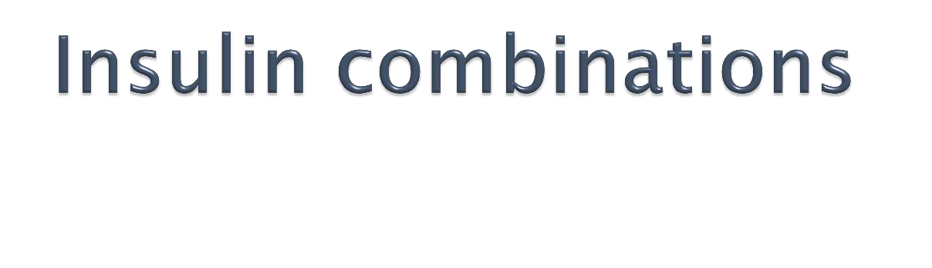
 Various premixed combinations of human insulins are available
70% NPH insulin plus 30% regular insulin (Humulin 70/30®)
50% NPH insulin plus 50% regular insulin
75% NPL insulin plus 25% insulin lispro (Humalog Mix®)

Slide 46
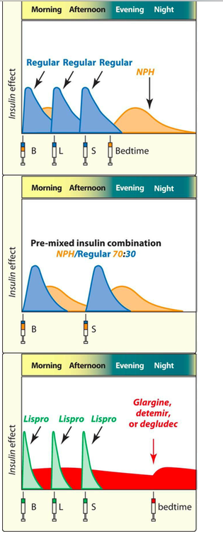

Slide 47
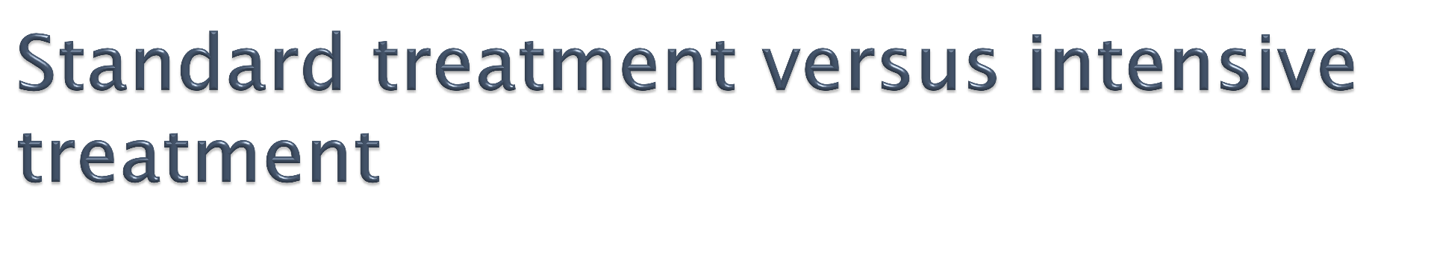
Standard treatment involves injection of insulin twice daily صبح ومساء
Intensive treatment seeks to normalize blood glucose through more frequent injections of insulin (three or more times daily in response to monitoring blood glucose levels) اكثر من 3 مرات

Slide 48
 Normal mean blood glucose ≤ 115 mg/dL with HbA1c content ≤ 5.7
For patients with diabetes:
  Target mean blood glucose levels ≤ 154 mg/dL
  HbA1c ≤ 7% في اجهزة جديدة تقييس هذا وتقييس السكر بالدم
This is more likely to be achieved with intensive treatment

Slide 49
The frequency of hypoglycemic episodes, coma, and seizures is higher with intensive treatment
Patients on intensive therapy show a significant reduction in long-term complications of diabetes as retinopathy, nephropathy, and neuropathy
Intensive therapy has not been shown to significantly reduce the macrovascular complications of diabetes
Intensive therapy is not recommended for patients with longstanding diabetes, significant microvascular complications, advanced age, and hypoglycemic unawareness

Slide 50
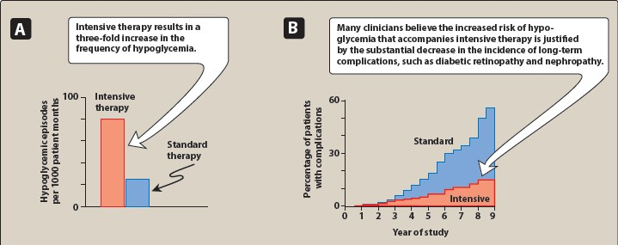

Slide 51
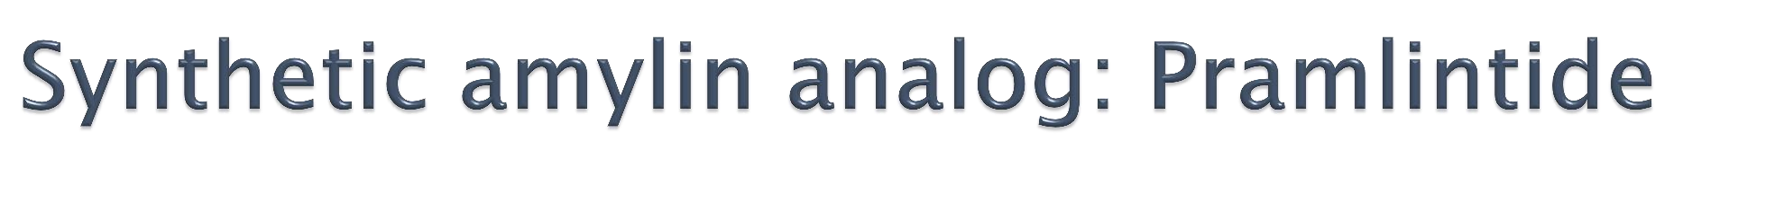
Used as an adjunct to mealtime insulin therapy in patients with type 1 and type 2 diabetes
Acts as amylinomimetic, delaying gastric emptying, decreasing postprandial glucagon secretion, and improving satiety من البنكرياس بطلع بعد الأكل بخرج من خلايا بيتا
Administered SC and should be injected immediately prior to meals
When pramlintide is initiated, the dose of rapid- or short-acting insulin should be decreased by 50% prior to meals to avoid a risk of severe hypoglycemia
Pramlintide may not be mixed in the same syringe with any insulin preparation
هرمون

Slide 52
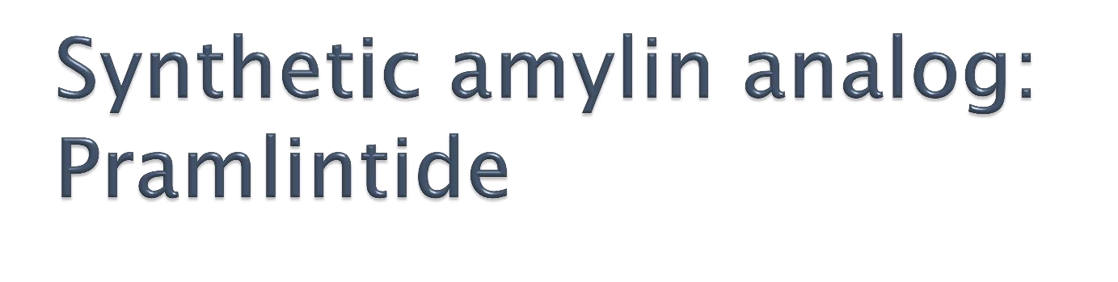
 Adverse effects
Nausea
Anorexia
Vomiting
 Pramlintide should not be given to patients with diabetic gastroparesis, cresol hypersensitivity, or hypoglycemic unawareness

Slide 53

Oral glucose results in a higher secretion of insulin than occurs when an IV glucose “incretin effect”
Incretin effect is markedly reduced in type 2 diabetes
The incretin effect occurs because the gut releases incretin hormones, notably GLP-1 Glucagon and glucose dependent insulinotropic polypeptide after a meal
Incretin hormones are responsible for 60%-70% of postprandial insulin secretion
Work as incretin hormone when increase it increase insulin
only type 2

Slide 54
Abliglutide
Dulaglutide
Semaglutide
Liraglutide (Victoza®)
Exenatide (Bydureon®, Byetta®)
ابر بس مش انسولين وبنفع للنوع 2 فقط
التهاب البنكرياس فش اله علاج مشكلة يعني الميتفورين أأمن منه لسا
Injectable incretin mimetics are used for the treatment of patients with type 2 diabetes
These agents may be used as adjunct therapy in patients who have failed to achieve adequate glycemic control on a sulfonylurea, metformin, a glitazone, or a combination of them

Slide 55
Mechanism of action
The incretin mimetics are analogs of GLP-1 that act as GLP-1 receptor agonists
Improve glucose- dependent insulin secretion
Slow gastric emptying time, decrease food intake
Decrease postprandial glucagon secretion
Promote β-cell proliferation
Weight gain and postprandial hyperglycemia are reduced
HbA1c levels decline

Slide 56
Administered subcutaneously
Abliglutide Dulaglutide Semaglutide (long acting , administered once weekly)
Liraglutide is highly protein bound and has a long half life allowing for once-daily dosing
Exenatide should be injected twice daily within 60 minutes prior to morning and evening meals
Once Weekly (extended release)
Exenatide should be avoided in patients with severe renal impairment

Slide 57
Adverse effects
Nausea, vomiting, diarrhea, constipation
Patients may form antibodies to these agents, in most cases the antibodies do not result in adverse effects
Have been associated with pancreatitis

Slide 58

Useful in the treatment of patients who have type 2 diabetes and cannot be managed by diet alone
Patients who have developed diabetes after age 40 and have had diabetes less than 5 years are most likely to respond well to oral glucose-lowering agents
Patients with long-standing disease may require combination of glucose-lowering drugs/ insulin
Insulin is added because of the progressive decline in β cells that occurs due to the disease or aging
Oral glucose-lowering agents should not be given to patients with type 1 diabetes

Slide 59

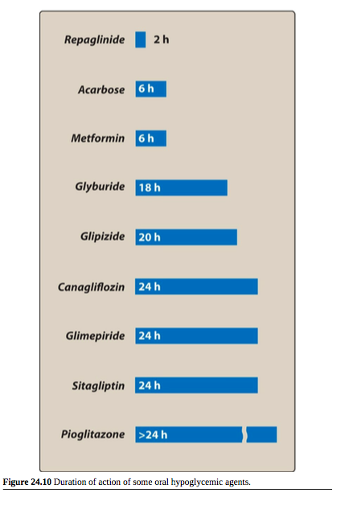
 Insulin secretagogues
Sulfonylureas
Glinides
Insulin sensitizers
  Biguanides: Metformin
  Thiazolidinediones:
α-Glucosidase inhibitor
Dipeptidyl peptidase-IV inhibitors
SGLT2 inhibitors
Fasting Glucose 100 المفروض ما يكون عالي يعني صباحاً
acarbose مع الأكل نوخذه وبمنع امتصاص من الكاربوهيدرات
المفروض ما في سكر بالبول ولكن بمرض السكري موجود سكر وزمان كانوا يتذوقوه !

Slide 60
 Insulin secretagogues: Promote insulin release from the β cells of the pancreas تزيد افراز الانسولين وما بنفع مع السكري 1
Sulfonylureas
  Glibenclamide= Glyburide (US) (Glucocare®, Gluconil®, Declamide®, Daonil®) حبة صغيرة
  Glimepiride (Amaryl®)
  Glipizide(Gluco-Rite®)
Glinides
  Repaglinide (Novonorm®) بشتغل فقط ساعتين فمناسب مع الأكل
  Nateglinide

Slide 61

Promote insulin release from the β cells of the pancreas
The primary drugs used today are the second- generation drugs glibenclamide, glipizide, and glimepiride
Mechanism of action:
Stimulation of insulin release from the β cells of the pancreas by blocking the ATP-sensitive K⁺ channels, resulting in depolarization and Ca²⁺ influx Main MOA
Reduction in hepatic glucose production
Increase in peripheral insulin sensitivity هنا بالعادة الميتفورمين

Slide 62
Adverse effects:
Weight gain
Hyperinsulinemia
Hypoglycemia اذا اخذنا ميتفورمين لحاله ما في خطر من هذه
Should be used with caution in patients with hepatic or renal insufficiency, because drug accumulation may cause hypoglycemia
Renal impairment is a particular problem in the case of agents metabolized to active compounds like glibenclamide
Glibenclamide has minimal transfer across the placenta and
may be a safe alternative to insulin therapy in pregnancy

Slide 63

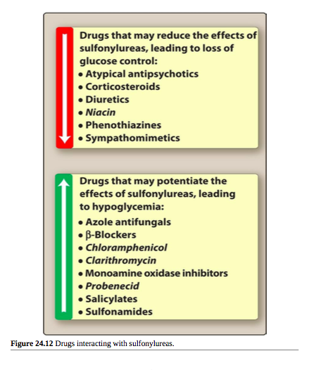

Slide 64

Repaglinide Half life 2 hours
Nateglinide
اذا بدنا نعطي Combination
لازم يكون الميكانيزم مختلف
Mechanism of action:
Like the sulfonylureas, their action is dependent on functioning pancreatic β cells
They bind to ATP-sensitive potassium channels leading to release of insulin
Categorized as postprandial glucose regulators; they are particularly effective in early release of insulin after a meal

Slide 65
The glinides have a rapid onset and a short duration of action
Combined therapy of these agents with metformin (Insulin sensitivity) or the glitazones is better than monotherapy in improving glycemic control
Glinides should not be used in combination with sulfonylureas (overlapping MOA)

Slide 66
Well absorbed orally after being taken 1 to 30 minutes before meals
Metabolized to inactive products by CYP3A4
Excreted through the bile
مناح لناس عندهم مشاكل بالكلى

Slide 67
Drugs that inhibit CYP3A4 (ketoconazole, itraconazole, fluconazole, erythromycin, and clarithromycin) may enhance the glucose-lowering effect of repaglinide
Drugs that increase levels of CYP3A4 (barbiturates, carbamazepine, and rifampin) may decrease their glucose lowering effect
Repaglinide concurrent use with gemfibrozil(antihyperlipidemic) is contraindicated due to reports of severe hypoglycemia

Slide 68
Adverse effects
Hypoglycemia
(lower incidence than sulfonylureas)
Weight gain
(less than with sulfonylureas)
Must be used with caution in patients with hepatic impairment Liver

Slide 69

Insulin sensitizers improve insulin action
Lower blood sugar by improving target-cell response to insulin without increasing pancreatic insulin secretion-No risk for hypoglycemia
Biguanides
Thiazolidinediones
ميتفورمين حبة كبيرة

Slide 70

Metformin (Glucomet®, Glucophage®, Diamet®) Antihyperglucemics
Increases glucose uptake and use by target tissues, decreasing insulin resistance
Does not promote insulin secretion (hyperinsulinemia is not a problem)
The risk of hypoglycemia is less than with sulfonylureas
ابر انسولين ما بكفوا لحالهم
وممكن يخرب b cells
اذا ضلت الاستجابة ضئيلة يعني

Slide 71

Mechanism of action:
Reduces hepatic glucose output by inhibiting hepatic gluconeogenesis الجسم بفكر انه الجسم ما فيه جلوكوز كفاية لانه ما في ادخال للخلايا ولا تحويل
Slows intestinal absorption of sugars and improves peripheral glucose uptake and utilization
Reduce hyperlipidemia
(LDL and VLDL cholesterol concentrations fall, and HDL cholesterol rises)
The patient commonly loses weight because of loss of appetite
تبين انه اذا بوخذوه مع السكري بصير في ضعف ولكن اذا بوخذوه فقط للتضعيف التأثير ما بكون كبير Metformin Vs Weight loss
Diabetics Metabolic disorder

Slide 72
The ADA recommends metformin as the drug of choice for newly diagnosed type 2 diabetics
Metformin may be used alone or in combination with one of the other agents as well as with insulin
Hypoglycemia may occur when metformin is taken in combination with insulin

Slide 73
Metformin is well absorbed orally
Not bound to serum proteins
Not metabolized
Excreted via the urine

Slide 74
Adverse effects:
GI adverse effects
Metformin is contraindicated in diabetic patients with renal and/or hepatic disease and in those with diabetic ketoacidosis insulin low, glucose high منعطي انسولين ICU حالة طارئة يعني
Should be discontinued in cases of acute MI, exacerbation of CHF, and severe infection
Rarely fatal lactic acidosis has occurred (lactic acidosis) rare, but اذا صار منوقف الدواء
Long-term use may interfere with vitamin B12 absorption

Slide 75
Metformin is effective in the treatment of polycystic ovary disease
لها علاقة Insulin resistance
Its ability to lower insulin resistance in these women can result in ovulation and possibly pregnancy

Slide 76

Insulin sensitizers
Insulin is required for their action
Do not promote insulin release
Hyperinsulinemia is not a risk
Troglitazone (withdrawn after deaths from hepatotoxicity) مش للحفظ
Pioglitazone (Actos®)
Rosiglitazone (Avandia®)

Slide 77
Mechanism of action
 The exact mechanism by which the TZDs lower insulin
resistance is unknown
 TZDs target the PPARγ

Ligands for PPARγ regulate adipocyte production and
secretion of fatty acids and glucose metabolism, resulting in increased insulin sensitivity in adipose tissue, liver, and skeletal muscle
Hyperglycemia, hyperinsulinemia, hypertriglyceridemia, and elevated HbA1c levels اهم Parameter في السكريare improved
LDL levels are not affected by pioglitazone
LDL levels have increased with rosiglitazone
HDL levels increase with both drugs

Slide 78
Pioglitazone and rosiglitazone can be used as monotherapy or in combination with other glucose- lowering agents or insulin
The dose of insulin required for adequate glucose control in these circumstances may have to be lowered
ADA recommends pioglitazone as a tier 2 alternative for patients who fail or have contraindications to metformin therapy
Rosiglitazone is not recommended due to concerns regarding cardiac adverse effects

Slide 79

Extensively bound to serum albumin
Both undergo extensive metabolism by CYP450
Some metabolites of pioglitazone have activity
) longer duration of action (
Elimination of pioglitazone and its metabolites is mainly in the bile اذا في مشاكل بالكلى بكون هذا البدل عن الميتفورمين
The metabolites of rosiglitazone are primarily excreted in the urine

Slide 80
Adverse effects مهم وعليه سؤال
Very few cases of liver toxicity with rosiglitazone or
pioglitazone
Because of deaths due to hepatotoxicity from troglitazone it is
recommended that liver enzyme are periodically checked
Weight increase can occur
Osteopenia and increased fracture risk

Increased risk of myocardial infarction and death from
cardiovascular causes with rosiglitazone
Headache
Anemia

May cause resumption of ovulation in some women who have
been anovulatory
 Premenopausal women should be counseled about the need for adequate contraception while taking TZDs
رقم واحد لمرضى السكر هو الميتفورمين

Slide 81
Acarbose (Acrose®, Prandase®)
Miglitol
Oral drugs for the treatment of patients with type 2 diabetes
مش مهمين كثير

Slide 82
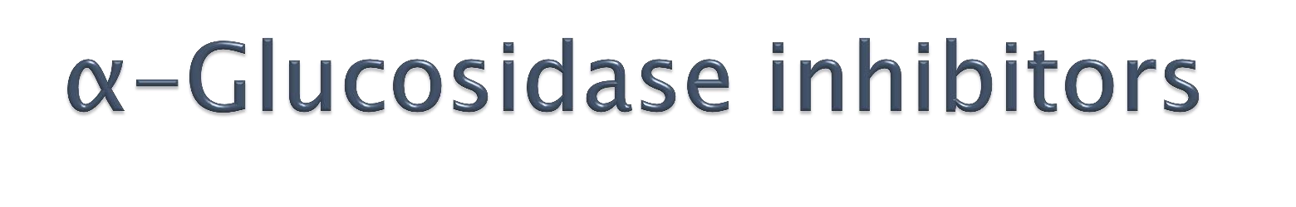
Mechanism of action
Taken at the beginning of meals
Act by delaying the digestion of carbohydrates lowering postprandial glucose levels
Reversible inhibitors of membrane-bound α- glucosidase in the intestine
This enzyme is responsible for hydrolysis of oligosaccharides to glucose and other sugars
Acarbose also inhibits α-amylase, interfering with the breakdown of starch to oligosaccharides فبطلع من الجسم
The postprandial rise of blood glucose is blunted
الأكل نأخذه بأثروا على النشا Starch مع

Slide 83
Adverse effects
Flatulence, diarrhea, and abdominal cramping
Patients with IBD, colonic ulceration, or intestinal obstruction should not use these drugs
No hypoglycemia if used alone
Hypoglycemic patient should be treated with glucose rather than sucrose, because sucrase is also inhibited by these drugs

Slide 84
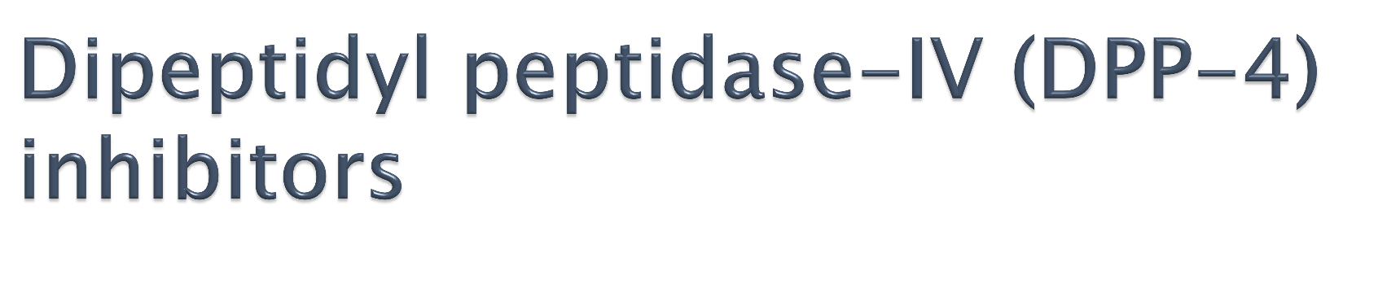
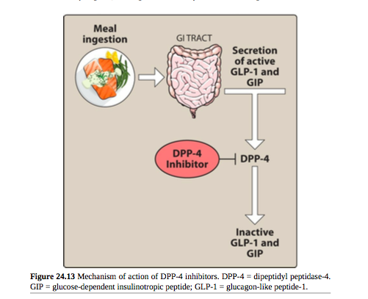
Sitagliptin (Januvia®)
Saxagliptin (Onglyza®)
Alogliptin
Linagliptin (Tradjenta®)
Orally active DPP-4 inhibitors used for the treatment of patients with type 2 diabetes
Combinations with metformin are available
  Sitagliptin + metformin (Januet®)
  Vildagliptin + metformin (Eucreas®)
  Enzymes that break incretin وهكذا بزيد افراز الانسولين
  بمنع تكسير الانكريتين الدواء

Slide 85

Mechanism of action
Inhibit the enzyme DPP-4, which is responsible for the inactivation of incretin hormones such as GLP-1
Prolonging the activity of incretin hormones results in increased insulin release in response to meals and reduction in glucagon secretion

Slide 86
 DPP-4 inhibitors may be used as monotherapy or in combination with a sulfonylurea, metformin, glitazones, or insulin
Sitagliptin and saxagliptin are excreted in urine
  Dosage adjustments for both DPP-4 inhibitors are
recommended for patients with renal dysfunction
Saxagliptin is metabolized by CYP450
  Strong inhibitors of CYP3A4/5, such as nelfinavir, atazanavir للايدز, ketoconazole, and clarithromycin, may increase levels of saxagliptin

Slide 87

Adverse effects
Nasopharyngitis
Headache
Pancreatitis has occurred with sitagliptin
Alogliptin and saxagliptin increase the risk of heart failure hospitalization

Slide 88
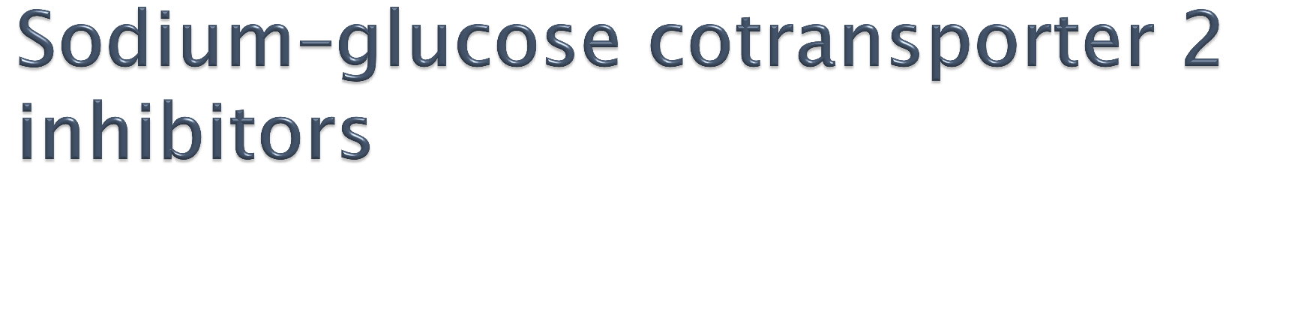
Dapagliflozin (Forxiga®)
Canagliflozin Mechanism of action:
SGLT2 is responsible for reabsorbing filtered glucose in the tubular lumen of the kidney
By inhibiting SGLT2, these agents decrease reabsorption of glucose, increase urinary glucose excretion, and lower blood glucose
Decreases reabsorption of sodium and causes osmotic diuresis reducing systolic blood pressure
اخراج الجلوكوز بالبول بدل ما يعمل مشاكل بالقلب والاطراف والعيون
مريض السكري عنده التهابات البول أكثر
التئام الجروح بطيء لدى مرضى السكري

Slide 89

Given once daily in the morning
Canagliflozin should be taken before the first meal of the day
Metabolized by glucuronidation to inactive metabolites
Should be avoided in patients with renal dysfunction

Slide 90
Adverse effects:
Female genital mycoticفطريات infections urinary tract infections, and urinary frequency
Also male
Hypotension

Slide 91
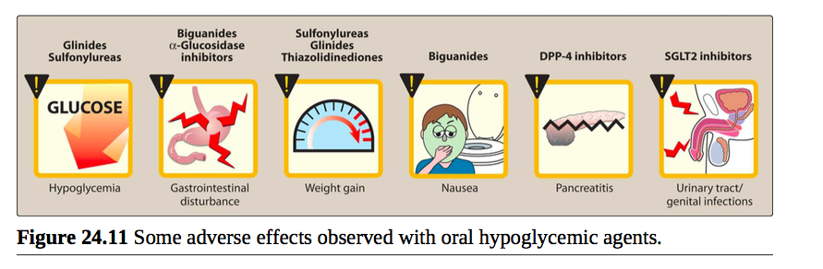

Slide 92

Bromocriptine and colesevelam produce modest reductions in HbA1c
The mechanism of action of glucose lowering is unknown
Indicated for type 2 diabetes
Modest efficacy, adverse effects limit their use in clinical practice

Slide 93
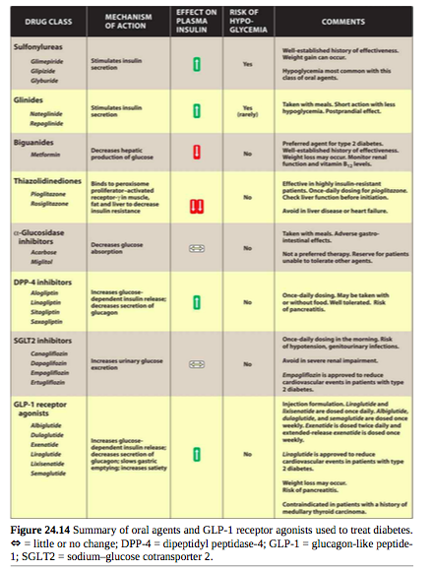

Slide 94
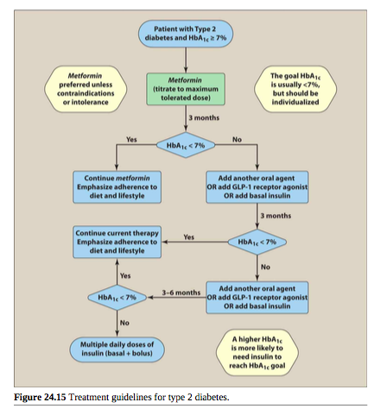

Slide 95
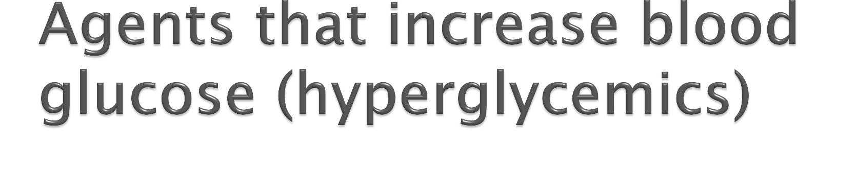
Glucagon :
Uses
First aid in cases of severe hypoglycemia when the victim is unconscious or for other reasons cannot take glucose orally
Treatment of overdose with beta blockers
It has positive inotropic action and chronotropic action on the heart

