Slide 1
Cardiovascular disease (CVD)

Slide 2
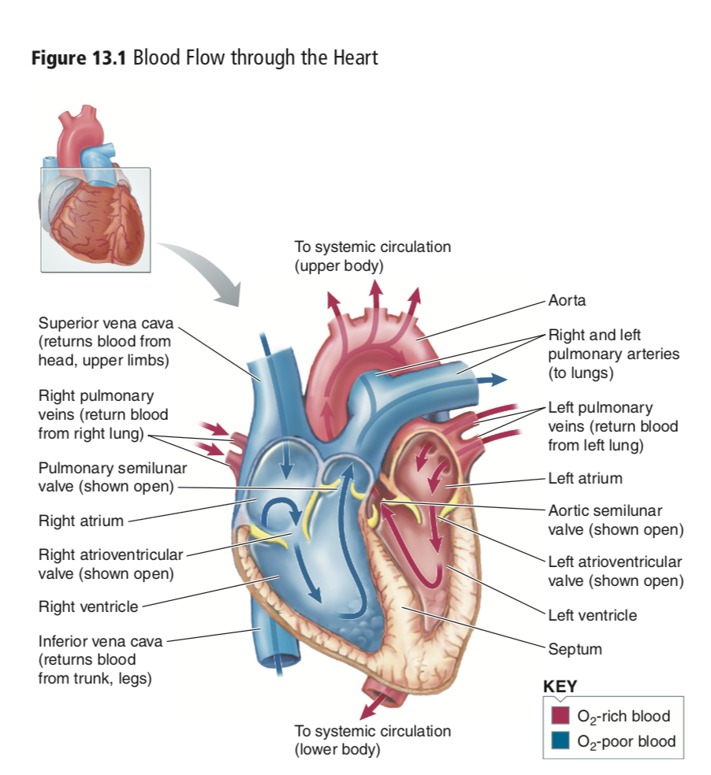
The role of the cardiovascular system is to regulate blood flow to the tissues in order to deliver oxygenated blood and nutrients as well as to retrieve waste products from cellular metabolism.
hormone transport, maintenance of fluid volume, regulation of pH (to control acidosis and alkalosis), and gas exchange.

Slide 3
Cardiovascular diseases: a class of diseases involving heart or blood vessels (arteries & veins) throughout the body; caused by atherosclerosis and/or hypertension
CVD is a global health issue; it is the leading cause of death worldwide
Types of CVD
Ischemic heart disease ( Heart not getting enough oxygen)
Cardiomyopathy - diseases of cardiac muscle (makes it harder for your heart to pump blood to the rest of your body)
Hypertensive heart disease - diseases of the heart secondary to high blood pressure
Heart failure
Cardiac dysrhythmias - abnormalities of heart rhythm
Stroke and cerebrovascular disease (CVA = CerebroVascular Accident)-disease of the blood vessels supplying the brain
Peripheral arterial disease (PAD or PVD = Peripheral artery/vascular disease)
  Peripheral arterial disease occurs when there's a blockage in the arteries to the limbs, usually the legs
Coronary heart disease (CHD): is the narrowing or blockage of the coronary arteries, usually caused by atherosclerosis, can lead to heart attack

Slide 4
Atherosclerosis
“Hardening of the Arteries”
Artery walls THICKEN due to
Accumulation of fatty deposits
Fibrous connective tissue
Smooth muscle cells
Plaque
In atherosclerosis, sometimes referred to as “hardening of the arteries,” the artery
walls become progressively thickened due to an accumulation of fatty deposits, fibrous connective tissue, and smooth muscle cells, collectively known as plaque

Slide 5
Vulnerable plaque has only a thin, fibrous barrier separating its lipid-rich core from the arterial lumen.
Highly susceptible to rupture
When it ruptures, promotes blood clot formation (thrombosis) within the artery
May enlarge in time and ultimately obstruct blood flow
Plaque can exist in a stable form that does not cause complications or an unstable
form called vulnerable plaque.

Slide 6
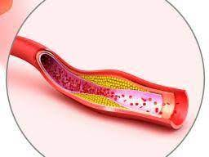
Atherosclerosis
Aneurysm
Narrow the lumen of an artery and interfere with blood flow
Most complications of atherosclerosis result from the deficiency of blood and oxygen within the tissue served by an obstructed artery (ischemia)
Atherosclerosis can affect almost any organ or tissue in the body
Plaque can weaken the blood vessel wall, and eventually the pressure of blood flow can cause the damaged region to stretch and balloon outward-Aneurysm—the abnormal dilation of a blood vessel

Slide 7
Atherosclerosis Development
Atherosclerosis can begin to develop as early as childhood or adolescence
Initially arises in response to minimal but chronic injuries that damage the inner arterial wall
An injury that disrupts blood flow causes an inflammatory response
Inflammatory mediators: immune cells, cytokines, increase permeability of the artery wall
Low-density lipoproteins (LDL) slip under the artery’s thin layer of endothelial cells
LDLs oxidize
Arterial macrophages engulf altered LDL -> foam cells
Fatty deposits along artery walls, known as fatty streaks

Slide 8
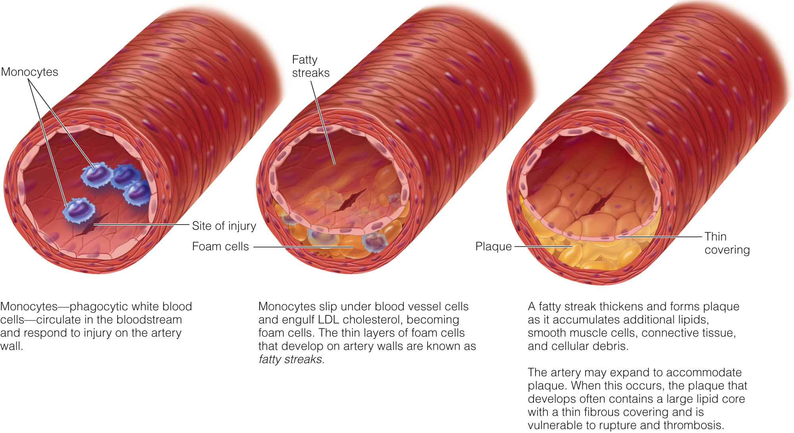
Notes:
the onset of lesion formation, the damage to the endothelial layer attracts platelets to the area These platelets attach to the endothelium and form a small clot termed thrombus. As platelets adhere to the subendothelial surfaces at the site of injury, they begin to secrete both adenosine diphosphate (ADP), which promotes platelet aggregation, and platelet-derived growth factor (PDGF), which attracts monocytes and promotes smooth muscle cell
Nitric oxide (NO) is a substance naturally produced by endothelial cells and a number of other cells. NO produced in the endothelial cells controls the normal relaxation of smooth muscle in the arteries and arterioles. Low levels of NO exacerbate the inflammatory state that con- tributes to the atherosclerotic process.

Slide 9
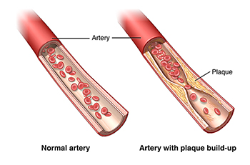
Expansion
Narrowing
As atherosclerosis progresses, the artery often expands outward to accommodate the plaque
lumen diameter is unchanged
When artery expands , blood flow not disrupted
unstable vulnerable plaque, which is more likely to rupture, induce clotting
May Lead to heart attack and stoke In other cases, the accumulating plaque causes narrowing, rather than expansion, of the artery.
Obstruct blood flow
advanced atherosclerosis is generally characterized by both outward expansion of the artery and luminal narrowing

Slide 10
Cause of Atherosclerosis
Inflammation
Inflammation from possible sources (adipose, GI tract, smoking)
Increase in circulating cytokines/inflammatory mediators chronically
Damage to endothelial wall due to presence of inflammatory response
LDL get into sub-endothelial space, are oxidized by immune cells
LDL
Too much LDL circulating
LDL gets older and smaller
Can squeeze between endothelial cells
Its presence in sub-endothelial space is inflammatory

Slide 11
Causes of Atherosclerosis
Direct damage to the artery wall or allowing lipid materials to penetrate
Shear Stress/Hypertension: Stress of blood flow along artery walls can cause physical damage- Hypertension
Abnormal Blood Lipids: When LDL levels are high, they are actively taken up and retained in susceptible regions in the artery wall
High LDL and VLDL and low HDL
LDL vary in size and density
The smallest, most dense LDL can slip into artery walls easily and are more atherogenic than the larger, less dense LDL
Effect of low HDL?
Notes:
remove cholesterol from circulation and contain proteins that inhibit inflammation

Slide 12
Cigarette Smoking: can cause arterial injury & chronic inflammation
Diabetes Mellitus: Chronic hyperglycemia leads to the accumulation of advanced glycation end products (AGEs), which promote inflammation and oxidative stress
Age and Gender
As a person ages, arterial cells tend to degenerate, and risk factors for CVD accumulate. The risk of atherosclerosis increases significantly in men and women older than 45 and 55 years of age
After menopause, women’s risk increases, in part, because the decline in estrogen has unfavorable effects on lipoprotein levels and arterial function

Slide 13
Consequences of Atherosclerosis
Thrombosis: Process of a blood clot
blood clots block your blood vessels
https://www.webmd.com/dvt/ss/slideshow-thrombosis-types

Slide 14
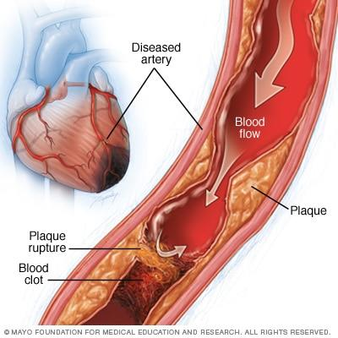
Consequences of Atherosclerosis
Ischemia
Embolism
A portion of a clot can also break free (embolus) and travel through the circulatory system until it lodges in a narrowed artery and shuts off blood flow to the surrounding tissue (embolism)
Deficiency of blood and oxygen within the tissue served by an obstructed artery.
reduces the heart muscle's ability to pump blood. A sudden, severe blockage of one of the heart's artery can lead to a heart attack.

Slide 15
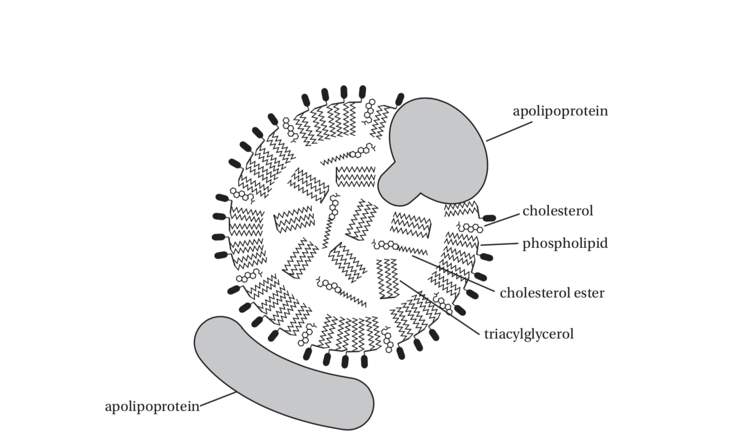
Review of lipoproteins

Slide 16
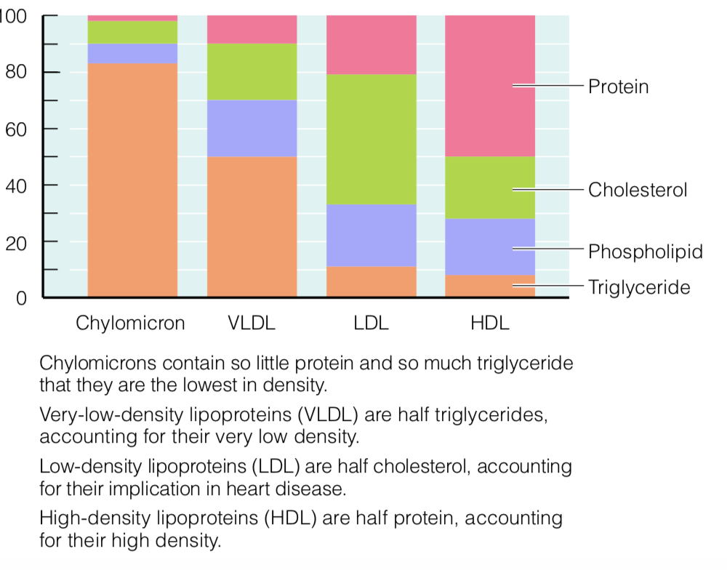

Slide 17
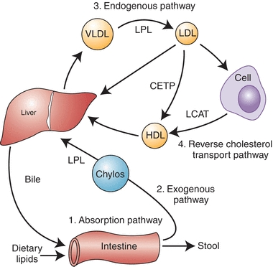

Lipoproteins metabolism

Slide 18
LDL Build Up in the Blood?
When LDL endocytosed by cell , lipids get degraded into basic components
• Accumulation of cholesterol in cell:
o Down-regulates LDL-Receptor
o Down-regulates cholesterol synthesis
Competition for LDL-R mediated uptake
Decreased numbers of LDL receptors, which leads to more LDL cholesterol staying in circulation
May also increase expression of genes for fat and cholesterol synthesis
Goldstein, J. L., & Brown, M. S. (2009). The ldl receptor. Arteriosclerosis, Thrombosis, and Vascular Biology, 29(4), 431-438. doi:10.1161/atvbaha.108.179564
Notes:
An decrease in the number of receptors on the surface of target cells, making the cells less sensitive to a hormone or another agent.

Slide 19
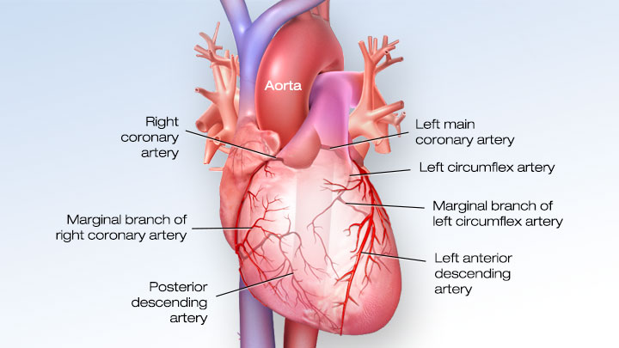
Coronary Heart Disease (CHD)
CHD is characterized by impaired blood flow through the coronary arteries, which may lead to:
Angina pectoris(chest pain )
Heart attack
Sudden death
The coronary arteries are the major blood vessels that supply the heart with blood, oxygen and nutrients
https://watchlearnlive.heart.org/index.php?moduleSelect=corart

Slide 20
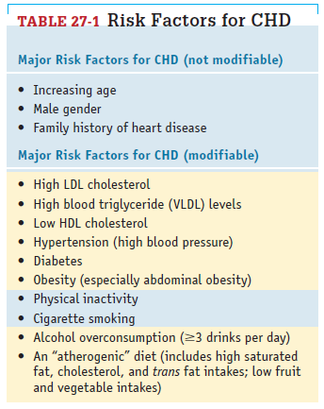
Coronary Heart Disease (CHD)
The American College of Cardiology (ACC) and American Heart Association (AHA) recommend a review of CHD risk factors every 4 to 6 years in individuals who are 20 to 79 years of age
Most of the risk factors can be modified with the appropriate diet and lifestyle changes

Slide 21
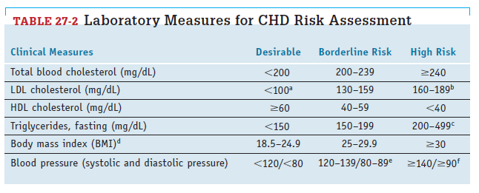
Clinical Measures
CHD risk assessment

Slide 22
Other assessments
Ratio of total cholesterol to HDL cholesterol
Ratio of LDL cholesterol to HDL cholesterol
Blood pressure and body weight measurements
Additional detail about blood lipids
  LDL and HDL subclasses
  LDL particle number
  Levels of proteins or enzymes associated with lipoproteins (especially apolipoprotein B—a component of LDL and VLDL)
Coronary artery calcium score- used to assess atherosclerosis ( conducted using a CT scan that analyzes the calcium content of plaque in the coronary arteries)
Inflammatory biomarkers: for example, Levels of C-reactive protein

Slide 23
Elevated LDL levels are directly related to the development of atherosclerosis,
low HDL levels often coexist with other lipid abnormalities;
  A low HDL level is highly predictive of CHD risk
Sometimes chronic inflammation may lead to HDL dysfunction
  Thus, increased CHD risk can exist despite high HDL concentrations
LDL-lowering treatments can successfully reduce the rates of cardiovascular events

Slide 24
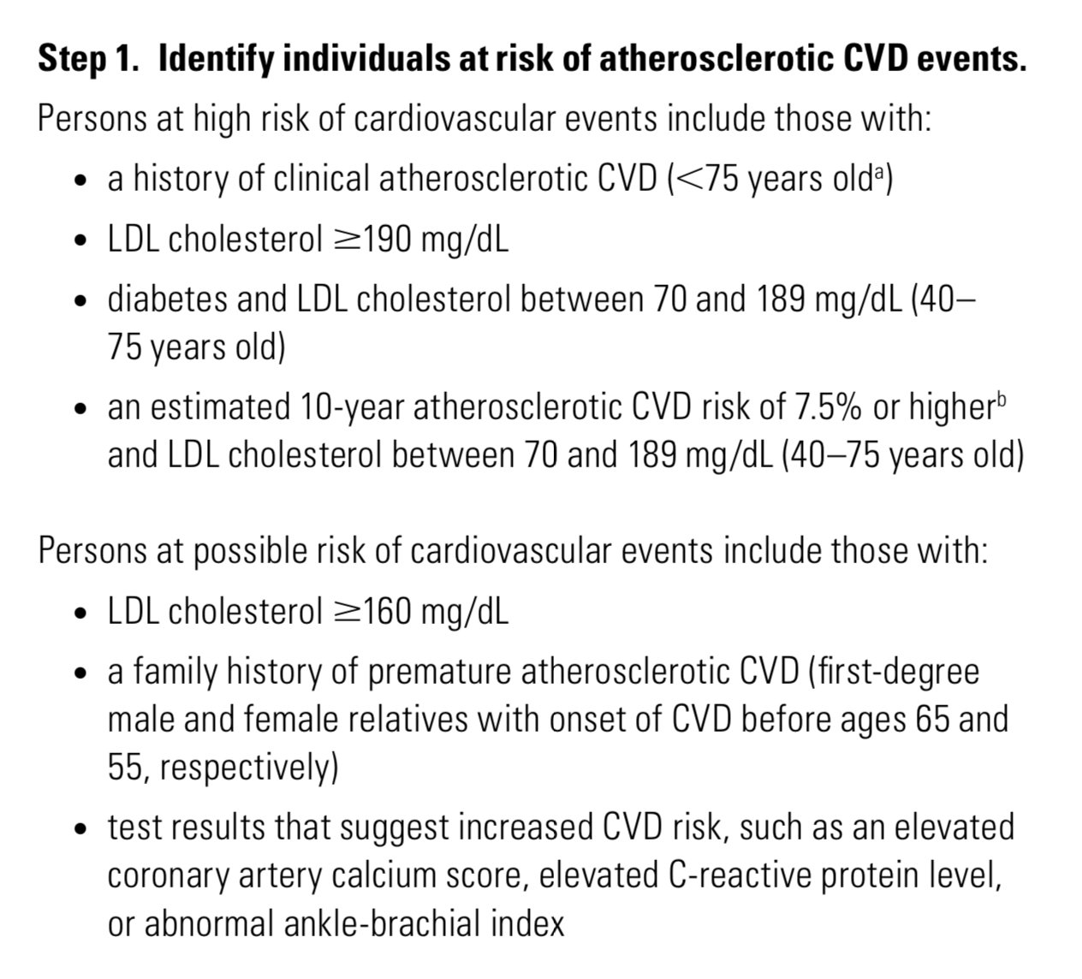
Treatment Strategies for Lowering Cholesterol levels and Atherosclerotic CVD Risk
Treatment emphasize both lifestyle practices and drug strategies that reduce risk
identify a patient’s level of risk for atherosclerotic events
Determine treatment strategies based on the LDL level and other risk factors
Basic treatment steps/ guidelines

Slide 25
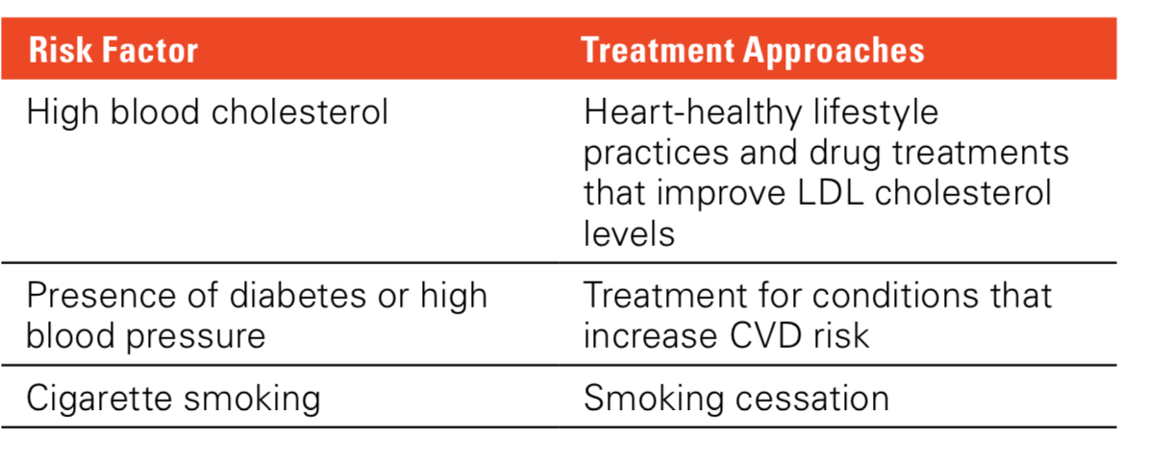
Treatment Strategies/cont.
Step 2. Determine the strategies that will lower LDL cholesterol and reduce CVD risk
Treatment approaches are based on a patient’s level of risk and specific risk factors
With effective lifestyle intervention, reliance on drug treatment can be reduced

Slide 26
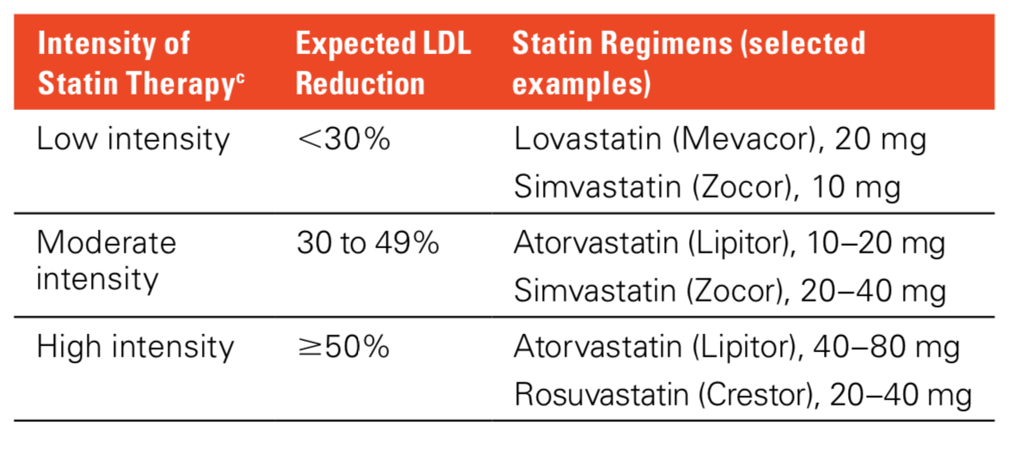
Treatment Strategies/ cont.
Step 3. Determine the appropriate medication and dosage
statin drugs, which interfere with cholesterol production in the liver
physicians determine whether the patient should receive low, moderate, or high-intensity statin therapy
If patient is intolerant to statin medications, alternative cholesterol-lowering drugs are used

Slide 27
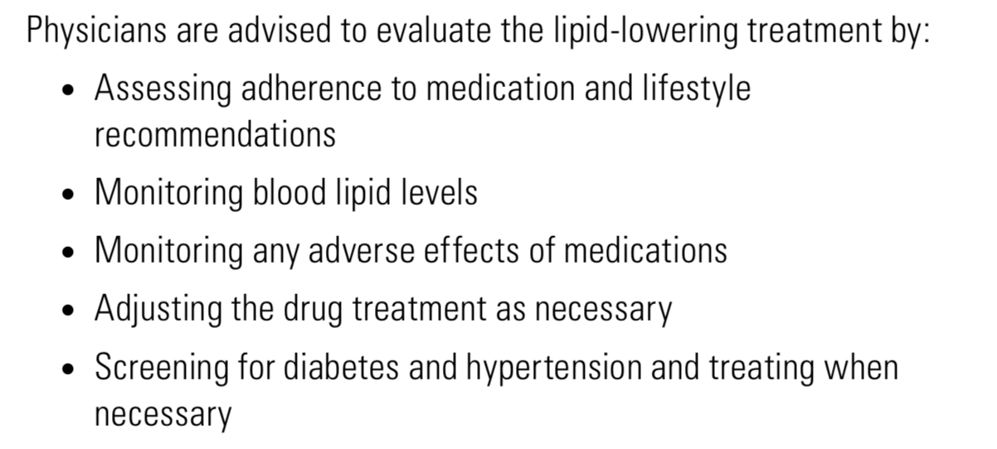
Treatment Strategies/cont.
Step 4. Regularly monitor patient compliance and outcomes

Slide 28
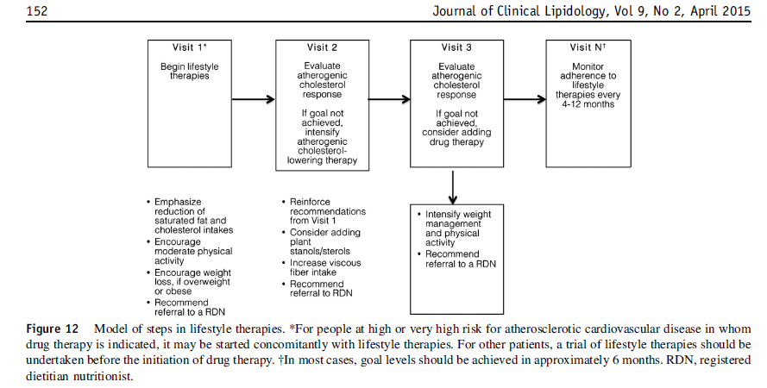
lifestyle therapy (first line intervention choice) and medication

Slide 29
Lifestyle Management to Reduce CHD Risk
Healthy dietary pattern
Regular physical activity
Nonsmoking status
Maintaining a healthy body weight
Biomarkers for Ideal cardiovascular health
Total blood cholesterol < 200 mg/dL
Blood pressure <120/< 80 mm Hg
Fasting plasma glucose <100 mg/dL

Slide 30
Lifestyle Management to Reduce CHD Risk/ DIET
Dietary Strategies that can improve the lipoprotein profiles
Adopt a healthy dietary pattern (USDA Food Pattern or the DASH Eating Plan)
Limit Intake of :
    Saturated fat < 7 percent of total kcal
    Cholesterol <200 milligrams per day.
    Replace saturated fats with unsaturated fats from fish, vegetable oils, and nuts
    w/ carbohydrates from whole grains, legumes, fruits, and vegetables
NO trans fat

Slide 31
Lifestyle Management to Reduce CHD Risk/ DIET(CONTINUED)
4. Choose foods high in soluble fibers (oats, barley, legumes, and fruit)
  Use dietary supplements that contain psyllium seed husks to help lower LDL cholesterol levels.
  Intake of plant sterol is recommended
5. Regular intake of fish
6. Limit alcohol :
    1 drink / day for women
    2 drinks/day for men
7. Consume a low-sodium diet that is high in fruits and vegetables, whole grains, nuts, and low-fat milk products.

Slide 32
Lifestyle Choices
Physical activity
  Moderate-to-vigorous aerobic activity(40 minutes per session)
  At least 3 or 4 days per week
Tobacco avoidance
Weight Reduction
  In overweight or obese individuals, weight reduction may improve some CVD risk factors
  weight-management program: prevent weight gain, reduce body weight, and maintain a lower body weight over the long term
  Initially, if a patient is put on a weight management program
  Initial goal : Lose 5-10% of original body weight

Slide 33
People with high cholesterol can benefit from diets that emphasize
vegetables, fruit, and whole grains
low-fat milk products,
Lean poultry, fish
legumes, non-tropical vegetable oils and nuts
Limited sweets, sugar-sweetened beverages, and red meats
EXAMPLE : DASH Eating Plan

Slide 34
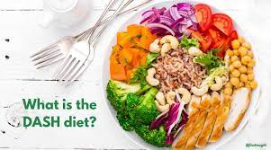
The History of DASH
The DASH study involved 459 adults
27% of the participants had hypertension.
This study found that blood pressures were reduced with an eating plan that is low in saturated fat, cholesterol, and total fat, and that emphasizes fruits, vegetables, and low-fat dairy foods (high in whole-grain products, fish, poultry, and nuts. reduced in red meat, sweets, and sugar-containing beverages) high in calcium, potassium and magnesium) vs, a typical American diet but higher in fruits and veggies
DASH Sodium study looked at the same two dietary patterns but also tested the effect of reducing sodium
Results showed that reducing dietary sodium lowered BP for both eating plans. At each sodium level, BP was lower on the DASH eating plan. Lowest BP for participants who followed a DASH plan and reduced sodium to 1500 mg per day

Slide 35
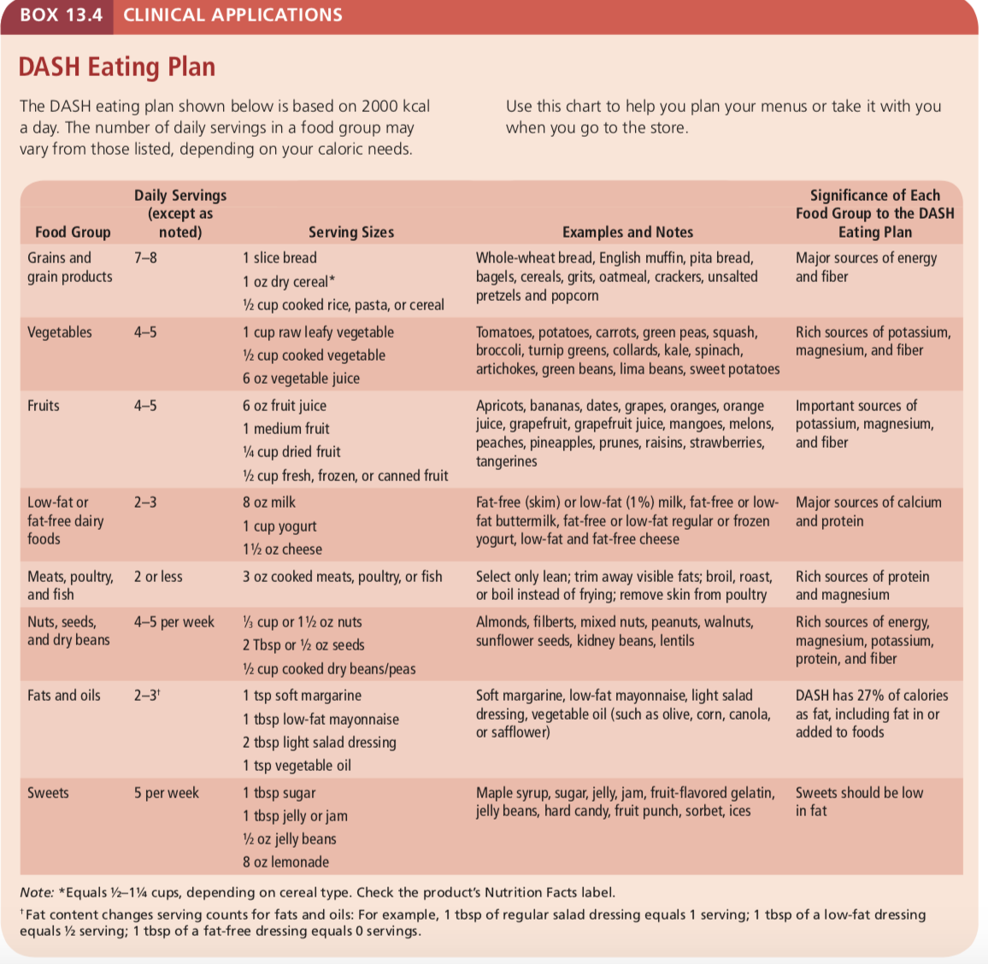
DASH

Slide 36
Saturated Fat
Saturated fat has the strongest effect on blood cholesterol levels, and replacing saturated fats with polyunsaturated or monounsaturated fats can generally lower LDL levels
Recommendation : limit saturated fat intake <7 percent of kcal consumed
Where is saturated fat present ?
Switching from butter to vegetable oil is enough ?

Slide 37
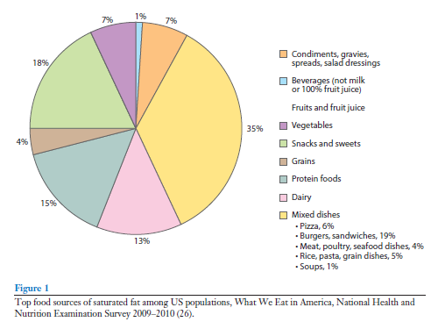
Saturated fat SOURCES
Effective ways of reducing saturated fat.
Avoiding certain types of desserts high in sat fat
Choosing low/no fat dairy
Lean meats/ fish

Slide 38
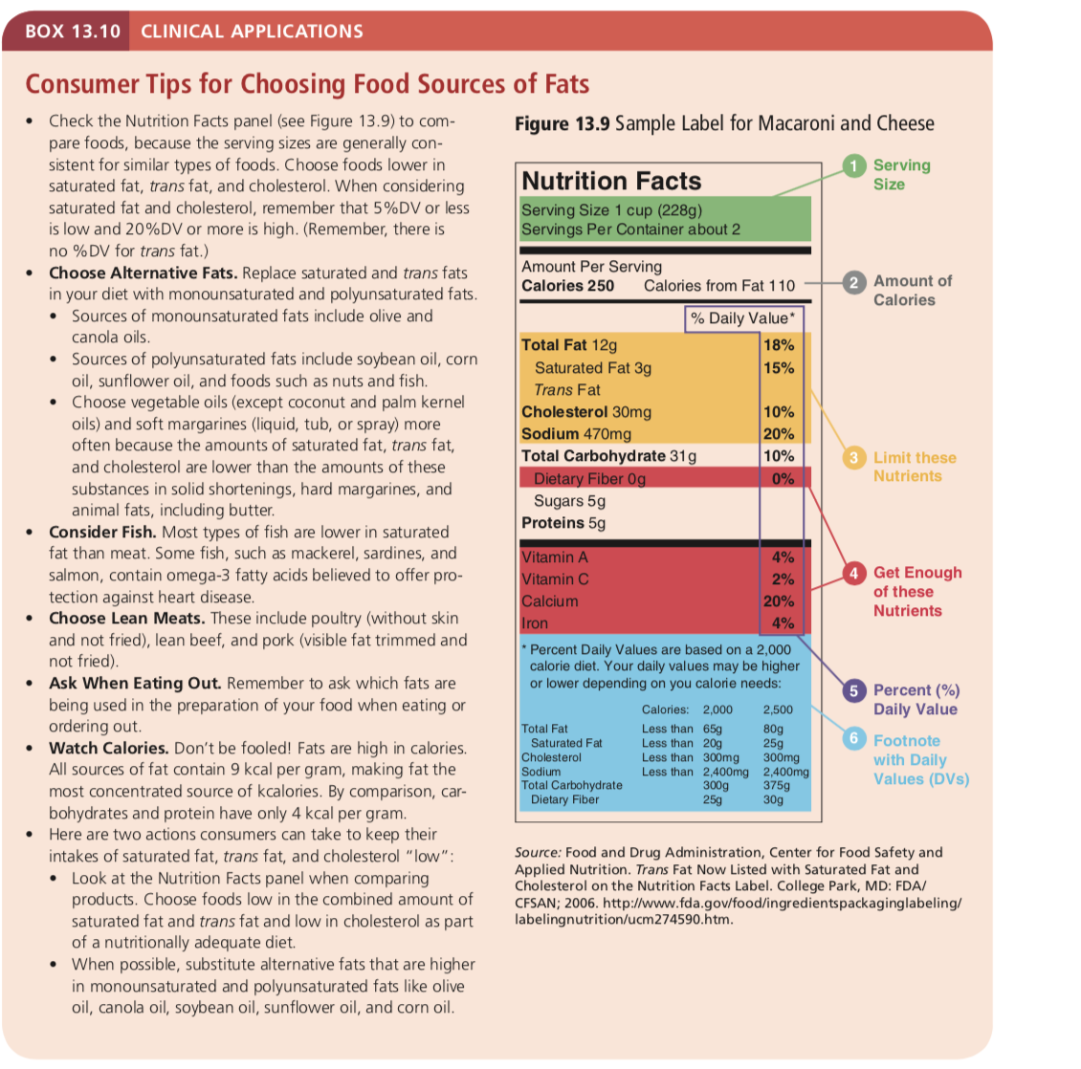

Slide 39
Recommendation are based on reducing saturated fat because of increasing effects SFA has on LDL levels
HOWEVER, the dietary sources of saturated fat may cause different responses in LDL levels
EXAMPLE: DAIRY AND CVD
Evidence from observational studies does NOT support a direct association between dairy intake (even full fat dairy) and increased CVD incidence
Dairy products & fermented dairy, do not have negative effects on blood lipids
Consumption of red Meat has a positive association w/ CVD risk
Consumption of Dairy has an inverse association w/ CVD risk
The composition of SFA in dairy and red meat is different
Dairy has more short and medium chain SFA
Other beneficial components of dairy may play a role in explaining this inverse relationship (calcium may interfere with fat absorption in the intestine)
REMEMBER: GUIDELINES STILL RECOMMEND LOW/NO FAT DAIRY
Chen, Li et al, AJCN, 2016
Arne Astrup, AJCN, 2014
Otto, Mozzafarian et al, AJCN, 2012

Slide 40
Cho INSTEAD OF SAT FAT?
Replacing saturated fats with carbohydrates can also lower LDL cholesterol
BUT may increase blood triglyceride (VLDL)
THUS choosing appropriate CHO limiting added sugars and including fiber-rich foods
High Dietary CHO (especially simple carbs), and excess calories, can drive increased VLDL secretion, resulting in increased LDL, especially the atherogenic small dense LDL

Slide 41
cHO
Dietary CHO increases hepatic TG
TG drive the secretion of VLDL
VLDLs are TG rich and are broken down by lipoprotein lipase to form LDLs
LDLs can stay in blood plasma, if LDL receptor affinity is reduced

Slide 42
Polyunsaturated and Monounsaturated Fat
Replacing saturated fat with either polyunsaturated or monounsaturated fat helps to lower LDL levels
Replacing saturated fat with polyunsaturated fat has been associated with reductions in morbidity and mortality from CHD
polyunsaturated fat in the diet consists of omega-6 fatty acids such as linoleic acid; omega-3 fatty acids

Slide 43
pufas
There is an assumption that all PUFAs result in a reduction in blood cholesterol
PUFAs comprises multiple species of n−3 and n−6 PUFAs
Benefits of n−3 PUFAs are reported in several RCT, however, such benefits are not necessarily generally applicable to n−6
Diets that are high in n-3 PUFAs have proven to provide protective effect against CVD
Human beings evolved on a diet with a ratio of omega-6 to omega-3 of 1:1
Today this ration is about 15/1
Simopoulos AP. The importance of the ratio of omega-6/omega-3 essential fatty acids. Biomed Pharmacother. 2002 Oct;56(8):365-79. doi: 10.1016/s0753-3322(02)00253-6. PMID: 12442909.

Slide 44
PUFAS
Omega-3 PUFAs have been shown to decrease the production of inflammatory mediators, having a positive effect in obesity and diabetes mellitus type-2 AND CVD risk factors.
Omega-6 PUFA effects may be are pro-inflammatory
Omega-6 PUFA arachidonic acid (ARA)makes up a large portion of the fatty acids present in the membrane phospholipids of cells involved in inflammation
ARA is a precursor to a number of potent pro-inflammatory mediators
Possibly, by increasing dietary intake of the omega-6 fatty acids ARA or its precursor linoleic acid (LA) may increase inflammation.
Innes JK, Calder PC. Omega-6 fatty acids and inflammation. Prostaglandins Leukot Essent Fatty Acids. 2018 May;132:41-48. doi: 10.1016/j.plefa.2018.03.004. Epub 2018 Mar 22. PMID: 29610056.

Slide 45
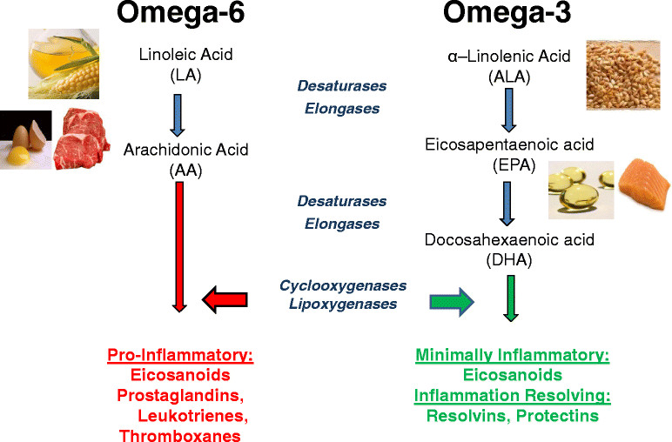
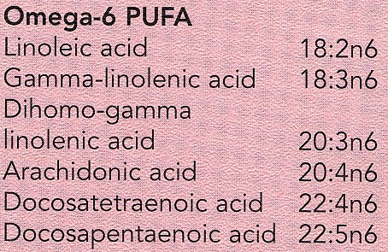
Food sources of omega-6
soybeans
corn
safflower and sunflower oils.
nuts and seeds.
meat, poultry, fish and eggs.
https://www.researchgate.net/figure/Dietary-sources-and-general-metabolic-pathway-for-omega-6-and-omega-3-polyunsaturated_fig1_275836096

Slide 46
Fish and Omega-3 Fatty Acids
Omega-3 may benefit people who have had a heart attack by:
Suppressing inflammation
Lowering blood triglyceride levels
Reducing blood clotting
Fish especially is also low in saturated fat and typically replaces animal fat
AHA recommendations: 2 or more servings of fish per week, with an emphasis on fatty fish

Slide 47
TOTAL FAT
Recommendation for total fat is 20 to 35 percent of the energy intake
Individuals with elevated blood triglycerides may benefit from achieving a fat intake at the upper end of this range (30 to 35 percent) to reduce carbohydrate intake
Trans Fats Trans fats can raise LDL levels, and when they replace saturated fats in the diet (as when stick margarine replaces butter), and may reduce HDL levels
May also promote inflammation
Sources of trans fats : products made with partially hydrogenated vegetable oils; (baked goods such as crackers, cookies, and doughnuts; potato chips and corn chips, French fries and fried chicken)
trans fat intake should be kept as low as possible

Slide 48
Dietary Cholesterol
The influence of dietary cholesterol on CHD risk is some- what unclear
Some studies suggest that high cholesterol intake can raise LDL levels
Most recommendation: <200 milligrams per day.

Slide 49
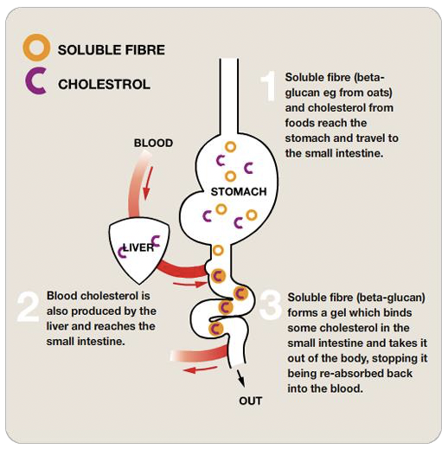
Soluble fiber
Fiber binds bile salts in the GI tract
Cholesterol removed from serum for bile acid synthesis in an effort to restore bile acid pool
Promotes synthesis of short chain fatty acids via fermentation in the colon. SCFA’s inhibit hepatic cholesterol synthesis ( inhibits the rate limiting enzyme involved in endogenous biosynthesis of cholesterol)
www.nestle.co.nz

Slide 50
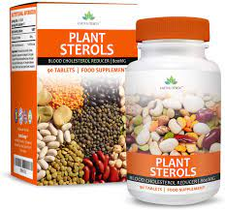
Plant Sterols
Cholesterol-like compounds that occur naturally in plant-based foods
Help to lower LDL cholesterol levels by interfering with cholesterol and bile absorption
Blocked cholesterol and plant sterols are eliminated from body
Found in food or can be taken as a supplement
Sometimes added to foods such as margarine and orange juice
2 grams of plant sterols daily can lower LDL cholesterol by up to 10 percent

Slide 51
Blood Pressure Reduction
Excessive dietary sodium may raise blood pressure
Dietary potassium can help to lower blood pressure
A low-sodium diet , high in fruits and vegetables, whole grains, nuts, and low-fat milk products has been found to substantially reduce blood pressure, largely due to the diet’s content of potassium and several other minerals that have blood pressure–lowering effects (the DASH Eating Plan)

Slide 52
Regular Physical Activity
Regular aerobic activity can reverse risk factors for CHD:
Lower LDL levels
Reduce blood pressure
Improve insulin sensitivity
Promote weight loss
Strengthen heart muscle
Increase coronary artery size and tone
Physical Activity Rec’d
Moderate-to-vigorous aerobic activity (40 minutes per session) 3 to 4 times/ week
Physical activity can be divided into several sessions during the day ( instead of continuous 40 min at a time) especially if patient is sedentary and has CVD ( PA should be increased gradually)
Notes:
vigorous activity increases the risk of a heart attack or sudden death in individuals with diagnosed heart disease

Slide 53
Vitamin Supplementation and CHD Risk
B vitamins and homocysteine
Elevated blood homocysteine is a risk factor for CHD ( can damage the arteries lining)
Increased intakes of folate, vitamin B6, and vitamin B12 can lower homocysteine levels BUT clinical trials have not demonstrated that supplementation with these vitamins can reduce the incidence of heart attack for people at risk
Antioxidant Supplements
Oxidative stress promotes atherosclerosis
Several epidemiological studies have suggested that antioxidant-rich diets can protect against CHD, but because persons who consume such diets usually maintain a healthy lifestyle and body weight as well, it has been difficult to determine whether the antioxidants were responsible for the effect
Not enough data to recommend antioxidants for CVD or heart disease prevention

Slide 54
Hypertriglyceridemia
Risk Factors: Overweight and obesity, a sedentary lifestyle, cigarette smoking, and high intakes of alcohol and refined carbohydrates (particularly sucrose and fructose)
Thus, controlling these risk factors is the basic treatment for hypertriglyceridemia
Extreme elevations (>500 mg/dl) in blood triglycerides are usually caused by genetic factors. Addition to dietary and lifestyle changes, medications are usually necessary
If blood triglycerides exceed 1000 mg/dl, a very low-fat diet may be required ((providing less than 15 percent of calories from fat, may be required )
Fish oil supplements are sometimes recommended for treating hypertriglyceridemia.
Notes:
Fish Oil counteracts intracellular lipolysis in adipocytes by suppressing adipose tissue inflammation. In addition, FO increases extracellular lipolysis by lipoprotein lipase (LpL) in adipose, heart and skeletal muscle and enhances hepatic and skeletal muscle β-oxidation which contributes to reduced FA delivery to the liver

Slide 55
Drug Therapies for CHD Prevention
Drugs most often prescribed for lowering LDL levels are the statins which work by reducing cholesterol synthesis in the liver
Other medications work by reducing cholesterol levels through inhibiting cholesterol absorption
Bile acid sequestrants reduce LDL levels by interfering with bile acid reabsorption in the small intestine.

Slide 56
Drug Therapies for CHD Prevention
PCSK9 inhibitors are injectable medications that lower LDL by enhancing the liver’s ability to remove cholesterol from the blood
  Inhibition of secreted PCSK9 should therefore increase the number of available LDLRs on the cell surface and increase uptake of LDL‐C
In addition to lipid-lowering medications, some people may require drugs that suppress blood clotting (such as anticoagulants and aspirin) or reduce blood pressure.
Vasodilators may be given
Notes:
inhibitory action on recycling of the LDL receptor (LDLR). LDLR on the liver cell surface binds to LDL and the LDLR–LDL complex is then internalized, after which the LDLR is normally recycled back to the cell surface up to 150 times.

Slide 57
Diet Drug Interactions
Anticoagulants AND Vitamin K intake
You don't need to stop eating food high in vitamin K but patients should know food that contain vitamin K
Vitamin K RDA: Males 120 mcg, Female 90 mcg
You might limit foods that are high in vitamin K to about 1 serving a day. (Cooked leafy green
vegetables. Examples are kale, spinach, turnip greens, and mustard greens. One serving is 1⁄2 cup)
You might limit foods that are medium-high in vitamin K to about 3 servings a day. (Cooked Brussels sprouts, broccoli, cabbage, and asparagus (serving=1⁄2 cup), and raw leafy green vegetables, such as spinach, green leaf lettuce, romaine lettuce, and endive (serving=1 cup.))
https://myhealth.alberta.ca
Notes:
Vitamin K is an essential co-factor for the synthesis of several coagulation factors. Oral anticoagulants competitively inhibit enzymes that participate in vitamin K metabolism

Slide 58
Diet Drug Interactions
Antihypertensives
  Beta-blockers: block the release/effect of the stress hormones adrenaline and noradrenaline in certain parts of the body
  block the vascular muscle action that normally responds to sympathetic stimulation. This reduces stroke volume and thus BP.
      Hypoglycemia concern ( may mask hypoglycemia)
  Calcium channel blockers:
    affect the movement of calcium, which causes the blood vessels to relax and therefore reduces vasoconstriction.
    nausea & constipation, licorice, grapefruit juice can interact with medicine and increase it’s effect
  ACE inhibitors
    Vasodilators that reduce BP by decreasing peripheral vascular resistance by interfering with the production of angiotensin II from angiotensin I
    Reduced taste sensation, potassium (increase K levels)
Nitroglycerin (vasodilator): taste perception
Statins: GI constipation, grapefruit can interact with drug and increase it’s effect
Diuretics: dry mouth, decreased taste perceptions, anorexia, Fluid and electrolyte imbalances
Notes:
Statins are metabolized in your intestines by an enzyme called CYP3A, which normally reduces the amount of drug that enters your bloodstream. Grapefruit juice contains compounds called furanocoumarins that inhibit CYP3A
ACE Inhibitors, decreased aldosterone concentrations which interact with potassium pumps

Slide 59
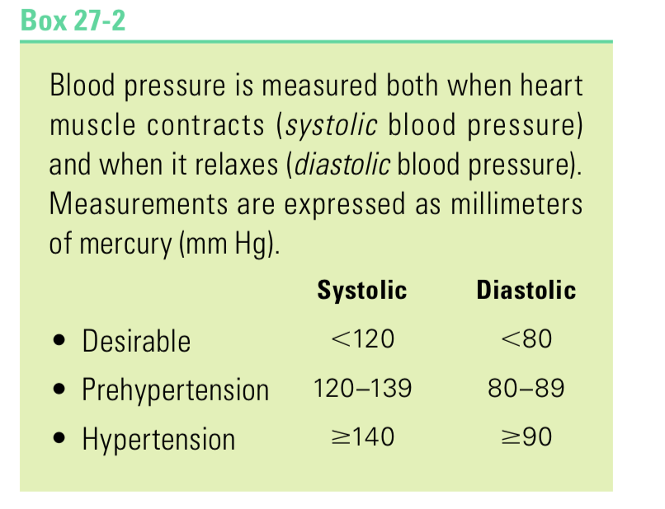
Hypertension
Normal Blood Pressure
Systolic / Diastolic ≤ 120/80 mm Hg
Untreated HTN is a risk factor for:
Heart disease, Stroke, Renal disease

Slide 60
Hypertension
Systolic BP: force exerted by blood on walls of blood vessels during contraction of ventricles
Diastolic BP: force exerted during relaxation
Blood pressure in the arteries should be high enough to push oxygenated blood into circulation blood but not so high it causes damage in the vessels
Elevated blood pressure forces the heart to work harder to eject blood into the arteries; this effort weakens heart muscle and increases the risk of developing heart arrhythmias, heart failure, and even sudden death

Slide 61
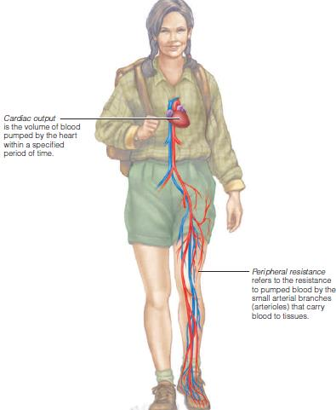
Hypertension
Blood pressure depends on the volume of blood pumped by the heart (cardiac output) and the resistance the blood encounters in the arterioles (peripheral resistance). When either cardiac output or peripheral resistance increases, blood pressure rises.

Slide 62
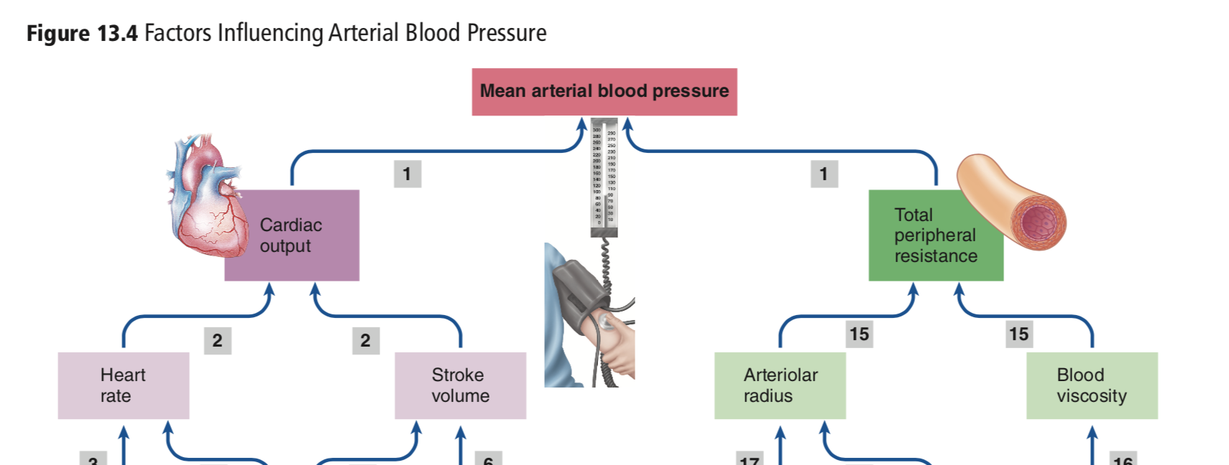
Hypertension
Cardiac Output:
Influenced by Na+ and H2O balance control blood volume ( RAAS)
balance between parasympathetic activity which decreases heart rate, and sympathetic activity which increases heart rate
peripheral resistance influenced by diameters of the arterioles and blood viscosity
Blood pressure is therefore influenced by SNS which can cause vaspconstriction
volume of red blood cells
Local metabolic controls in skeletal muscles and SNS , PNS which control vasoconstriction and vasodilation
Angiotensin II is part of the RAAS,

Slide 63
the renin-angiotensin-aldosterone system (RAAS)
The kidneys also play a role in regulating blood pressure by controlling the secretion of the hormones involved in vasoconstriction and retention of sodium and water
Cells in the kidneys respond to low blood pressure by releasing an enzyme called renin.
Renin causes the kidneys to reabsorb sodium.
The renin-angiotensin-aldosterone system (RAAS)
Sodium reabsorption, in turn, is always accompanied by water retention, which helps to raise blood volume and blood pressure
Additionally, Renin converts a a protein from the liver called angiotensinogen to angiotensin I
angiotensin II. Angiotensin II is a powerful vasoconstrictor that narrows the diameters of blood vessels, thereby raising the blood pressure.

Slide 64
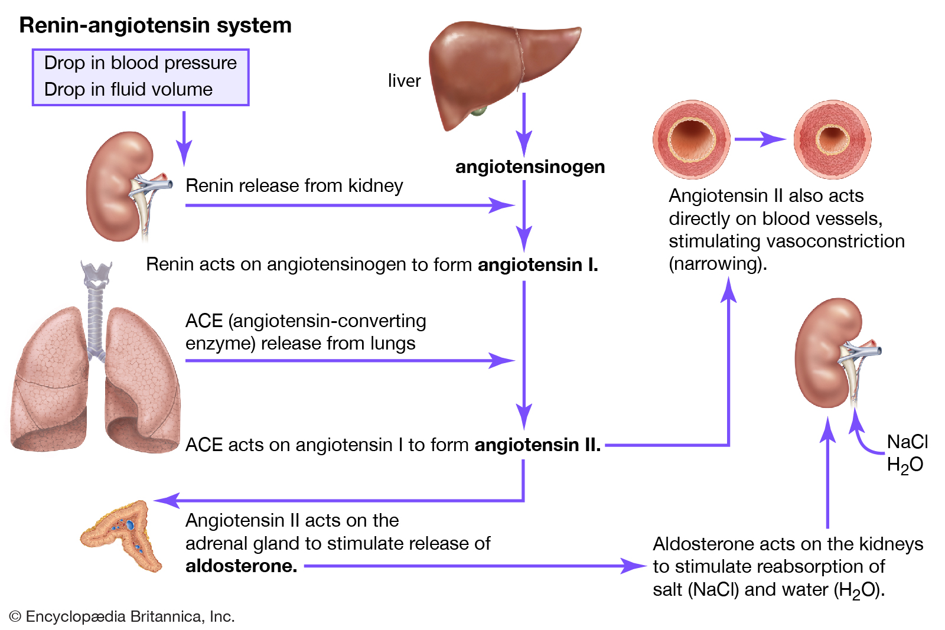
the renin-angiotensin-aldosterone system (RAAS)
Angiotensin II stimulates the release of the hormone Aldosterone from the adrenal glands Aldosterone signals the kidneys to excrete potassium and to retain more sodium and water
Britannica, The Editors of Encyclopaedia. "Renin-angiotensin system". Encyclopedia Britannica, 14 Aug. 2017, https://www.britannica.com/science/renin-angiotensin-system.

Slide 65
Factors That Contribute to Hypertension
Primary hypertension: Cause is unknown, hypertension develops gradually over time: may be due to individual differences within the renin–angiotensin–aldosterone control and differences in identified genes that affect sodium retention,8 and lifestyle choices that exacerbate the problem
Secondary hypertension abnormality in an organ or hormone involved in blood pressure regulation ( For example: over production of hormones that simulate water retention and vasoconstriction, thereby raising blood pressure)
But as a result of another primary problem, such as kidney disease, other cardiovascular diseases, endocrine disorders,

Slide 66
risk factors for hypertension
Aging: Risk increases with age (2/3 of people >65 years have HTN)
Genetic Factors: Risk is similar in family members
Obesity: 60% of people with HTN are obese (stimulating the sympathetic nervous system and activating hormonal processes that promote sodium reabsorption and blood vessel constriction)
  SNS Activation: increased heart rate, CO, arteries constriction
Salt Sensitivity: 50% of HTN patients have salt sensitivity
Alcohol: heavy drinking increases the severity (stimulates sympathetic nervous system)
Dietary Factors: increased intakes of K, Ca, and Mg can reduce blood pressure

Slide 67
Treatment
Blood pressure reduction of 10 mm Hg in systolic blood pressure or 5 mm Hg diastolic BP lowers the risks of death from CHD and stroke by about 45 and 55 percent, respectively
The goal of hypertension treatment is to reduce blood pressure to <140/<90 mm Hg
For people with diagnosed CHD, diabetes, or kidney disease, the blood pressure goal is <130/<80 mm Hg.

Slide 68
Treatment
Weight Reduction: In obese individuals, weight reduction may lower blood pressure significantly
Dietary Approaches for Blood Pressure Reduction: A diet that emphasizes fruits, vegetables, and whole grains and includes low fat milk products, nuts, poultry and fish (more fiber, potassium, magnesium, and calcium than the typical diet)
limits red meat, sweets, sugar-containing beverages, saturated fat (to 7 percent of calories), and cholesterol (to 150 milligrams per day)- DASH DIET
low sodium intake
  (Average sodium intakes for men and women are about 4200 milligrams and 3000 milligrams per day, respectively)
  2.4 g/d sodium ((about 1 teaspoon of salt) a day/ includes all sodium consumed, whether added in cooking or at the table, or already present in food products.
  1.5 g/d sodium

Slide 69
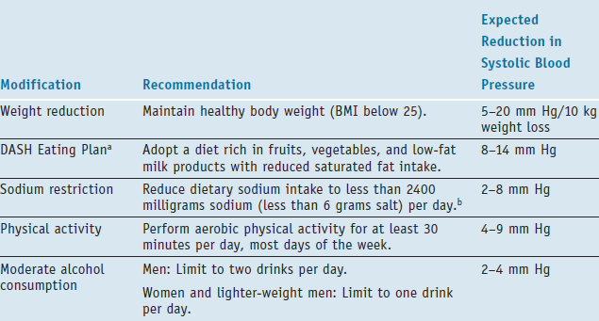

Slide 70
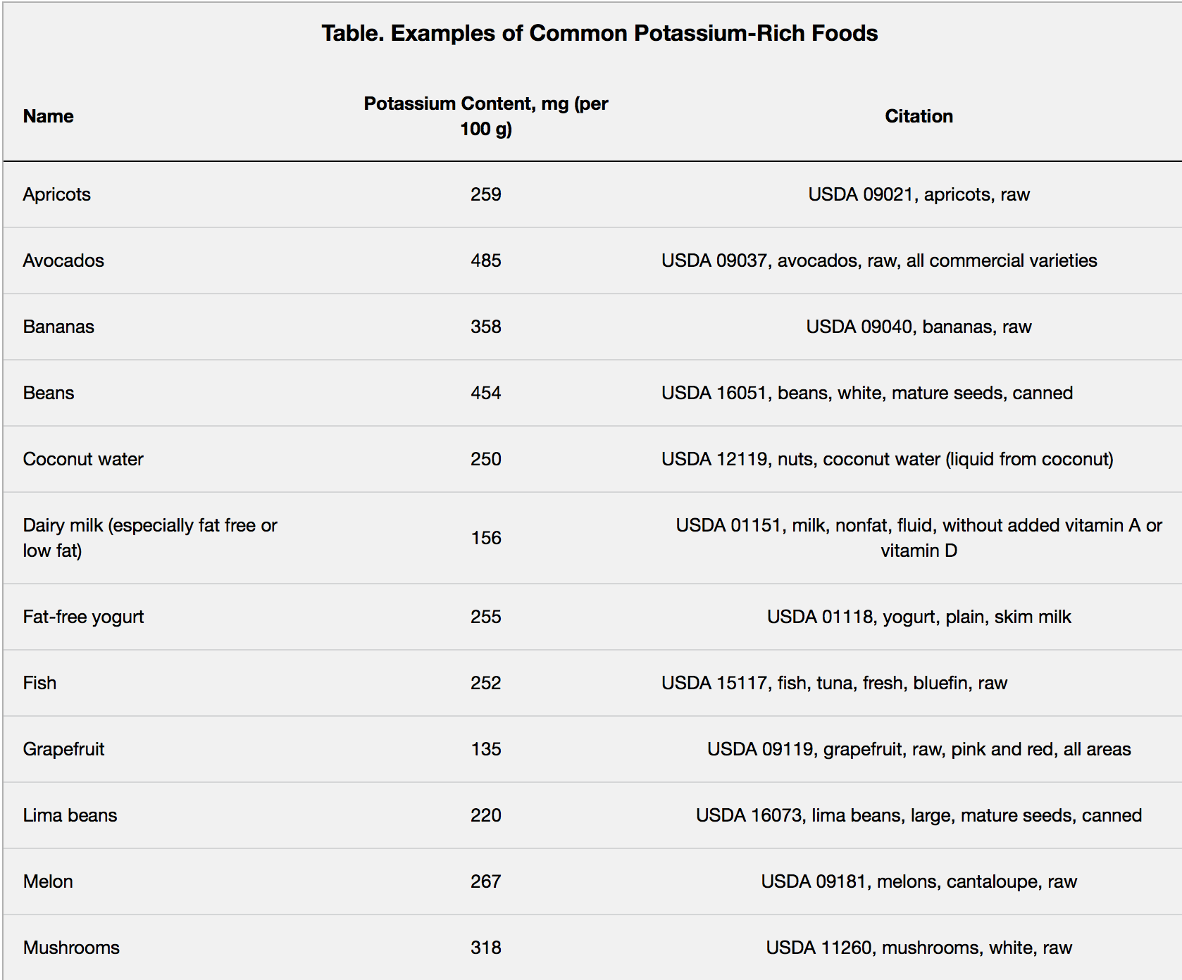
Staruschenko, A. (2018). Beneficial effects of high potassium. Hypertension, 71(6), 1015-1022. doi:10.1161/hypertensionaha.118.10267

Slide 71
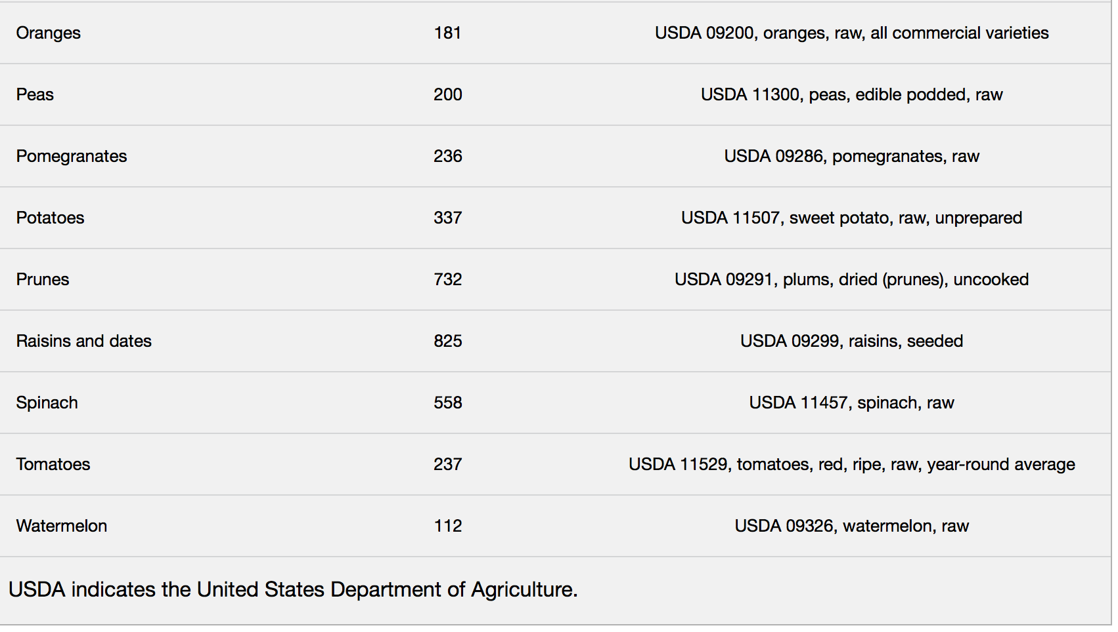
Staruschenko, A. (2018). Beneficial effects of high potassium. Hypertension, 71(6), 1015-1022. doi:10.1161/hypertensionaha.118.10267

Slide 72
Strategies to Lower Sodium
General recommendations: No salt at table, minimal salt in cooking, avoid highly processed foods -- use more fresh foods & foods cooked at home from scratch.
Use alternative seasonings (lemon, herbs, KCl salt substitute)
More calories in a meal equals more sodium – Skip Jumbo Sizing
Fill 1⁄2 your plate with fruits and veggies – Potassium important for healthy BP

Slide 73
Strategies to Lower Sodium
Check food labels
  The labeling term low sodium is a better guide than the terms reduced sodium (contains 25 percent less sodium than the regular product)
  light in sodium (contains 50 percent less sodium).
  low sodium, contain less than 140 milligrams of sodium per serving
Recognize the high-sodium foods in each food category, which include : Snack foods made with added salt, Processed meats, Processed fish, Tomato-based products, Canned soups and broths, Cheese, Bakery products, Condiments and relishes, Flavoring sauces

Slide 74
Strategies to Lower Sodium
When cooking : Don’t add salt when cooking rice, pasta, and hot cereals.
Rinse canned foods or foods soaked in brine before using to remove the sodium.
Eating Out: Ask that foods be prepared without added salt
Avoid choosing menu items that have salty ingredients such as pickles, olives, and cheese
Choose fruit or vegetables as a side dish, instead of chips or fries.
https://www.nhlbi.nih.gov/health-topics/dash-eating-plan

Slide 75
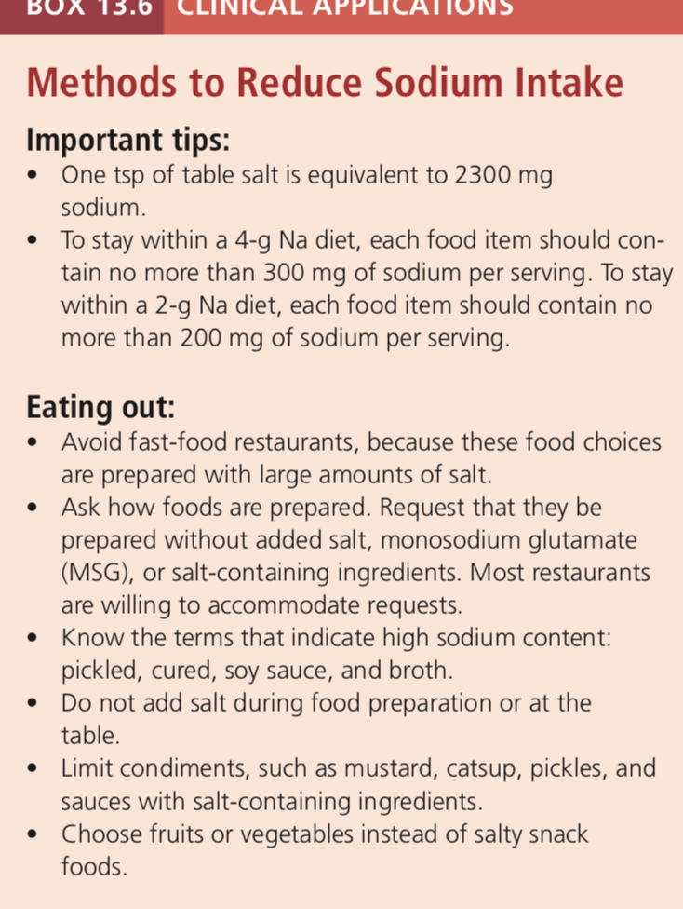

Slide 76
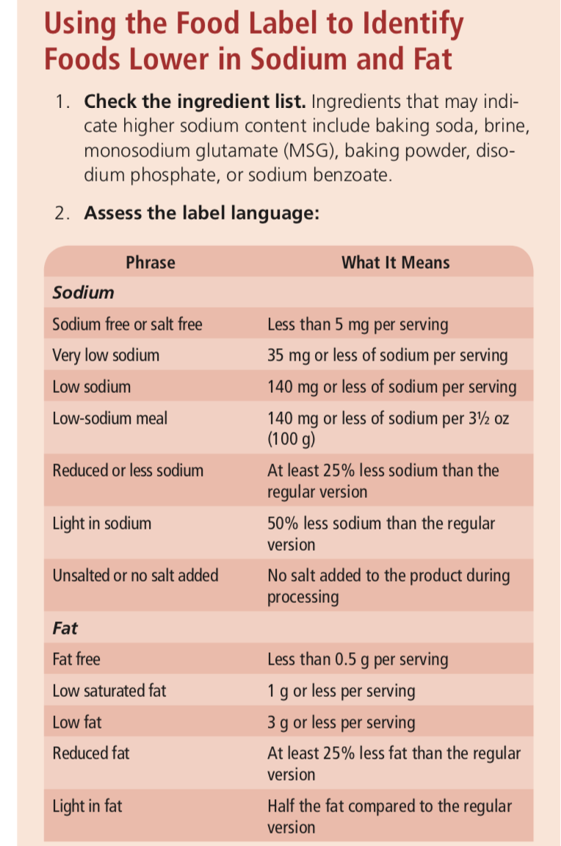

Slide 77
http://www.nhlbi.nih.gov/health/health-topics/topics/dash/followdash.html

Slide 78
TLC DIET
TLC = Therapeutic Lifestyle Changes
Meant to help lower high cholesterol levels in individuals
a TLC-like eating plan has also been shown to positively affect blood pressure and serum triglyceride levels with little or no effect on HDL levels

Slide 79
Saturated Fat | <7% of total kcals
Polyunsat. Fat | <10% of total kcals
Monounsat. Fat | Up to 20% of total kcals
Total Fat | 25 – 35% of total kcals
Carbohydrates | 50 – 60% of total kcals
Fiber | 20 – 30 g/d
Protein | 15% of total kcals
Sodium | <2400 mg/d
Stanol Esters | 3-4 g/d

Slide 80
Breads/Cereals/ Grains : 6 or more servings a day—adjust to calorie needs
Vegetables/
Dry Beans/Peas : 3–5 servings a day
Fruits : 2–4 servings a day
Dairy Products : 2–3 servings a day—fat free or low fat (for example, 1% milk)
Eggs : 2 or fewer yolks per week—including yolks in baked goods and in cooked or processed foods
Meat/Poultry/Fish : 5 or less ounces a day (141.75 g) : Poultry without skin and fish are lower in saturated fat. Lean cuts of meat have less fat and are rich sources of protein and iron. Be sure to trim any fat from meat
Fats/Oils : Amount depends on daily calorie level Nuts are high in calories and fat, but have mostly unsaturated fat. Nuts can be eaten in moderation on the TLC diet—be sure the amount you eat fits your calorie intake.
Diet Options: Stanol/sterol– containing food products
https://www.nhlbi.nih.gov/files/docs/public/heart/chol_tlc.pdf

Slide 81
Stroke
About 87 percent of strokes are ischemic strokes, caused by the obstruction of blood flow to brain tissue (Most ischemic strokes are a result of ruptured atherosclerotic plaque and subsequent blood clot formation)
Hemorrhagic strokes occur in 13 percent of cases and result from bleeding within the brain ( Damage in brain tissue)
  often result from the rupture of a blood vessel that has been weakened by atherosclerosis and chronic hypertension.

Slide 82
Stroke
Prevention
Stroke is largely preventable by recognizing its risk factors and making lifestyle choices that reduce risk.
Hypertension
Elevated LDL cholesterol
Diabetes mellitus
Cigarette smoking
A history of CVDs
Medications that suppress blood clotting reduce the risk of ischemic stroke, especially in people who have suffered a first stroke or a transient ischemic attack

Slide 83
stroke
Management
The effects of a stroke vary according to the area of the brain that has been injured. For example: Body movements, Senses, Speech
Ischemic stroke: Ideally, thrombolytic (clot-busting) drugs are used within the first few hours. Rehabilitation programs typically start as soon as possible after stabilization (physical therapy, speech and language pathology, and kinesiotherapy)
MNT: maintain nutrition status and overall health despite the disabilities

Slide 84
Heart Failure
Heart failure (HF): characterized by the heart’s inability to pump adequate blood, resulting in inadequate blood delivery and a buildup of fluids in the veins and tissues.
Diseases of the heart (valves, muscle, blood vessels) can lead to HF
HF has many causes, but generally it’s a consequence of disorders that create extra work for the heart muscle (Example: hypertension & CHD)
To accommodate the extra workload, the heart enlarges or pumps faster or harder, but it eventually may weaken enough to fail completely.

Slide 85
Left-sided heart failure. The left side of the heart normally receives blood from the lungs and pumps it to peripheral tissues. A weakened left heart may allow fluid to build up in the lungs – can lead to extreme shortness of breath, limited oxygen for activity and respiratory failure
Right-sided heart failure. The right side of the heart normally receives blood from the peripheral tissues and pumps blood to the lungs. Fluid accumulation in the lower extremities, liver and abdomen (chest pain, digestion and absorption difficulty , swelling in the legs, ankles, and feet
Cardiac cachexia (severe malnutrition characterized by significant weight loss and tissue wasting)

Slide 86
Heart Failure
Medical therapy + MNT
MNT
Sodium restriction of ≤ 2000 milligrams daily to reduce the likelihood of fluid retention
Fluid intakes may be restricted to 2 liters per day or less
Small, frequent meals are better tolerated.
Constipation management: maintaining an adequate fiber intake can help to minimize problems.
Restrict or avoid alcoholic beverages.
Calcium: patients with HF usually have lower bony density. Patients are also at risk of thiamin deficiency

Slide 87
In CLASS EXERCISE
Patient is a 60 years old male who comes to the ER complaining of chest pain. Tests show that he has suffered an MI. The RD is consulted for pt education. patient reports that he has gained 15 kg in the previous year
His work schedule causes him to eat out often. In addition, he is physically inactive. AB also reports that he has a family history of CHD
Diet Recall:
Breakfast : egg, cheese & sausage sandwich
Coffee & 4 creamers 2 sugar
Lunch: turkey& cheese on white bread w mayo
iced tea, sweetened 21 oz
Medium potato chip bag
Dinner : fried chicken breast
Mashed potatoes with gravy
Corn with butter
Cheesecake
2 cans of soda
HT: 175 cm
WT: 86 kg
Waist Circ: 105cm
BP: 140/93
Chol: 259
LDL: 180
HDL: 58
TG: 234

Slide 88
Define problems multi-dimensionally
Select alternative solutions
What will you counsel patient on ?

Slide 89
TLC – Practice
Calculate the nutrition needs for a patient , a 55 year old male, who has recently been diagnosed with Atherosclerosis and HTN
Use TLC diet rec’d to figure out the nutrient composition of a diet he should follow and base your calculations on 2850 kcals for weight maintenance.

