Slide 1
Problems Ch 7
+ Assignments 8 and 7
Ch 7: Tunneling

Slide 2
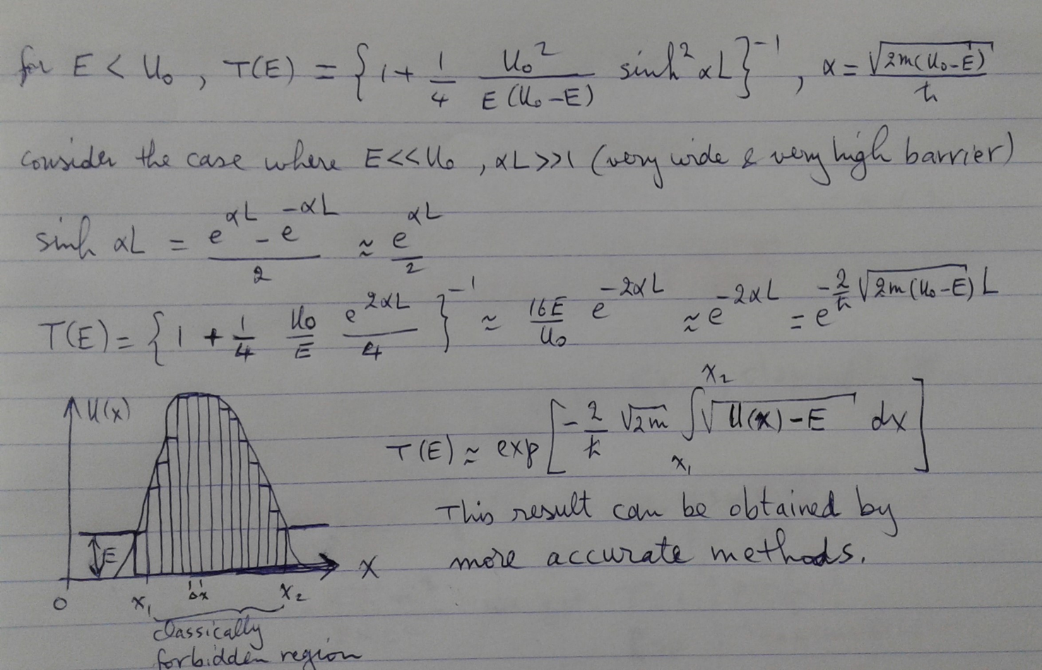

$$T\left(E\right)=exp\left\{−\frac{2}{ħ}\sqrt{2m}\int_{x_{1}}^{x_{2}}{\sqrt{U(x)−E}dx}\right\}$$

Slide 3
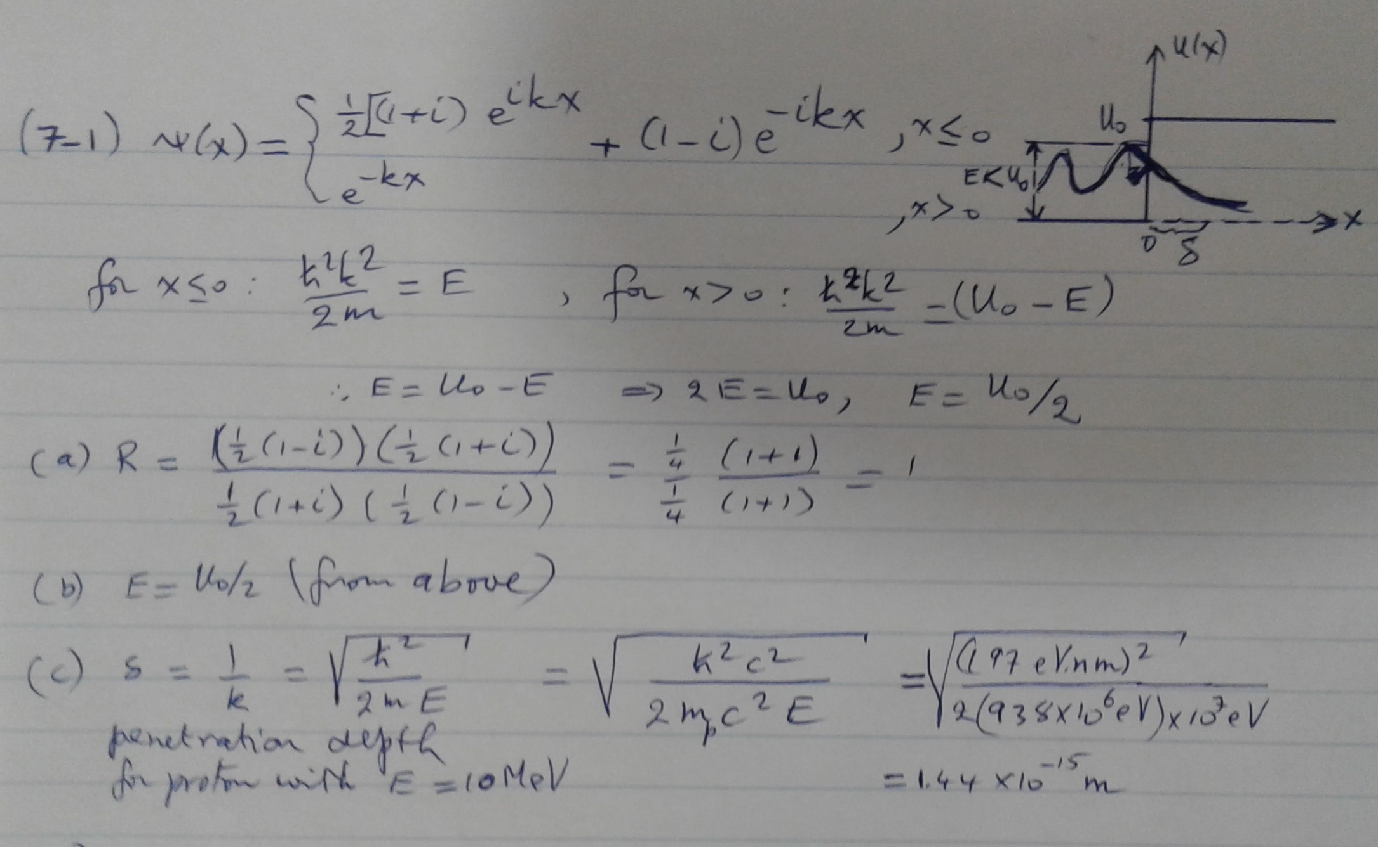
Problem 7-1

Slide 4
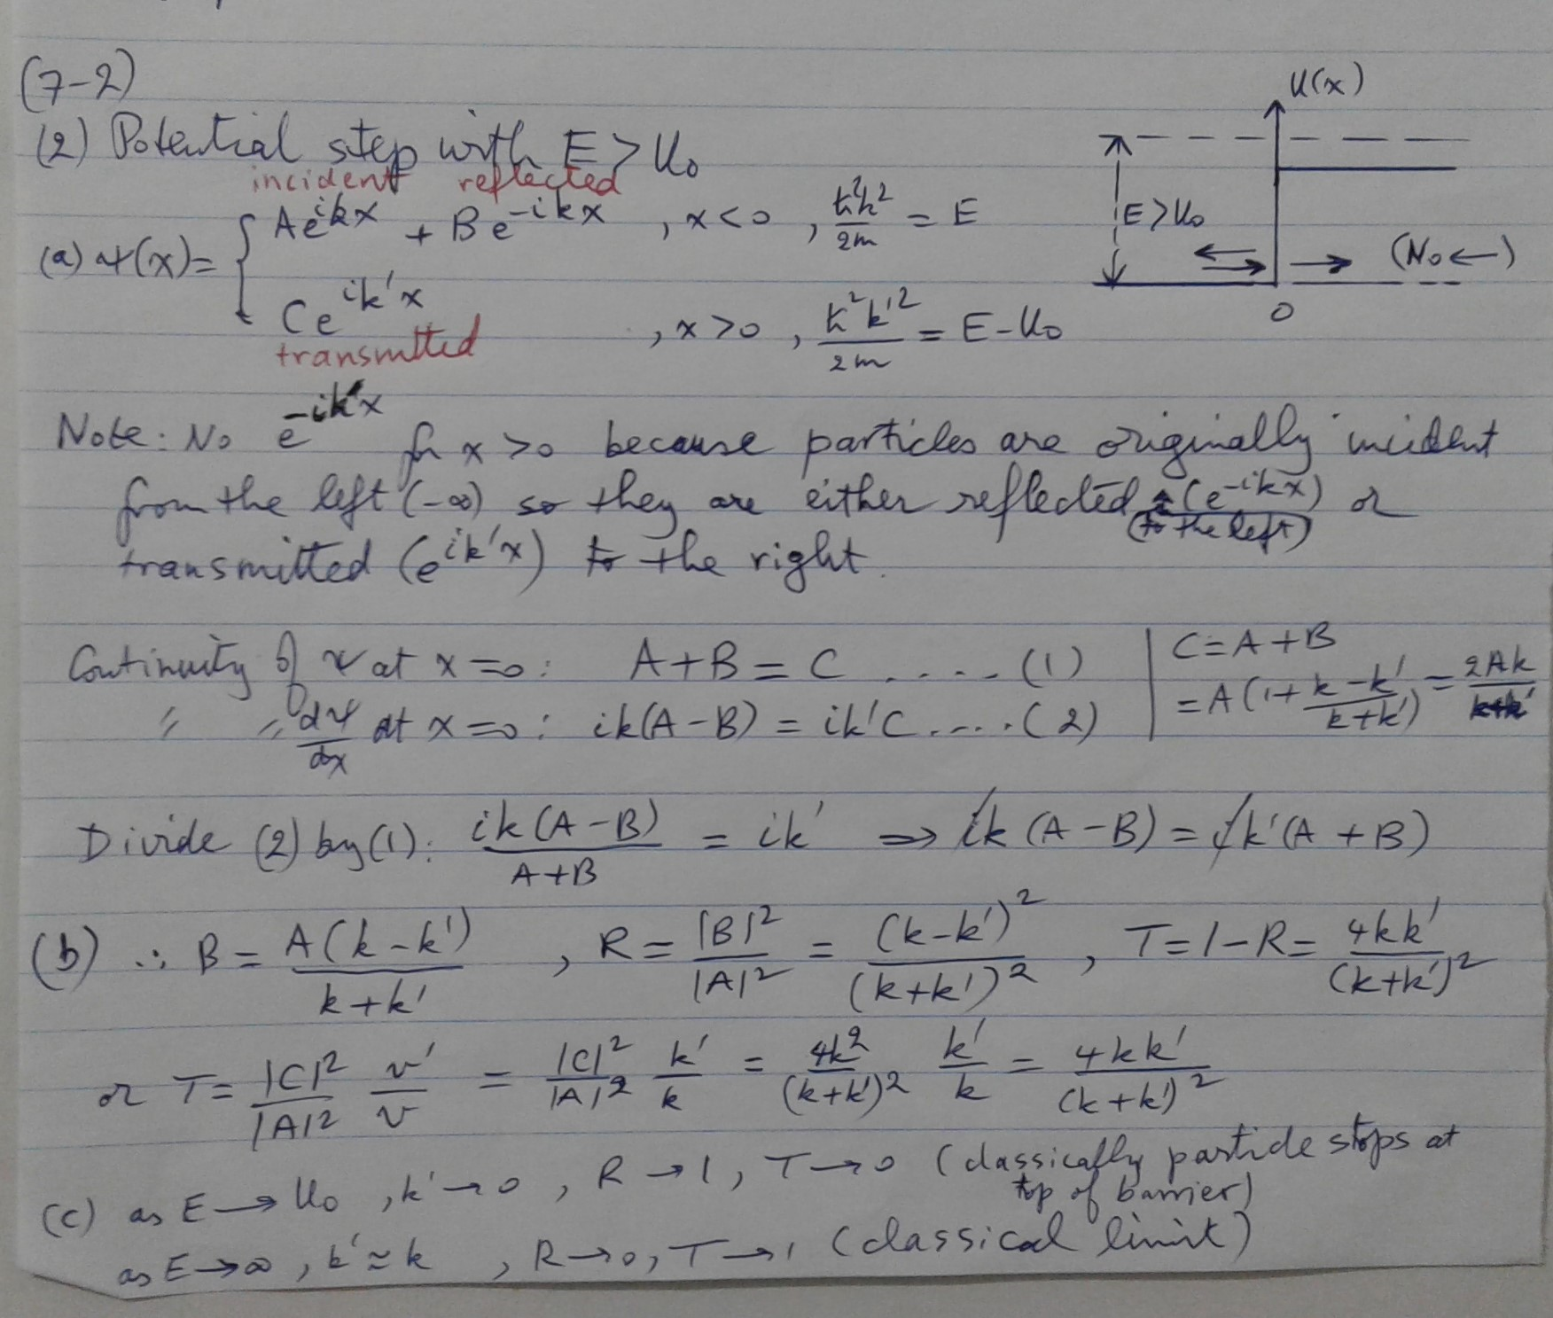

Slide 5
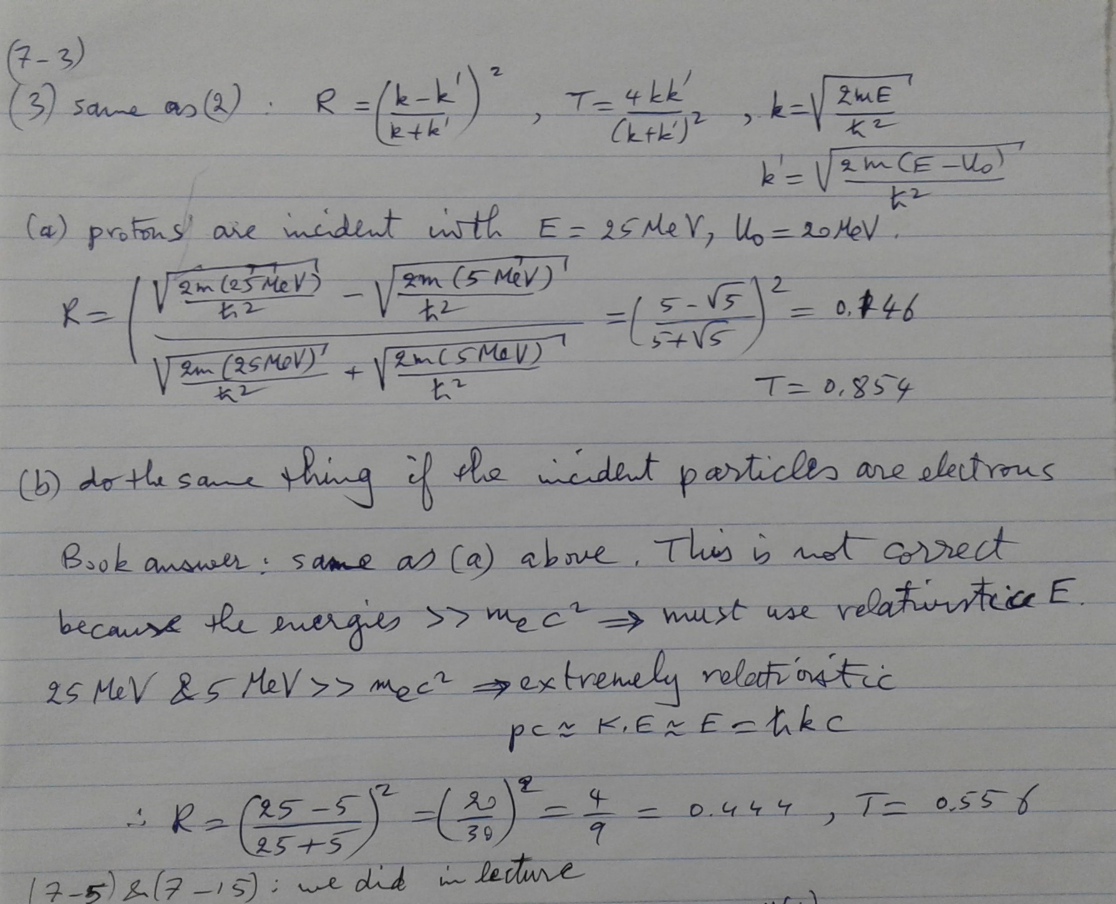

Slide 6
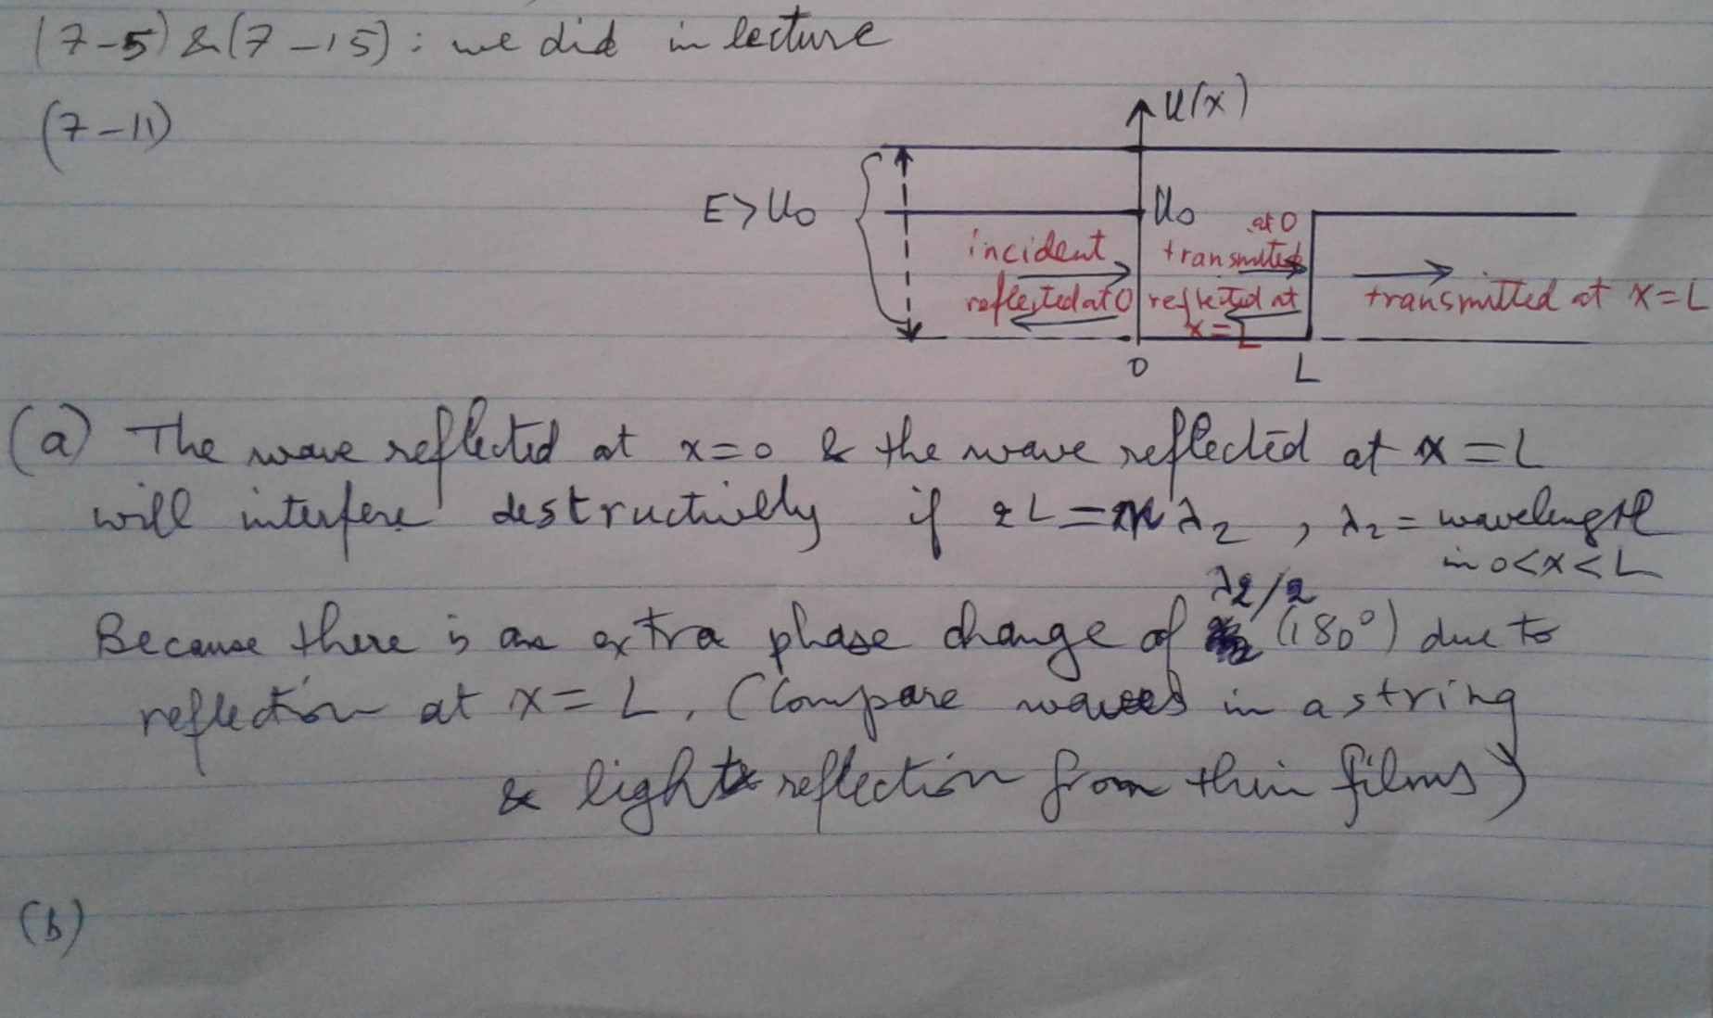
Reflection from a finite square well

Slide 7
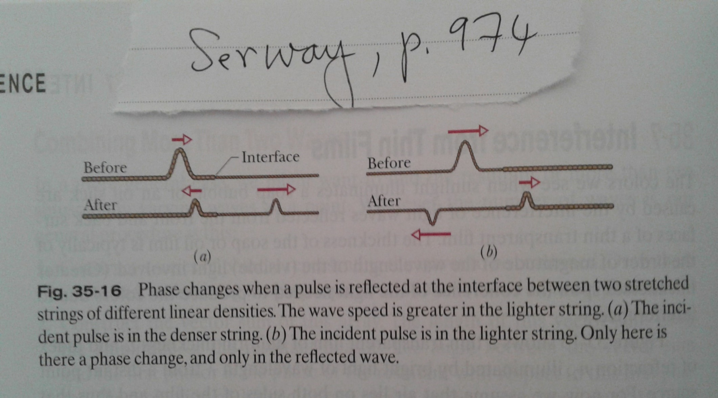
Change of phase due to reflection at boundary between 2 strings

Slide 8
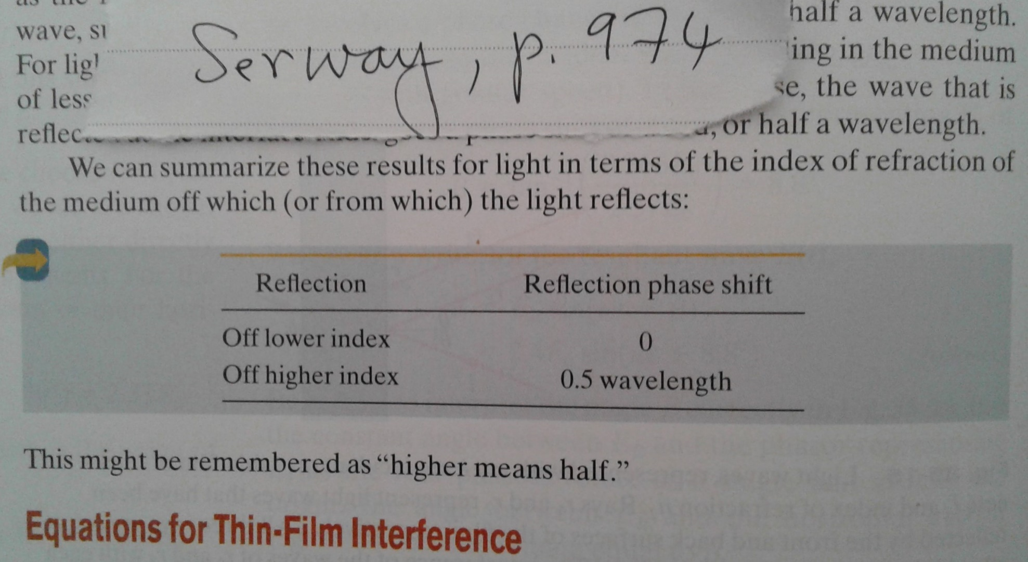
Phase change when light is reflected from thin films

Slide 9
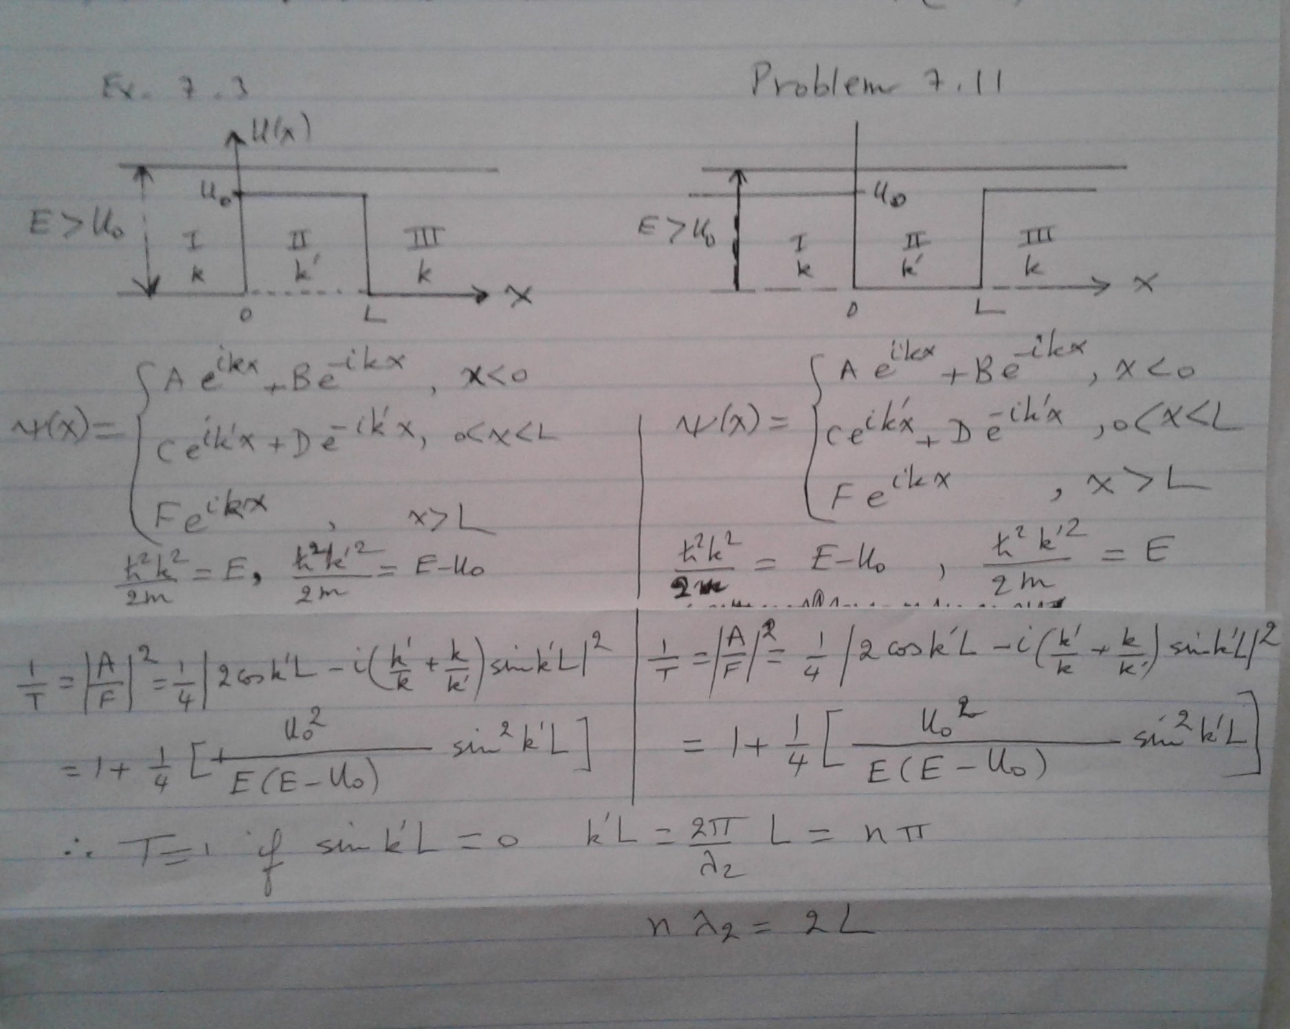
Problem 7-11 (continued)

Slide 10
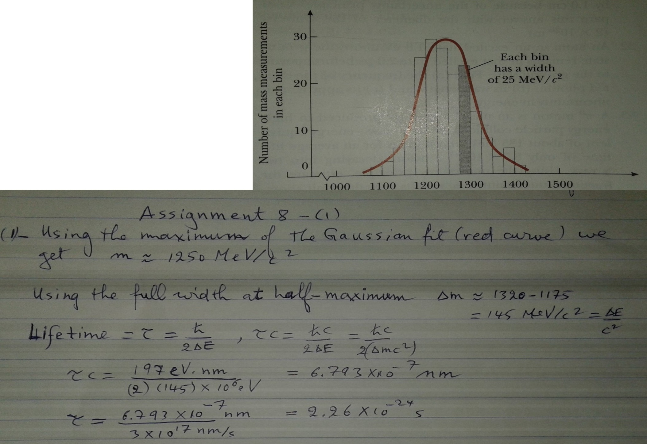

Slide 11
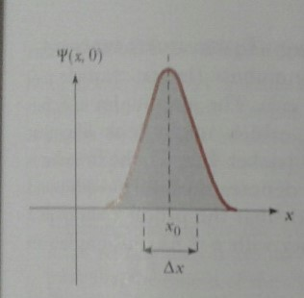
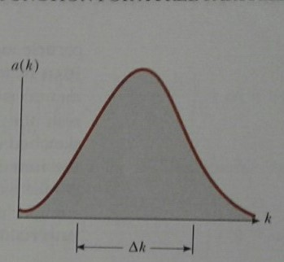
Uncertainty = FWHM

Slide 12
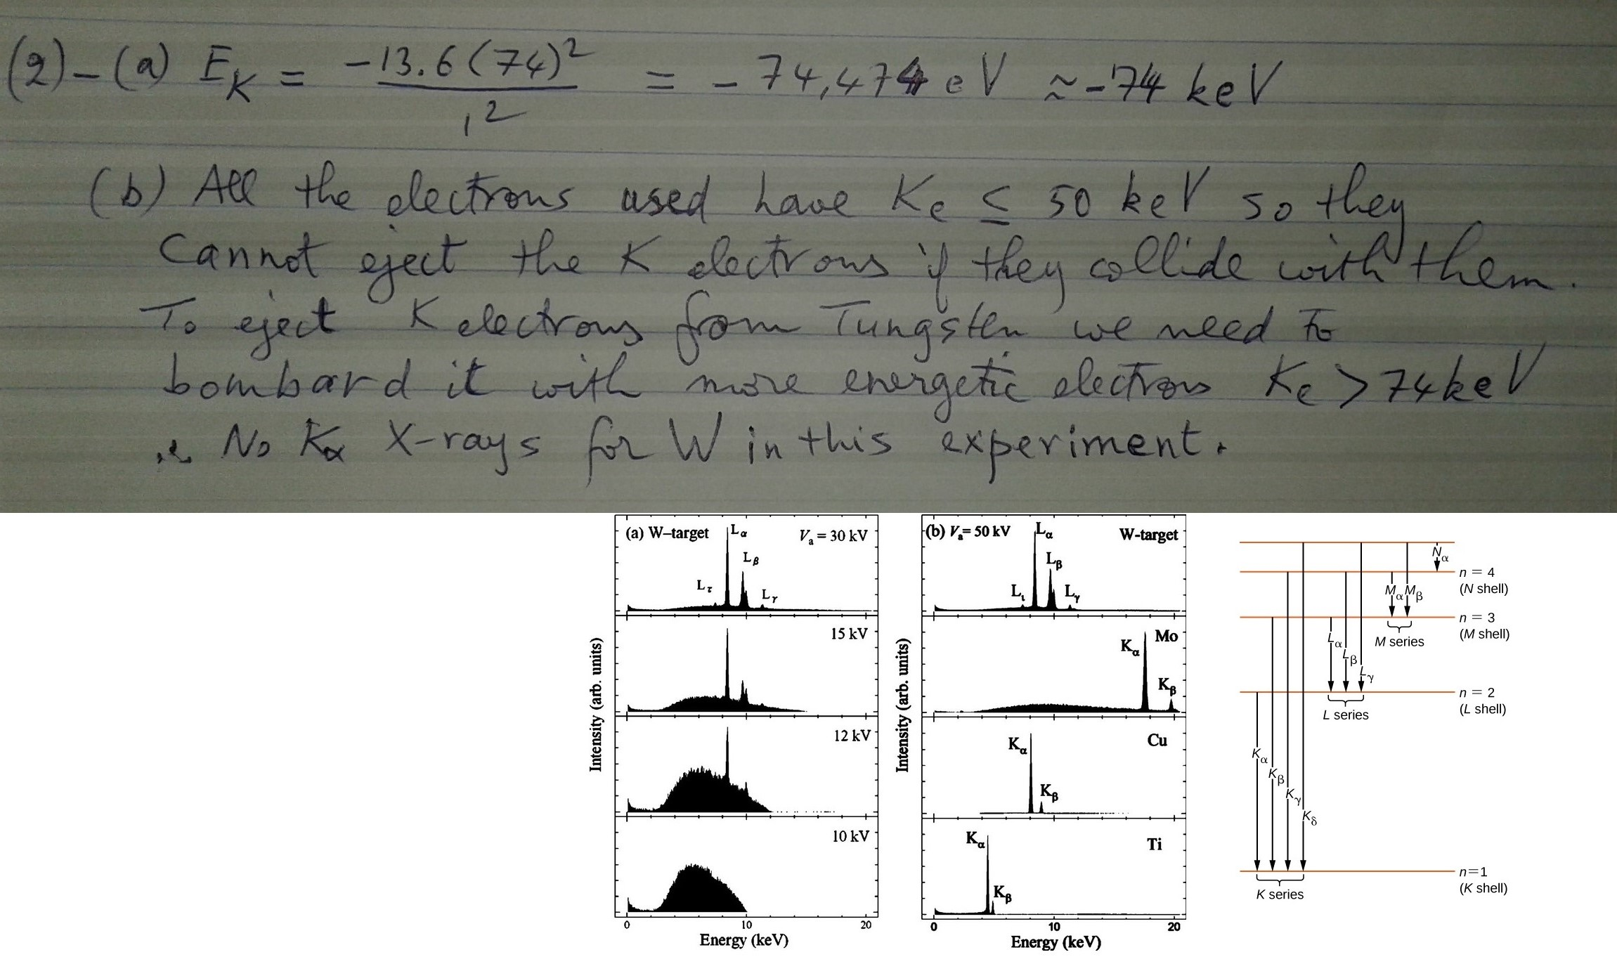

Slide 13
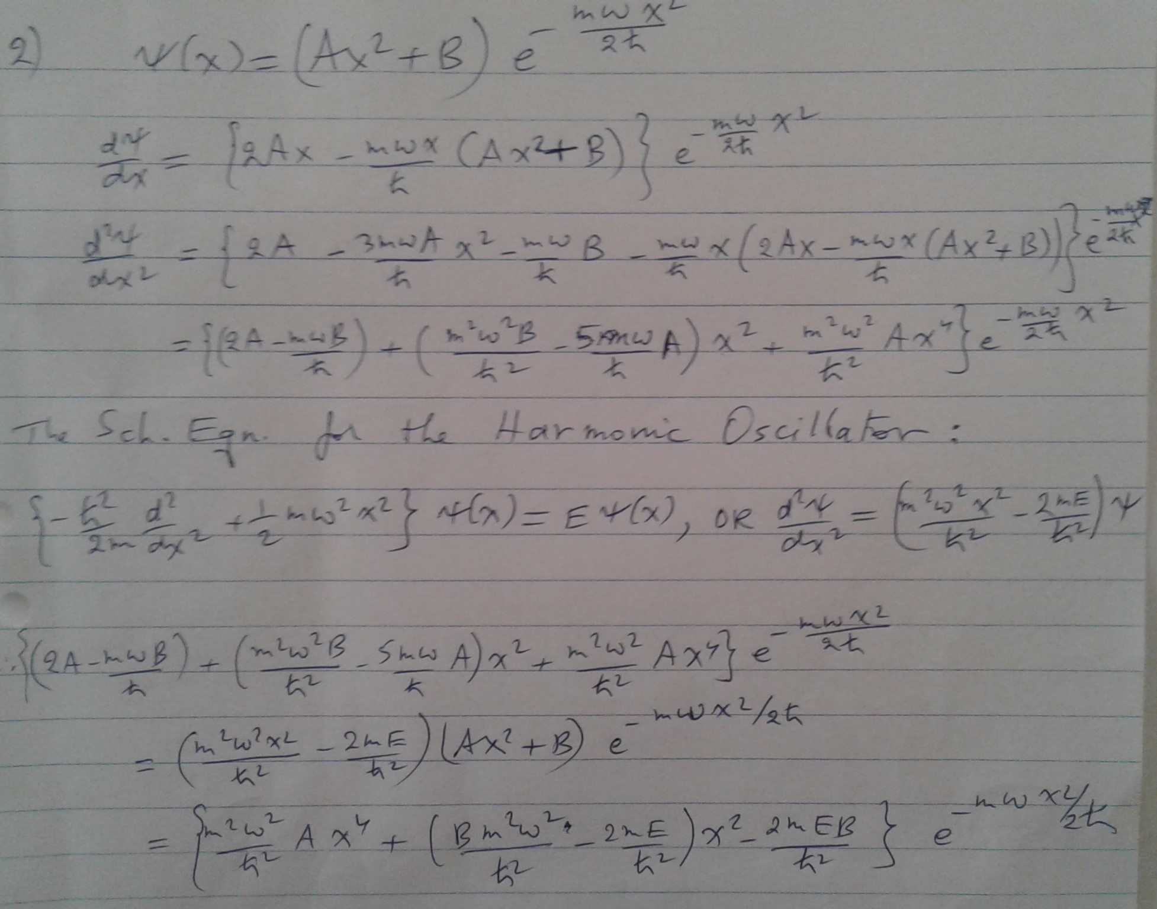
Assignment 7 Problem 2

Slide 14
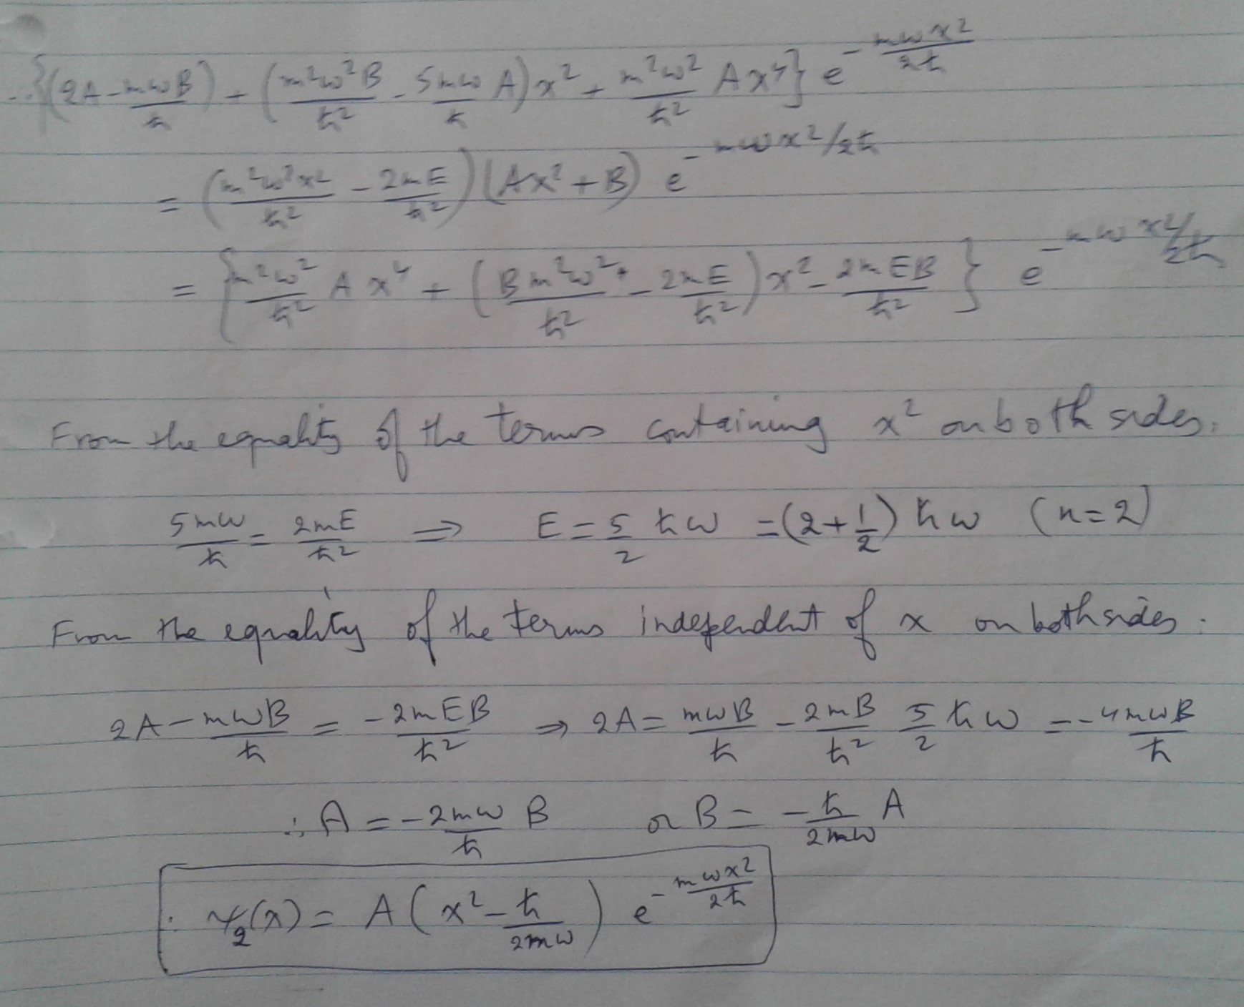

Slide 15
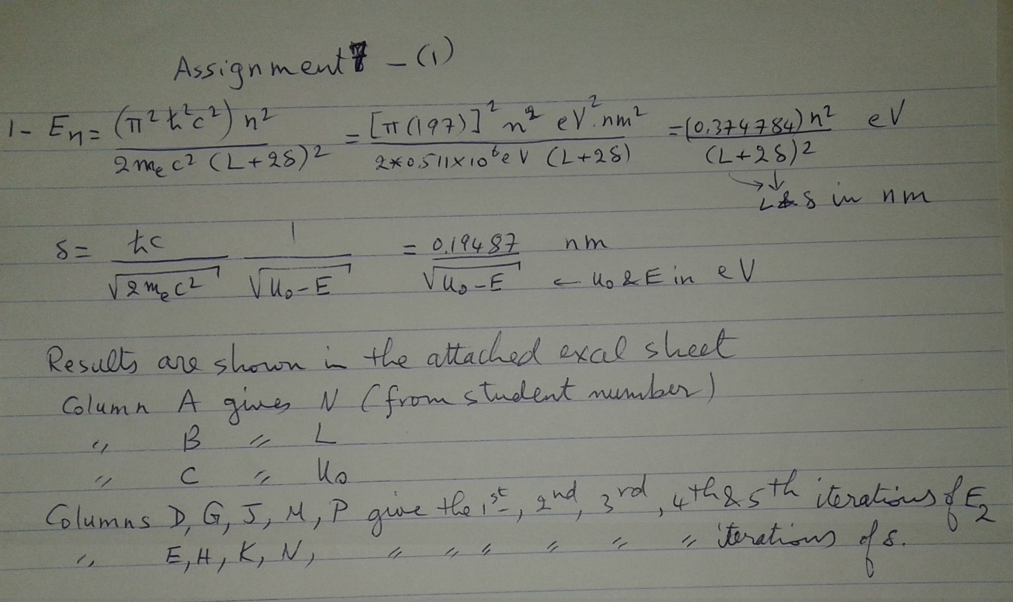
0.0162 is only 3 significant figures
It is NOT 5 significant figures

