Slide 1
Metabolism
Book Chapter 3
Carbohydrates

Slide 2
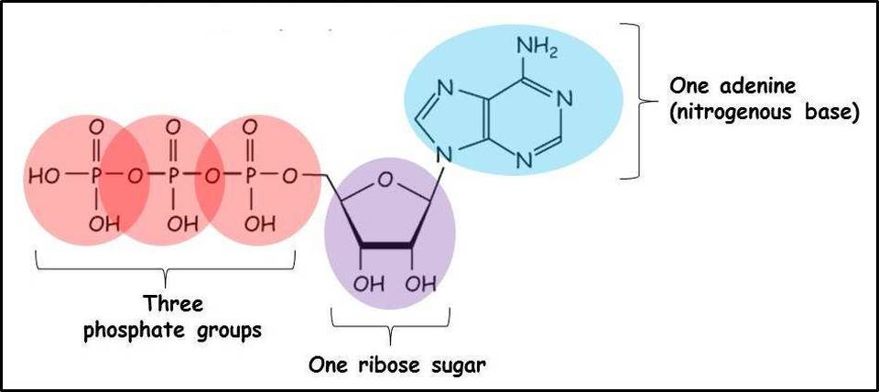
Concepts in Metabolism
ATP is the universal currency of energy
ATP is generated by the oxidation of fuel molecules such as glucose, fatty acids, and amino acids
The hydrolysis of ATP to yield ADP and phosphate is highly exergonic
The structure of ATP is a nucleoside triphosphate, consisting of a nitrogenous base (adenine), a ribose sugar, and three serially bonded phosphate groups

Slide 3
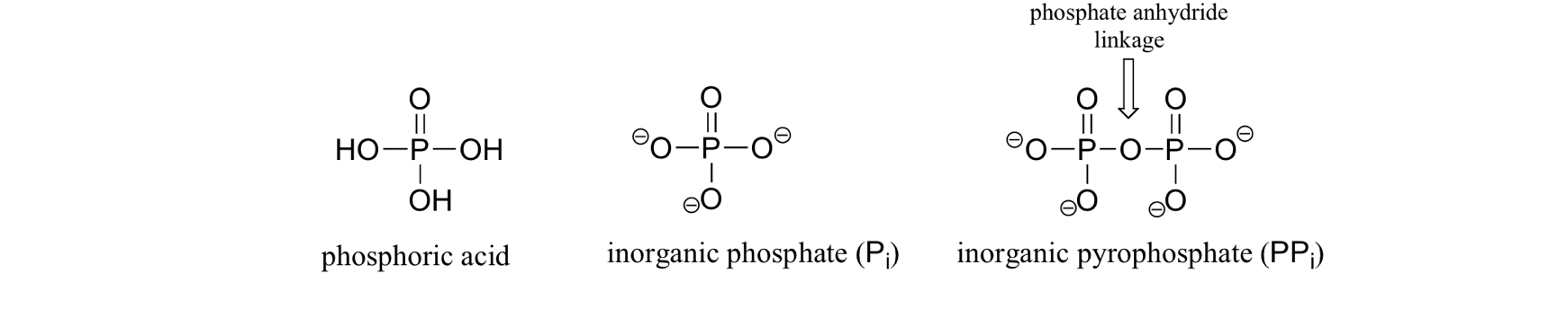

Slide 4
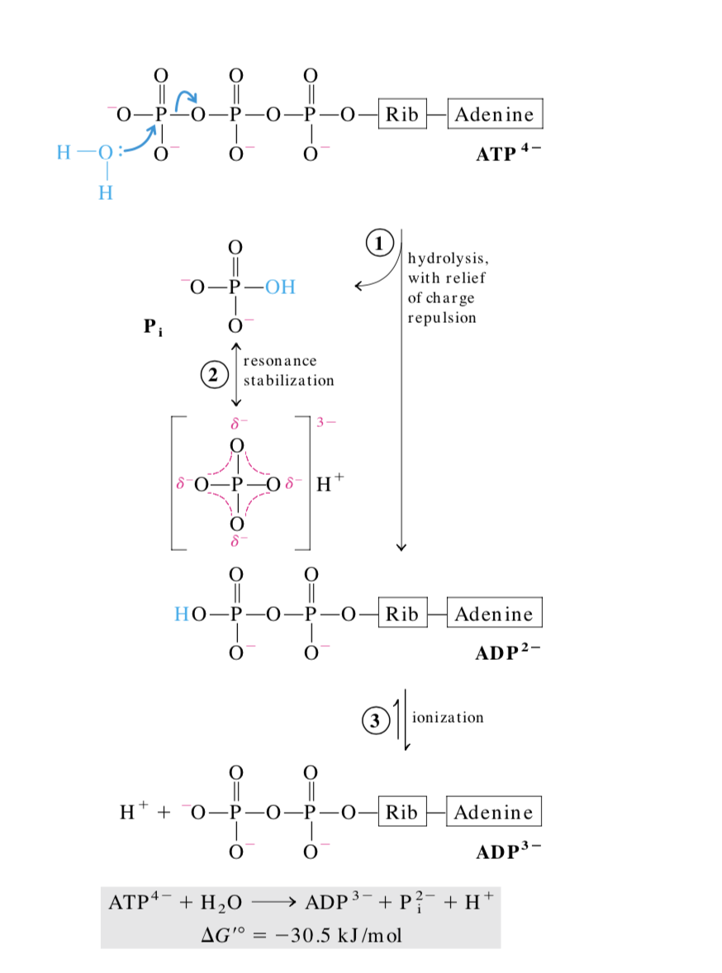
ATP is highly unstable because of the repulsion of negative charges between the phosphate groups
ATP becomes hydrolyzed into ADP, or further to AMP, and free inorganic phosphate groups. The process of ATP hydrolysis to ADP is energetically favorable
The high energy bonds between the phosphate groups can be broken to power a variety of reactions used in all aspects of cell function
The removal of one phosphate group (phosphoanhydride bond is broken)
Hydrolysis
Notes:
Resonance in the products stabilizes it

Slide 5
ATP is considered the energy currency of the cell because it provides readily releasable energy in the bond between the second and third phosphate groups
The majority of ATP synthesis occurs in cellular respiration within the mitochondrial matrix
ATP is consumed for energy in processes such as
  Ion transport ( active transport)
  muscle contraction
  nerve impulse propagation
  substrate phosphorylation, and chemical synthesis

Slide 6
ATP Synthesis
ATP production can occur in the presence of oxygen from cellular respiration, beta-oxidation, ketosis, lipid, and protein catabolism, as well as under anaerobic conditions.
Our body generate energy through glycolysis, the citric acid cycle (or the Krebs's cycle), and the electron transport chain (or the oxidative phosphorylation pathway).
Together these 3 stages are referred to as cellular respiration

Slide 7
3 important stages of cellular respiration:
Glycolysis
Glucose is split into two molecules called pyruvate and 2 ATP molecules are generate per molecule of glucose as well as 2 molecules of NADH
Occurs in the cytoplasm of the cell

Slide 8
Krebs Cycle (also known as the Citric Acid Cycle): Uses the pyruvate molecules from Glycolysis ( acetyl coA) to generate ATP as well as several molecules of FADH2 and NADH for the electron transport chain.
Krebs Cycle takes place in the mitochondrial matrix and requires oxygen.

Slide 9
Electron transport chain (ETC)
NADH and FADH2 molecules formed during Glycolysis and Krebs Cycle, the electron transport chain creates a proton gradient that ultimately leads to the production of about 32 molecules of ATP. The ETC takes place in the mitochondrial matrix and requires oxygen

Slide 10
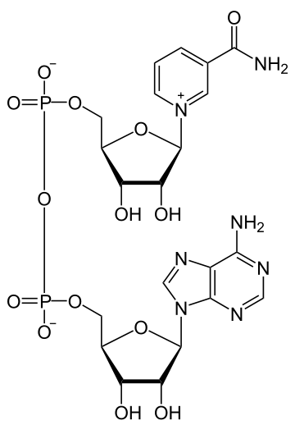
Important High Energy Molecules in Metabolism
Nicotinamide adenine dinucleotide (NAD⁺/NADH) (Ratio 1000)
Involved in Redox reaction
Precursor for the coenzyme Vitamin B3- Niacin

Slide 11
Important High Energy Molecules in Metabolism
Nicotinamide adenine dinucleotide
Active coenzyme form of vitamin B3
The low energy form NAD⁺
High energy form NADH ( reduced form)
NAD+ accepts two electrons and a hydrogen in reaching the high energy state.
NADH is used in the electron transport chain to provide energetic electrons that power production of ATP

Slide 12
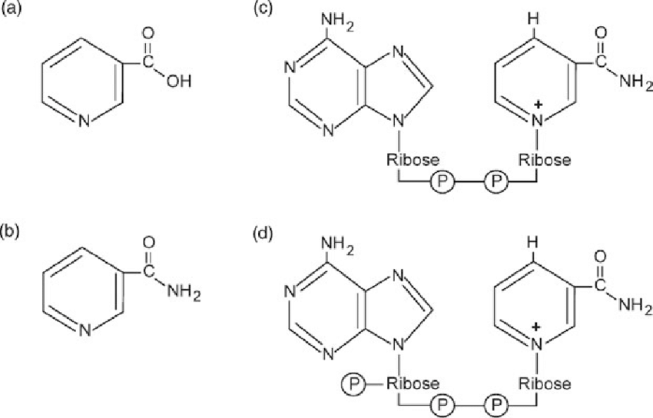
Important High Energy Molecules in Metabolism
Nicotinamide Adenine Dinucleotide Phosphate
Derived from Niacin
NADP⁺/NADPH (ratio 0.1)
NADPH is often used in reactions that build molecules
nicotinamide
NAD+
nicotinic acid
NADP+
Young GS, Kirkland JB. Nutr Res Rev. 2008 Jun;21(1):42-55. doi: 10.1017/S0954422408945182.

Slide 13
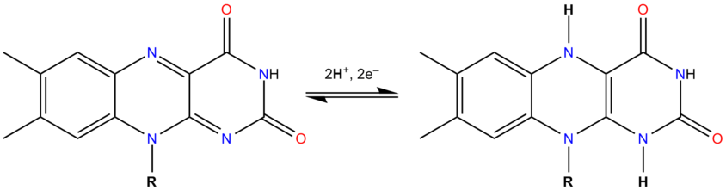
Important High Energy Molecules in Metabolism
Flavin adenine dinucleotide
Derived from Riboflavin (B₂)
Redox coenzyme
FAD accepts two electrons and two protons to produce its reduced form, FADH₂
FADH₂ is used in electron transport chain to rive the synthesis of ATP.
FAD
FADH2

Slide 14
Carbohydrates
Advanced nutrition and human
metabolism, 7 edition, Chapter 3

Slide 15
Carbohydrates
Main structural component of plants and they provide food energy in the form of starch and sugars
Metabolic intermediates
Constituents of RNA and DNA
structural elements of cells and tissues
Energy storage molecules in the body

Slide 16
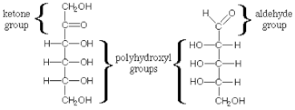
Carbohydrates are constructed from carbon, oxygen, and hydrogen atoms
C‒H2O)n
Aldehydes or ketones with multiple hydroxyl groups

Slide 17
Simple Carbohydrates = “sugars”
1-3 saccharides
trioses, tetroses, pentoses, hexoses, and heptoses.
Example: ketopentose , aldohexose
Complex Carbohydrates = Starch
Polysaccharides
Complex Carbohydrates = Fiber
different chemical bonds than starches

Slide 18
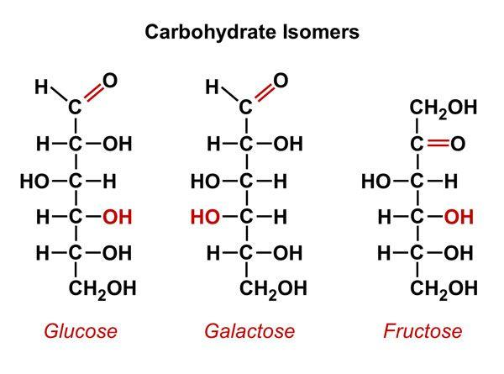
asymmetric carbon atoms
Notes:
asymmetric carbons are C-2, C-3, C-4, and C-5.

Slide 19
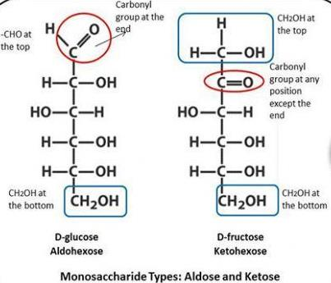
the asymmetric carbon atom farthest from the carbonyl group indicates the D- or L-stereoisomer, with the hydroxyl group on the left side for the L configuration.
Both D and L monosaccharides are present in nature, although the vast majority are D isomers
digestive and cellular enzymes tend to be specific for D monosaccharides,

Slide 20

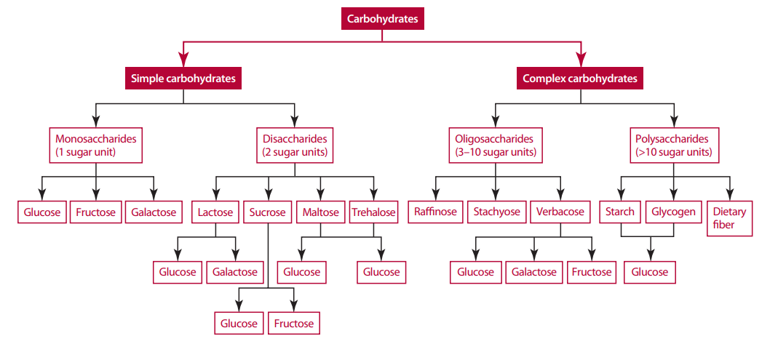

Slide 21
In solution, monosaccharides form a cyclic ring structure through a reaction between the carbonyl group and a single hydroxyl group
The rings form spontaneously in solution and are energetically more stable than the open chain.
a cyclic Aldehyde → a hemiacetal
cyclized sugar with a keto group → hemiketal.

Slide 22
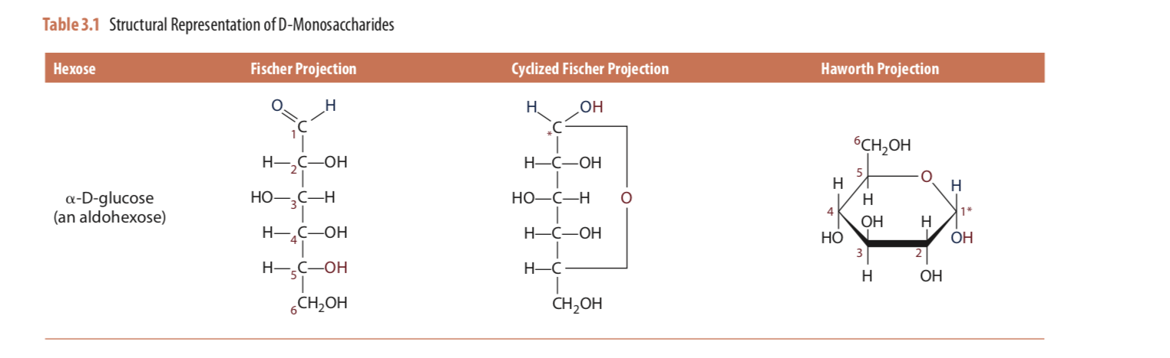
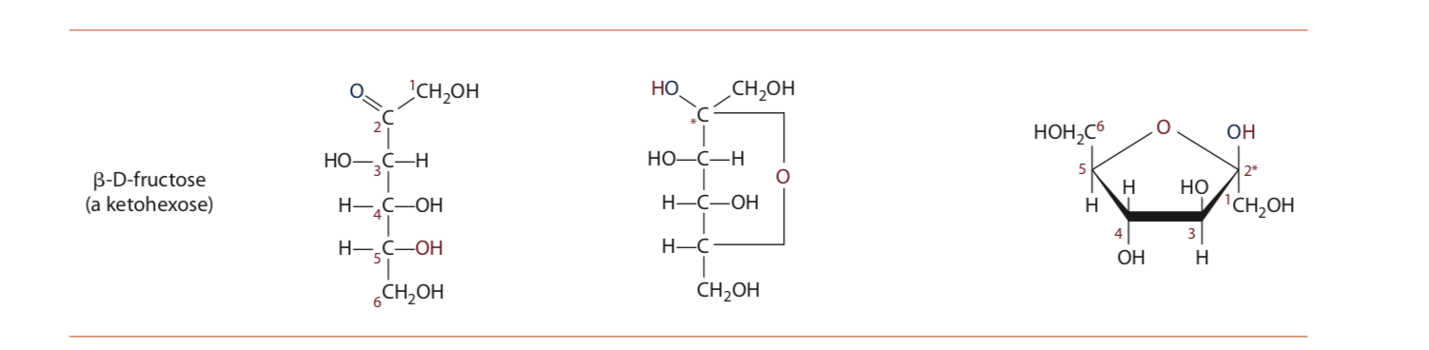
Alpha
Beta
Notes:
the b isomer is drawn with the 2OH group above the plan of the ring structure

Slide 23
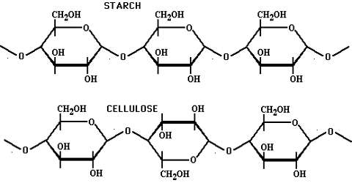
Stereoisomerism
Stereoisomerism why does it matter?
Stereoisomerism in monosaccharides and other nutrients such as amino acids and lipids, has important metabolic implications
Some enzymes can be stereo- specific
e.g. digestive enzyme a-amylase recognizes only the alpha-linkage between a-D- glucose molecules found in starch, but does not recognize the beta-linkage between b-D-glucose molecules found in cellulose.

Slide 24
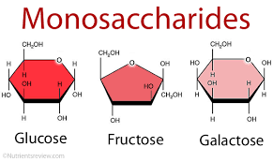
D-Glucose (dextrose) fruits, honey, maple sugar
D-Fructose fruits, honey, maple sugar, HFCS
D-Galactose component of lactose, small amounts in some fruits and vegetables (plums, broccoli, Brussel sprouts, onion
https://www.nutrientsreview.com/carbs/monosaccharides-simple-sugars.html

Slide 25
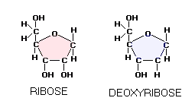
Pentoses
Compared to the hexoses, pentose sugars furnish little dietary energy because few are available in the diet.
However, they are incorporated into metabolically important compounds (synthesized from hexose precursors): The aldopentose ribose, for example, is a constituent of key nucleotides such as ATP, ADP, AMP, cAMP, NAD+, NADP+
https://www.healthknot.com/carbohydrates.html

Slide 26
Disaccharides
Made up of two monosaccharide units joined through a glyosidic bond.
The attachment is formed between a hydroxyl group on the anomeric carbon of one monosaccharide unit and a hydroxyl group on a nonanomeric carbon of a second monosaccharide, while forming one molecule of water.
The glyosidic bond is termed a or b in reference to the anomeric carbon’s hydroxyl group orientation before the glycosidic bond was formed

Slide 27
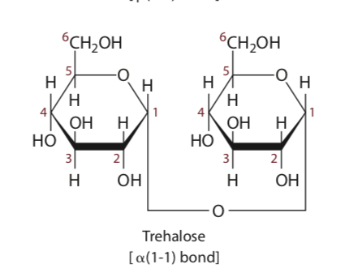
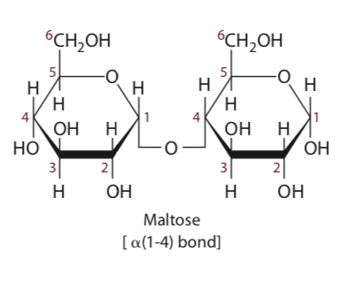
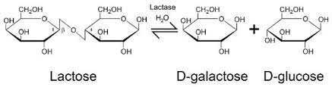
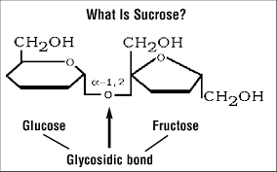
Notes:
Maltose and lactose are considered reducing sugar because of one anomeric C

Slide 28
Maltose: formed primarily from the partial hydrolysis of starch. Found commonly in malt beverages such as beer and malt liquors. It consists of two glucose units linked through an α(1-4) glycosidic bond, although it also may exist in the β form.
Lactose: Found naturally only in milk and milk products. It is composed of galactose linked by a β(1-4) glycosidic bond to glucose. The glucose can exist in either the α or β form
Sucrose: Most widely distributed of the disaccharides. It is composed of glucose and fructose and is structurally unique in that its glycosidic bond involves the anomeric hydroxyl of both residues. The linkage is α with respect to the glucose residue and β with respect to the fructose residue.
Trehalose: Found naturally in fungi (mushrooms) and in other foods of the plant kingdom. Trehalose is an α(1-1) linkage of two D-glucose molecules. Since trehalose is digested slowly, provokes a low glycemic response, and possesses different physical and chemical properties from other sugars, it has become an ingredient in processed foods in Japan and other countries

Slide 29
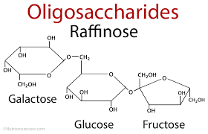
Oligosaccharides
contain 3–10 saccharide units
Common oligosaccharides include:
Raffinose ( 3 saccharides)
Stachyose (4 saccharides)
Verbascose (5 saccharides)
Each is composed of glucose, galactose, and fructose and are found in dried beans, peas, lentils, bran, and whole grains
Human digestive enzymes do not hydrolyze their glycosidic bonds, but the bacteria within the intestine can digest them
Can cause intestinal discomfort

Slide 30
Oligosaccharides
Dextrins are a category of oligosaccharides composed entirely of glucose units
Produced commercially and used as an additive in foods, pharmaceuticals, and nutritional supplements
Thickening agent
Fat replacer
Energy source in enteral nutrition (tube feeding) formulas, infant formulas, and sports drinks.
Notes:
Dextrins are made from starch, which is hydrolyzed under controlled conditions to produce glucose chains of desired lengths

Slide 31
Polysaccharides
The glycosidic bonding of monosaccharide residues may be repeated many times to form high- molecular-weight polymers called polysaccharides.
Starch and glycogen, for example, are made entirely of glucose units. Starch and glycogen are the major storage forms of carbohydrate in plant and animal tissues
The reducing property of saccharides is important in determining how digestive enzymes work together when hydrolyzing dietary starch
Some enzymes (e.g., a-amylase) hydrolyze glycosidic bonds in the interior of the polyglucose chain, whereas other enzymes (e.g., glucoamylase) hydrolyze the glycosidic bond at the terminal nonreducing end.

Slide 32
Starch
Made of two types of polymers
  Amylose (linear unbranched chain in which the glucose units are attached solely through alpha (1-4) glycosidic bonds)
  Amylopectin (branched-chain polymer, with branch points occurring through alpha(1-6) bond)
    Branch points (occurring every 24 to 30 residues)
  Both are polymers of a-D-glucose
Both amylose and amylopectin occur in cereal grains, potatoes, legumes, and other vegetables. Amylose contributes about 15% to 20%, and amylopectin 80% to 85%, of the total starch content of these foods.

Slide 33
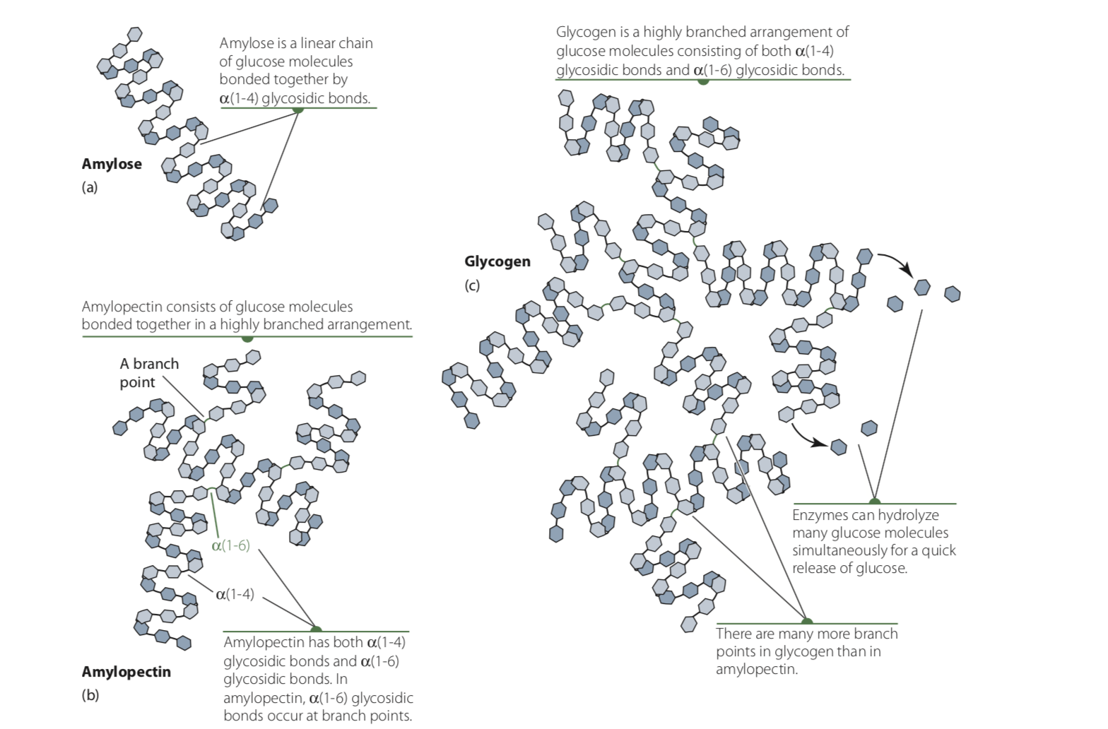

Slide 34
Glycogen
Glycogen is the major form of stored carbohydrate in animal tissues, localized primarily in liver and skeletal muscle
The glucose units within glycogen serve as a readily available source of glucose
  glycogen is a polymer of alpha (1-4) linked subunits of glucose
  alpha(1-6) bond) linked branches, but glycogen is more extensively branched (on average, every 8 to 12 residues)
  The highly linked branches is what makes glycogen a readily used source of glucose
Glycogenolysis : glucose units are sequentially removed by enzymatic hydrolysis from the nonreducing ends of the glycogen chains. The liberated glucose molecule then enters energy-releasing pathways of metabolism.
Notes:
Glycogenolysis is the breakdown of glycogen (n) to glucose-1-phosphate and glycogen (n-1).

Slide 35
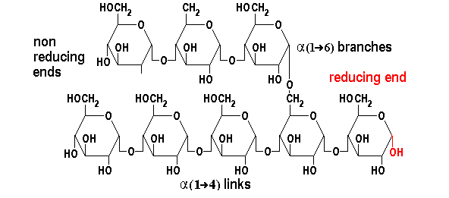

Slide 36
Each branch in glycogen ends with a nonreducing sugar unit, a glycogen molecule has as many nonreducing ends as it has branches, but only one reducing end. When glycogen is used as an energy source, glucose units are removed one at a time from the nonreducing ends.
Degradative enzymes that act only at nonreducing ends can work simultaneously on the many branches, speeding the conversion of the polymer to monosaccharides.

Slide 37
Glycogen Breakdown
Requires three enzymes
Glycogen Phosphorylase: The first step of glycogen breakdown is phosphorolysis, which is catalyzed by an enzyme called glycogen phosphorylase. This enzyme uses an orthophosphate(HPO₄^{_2}) to cleave an alpha 1,4 - glycosidic bond between a terminal glucose with a free hydroxyl group on the 4th carbon and the adjacent glucose. The products of this reaction are a glucose 1-phosphate and a glycogen that contains one less glucose.
Debranching Enzyme
  Transferase
  Alpha 1,6 glucosidase
Phosphoglucomutase
Notes:
First step Glycogen Phosphorylase: : energetically favorable because we don’t use an ATP molecule to make glucose-1-p ( to add a phosphate group)- bypassing usuage of an ATP
we also have a lot more orthophosphate than gluc-1-p, so more reactant, thus pushing reaction forward..

Slide 38
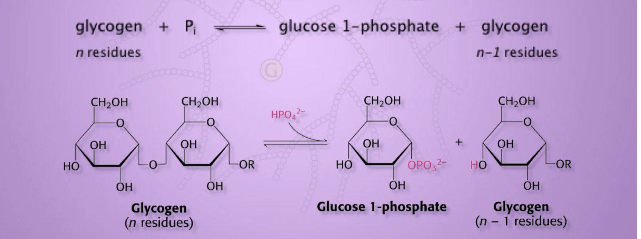
GLYCOGEN BREAKDOWN
Glycogen phosphorylase
phosphorylase
phosphorylase

Slide 39
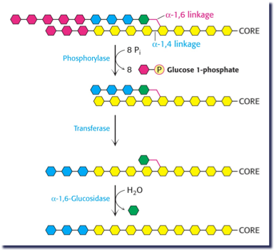
Glycogen phosphorylase cleaves a(1-4) glycosidic bonds, BUT cannot hydrolyze a(1-6) bonds Phosphorylase acts repetitively along linear portions of the glycogen molecule until it reaches a point four glucose residues away from an a(1-6) branch point.
Here the degradation process stops, resuming only after another enzyme, the debranching enzyme, cleaves the a(1-6) bond at the branch point

Slide 40
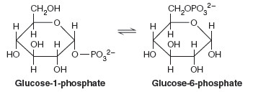
In the final step, an enzyme called Phosphoglucomutase converts the glucose 1-phosphate into glucose 6-phosphate.
When glycogenolytic activity is high, the f`ormation of increased amounts of glucose-1-phosphate shifts the phosphoglucomutase reaction toward production of the 6-phosphate isomer
Phosphoglucomutase

Slide 41
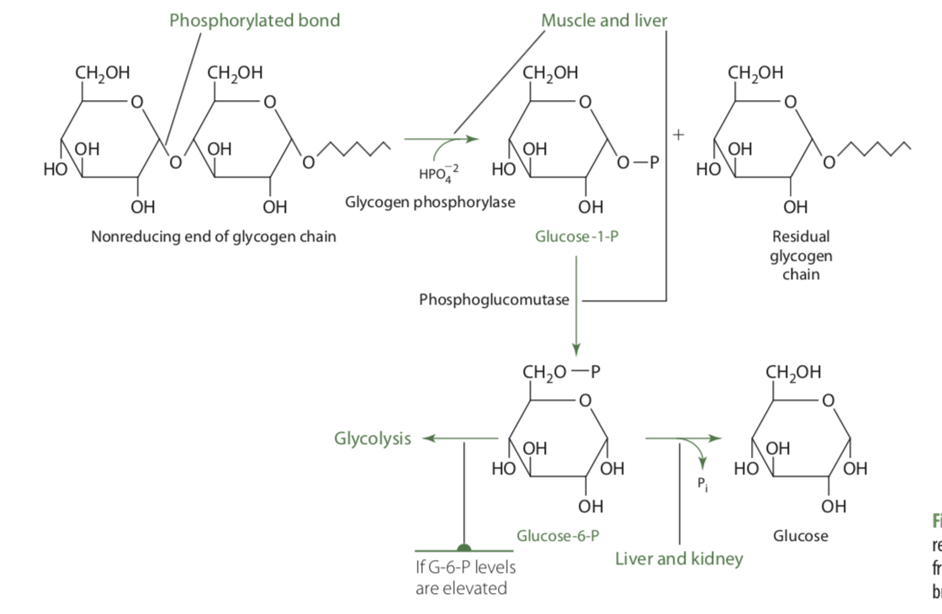
Glucose-6-phosphate can be converted to free glucose by the action of glucose-6-phosphatase. This enzyme is not expressed in muscle cells or adipocytes.
Free glucose can be formed only from liver or kidney glycogen and transported through the bloodstream to other tissues for oxidation

Slide 42
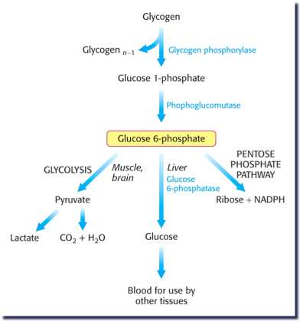

Slide 43
Cellulose
Major component of cell walls in plants
Glycosidic bonds connecting the glucose units are beta(1-4),
Alpha-amylase CANT break down
Dietary fiber and is not considered an energy source
Colonic bacteria can digest cellulose, resulting in several digestion products including short-chain fatty acids that provide energy to the body and play important roles in the gastrointestinal tract

Slide 44
DIGESTION
Only monosaccharides can be absorbed into intestinal mucosal cells (enterocytes)
Glucose and fructose, when present in food as monosaccharides, require no digestion prior to being absorbed into intestinal cells.
Poly-, tri-, and disaccharides therefore must be hydrolyzed. The hydrolytic enzymes involved are collectively called glycosidases or, alternatively, carbohydrases.

Slide 45
Digestion
Digestion of the starches, amylose and amylopectin, starts in the mouth--> key enzyme is salivary a-amylase
  (Hydrolyzes alpha(1-4) glycosidic linkages)
Due to the short period of time that food is in the mouth, this produces few mono-or disaccharides.
Action continues in the stomach until the gastric acid penetrates the food bolus and lowers the pH.

Slide 46
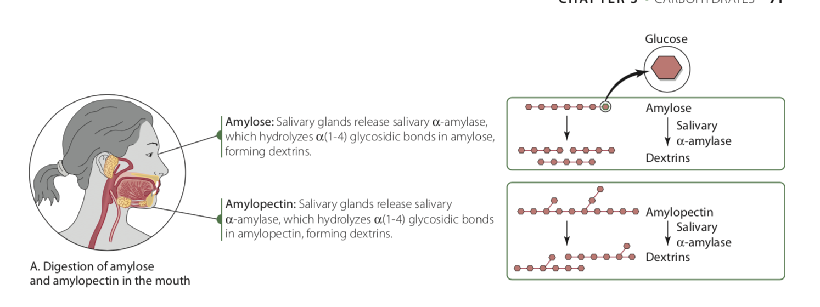
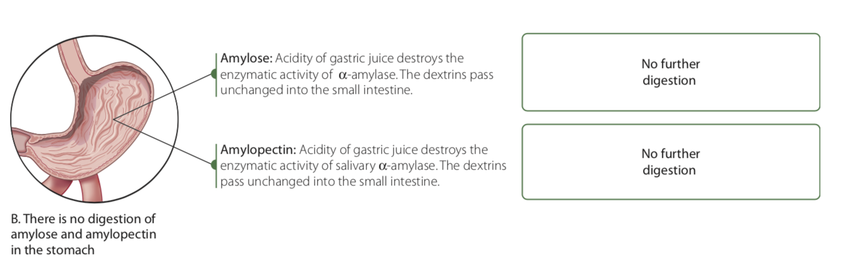

Slide 47
The starches move into the duodenum and jejunum:
Acted upon by pancreatic α-amylase (pancreatic bicarbonate elevates the pH to a favorable level)
The α-amylase hydrolyzes α(1-4) glycosidic bonds in both amylose and amylopectin to produce oligosaccharides (also called dextrins or limit dextrins), maltose, and maltotriose
The branched oligosaccharides, trisaccharide maltotriose, and maltose are further digested by specific enzymes in the brush border.
α-amylase can further break the oligosaccharides down to maltose and maltotriose.

Slide 48
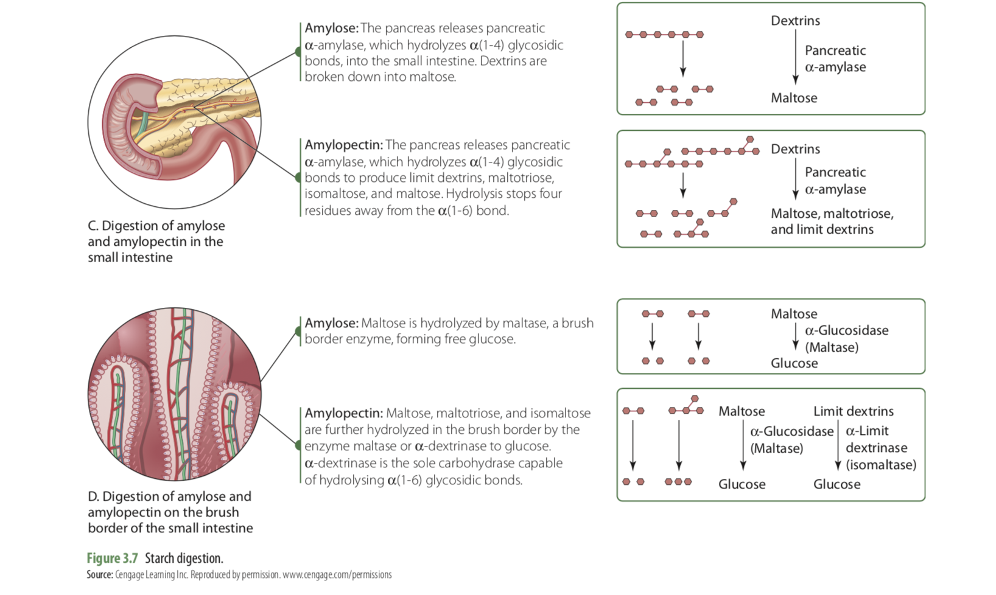

Slide 49
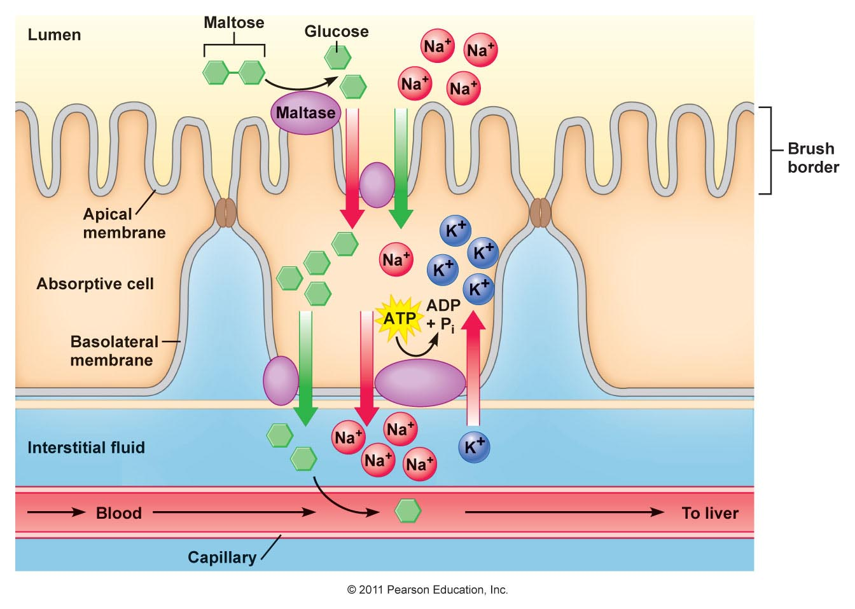
Digestion of Disaccharides
No significant digestion of disaccharides or small oligosaccharides occurs in the mouth, stomach, or lumen of the small intestine
Takes place almost entirely within the brush border of the upper small intestine via disaccharidase activity.
Brush border enzymes: enzymes embedded in villi membrane of enterocytes
http://droualb.faculty.mjc.edu/Course%20Materials/Physiology%20101/Chapter%20Notes/Fall%202007/chapter_20%20Fall%202007%20Phy%20101.htm

Slide 50
Digestion of Disaccharides
Enzymes:
Lactase: catalyzes the cleavage of lactose to galactose and glucose. Lactase activity is high in infants, but in most mammals, including humans, it decreases a few years after weaning.
Sucrase: hydrolyzes sucrose to yield one glucose and one fructose residue.
Maltase: hydrolyzes maltose to yield two glucose units. Isomaltase (α-dextrinase) hydrolyzes the α(1-6) bond of isomaltose
Trehalase: hydrolyzes the α(1-1) glycosidic bonds of trehalose to yield two molecules of glucose

Slide 51
Absorption
Small intestines wall is composed of absorptive enterocytes( epithelium cells) and mucus-secreting goblet cells that line projections, called villi, that extend into the lumen.
Anatomic advantage: presents an enormous surface area to the intestinal contents, thereby facilitating absorption.
Digestion and absorption of carbohydrates are so efficient that nearly all monosaccharides are usually absorbed by the end of the jejunum.
http://education.med.nyu.edu/mbm/carbohydrates/digestionAbsorption.shtml

