Slide 1
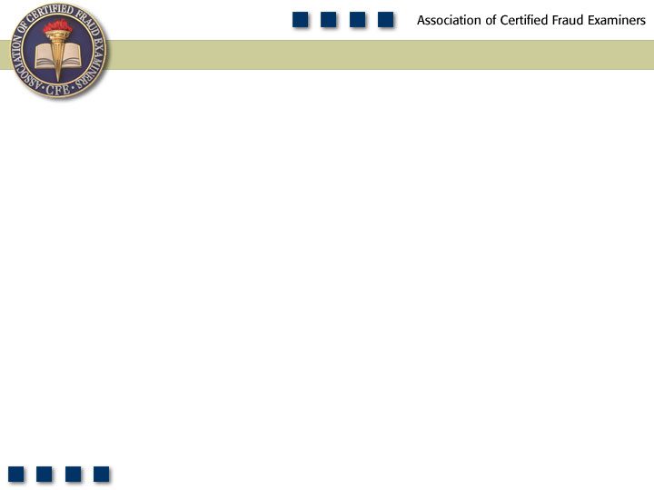
Chapter 4
Billing Schemes

Slide 2

Pop Quiz
What is a pass-through billing scheme?

Slide 3
Learning Objectives
List the five major categories of fraudulent disbursements.
Define the term “billing schemes.”
List the three categories of billing schemes.
Understand what a shell company is and how it is formed.
List and understand the four ways false invoices are approved for payment.
Understand why most shell company schemes involve the purchase of services rather than goods.
Understand how a pass-through scheme differs from the usual shell company schemes.
Be familiar with the methods identified in this chapter for preventing and detecting shell company schemes.

Slide 4
Learning Objectives
Understand how pay-and-return schemes work.
Understand how non-accomplice vendor schemes work.
Be familiar with the methods identified in this chapter for preventing and detecting non-accomplice vendor schemes.
Understand how personal purchases schemes work.
Be familiar with the methods identified in this chapter for preventing and detecting personal purchases schemes.
Be familiar with proactive audit tests that can be used to detect billing schemes.

Slide 5
Billing Schemes
Shell Company
Non-Accomplice
Vendor
Personal
Purchases

Slide 6
Frequency of Fraudulent Disbursements

Slide 7
Median Loss of Fraudulent Disbursements

Slide 8
Billing Schemes
The perpetrator uses false documentation to cause a payment to be issued for a fraudulent purpose
Fraudulent disbursement is issued in same manner as a legitimate disbursement
Schemes
Shell company schemes
Non-accomplice vendor schemes
Personal purchases schemes

Slide 9
Shell Company Schemes
Fictitious entities created for the sole purpose of committing fraud
Bank account is usually set up in the company’s name
Forming a shell company
Certificate of incorporation or assumed-name certificate set up
Shell company may be formed in someone else’s name
Best way is to set up company under a fictitious name
Set up entity’s address – home address, post office box, or friend/relative’s address

Slide 10
Shell Company
Submitting false invoices
Invoice is manufactured using a professional printer, personal computer, or typewriter
Self-approval of fraudulent invoices
Most fraudsters are in a position to approve payment
Approvals may be forged
“Rubber stamp” supervisors
Don’t check the documentation
Approve whatever is submitted
Reliance on false documents
Without approval authority, fraudster submits false documents – purchase order, invoice, and receiving report

Slide 11
Shell Company
Collusion
Two or more employees conspire to steal
More difficult to detect
Circumvents controls implemented to prevent fraud
Purchases of services rather than goods
Purchases of service are preferable to purchases of goods
Services are intangible and fraud is more difficult to detect
Pass-through schemes
Goods or services are purchased by the employee and resold to the victim company at an inflated price

Slide 12
Preventing and Detecting Shell Company Schemes
Maintain and regularly update an approved vendor list
Independently verify all vendors before payment
Identifying shell company invoices
Lack of detail on the fraudulent invoice
Invoice that lacks detailed descriptions of the items billed
Mailing address may be an indicator of fraud
Consecutively numbered invoices over a period of time
Reviewing payables and sorting payments by vendor and invoice number

Slide 13
Preventing and Detecting Shell Company Schemes
Testing for shell company schemes
Investigate budget overruns and departments that regularly exceed their budget
Conduct horizontal analysis of expenses
Investigate unexplained increases in “soft” accounts
Investigate unexplained increases in quantity of items purchased

Slide 14
Preventing and Detecting Shell Company Schemes
Testing for shell company schemes
Monitor trends in average unit price
Investigate goods and services that would not normally be purchased
Compare vendor addresses to employee addresses
Run reports of average turnaround time for invoices to look for unusual payment patterns

Slide 15
Preventing and Detecting Shell Company Schemes
Verifying whether a shell company exists
Use the Internet to verify the vendor
Contact others in the industry
Verify vendor’s address through a site visit or by using satellite imaging software
Identifying the employee behind a shell company
Conduct a public records search of the company’s registration
Be alert for related names, addresses, phone numbers, Social Security numbers, and other identities
Match vendor payments with payroll checks
Conduct surveillance of mail drops to see who picks up the checks

Slide 16
Billing Schemes – Non-Accomplice Vendors
Vendor is not a part of the scheme
Pay-and-return schemes
Payments owed to legitimate vendors intentionally mishandled
Double pay an invoice
Pay the wrong the vendor
Overpay the invoice amount
Purchase excess merchandise
Overbilling with a non-accomplice vendor’s invoices
Fake invoice is created for a vendor that regularly does business with victim organization
Rerun an invoice already paid

Slide 17
Preventing and Detecting Non-Accomplice Vendor Fraud
Incoming checks should be photocopied and attached to the remittance advice
Regarding overpayments, banks should be instructed not to cash checks payable to an organization
Spot check past accounts payable files when a pay-and-return scheme is suspected

Slide 18
Personal Purchases With Company Funds
Employees make personal purchases for themselves, their businesses, their family, or their friends using company money
Perpetrator causes the victim company to order and pay for an unneeded asset

Slide 19
Personal Purchases Through False Invoices
The fraudster is authorizer of invoices
Falsifying documents such as purchase orders to obtain authorization
Altering existing purchase orders
False purchase requisitions
Misrepresent the nature of the purchase
Change the delivery address of the purchase

Slide 20
Personal Purchases on Credit Cards, Purchasing Cards, or Other Company Accounts
Employees make purchases using their company credit cards, purchasing cards, or running accounts with vendors
Company cards may be stolen or “borrowed” from authorized users
Charge accounts
Employees order items using an existing account with the vendor
Returning merchandise for cash/credit
Employee purchases a good or service, receives reimbursement, and then returns the item for a credit

Slide 21
Preventing and Detecting Personal Purchases
Conduct a thorough review of each credit card or purchasing card statement independent of the signature authority
Only original support for the reimbursement should be allowed
Card issuer should send two copies of the statement to two different individuals within the organization
Card statements should be compared with employee expense vouchers for duplications, and monitored for unexplained increases in purchasing levels

