Slide 1
Intervention for language in infants and preschool children
Chapter 4

Slide 2
early intervention is crucial for infants:
Who do not demonstrate these prerequisite skills within the typically expected time frame.
2. for children who are considered at risk for developing language difficulties due to factors :
such as prematurity, low birth weight, family history, medical complications.

Slide 3
ASHA Early Intervention Guidelines:
Prevention
Screening
Evaluation and assessment
Planning, implementing, and monitoring intervention
Consultation with and education for tam members, including families and other
professionals
Service coordination
Transition planning
Advocacy

Slide 4
Cont..
Intervention provided during the first 2 years of life is thought to be extremely productive because it capitalizes on the rapid neural growth and learning potential of the young brain.
Although the term natural environment has often been assumed to refer to a child’s home, it actually encompasses all settings and individuals with whom the child has regular contact.

Slide 5
Cont..
With infants and toddlers, more than with any other single age group, the clinician will likely work in an interdisciplinary or transdisciplinary model of service delivery.
interdisciplinary model:
each team member functions within his or her specific discipline and shares information with other team members through established channels such as team meetings.

Slide 6
Cont..
transdisciplinary model :
traditional professional boundaries.
They receive training in other disciplines and interchangeably provide services as needed by the child and family

Slide 7
Cont..
The goal of early intervention (EI) is the development of basic skills thought to be critical to successful speech, language, and communication learning.
The primary therapy strategies for infants are repeated, interactive exposure to authentic learning experiences in natural environments and modeling/stimulation

Slide 8
Pre-linguistic and early language skills
Localization:
Infants demonstrate awareness of sounds in their environment by turning toward and visually searching for the source of a sound. This auditory–visual association marks the beginning of an infant’s conceptual grasp of cause–effect relations.

Slide 9
Developmental sequence for appropriate response level:
3 to 4 months: Primitive attempt to turn head
4 to 7 months: Localization to side only
7 to 13 months: Localization to side or below
13 to 21 months: Localization to side, below, or above
21 to 24 months : Direct localization to any angle

Slide 10
Cont..
2. Joint\shared attention:
Joint attention between an adult and infant highlights the relationship between the adult’s utterances and the objects, actions, or concepts they represent.
One effective method for facilitating joint attention is to place noisy object in front of the infant, look at it, and comment on it.

Slide 11
Cont..
3. Mutual Gaze:
is a characteristic of early communicative development in which the infant and caregiver look at each other during social interactions.
serves as a basic building block for later development of the important skill of turn-taking in conversation
can be enhanced when adult eye contact is accompanied by smiling and other facial expressions, touching, and novel or entertaining vocalizations.

Slide 12
Cont..
4. Joint Action and Routines:
Joint action between an adult and infant occurs in play sequences known as sound–gesture games or routines such as peekaboo.
A routine is a prepackaged or ritualized exchange between an adult and infant.
It is generally believed that the regularity and invariance of these routines allow the infant to make his or her first attempts at “cracking the linguistic code” and acquiring the first words. And also important for building blocks of conversational exchanges.

Slide 13
Cont..
acquisition sequence for young children:
■ At approximately 6 months, infants show enjoyment and pleasure (i.e., change in
facial expression or body posture) when a parent initiates a sound–gesture routine.
■ By 7 months, the infant anticipates the game when the adult produces the verbal
component alone (independent of any gesture).
■ The 8- to 9-month-old baby initiates as well as participates in the game (e.g., crawls
behind the door and peeks his head out while smiling).

Slide 14
Cont..
5. vocalization:
The first year of life is characterized, in part, by rapid physical growth and neuromuscular maturation.
As a result, the infant gains increasing control over the speech mechanism and exhibits significant expansion in the quality and variety of vocalizations.
Table 4-1 p. 169

Slide 15
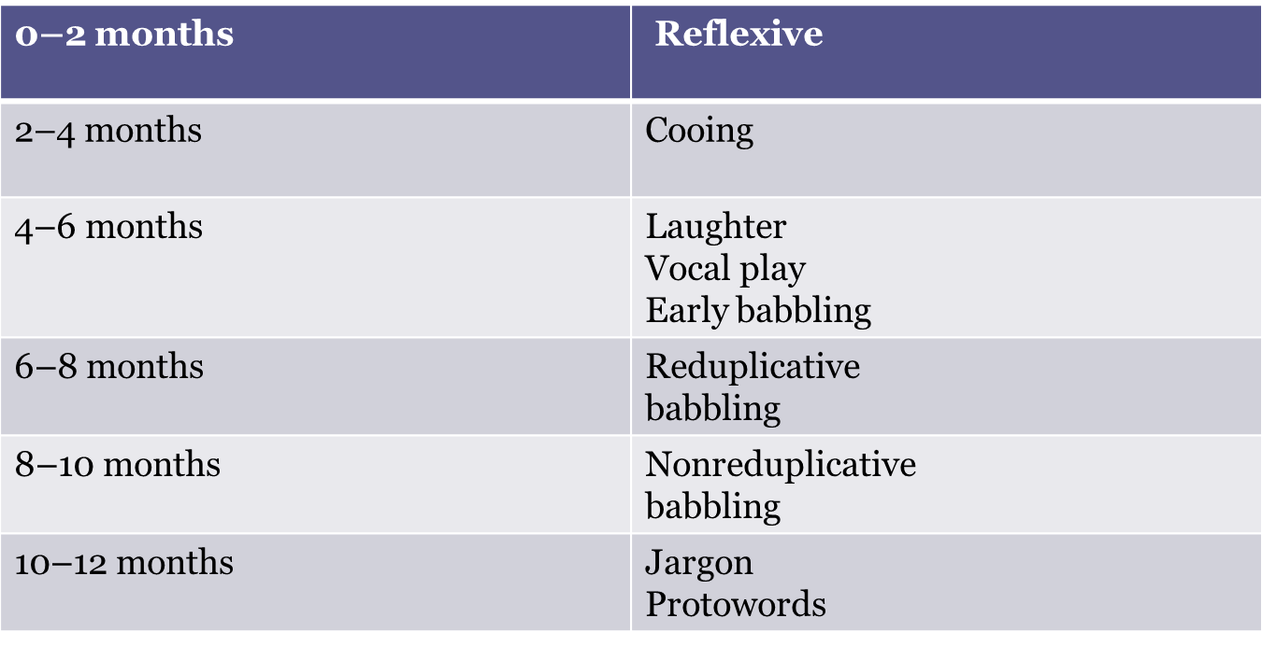
Stages of Vocal Development in Infancy

Slide 16
Cont..
6. intentional communication:
The meaning that a speaker wishes a message to convey.
At about 9 months of age, infants discover
intentional communication and begin to express their communicative intentions through gesture and vocalization.

Slide 17
Cont..
Evidence suggests that the rate of preverbal communication in young children with developmental delays is a strong predictor of later vocabulary usage.
The frequency of intentional communication is also predictive: Higher rates of nonverbal intentional communication during the preverbal stage are associated with better language outcomes 1 to 2 years later.

Slide 18
Intervention in the area of communicative intentions may be aimed at:
(1) Increasing the number of different types of intentions a child can understand or express.
(2) increasing the variety of forms (e.g. vocalization, gesture, word) understood or used to express a given intention

Slide 19
Cont..
7. Non-symbolic Play and Symbolic Play:
Infants gain experience in how both receptive and expressive language function by participating in play sequences. In addition , play is the most important context for the development of social communication skills and the natural context for early language learning.
In early types of play, children use objects for their intended purposes (functional play). And do not require the use of symbolic agents .
examples of functional play include activities such as running, filling and emptying receptacles, driving toy cars, and water play

Slide 20
Cont..
Later, symbolic forms of play emerge, where, the child substitutes objects or events for other objects/events. Examples include pretending to talk on the telephone or using a stick as a sword

Slide 21
some suggested themes and activities for facilitating play:
Pretending to act out sequences of familiar actions such as pouring liquid into a cup, taking a sip, and then spilling the liquid onto the floor
Using dough or clay to create “pretend” food such as hot dogs or pancakes
Using miniature people, cars, or dishes to act out daily routines such as taking a bath,
going to the store, or having a birthday party

Slide 22
Cont..
8. Initial Vocabulary/First Lexicon:
Infants begin to understand a few familiar words between 6 and 8 months of age.
Production of first true words occurs around the first birthday.
Early vocabulary development can be stimulated at the receptive and/or expressive

Slide 23
Cont..
Strategies for facilitating the acquisition of early lexical items are frequently based on semantic function rather than grammatical classification.
Three main considerations in the selection of target vocabulary are:
(1) words that can be used in many different contexts during the child’s daily activities;
(2) words that are important to the child, such as names of significant others or types of favorite foods or toys; and
(3) words that represent dynamic rather than static
states

Slide 24
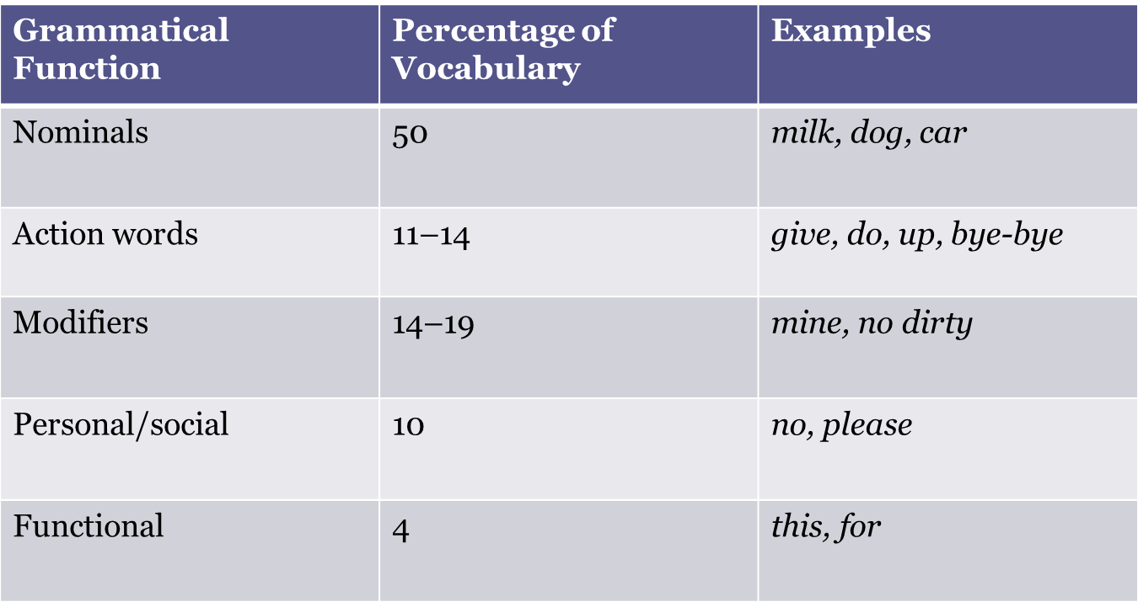
Grammatical Classification of the First 50 Words Produced

Slide 25
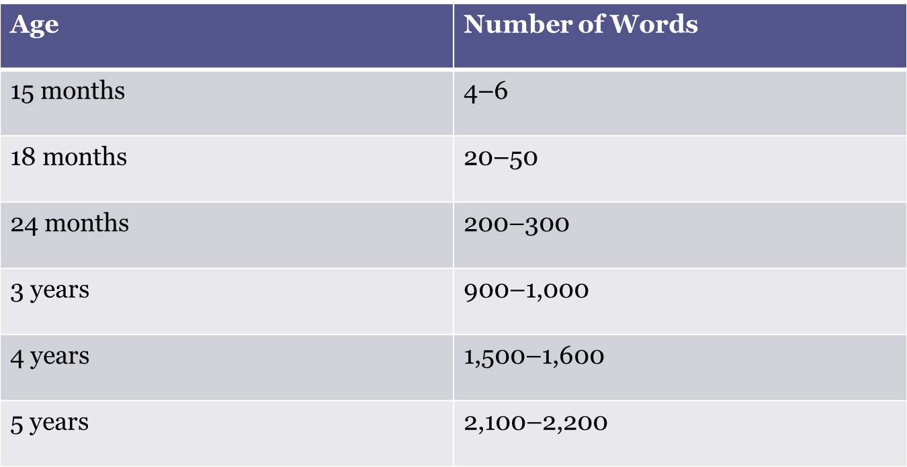
Expressive vocabulary growth

