Slide 1
Chapter Eight
Product, Services, and Brands: Building Customer Value

Slide 2
Product, Services, and Branding Strategy
Topic Outline
What Is a Product?
Product and Services Decisions
Services Marketing
Branding Strategy: Building Strong Brands

Slide 3

What Is a Product?
Products, Services, and Experiences
Product is anything that can be offered in a market for attention, acquisition, use, or consumption that might satisfy a need or want
Service is a product that consists of activities, benefits or satisfaction that is essentially intangible and does not result in the ownership of anything
Notes:
Note to Instructor
This Web link is a great example of a store that creates experiences: Jordan’s Furniture in the Boston. These furniture stores include an Imax theater, an amusement park quality motion ride, a trapeze school, and Mardi Gras parades. You can visit their stores through their Web sites.

Slide 4
What Is a Product?
Products, Services, and Experiences
Experiences represent what buying the product or service will do for the customer
Notes:
Note to Instructor
This Web link is a great example of a store that creates experiences: Jordan’s Furniture in the Boston. These furniture stores include an Imax theater, an amusement park quality motion ride, a trapeze school, and Mardi Gras parades. You can visit their stores through their Web sites.

Slide 5
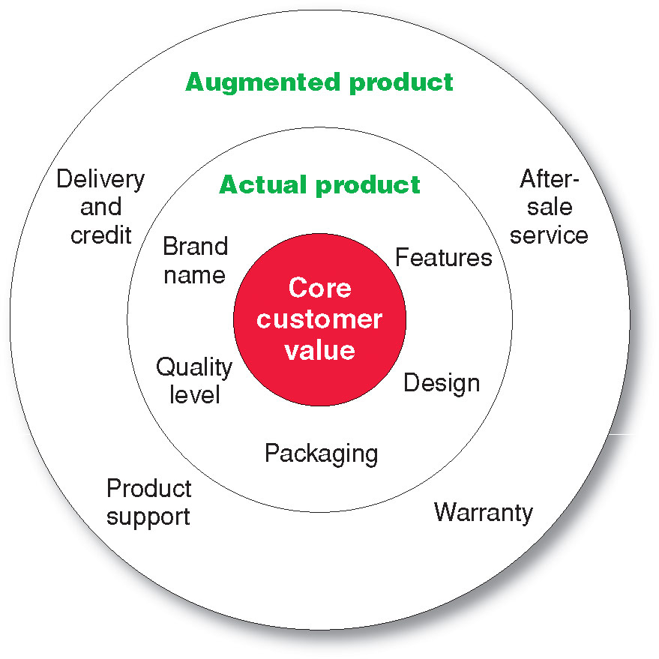
What Is a Product?
Levels of Product and Services
Notes:
Note to Instructor
Core benefits represent what the buyer is really buying.
Actual product represents the design, brand name, and packaging that delivers the core benefit to the customer.
Augmented product represents additional services or benefits of the actual product.
It is a good idea for the students to bring in some products so the class can discuss the levels of product and services. Products including Gatorade, toothpaste, facial moisturizer or cosmetics work well in this discussion. You can often find augmented product features on the product’s Web sites including games, features and support.

Slide 6
What Is a Product?
Product and Service Classifications

Slide 7
What Is a Product?
Product and Service Classifications
Consumer products are products and services for personal consumption
Classified by how consumers buy them
  Convenience products
  Shopping products
  Specialty products
  Unsought products

Slide 8
What Is a Product?
Product and Service Classifications
Convenience products
consumer products and services that the customer usually buys frequently, immediately, and with a minimum comparison and buying effort
  Newspapers
  Candy
  Fast food

Slide 9
What Is a Product?
Product and Service Classifications
Shopping products
consumer products and services that the customer compares carefully on suitability, quality, price, and style
  Furniture
  Cars
  Appliances

Slide 10
What Is a Product?
Product and Service Classifications
Specialty products
consumer products and services with unique characteristics or brand identification for which a significant group of buyers is willing to make a special purchase effort
    Medical services
    Designer clothes
    High-end electronics

Slide 11
What Is a Product?
Product and Service Classifications
Unsought products
consumer products that the consumer does not know about or knows about but does not normally think of buying
    Life insurance
    Funeral services
    Blood donations
Notes:
Note to Instructor
Discussion Question
What is a product that could be convenience, shopping, and specialty?
This is a bit of a puzzle. They might realize that a camera could fall into several categories depending on the buyer and the situation. Certainly, if you are on vacation and you forgot your camera, you would pick one up at a convenience store, pharmacy, or maybe the hotel store. If you were a professional photographer, a camera purchase could easily be specialty if you were buying a $5,000 camera. Other examples might include mats for the floor of a automobile, tires, or a fan.

Slide 12
What Is a Product?
Product and Service Classifications
Industrial products
products purchased for further processing or for use in conducting a business
Classified by the purpose for which the product is purchased
      Materials and parts
      Capital
      Raw materials

Slide 13

What Is a Product?
Product and Service Classifications
Capital items are industrial products that aid in the buyer’s production or operations
Materials and parts include raw materials and manufactured materials and parts usually sold directly to industrial users
Supplies and services include operating supplies, repair and maintenance items, and business services
Notes:
Note to Instructor
This Web link brings you to CBIZ—a consulting firm for businesses. It is interesting to look at their drop-down menus for an overview of the services they offer.

Slide 14
What Is a Product?
Organizations, Persons, Places, and Ideas
Organization marketing consists of activities undertaken to create, maintain, or change attitudes and behavior of target consumers toward an organization

Slide 15

What Is a Product?
Organizations, Persons, Places, and Ideas
Person marketing consists of activities undertaken to create, maintain, or change attitudes and behavior of target consumers toward particular people
Notes:
Note to Instructor
The text highlights Rachael Ray, a one-woman marketing phenomenon.
Beyond her Food Network shows, she landed her own daytime talk show; endorses
a litany of orange-colored cookware, bakeware, and cutlery; has her own brand
of dog food called Nutrish; and brands her own EVOO (extra virgin olive oil, for those
not familiar with Rayisms).

Slide 16
What Is a Product
Organizations, Persons, Places, and Ideas
Place marketing consists of activities undertaken to create, maintain, or change attitudes and behavior of target consumers toward particular places
Social marketing is the use of commercial marketing concepts and tools in programs designed to influence individuals’ behavior to improve their well-being and that of society
Notes:
Note to Instructor
The text highlights Tourism Ireland,
the agency responsible for marketing Irish tourism to the rest of the world, invites travelers
to “Go where Ireland takes you.” The agency works with the travel trade, media, and other
partners in key world markets, such as the United States, Canada, Australia, and a dozen
European countries. At its Discover Ireland Web site, Tourism Ireland offers information
about the country and its attractions, a travel planner, special vacation offers, lists of tour
operators, and much more information that makes it easier to say “yes” to visiting Ireland.

Slide 17
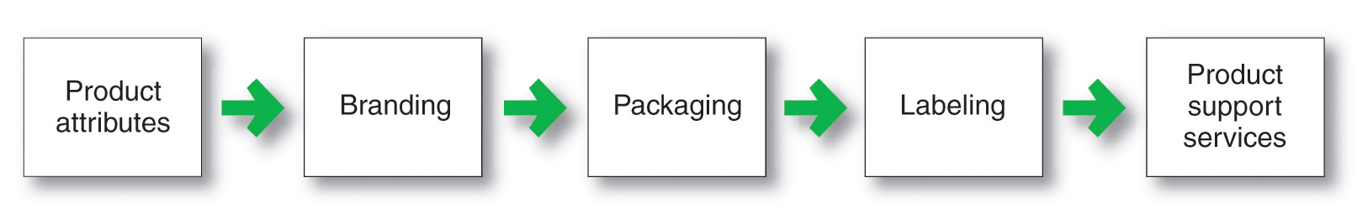
Product and Service Decisions
Individual Product and Service Decisions
Notes:
Now we dig into the specific
decisions that companies must make
when designing and marketing
products and services.

Slide 18
Product and Service Decisions
Individual Product and Service Decisions
Product or service attributes
communicate and deliver the benefits
Quality
Features
Style and design

Slide 19
Product and Service Decisions
Individual Product and Service Decisions
Product Quality Level is the level of quality that supports the product’s positioning
Product Conformance Quality is the product’s freedom from defects and consistency in delivering a targeted level of performance
Notes:
Product quality
The characteristics of a product or service
that bear on its ability to satisfy stated or
implied customer needs.
Product quality is one of the marketer’s major positioning tools. Quality
has a direct impact on product or service performance; thus, it is closely linked to customer
value and satisfaction

Slide 20
Product and Service Decisions
Individual Product and Service Decisions
Product features
are a competitive tool for differentiating a product from competitors’ products
are assessed based on the value to the customer versus the cost to the company

Slide 21
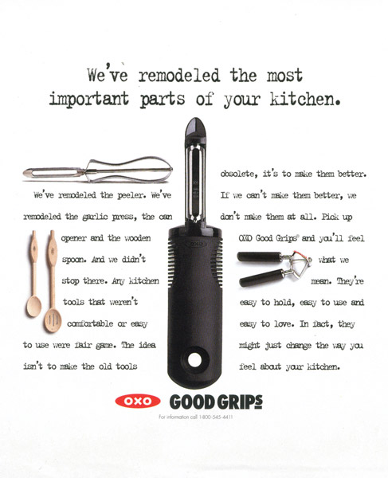

Product and Service Decisions
Individual Product and Service Decisions
Style describes the appearance of the product
Design contributes to a product’s usefulness as well as to its looks
Notes:
Note to Instructor
The text highlights OXO’s unique design for their product. This link takes you to the OXO Web site to explore some of there products.

Slide 22
Product and Service Decisions
Individual Product and Service Decisions
Brand is the name, term, sign, or design—or a combination of these—that identifies the maker or seller of a product or service
Notes:
Note to Instructor
Discussion Questions
What brands do you tend to purchase consistently? Why?
This discussion should lead to the consumer benefits of brands including quality and consistency. It is interesting to now ask students what the benefits might be for the seller of having a strong brand. This will include segmentation, positioning, and the ability to communicate product features

Slide 23
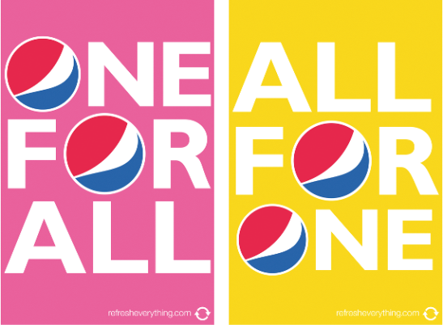
Product and Service Decisions
Individual Product and Service Decisions
Packaging involves designing and producing the container or wrapper for a product
Labels identify the product or brand, describe attributes, and provide promotion
Notes:
Note to Instructor

Slide 24

Product and Service Decisions
Individual Product and Service Decisions
Product support services augment actual products
Notes:
Note to Instructor
Companies must continually:
Assess the value of current services to obtain ideas for new ones.
Assess the costs of providing these services.
Develop a package of services to satisfy customers and provide profit to the company.

Slide 25
Product and Service Decisions
Product Line Decisions
Product line is a group of products that are closely related because they function in a similar manner, are sold to the same customer groups, are marketed through the same types of outlets, or fall within given price ranges

Slide 26
Product and Service Decisions
Product Line Decisions
Product line length is the number of items in the product line
Line stretching
Line filling
Notes:
Note to Instructor
Product line stretching is when a company lengthens its product line beyond its current range.
Product line filling occurs when companies add more items within the present range of the line.
Downward product line stretching is used by companies at the upper end of the market to plug a market hole or respond to a competitor’s attack.
Upward product line stretching is by companies at the lower end of the market to add prestige to their current products.
Combination line stretching is used by companies in the middle range of the market to achieve both goals of upward and downward line stretching.

Slide 27

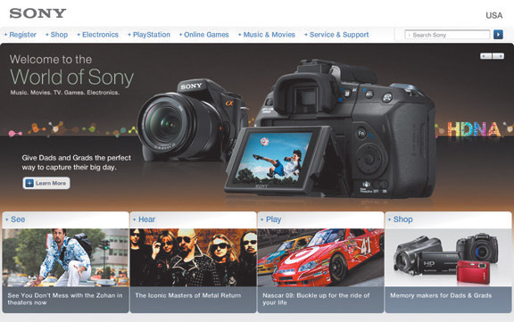
Product and Service Decisions
Product Mix Decisions
Product mix consists of all the products and items that a particular seller offers for sale
        Width
        Length
        Depth
        Consistency
Notes:
Note to Instructor
In slideshow view, click on movie icon to launch Swiss Army video snippet. See accompanying DVD for full video segment.
Product mix width is the number of different product lines the company carries.
Product mix length is the total number of items the company carries within its product lines.
Product mix depth is the number of versions offered of each product in the line.
Consistency is how closely the various product lines are in end use, production requirements, or distribution channels.

Slide 28
Services Marketing
Types of Service Industries
Government
Private not-for-profit organizations
Business services

Slide 29
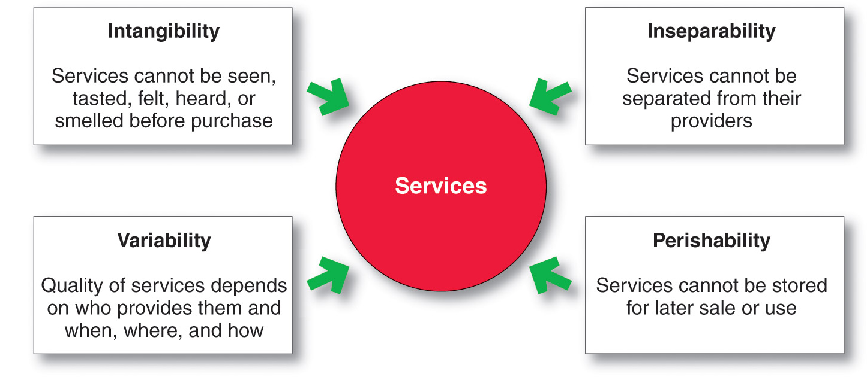
Services Marketing
Nature and Characteristics of a Service
Notes:
Note to Instructor
Intangibility refers to the fact that services cannot be seen, tasted, felt, heard, or smelled before they are purchased.
Inseparability refers to the fact that services cannot be separated from their providers.
Variability refers to the fact that service quality depends on who provides the services as well as when, where, and how they are provided.
Perishability refers to the fact that services cannot be stored for later sale or use.

Slide 30
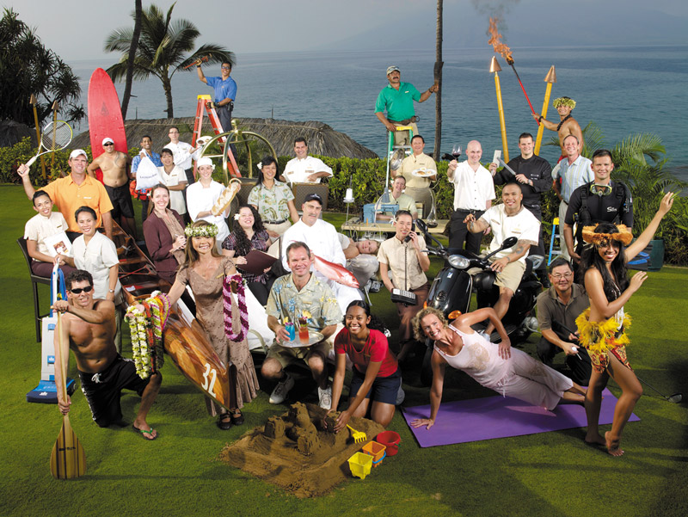
Services Marketing
Marketing Strategies for Service Firms
In addition to traditional marketing strategies, service firms often require additional strategies
Service-profit chain
Internal marketing
Interactive marketing

Slide 31
Services Marketing
Marketing Strategies for Service Firms
Service-profit chain links service firm profits with employee and customer satisfaction
Internal service quality
Satisfied and productive service employees
Greater service value
Satisfied and loyal customers
Healthy service profits and growth

Slide 32
Services Marketing
Marketing Strategies for Service Firms
Internal marketing means that the service firm must orient and motivate its customer contact employees and supporting service people to work as a team to provide customer satisfaction
Internal marketing must precede external marketing

Slide 33
Services Marketing
Marketing Strategies for Service Firms
Interactive marketing means that service quality depends heavily on the quality of the buyer-seller interaction during the service encounter
Service differentiation
Service quality
Service productivity

Slide 34
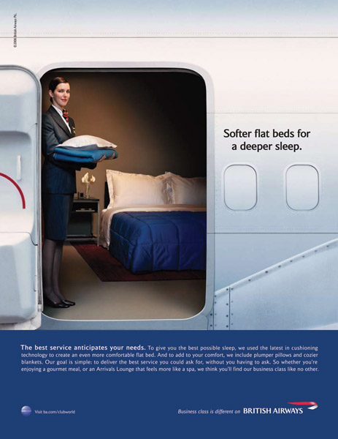
Services Marketing
Marketing Strategies for Service Firms
Managing service differentiation creates a competitive advantage from the offer, delivery, and image of the service
Offer can include distinctive features
Delivery can include more able and reliable customer contact people, environment, or process
Image can include symbols and branding

Slide 35
Services Marketing
Marketing Strategies for Service Firms
Managing service quality provides a competitive advantage by delivering consistently higher quality than its competitors
Service quality always varies depending on interactions between employees and customers

Slide 36
Services Marketing
Marketing Strategies for Service Firms
Managing service productivity refers to the cost side of marketing strategies for service firms
Employee recruiting, hiring, and training strategies
Service quantity and quality strategies

Slide 37
Branding Strategy: Building Strong Brands
Brand equity
The differential effect that knowing the
brand name has on customer response to
the product or its marketing.

Slide 38
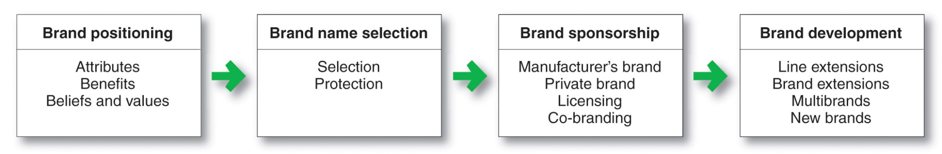
Branding Strategy: Building Strong Brands

Slide 39
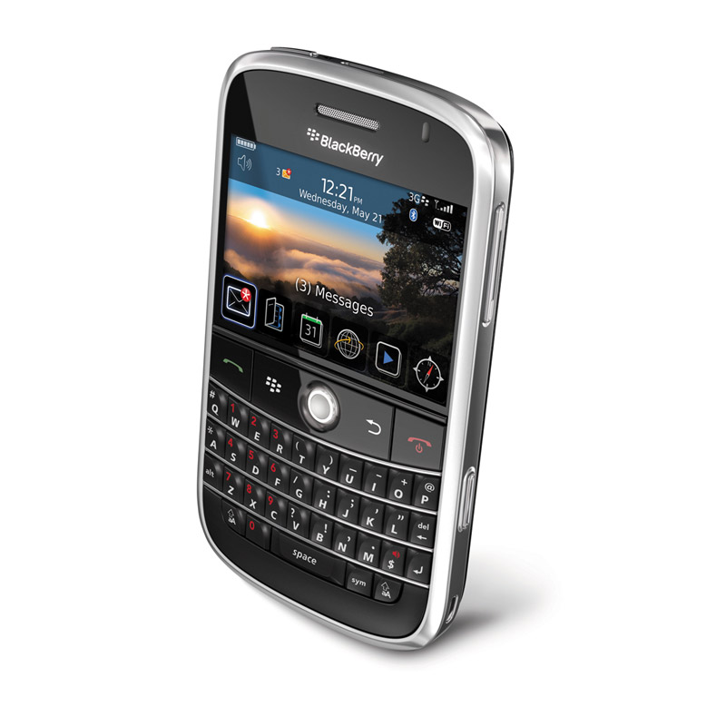
Branding Strategy: Building Strong Brands
Brand Positioning
Brand strategy decisions include:
Product attributes
Product benefits
Product beliefs and values
Notes:
Note to Instructor

Slide 40
Branding Strategy: Building Strong Brands
Brand Name Selection
Desirable qualities
Suggest benefits and qualities
Easy to pronounce, recognize, and remember
Distinctive
Extendable
Translatable for the global economy
Capable of registration and legal protection
Notes:
Note to Instructor
The text has example for each of these:
It should suggest something about the product’s benefits and qualities. Examples: Beautyrest, Die Hard, Intensive Care, Curves (women’s fitness centers).
It should be easy to pronounce, recognize, and remember: Tide, Silk, iPod Touch, JetBlue.
The brand name should be distinctive: Lexus, Zappos.
It should be extendable: Amazon.com began as an online bookseller but chose a name that would allow expansion into other categories.
The name should translate easily into foreign languages. Before changing its name to Exxon, Standard Oil of New Jersey rejected the name Enco, which it learned meant a stalled engine when pronounced in Japanese

Slide 41
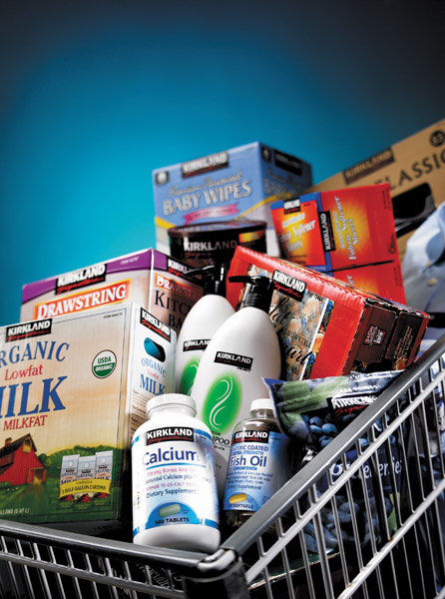
Branding Strategy: Building Strong Brands
Brand Sponsorship
Manufacturer’s brand
Private brand
Licensed brand
Co-brand

Slide 42
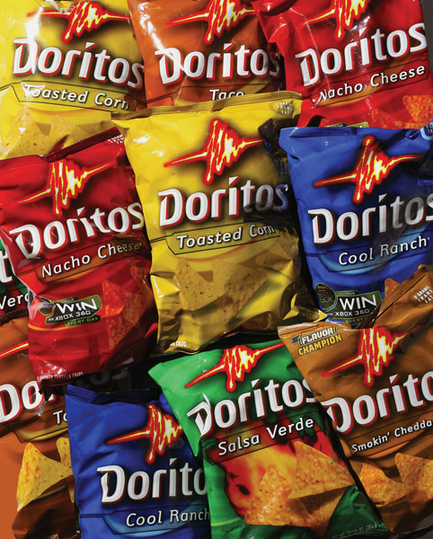
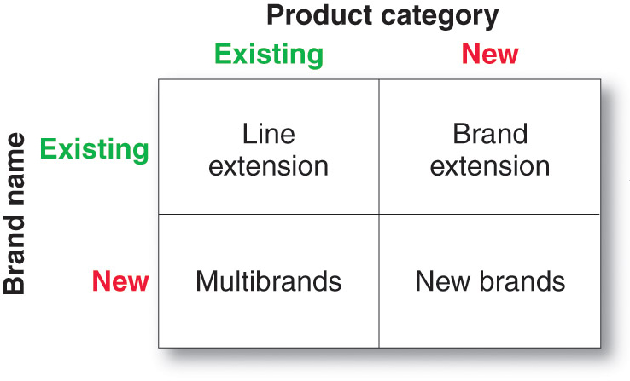
Branding Strategy: Building Strong Brands
Brand Development Strategies

Slide 43
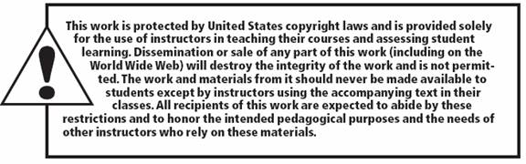
All rights reserved. No part of this publication may be reproduced, stored in a retrieval system, or transmitted, in any form or by any means, electronic, mechanical, photocopying, recording, or otherwise, without the prior written permission of the publisher. Printed in the United States of America.
Copyright © 2012 Pearson Education, Inc.
Publishing as Prentice Hall

