Slide 1
Exp #3
Using Intents and Notifications
SLIDES BY: Tarek Zidan and Mohamad Balawi

Slide 2
Intents
It is a data structure that represents an operation to be performed. Intents are constructed by one component that wants to do some work and received by one activity that can perform that work. Main usage:
Starting Activities
Broadcasting and Receiving Messages
Launching Services

Slide 3
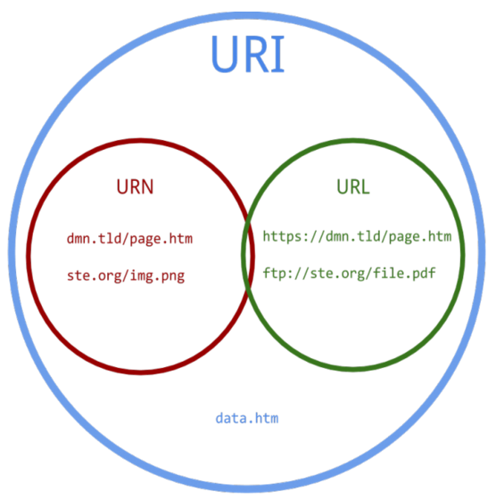
URI (Uniform Resource Identifier)
A Uniform Resource Identifier (URI) is a string of characters identifying a resource online. It’s like an address that tells computers where to find something, such as a webpage, file, or image.
For example, a URL (like "https://www.example.com") is a type of URI. URIs can point to other things besides web pages, making them a broad way to reference resources.
String can be transformed into a Uri using:
  Uri.parse(“tel:00970”)

Slide 4
Intent Fields (1)
Action: String represents a desired operation.
    Intent.ACTION_SENDTO: Open Gmail to send an email
    Intent.ACTION_DIAL: Dial a number
    Intent.ACTION_VIEW: Open Google Maps
  By passing it in the constructor
  By setAction method
Data: data associated with the intent, formatted as URI.
    Uri gmailUri = Uri.parse("mailto:tzidan@birzeit.edu");
    intent.setData(gmailUri);

Slide 5
Intent Fields (2)
Extras: Additional information you need to provide (key/value pairs).
    intent.putExtra(Intent.EXTRA_SUBJECT, "My Subject");
    intent.putExtra(Intent.EXTRA_TEXT, "Content of the message");
Component: The component that should receive this intent.
  Use this field when there is exactly one component that should receive the intent.
    Intent intent = new Intent(SourceActivity.this, DestActivity.class);
    Intent.setComponent(DestActivity.class);

Slide 6
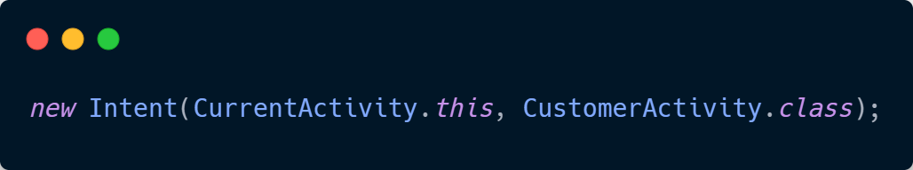
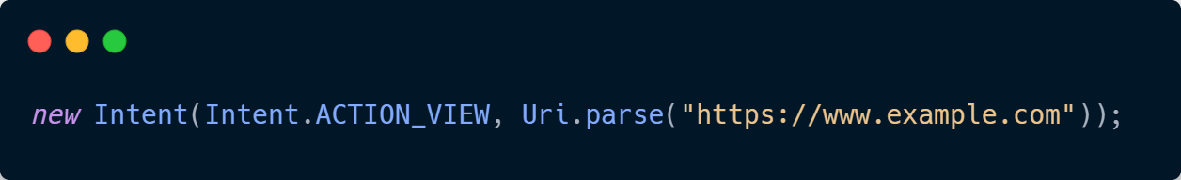
Types of Intents
Explicit Intent: This type of intent is used to start a specific component within your own application. You specify the target component by naming it directly, example:
Implicit Intent: In this type of intent you don’t specify the target component:

Slide 7
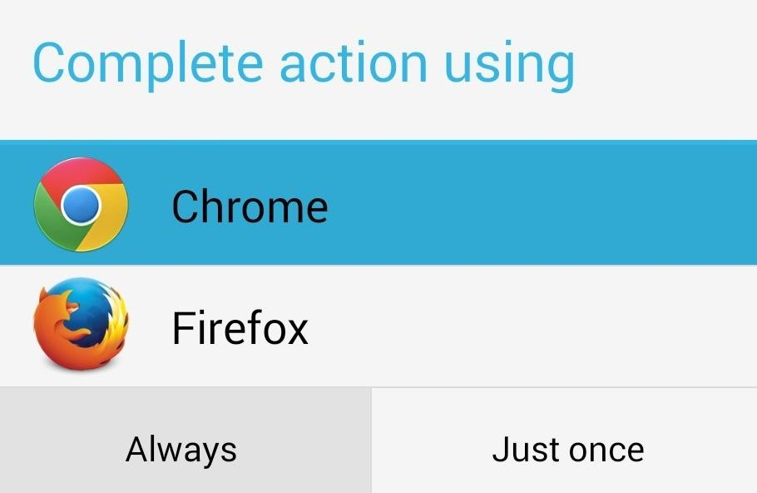
Intent resolution
Happens when you use Implicit Intent.
Example:

Slide 8
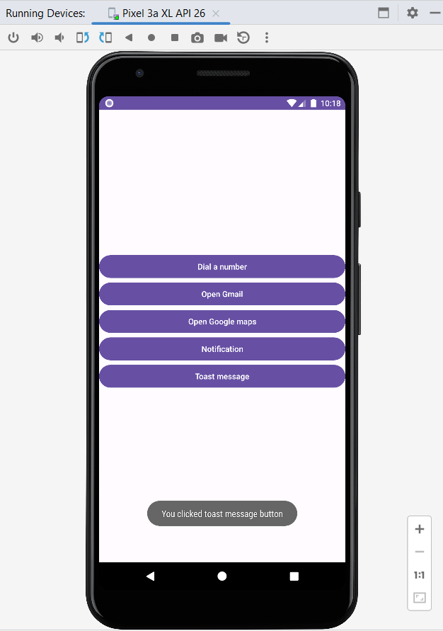
Toast Messages
Messages that pop up on the current window.
It automatically fades into and out of the view without user interaction or response.

Slide 9
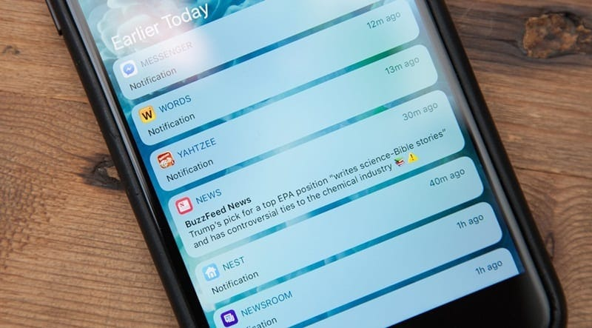
User Notifications (1)

Slide 10
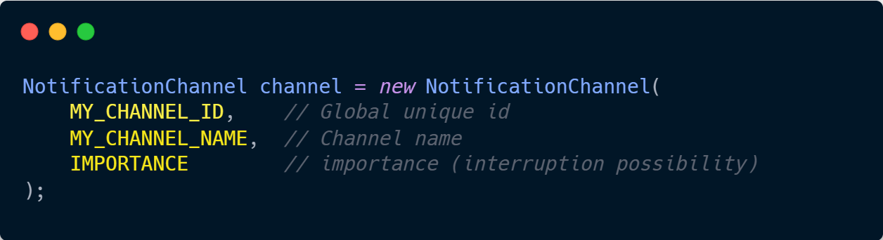
User Notifications (2)
Sent over notification channel that needs: ID, NAME, and IMPORTANCE VALUE.
Controlled by the device system.
how do you send notifications?
The application needs to create a notification channel before sending any notifications.
(unique for the application's package)

Slide 11
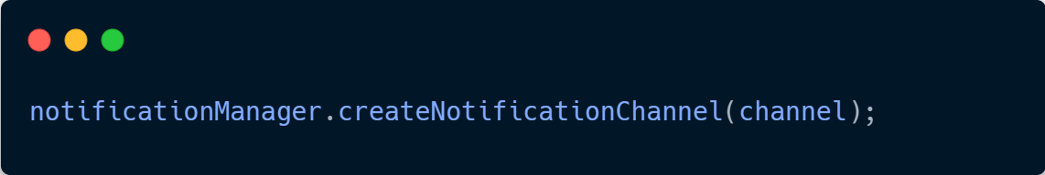
User Notifications (3)
The new channel needs to be added to the notification manager.

Slide 12
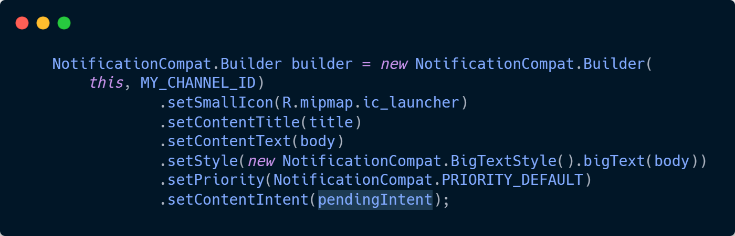
User Notifications (4)
The notification is built using notification builder.

Slide 13
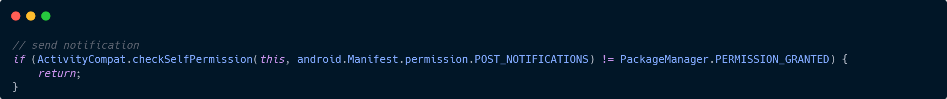
User Notifications (5)
The permission to push notifications needs to checked at runtime.

Slide 14
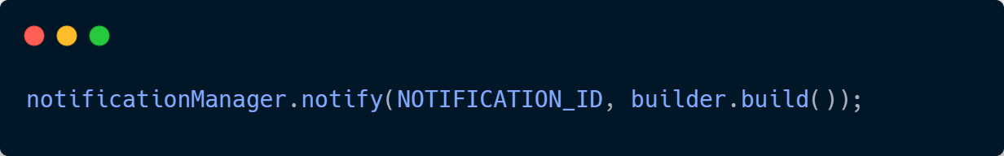
User Notifications (6)
The notification is sent with a notification ID.

Slide 15
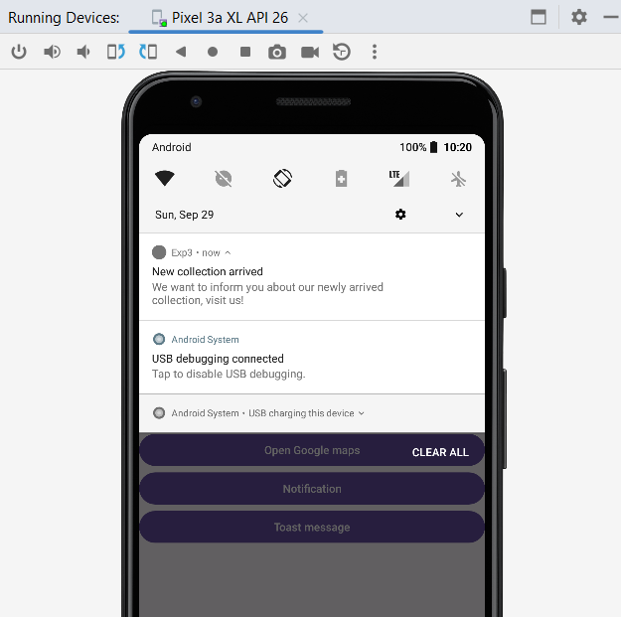
Final Result

Slide 16
activity_main.xml

Slide 17
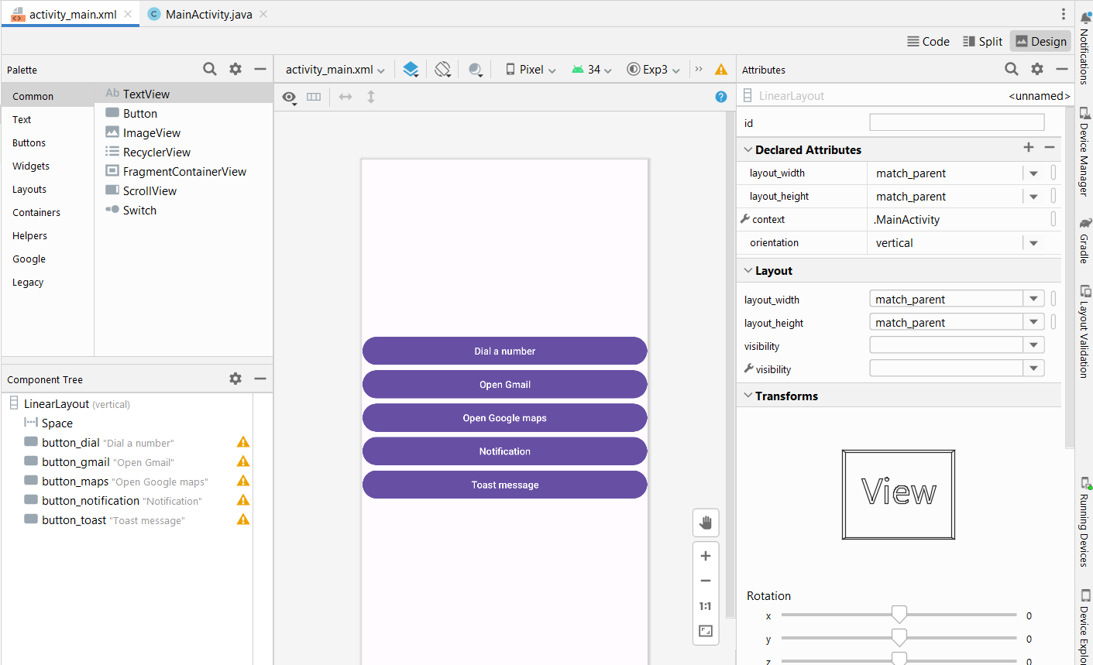

Slide 18
MainActivity.java

Slide 19
Notes
To access Gmail, when clicking the button, you should first sign up for your account.
To access Google Maps when clicking the button, it should be connected to the Google account before clicking.
Be aware of functions that should be written outside the onCreate() function.
When passing an email, it should be one of an array of strings, not as in the lab manual.
RFC 822- Standard for the Format of Internet Text Messages. A message consists of header fields and, optionally, a body. The body is simply a sequence of lines containing ASCII characters. It is separated from the headers by a null line.

Slide 20
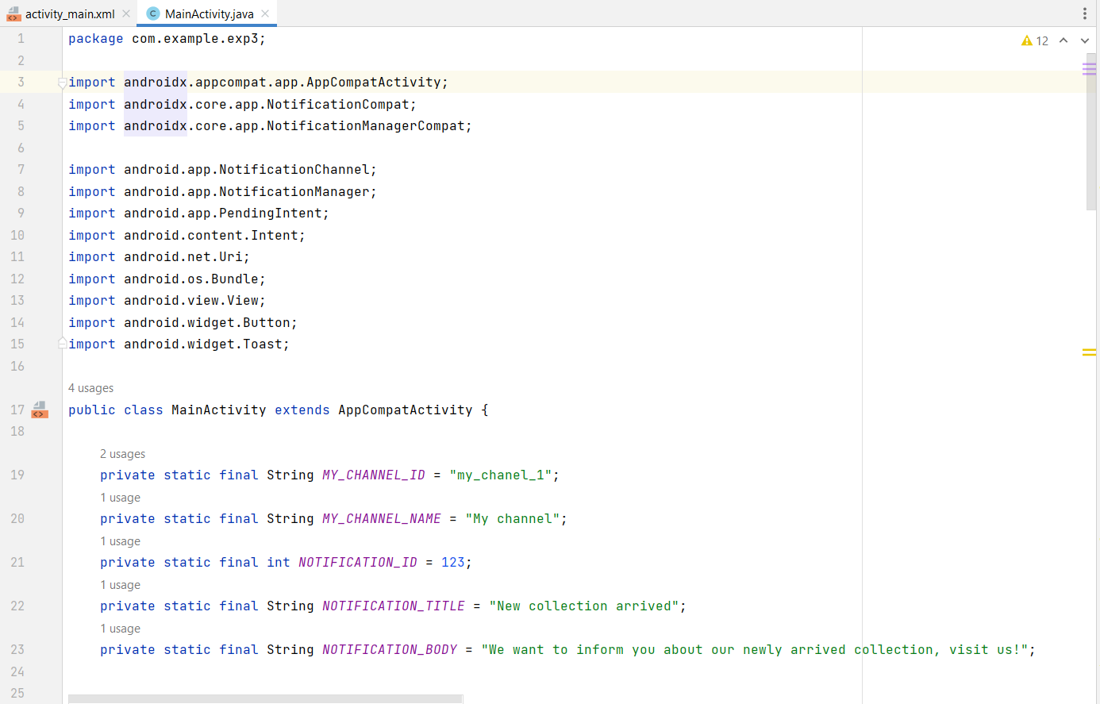
Libraries and final definitions

Slide 21
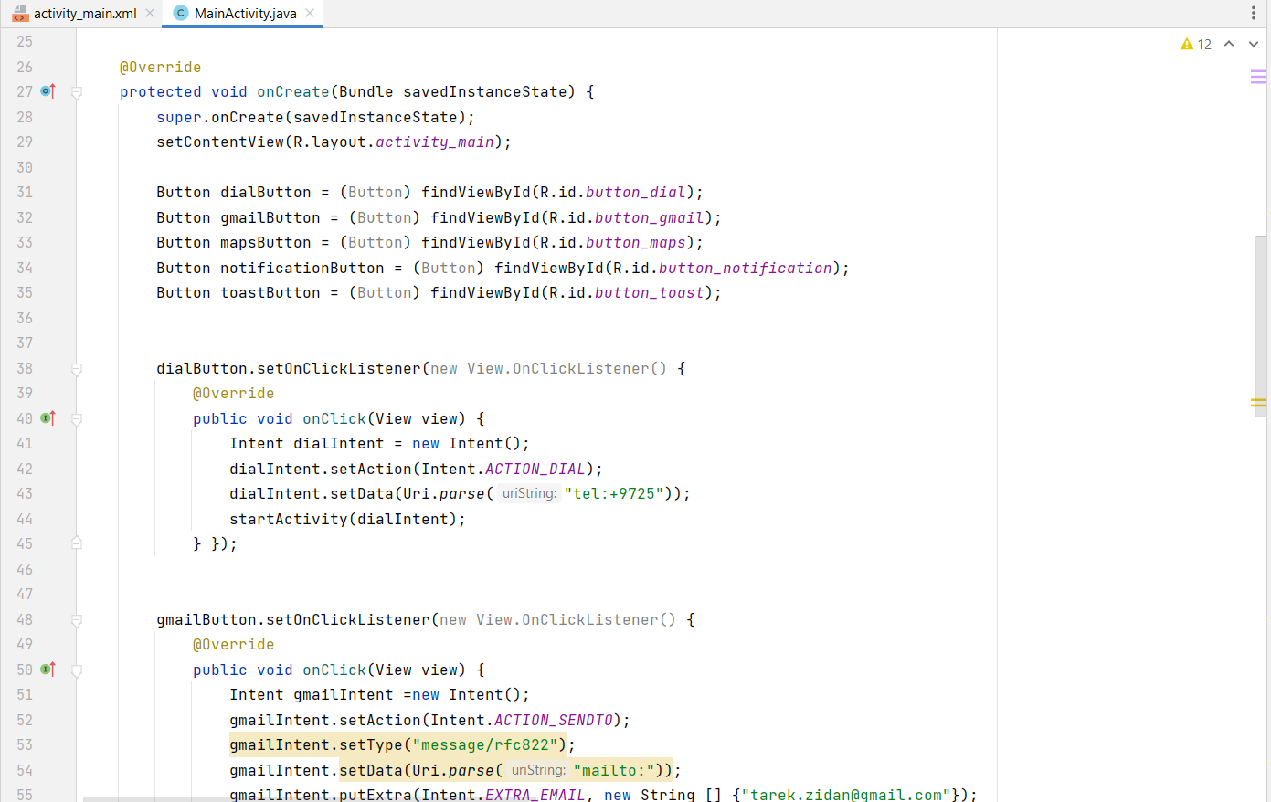
Inside onCreate: buttons references and their setOnClickListeners

Slide 22
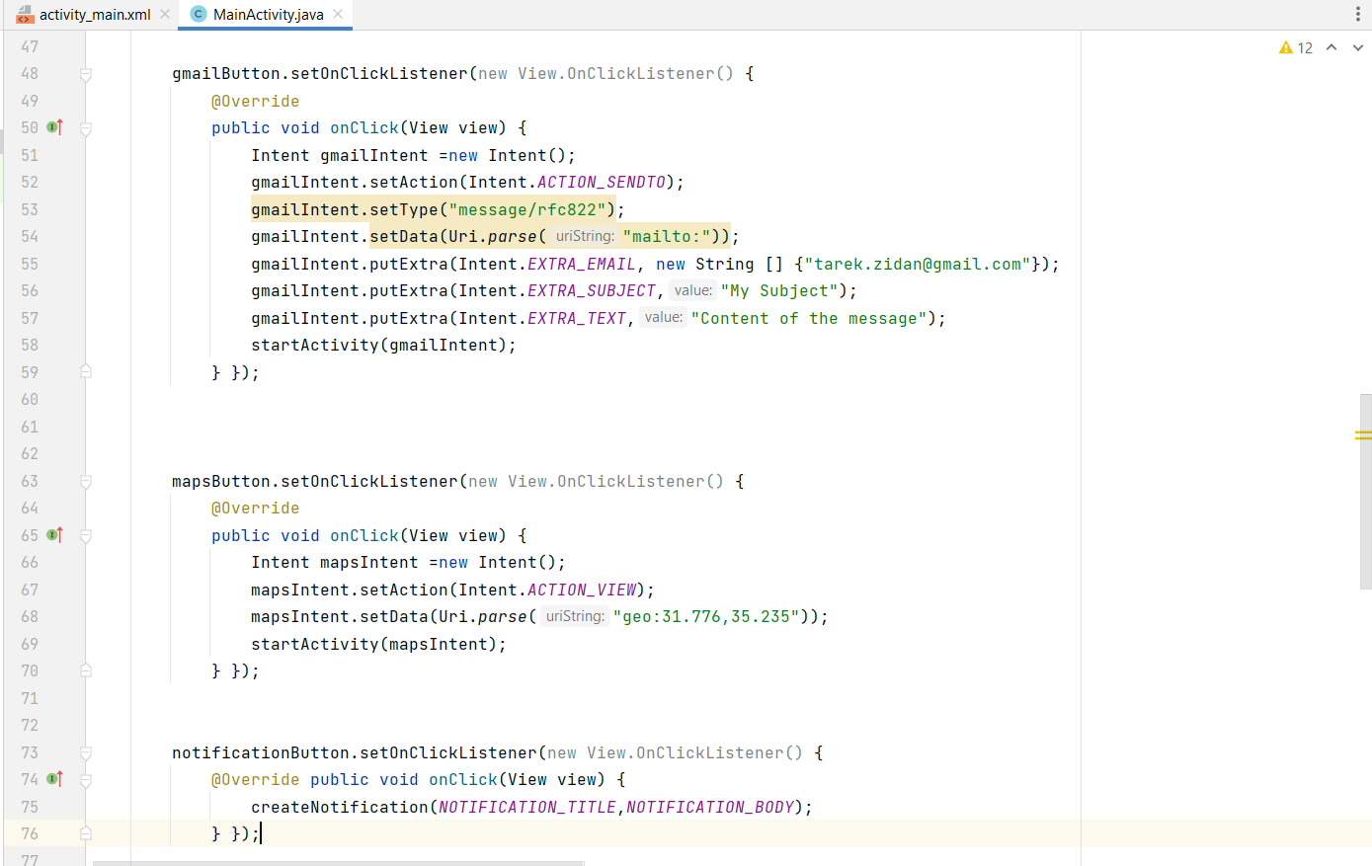
Inside onCreate: buttons references and their setOnClickListeners

Slide 23
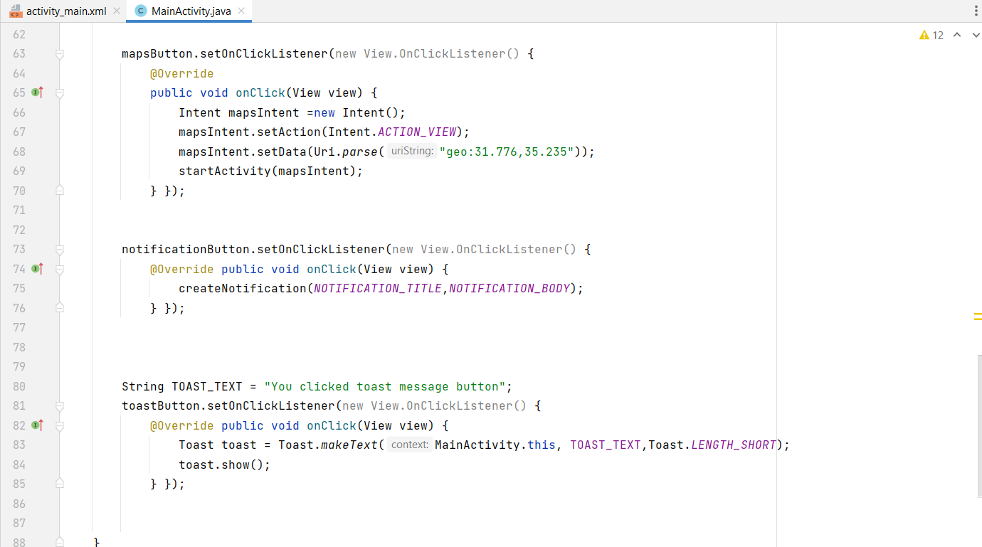
Inside onCreate: buttons references and their setOnClickListeners

Slide 24
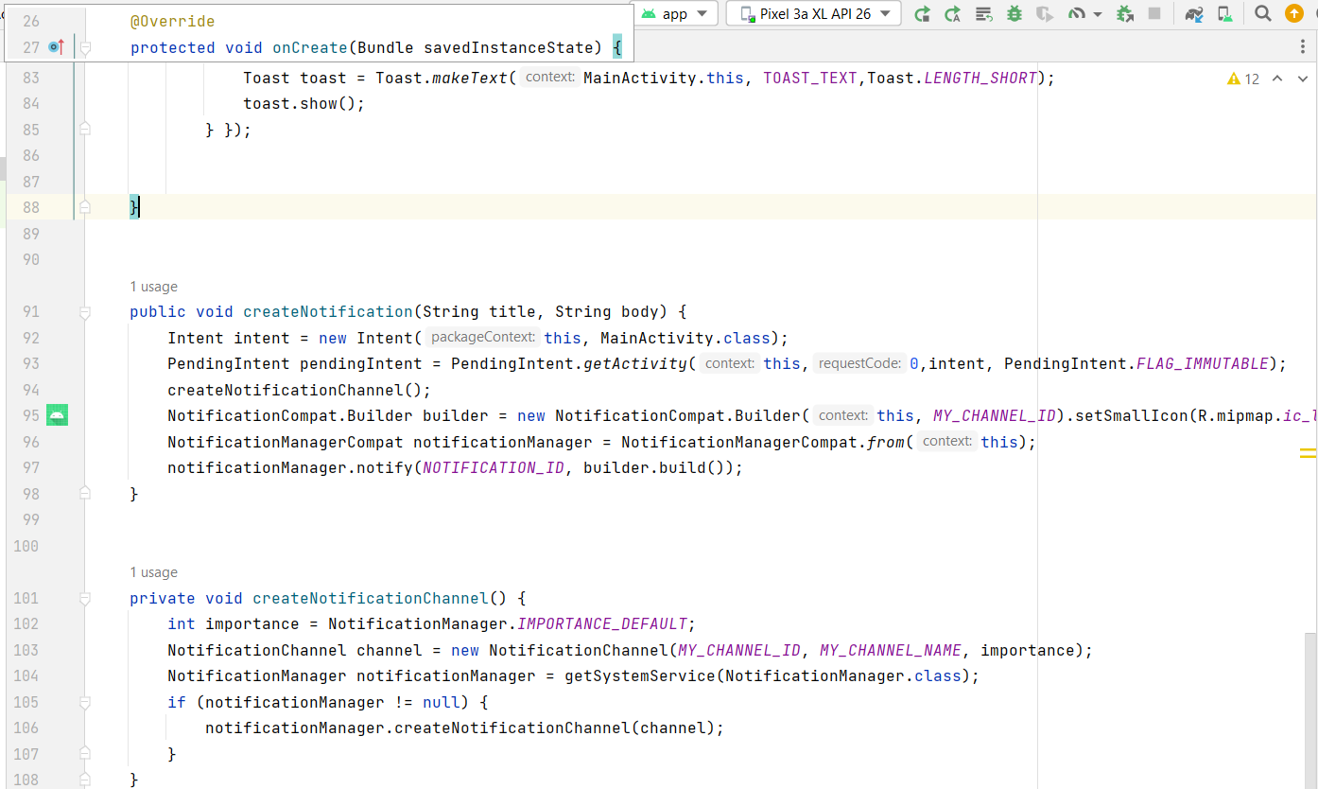
Outside onCreate: Notification functions and settings

