Slide 1
Fluid Mechanics I
Chapter 6
Viscous flow in ducts
Dr. Afif Akel Hasan
Mechanical & Mechatronics Engineering

Slide 2
Outline
Laminar and Turbulent flow
Entrance effect
Friction losses in smooth pipes
Friction losses in rough pipes
Minor losses
Energy equation for pipe flow
Pipe flow problems.

Slide 3
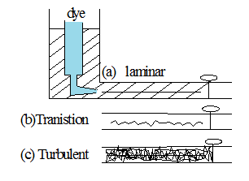
laminar & turbulent flow
laminar flow : in laminar flow a well – ordered pattern prevails , where by fluid layers are assumed to slide over each other.
Reynold experiment;
  when the valve is opened slightly the dye will move through pipe intact forming a thread , in this case flow is laminar.
  when valve is progressively opened the dye assumed fluctuating motion as it flows through the pipe here transitions is taking place
  further opening of valve results in a condition where by an irregular fluctuation is developed in the flow . When the dye is completely dispersed in the pipe . This irregular flow is turbulent flow .

Slide 4
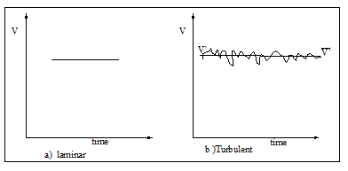
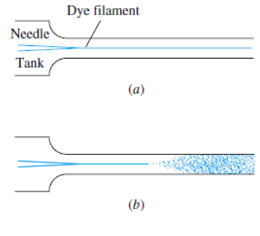
laminar & turbulent flow
laminar flow is well – ordered flow ,
Turbulent flow is an irregular ( fluctuating ) one .
laminar flow has a constant ( well – ordered ) velocity V` .
Turbulent flow velocity is fluctuated from V to V`
Fig. 6.5 Reynolds’ sketches of pipe-flow transition: (a) low-speed, laminar flow; (b) high-speed, turbulent flow

Slide 5
Laminar & Turbulent Flow
Fig. 6.2 Flow issuing at constant speed from a pipe: (a) high viscosity, low-Reynolds-number, laminar flow; (b) low-viscosity, high-Reynolds-number, turbulent flow.

Slide 6
Laminar & Turbulent Flow
Re is the criteria of transition from laminar to Turbulent
Re = (ρVD/µ ) = (VD/ν ) =( Inertial force / Viscous force)
For pipe flow Re_{critical} = 2300
200<Re <4000 transition
Re > 4000 well developed turbulent flow .

Slide 7
EXAMPLE 6.1 P . 326
The accepted transition Reynolds number for flow in a circular pipe is Re_{d}, _{critical} = 2300. For flow through a 5-cm-diameter pipe, at what velocity will this occur at 20°C for (a) airflow and (b) water flow?
Thus transition is specified at Vd/ν = 2300.
These are very low velocities, so most engineering air and water pipe flows are turbulent, not laminar. We might expect laminar duct flow with more viscous fluids such as lubricating oils or glycerin.

Slide 8
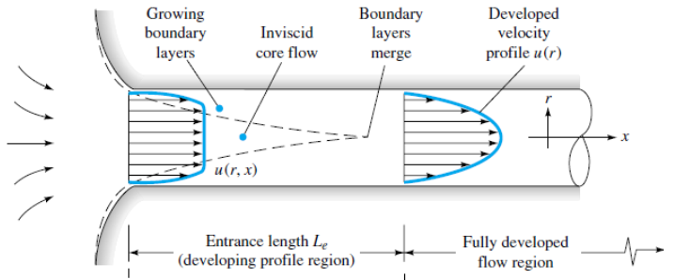
Entrance effect
An internal flow is constrained by the bounding walls, and the viscous effects will grow and meet and permeate the entire flow.
Viscous boundary layers grow downstream, retarding the axial flow u(r, x) at the wall and thereby accelerating the center-core flow to maintain the incompressible continuity requirement.
At a finite distance from the entrance, the boundary layers merge and the inviscid core disappears.
The tube flow is then entirely viscous, and the axial velocity adjusts
slightly further until at x= Le it no longer changes with x and is said to be fully developed, u= u(r) only.

Slide 9
Entrance effect
Downstream of x ≥ Le the velocity profile is constant, the wall shear is constant, and the pressure drops linearly with x, for either laminar or turbulent flow.

Slide 10
Entrance length
Dimensional analysis shows that the Reynolds number is the only parameter affecting entrance length.
For laminar flow the accepted correlation is
In turbulent flow the boundary layers grow faster, and Le is relatively shorter, according to the approximation for smooth walls

Slide 11
EXAMPLE 6.2
A ½ in-diameter water pipe is 60 ft long and delivers water at 5 gal/min at 20°C. What fraction of this pipe is taken up by the entrance region?
This is greater than 2300; hence the flow is fully turbulent

Slide 12
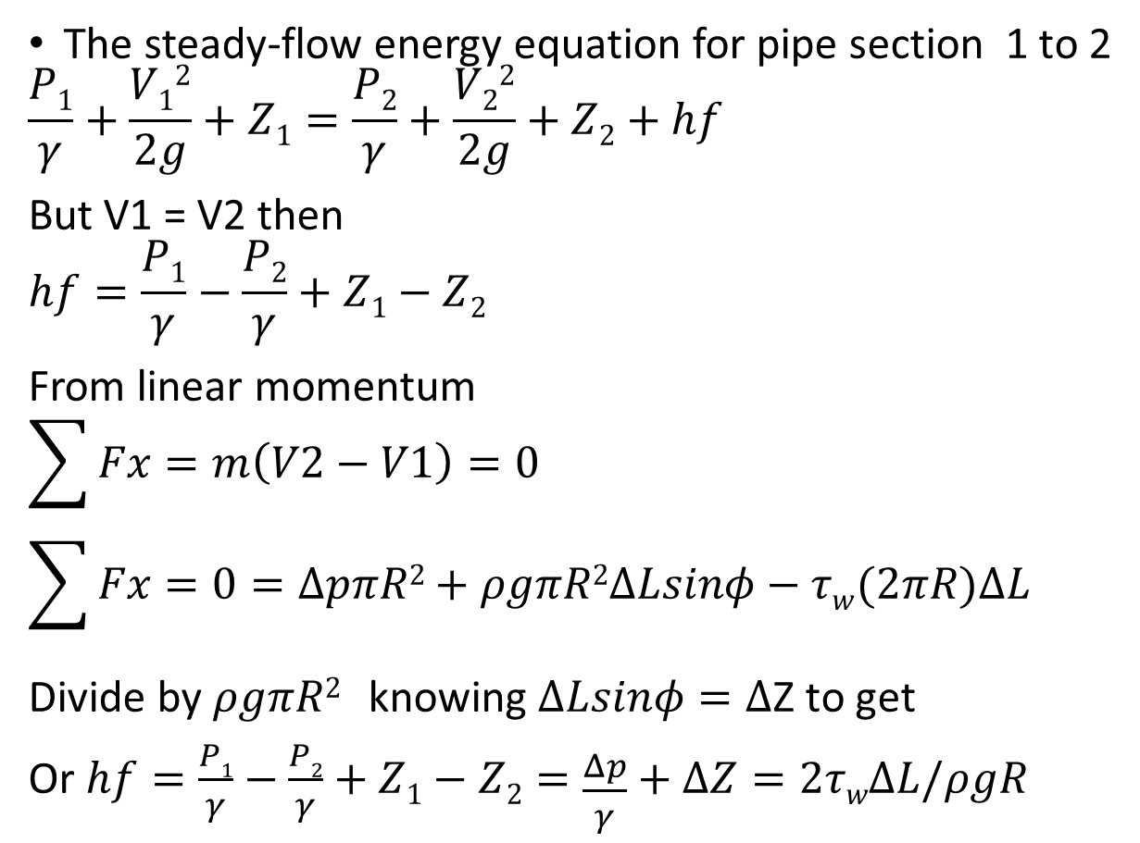
Flow in a Circular Pipe, h_{f}
The steady-flow energy equation for pipe section 1 to 2
$$\frac{P1}{γ}+\frac{V12}{2g}+Z1=\frac{P2}{γ}+\frac{V22}{2g}+Z2+hf$$
But V1 = V2 then
$$hf=\frac{P1}{γ}−\frac{P2}{γ}+Z1−Z2$$
From linear momentum
$$\sum{Fx=m\left(V2−V1\right)=0}$$
$$\sum{Fx=0}=∆pπR2+ρgπR2ΔLsinφ−τw(2πR)ΔL$$
Divide by $ρgπR2$ knowing $ΔLsinφ=Δ$Z to get
Or $hf=\frac{P1}{γ}−\frac{P2}{γ}+Z1−Z2=\frac{Δp}{γ}+ΔZ=2τwΔL/ρgR$

Slide 13
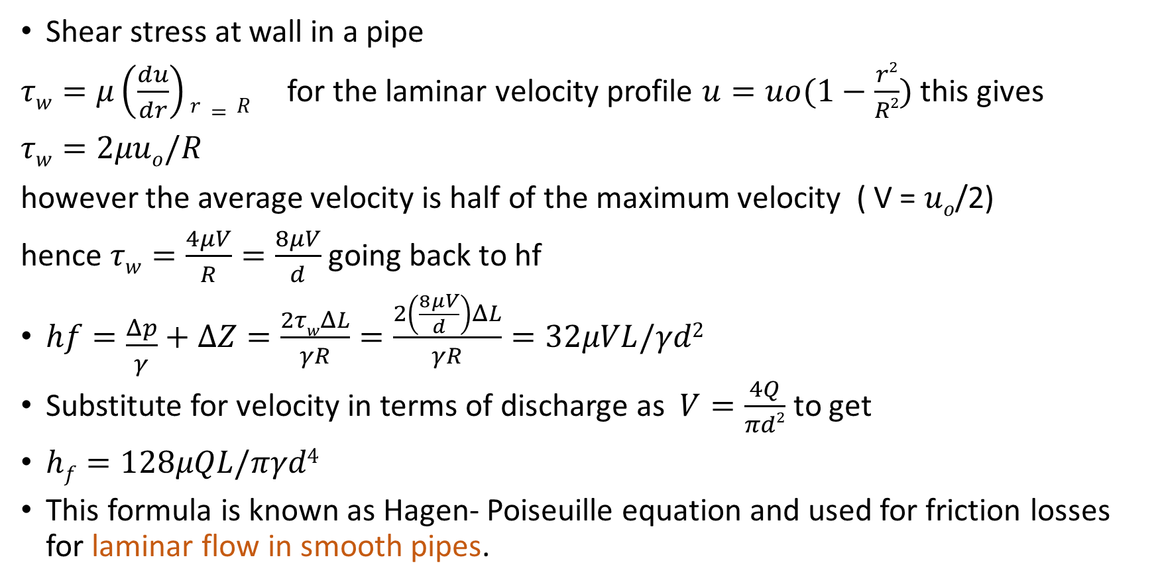
For laminar flow
Shear stress at wall in a pipe
$τw=μ\left(\frac{du}{dr}\right)r=R$ for the laminar velocity profile $u=uo(1−\frac{r2}{R2})$ this gives
$τw=2μuo/R$
however the average velocity is half of the maximum velocity ( V = $uo$/2)
hence $τw=\frac{4μV}{R}=\frac{8μV}{d}$ going back to hf
$hf=\frac{Δp}{γ}+ΔZ=\frac{2τwΔL}{γR}=\frac{2\left(\frac{8μV}{d}\right)ΔL}{γR}=32μVL/γd2$
Substitute for velocity in terms of discharge as $V=\frac{4Q}{πd2}$ to get
$hf=128μQL/πγd4$
This formula is known as Hagen- Poiseuille equation and used for friction losses for laminar flow in smooth pipes.

Slide 14
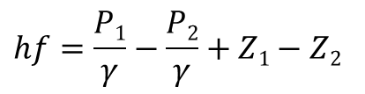
EXAMPLE 6.4
An oil with 900 kg/m³ and 0.0002 m²/s flows upward through an inclined pipe as shown in Fig. E6.4. The pressure and elevation are known at sections 1 and 2, 10 m apart. Assuming steady laminar flow, (a) verify that the flow is up, (b) compute hf between 1 and 2, and compute (c) Q, (d) V, and (e) Red. Is the flow really laminar?
$$hf=\frac{P1}{γ}−\frac{P2}{γ}+Z1−Z2$$

Slide 15

EXAMPLE 6.4
$$hf=128μQL/πγd4$$
This is well below the transition value Red 2300, and so we are fairly certain the flow is laminar.

Slide 16
EXAMPLE 6.5
A liquid of specific weight γ= 58 lb/ft³ flows by gravity through a 1-ft tank and a 1-ft capillary tube at a rate of 0.15 ft³/h, as shown in Fig. E6.5. Sections 1 and 2 are at atmospheric pressure. K.E correction =2. Neglecting entrance effects, compute the viscosity of the liquid.
Meanwhile P1= P2 pa, and V1= 0 in the large tank. Therefore, approximately

Slide 17

EXAMPLE 6.5
$$hf=32μVL/γd2$$
Note that L in this formula is the pipe length of 1 ft. Finally, check the Reynolds number

Slide 18
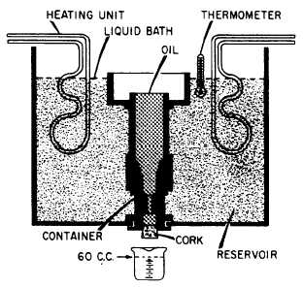

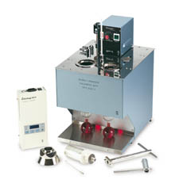



Viscometers
Saybolt viscometer
Viscosity in centipoise from seconds Saybot
$$hf=128μQL/πγd4$$
$$hf=32μVL/γd2$$

Slide 19
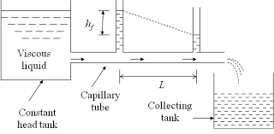
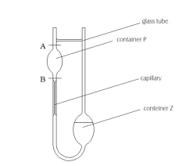
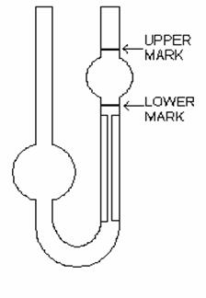

Capillary viscometer
$$hf=128μQL/πγd4$$

Slide 20
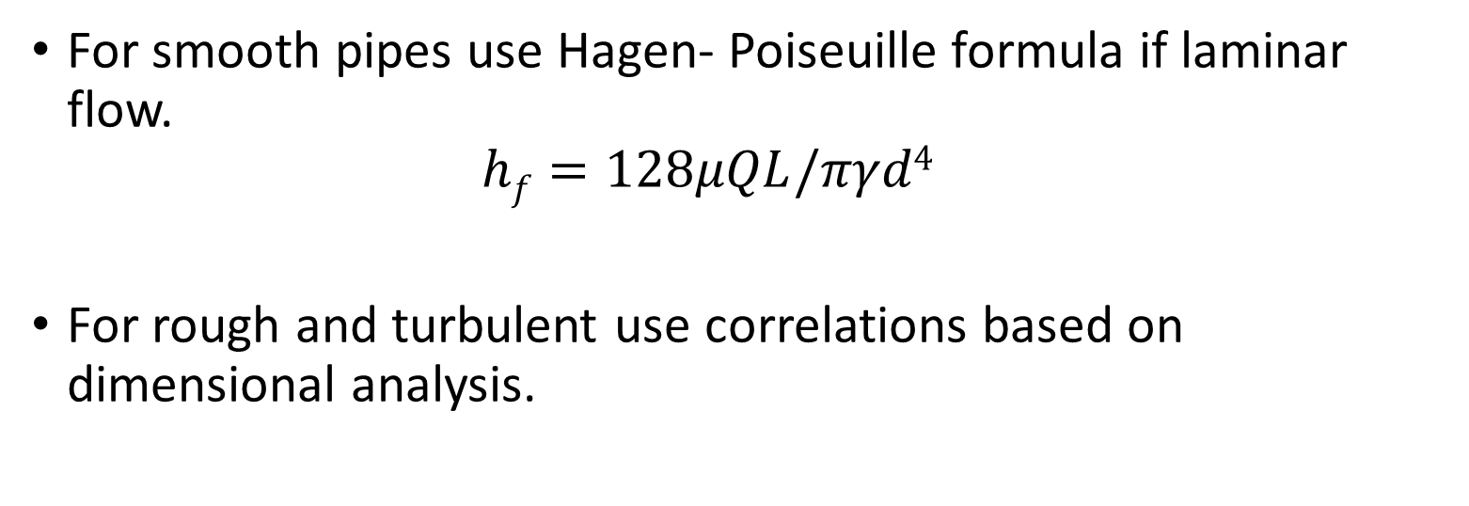
Friction losses
For smooth pipes use Hagen- Poiseuille formula if laminar flow.
  $$hf=128μQL/πγd4$$
For rough and turbulent use correlations based on dimensional analysis.

Slide 21
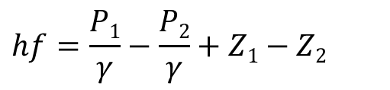
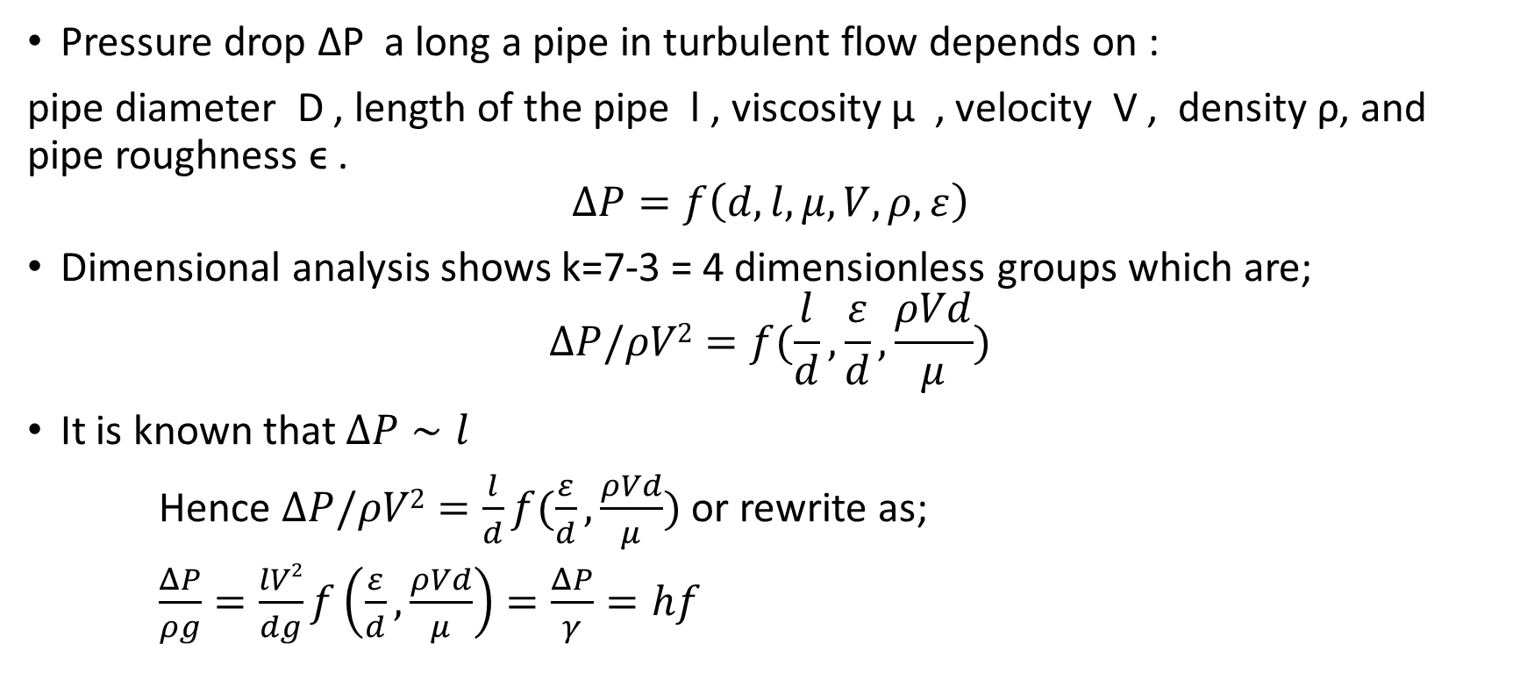
Friction head loss
Pressure drop ∆P a long a pipe in turbulent flow depends on :
pipe diameter D , length of the pipe l , viscosity µ , velocity V , density ρ, and pipe roughness ϵ .
$$ΔP=f\left(d,l,μ,V,ρ,ε\right)$$
Dimensional analysis shows k=7-3 = 4 dimensionless groups which are;
$$ΔP/ρV2=f(\frac{l}{d},\frac{ε}{d},\frac{ρVd}{μ})$$
It is known that $ΔP∼l$
Hence $ΔP/ρV2=\frac{l}{d}f(\frac{ε}{d},\frac{ρVd}{μ})$ or rewrite as;
$\frac{ΔP}{ρg}=\frac{lV2}{dg}f\left(\frac{ε}{d},\frac{ρVd}{μ}\right)=\frac{ΔP}{γ}=hf$
$$hf=\frac{P1}{γ}−\frac{P2}{γ}+Z1−Z2$$

Slide 22
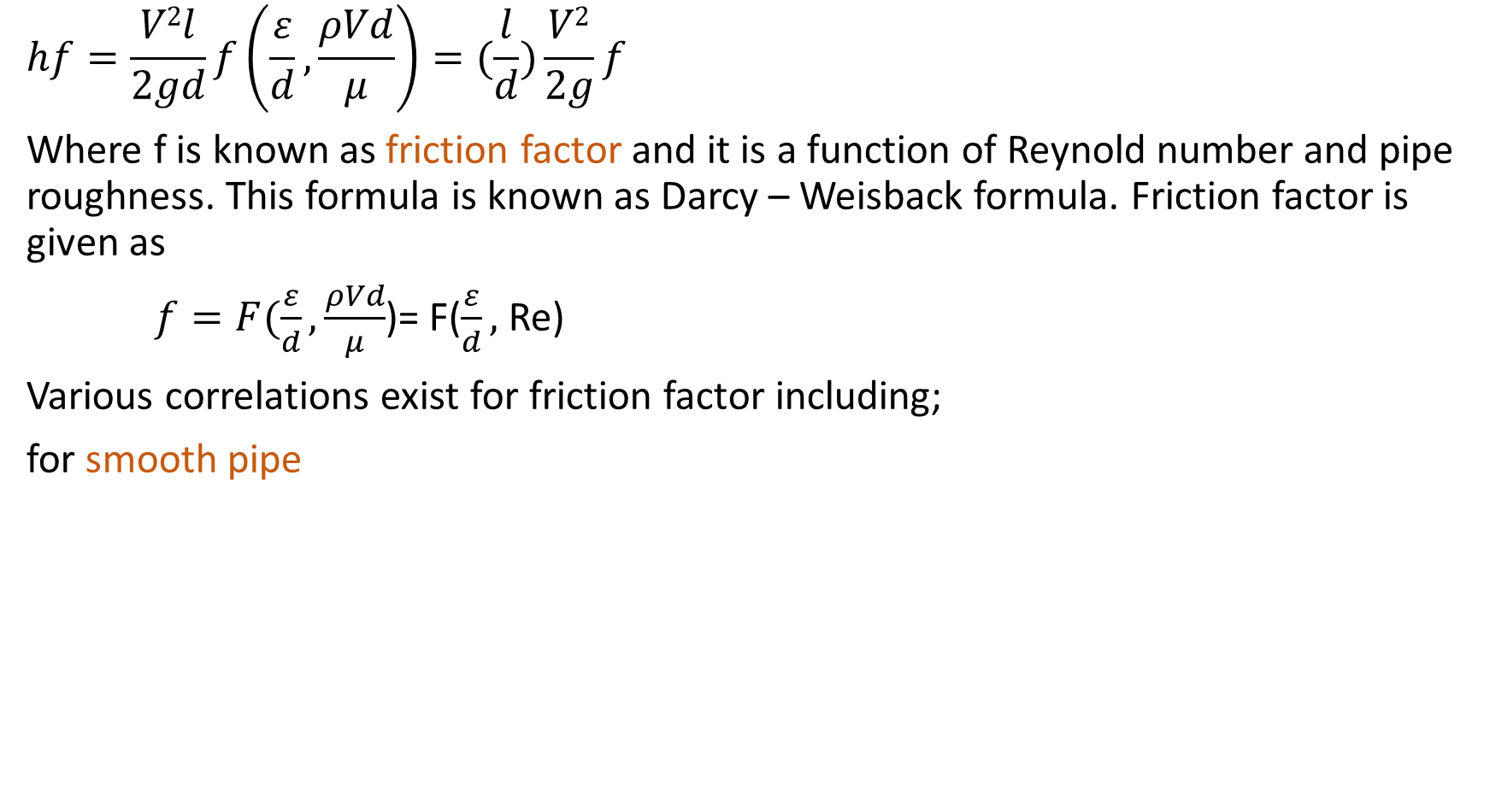
Friction head loss
$$hf=\frac{V2l}{2gd}f\left(\frac{ε}{d},\frac{ρVd}{μ}\right)=(\frac{l}{d})\frac{V2}{2g}f$$
Where f is known as friction factor and it is a function of Reynold number and pipe roughness. This formula is known as Darcy – Weisback formula. Friction factor is given as
$f=F(\frac{ε}{d},\frac{ρVd}{μ}$)= F($\frac{ε}{d},$ Re)
Various correlations exist for friction factor including;
for smooth pipe

Slide 23
Friction head loss
For rough pipes see equation 6.64 Page 348 and 6.49 Page 348 .
Colebrook equation
It was plotted in 1944 by Moody into what is now called the Moody chart for pipe friction
An alternate explicit formula given by Haaland

Slide 24
Moody chart for pipe
friction with smooth and rough
walls.

Slide 26
Table 6.1 Recommended Roughness Values for Commercial Ducts

Slide 27
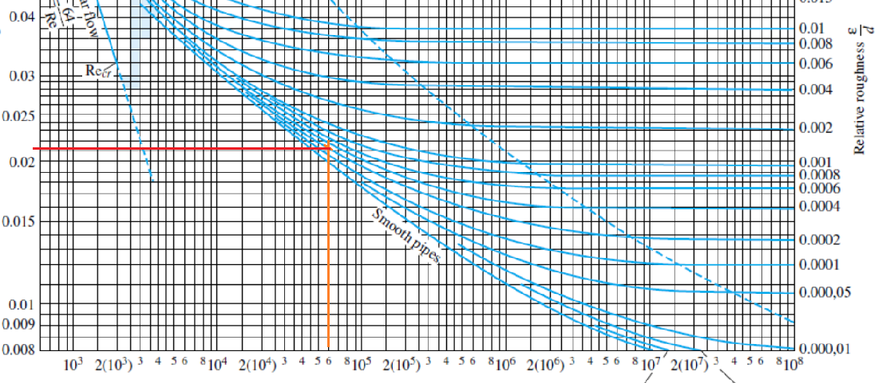
Examples Moody chart
Re = 6x10⁴ , ϵ/d =0.0002
From chart f =0.021

Slide 28
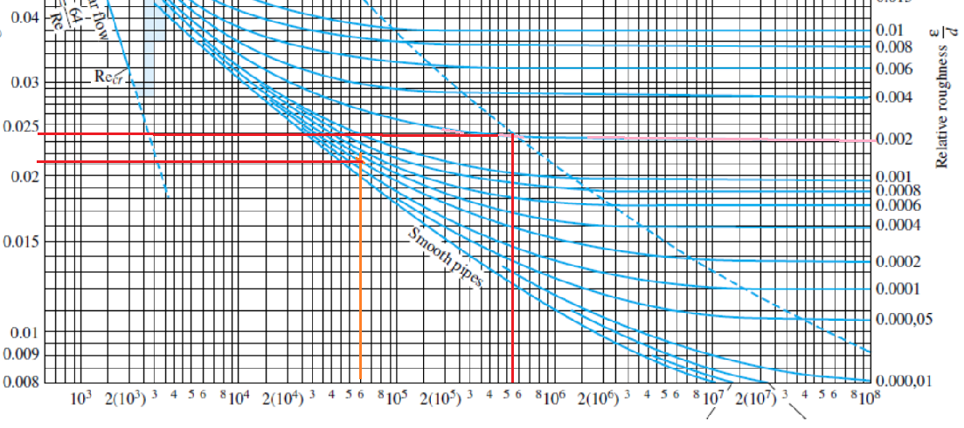
Examples Moody chart
Re = 550000=5.5x10⁵ , ϵ/d =0. 002
From chart f =0.024

Slide 29
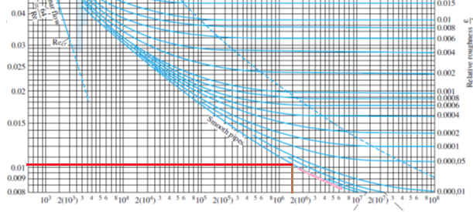
Examples Moody chart
Re = 2000000=2x10⁶ , smooth pipe
From chart f =0.0105

Slide 30
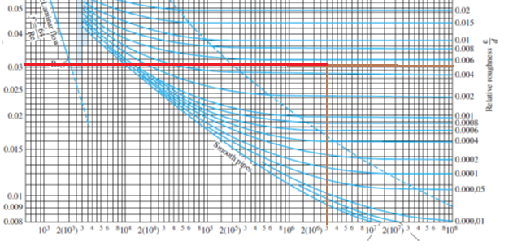

Examples Moody chart
Cast iron pipe with d = 5 cm and Re=3x10⁶
For cast iron roughness ϵ= 0.26 mm then$\frac{ε}{d}=\frac{0.26}{50}=0.0052$
From chart f = 0.03

Slide 31
EXAMPLE 6.6
Compute the loss of head and pressure drop in 200 ft of horizontal 6-in-diameter asphalted cast-iron pipe carrying water with a mean velocity of 6 ft/s.
Re = (ρVD/µ ) = (VD/ν )= 2.7x 10⁵
ϵ/d =0.0004/(6/12) = 0.0008
ϵ /d = 0.0008, and Re 2.7x 10⁵ approximately, f = 0.02
The pressure drop for a horizontal pipe (z1= z2) is

Slide 32
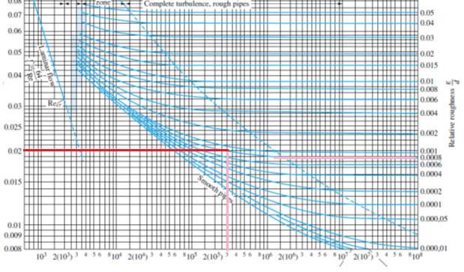
EXAMPLE 6.6
ϵ /d = 0.0008, and Re 2.7x 10⁵ approximately, f = 0.02

Slide 33
EXAMPLE 6.7
Oil, with 900 kg/m3 and ν= 0.00001 m²/s, flows at 0.2 m³/s through 500 m of 200-mmdiameter cast-iron pipe. Determine (a) the head loss and (b) the pressure drop if the pipe slopes down at 10° in the flow direction.

Slide 34
EXAMPLE 6.7
Enter the Moody chart on the right at ϵ /d= 0.0013 with Re= 128,000, f = 0.0225

Slide 35
Minor losses
Head loss :
1) Friction losses (Major losses )
2) Minor losses : (i) entrance and exit .
(ii) enlargement and contraction .
(iii) fittings .
Minor losses : h_{minor} = K (V²/2g) = h_{m}
K : coefficient is given for various fitting
Total head losses are

Slide 36



Exit and entrance
For all types of exits : inward , rounded , K = 1
Entrance losses
(i)square entrance K = 0.5
(ii)Rounded K = 0.01 –0.05 or F. White p.372 fig 6.21 (b)
(iii)Re-entrant ( inward) K = 0.8-1.0 see fig 6.24(a) P.372 “F. White “

Slide 37
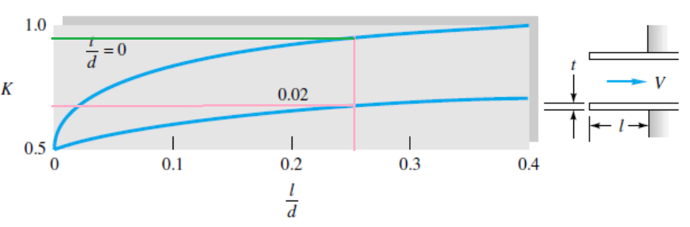
Entrance
Fig. 6.21 Entrance and exit loss coefficients:
reentrant inlets
Example: L=0.5 in and d=2 in. then L/d = 0.5/2=0.25 and K=0.9 for thin tube and 0.7 if tube is 0.05 in thick ( t/d=0.05/2=.025)

Slide 38
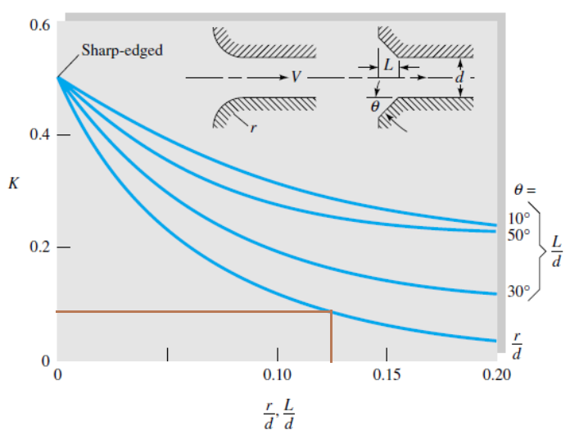
Entrance
Fig. 6.21 (b) rounded and beveled inlets.
Example d=2 in, r=0.25 then r/d = 0.125 and K=0.1

Slide 39
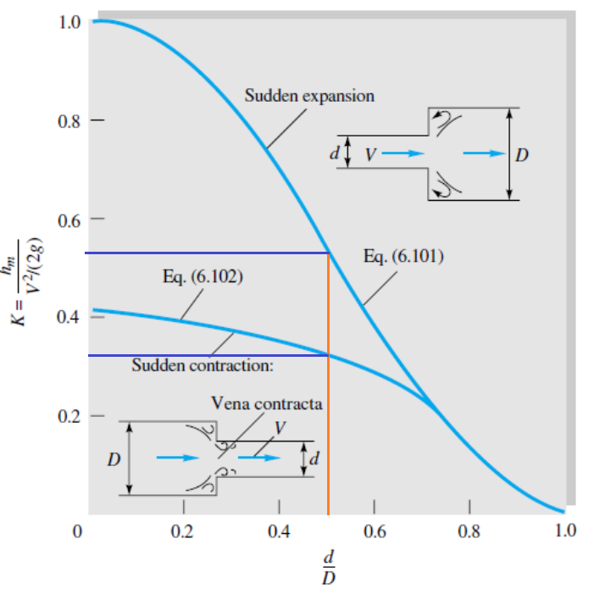
Sudden expansion/ Contraction
It can be shown using continuity , Bernoulli's ,and moment equations that for a sudden expansion ,
h_{m} = K_{SE}( V² /2g )
where
Sudden contraction may use ,
See (fig 6.22 P.372 F. White )
Example if d=1 in and D=2 in: find K_{SE} and K_{SC} Then d/D=0.5 and
K_{SE} =0.55 while K_{SC}= 0.32

Slide 40
Gradual expansion
Fig. 6.23 Flow losses in a gradual conical expansion region P. 373 “F. White”

Slide 41
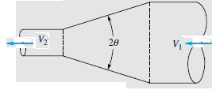
Gradual contraction
For a gradual contraction, the loss is very small, as seen from the following experimental values.

Slide 42
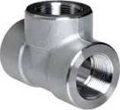
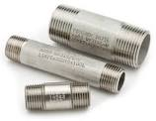
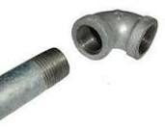
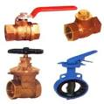
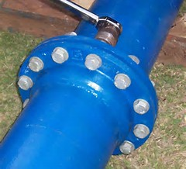
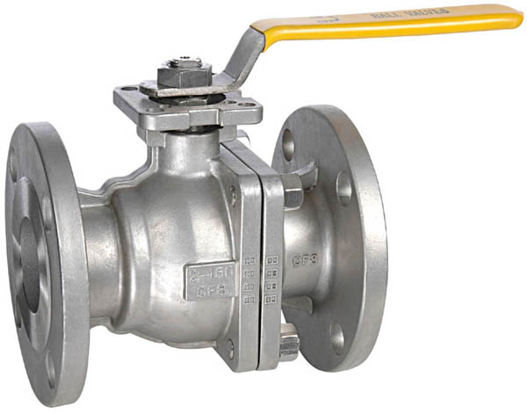
Pipe fittings
h_{minor} = K (V²/2g)
K depends on type of fitting, pipe diameter, type of connection.
Pipe connections : screwed or flanged
Type of fittings include; valves, elbows, tees.

Slide 43
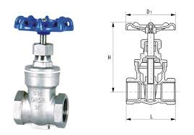
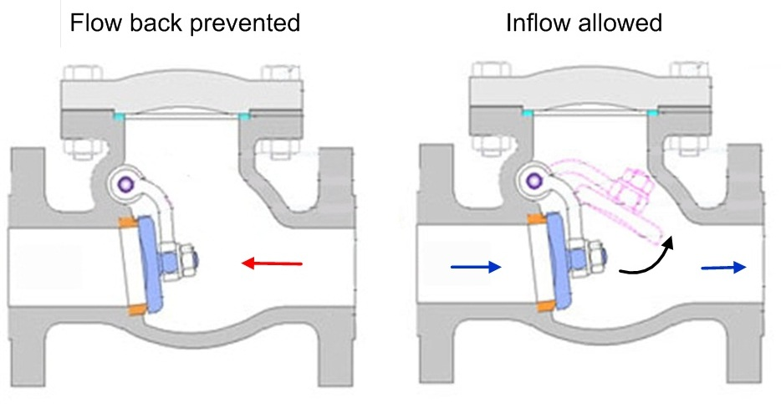
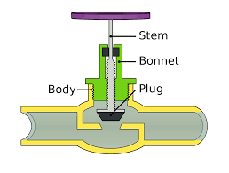
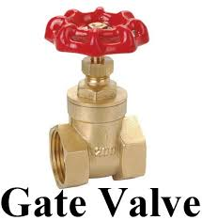
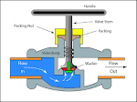
Valves
Gate valves
Non-return valves
Globe valves
Angle valves

Slide 44
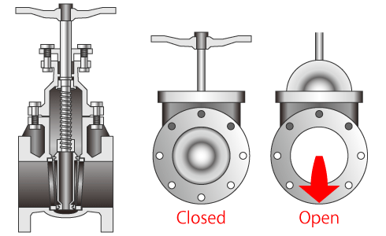
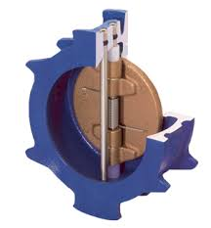
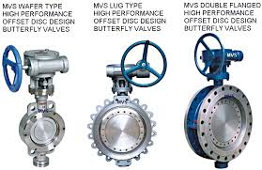
Disk valves

Slide 45
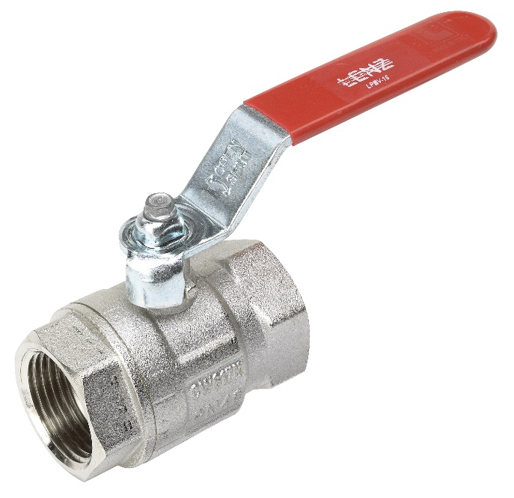
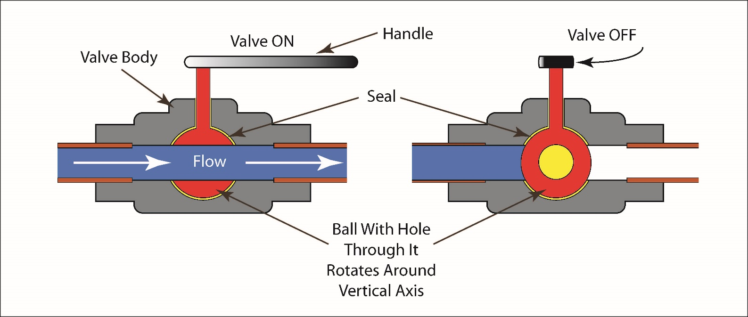
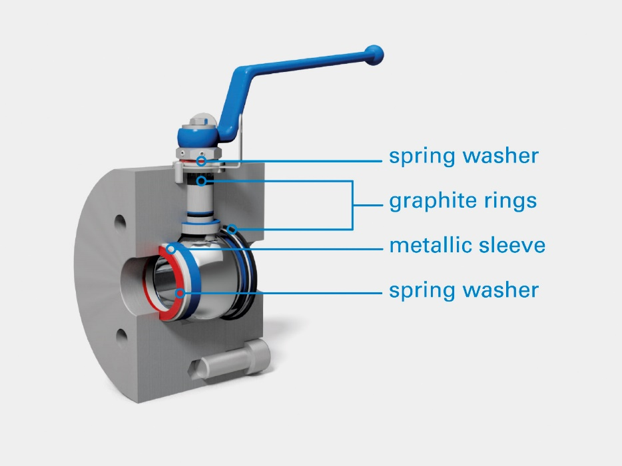
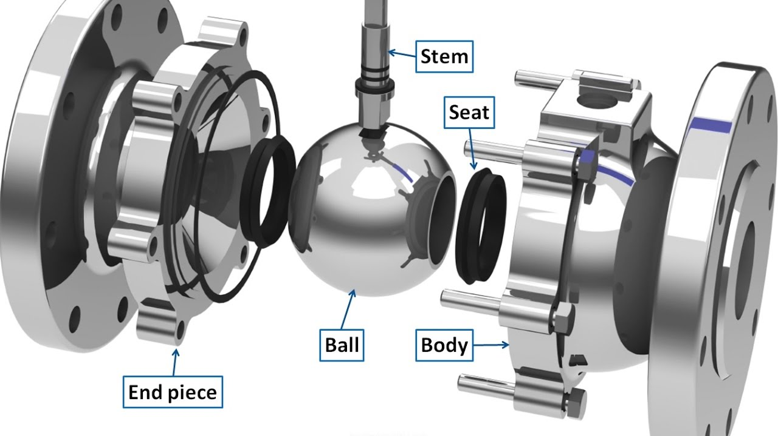
Ball valve

Slide 46
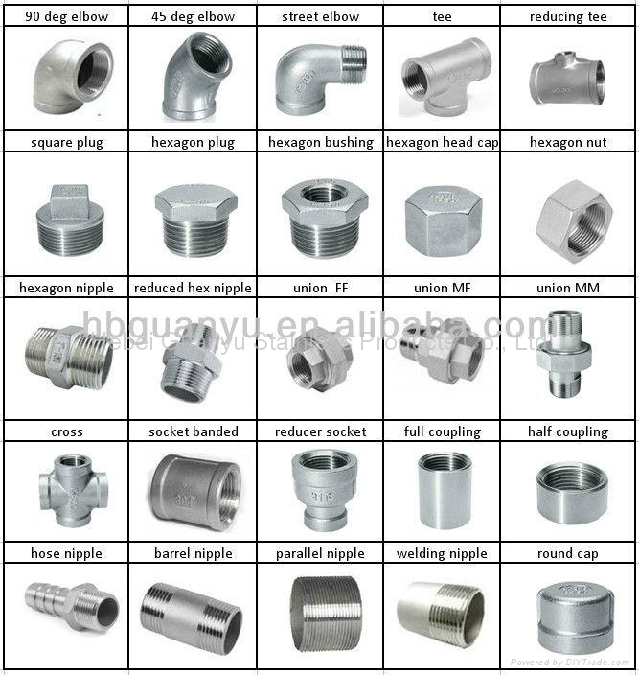
Pipe fittings

Slide 47
Resistance Coefficients -fittings
h_{minor} = K (V²/2g)

Slide 48
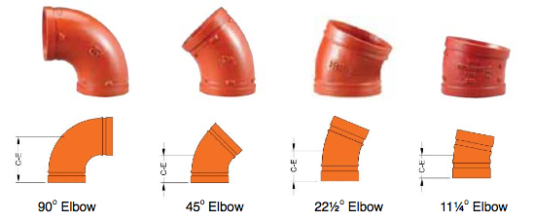
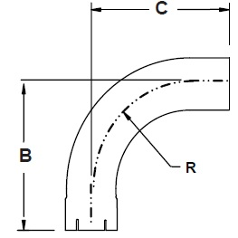
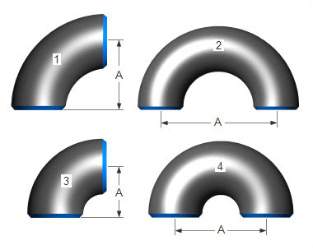
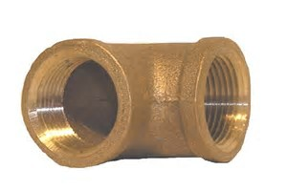
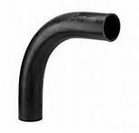
Elbows

Slide 49






Tees

Slide 50

Examples
Find K for 2 inch screwed 90 regular elbow? K=0.95
Find K for 2 inch flanged 90 regular elbow? K=0.39
Find K for 4 inch gate valve fully open if flanged, if screwed?
Flanged K=0.16, screwed K=0.11

Slide 51
Partially opened valves
Fig. 6.18b Average-loss coefficients for partially open valves

Slide 52
Equivalent length
Minor losses expressed in terms of equivalent length L_{e} of pipe that has the same head losses for the same flow.
f (L_{e} /D) (V² /2g) = K (V² /2g)
then L_{e} = KD/f
L_{e} is added to pipe length in L_{l} = [( L_{e} + L ) /D] (V² /2g) f
Example if K = 20 for a pipe where f = 0.02 and D = 300 mm then
L_{e} = (20*(0.3)/0.02) = 300 m
In general L_{e} = (D/f) ∑K_{i}

Slide 53
EXAMPLE 6.16
Water, ρ=1.94 slugs/ft3 and ν=0.000011 ft2/s, is pumped between two reservoirs at 0.2 ft3/s through 400 ft of 2-in-diameter pipe and several minor losses, as shown in Fig. E6.16. The roughness ratio is ϵ/d = 0.001. Compute the pump horsepower required.

Slide 54
EXAMPLE 6.16

Slide 55
Multiple pipe problems
Fig. 6.24 Examples of multiple-pipe
systems: (a) pipes in series;
(b) pipes in parallel; (c) the three-reservoir
junction problem
Single path pipe problems are covered in this course.

Slide 56
Pipe problems
Three Types of Pipe-Flow Problems;
  Pressure drop, power unknown Type 1
  Given d, L, and V or Q,ρ ,µ , and g, compute the head loss hf (head- loss problem).
  Flow rate is unknown Type 2
Given d, L, hf ,ρ ,µ , and g, compute the velocity V or flow rate Q (flow- rate problem).
  Pipe diameter is unknown Type 3
  Given Q, L, hf , ρ ,µ and g, compute the diameter d of the pipe (sizing problem).

Slide 57
Type 1 Pressure is unknown
Straight forward solution . Conditions at one section , l, ϵ , geometry ,flow are all given and the condition at other section is desired ( P₂ or ∆P ).
See example 6.16 pump head and power are required.

Slide 58

Pipe equations

Slide 59
Type 2 Find the Flow Rate
Pressure ,L ,ϵ , and geometry are given.
Iterative procedure is followed using Energy equation, and Moody’s chart as follows:
  1) assume friction factor f
  2) solve energy equations for V
  3) calculate Re and find new ‘f” .
  4) compare new “f” with previous one if small difference then use this ‘f’ to find V then Q . If still large difference then go to “2” above and repeat procedure .

Slide 60
Example : 5.13 p .240 Streeter
Water at 15 ºC ( ϒ = 1.13x 10⁻⁶ m² /s ) flows through 300 mm diameter riveted steel ϵ= 3 mm with head loss of 6 m = h_{loss} in 300 m . Determine the flow .
(ϵ/D ) = (0.003/0.30) = 0.01
assume f ₁ = 0.04
Energy equation h_{l}= f (L/D)(V²/2g) = 6m
V=(2gh_{l}D/Lf)^{0.5} , V = 1.715 m/s
Re = (ρVD/m ) = (VD/ν ) = 455000 from Moody’s chart
f₂ =0.038
since |f₂ – f₁| = 0.002 is small enough then Q = AV = (∏/4)(0.3)² V
Q = 0.1245 m³/s

Slide 61
EXAMPLE 6.9
Oil, with 950 kg/m3 and ν=2 E-5 m2/s, flows through a 30-cm-diameter pipe 100 m long with a head loss of 8 m. The roughness ratio is ε/d =0.0002. Find the average velocity and flow rate.
Energy equation Steady flow same Z no change in velocity, only pressure drop due to friction.
hf =8

Slide 64
Type 3; Diameter is Unknown
Pressure ,L,ϵ,Q and geometry are given, diameter is desired .
Follow iterative procedure
Write energy equation in terms “f” and “D”
Assumed friction factor f₁ ,then solve energy equation for “first diameter D₁ “
Calculate V = (Q/A ) then Re then f₂ from Moody’s chart
Now find “new D₂ “ from energy equation if new f is close to previous f then stop if not repeat procedure | f₂ – f₁ | < ∂
note : select the next largest pipe size for nominal or commercial pipe.

Slide 65
Diameter is Unknown

Slide 66
Example 5.14 p . 242 Streeter
Determine the size of clean wrought – iron pipe required to convey 250 liter/s oil (ν = 1x10⁻⁵ m²/s) through 3000 m with head loss h_{f} = 25m.N/N.
h_{f} = (l/D)f(V²/2g)
V = Q/[(π/4)D²]
h_{f} = (f/2g)(l/D)(Q²/π)(16/D⁴)
D⁵ = (8 l Q² / h_{f} gπ²) f = C f
D⁵ = (8 * 3000 * 0.25² / 25 * 9.8 *π²) f = 0.62 f
- assume f₁ = 0.02 then D₁ = 0.62 * 0.02 = 0.0416 m
- Re = (VD/ν ) = (4Q/ π Dν ) =
(4 * 0.25/ π * D *10⁻⁵ ) = 31830/D = 76500
(e/D) = 0.00011 from Moody f₂ = 0.0195
D₂ = [0.62f]^{0.5} = 0.413 Re = 75700 ➔ f₃ = 0.0196
| f₃ – f₂ | = 0.0001 then D = 0.413 m

Slide 68
Non circular Conduits
For non circular cross section ,you may solve using all previous relation and method by replacing the diameter with hydraulic diameter.
D_{h} = 4 (cross section Area / wetted perimeter ) = 4A/P_{w}
Example:
(i) Circular D_{h} = 4π (D²/4)/ π D = D
(ii) Rectangular D_{h} = 4ba/(2b+2a) = 2 ba/(b+a)
  For two parallel sheets where length b is much larger than separation a between the sheets D_{h} = 2 ba/(b+a) = 2a
(iii) Circular annulus
D_{h} = 4[π(D₁²/4) - π(D₂²/4)]/ [π D₁ + π D₂] = [(D₁²-D₂² )/(D₁+D₂)] = (D₁-D₂)

Slide 69
hydraulic diameter
Concentric annulus
Deff/Dh= 1/ζ are given in Table 6.3
Effective diameter solution is not required only hydraulic diameter solution.

Slide 70
EXAMPLE 6.13
Fluid flows at an average velocity of 6 ft/s between horizontal parallel plates a distance of 2.4 in apart. Find the head loss and pressure drop for each 100 ft of length for ρ= 1.9 slugs/ft3 and (a) ν=0.00002 ft3/s and (b) ν=0.002 ft3/s. Assume smooth walls.
The spacing is 2h = 2.4 in= 0.2 ft, and Dh =4h= 0.4 ft.
  separation a between the sheets
  D_{h} = 2a
For reasonable accuracy, simply look on the Moody chart for smooth walls

Slide 71
EXAMPLE 6.14
What should the reservoir level h be to maintain a flow of 0.01 m3/s through the commercial steel annulus 30 m long shown in Fig. E6.14? Neglect entrance effects and take ρ=1000 kg/m3 and ν=1.02x10⁶ m2/s for water.

Slide 72
EXAMPLE 6.14
where 0.046 mm has been read from Table 6.1 for commercial steel surfaces. From the Moody chart, read f = 0.0232.

Slide 73
End of pipe flow

