Slide 1
Basic Structure of JavaFX
Application
Override the start(Stage) method
Stage, Scene, and Nodes
MyJavaFX
Run
MultipleStageDemo
Run
Notes:
import javafx.application.Application;
import javafx.scene.Scene;
import javafx.scene.control.Button;
import javafx.stage.Stage;
public class MultipleStageDemo extends Application {
@Override // Override the start method in the Application class
public void start(Stage primaryStage) {
// Create a scene and place a button in the scene
Scene scene = new Scene(new Button("OK"), 200, 250);
primaryStage.setTitle("MyJavaFX"); // Set the stage title
primaryStage.setScene(scene); // Place the scene in the stage
primaryStage.show(); // Display the stage
Stage stage = new Stage(); // Create a new stage
stage.setTitle("Second Stage"); // Set the stage title
// Set a scene with a button in the stage
stage.setScene(new Scene(new Button("New Stage"), 200, 250));
stage.show(); // Display the stage
}
/**
* The main method is only needed for the IDE with limited
* JavaFX support. Not needed for running from the command line.
*/
public static void main(String[] args) {
launch(args);
}
}

Slide 2
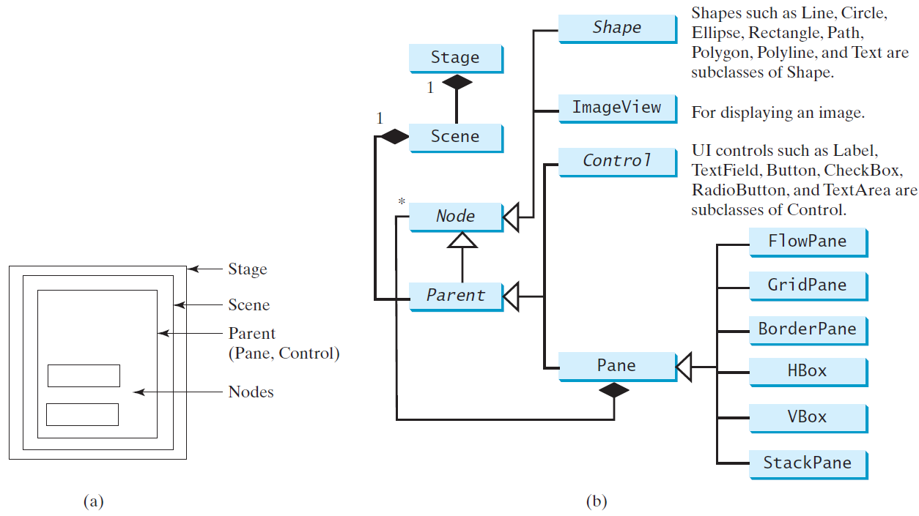
Panes, UI Controls, and Shapes
ButtonInPane
Run
Notes:
import javafx.application.Application;
import javafx.scene.Scene;
import javafx.scene.control.Button;
import javafx.scene.layout.StackPane;
import javafx.stage.Stage;
public class ButtonInPane extends Application {
@Override // Override the start method in the Application class
public void start(Stage primaryStage) {
// Create a scene and place a button in the scene
StackPane pane = new StackPane();
pane.getChildren().add(new Button("OK"));
Scene scene = new Scene(pane, 200, 50);
primaryStage.setTitle("Button in a pane"); // Set the stage title
primaryStage.setScene(scene); // Place the scene in the stage
primaryStage.show(); // Display the stage
}
/**
* The main method is only needed for the IDE with limited
* JavaFX support. Not needed for running from the command line.
*/
public static void main(String[] args) {
launch(args);
}
}

Slide 3
Display a Shape
This example displays a circle in the center of the pane.
ShowCircle
Run
Notes:
import javafx.application.Application;
import javafx.scene.Scene;
import javafx.scene.layout.Pane;
import javafx.scene.paint.Color;
import javafx.scene.shape.Circle;
import javafx.stage.Stage;
public class ShowCircle extends Application {
@Override // Override the start method in the Application class
public void start(Stage primaryStage) {
// Create a circle and set its properties
Circle circle = new Circle();
circle.setCenterX(100);
circle.setCenterY(100);
circle.setRadius(50);
circle.setStroke(Color.BLACK); // Set circle stroke color
circle.setFill(Color.WHITE);
// Create a pane to hold the circle
Pane pane = new Pane();
pane.getChildren().add(circle);
// Create a scene and place it in the stage
Scene scene = new Scene(pane, 200, 200);
primaryStage.setTitle("ShowCircle"); // Set the stage title
primaryStage.setScene(scene); // Place the scene in the stage
primaryStage.show(); // Display the stage
}
/**
* The main method is only needed for the IDE with limited
* JavaFX support. Not needed for running from the command line.
*/
public static void main(String[] args) {
launch(args);
}
}

Slide 4
Binding Properties
JavaFX introduces a new concept called binding property that enables a target object to be bound to a source object. If the value in the source object changes, the target property is also changed automatically. The target object is simply called a binding object or a binding property.
ShowCircleCentered
Run

Slide 5
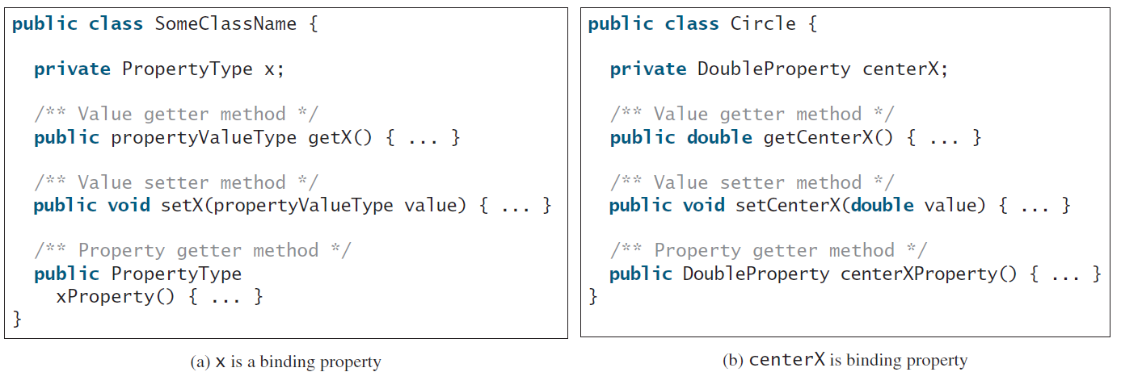
Binding Property: getter, setter, and property getter

Slide 6
Uni/Bidirectional Binding
BindingDemo
Run
BidirectionalBindingDemo
Run

Slide 7
Common Properties and Methods for Nodes
style: set a JavaFX CSS style
rotate: Rotate a node
NodeStyleRotateDemo
Run
Notes:
import javafx.application.Application;
import javafx.scene.Scene;
import javafx.scene.control.Button;
import javafx.stage.Stage;
import javafx.scene.layout.StackPane;
public class NodeStyleRotateDemo extends Application {
@Override // Override the start method in the Application class
public void start(Stage primaryStage) {
// Create a scene and place a button in the scene
StackPane pane = new StackPane();
Button btOK = new Button("OK");
btOK.setStyle("-fx-border-color: blue;");
pane.getChildren().add(btOK);
pane.setRotate(45); // Rotate pane 45 degrees
pane.setStyle(
"-fx-border-color: red; -fx-background-color: lightgray;");
Scene scene = new Scene(pane, 200, 250);
primaryStage.setTitle("NodeStyleRotateDemo"); // Set the stage title
primaryStage.setScene(scene); // Place the scene in the stage
primaryStage.show(); // Display the stage
}
/**
* The main method is only needed for the IDE with limited
* JavaFX support. Not needed for running from the command line.
*/
public static void main(String[] args) {
launch(args);
}
}

Slide 8
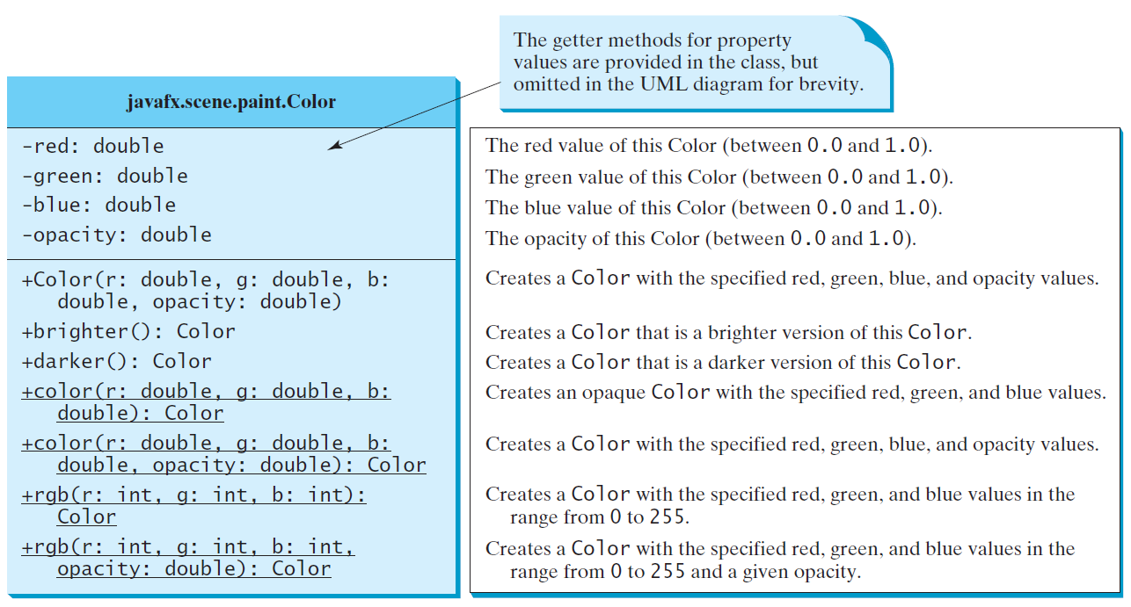
The Color Class

Slide 9
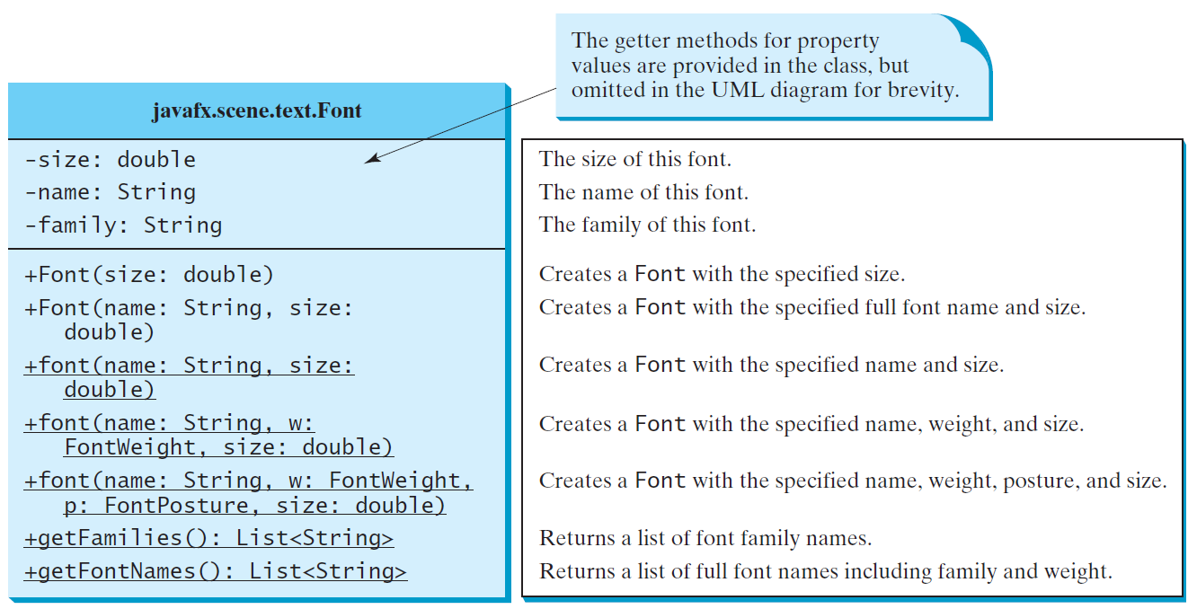
The Font Class
FontDemo
Run
Notes:
import javafx.application.Application;
import javafx.scene.Scene;
import javafx.scene.layout.*;
import javafx.scene.paint.Color;
import javafx.scene.shape.Circle;
import javafx.scene.text.*;
import javafx.scene.control.*;
import javafx.stage.Stage;
public class FontDemo extends Application {
@Override // Override the start method in the Application class
public void start(Stage primaryStage) {
// Create a pane to hold the circle
Pane pane = new StackPane();
// Create a circle and set its properties
Circle circle = new Circle();
circle.setRadius(50);
circle.setStroke(Color.BLACK);
circle.setFill(new Color(0.5, 0.5, 0.5, 0.1));
pane.getChildren().add(circle); // Add circle to the pane
// Create a label and set its properties
Label label = new Label("JavaFX");
label.setFont(Font.font("Times New Roman",
FontWeight.BOLD, FontPosture.ITALIC, 20));
pane.getChildren().add(label);
// Create a scene and place it in the stage
Scene scene = new Scene(pane);
primaryStage.setTitle("FontDemo"); // Set the stage title
primaryStage.setScene(scene); // Place the scene in the stage
primaryStage.show(); // Display the stage
}
/**
* The main method is only needed for the IDE with limited
* JavaFX support. Not needed for running from the command line.
*/
public static void main(String[] args) {
launch(args);
}
}

Slide 10
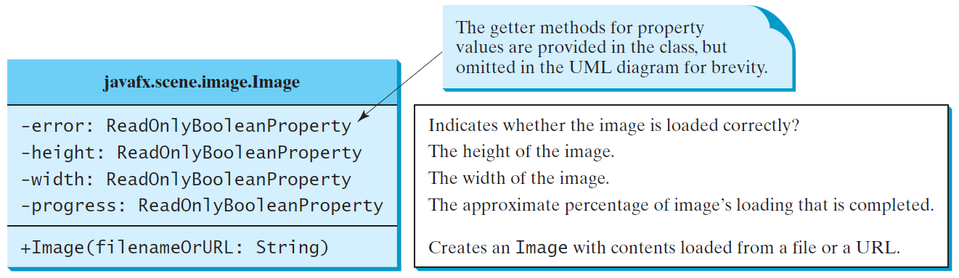
The Image Class

Slide 11
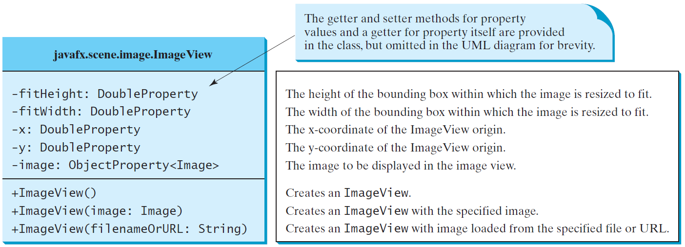
The ImageView Class
ShowImage
Run
Notes:
import javafx.application.Application;
import javafx.scene.Scene;
import javafx.scene.layout.HBox;
import javafx.scene.layout.Pane;
import javafx.geometry.Insets;
import javafx.stage.Stage;
import javafx.scene.image.Image;
import javafx.scene.image.ImageView;
public class ShowImage extends Application {
@Override // Override the start method in the Application class
public void start(Stage primaryStage) {
// Create a pane to hold the image views
Pane pane = new HBox(10);
pane.setPadding(new Insets(5, 5, 5, 5));
Image image = new Image("image/us.gif");
pane.getChildren().add(new ImageView(image));
ImageView imageView2 = new ImageView(image);
imageView2.setFitHeight(100);
imageView2.setFitWidth(100);
pane.getChildren().add(imageView2);
ImageView imageView3 = new ImageView(image);
imageView3.setRotate(90);
pane.getChildren().add(imageView3);
// Create a scene and place it in the stage
Scene scene = new Scene(pane);
primaryStage.setTitle("ShowImage"); // Set the stage title
primaryStage.setScene(scene); // Place the scene in the stage
primaryStage.show(); // Display the stage
}
/**
* The main method is only needed for the IDE with limited
* JavaFX support. Not needed for running from the command line.
*/
public static void main(String[] args) {
launch(args);
}
}

Slide 12
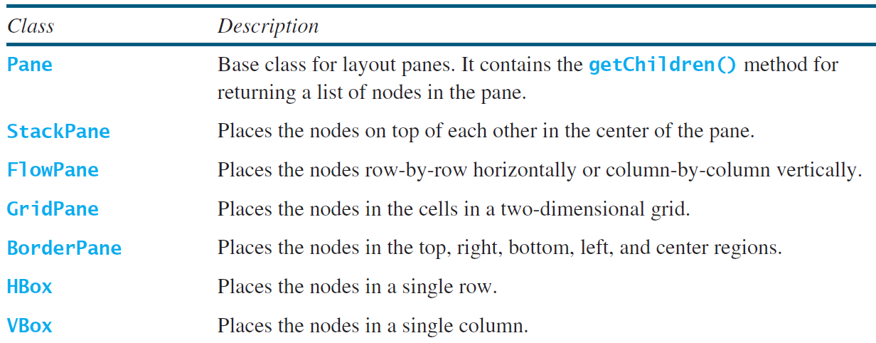
Layout Panes
JavaFX provides many types of panes for organizing nodes in a container.

Slide 13
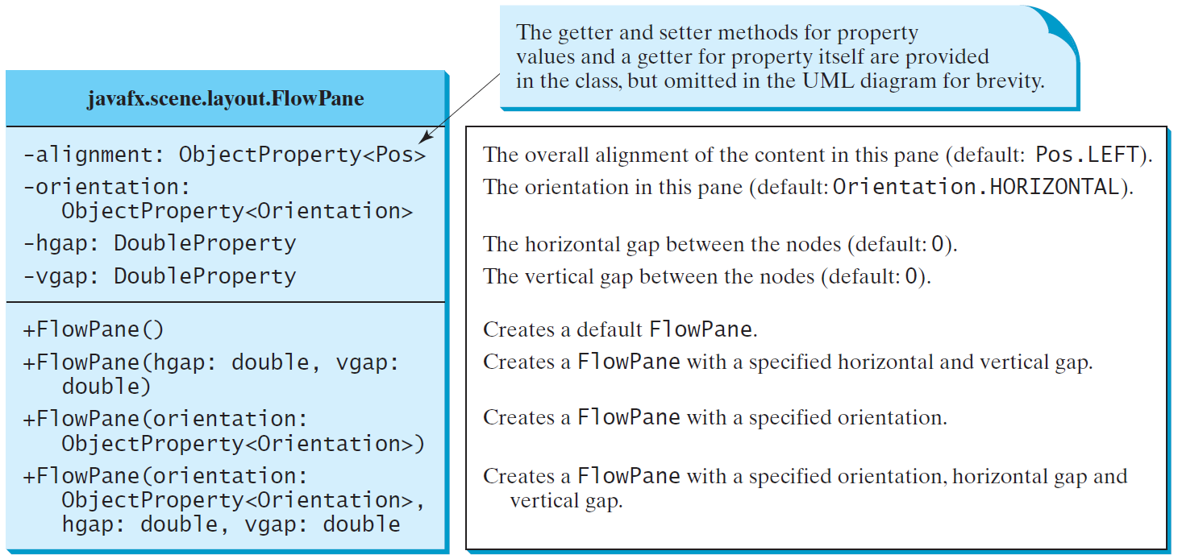
FlowPane
MultipleStageDemo
Run
Notes:
package JavaFX;
import javafx.application.Application;
import javafx.geometry.Insets;
import javafx.geometry.Orientation;
import javafx.scene.Scene;
import javafx.scene.control.Label;
import javafx.scene.control.TextField;
import javafx.scene.layout.FlowPane;
import javafx.stage.Stage;
public class ShowFlowPane extends Application {
@Override // Override the start method in the Application class
public void start(Stage primaryStage) {
// Create a pane and set its properties
FlowPane pane = new FlowPane(Orientation.VERTICAL);
pane.setPadding(new Insets(11, 12, 13, 14));
pane.setHgap(5); // Set hGap to 5px
pane.setVgap(5);
// Place nodes in the pane
pane.getChildren().addAll(new Label("First Name:"),
new TextField(), new Label("MI:"));
TextField tfMi = new TextField();
tfMi.setPrefColumnCount(1);
pane.getChildren().addAll(tfMi, new Label("Last Name:"),
new TextField());
// Create a scene and place it in the stage
Scene scene = new Scene(pane, 200, 250);
primaryStage.setTitle("ShowFlowPane"); // Set the stage title
primaryStage.setScene(scene); // Place the scene in the stage
primaryStage.show(); // Display the stage
}
/**
* The main method is only needed for the IDE with limited
* JavaFX support. Not needed for running from the command line.
*/
public static void main(String[] args) {
launch(args);
}
}

Slide 14
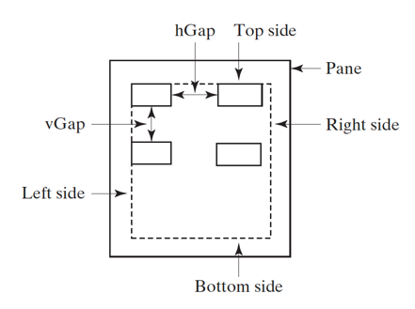
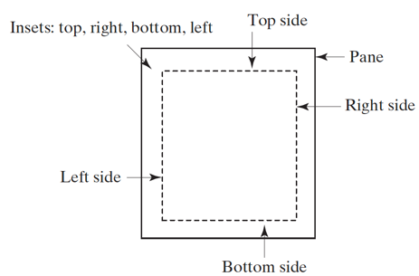
Gaps

Slide 15
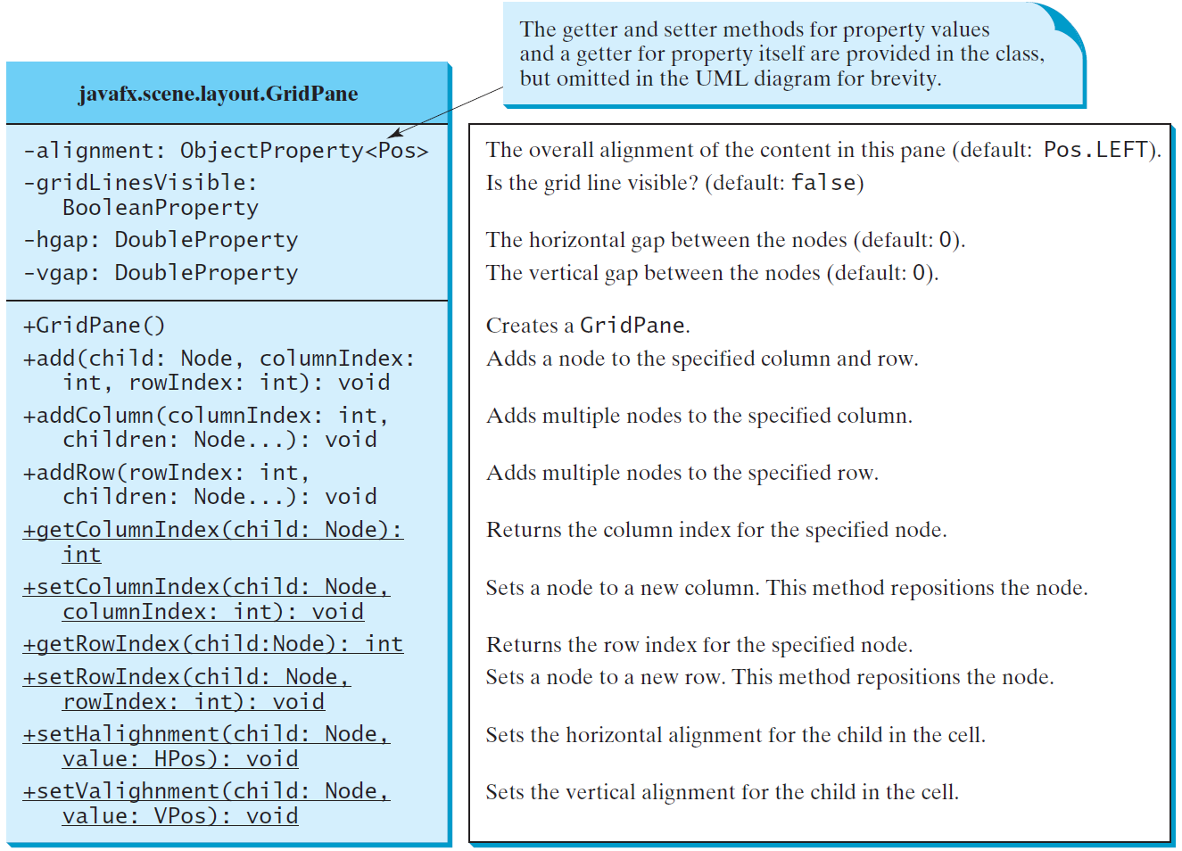
GridPane
ShowGridPane
Run
Notes:
package JavaFX;
import javafx.application.Application;
import javafx.geometry.HPos;
import javafx.geometry.Insets;
import javafx.geometry.Pos;
import javafx.scene.Scene;
import javafx.scene.control.Button;
import javafx.scene.control.Label;
import javafx.scene.control.TextField;
import javafx.scene.layout.GridPane;
import javafx.stage.Stage;
public class ShowGridPane extends Application {
@Override // Override the start method in the Application class
public void start(Stage primaryStage) {
// Create a pane and set its properties
GridPane pane = new GridPane();
pane.setAlignment(Pos.CENTER); // Set center alignment
pane.setPadding(new Insets(11.5, 12.5, 13.5, 14.5));
pane.setHgap(5.5);
pane.setVgap(5.5); // Set vGap to 5.5px
// Place nodes in the pane
pane.add(new Label("First Name:"), 0, 0);
pane.add(new TextField(), 1, 0);
pane.add(new Label("MI:"), 0, 1);
pane.add(new TextField(), 1, 1);
pane.add(new Label("Last Name:"), 0, 2);
pane.add(new TextField(), 1, 2);
Button btAdd = new Button("Add Name");
pane.add(btAdd, 1, 3);
GridPane.setHalignment(btAdd, HPos.RIGHT);
// Create a scene and place it in the stage
Scene scene = new Scene(pane);
primaryStage.setTitle("ShowGridPane"); // Set the stage title
primaryStage.setScene(scene); // Place the scene in the stage
primaryStage.show(); // Display the stage
}
/**
* The main method is only needed for the IDE with limited
* JavaFX support. Not needed for running from the command line.
*/
public static void main(String[] args) {
launch(args);
}
}

Slide 16
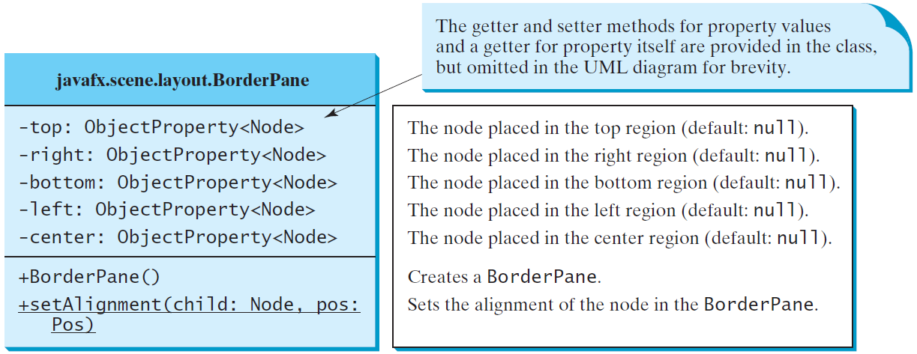
BorderPane
ShowBorderPane
Run
Notes:
package JavaFX;
import javafx.application.Application;
import javafx.geometry.Insets;
import javafx.scene.Scene;
import javafx.scene.control.Label;
import javafx.scene.layout.BorderPane;
import javafx.scene.layout.StackPane;
import javafx.stage.Stage;
public class ShowBorderPane extends Application {
@Override // Override the start method in the Application class
public void start(Stage primaryStage) {
// Create a border pane
BorderPane pane = new BorderPane();
// Place nodes in the pane
pane.setTop(new CustomPane("Top"));
pane.setRight(new CustomPane("Right"));
pane.setBottom(new CustomPane("Bottom"));
pane.setLeft(new CustomPane("Left"));
pane.setCenter(new CustomPane("Center"));
// Create a scene and place it in the stage
Scene scene = new Scene(pane);
primaryStage.setTitle("ShowBorderPane"); // Set the stage title
primaryStage.setScene(scene); // Place the scene in the stage
primaryStage.show(); // Display the stage
}
public static void main(String[] args) {
launch(args);
}
}
// Define a custom pane to hold a label in the center of the pane
class CustomPane extends StackPane {
public CustomPane(String title) {
getChildren().add(new Label(title));
setStyle("-fx-border-color: red");
setPadding(new Insets(11.5, 12.5, 13.5, 14.5));
}
}

Slide 17
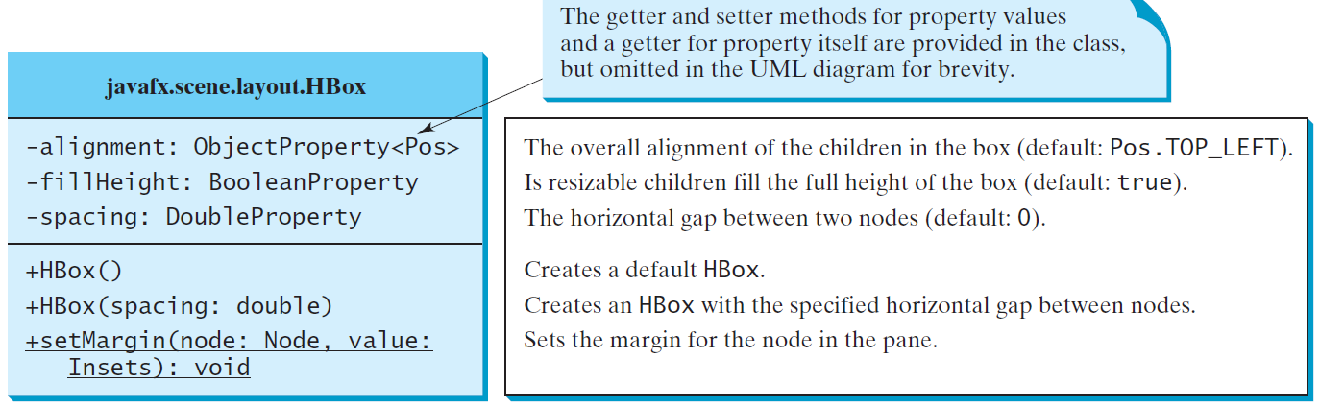
HBox

Slide 18
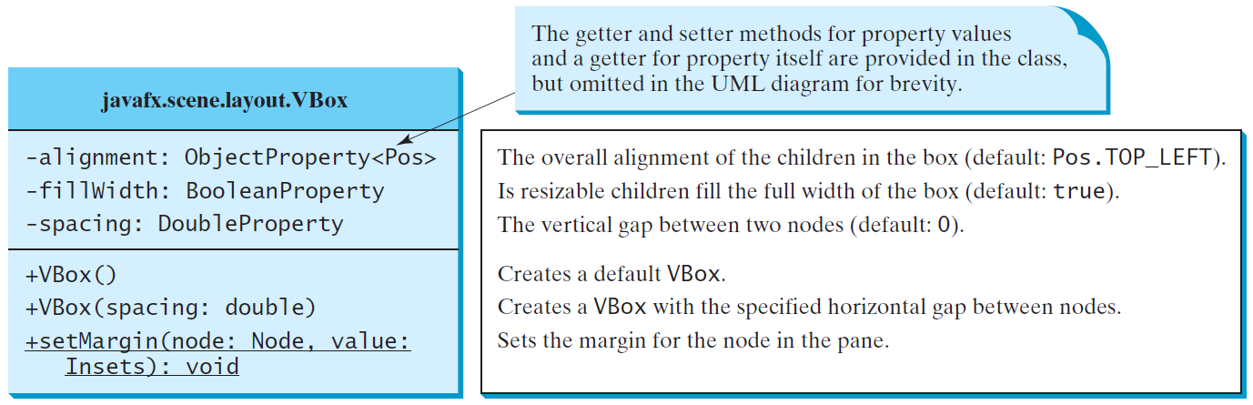
VBox
ShowHBoxVBox
Run
Notes:
package JavaFX;
import java.io.FileInputStream;
import java.io.FileNotFoundException;
import javafx.application.Application;
import javafx.geometry.Insets;
import javafx.scene.Scene;
import javafx.scene.control.Button;
import javafx.scene.control.Label;
import javafx.scene.layout.BorderPane;
import javafx.scene.layout.HBox;
import javafx.scene.layout.VBox;
import javafx.stage.Stage;
import javafx.scene.image.Image;
import javafx.scene.image.ImageView;
public class ShowHBoxVBox extends Application {
@Override // Override the start method in the Application class
public void start(Stage primaryStage) throws FileNotFoundException {
// Create a border pane
BorderPane pane = new BorderPane();
// Place nodes in the pane
pane.setTop(getHBox());
pane.setLeft(getVBox());
// Create a scene and place it in the stage
Scene scene = new Scene(pane);
primaryStage.setTitle("ShowHBoxVBox"); // Set the stage title
primaryStage.setScene(scene); // Place the scene in the stage
primaryStage.show(); // Display the stage
}
private HBox getHBox() throws FileNotFoundException {
HBox hBox = new HBox(15); // Create an HBox with 15px spacing
hBox.setPadding(new Insets(15, 15, 15, 15));
hBox.setStyle("-fx-background-color: gold");
hBox.getChildren().add(new Button("Computer Science"));
hBox.getChildren().add(new Button("Chemistry"));
FileInputStream input = new FileInputStream("BZU_logo.jpg");
Image image = new Image(input);
ImageView imageView = new ImageView(image);
hBox.getChildren().add(imageView);
return hBox;
}
private VBox getVBox() {
VBox vBox = new VBox(15); // Create a VBox with 15px spacing
vBox.setPadding(new Insets(15, 5, 5, 5));
vBox.getChildren().add(new Label("Courses"));
Label[] courses = {new Label("CSCI 1301"), new Label("CSCI 1302"),
new Label("CSCI 2410"), new Label("CSCI 3720")};
for (Label course: courses) {
VBox.setMargin(course, new Insets(0, 0, 0, 15));
vBox.getChildren().add(course);
}
return vBox;
}
/**
* The main method is only needed for the IDE with limited
* JavaFX support. Not needed for running from the command line.
*/
public static void main(String[] args) {
launch(args);
}
}

Slide 19
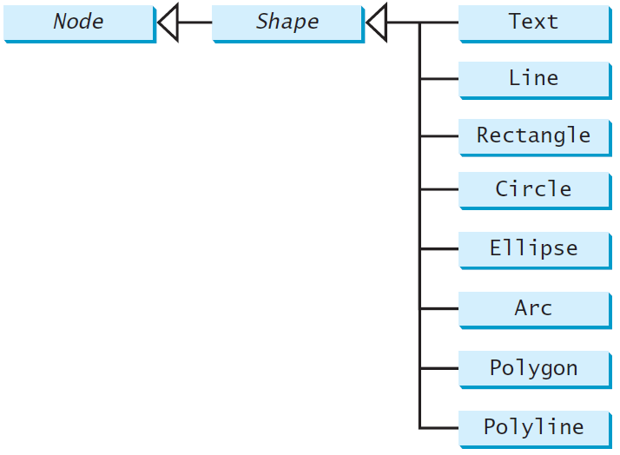
Shapes
JavaFX provides many shape classes for drawing texts, lines, circles, rectangles, ellipses, arcs, polygons, and polylines.

Slide 20
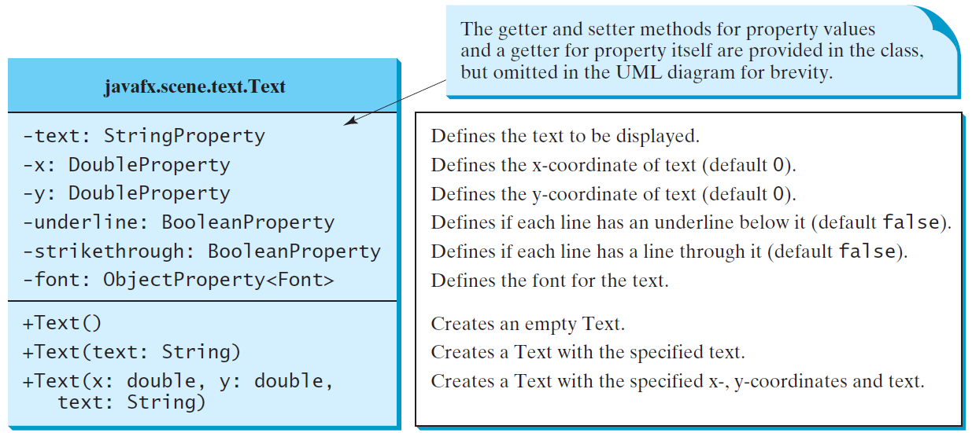
Text

Slide 21
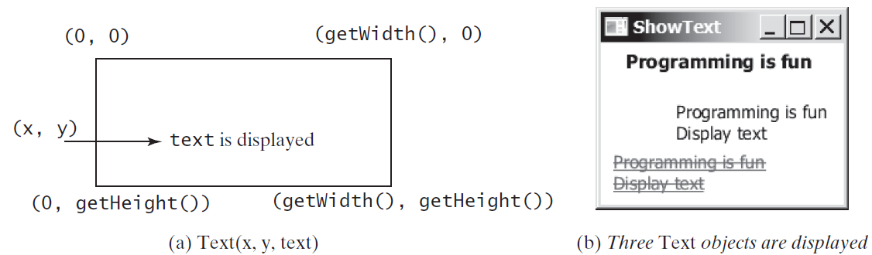
Text Example
ShowText
Run
Notes:
package JavaFX;
import javafx.application.Application;
import javafx.scene.Scene;
import javafx.scene.layout.Pane;
import javafx.scene.paint.Color;
import javafx.geometry.Insets;
import javafx.stage.Stage;
import javafx.scene.text.Text;
import javafx.scene.text.Font;
import javafx.scene.text.FontWeight;
import javafx.scene.text.FontPosture;
public class ShowText extends Application {
@Override // Override the start method in the Application class
public void start(Stage primaryStage) {
// Create a pane to hold the texts
Pane pane = new Pane();
pane.setPadding(new Insets(5, 5, 5, 5));
Text text1 = new Text(20, 20, "Programming is fun");
text1.setFont(Font.font("Courier", FontWeight.BOLD,
FontPosture.ITALIC, 15));
pane.getChildren().add(text1);
Text text2 = new Text(60, 60, "Programming is fun\nDisplay text");
pane.getChildren().add(text2);
Text text3 = new Text(10, 100, "Programming is fun\nDisplay text");
text3.setFill(Color.RED);
text3.setUnderline(true); // Underline for text3
text3.setStrikethrough(true); // Strikethrough for text3
pane.getChildren().add(text3);
// Create a scene and place it in the stage
Scene scene = new Scene(pane);
primaryStage.setTitle("ShowText"); // Set the stage title
primaryStage.setScene(scene); // Place the scene in the stage
primaryStage.show(); // Display the stage
}
/**
* The main method is only needed for the IDE with limited
* JavaFX support. Not needed for running from the command line.
*/
public static void main(String[] args) {
launch(args);
}
}

Slide 22
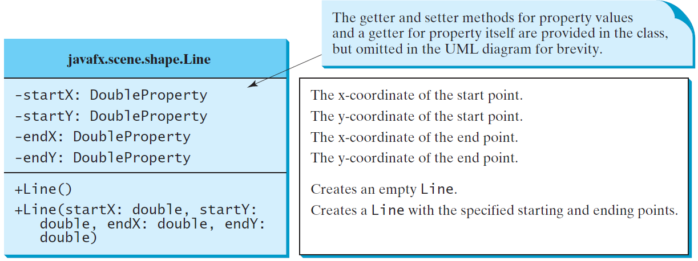
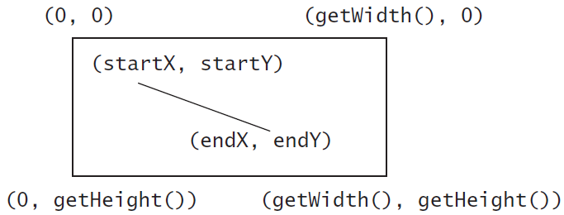
Line
ShowLine
Run
Notes:
import javafx.application.Application;
import javafx.scene.Scene;
import javafx.scene.layout.Pane;
import javafx.scene.paint.Color;
import javafx.stage.Stage;
import javafx.scene.shape.Line;
public class ShowLine extends Application {
@Override // Override the start method in the Application class
public void start(Stage primaryStage) {
// Create a scene and place it in the stage
Scene scene = new Scene(new LinePane(), 200, 200);
primaryStage.setTitle("ShowLine"); // Set the stage title
primaryStage.setScene(scene); // Place the scene in the stage
primaryStage.show(); // Display the stage
}
}
class LinePane extends Pane {
public LinePane() {
Line line1 = new Line(10, 10, 10, 10);
line1.endXProperty().bind(widthProperty().subtract(10));
line1.endYProperty().bind(heightProperty().subtract(10));
line1.setStrokeWidth(5);
line1.setStroke(Color.GREEN);
getChildren().add(line1);
Line line2 = new Line(10, 10, 10, 10);
line2.startXProperty().bind(widthProperty().subtract(10));
line2.endYProperty().bind(heightProperty().subtract(10));
line2.setStrokeWidth(5);
line2.setStroke(Color.GREEN);
getChildren().add(line2);
}
}

Slide 23
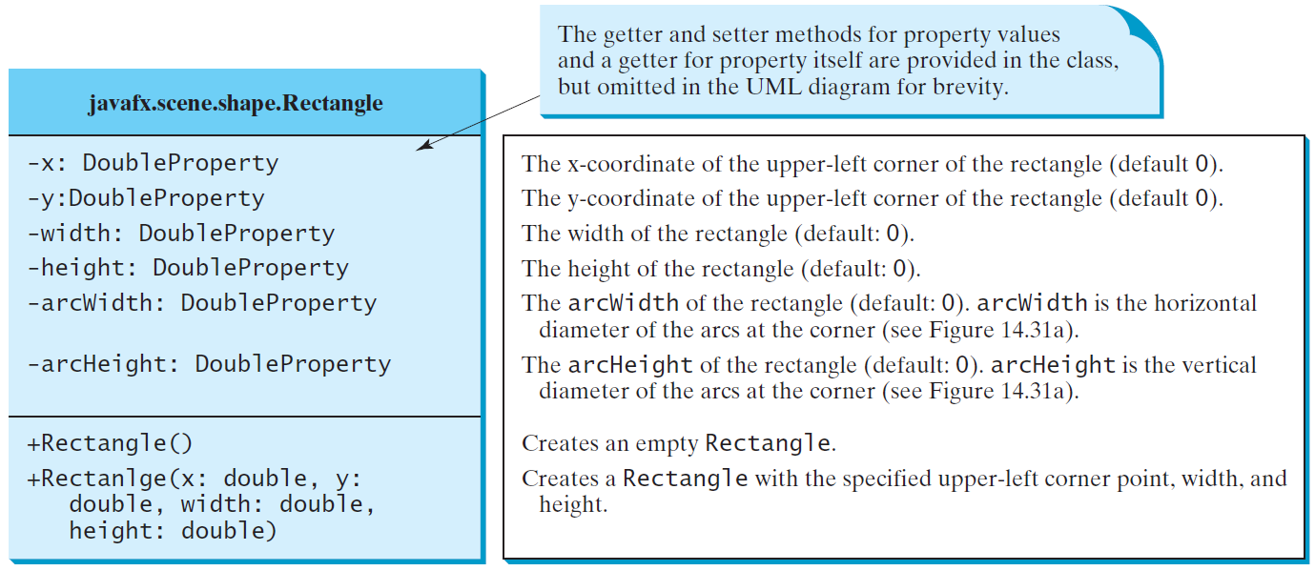
Rectangle

Slide 24
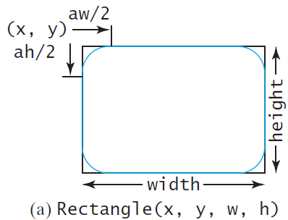
Rectangle Example
ShowRectangle
Run

Slide 25
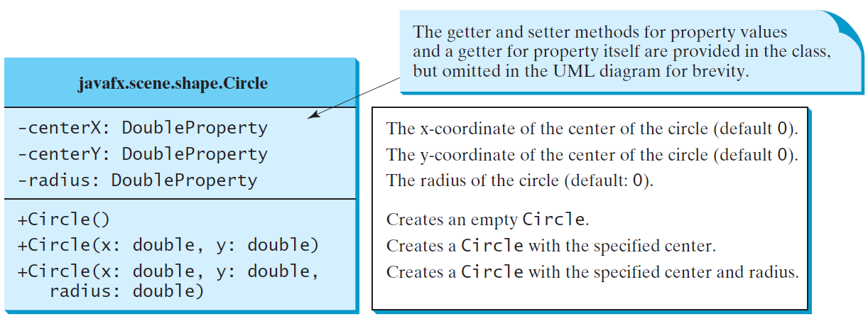
Circle

Slide 26
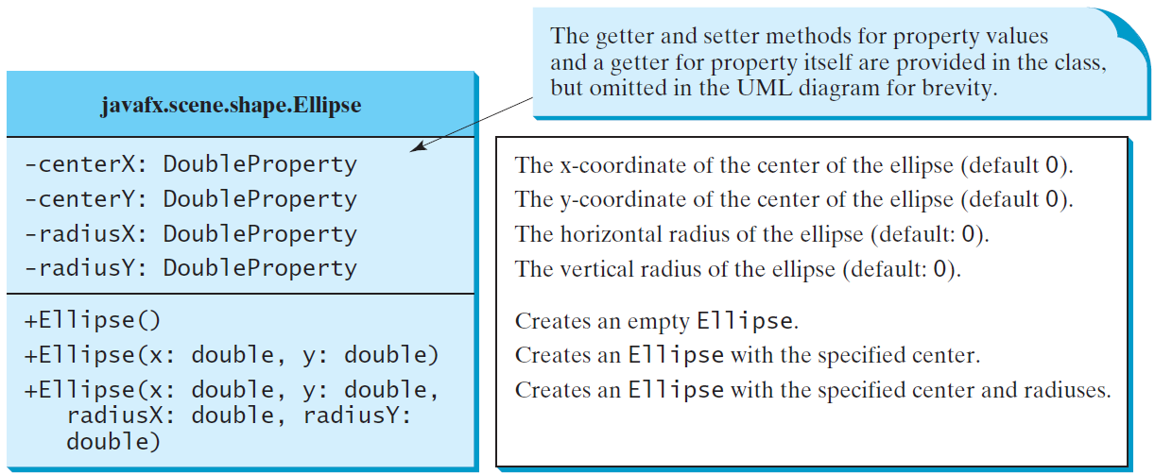
Ellipse
ShowEllipse
Run

Slide 27
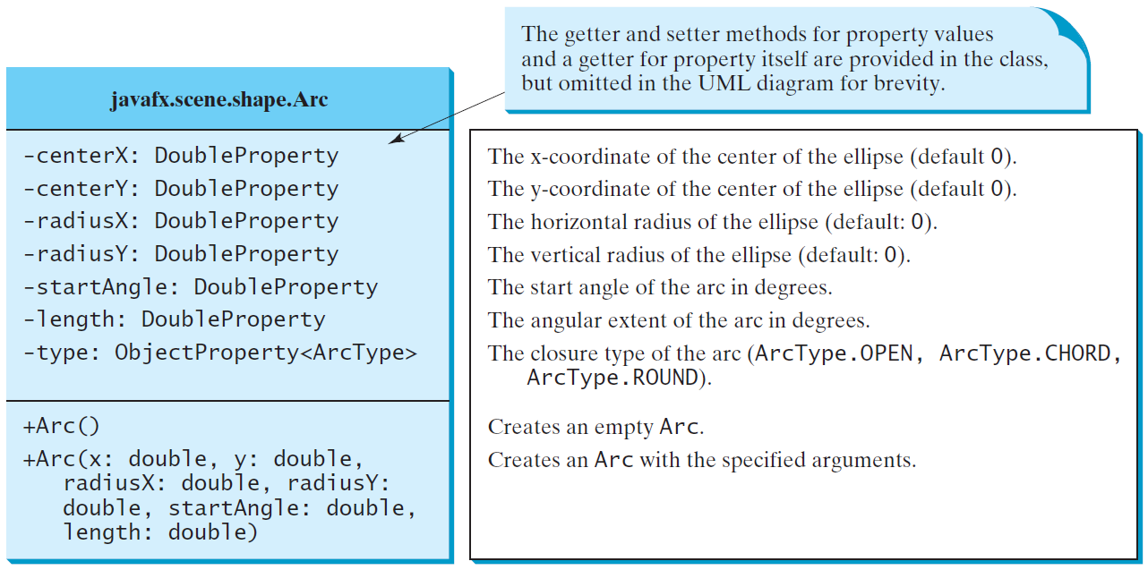
Arc

Slide 28
Arc Examples
ShowArc
Run
Notes:
import javafx.application.Application;
import javafx.scene.Scene;
import javafx.scene.Group;
import javafx.scene.layout.BorderPane;
import javafx.scene.paint.Color;
import javafx.stage.Stage;
import javafx.scene.shape.Arc;
import javafx.scene.shape.ArcType;
import javafx.scene.text.Text;
public class ShowArc extends Application {
@Override // Override the start method in the Application class
public void start(Stage primaryStage) {
Arc arc1 = new Arc(150, 100, 80, 80, 30, 35); // Create an arc
arc1.setFill(Color.RED); // Set fill color
arc1.setType(ArcType.ROUND); // Set arc type
Arc arc2 = new Arc(150, 100, 80, 80, 30 + 90, 35);
arc2.setFill(Color.WHITE);
arc2.setType(ArcType.OPEN);
arc2.setStroke(Color.BLACK);
Arc arc3 = new Arc(150, 100, 80, 80, 30 + 180, 35);
arc3.setFill(Color.WHITE);
arc3.setType(ArcType.CHORD);
arc3.setStroke(Color.BLACK);
Arc arc4 = new Arc(150, 100, 80, 80, 30 + 270, 35);
arc4.setFill(Color.GREEN);
arc4.setType(ArcType.CHORD);
arc4.setStroke(Color.BLACK);
// Create a group and add nodes to the group
Group group = new Group();
group.getChildren().addAll(new Text(210, 40, "arc1: round"),
arc1, new Text(20, 40, "arc2: open"), arc2,
new Text(20, 170, "arc3: chord"), arc3,
new Text(210, 170, "arc4: chord"), arc4);
// Create a scene and place it in the stage
Scene scene = new Scene(new BorderPane(group), 300, 200);
primaryStage.setTitle("ShowArc"); // Set the stage title
primaryStage.setScene(scene); // Place the scene in the stage
primaryStage.show(); // Display the stage
}
/**
* The main method is only needed for the IDE with limited
* JavaFX support. Not needed for running from the command line.
*/
public static void main(String[] args) {
launch(args);
}
}

Slide 29
Polygon and Polyline

Slide 30
Polygon
ShowPolygon
Run
Notes:
import javafx.application.Application;
import javafx.collections.ObservableList;
import javafx.scene.Scene;
import javafx.scene.layout.Pane;
import javafx.scene.paint.Color;
import javafx.stage.Stage;
import javafx.scene.shape.Polygon;
public class ShowPolygon extends Application {
@Override // Override the start method in the Application class
public void start(Stage primaryStage) {
// Create a scene and place it in the stage
Scene scene = new Scene(new MyPolygon(), 400, 400);
primaryStage.setTitle("ShowPolygon"); // Set the stage title
primaryStage.setScene(scene); // Place the scene in the stage
primaryStage.show(); // Display the stage
}
/**
* The main method is only needed for the IDE with limited
* JavaFX support. Not needed for running from the command line.
*/
public static void main(String[] args) {
launch(args);
}
}
class MyPolygon extends Pane {
private void paint() {
// Create a polygon and place polygon to pane
Polygon polygon = new Polygon();
polygon.setFill(Color.WHITE);
polygon.setStroke(Color.BLACK);
ObservableList<Double> list = polygon.getPoints();
double centerX = getWidth() / 2, centerY = getHeight() / 2;
double radius = Math.min(getWidth(), getHeight()) * 0.4;
// Add points to the polygon list
for (int i = 0; i < 6; i++) {
list.add(centerX + radius * Math.cos(2 * i * Math.PI / 6));
list.add(centerY - radius * Math.sin(2 * i * Math.PI / 6));
}
getChildren().clear(); // Clear pane
getChildren().add(polygon);
}
@Override
public void setWidth(double width) {
super.setWidth(width);
paint();
}
@Override
public void setHeight(double height) {
super.setHeight(height);
paint();
}
}

Slide 31
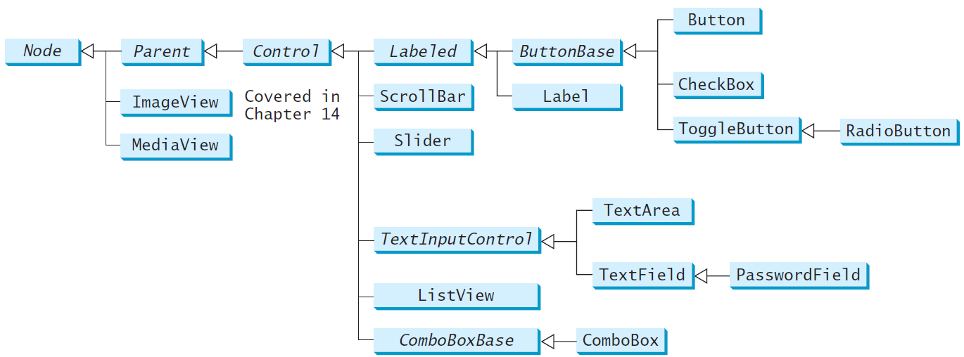
Frequently Used UI Controls
Throughout this book, the prefixes lbl, bt, chk, rb, tf, pf, ta, cbo, lv, scb, sld, and mp are used to name reference variables for Label, Button, CheckBox, RadioButton, TextField, PasswordField, TextArea, ComboBox, ListView, ScrollBar, Slider, and MediaPlayer.

Slide 32
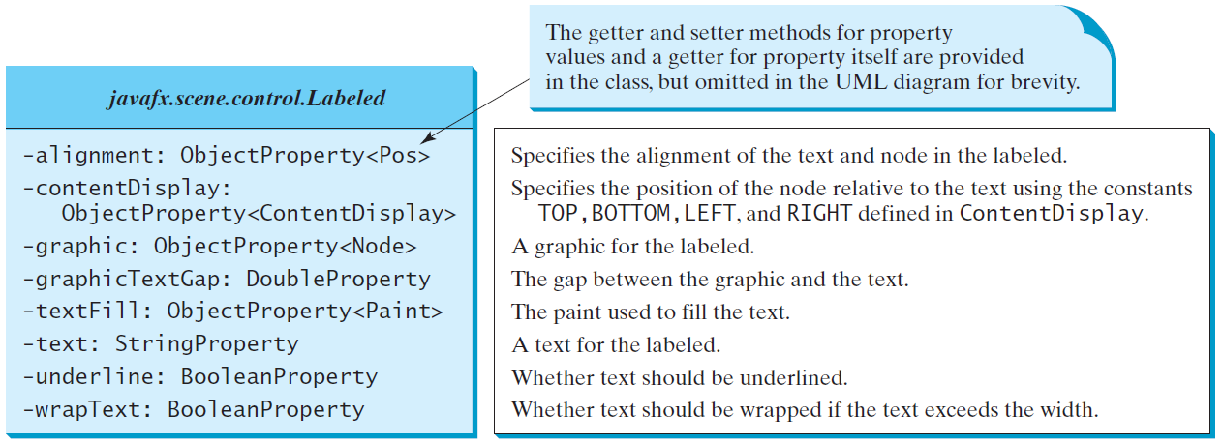
Labeled
A label is a display area for a short text, a node, or both. It is often used to label other controls (usually text fields). Labels and buttons share many common properties. These common properties are defined in the Labeled class.

Slide 33
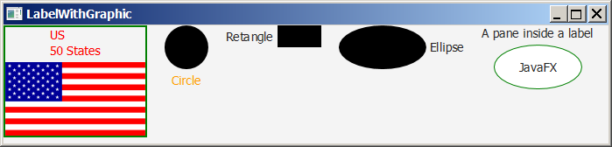
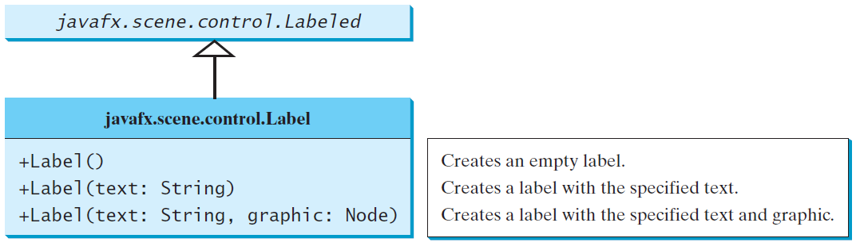
Label
The Label class defines labels.
LabelWithGraphic
Run
Notes:
import javafx.application.Application;
import javafx.stage.Stage;
import javafx.scene.Scene;
import javafx.scene.control.ContentDisplay;
import javafx.scene.control.Label;
import javafx.scene.image.Image;
import javafx.scene.image.ImageView;
import javafx.scene.layout.HBox;
import javafx.scene.layout.StackPane;
import javafx.scene.paint.Color;
import javafx.scene.shape.Circle;
import javafx.scene.shape.Rectangle;
import javafx.scene.shape.Ellipse;
public class LabelWithGraphic extends Application {
@Override // Override the start method in the Application class
public void start(Stage primaryStage) {
ImageView us = new ImageView(new Image("image/us.gif"));
Label lb1 = new Label("US\n50 States", us);
lb1.setStyle("-fx-border-color: green; -fx-border-width: 2");
lb1.setContentDisplay(ContentDisplay.BOTTOM);
lb1.setTextFill(Color.RED);
Label lb2 = new Label("Circle", new Circle(50, 50, 25));
lb2.setContentDisplay(ContentDisplay.TOP);
lb2.setTextFill(Color.ORANGE);
Label lb3 = new Label("Rectangle", new Rectangle(10, 10, 50, 25));
lb3.setContentDisplay(ContentDisplay.RIGHT);
Label lb4 = new Label("Ellipse", new Ellipse(50, 50, 50, 25));
lb4.setContentDisplay(ContentDisplay.LEFT);
Ellipse ellipse = new Ellipse(50, 50, 50, 25);
ellipse.setStroke(Color.GREEN);
ellipse.setFill(Color.WHITE);
StackPane stackPane = new StackPane();
stackPane.getChildren().addAll(ellipse, new Label("JavaFX"));
Label lb5 = new Label("A pane inside a label", stackPane);
lb5.setContentDisplay(ContentDisplay.BOTTOM);
HBox pane = new HBox(20);
pane.getChildren().addAll(lb1, lb2, lb3, lb4, lb5);
// Create a scene and place it in the stage
Scene scene = new Scene(pane, 450, 150);
primaryStage.setTitle("LabelWithGraphic"); // Set the stage title
primaryStage.setScene(scene); // Place the scene in the stage
primaryStage.show(); // Display the stage
}
/**
* The main method is only needed for the IDE with limited
* JavaFX support. Not needed for running from the command line.
*/
public static void main(String[] args) {
launch(args);
}
}

Slide 34
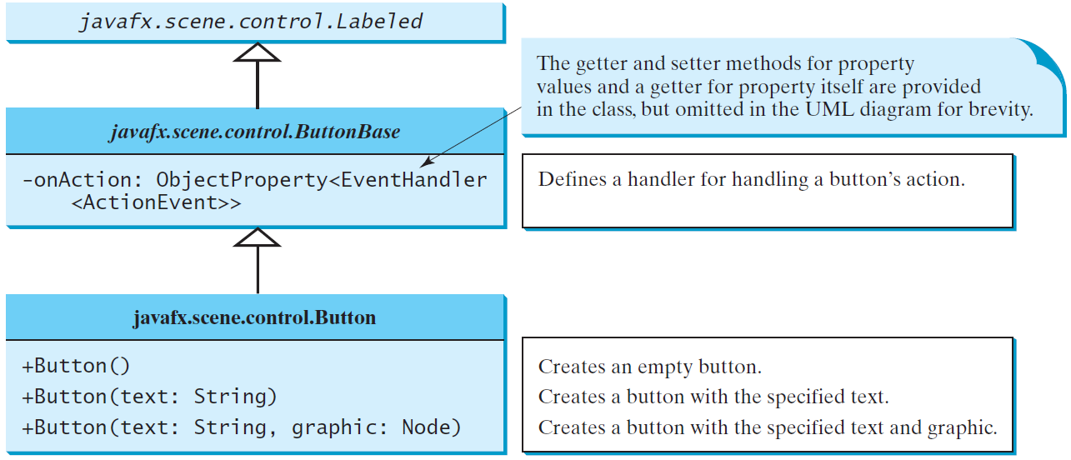
ButtonBase and Button
A button is a control that triggers an action event when clicked. JavaFX provides regular buttons, toggle buttons, check box buttons, and radio buttons. The common features of these buttons are defined in ButtonBase and Labeled classes.

Slide 35
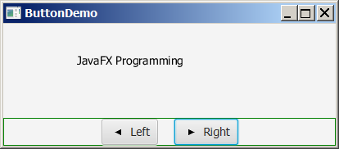
Button Example
ButtonDemo
Run
Notes:
package JavaFX;
import javafx.application.Application;
import javafx.stage.Stage;
import javafx.geometry.Pos;
import javafx.scene.Scene;
import javafx.scene.control.Button;
import javafx.scene.image.ImageView;
import javafx.scene.layout.BorderPane;
import javafx.scene.layout.HBox;
import javafx.scene.layout.Pane;
import javafx.scene.text.Text;
public class ButtonDemo extends Application {
protected Text text = new Text(50, 50, "JavaFX Programming");
protected BorderPane getPane() {
HBox paneForButtons = new HBox(20);
Button btLeft = new Button("Left");
Button btRight = new Button("Right");
paneForButtons.getChildren().addAll(btLeft, btRight);
paneForButtons.setAlignment(Pos.CENTER);
paneForButtons.setStyle("-fx-border-color: green");
BorderPane pane = new BorderPane();
pane.setBottom(paneForButtons);
Pane paneForText = new Pane();
paneForText.getChildren().add(text);
pane.setCenter(paneForText);
btLeft.setOnAction(e -> text.setX(text.getX() - 10));
btRight.setOnAction(e -> text.setX(text.getX() + 10));
return pane;
}
@Override // Override the start method in the Application class
public void start(Stage primaryStage) {
// Create a scene and place it in the stage
Scene scene = new Scene(getPane(), 450, 200);
primaryStage.setTitle("ButtonDemo"); // Set the stage title
primaryStage.setScene(scene); // Place the scene in the stage
primaryStage.show(); // Display the stage
}
/**
* The main method is only needed for the IDE with limited
* JavaFX support. Not needed for running from the command line.
*/
public static void main(String[] args) {
launch(args);
}
}

Slide 36
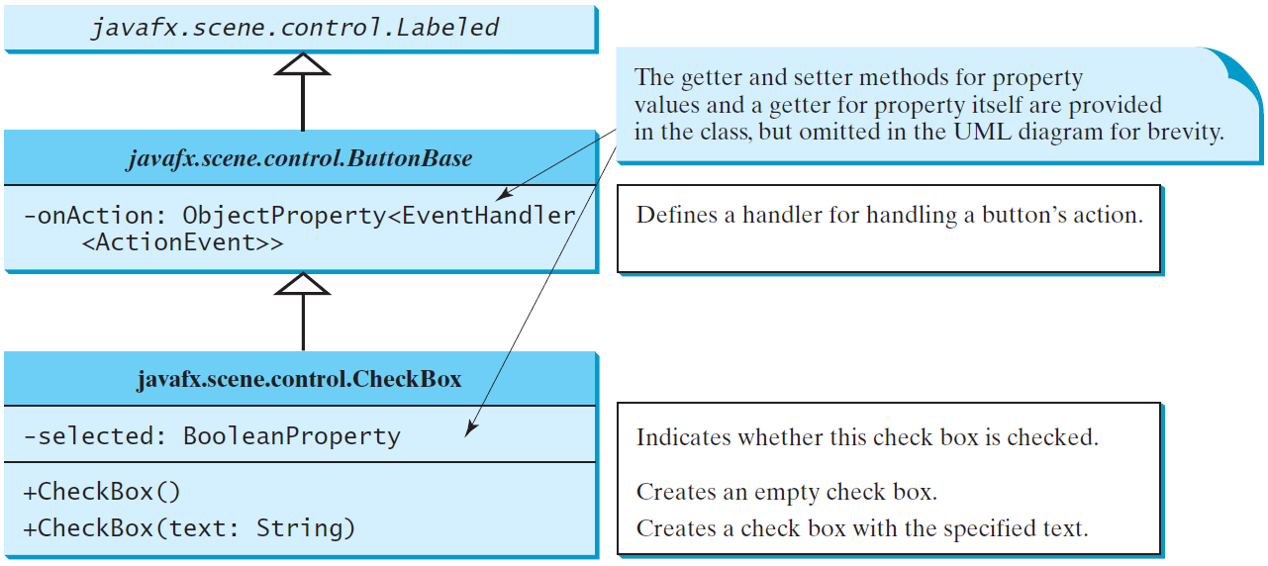
CheckBox
A CheckBox is used for the user to make a selection. Like Button, CheckBox inherits all the properties such as onAction, text, graphic, alignment, graphicTextGap, textFill, contentDisplay from ButtonBase and Labeled.

Slide 37
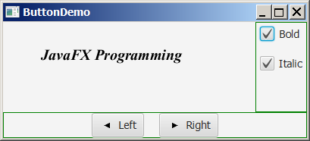
CheckBox Example
CheckBoxDemo
Run
Notes:
package JavaFX;
import javafx.event.ActionEvent;
import javafx.event.EventHandler;
import javafx.geometry.Insets;
import javafx.scene.Scene;
import javafx.scene.control.Button;
import javafx.scene.control.CheckBox;
import javafx.scene.layout.BorderPane;
import javafx.scene.layout.VBox;
import javafx.scene.text.Font;
import javafx.scene.text.FontPosture;
import javafx.scene.text.FontWeight;
import javafx.stage.Stage;
public class CheckBoxDemo extends ButtonDemo {
@Override // Override the getPane() method in the super class
protected BorderPane getPane() {
BorderPane pane = super.getPane();
Font fontBoldItalic = Font.font("Times New Roman",
FontWeight.BOLD, FontPosture.ITALIC, 20);
Font fontBold = Font.font("Times New Roman",
FontWeight.BOLD, FontPosture.REGULAR, 20);
Font fontItalic = Font.font("Times New Roman",
FontWeight.NORMAL, FontPosture.ITALIC, 20);
Font fontNormal = Font.font("Times New Roman",
FontWeight.NORMAL, FontPosture.REGULAR, 20);
text.setFont(fontNormal);
VBox paneForCheckBoxes = new VBox(20);
paneForCheckBoxes.setPadding(new Insets(5, 5, 5, 5));
paneForCheckBoxes.setStyle("-fx-border-color: green");
CheckBox chkBold = new CheckBox("Bold");
CheckBox chkItalic = new CheckBox("Italic");
paneForCheckBoxes.getChildren().addAll(chkBold, chkItalic);
pane.setRight(paneForCheckBoxes);
EventHandler<ActionEvent> handler = e -> {
if (chkBold.isSelected() && chkItalic.isSelected()) {
text.setFont(fontBoldItalic); // Both check boxes checked
}
else if (chkBold.isSelected()) {
text.setFont(fontBold); // The Bold check box checked
}
else if (chkItalic.isSelected()) {
text.setFont(fontItalic); // The Italic check box checked
}
else {
text.setFont(fontNormal); // Both check boxes unchecked
}
};
chkBold.setOnAction(handler);
chkItalic.setOnAction(handler);
return pane; // Return a new pane
}
@Override // Override the start method in the Application class
public void start(Stage primaryStage) {
super.start(primaryStage);
primaryStage.setTitle("CheckBoxDemo"); // Set the stage title
}
/**
* The main method is only needed for the IDE with limited
* JavaFX support. Not needed for running from the command line.
*/
public static void main(String[] args) {
launch(args);
}
}

Slide 38
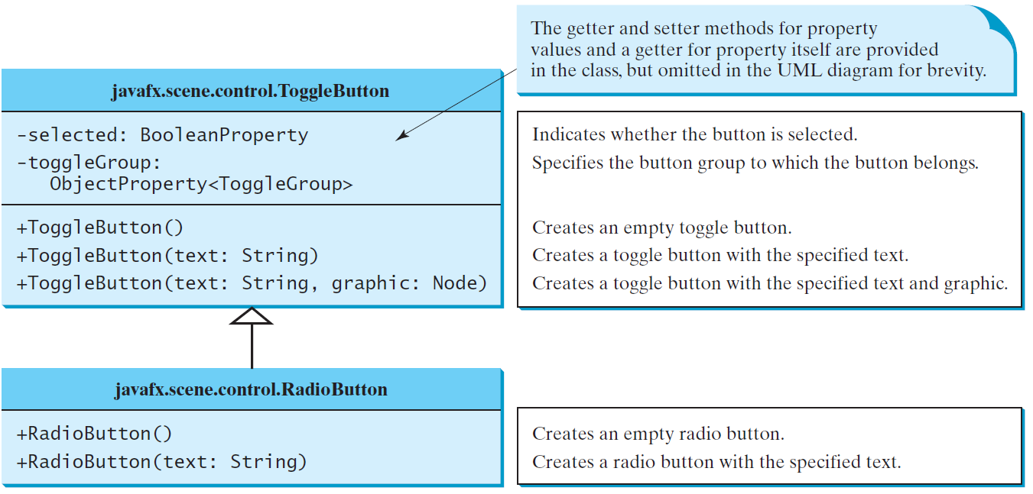
RadioButton
Radio buttons, also known as option buttons, enable you to choose a single item from a group of choices. In appearance radio buttons resemble check boxes, but check boxes display a square that is either checked or blank, whereas radio buttons display a circle that is either filled (if selected) or blank (if not selected).

Slide 39
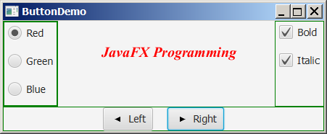
RadioButton Example
RadioButtonDemo
Run
Notes:
package JavaFX;
import javafx.geometry.Insets;
import javafx.scene.control.RadioButton;
import javafx.scene.control.ToggleGroup;
import javafx.scene.layout.BorderPane;
import javafx.scene.layout.VBox;
import javafx.scene.paint.Color;
public class RadioButtonDemo extends CheckBoxDemo {
@Override // Override the getPane() method in the super class
protected BorderPane getPane() {
BorderPane pane = super.getPane();
VBox paneForRadioButtons = new VBox(20);
paneForRadioButtons.setPadding(new Insets(5, 5, 5, 5));
paneForRadioButtons.setStyle
("-fx-border-width: 2px; -fx-border-color: green");
RadioButton rbRed = new RadioButton("Red");
RadioButton rbGreen = new RadioButton("Green");
RadioButton rbBlue = new RadioButton("Blue");
paneForRadioButtons.getChildren().addAll(rbRed, rbGreen, rbBlue);
pane.setLeft(paneForRadioButtons);
ToggleGroup group = new ToggleGroup();
rbRed.setToggleGroup(group);
rbGreen.setToggleGroup(group);
rbBlue.setToggleGroup(group);
rbRed.setOnAction(e -> {
if (rbRed.isSelected()) {
text.setFill(Color.RED);
}
});
rbGreen.setOnAction(e -> {
if (rbGreen.isSelected()) {
text.setFill(Color.GREEN);
}
});
rbBlue.setOnAction(e -> {
if (rbBlue.isSelected()) {
text.setFill(Color.BLUE);
}
});
return pane;
}
/**
* The main method is only needed for the IDE with limited
* JavaFX support. Not needed for running from the command line.
*/
public static void main(String[] args) {
launch(args);
}
}

Slide 40
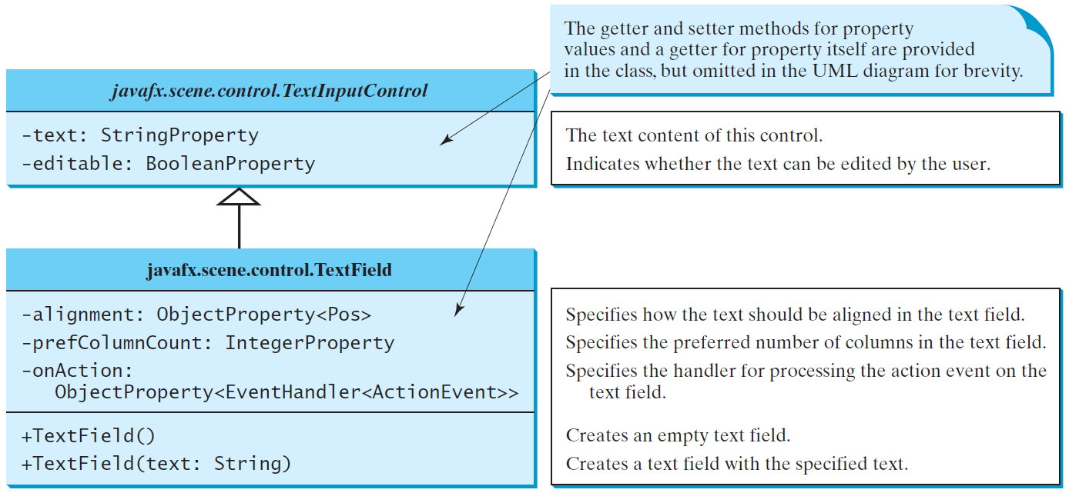
TextField
A text field can be used to enter or display a string. TextField is a subclass of TextInputControl.

Slide 41
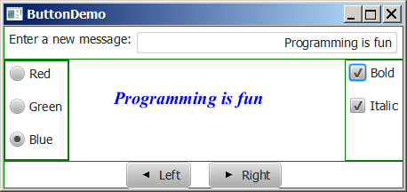
TextField Example
TextFieldDemo
Run
Notes:
package JavaFX;
import javafx.geometry.Insets;
import javafx.geometry.Pos;
import javafx.scene.control.Label;
import javafx.scene.control.TextField;
import javafx.scene.layout.BorderPane;
public class TextFieldDemo extends RadioButtonDemo {
@Override // Override the getPane() method in the super class
protected BorderPane getPane() {
BorderPane pane = super.getPane();
BorderPane paneForTextField = new BorderPane();
paneForTextField.setPadding(new Insets(5, 5, 5, 5));
paneForTextField.setStyle("-fx-border-color: green");
paneForTextField.setLeft(new Label("Enter a new message: "));
TextField tf = new TextField();
tf.setAlignment(Pos.BOTTOM_RIGHT);
paneForTextField.setCenter(tf);
pane.setTop(paneForTextField);
tf.setOnAction(e -> text.setText(tf.getText()));
return pane;
}
/**
* The main method is only needed for the IDE with limited
* JavaFX support. Not needed for running from the command line.
*/
public static void main(String[] args) {
launch(args);
}
}

