Slide 1
Econometrics
Ch3.
The Two Variable Model: HYPOTHESIS TESTING

Slide 2
Assumptions of Classical Linear Regression Model
Regression model is linear in parameters
X variable is no stochastic
Mean value of disturbance is zero E(ui/Xi)=0
Homoscedasticity of u - var(ui)=σ ²
It means variance of the error terms is constant
No autocorrelation between error terms Cov(ui,uj)=0
Zero covariance between X and u Cov(ui,Xi)=0

Slide 3
Assumptions continued..
No. of observations N must b greater than parameters to be estimated.
Variability essential in X values. Var(X)>0
Regression model is correctly specified.
There is no multicollinearity (applicable only to multiple variable model)
Indicates no exact linear relationship between X1 and X2

Slide 4

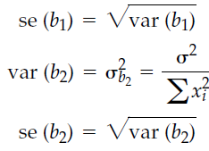


VARIANCES AND STANDARD ERRORS OF ORDINARY LEAST SQUARES ESTIMATORS

Slide 5
Properties of the OLS Estimator
If assumptions 1. through 4. hold, then the estimators determined by OLS are known as Best Linear Unbiased Estimators (BLUE).
What does the acronym stand for?
Best : means that the OLS estimator (b) has minimum variance among the class of linear unbiased estimators.
Estimator: b is an estimator of the true value of β.
Linear: b is a linear estimator.
Unbiased: On average, the actual value of the b will be equal to the true value.

Slide 6
Sample Size Considerations
Simple regression can be effective with a sample size of 20
The minimum ratio of observations to variables is 5 to 1, but the preferred ratio is 15 or 20 to 1, and this should increase when stepwise estimation is used.
Maximizing the degrees of freedom improves generalizability and addresses both model parsimony and sample size concerns.

Slide 7
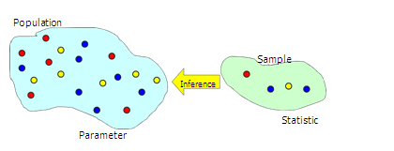
Hypotheses Testing
In addition to estimation, hypothesis testing is a procedure for making inferences about a population.
Hypothesis testing allows us to determine whether enough statistical evidence exists to conclude that a belief (i.e. hypothesis) about a parameter is supported by the data.

Slide 8
Types of Hypotheses
Simple vs. multiple
Simple: one statement/question/ or condition is being tested
Multiple: more than one statement is being tested

Slide 9
Hypothesis Testing Procedure
Develop null and alternative hypotheses
Select α and determine the rejection region
Determine degrees of freedom
Find critical t value from t table
One-tail tests: Use α
Two-tail tests: Use column α /2
Compare absolute value of computed t ratio to the critical t value from the table

Slide 10
Hypothesis Testing Procedure
If the computed t value is less than the critical table value then we cannot reject the null hypothesis at our chosen level of confidence
Does not mean that the null is true
If the computed t value exceeds the critical table value then we reject the null hypothesis in favor of the alternative hypothesis at our chosen level of confidence
Does not mean that the alternative is true

Slide 11
Hypothesis Testing: Some Concepts
We will always have two hypotheses that go together, the null hypothesis (denoted H₀) and the alternative hypothesis (denoted H₁).
The null hypothesis is the statement or the statistical hypothesis that is actually being tested. The alternative hypothesis represents the remaining outcomes of interest.
For example, suppose given the regression results above, we are interested in the hypothesis that the true value of β is in fact 0.5. We would use the notation
H₀ : β = 0.5
H₁ : β ≠ 0.5
This would be known as a two sided test.

Slide 12
The Null hypothesis
H ₀ : β = c
This hypothesis is a belief we maintain until proven otherwise

Slide 13
The Alternative Hypotheses
H₁ : β ≠ c
H₁ : β > c
H₁ : β < c

Slide 14


The Test Statistic
Decision rule
|t*| ≥ t then reject H₀

Slide 15
One-Sided Hypothesis Tests
Sometimes we may have some prior information that, for example, we would expect β > 0.5 rather than β < 0.5. In this case, we would do a one- sided test:
H₀ : β = 0.5
H₁ : β > 0.5
or we could have had
H₀ : β = 0.5
H₁ : β < 0.5
There are two ways to conduct a hypothesis test: via the test of significance approach or via the confidence interval approach.

Slide 16
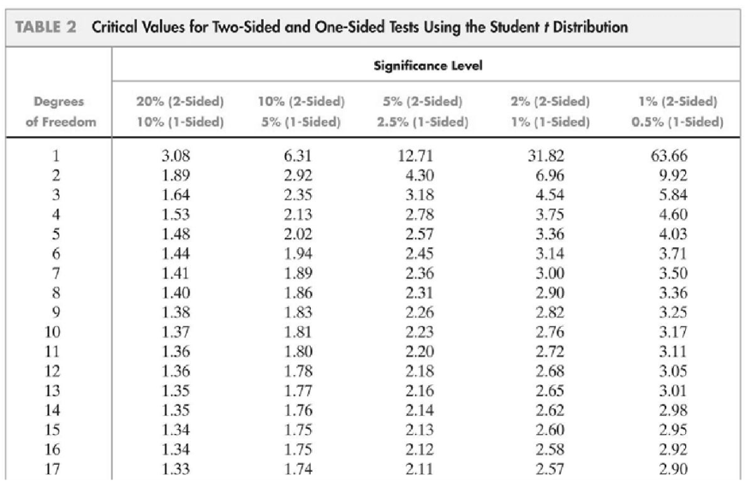
T-table

Slide 17
Using p-values instead of α
P-value is the lowest α that enable us to reject H0
When the p-value is less than or equal to α, the level of significance of the test, we reject H0 and accept H1.
When the p-value is greater than α, we do not reject H0.

Slide 18
Interpreting the p-value
The smaller the p-value, the more statistical evidence exists to support the alternative hypothesis.
If the p-value is less than 1%, there is overwhelming evidence that supports the alternative hypothesis.
If the p-value is between 1% and 5%, there is a strong evidence that supports the alternative hypothesis.
If the p-value is between 5% and 10% there is a weak evidence that supports the alternative hypothesis.
If the p-value exceeds 10%, there is no evidence that supports the alternative hypothesis.

Slide 19
Interpreting the p-value…
Compare the p-value with the selected value of the significance level:
If the p-value is less than α, we judge the p- value to be small enough to reject the null hypothesis.
If the p-value is greater than α, we do not reject the null hypothesis.

Slide 20
Interpreting the p-value…
We make a correct decision if:
The null hypothesis is false and we decide to reject it.
The null hypothesis is true and we decide accept it.
Our decision is incorrect if:
The null hypothesis is true and we decide to reject it.
This is a type I error.
The null hypothesis is false and we decide to accept it.
This is a type II error.

Slide 21
The Confidence Interval Approach to Hypothesis Testing
An example of its usage: We estimate a parameter, say to be 0.93, and a “95% confidence interval” to be (0.77,1.09). This means that we are 95% confident that the interval containing the true (but unknown) value of β.
Confidence intervals are almost invariably two-sided, although in theory a one-sided interval can be constructed.

Slide 22
How to Carry out a Hypothesis Test Using Confidence Intervals
1. Calculate b1, b2 and ^{SE (}b1⁾, SE(b2) as before.
2. Choose a significance level, α, (again the convention is 5%). This is equivalent to choosing a (1- α)×100% confidence interval, i.e. 5% significance level = 95% confidence interval.
3. Use the t-tables to find the appropriate critical value, which will again have n-2 degrees of freedom.
4. The confidence interval is given by:
5. Perform the test: If the hypothesized value of β (β *:Usually zero) lies outside the confidence interval, then reject the null hypothesis that β = β*, otherwise do not reject the null.

Slide 23
Factors affecting the decision to accept or reject the null hypothesis
The probability of rejecting H0 increases as:
The sample size increase (degrees of freedom)
The significance level increases
The smaller the variance of the estimated parameters
The smaller the variance of the error term

Slide 24
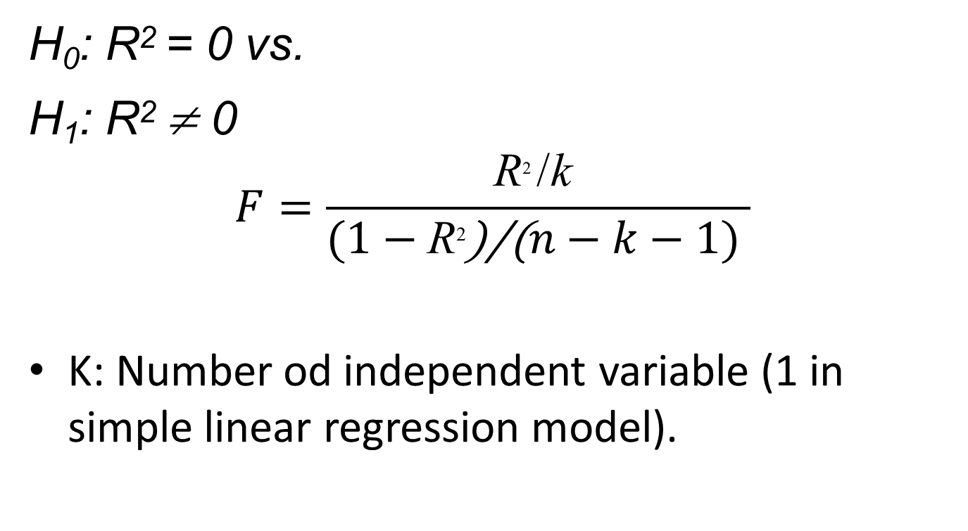
Testing the overall significance of the model: F-test
H₀: R² = 0 vs.
H₁: R² ≠ 0
$$F=\frac{\text{R}\text{2 }\text{/}\text{k} }{(1−\text{R}\text{2}\text{)/(}n−k−1) }$$
K: Number od independent variable (1 in simple linear regression model).

Slide 25
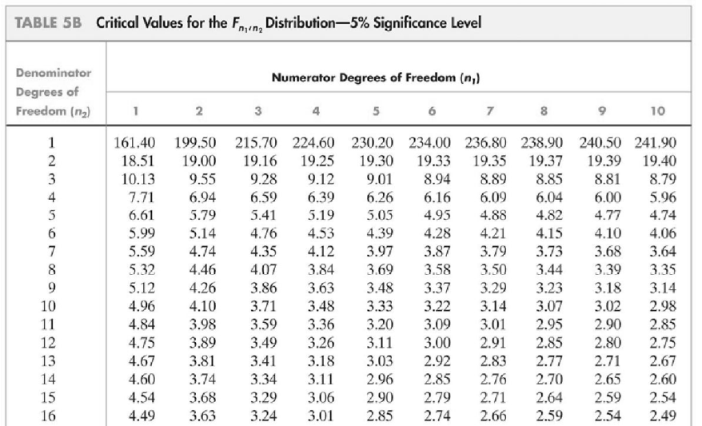

Slide 26
Example
Let N=10, k=2, R² =0.518
d.f. = 1 and 8
H₀: R² = 0
H₁: R² ≠ 0
F*= [0.518/1]/[(1 – 0.518)/(10-2)] = 8.60
F critical: F(1, 8, 5%)= 5.32.
Decision Rule: F* > F critical
So we reject H_{0,} and we can conclude that the model is statistically significant.

Slide 27
Goodness-of-Fit
A natural question is how well the regression line “fits” or explains the data. There are two regression statistics that provide complementary measures of the quality of fit:
The regression R2 measures the fraction of the variance of Y that is explained by X; it is unitless and ranges between zero (no fit) and one (perfect fit)
Or the fraction of the total sum of squares (SST) that is explained by the model, call this the R-squared of regression
The regression R2 is the fraction of the sample variance of Yi “explained” by the regression.

Slide 28
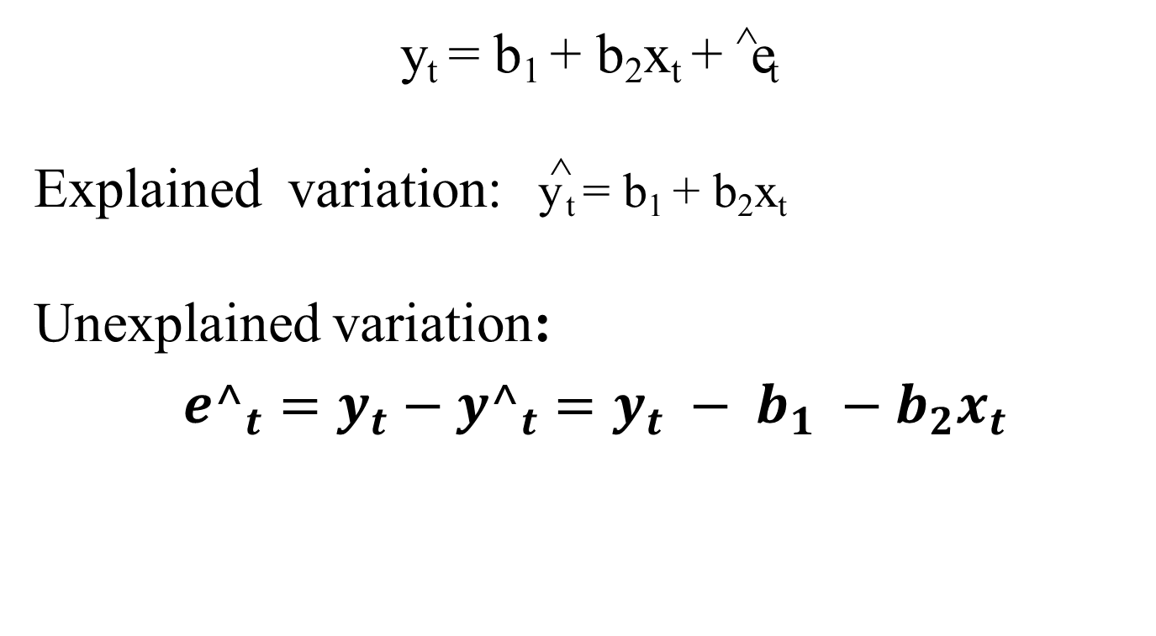
Explaining Variation in y_{t}
y_{t} = b₁ + b₂x_{t} + ^e_{t}
Explained variation: y^ _{t} = b₁ + b₂x_{t}
Unexplained variation:
${e^}_{t}=y_{t}{ − {y^}_{t}=y_{t} − b_{1} −b_{2}x_{t}}_{ }$

Slide 29
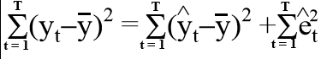
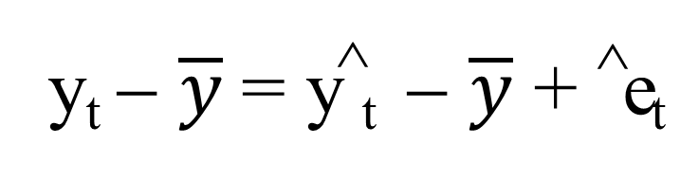

Explaining Variation in y_{t}
y_{t} = y^_{t} + ^e_{t}
using $\overline{y}$as baseline
y_{t} − $\overline{y}$= y^_{t} − $\overline{y}$ + ^e_{t}
SST = SSR + SSE
Total sum od square = Regression sum of square + Error sum of square

Slide 30
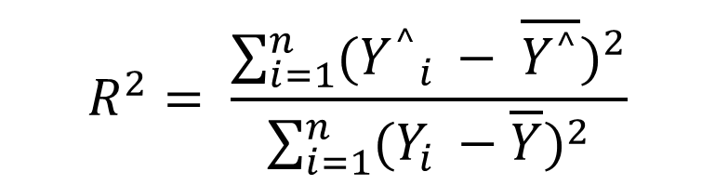
Coefficient of Determination
What proportion of the variation in y_{t} is explained?
0 < R² < 1
$$R^{2}= \frac{\sum_{i=1}^{n}{{({Y^{^}}_{i }− \overline{Y^{^}})}^{2}}}{\sum_{i=1}^{n}{{(Y_{i }−\overline{Y})}^{2}}}$$

Slide 31
Coefficient of Determination
R² = 0 means ESS = 0
R² = 1 means ESS = TSS
0 ≤ R² ≤ 1
For regression with a single X, R² = the square of the correlation coefficient between X and Y

