Slide 1


Slide 2
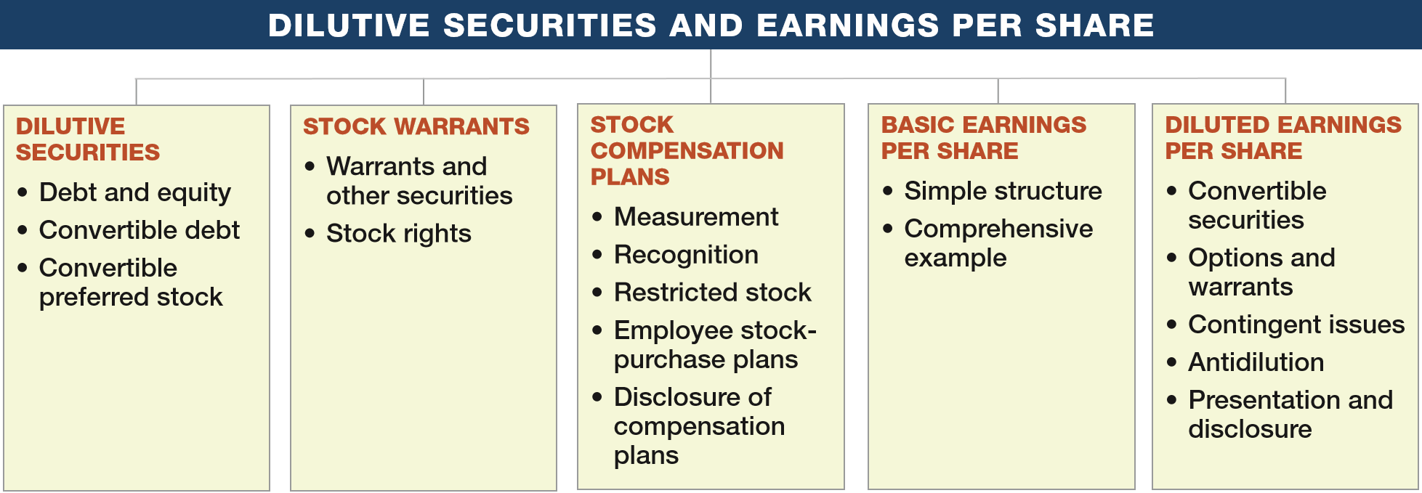
PREVIEW OF CHAPTER 16
Intermediate Accounting
16th Edition
Kieso ● Weygandt ● Warfield

Slide 3
LEARNING OBJECTIVES
16
Dilutive Securities and Earnings per Share
After studying this chapter, you should be able to:
Describe the accounting for the issuance, conversion, and retirement of convertible securities.
Contrast the accounting for stock warrants and for stock warrants issued with other securities.
Describe the accounting and reporting for stock compensation plans.
Compute basic earnings per share.
Compute diluted earnings per share.
LO 1

Slide 4
DILUTIVE SECURITIES
Debt and Equity
Should companies report these financial instruments as a liability or equity?
Stock Options
Convertible Securities
Preferred Stock
LO 1

Slide 5
DILUTIVE SECURITIES
Accounting for Convertible Debt
Convertible bonds can be changed into other corporate securities during some specified period of time after issuance.
Benefit of a Bond (guaranteed interest and principal)
+
Privilege of Exchanging it for Stock
(at the holder’s option)
LO 1

Slide 6
Accounting for Convertible Debt
Two main reasons corporations issue convertibles:
To raise equity capital without giving up more ownership control than necessary.
Obtain debt financing at cheaper rates.
The accounting for convertible debt involves reporting issues at the time of (1) issuance, (2) conversion, and (3) retirement.
LO 1

Slide 7
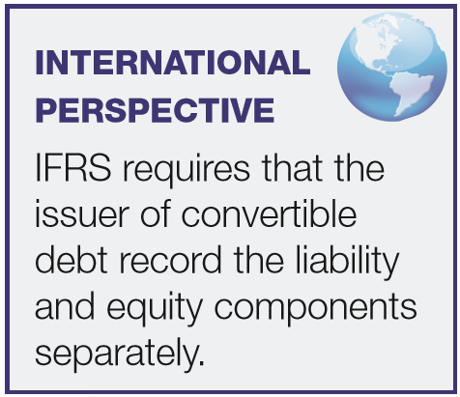
Accounting for Convertible Debt
At Time of Issuance
Recording convertible bonds follows the method used to record straight debt issues, with any discount or premium amortized over the term of the debt.
LO 1

Slide 8
Accounting for Convertible Debt
Illustration: Miller Corporation issued $4,000,000 par value, 7% convertible bonds at 99 for cash. If the bonds had not included the conversion feature, they would have sold for 95. Record the entry at date of issuance.
Issue Price =
($4,000,000 x 99% = $3,960,000)
Cash 3,960,000
Discount on Bonds Payable 40,000
Bonds Payable 4,000,000
LO 1

Slide 9
Accounting for Convertible Debt
At Time of Conversion
Companies use the book value method when converting bonds.
When the debtholder converts the debt to equity, the issuing company recognizes no gain or loss upon conversion.
LO 1

Slide 10
Accounting for Convertible Debt
Illustration: Moore Corporation has outstanding 2,000, $1,000 bonds, each convertible into 50 shares of $10 par value common stock. The bonds are converted on December 31, 2017, when the unamortized discount is $30,000 and the market price of the stock is $21 per share. Prepare the entry to record the conversion of the bonds.
Bonds Payable 2,000,000
Discount on Bonds Payable 30,000
Common Stock (2,000 x 50 x $10) 1,000,000
Paid-in Capital in Excess of Par—Common 970,000
LO 1

Slide 11
Accounting for Convertible Debt
Induced Conversion
Issuer wishes to encourage prompt conversion.
Issuer offers additional consideration, called a “sweetener.”
Sweetener is an expense of the current period.
LO 1

Slide 12
Accounting for Convertible Debt
Illustration: Moore Corporation has outstanding 2,000, $1,000 bonds, each convertible into 50 shares of $10 par value common stock. Assume Moore wanted to reduce its annual interest cost and agreed to pay the bondholders $70,000 to convert.
Bonds Payable 2,000,000
Discount on Bonds Payable 30,000
Common Stock (2,000 x 50 x $10) 1,000,000
Paid-in Capital in Excess of Par—Common 970,000
Same
Debt Conversion Expense 70,000
Cash 70,000
LO 1

Slide 13
Accounting for Convertible Debt
Retirement of Convertible Debt
Recognized same as retiring debt that is not convertible.
Difference between the cash acquisition price and carrying amount should be reported as gain or loss in the income statement.
LO 1

Slide 14
DILUTIVE SECURITIES
Convertible Preferred Stock
Convertible preferred stock includes an option for the holder to convert preferred shares into a fixed number of common shares.
  Classified as part of stockholders’ equity, unless mandatory redemption exists.
  No theoretical justification for recognizing a gain or loss when exercised.
LO 1

Slide 15
Convertible Preferred Stock
Illustration: Gall Inc. issued 2,000 shares of $10 par value common stock upon conversion of 1,000 shares of $50 par value preferred stock. The preferred stock was originally issued at $60 per share. The common stock is trading at $26 per share at the time of conversion. Prepare the entry to record the conversion.
Preferred Stock 50,000
Paid-in Capital in Excess of Par—Preferred 10,000
Common Stock (2,000 x $10) 20,000
Paid-in Capital in Excess of Par—Common 40,000
LO 1

Slide 16
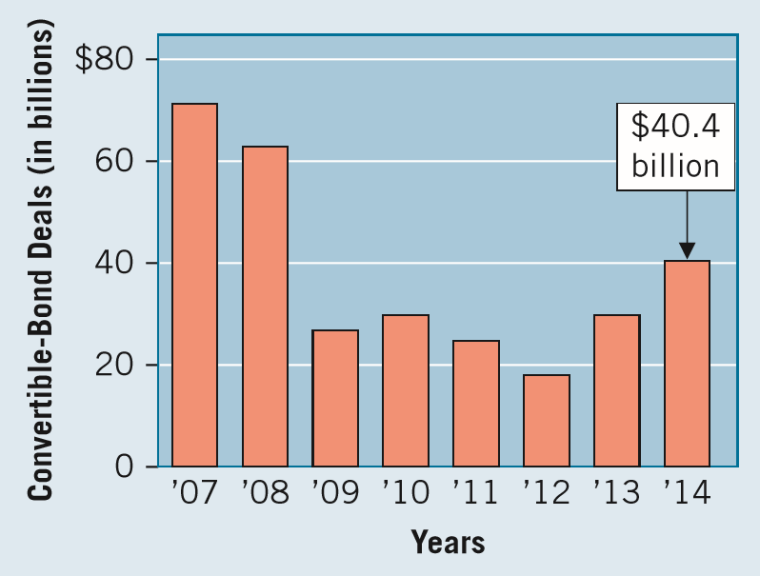
WHAT DO THE NUMBERS MEAN? HOW LOW CAN YOU GO?
WHAT’S YOUR PRINCIPLE
What do Tesla Motors Inc., Twitter Inc., AOL Inc., Red Hat Inc., and Priceline Group Inc. all have in common? They are part of the wave of U.S. companies who have raised capital in the convertible bond market. And quite a wave it is. As indicated in the chart below, U.S. companies recently issued over $40 billion of convertible bonds.
These bonds are popular with issuing companies and investors. As we have discussed, companies like them because they allow them to raise money at rates lower than those on ordinary bonds. Investors like them because, at a time of low interest rates, they can book extra proﬁt if the issuer’s stock price rises. However,
(continued)
LO 1

Slide 17
WHAT DO THE NUMBERS MEAN? HOW LOW CAN YOU GO?
WHAT’S YOUR PRINCIPLE
depending on the features of the bond and the stock value, some unusual results may be observed. Consider the convertible bonds issued by STMicroelectronics (STM). STM’s 10-year bonds have a zero coupon and are convertible into STM common stock at an exercise price of $33.43. When issued, the bonds sold at an effective yield of minus 0.05 percent. That’s right—a negative yield. How could this happen? When STM issued the bonds, investors thought the options to convert were so valuable that they were willing to take zero interest payments and invest an amount in excess of the maturity value of the bonds. In essence, the investors are paying interest to STM, and STM records interest revenue. Why would investors do this? If the stock price rises, as many thought it would for STM and many tech companies at this time, these bond investors could convert and get a big gain in the stock. Investors did get some additional protection in the deal: They can redeem the $1,000 bonds after three years and receive $975 (and after ﬁve and seven years, for lower amounts) if it looks like the bonds will never convert. In the end, STM has issued bonds with a signiﬁcant equity component. And because the entire bond issue is classiﬁed as debt, STM records negative interest expense.
Sources: STM Financial Reports. See also Floyd Norris, “Legal but Absurd: They Borrow a Billion and Report a Profit,” The New York Times (August 8, 2003), p. C1; and M. Cherney, “Convertible Bonds Take Off in Low-Yield Era,” Wall Street Journal (October 5, 2014).
LO 1

Slide 18
LEARNING OBJECTIVES
16
Dilutive Securities and Earnings per Share
After studying this chapter, you should be able to:
Describe the accounting for the issuance, conversion, and retirement of convertible securities.
Contrast the accounting for stock warrants and for stock warrants issued with other securities.
Describe the accounting and reporting for stock compensation plans.
Compute basic earnings per share.
Compute diluted earnings per share.
LO 2

Slide 19
STOCK WARRANTS
Warrants are certificates entitling the holder to acquire shares of stock at a certain price within a stated period.
Normally arises under three situations:
  To make the security more attractive.
  Existing stockholders have a preemptive right to purchase common stock first.
  To executives and employees as a form of compensation.
LO 2

Slide 20
STOCK WARRANTS
Stock Warrants Issued with Other Securities
Basically long-term options to buy common stock at a fixed price.
  Generally life of warrants is five years, occasionally ten years.
  Proceeds allocated between the two securities.
  Allocation based on fair market values.
  Two methods of allocation:
  (1) proportional method
  (2) incremental method
LO 2

Slide 21
STOCK WARRANTS
Proportional Method
Determine:
  value of the bonds without the warrants, and
  value of the warrants.
The proportional method allocates the proceeds using the proportion of the two amounts, based on fair values.
LO 2

Slide 22
Proportional Method
Illustration: Margolf Corp. issued 2,000, $1,000 bonds at 101. Each bond was issued with one detachable stock warrant. After issuance, the bonds were selling in the market at 98, and the warrants had a market value of $40. Use the proportional method to record the issuance of the bonds and warrants.
LO 2

Slide 23
Proportional Method
Cash 2,020,000
Discount on Bonds Payable 59,216
Bonds Payable 2,000,000
Paid-in Capital – Stock Warrants 79,216
LO 2

Slide 24
Proportional Method
Illustration: Assume each warrant can be exercised to buy one share of common stock ($5 par value) of Margolf Inc. for $30 per share. If investors exercise all 2,000 warrants (one warrant per one share of stock), Margolf Inc. makes the following entry.
Cash (2,000 x $30) 60,000
Paid-in Capital – Stock Warrants 79,216
Common Stock (2,000 x $5) 10,000
Paid-in Capital in Excess of Par—Common Stock 129,216
LO 2

Slide 25
STOCK WARRANTS
Incremental Method
Where a company cannot determine the fair value of either the warrants or the bonds.
  Use the security for which fair value can determined.
  Allocate the remainder of the purchase price to the security for which it does not know fair value.
LO 2

Slide 26
Incremental Method
Illustration: McCarthy Inc. issued 2,000, $1,000 bonds at 101. Each bond was issued with one detachable stock warrant. After issuance, the bonds were selling in the market at 98. Market price of the warrants, without the bonds, cannot be determined. Use the incremental method to record issuance of the bonds and warrants.
LO 2

Slide 27
Incremental Method
Cash 2,020,000
Discount on Bonds Payable 40,000
Bonds Payable 2,000,000
Paid-in Capital – Stock Warrants 60,000
LO 2

Slide 28
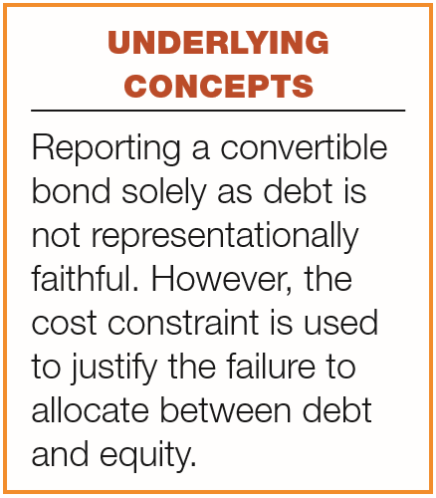
STOCK WARRANTS
Conceptual Questions
Detachable warrants involves two securities,
  a debt security,
  a warrant to purchase common stock.
Nondetachable warrants
  do not require an allocation of proceeds between the bonds and the warrants,
  companies record the entire proceeds as debt.
LO 2

Slide 29
STOCK WARRANTS
Rights to Subscribe to Additional Shares
Stock Right - existing stockholders have the right (preemptive privilege) to purchase newly issued shares in proportion to their holdings.
  Price is normally less than current price of the shares.
  Companies make only a memorandum entry.
LO 2

Slide 30
EVOLVING ISSUE IS THAT ALL DEBT?
WHAT’S YOUR PRINCIPLE
Many argue that the conversion feature of a convertible bond is not signiﬁcantly different in nature from the call represented by a warrant. The question is whether, although the legal forms differ, sufﬁcient similarities of substance exist to support the same accounting treatment. Some contend that inseparability per se is an insufﬁcient basis for restricting allocation between identiﬁable components of a transaction.
Examples of allocation between assets of value in a single transaction do exist, such as allocation of values in basket purchases and separation of principal and interest in capitalizing long-term leases. Critics of the current accounting for convertibles say that to deny recognition of value to the conversion feature merely looks to the form of the instrument and does not deal with the substance of the transaction. In an exposure draft on this subject (project now inactive), the FASB indicates that companies should separate the debt and equity components of securities such as convertible debt or bonds issued with nondetachable warrants (see footnotes 1 and 6).
We agree with this position. In both situations (convertible debt and debt issued with warrants, whether detachable or not), the investor has made a
(continued)
LO 2

Slide 31
EVOLVING ISSUE IS THAT ALL DEBT?
WHAT’S YOUR PRINCIPLE
payment to the company for an equity feature—the right to acquire an equity instrument in the future. The only real distinction between them is that the additional payment made when the equity instrument is formally acquired takes different forms. The warrant holder pays additional cash to the issuing company; the convertible debt holder pays for stock by forgoing the receipt of interest from conversion date until maturity date and by forgoing the receipt of the maturity value itself. Thus, the difference is one of method or form of payment only, rather than one of substance. However, until the profession ofﬁcially reverses its stand with respect to accounting for convertible debt, companies will continue to report convertible debt and bonds issued with nondetachable warrants solely as debt.
LO 2

Slide 32
LEARNING OBJECTIVES
16
Dilutive Securities and Earnings per Share
After studying this chapter, you should be able to:
Describe the accounting for the issuance, conversion, and retirement of convertible securities.
Contrast the accounting for stock warrants and for stock warrants issued with other securities.
Describe the accounting and reporting for stock compensation plans.
Compute basic earnings per share.
Compute diluted earnings per share.
LO 3

Slide 33
STOCK COMPENSATION PLANS
Stock Option - gives key employees option to purchase common stock at a given price over extended period of time.
Effective compensation programs are ones that:
  Base compensation on performance.
  Motivate employees.
  Help retain executives and recruit new talent.
  Maximize employee’s after-tax benefit.
  Use performance criteria over which employee has control.
LO 3

Slide 34
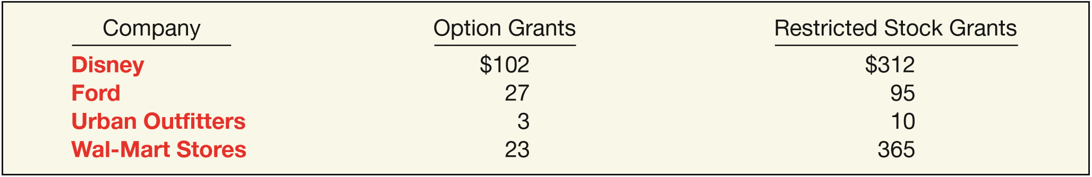
STOCK COMPENSATION PLANS
Illustration 16-3 indicates that option expense is a much smaller element of compensation relative to restricted stock at companies such as Ford and Wal-Mart Stores, Inc.
ILLUSTRATION 16-3
2014 Company Equity Grants ($ in millions)
Many companies decided to cut back on the issuance of options, both to avoid such accounting manipulations and to head off investor doubts. In addition, GAAP now results in companies recording a higher expense when stock options are granted.
LO 3

Slide 35
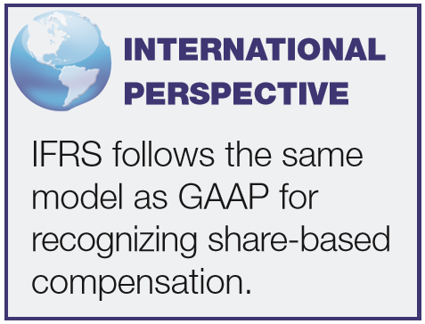
STOCK COMPENSATION PLANS
Measurement—Stock Compensation
GAAP requires companies to recognize compensation cost using the fair-value method.
Under the fair-value method, companies use acceptable option-pricing models to value the options at the date of grant.
LO 3

Slide 36
WHAT DO THE NUMBERS MEAN? WHAT’S THE DEBATE ABOUT?
WHAT’S YOUR PRINCIPLE
The FASB faced considerable opposition when it proposed the fair value method for accounting for stock options. This is not surprising, given that the fair value method results in greater compensation costs relative to the intrinsic-value model. Merrill Lynch estimated that if all S&P 500 companies were to expense options, reported proﬁts would fall by as much as 10 percent. Nevertheless, some companies, such as Coca-Cola, General Electric, Wachovia, and Bank One, decided to use the fair value method.
You might think investors would punish companies that decided to expense stock options. After all, most of corporate America has been battling for years to avoid having to expense them, worried that accounting for those perks would destroy earnings. Yet, for this small band of big-name companies that voluntarily made the switch to expensing, investors for the most part showered them with love. As shown in the following table, with a few exceptions, the stock prices of the “expensers,” from Cinergy to The Washington Post, outpaced the market after they announced the change.
(continued)
LO 3

Slide 37
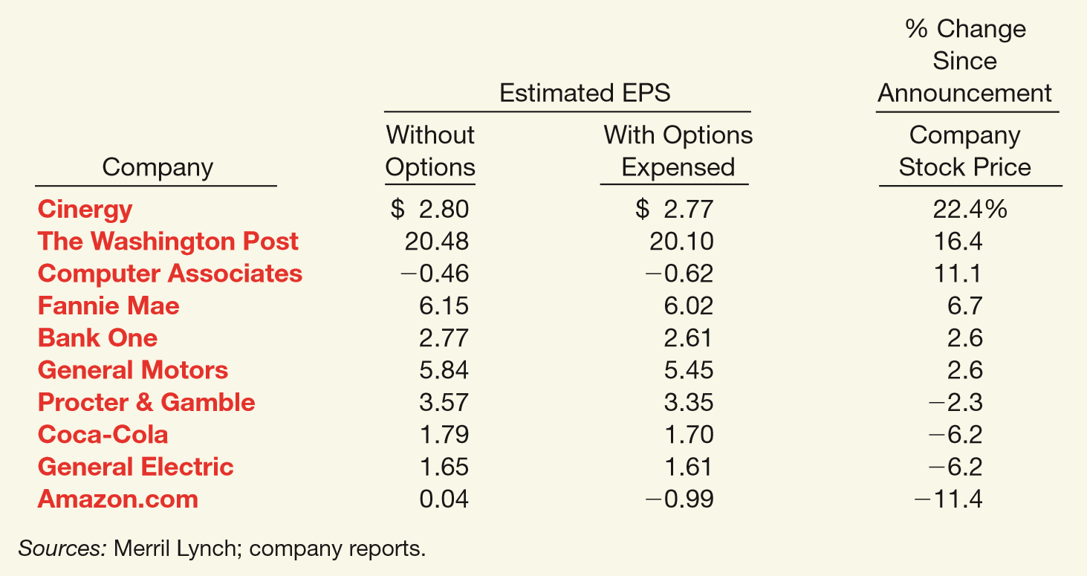
WHAT DO THE NUMBERS MEAN? WHAT’S THE DEBATE ABOUT?
WHAT’S YOUR PRINCIPLE
(continued)
LO 3

Slide 38
WHAT DO THE NUMBERS MEAN? WHAT’S THE DEBATE ABOUT?
WHAT’S YOUR PRINCIPLE
So what’s the fuss? As the CFO of Coca-Cola stated, “There is no doubt that stock options are compensation. If they weren’t, none of us would want them.” It is puzzling why some companies continued to ﬁght implementation of the expensing rule. Indeed, the market’s general positive reaction to the expensing of stock options provides a good case study supporting the value that investors place on transparent accounting and earnings.
Sources: David Stires, “A Little Honesty Goes a Long Way,” Fortune (September 2, 2002), p. 186; and Troy Wolverton, “Foes of Expensing Welcome FASB Delay,” TheStreet.com (October 15, 2004).
LO 3

Slide 39
STOCK COMPENSATION PLANS
Recognition—Stock Compensation
Two main accounting issues:
  How to determine compensation expense.
  Over what periods to allocate compensation expense.
LO 3

Slide 40
Recognition—Stock Compensation
Determining Expense
  Compensation expense based on the fair value of the options expected to vest on the date they grant the options to the employee(s) (i.e., the grant date).
Allocating Compensation Expense
  Recognizes compensation expense in the periods in which its employees perform the service—the service period.
LO 3

Slide 41
Recognition—Stock Compensation
Illustration: On November 1, 2016, the stockholders of Searle Company approve a plan that grants the company’s five executives options to purchase 2,000 shares each of the company’s $1 par value common stock. The company grants the options on January 1, 2017. The executives may exercise the options at any time within the next 10 years. The option price per share is $60, and the market price of the shares at the date of grant is $70 per share. Under the fair value method, the company computes total compensation expense by applying an acceptable fair value option-pricing model. The fair value option-pricing model determines Searle’s total compensation expense to be $220,000.
LO 3

Slide 42
Recognition—Stock Compensation
Basic Entries. Assume that the expected period of benefit is two years, starting with the grant date. Searle would record the transactions related to this option contract as follows.
Dec. 31, 2017
Compensation Expense 110,000
Paid-in Capital – Stock Options 110,000
*
Dec. 31, 2018
Compensation Expense 110,000
Paid-in Capital - Stock Options 110,000
*
($220,000 ÷ 2)
LO 3

Slide 43
Recognition—Stock Compensation
Exercise. If Searle’s executives exercise 2,000 of the 10,000 options (20 percent of the options) on June 1, 2020 (three years and five months after date of grant), the company records the following journal entry.
June 1, 2020
Cash (2,000 x $60) 120,000
Paid-in Capital - Stock Options 44,000
Common Stock (2,000 x $1) 2,000
Paid-in Capital in Excess of Par - Common 162,000
LO 3

Slide 44
Recognition—Stock Compensation
Expiration. If Searle’s executives fail to exercise the remaining stock options before their expiration date, the company records the following at the date of expiration.
Jan. 1, 2027
Paid-in Capital - Stock Options 176,000
Paid-in Capital – Expired Stock Options 176,000
*
*
($220,000 x 80%)
LO 3

Slide 45
Recognition—Stock Compensation
Adjustment. A company does not adjust compensation expense upon expiration of the options.
However, if an employee forfeits a stock option because the employee fails to satisfy a service requirement (e.g., leaves employment), the company should adjust the estimate of compensation expense recorded in the current period (as a change in estimate).
LO 3

Slide 46
STOCK COMPENSATION PLANS
Restricted Stock
Restricted-stock plans transfer shares of stock to employees, subject to an agreement that the shares cannot be sold, transferred, or pledged until vesting occurs.
Major Advantages:
  Never becomes completely worthless.
  Generally results in less dilution to existing stockholders.
  Better aligns employee incentives with company incentives.
LO 3

Slide 47
Restricted Stock Example
Illustration: On January 1, 2017, Skidmore Company issues 1,000 shares of restricted stock to its CEO, Rail Stalker. Skidmore’s stock has a fair value of $20 per share on January 1, 2017. Additional information is as follows.
  The service period related to the restricted stock is five years.
  Vesting occurs if Stalker stays with the company for a five-year period.
  The par value of the stock is $1 per share.
Skidmore makes the following entry on the grant date (January 1, 2017).
LO 3

Slide 48
Restricted Stock Example
Illustration: Skidmore makes the following entry on the grant date (January 1, 2017).
Unearned Compensation 20,000
Common Stock (1,000 x $1) 1,000
Paid-in Capital in Excess of Par (1,000 x $19) 19,000
Unearned Compensation represents the cost of services yet to be performed, which is not an asset. Unearned Compensation is reported as a component of stockholders’ equity in the balance sheet.
LO 3

Slide 49
Restricted Stock Example
Illustration: Record the journal entry at December 31, 2017, Skidmore records compensation expense.
Compensation Expense 4,000
Unearned Compensation 4,000
Skidmore records compensation expense of $4,000 for each of the next four years (2018, 2019, 2020, and 2021).
LO 3

Slide 50
Restricted Stock Example
Illustration: Assume that Stalker leaves on February 3, 2019 (before any expense has been recorded during 2019). The entry to record this forfeiture is as follows
Common Stock 1,000
Paid-in Capital in Excess of Par - Common 19,000
Compensation Expense ($4,000 x 2) 8,000
Unearned Compensation 12,000
LO 3

Slide 51
STOCK COMPENSATION PLANS
Employee Stock-Purchase Plans
Generally permit all employees to purchase stock at a discounted price for a short period of time.
Plans are considered compensatory unless they satisfy all three conditions presented below.
  Substantially all full-time employees may participate on an equitable basis.
  The discount from market is small.
  The plan offers no substantive option feature.
LO 3

Slide 52
STOCK COMPENSATION PLANS
Disclosure of Compensation Plans
Company with one or more share-based payment arrangements must disclose:
  Nature and extent of such arrangements.
  Effect on the income statement of compensation cost.
  Method of estimating the fair value of the goods or services received, or the fair value of the equity instruments granted (or offered to grant).
  Cash flow effects.
LO 3

Slide 53
LEARNING OBJECTIVES
16
Dilutive Securities and Earnings per Share
After studying this chapter, you should be able to:
Describe the accounting for the issuance, conversion, and retirement of convertible securities.
Contrast the accounting for stock warrants and for stock warrants issued with other securities.
Describe the accounting and reporting for stock compensation plans.
Compute basic earnings per share.
Compute diluted earnings per share.
LO 4

Slide 54

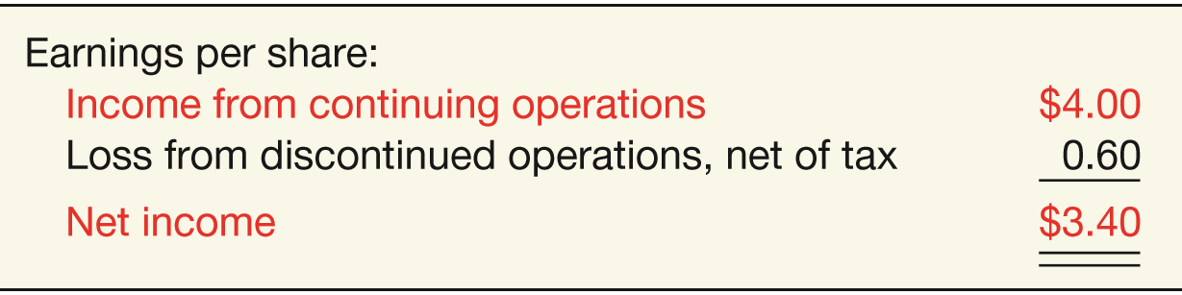
BASIC EARNINGS PER SHARE
Earnings per share indicates the income earned by each share of common stock.
  Companies report earnings per share only for common stock.
  When the income statement contains intermediate components, such as discontinued operations, companies should disclose earnings per share for each component.
ILLUSTRATION 16-7
Income Statement Presentation of EPS
ILLUSTRATION 16-8
Income Statement Presentation of EPS Components
LO 4

Slide 55
BASIC EARNINGS PER SHARE
Earnings per Share—Simple Capital Structure
Simple Structure--Common stock; no potentially dilutive securities.
Complex Structure--Includes securities that could dilute earnings per common share.
“Dilutive” means the ability to influence the EPS in a downward direction.
LO 4

Slide 56

BASIC EARNINGS PER SHARE
Preferred Stock Dividends
Subtracts the current-year preferred stock dividend from net income to arrive at income available to common stockholders.
ILLUSTRATION 16-9
Formula for Computing Earnings per Share
Preferred dividends are subtracted on cumulative preferred stock, whether declared or not.
LO 4

Slide 57
BASIC EARNINGS PER SHARE
Weighted-Average Number of Shares Outstanding
Companies must weight the shares by the fraction of the period they are outstanding.
When stock dividends or share splits occur, companies need to restate the shares outstanding before the share dividend or split.
LO 4

Slide 58
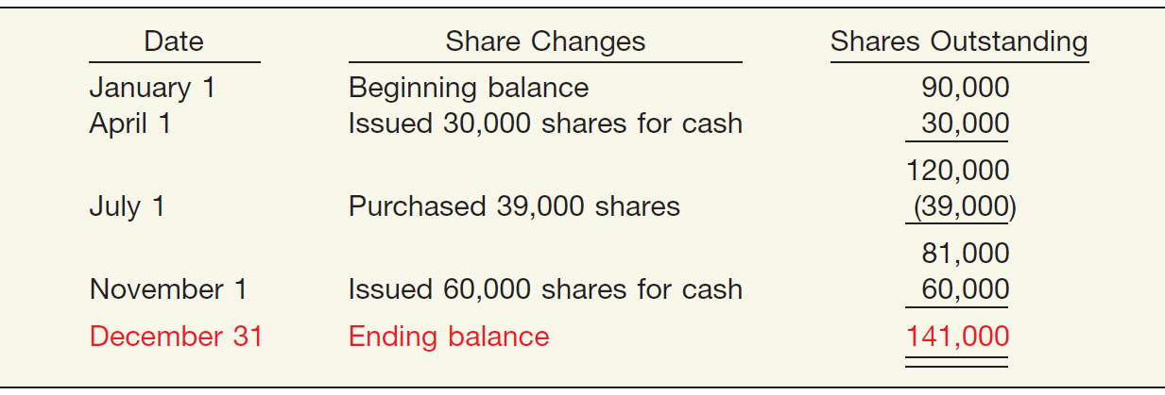
Weighted-Average Shares Outstanding
Illustration: Zachsmith Inc. has the following changes in its common stock during the period.
Compute the weighted-average number of shares outstanding for Zachsmith Inc.
ILLUSTRATION 16-10
Shares Outstanding, Ending Balance
LO 4

Slide 59
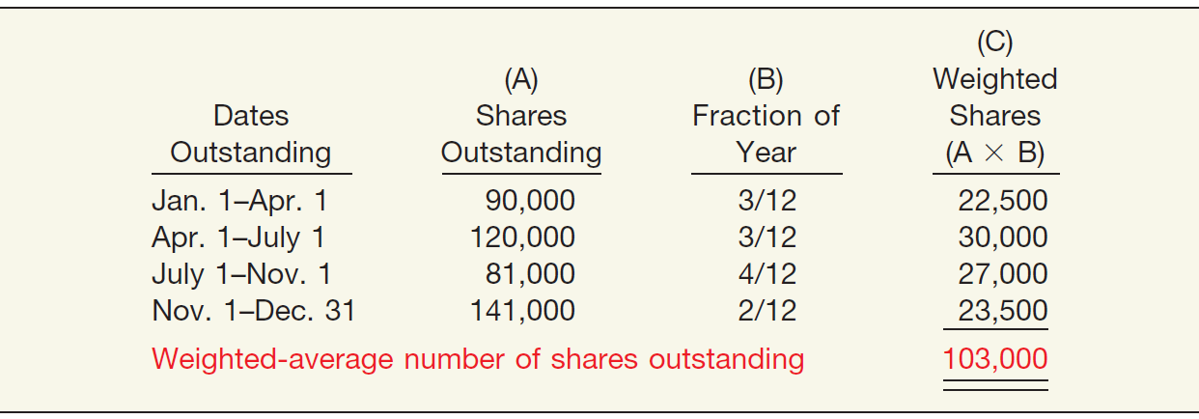
Weighted-Average Shares Outstanding
ILLUSTRATION 16-10
ILLUSTRATION 16-11
Weighted-Average Number of Shares Outstanding
LO 4

Slide 60
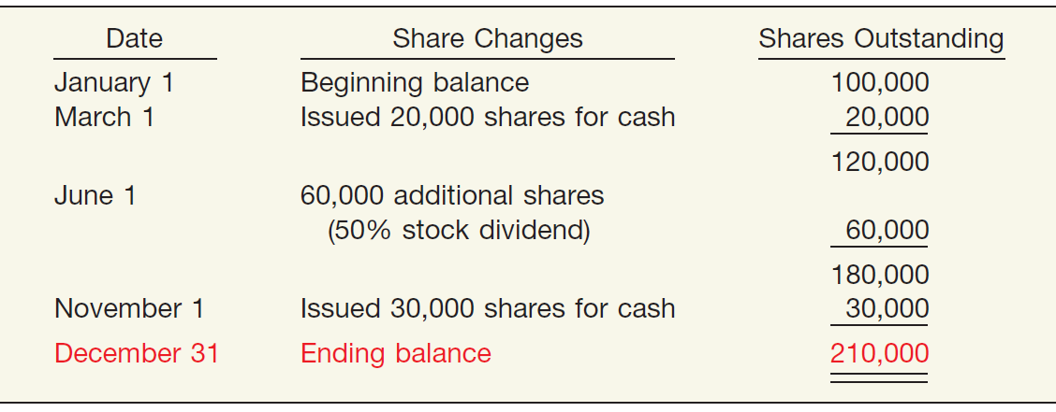
Weighted-Average Shares Outstanding
Illustration: Bergman Company has the following changes in its common stock during the period.
Compute the weighted-average number of shares outstanding for Bergman Company.
ILLUSTRATION 16-12
Shares Outstanding, Ending Balance— Bergman Company
LO 4

Slide 61
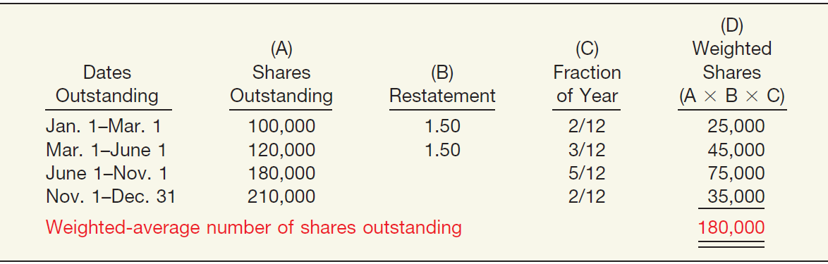
Weighted-Average Shares Outstanding
ILLUSTRATION 16-12
ILLUSTRATION 16-13
Weighted-Average Number of Shares Outstanding— Stock Issue and Stock Dividend
LO 4

Slide 62
LEARNING OBJECTIVES
16
Dilutive Securities and Earnings per Share
After studying this chapter, you should be able to:
Describe the accounting for the issuance, conversion, and retirement of convertible securities.
Contrast the accounting for stock warrants and for stock warrants issued with other securities.
Describe the accounting and reporting for stock compensation plans.
Compute basic earnings per share.
Compute diluted earnings per share.
LO 5

Slide 63
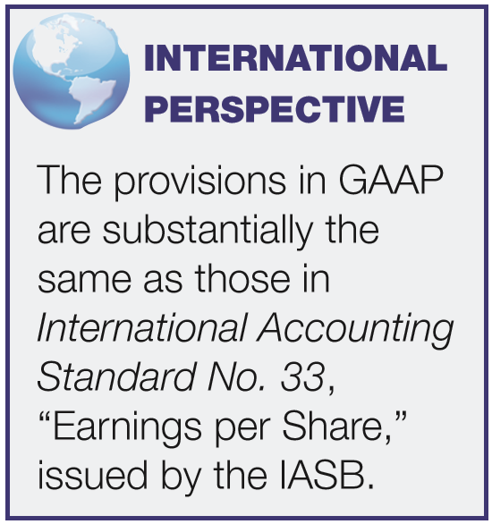
DILUTED EARNINGS PER SHARE
Complex Capital Structure exists when a business has
  convertible securities,
  options, warrants, or other rights
that upon conversion or exercise could dilute earnings per share.
Company generally reports both basic and diluted earnings per share.
LO 5

Slide 64
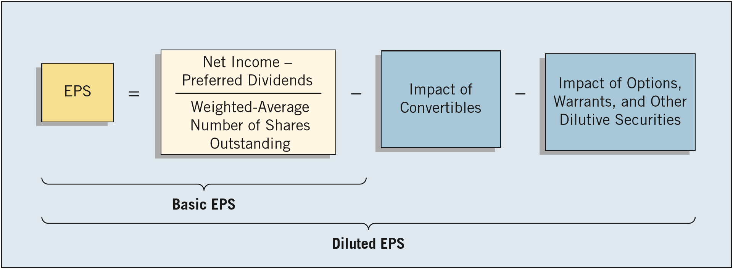
DILUTED EARNINGS PER SHARE
Diluted EPS includes the effect of all potential dilutive common shares that were outstanding during the period.
Companies will not report diluted EPS if the securities in their capital structure are antidilutive.
ILLUSTRATION 16-18
Relationship between Basic and Diluted EPS
LO 5

Slide 65
DILUTED EARNINGS PER SHARE
Diluted EPS — Convertible Securities
Measure the dilutive effects of potential conversion on EPS using the if-converted method.
This method for a convertible bond assumes:
the conversion at the beginning of the period (or at the time of issuance of the security, if issued during the period), and
the elimination of related interest, net of tax.
LO 5

Slide 66
Example — If-Converted Method
Illustration: Mayfield Corporation has net income of $210,000 for the year and a weighted-average number of common shares outstanding during the period of 100,000 shares. The company has two convertible debenture bond issues outstanding. One is a 6 percent issue sold at 100 (total $1,000,000) in a prior year and convertible into 20,000 common shares. Interest expense on the 6 percent convertibles is $60,000. The other is a 10 percent issue sold at 100 (total $1,000,000) on April 1 of the current year and convertible into 32,000 common shares. Interest expense on the 10 percent convertible bond is $75,000. The tax rate is 40 percent.
LO 5

Slide 67
Example — If-Converted Method
Calculate basic earnings per share.
Net income = $210,000
=
$2.10
Weighted-average shares = 100,000
LO 5

Slide 68
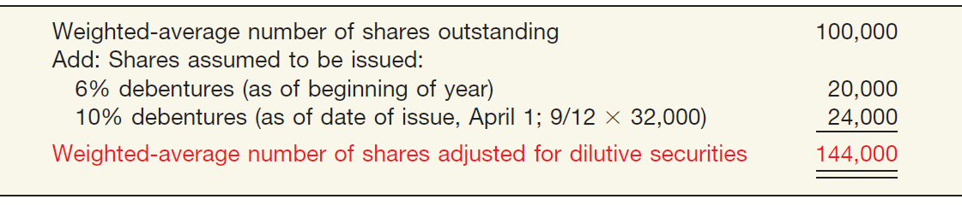
Example — If-Converted Method
Mayfield calculates the weighted-average number of shares outstanding, as follows.
ILLUSTRATION 16-20
Computation of Weighted-Average Number of Shares
Calculate diluted earnings per share.
LO 5

Slide 69
Example — If-Converted Method
When calculating Diluted EPS, begin with basic EPS.
Basic EPS
6% Debentures
10% Debentures
+
$210,000
$60,000 x (1 - .40)
+
$100,000 x (1 - .40) x 9/12
=
+
100,000
20,000
+
24,000
Basic EPS = $2.10
Effect on EPS = $1.80
Effect on EPS = $1.875
Diluted EPS = $2.02
LO 5

Slide 70
Example — If-Converted Method
Other Factors
The conversion rate on a dilutive security may change during the period in which the security is outstanding. In this situation, the company uses the most dilutive conversion rate available.
For Convertible Preferred Stock the company does not subtract preferred dividends from net income in computing the numerator. Why not?
Because for purposes of computing EPS, it assumes conversion of the convertible preferreds to outstanding common shares.
LO 5

Slide 71
Example — If-Converted Method
Illustration: In 2016, Chirac Enterprises issued, at par, 60, $1,000, 8% bonds, each convertible into 100 shares of common stock. Chirac had revenues of $17,500 and expenses other than interest and taxes of $8,400 for 2017. (Assume that the tax rate is 40%.) Throughout 2017, 2,000 shares of common stock were outstanding; none of the bonds was converted or redeemed.
Instructions
  (a) Compute diluted earnings per share for 2017.
  (b) Assume same facts as those for Part (a), except the 60 bonds were issued on September 1, 2017 (rather than in 2016), and none have been converted or redeemed.
LO 5

Slide 72
Example — If-Converted Method
(a) Compute diluted earnings per share for 2017.
Calculation of Net Income
Revenues $17,500
Expenses 8,400
Bond interest expense (60 x $1,000 x 8%) 4,800
Income before taxes 4,300
Income tax expense (40%) 1,740
Net income $ 2,580
LO 5

Slide 73
Example — If-Converted Method
(a) Compute diluted earnings per share for 2017.
When calculating Diluted EPS, begin with basic EPS.
Basic EPS
Net income = $2,580
=
$1.29
Weighted average shares = 2,000
LO 5

Slide 74
Example — If-Converted Method
(a) Compute diluted earnings per share for 2017.
When calculating Diluted EPS, begin with basic EPS.
Diluted EPS
+
$2,580
$4,800 (1 - .40)
$5,460
=
=
$.68
+
2,000
6,000
8,000
Basic EPS = $1.29
Effect on EPS = $.48
LO 5

Slide 75
Example — If-Converted Method
(b) Assume bonds were issued on Sept. 1, 2017 .
Calculation of Net Income
LO 5

Slide 76
Example — If-Converted Method
(b) Assume bonds were issued on Sept. 1, 2017 .
When calculating Diluted EPS, begin with basic EPS.
Diluted EPS
$4,500
+
$1,600 (1 - .40)
$5,460
=
=
$1.37
2,000
+
6,000 x 4/12 yr.
4,000
Basic EPS = $2.25
Effect on EPS = $.48
LO 5

Slide 77
Example — If-Converted Method
Illustration: Prior to 2017, Barkley Company issued 40,000 shares of 6% convertible, cumulative preferred stock, $100 par value. Each share is convertible into 5 shares of common stock. Net income for 2017 was $1,200,000. There were 600,000 common shares outstanding during 2017. There were no changes during 2017 in the number of common or preferred shares outstanding.
Instructions
  (a) Compute diluted earnings per share for 2017.
LO 5

Slide 78
Example — If-Converted Method
(a) Compute diluted earnings per share for 2017.
When calculating Diluted EPS, begin with basic EPS.
Basic EPS
Net income $1,200,000 – Pfd. Div. $240,000 *
=
$1.60
Weighted average shares = 600,000
* 40,000 shares x $100 par x 6% = $240,000 dividend
LO 5

Slide 79
Example — If-Converted Method
(a) Compute diluted earnings per share for 2017.
When calculating Diluted EPS, begin with basic EPS.
Diluted EPS
+
$1,200,000 – $240,000
$240,000
$1,200,000
=
=
600,000
+
200,000*
800,000
$1.50
Effect on EPS = $1.20
Basic EPS = $1.60
*(40,000 x 5)
LO 5

Slide 80
Example — If-Converted Method
(a) Compute diluted earnings per share for 2017 assuming each share of preferred is convertible into 3 shares of common stock.
Diluted EPS
+
$1,200,000 – $240,000
$240,000
$1,200,000
=
=
600,000
+
120,000*
720,000
$1.67
Effect on EPS = $2.00
Basic EPS = $1.60
*(40,000 x 3)
LO 5

Slide 81
Example — If-Converted Method
(a) Compute diluted earnings per share for 2017 assuming each share of preferred is convertible into 3 shares of common stock.
Diluted EPS
Basic = Diluted EPS
+
$1,200,000 – $240,000
$240,000
$1,200,000
=
=
600,000
+
120,000*
720,000
Antidilutive
$1.67
Effect on EPS = $2.00
Basic EPS = $1.60
*(40,000 x 3)
LO 5

Slide 82
DILUTED EARNINGS PER SHARE
Diluted EPS – Options and Warrants
Measure the dilutive effects of potential conversion using the treasury-stock method.
This method assumes:
the exercise the options or warrants at the beginning of the year (or date of issue if later), and
that the company uses those proceeds to purchase common stock for the treasury.
LO 5

Slide 83
Example — Treasury-Stock Method
Illustration: Zambrano Company’s net income for 2017 is $40,000. The only potentially dilutive securities outstanding were 1,000 options issued during 2016, each exercisable for one share at $8. None has been exercised, and 10,000 shares of common were outstanding during 2017. The average market price of the stock during 2017 was $20.
Instructions
  (a) Compute diluted earnings per share.
  (b) Assume the 1,000 options were issued on October 1, 2017 (rather than in 2016). The average market price during the last 3 months of 2017 was $20.
LO 5

Slide 84
Example — Treasury-Stock Method
(a) Compute diluted earnings per share for 2017.
Treasury-Stock Method
Proceeds if shares issued (1,000 x $8) $8,000
Purchase price for treasury shares $20
Shares assumed purchased 400
Shares assumed issued 1,000
Incremental share increase 600
÷
LO 5

Slide 85
Example — Treasury-Stock Method
(a) Compute diluted earnings per share for 2017.
When calculating Diluted EPS, begin with basic EPS.
Diluted EPS
$40,000
+
$40,000
=
=
$3.77
10,000
+
600
10,600
Basic EPS = $4.00
Options
LO 5

Slide 86
Example — Treasury-Stock Method
(b) Compute diluted earnings per share assuming the 1,000 options were issued on October 1, 2017.
Treasury-Stock Method
÷
x
LO 5

Slide 87
Example — Treasury-Stock Method
(b) Compute diluted earnings per share assuming the 1,000 options were issued on October 1, 2017.
Diluted EPS
$40,000
$40,000
=
=
$3.94
10,000
+
150
10,150
Basic EPS = $4.00
Options
LO 5

Slide 88
DILUTED EARNINGS PER SHARE
Contingent Issue Agreement
Contingent shares are issued as a result of the
passage of time condition or
upon attainment of a certain earnings or market price level.
Antidilution Revisited
Ignore antidilutive securities in all calculations and in computing diluted earnings per share.
LO 5

Slide 89
DILUTED EARNINGS PER SHARE
EPS Presentation and Disclosure
A company should show per share amounts for:
  Income from continuing operations,
  Income before extraordinary items, and
  Net income.
Per share amounts for a discontinued operation or an extraordinary item should be presented on the face of the income statement or in the notes.
LO 5

Slide 90
EPS Presentation and Disclosure
Complex capital structures and dual presentation of EPS require the following additional disclosures in note form.
  Description of pertinent rights and privileges of the various securities outstanding.
  A reconciliation of the numerators and denominators of the basic and diluted per share computations, including individual income and share amount effects of all securities that affect EPS.
  The effect given preferred dividends in determining income available to common stockholders in computing basic EPS.
  Securities that could potentially dilute basic EPS in the future that were excluded in the computation because they would be antidilutive.
  Effect of conversions subsequent to year-end, but before issuing statements.
LO 5

Slide 91
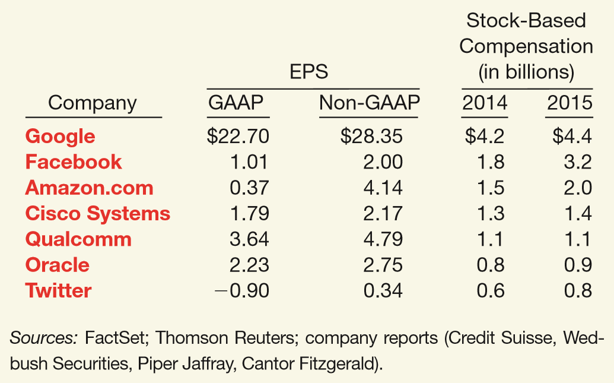
WHAT DO THE NUMBERS MEAN? PRO FORMA EPS CONFUSION
WHAT’S YOUR PRINCIPLE
Many companies are reporting pro forma EPS numbers along with GAAP-based EPS numbers in the ﬁnancial information provided to investors. Pro forma earnings generally exceed GAAP earnings because the pro forma numbers exclude such items as restructuring charges, impairments of assets, R&D expenditures, and stock compensation expense. In some industries such as high-tech, the major item excluded is stock compensation expense.
Google is a classic example. As indicated by one analyst, Google paid out huge, share-laden compensation packages totaling more than $300 million recently to three key executives. Only a small amount of this compensation will be reported in the non-GAAP income measures.
(continued)
LO 5

Slide 92
WHAT DO THE NUMBERS MEAN? PRO FORMA EPS CONFUSION
WHAT’S YOUR PRINCIPLE
Another case of possibly misleading pro forma reporting is social gaming company Zynga. It recently reported so much stock-compensation expense ($600 million) that it overwhelmed its operating proﬁt; these expenses took operating proﬁt negative to the tune of $406 million. The accounting? Zynga “window dressed” the expense by encouraging Wall Street analysts to use a non-GAAP pro forma accounting ﬁgure—“adjusted earnings before interest, taxes, depreciation and amortization”—that ignores the stock compensation. LinkedIn and Groupon also use non-GAAP metrics that exclude stock compensation. LinkedIn’s $30 million stock compensation expense roughly halved its operating proﬁt, while Groupon’s $94 million took operating proﬁt $203 million into the red. Wall Street analysts tend to go along with the accounting hocus-pocus, as it allows them to justify higher valuations for stocks. Investors should remember, however, that employee equity awards are real costs. As discussed in Chapter 4, SEC Regulation G requires companies to provide a clear reconciliation between pro forma and GAAP information. And this applies to EPS measures as well. This reconciliation is especially important, given the spike in pro forma reporting by companies adding back employee stock-option expense.
Sources: M. Moran, A. J. Cohen, and K. Shaustyuk, “Stock Option Expensing: The Battle Has Been Won; Now Comes the Aftermath,” Portfolio Strategy/Accounting, Goldman Sachs (March 17, 2005); R. Winkler, “Stock and Awe at Facebook and Zynga,” Wall Street Journal (February 16, 2012); and A. Bary, “How Much Do Silicon Valley Firms Really Earn?” Barrons (June 27, 2015).
LO 5

Slide 93
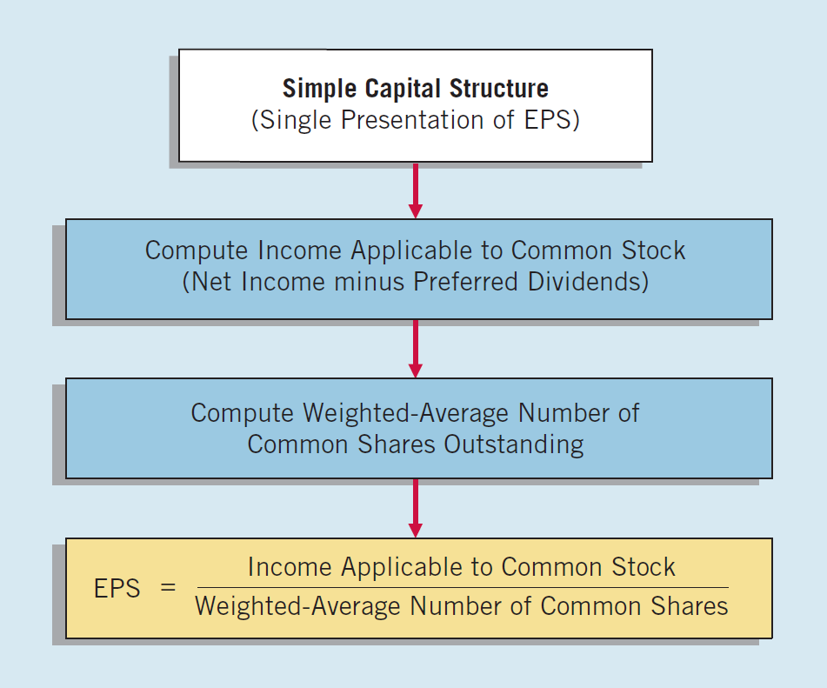
Summary of EPS Computation
ILLUSTRATION 16-28
Calculating EPS, Simple Capital Structure
LO 5

Slide 94
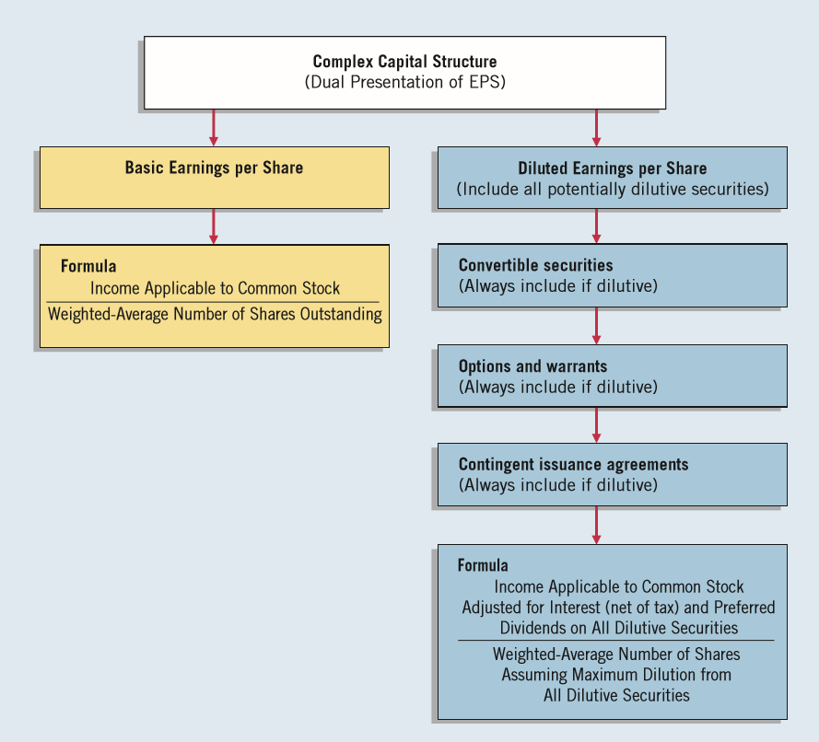
Earnings per Share
ILLUSTRATION 16-29
Calculating EPS, Complex Capital Structure
LO 5

Slide 95
APPENDIX 16A
ACCOUNTING FOR STOCK-APPRECIATION RIGHTS
Stock-Appreciation Rights (SARs):
  Company gives an executive the right to receive compensation equal to the share appreciation.
  Share appreciation is the excess of the market price of the stock at the date of exercise over a pre-established price.
  Company may pay the share appreciation in cash, shares, or a combination of both.
  Accounting for stock-appreciation rights depends on whether the company classifies the rights as equity or as a liability.
LO 6 Explain the accounting for stock-appreciation rights plans.

Slide 96
APPENDIX 16A
ACCOUNTING FOR STOCK-APPRECIATION RIGHTS
SARS — SHARE-BASED EQUITY AWARDS
Companies classify SARs as equity awards if at the date of exercise, the holder receives shares of stock from the company upon exercise.
  Holder receives shares in an amount equal to the share-price appreciation (the difference between the market price and the pre-established price).
  At the date of grant, the company determines a fair value for the SAR and then allocates this amount to compensation expense over the service period of the employees.
LO 6

Slide 97
APPENDIX 16A
ACCOUNTING FOR STOCK-APPRECIATION RIGHTS
SARS — SHARE-BASED LIABILITY AWARDS
Companies classify SARs as liability awards if at the date of exercise, the holder receives a cash payment. To record share-based liability:
  Measure the fair value of the award at the grant date and accrue compensation over the service period.
  Remeasure the fair value each reporting period, until the award is settled; adjust the compensation cost each period for changes in fair value prorated for the portion of the service period completed.
  Once the service period is completed, determine compensation expense each subsequent period by reporting the full change in market price as an adjustment to compensation expense.
LO 6

Slide 98
APPENDIX 16A
ACCOUNTING FOR STOCK-APPRECIATION RIGHTS
Illustration: American Hotels, Inc. establishes a stock-appreciation rights plan on January 1, 2017. The plan entitles executives to receive cash at the date of exercise for the difference between the market price of the stock and the pre-established price of $10 on 10,000 SARs. The fair value of the SARs on December 31, 2017, is $3, and the service period runs for two years (2017–2018).
Illustration 16A-1 indicates the amount of compensation expense to be recorded each period.
LO 6

Slide 99
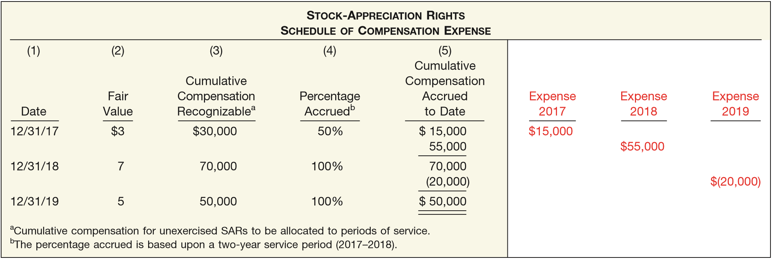
APPENDIX 16A
ACCOUNTING FOR STOCK-APPRECIATION RIGHTS
ILLUSTRATION 16A-1
Compensation Expense, Stock-Appreciation Rights
American Hotels records compensation expense in the first year as follows.
Compensation Expense 15,000
Liability under Stock-Appreciation Plan 15,000
LO 6

Slide 100
APPENDIX 16A
ACCOUNTING FOR STOCK-APPRECIATION RIGHTS
In 2019, when it records negative compensation expense, American would debit the account for $20,000. The entry to record the negative compensation expense is as follows.
Liability under Stock-Appreciation Plan 20,000
Compensation Expense 20,000
At December 31, 2019, the executives receive $50,000. American would remove the liability with the following entry.
Liability under Stock-Appreciation Plan 50,000
Cash 50,000
LO 6

Slide 101
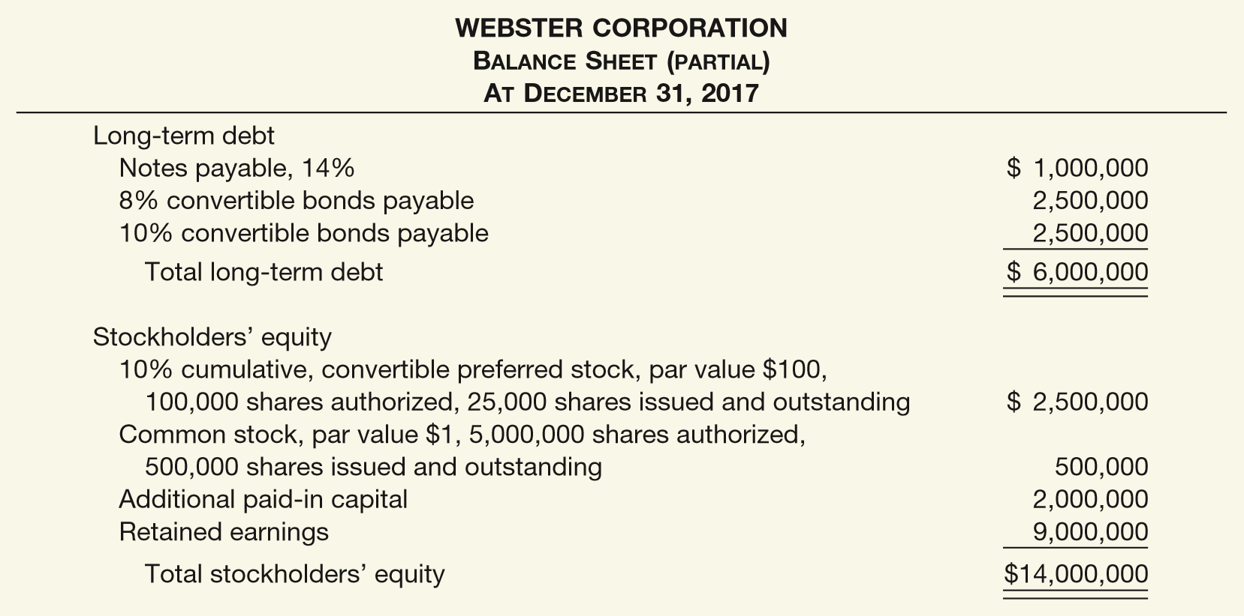
APPENDIX 16B
COMPREHENSIVE EARNINGS PER SHARE EXAMPLE
ILLUSTRATION 16B-1
Balance Sheet for Comprehensive Illustration
LO 7 Compute earnings per share in a complex situation.

Slide 102
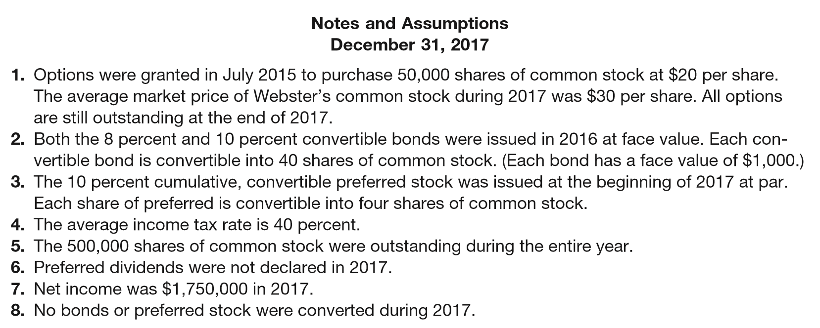
APPENDIX 16B
COMPREHENSIVE EARNINGS PER SHARE EXAMPLE
Illustration 16-B1
ILLUSTRATION 16B-1
Balance Sheet for Comprehensive Illustration
LO 7

Slide 103
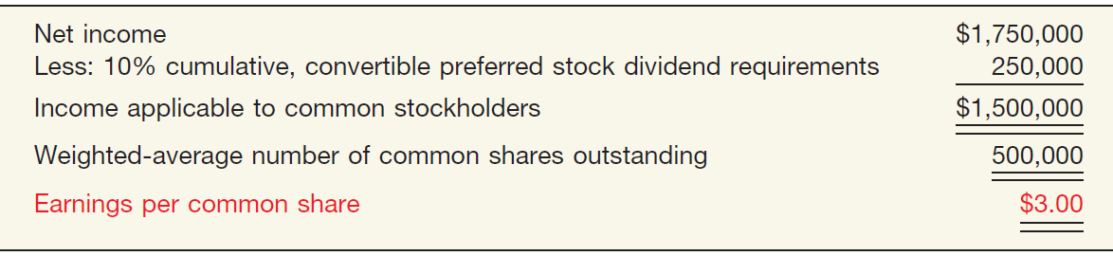
APPENDIX 16B
COMPREHENSIVE EARNINGS PER SHARE EXAMPLE
Computation of Earnings per Share—Simple Capital Structure
ILLUSTRATION 16B-2
Computation of Earnings per Share—Simple Capital Structure
LO 7

Slide 104
APPENDIX 16B
COMPREHENSIVE EARNINGS PER SHARE EXAMPLE
DILUTED EARNINGS PER SHARE
Steps for computing diluted earnings per share:
  Determine, for each dilutive security, the per share effect assuming exercise/conversion.
  Rank the results from step 1 from smallest to largest earnings effect per share.
  Beginning with the earnings per share based upon the weighted-average of common stock outstanding, recalculate earnings per share by adding the smallest per share effects from step 2. Continue this process so long as each recalculated earnings per share is smaller than the previous amount.
LO 7

Slide 105
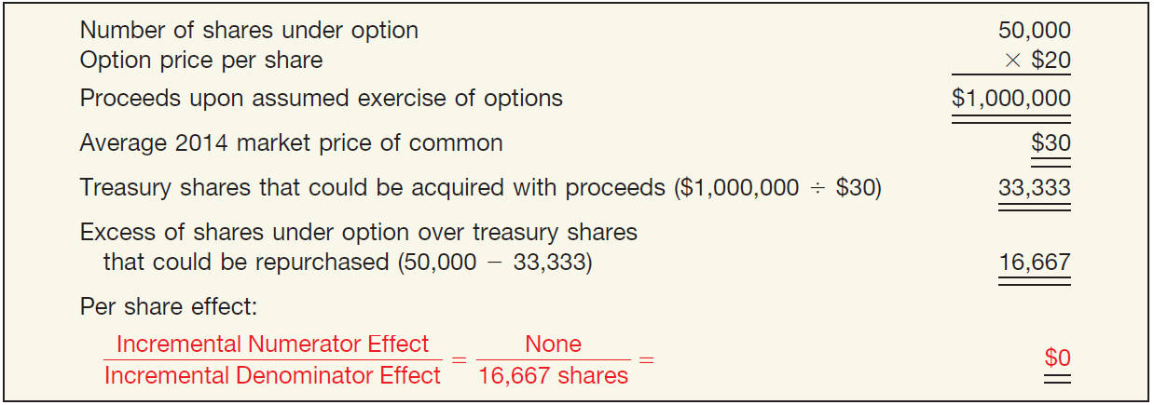
APPENDIX 16B
COMPREHENSIVE EARNINGS PER SHARE EXAMPLE
The first step is to determine a per share effect for each potentially dilutive security.
Per Share Effect of Options (Treasury-Share Method), Diluted Earnings per Share
ILLUSTRATION 16B-3
LO 7

Slide 106
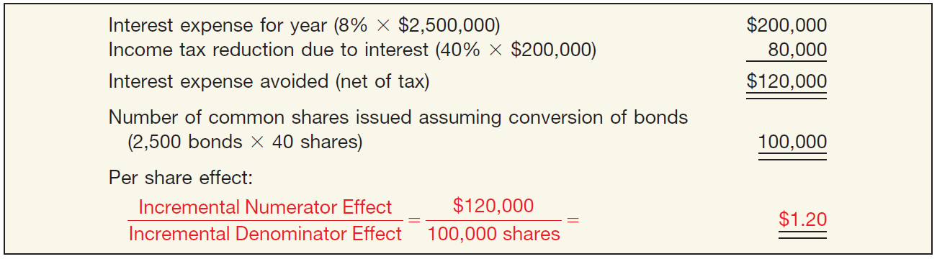
APPENDIX 16B
COMPREHENSIVE EARNINGS PER SHARE EXAMPLE
The first step is to determine a per share effect for each potentially dilutive security.
Per Share Effect of 8% Bonds (If-Converted Method), Diluted Earnings per Share
ILLUSTRATION 16B-4
LO 7

Slide 107
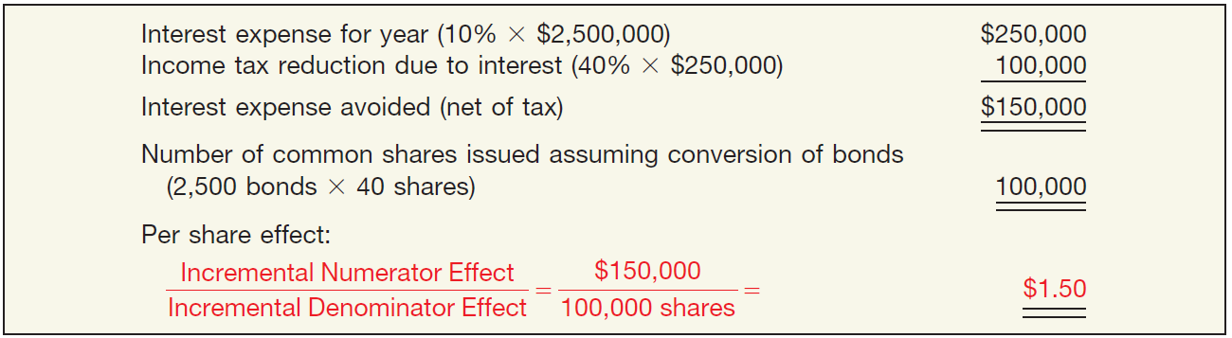
APPENDIX 16B
COMPREHENSIVE EARNINGS PER SHARE EXAMPLE
The first step is to determine a per share effect for each potentially dilutive security.
Per Share Effect of 10% Bonds (If-Converted Method), Diluted Earnings per Share
ILLUSTRATION 16B-5
LO 7

Slide 108
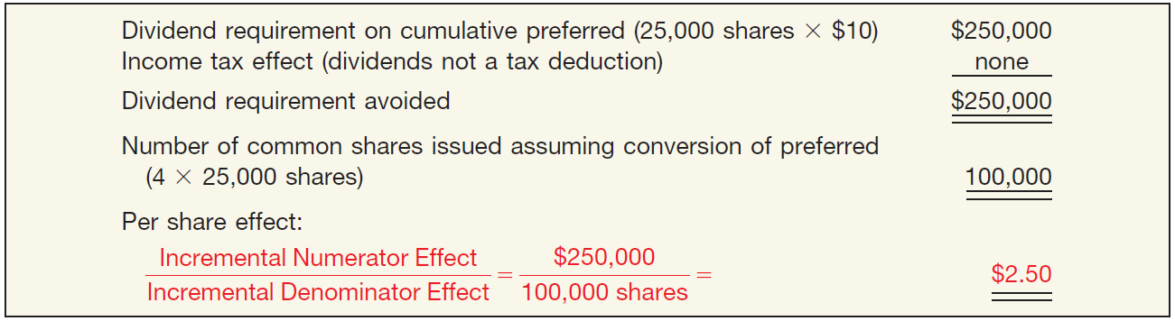
APPENDIX 16B
COMPREHENSIVE EARNINGS PER SHARE EXAMPLE
The first step is to determine a per share effect for each potentially dilutive security.
Per Share Effect of 10% Convertible preferred stocks (If-Converted Method), Diluted Earnings per Share
ILLUSTRATION 16B-6
LO 7

Slide 109
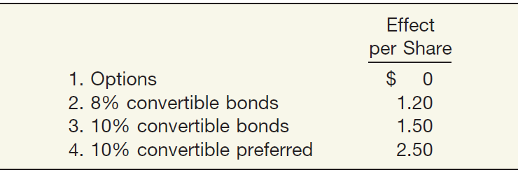
APPENDIX 16B
COMPREHENSIVE EARNINGS PER SHARE EXAMPLE
The first step is to determine a per share effect for each potentially dilutive security.
Ranking of per Share Effects (Smallest to Largest), Diluted Earnings per Share
ILLUSTRATION 16B-7
LO 7

Slide 110
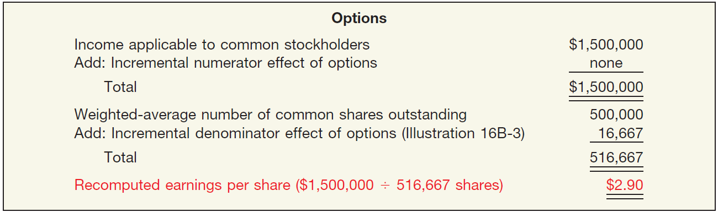
APPENDIX 16B
COMPREHENSIVE EARNINGS PER SHARE EXAMPLE
The next step is to determine earnings per share giving effect to the ranking.
Recomputation of EPS Using Incremental Effect of Options
The effect of the options is dilutive.
ILLUSTRATION 16B-8
LO 7

Slide 111
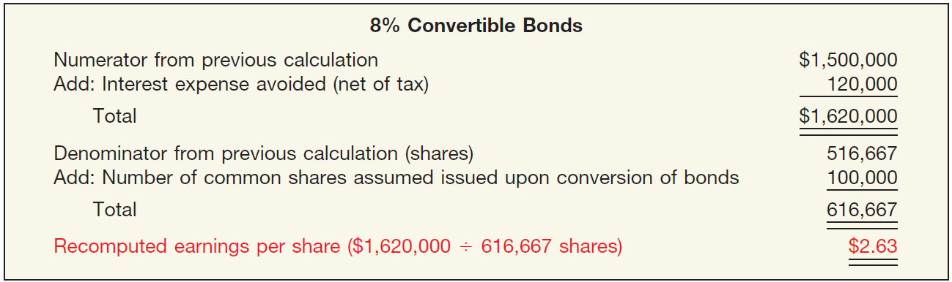
APPENDIX 16B
COMPREHENSIVE EARNINGS PER SHARE EXAMPLE
The next step is to determine earnings per share giving effect to the ranking.
Recomputation of EPS Using Incremental Effect of 8% Convertible Bonds
ILLUSTRATION 16-B9
The effect of the 8% convertible bonds is dilutive.
LO 7

Slide 112

APPENDIX 16B
COMPREHENSIVE EARNINGS PER SHARE EXAMPLE
The next step is to determine earnings per share giving effect to the ranking.
Recomputation of EPS Using Incremental Effect of 10% Convertible Bonds
ILLUSTRATION 16-B10
The effect of the 10% convertible bonds is dilutive.
LO 7

Slide 113
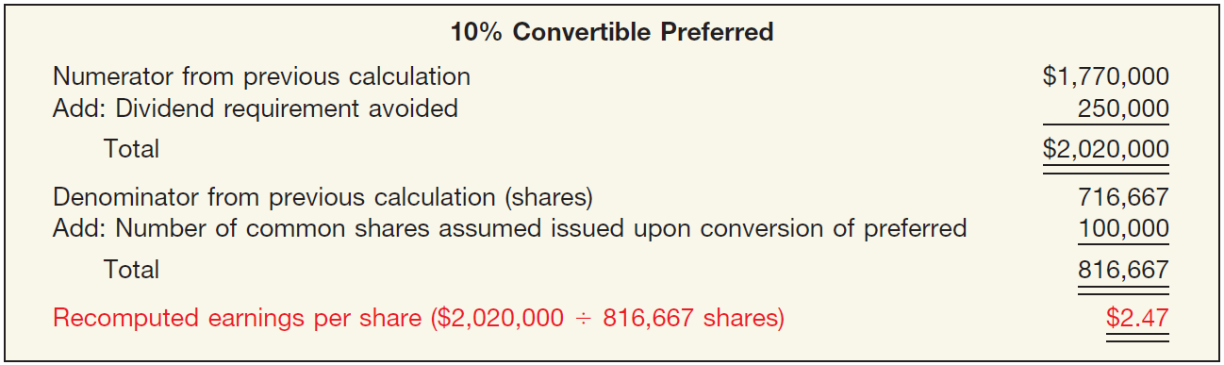
APPENDIX 16B
COMPREHENSIVE EARNINGS PER SHARE EXAMPLE
The next step is to determine earnings per share giving effect to the ranking
Recomputation of EPS Using Incremental Effect of 10% Convertible preferred
ILLUSTRATION 16-B11
The effect of the 10% convertible preferred stocks is NOT dilutive.
LO 7

Slide 114
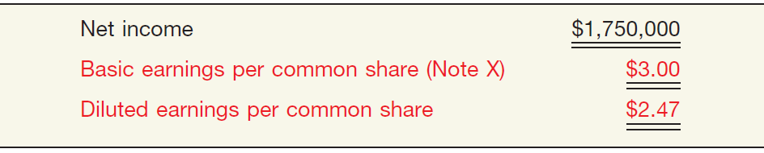
APPENDIX 16B
COMPREHENSIVE EARNINGS PER SHARE EXAMPLE
Finally, Webster Corporation’s disclosure of earnings per
share on its income statement.
ILLUSTRATION 16-B12
LO 7

Slide 115
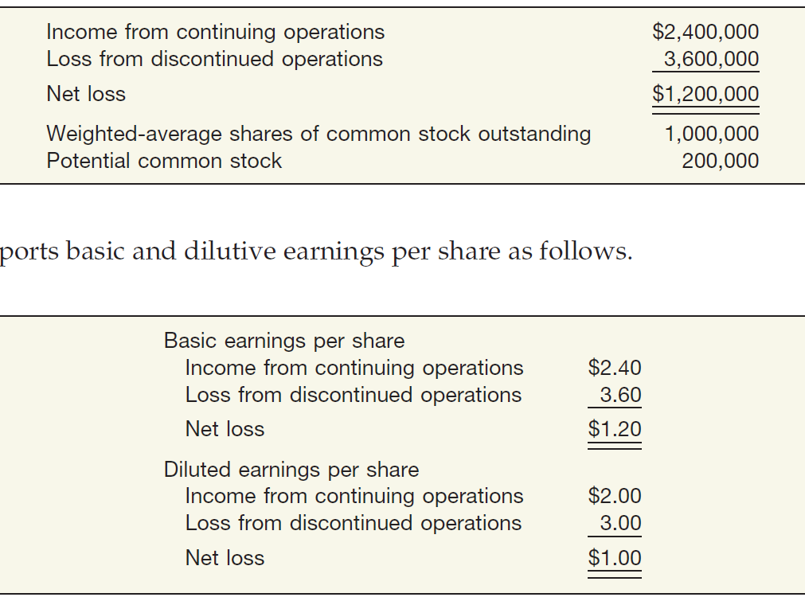
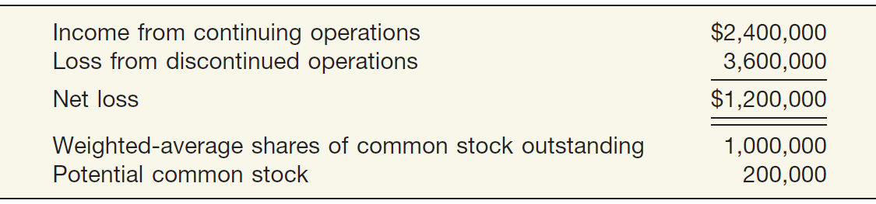
APPENDIX 16B
COMPREHENSIVE EARNINGS PER SHARE EXAMPLE
Assume that Barton Company provides the following information.
ILLUSTRATION 16-B13
ILLUSTRATION 16-B14
Basic and Diluted EPS
LO 7

Slide 116

RELEVANT FACTS - Similarities
  IFRS and GAAP follow the same model for recognizing stock-based compensation: The fair value of shares and options awarded to employees is recognized over the period to which the employees’ services relate.
  Although the calculation of basic and diluted earnings per share is similar between IFRS and GAAP, the Boards are working to resolve the few minor differences in EPS reporting. One proposal in the FASB project concerns contracts that can be settled in either cash or shares. IFRS requires that share settlement must be used, while GAAP gives companies a choice. The FASB project proposes adopting the IFRS approach, thus converging GAAP and IFRS in this regard.
LO 8 Compare the accounting for dilutive securities and earnings per share under GAAP and IFRS.

Slide 117
RELEVANT FACTS - Differences
  A significant difference between IFRS and GAAP is the accounting for securities with characteristics of debt and equity, such as convertible debt. Under GAAP, all of the proceeds of convertible debt are recorded as long-term debt. Under IFRS, convertible bonds are “bifurcated”—separated into the equity component (the value of the conversion option) of the bond issue and the debt component.
  Related to employee share-purchase plans, under IFRS, all employee share-purchase plans are deemed to be compensatory; that is, compensation expense is recorded for the amount of the discount. Under GAAP, these plans are often considered noncompensatory and therefore no compensation is recorded. Certain conditions must exist before a plan can be considered noncompensatory—the most important being that the discount generally cannot exceed 5 percent.
LO 8

Slide 118
RELEVANT FACTS - Differences
  Modification of a share option results in the recognition of any incremental fair value under both IFRS and GAAP. However, if the modification leads to a reduction, IFRS does not permit the reduction but GAAP does.
  Other EPS differences relate to (1) the treasury-stock method and how the proceeds from extinguishment of a liability should be accounted for, and (2) how to compute the weighted average of contingently issuable shares.
LO 8

Slide 119
ON THE HORIZON
The FASB has been working on a standard that will likely converge to IFRS in the accounting for convertible debt. Similar to the FASB, the IASB is examining the classification of hybrid securities; the IASB is seeking comment on a discussion document similar to the FASB Preliminary Views document, “Financial Instruments with Characteristics of Equity.” It is hoped that the Boards will develop a converged standard in this area. While GAAP and IFRS are similar as to the presentation of EPS, the Boards have been working together to resolve remaining differences related to earnings per share computations.
LO 8

Slide 120
IFRS SELF-TEST QUESTION
All of the following are key similarities between GAAP and IFRS with respect to accounting for dilutive securities and EPS except:
  the model for recognizing stock-based compensation.
  the calculation of basic and diluted EPS.
  the accounting for convertible debt.
  the accounting for modifications of share options, when the value increases.
LO 8

Slide 121
IFRS SELF-TEST QUESTION
Which of the following statements is correct?
  IFRS separates the proceeds of a convertible bond between debt and equity by determining the fair value of the debt component before the equity component.
  Both IFRS and GAAP assume that when there is choice of settlement of an option for cash or shares, share settlement is assumed.
  IFRS separates the proceeds of a convertible bond between debt and equity, based on relative fair values.
  Both GAAP and IFRS separate the proceeds of convertible bonds between debt and equity.
LO 8

Slide 122
IFRS SELF-TEST QUESTION
Under IFRS, convertible bonds:
  are separated into the bond component and the expense component.
  are separated into debt and equity components.
  are separated into their components based on relative fair values.
  All of the above.
LO 8

Slide 123
COPYRIGHT
“Copyright © 2016 John Wiley & Sons, Inc. All rights reserved. Reproduction or translation of this work beyond that permitted in Section 117 of the 1976 United States Copyright Act without the express written permission of the copyright owner is unlawful. Request for further information should be addressed to the Permissions Department, John Wiley & Sons, Inc. The purchaser may make back-up copies for his/her own use only and not for distribution or resale. The Publisher assumes no responsibility for errors, omissions, or damages, caused by the use of these programs or from the use of the information contained herein.”

