Slide 1

Chapter 5
Business Processes and Risks
ACCT 337: Internal Audit & Risk Management

Slide 2
What is a business process?
It is simply the set of connected activities linked with each other for the purpose of achieving an objective. There are three types of business activities: operating processes, management and support processes, and projects.

Slide 3
What are operating processes?
Operating processes for most organizations include the core processes through which the organization achieves its primary objectives.
For a manufacturing company, this would be the processes through which it makes and sells products.
For service providers such as a consulting firm or financial institution, it would be the processes by which they market and deliver their services.
Government entities such as a city fire department or not-for-profit organizations also have operating processes through which they deliver services.

Slide 4
What are projects?
Some organizations may use a different method to organize value creating activities.
This structure, called projects, is used when activities happen over an extended period of time, require a complex sequencing, and are relatively unique in that a specific activity is not done continuously.
Examples of organizations that often set up their core activities in this manner are engineering and construction firms

Slide 5
What are Management and support processes ?
Management and support processes are the activities that oversee and support the organization’s core value-creation processes.
While these processes will vary between organizations, they generally are necessary across all industries and support, but do not directly create, the value embedded in the organization’s objectives.
Management and support processes include those used to administer the organization’s human, financial, information and technology, and physical resources. Such support processes include recruitment, accounting, cash management, payroll, purchasing, etc.

Slide 6
Understanding Business Processes- IA
For internal auditors to add value and improve an organization’s operations, they must first understand the organization’s business model.
The business model includes the objectives of the organization and how its business processes are structured to achieve these objectives.
The model is defined by the organization’s vision, mission, and values, as well as sets of boundaries for the organization—what products or services it will deliver, what customers or markets it will target, and what supply and delivery channels it will use.

Slide 7
Documenting Business Processes (1/2)
Business processes must be documented. Typically, documentation is prepared by the process owner and people involved in the process.
Maintaining a set of up-to-date process documentation for all key processes is critical because it is used for 1) orienting new personnel, 2) defining areas of responsibility, 3) evaluating the efficiency of processes, 4) determining areas of primary concern, and 5) identifying key risks and controls.
Internal auditors also must document their understanding to support their overall assessment of risk and control in the organization and in any specific assurance engagements they conduct on the process.

Slide 8
Documenting Business Processes (2/2)
Two commonly used methods for documenting processes are process maps and process narratives.
Process maps are pictorial representations of inputs, steps, workflows, and outputs. They can be prepared at a high level, providing an overview of the process, or at the detailed activity level. Process maps also may include some accompanying narrative.

Slide 9
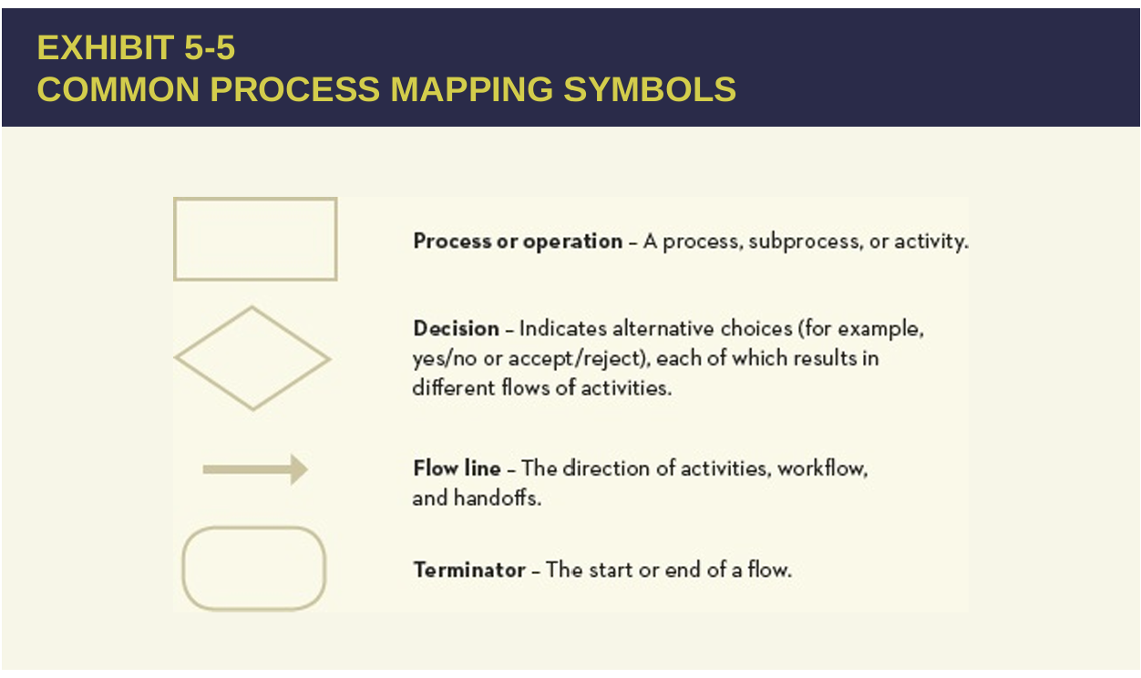
Process Map Symbols

Slide 10

High-Level Process Map Example

Slide 11

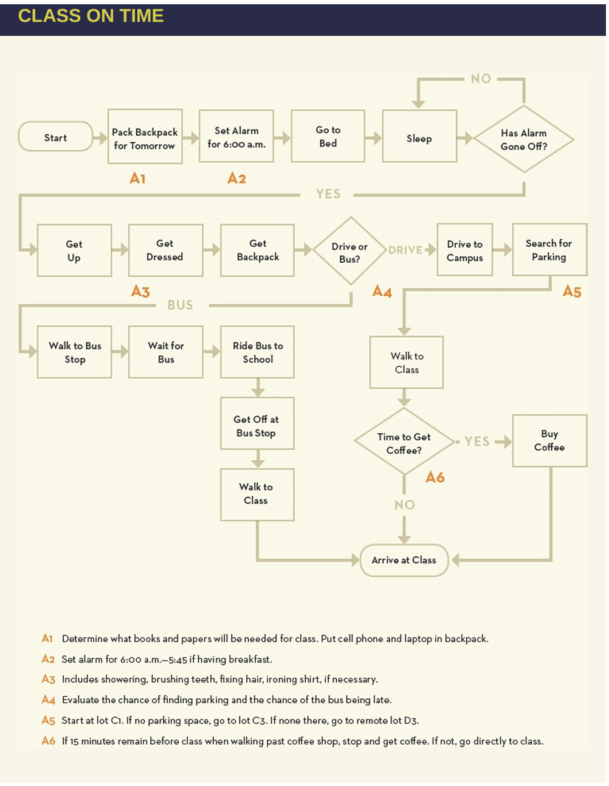
Detailed-Level Process Map Example

Slide 12
Business Risks
Once the internal auditor obtains an understanding of the organization’s objectives and the key processes used to achieve those objectives, the next step is to evaluate the business risks that could impede accomplishing the objectives.
The ability of the chief audit executive (CAE) and internal audit management to get a thorough understanding of the organization’s business risks will determine the extent to which the internal audit function will be able to fulfill its mission and add value to the organization.
It is helpful to develop an overall risk profile of the organization that identifies the critical risks to achieving each strategic objective.
For the increasing number of organizations that are implementing ERM, overall risk profiles may be developed by management.
In these cases, each internal audit function can build its risk assessment from the organization’s risk profile.
However, if such a profile does not exist, the internal audit function will need to create the profile as a starting point for its annual audit planning.

Slide 13
1st: Developing the Risk Profile
There are a number of different tools and methodologies to assist in developing the risk profile.
Despite the array of tools available, the assessment of organizational risk remains a very subjective process that requires experience and sound judgment.
A common approach might be to begin by conducting a brainstorming session with senior management or, if they are not available, with members of the internal audit function. The group might start with a generic risk model that depicts the categories and types of risks an organization might encounter.

Slide 14
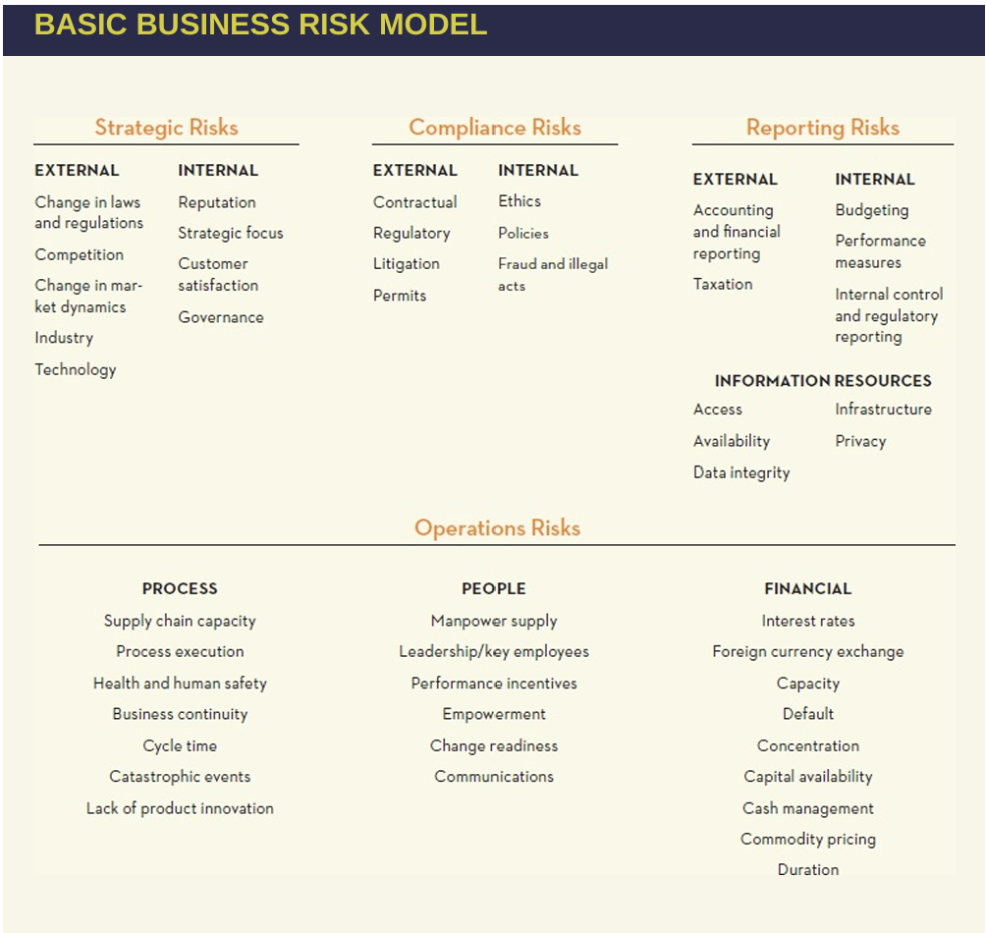
1st Developing the Risk Profile- Basic Business Risk Model

Slide 15
2^{nd:} Assessing Business Risk
The various risks are then assessed in terms of impact and likelihood.
Impact, the adverse effect of a risk outcome, is usually assessed on a continuum from low to high. Typically, this is done in terms of categories using three (high, medium, low) or five categories.
Establishing boundaries for each category is useful for gathering input from multiple people. In this model, the boundaries for impact are set in terms of dollar values and impact on business objectives.
However, some organizations set boundaries for other measures as well. For instance, some organizations establish impact in terms of reputation, health and safety, legal, or damage to assets. For health and safety, the categories might be slight injury, minor injury, major injury, fatality, and multiple fatalities, with the scale going from negligible to extreme (the impact scale shown in exhibit 5-8), respectively. Each organization will determine the terms used to signify impact.

Slide 16
2nd Assessing Business Risk
Likelihood can be evaluated by assessing the odds or probability of the risk occurring.
However, given the subjective nature of these assessments, most managers and internal auditors are more comfortable expressing likelihood in less precise categories.
Again, a three-category scale (high, medium, low) or a five-category scale (as shown in exhibit 5-8) is often used. As with impact, it does help to specify the category boundaries.
This is usually done in terms of specific or ranges of probabilities (as in the scale in exhibit 5-8). Using the risk assessment model in exhibit 5-8, the various risks from the basic business risk model (exhibit 5-7) can be placed on the matrix.

Slide 17

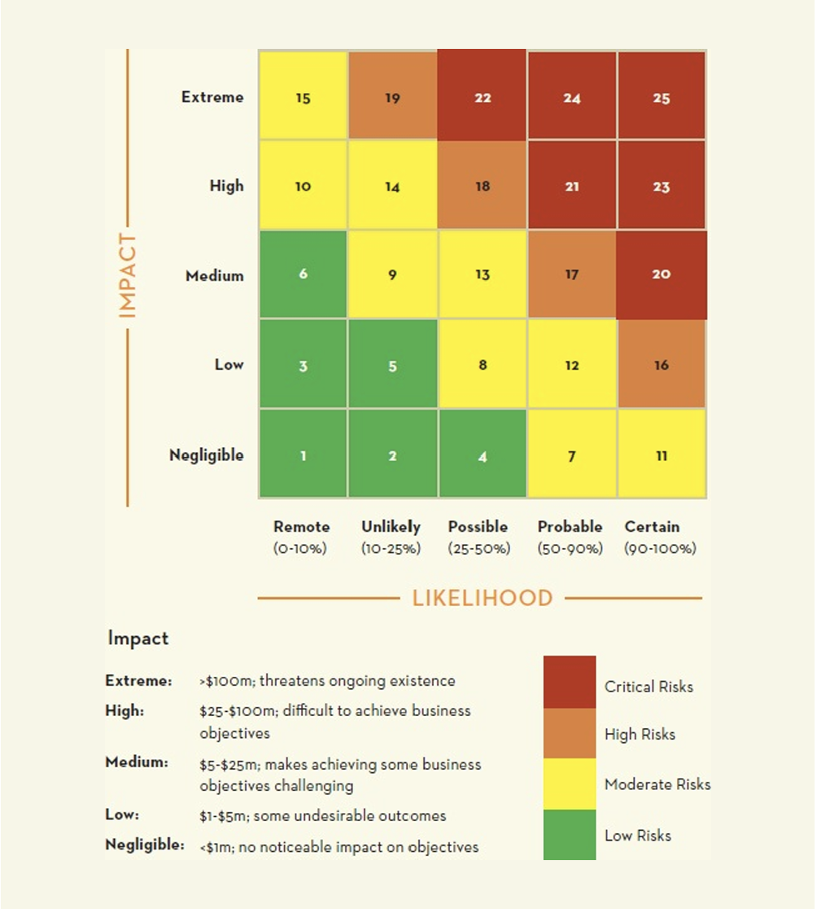
Risk Assessment Model (Risk Matrix)
Using the risk assessment model in exhibit 5-8, the various risks from the basic business risk model (exhibit 5-7) can be placed on the matrix.
Frequently, this is done in a group session involving senior management or, if they are not available, other levels of management and more experienced individuals from the internal audit function.
Using senior management and operations managers is preferable because they have the best understanding of the risks in their areas of responsibility.
In this meeting, risks are discussed and consensus is obtained regarding impact, likelihood, and position of the respective risk on the matrix.
The combination of impact and likelihood determines the relative importance of the risks.
Exhibit 5-8 shows the matrix broken into 25 boxes. In this model, boxes 20 through 25 represent critical risks, and boxes 16 through 19 represent high risks. These risks present the most serious challenge to meeting the organization’s objectives. Boxes 7 through 15 are moderate risks and boxes 1 through 6 are low risks.

Slide 18

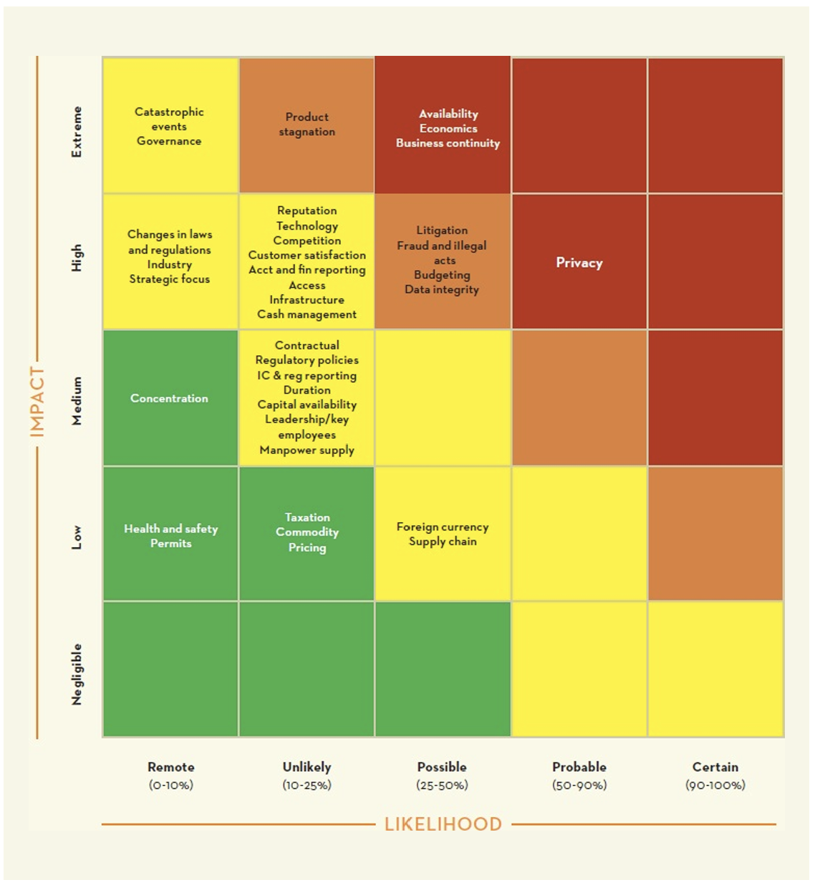
Mapping Risks to Risk Assessment Matrix
Exhibit 5-9 presents a mapping of the risk model to the risk assessment matrix for an online financial services company.
Four risks identified as critical appear in boxes 21 and 22. The risks in boxes 18 and 19 are considered high and, depending on how many objectives they impact, also may require extensive attention.

Slide 19
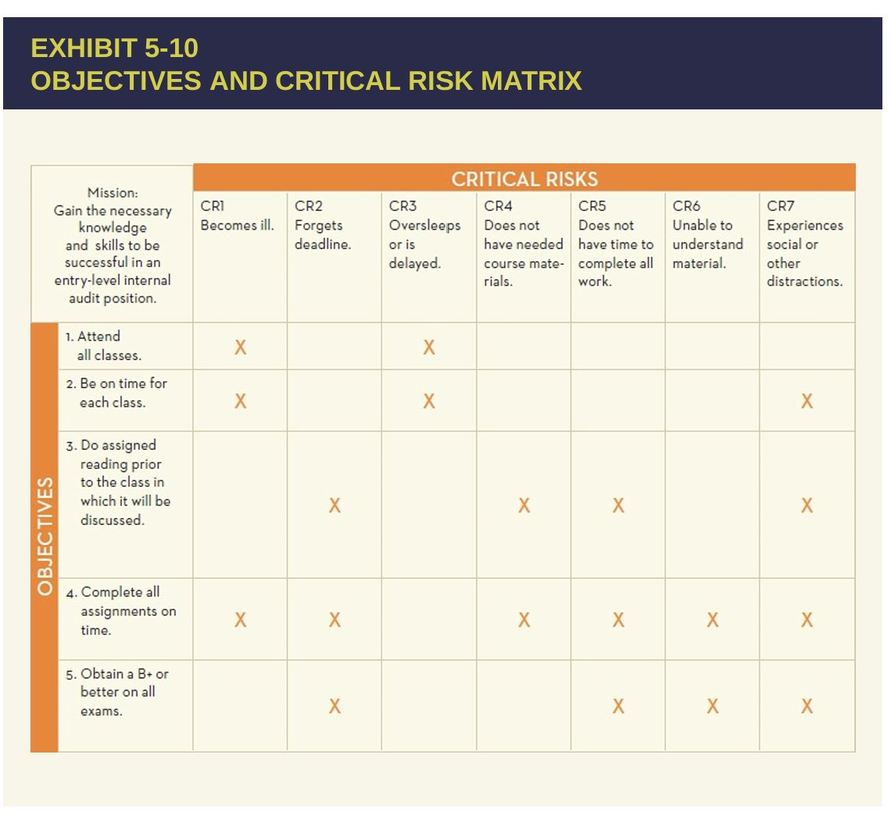
3rd Link Critical Risks to Specific Objectives
The next step is to formally link the identified risks to the specific objectives that each risk may impair. This helps to ensure that all key risks, and the resulting impact, have been identified. Returning to the example of getting to class on time, assume the mission this semester is to gain the necessary knowledge and skills to be successful in an entry level internal audit position. Several specific strategic objectives could be developed to accomplish this mission:
Attend all classes.
Be on time for each class.
Do assigned reading before the class in which it will be discussed.
Complete all assignments on time.
Obtain a B+ or better on all exams.
The process depicted in exhibits 5-4 and 5-6 that outlines getting to an 8:00 a.m. class on time contributes to objective 2 and, to an extent, objective 1.
Other processes, such as study processes, would be critical to objectives 3, 4, and 5.
A number of risks can be identified that could impede the achievement of the five objectives. For instance, becoming sick could impact the achievement of objectives 1, 2, and 4. Exhibit 5-10 presents seven critical risks and their potential to impede these five strategic objectives

Slide 20
4th Mapping Risks to the Business Processes- Risk Responses (1/2)
The next step would be to develop appropriate responses to each risk. To select appropriate response strategies effectively, an understanding of how risks relate to the organization’s business processes is necessary.
There are five responses an organization can take:
1. Acceptance: No action is taken to decrease risk impact or likelihood. The organization is willing to accept the risk at the current level rather than spend valuable resources deploying one of the other risk response options.
Example:
A small bookstore is located in an area that occasionally experiences mild flooding, but the impact on operations is minimal. The store owner decides not to invest in flood barriers or relocate, as the potential damage is low and the cost of prevention is high. The risk of flooding is accepted.
2. Avoidance: A decision is made to exit or divest of the activities giving rise to the risk. Risk avoidance may involve, for example, exiting a product line, deciding not to expand to a new geographical market, or selling a division.
Example:
A company was planning to expand its operations into a foreign market but decided not to enter a country due to high political instability and the associated risks (e.g., currency fluctuation, political turmoil). By avoiding the market, the company eliminates the risks associated with that expansion.

Slide 21
4th Mapping Risks to the Business Processes- Risk Responses (2/2)
3. Pursuit: Exploit the risk if taking such a risk is advantageous to the organization or is necessary to achieve a particular business objective.
Example:
A start-up tech company chooses to launch a new app in a highly competitive market with the knowledge that there is a significant risk of failure. However, the company believes that the potential financial rewards from dominating the market justify the risk, so they pursue the opportunity despite the competition.
4. Reduction: Action is taken to reduce the risk impact, likelihood, or both. This involves a myriad of everyday business decisions, such as implementing controls.
Example:
A construction company regularly experiences accidents on the job site. To reduce the risk, the company introduces safety training programs for all workers, provides personal protective equipment, and installs safety barriers around dangerous areas. These actions help reduce the likelihood of accidents and their impact.
5. Sharing: The risk impact or likelihood is reduced by transferring or otherwise sharing a portion of the risk. Common techniques include purchasing insurance products, engaging in hedging transactions, or outsourcing an activity.
Example:
A small business that manufactures products decides to purchase insurance to cover the risk of potential damage to their factory or inventory due to natural disasters. Additionally, the business outsources its IT infrastructure to a third-party vendor, thus transferring the risk of data breaches or cyberattacks to the vendor who has better resources for managing those risks.

Slide 22

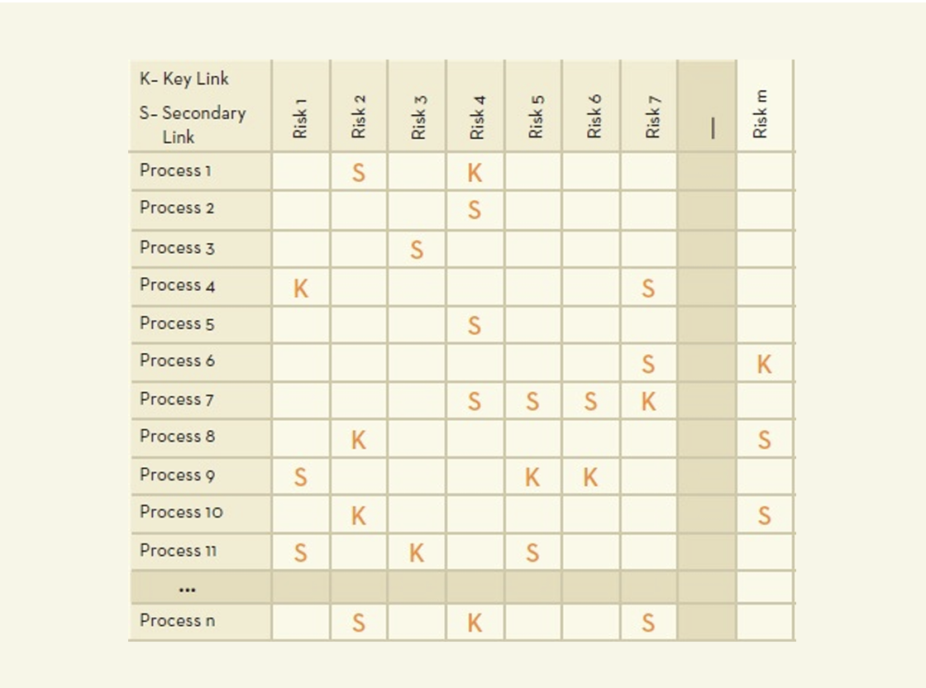
4th Mapping Risks to the Business Processes- Risk by Process Matrix
An effective means of depicting how the processes link to the underlying risks is to create a risk by process matrix.
The next step is to analyze the processes to determine if there are any associations between the processes and the risks.
Returning to the initial process example of getting to an 8:00 a.m. class on time, links between that process (exhibit 5-6) and the seven critical risks listed in exhibit 5 10 can be assessed.
There is clearly a direct association between this process and critical risk 3 (oversleeps or is delayed). There also would be an association with critical risk 4 (does not have needed course materials) because part of getting to the 8:00 a.m. class on time involves gathering needed materials for classes and studying the rest of the day. Critical risk 5 (does not have time to complete all work) and critical risk 6 (unable to understand material) are clearly not related to this process. They would be related to other processes such as time management, scheduling, and study processes.
After identifying the risks with which a particular process is associated, the associations should be evaluated as to whether the links are key or secondary. Key links are those in which the process plays a direct and key role in managing the risk. Secondary links are ones in which the process helps to manage the risk indirectly. In the example above, critical risk 3 would be judged as a key link, while critical risk 4 may only be considered a secondary link.

Slide 23
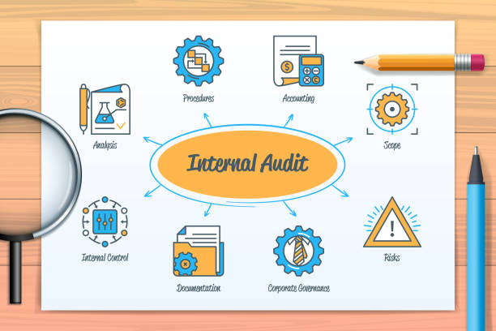
Risk-based Annual Internal Audit Plan
Once the risk by process matrix is complete, it can be used by the internal audit function to determine which engagements should be included in the function’s annual audit plan.
A first step could be to count the number of key and secondary links for each process. The number and nature of links between risks and process will influence the type of internal audit that may be conducted.
For example, a process with key links to several risks may be a good candidate for a comprehensive audit of the entire process. Alternatively, if a risk has key links to several processes, it may be more appropriate to conduct an audit of all such processes to provide assurance regarding the risk as a whole. Considerable experience is necessary to make these judgments. Also, a cycle for auditing each process could be established based on the impact and likelihood of the related risks. For example, processes with a key link to one or more critical risks or to several high and moderate risks may be audited on a one- or two-year cycle, and those with only secondary links to critical and high risks on a three-, four-, or five-year cycle.
Consideration also should be given to past audit results. For instance, even a process on a three- or four-year cycle should be audited before its cycle ends if the prior audit identifies significant issues.

