Slide 1
cerebral palsy
Definition
Cerebral 🡪 Hemisphares
Palsy 🡪 Any disorder that imapirs control of body movement
None progressive disease of the CNS secondary to a perinatal insult, resulting in varying degrees of motor milestone delay and dysfunction
Incidence
2 – 5 % of live births
Equally occurs among males and females

Slide 2
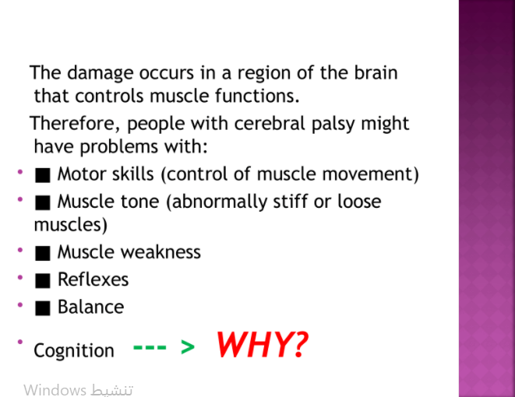

Slide 3
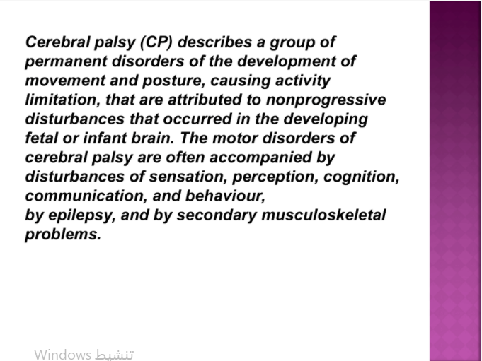

Slide 4
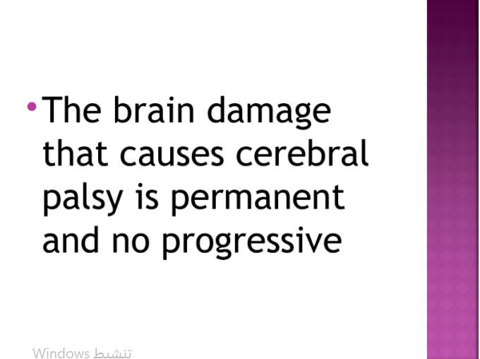

Slide 5
Etiology of Cerebral Palsy
Caused by dysfunction in parts of brain that control body movement and posture.
Dysfunction can occur when brain cells:
Fail to or abnormally grow
Damage due to lack of blood ,oxygen or nutrients
Damage caused by infections

Slide 6
Prenatal Etiology
Genetic or chromosomal causes
Parents age as related to sperm and egg viability
Exposure to toxins
Mother inquires infection during pregnancy
Infections in the birth canal or uterus

Slide 7
Natal Etiology
Prolonged labor
Placenta breaks down before infant is delivered
Infection in the birth canal
Poor health
Multiple births

Slide 8
Postnatal Etiology
Serious illness
Bleeding surrounding the brain
Anoxia due to accidents
Traumatic brain injuries
Low blood suger

Slide 9
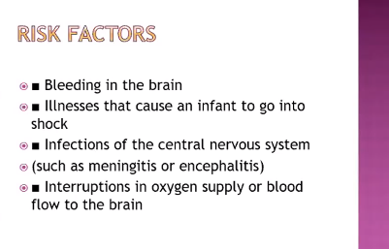

Slide 10
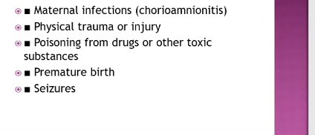

Slide 11
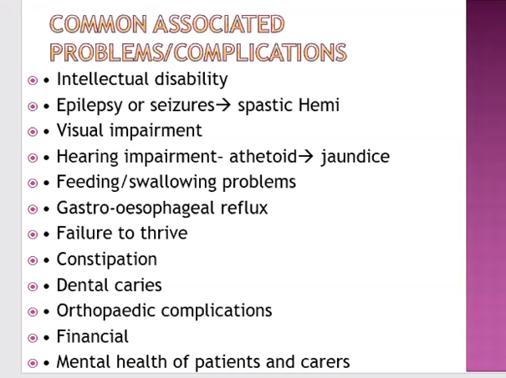

Slide 12
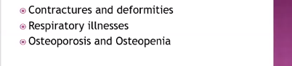

Slide 13
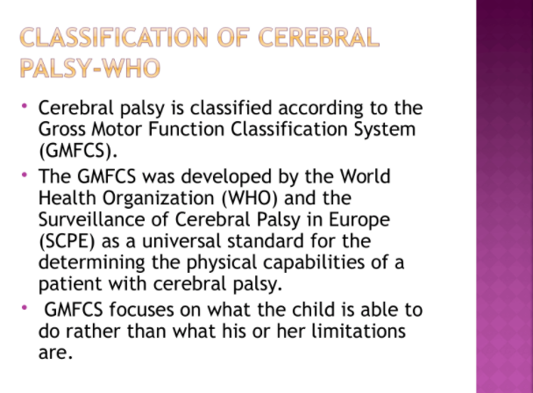

Slide 14
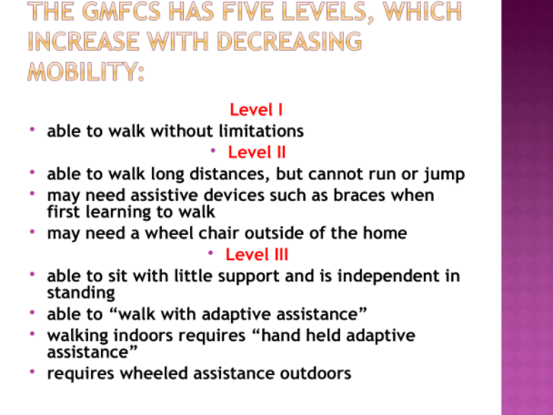

Slide 15
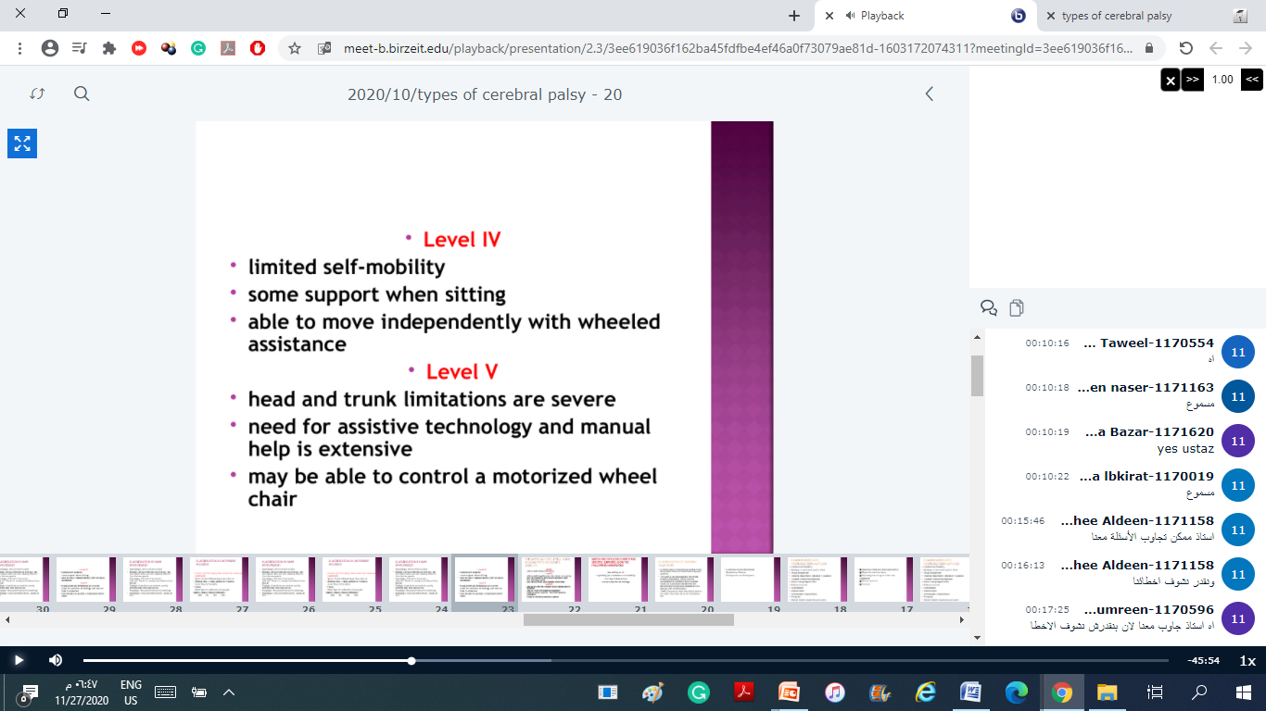

Slide 16
Classification by limb involvement
Quadriplegia: All four limbs involved
Diplegia : All four limbs may be involved , but two inferior limbs are more severely affected than the two superior
Hemiplegia: One side of the body is affected..The arm is usually more affected than the leg.
Triplegia: three limbs are involved ,usually affecting both arms and one leg.
Paraplegia :Two paired limbs are involved.
Monoplegia : only one limb involved , usually an arm.

Slide 17
Classification by Movement Disorder (neurological foundations) location of brain injury determines how movement is affected
Spastic Cerebral Palsy🡪 Upper Motor Neuron
Athetoid Palsy 🡪 Basal Ganglion
Ataxic Palsy 🡪 Cerebellar
Mixed Type 🡪 combination of any types
Spastic / Ataxic / Mixed / Athetoid /
65% 5% 12% 10%

Slide 18
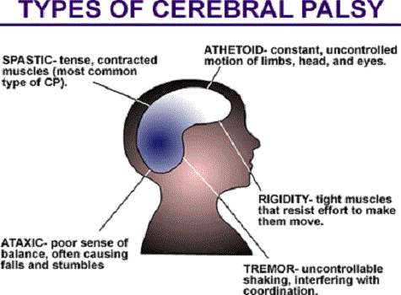

Slide 19
Spastic Diplegia
The most common type
Speech / intellect: normal – slightly impaired
UL : gross motor OK
minor incoordination of fine motor skills
LL : spastic :
Most walk independently by 4 years

Slide 20
Cerebral palsy
Spastic Hemiplegia
30 % of all CP
One side affection
upper > lower extremity
50 % mentally retarded
33 % seizures

Slide 21
Spastic Quadriplegia
All four limbs involved – and trunk
Often mentally retarded
With seizures
Most ( 80 % ) non walkers

Slide 22
Quadriplegia is a form of cerebral palsy that is characterized by the lack of the ability to move or feel both arms, both legs, and other parts of the body affected.
Quadriplegia in cerebral palsy is caused by an injury to the spinal cord, which sends messages to body parts important for movement and sensation

Slide 23
it is characterized by: a decrease in the normal level of tension that exists in muscles of the arms and legs. There is also a loss of power and sensation below the area of the spinal cord injury.
Many people with quadriplegia die of breathing failure because voluntary control over the muscles and organs that are necessary to breathe is dramatically impaired

Slide 24
feeding
There are two distinct problems, which
may occur separately or together:
• problems with sucking, chewing and
swallowing
• gastro-oesophageal reflux.

Slide 25
Feeding problems are caused by:
• Poor mouth closure or lip seal
• Inco-ordinate swallowing
tongue thrusting
• Poor positioning while feeding (as
this exacerbates all of the above)
• Gastro-oesophageal reflux, with or
without aspiration
• Drooling (oral incompetence)
• Dystonic posturing due to cold food
or incorrect positioning.

Slide 26
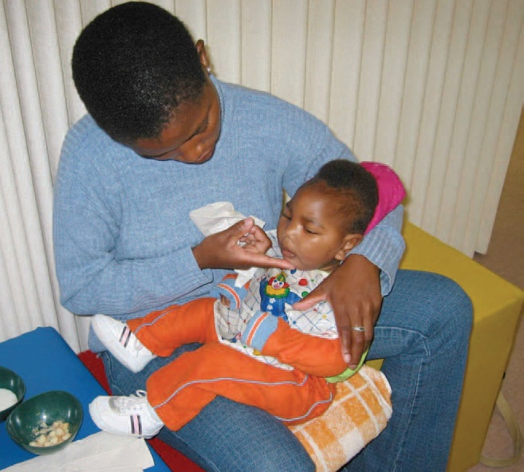
-Head-neck upright in
neutral or slight flexion
Straight back
supported by
mother’s
raised leg.
Shoulders down
and arms forward.
Towel supporting
child
Hips and knees
are flexed

Slide 27
Dyskinetic Cerebral Palsy
Cerebral palsy caused by disturbances to the extrapyramidal system that exhibits typical movment known as Dyskinesias .
Dyskinesias includes :
=Chorea : Rapid ,random and jerky movments.
=Athetosis: slow writhing movments which appear to flow in another
=Choreoathetosis
=Dystonia: repetitive ,twisting movments and disotred posture

Slide 28
Dyskinetic CP is characterized by :
Abnormalities in muscle tone that involve the hall body.
-changing patterns of tone from an hour to an hour and day to day.(increased muscle tone during the day and decreased tone while sleeping .
Notes:
‹#›

Slide 29
Ataxic Cerebral Palsy
Inability to maintain typical posture and perform typical movements(jerky and uncoordinated without the smooth flow of typical motion) typical mot as result from an abnormality in the Cerebellum.
Movements are jerky and uncoordinated without the smooth of typical motions.

Slide 30
How does ataxia effect ones speech?
1.Respiration-decreased breath support, reduced coordination of
breath/speech leading to excessive or paradoxical movements.
Speaking on residual air…what happens?
1) increased rate, decreased volume, and hash voice
2.Phonation- harsh vocal quality due to decreased muscle tone
3.Articulation-decreased oral tone, oral coordination, irregular
break downs ,distorted vowels, prolonged phonemes,
4.Resonation-seldomly a problem
5.Prosody-equal and excess stress ,problems with motor learning,
mono pitch, mono loudness

Slide 31
Ataxic Dysarthria
• Speech characterized by:
“drunkenness”, imprecise consonants
and vowels, slurred, distorted, irregular
breakdown, excess and equal stress,
slow rate of speech, mono pitch and
mono loudness .may display explosive
speech with por control of pitch and
loudness

Slide 32
Mixed Cerebral Palsy
Combination of more than one type of CP when no one is dominant on the other.

Slide 33
Treatment
1. Exercises
• Oromotor exercises targeting strengthening muscles
• Improving breath support, and coordinating breathing and speaking
• Increasing or controlling volume (e.g., Lee Silverman)
• Consonant/vowel drills, rate drills, over articulation practice
• Word, phrase, and sentence stress
• Pitch control

Slide 34
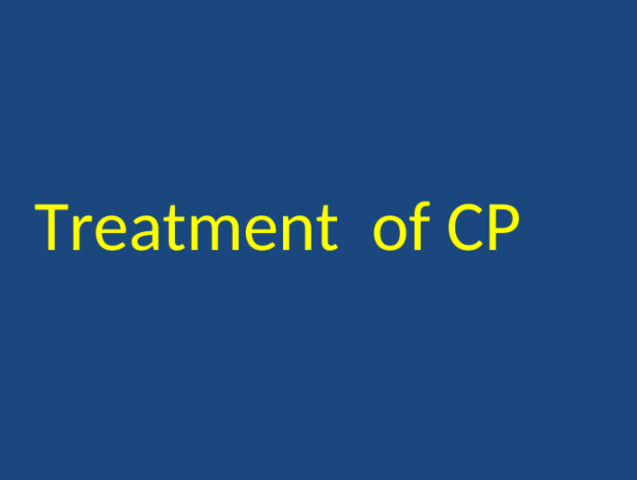

Slide 35
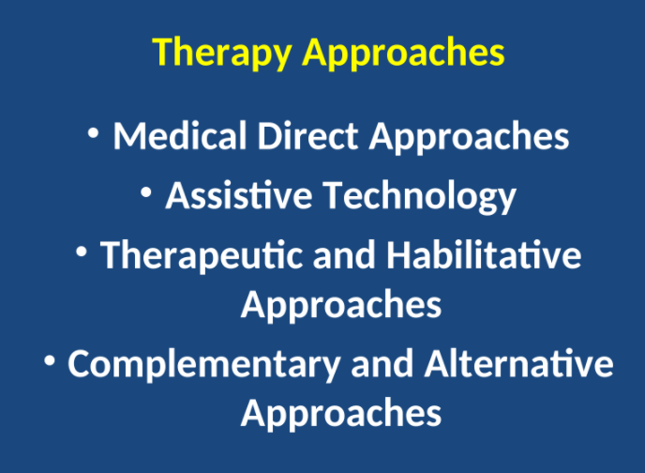

Slide 36
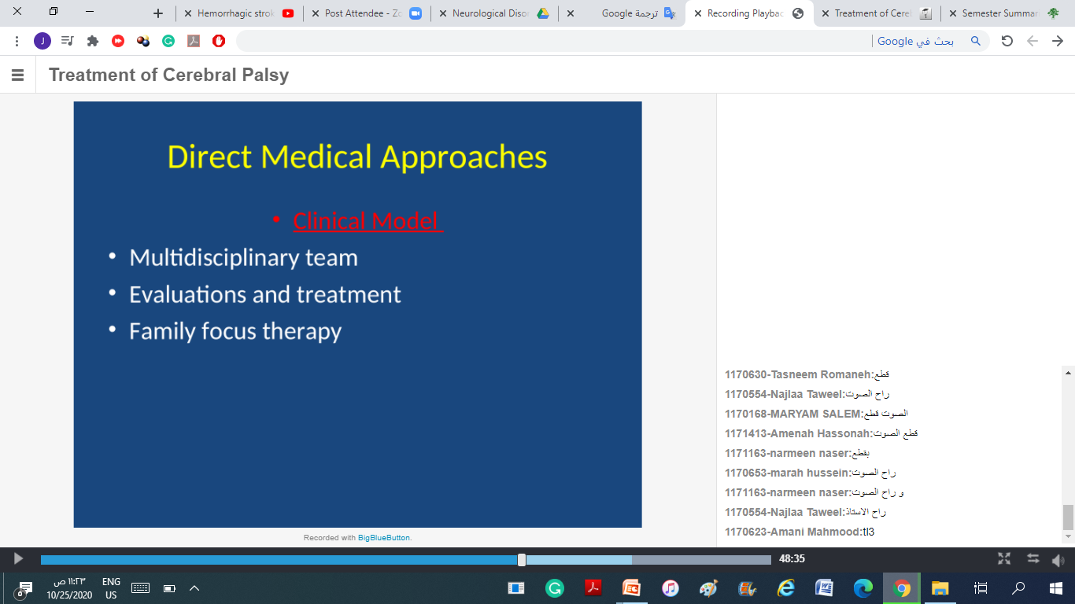

Slide 37
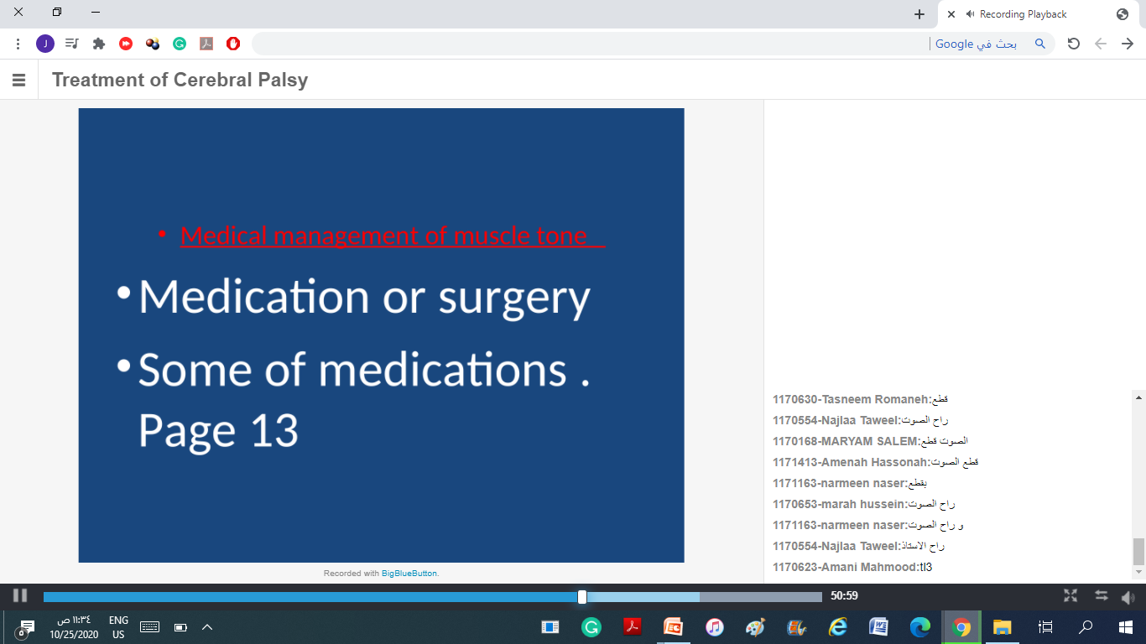

Slide 38
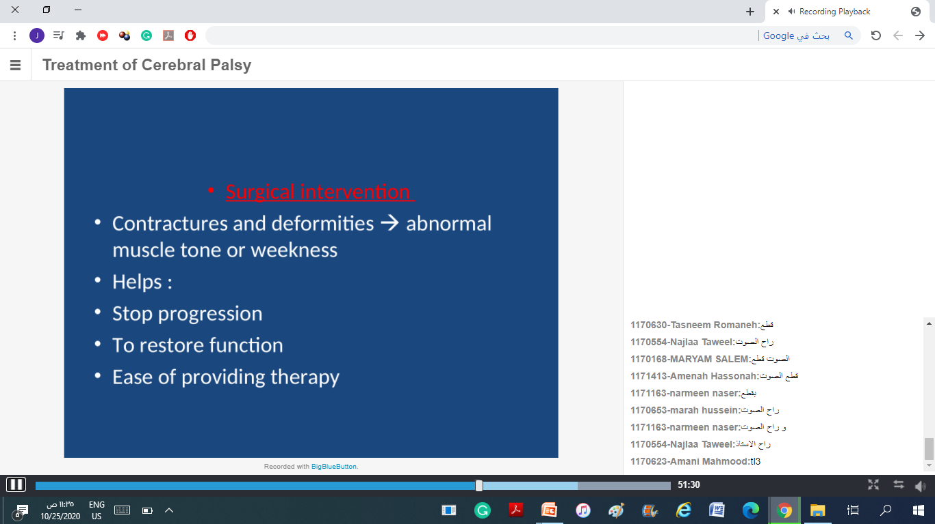

Slide 39
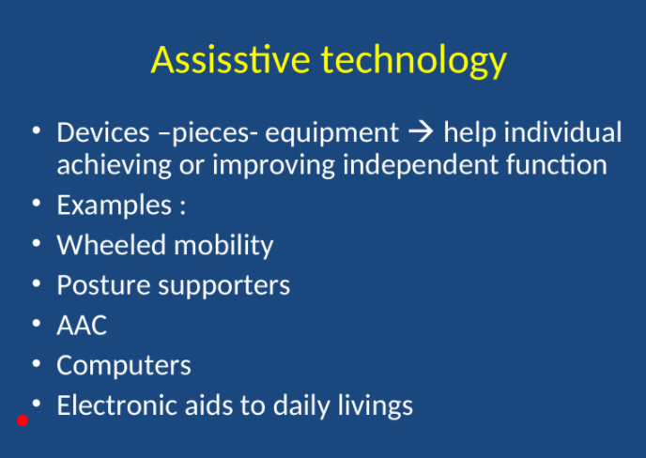

Slide 40
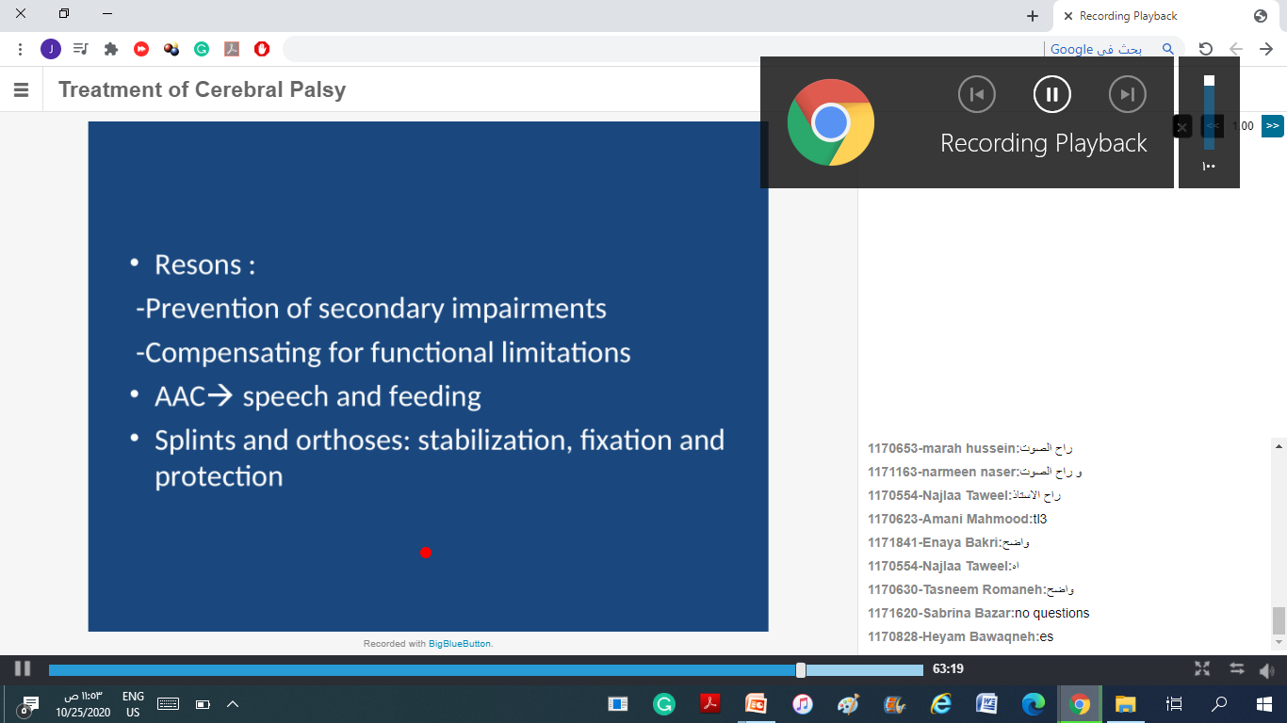

Slide 41
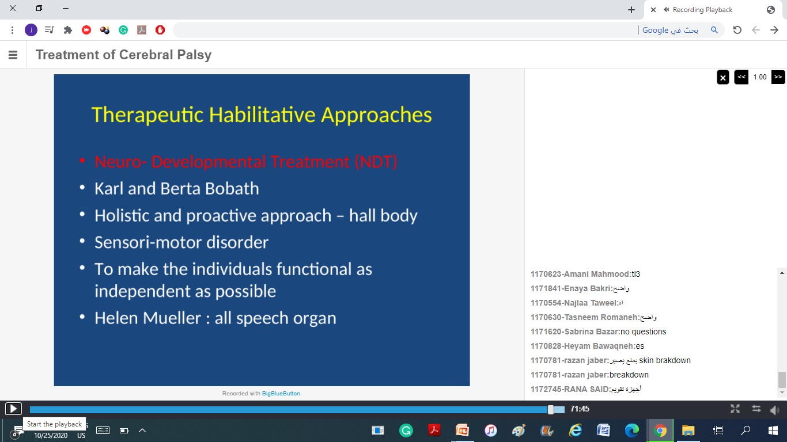

Slide 42
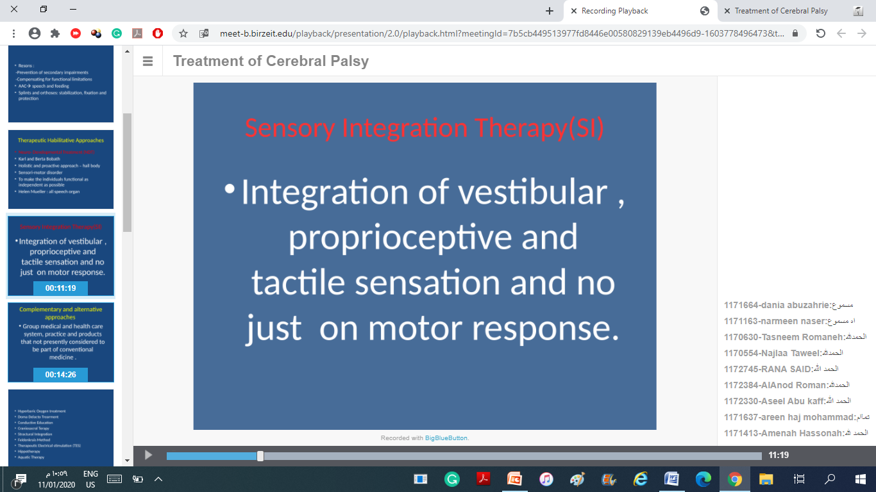

Slide 43
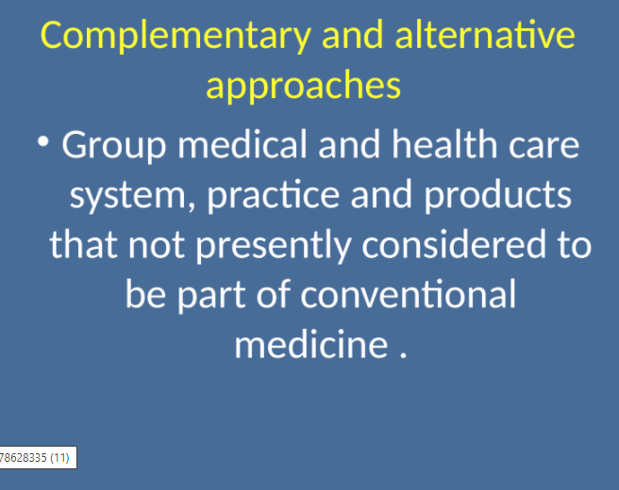

Slide 44
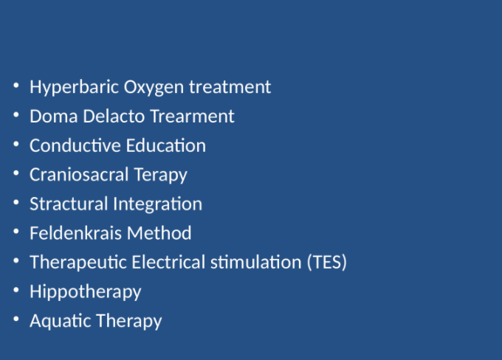

Slide 45
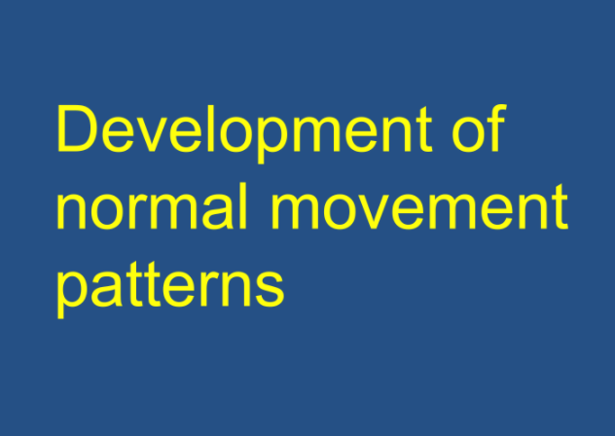

Slide 46
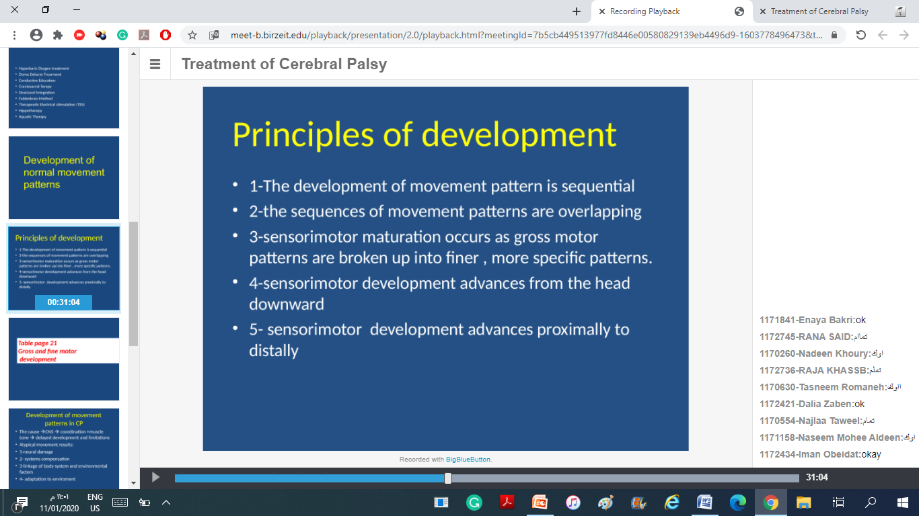

Slide 47
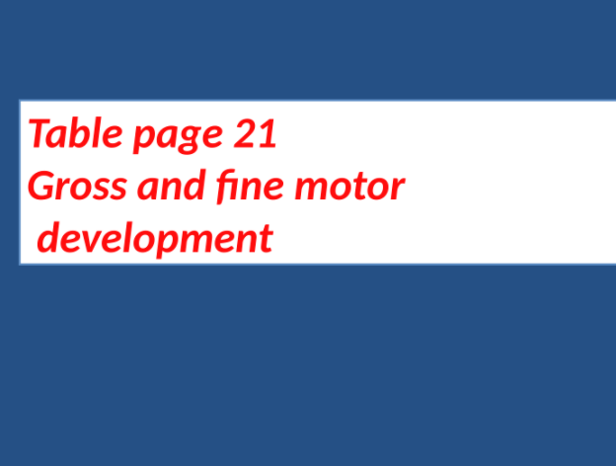

Slide 48
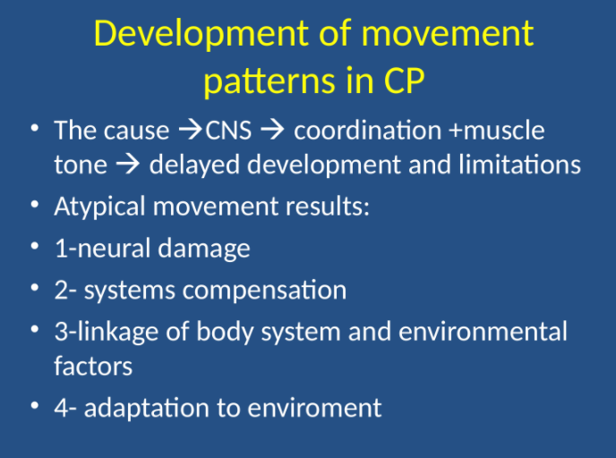

Slide 49
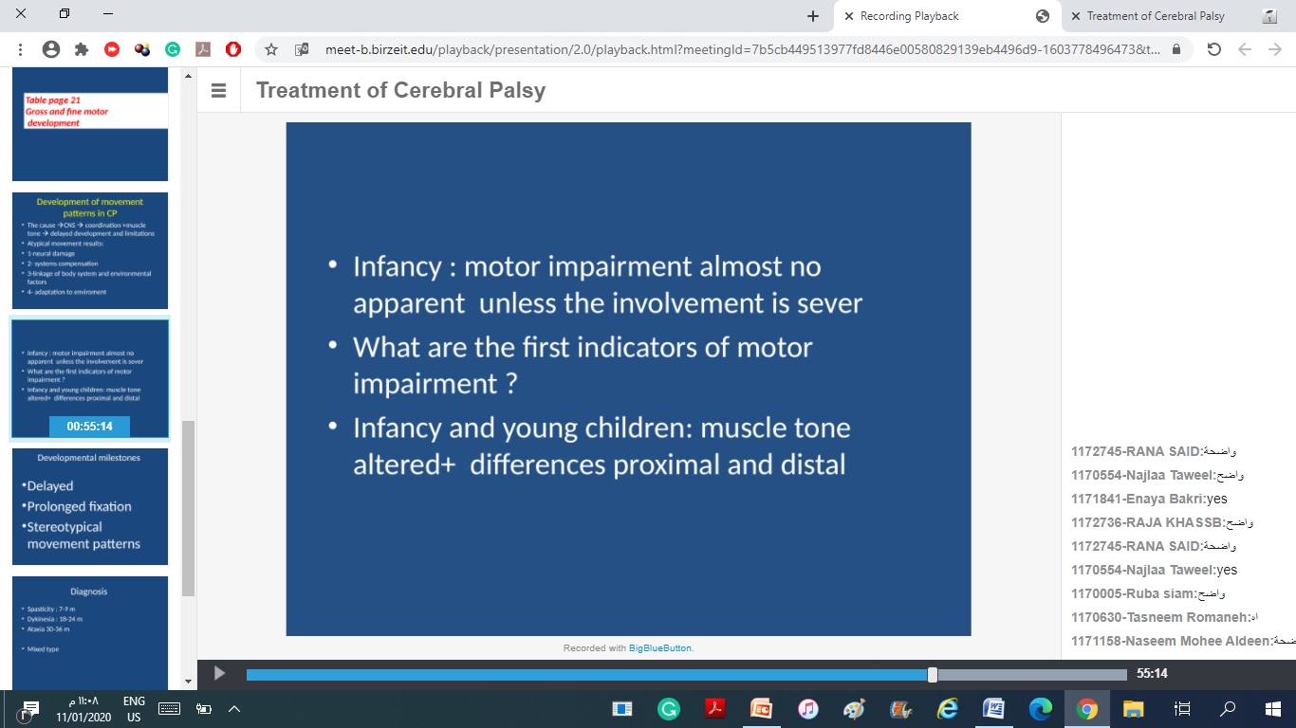

Slide 50
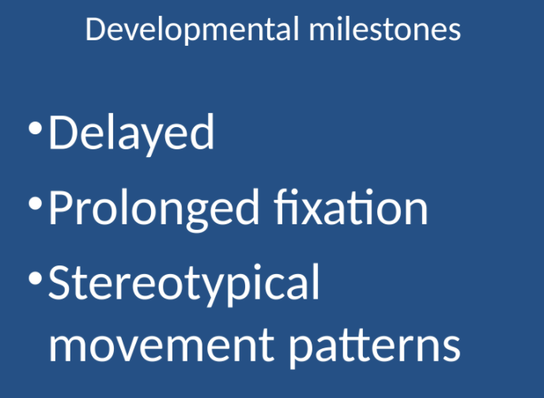

Slide 51
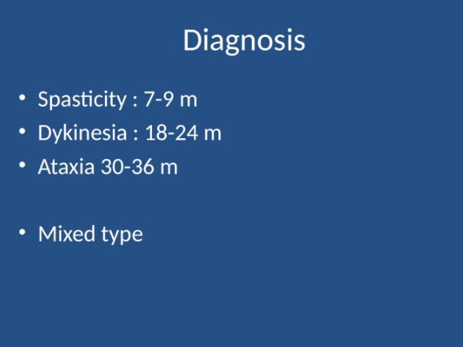

Slide 52
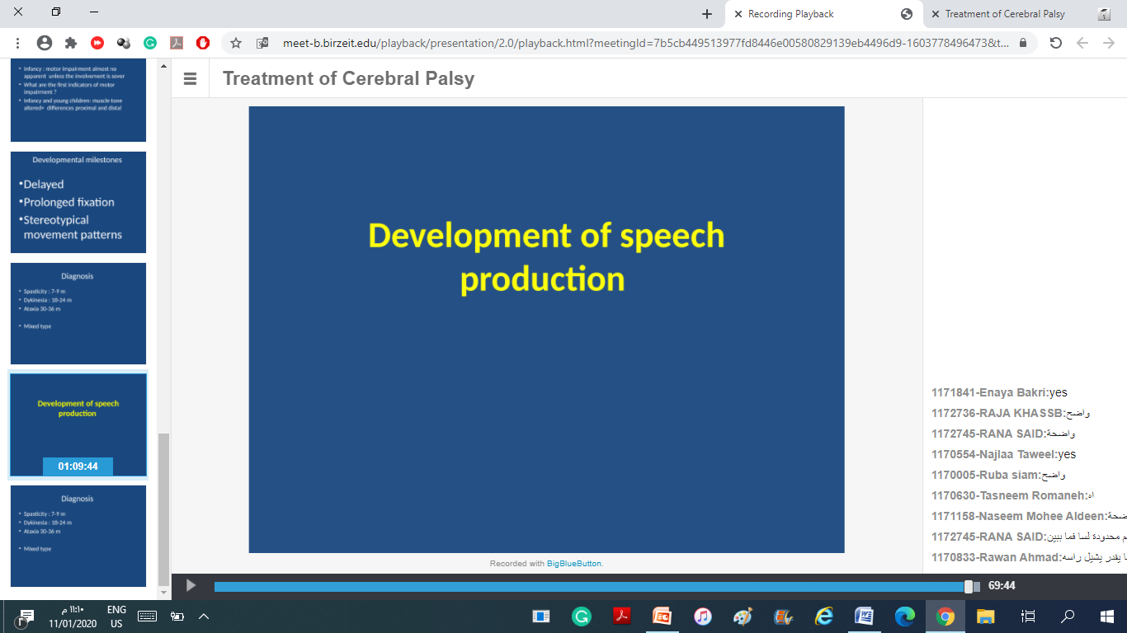

Slide 53
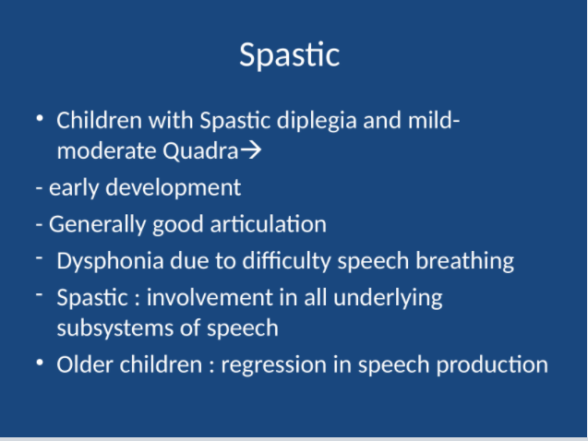

Slide 54
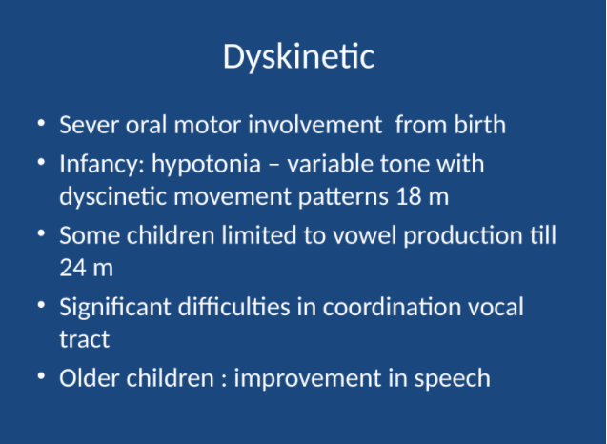

Slide 55
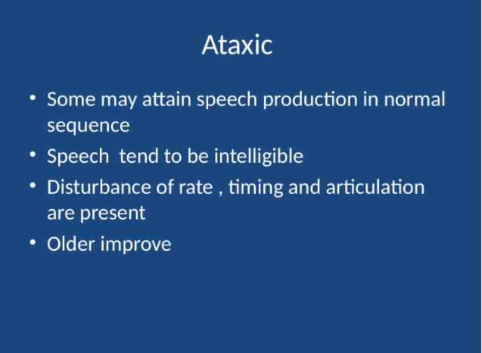

Slide 56
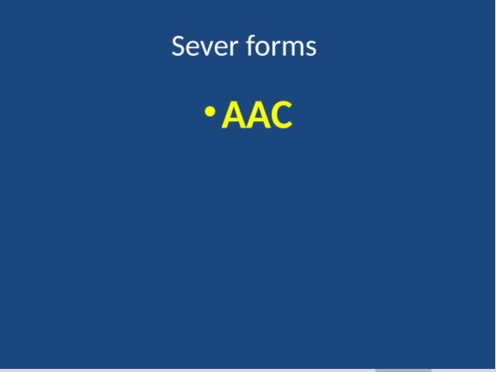

Slide 57
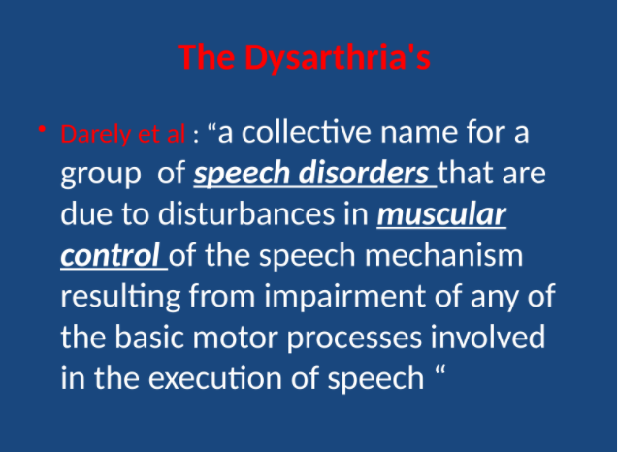

Slide 58
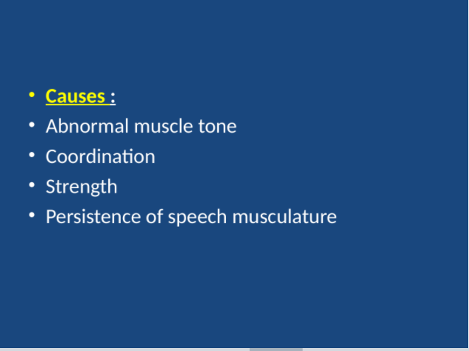

Slide 59
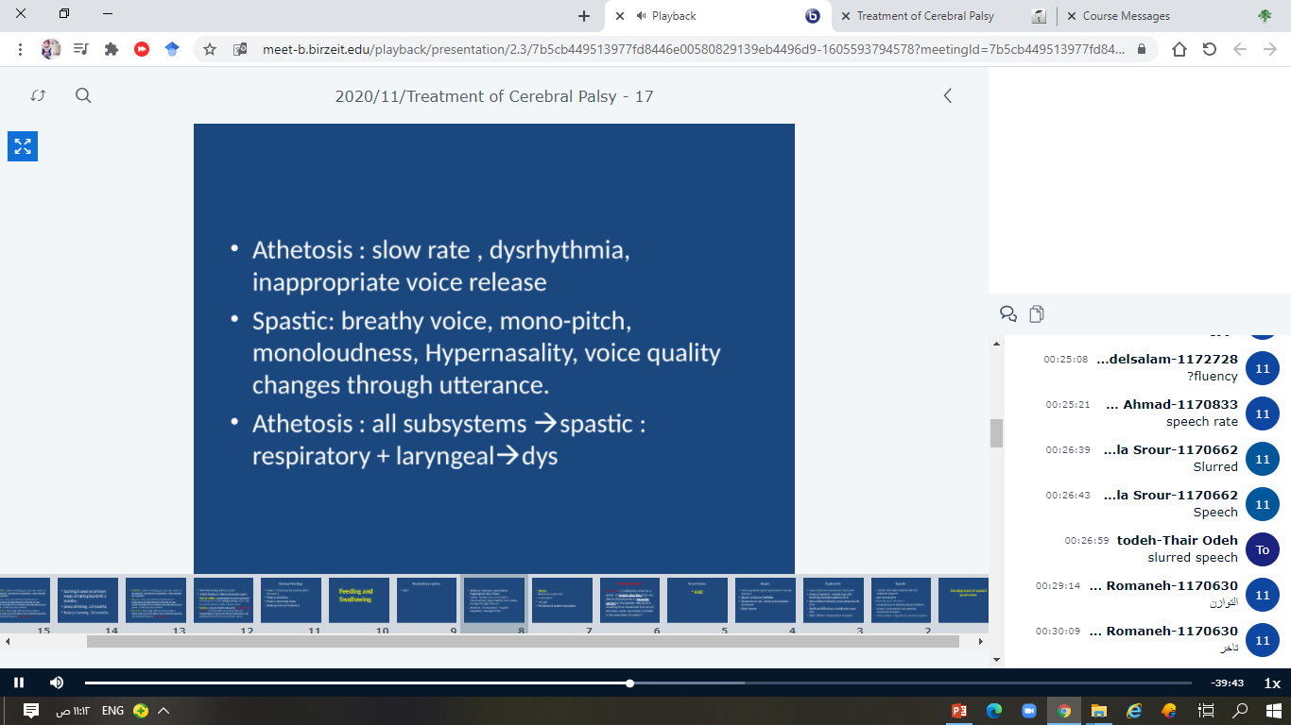

Slide 60
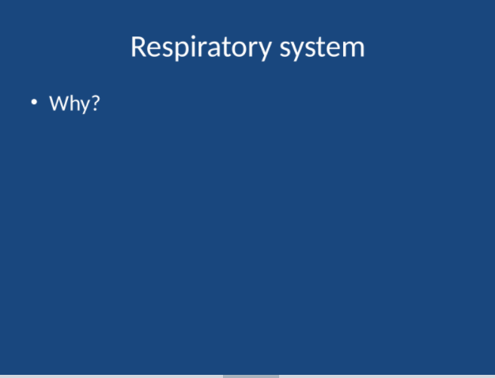

Slide 61
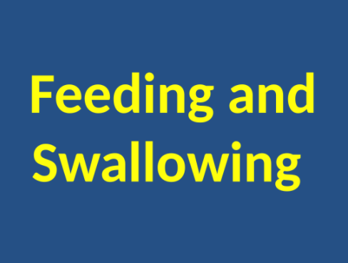

Slide 62
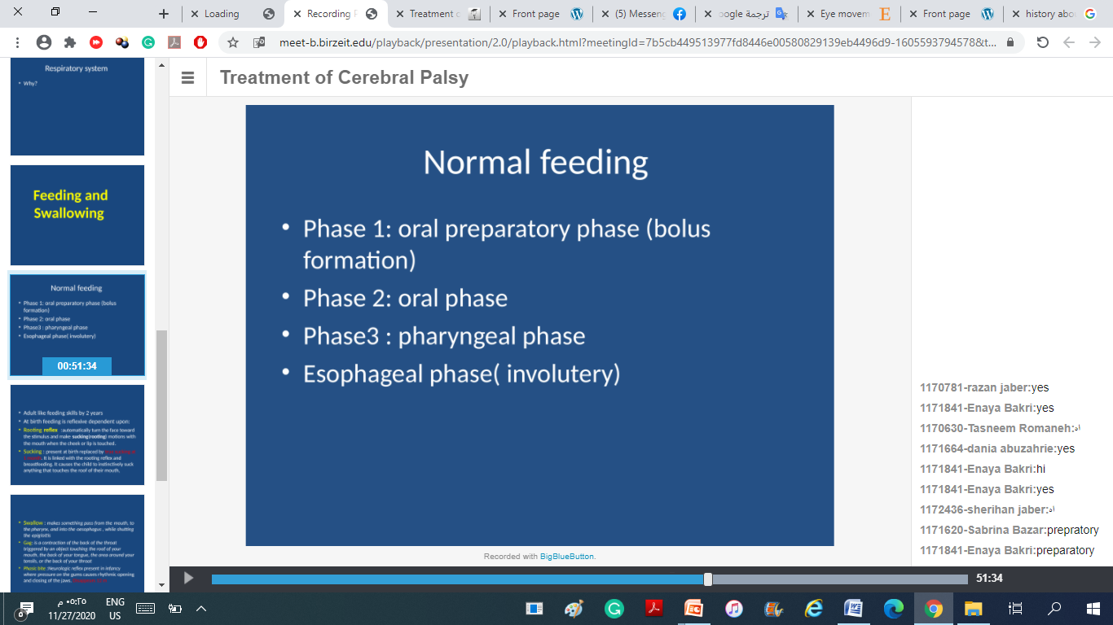

Slide 63
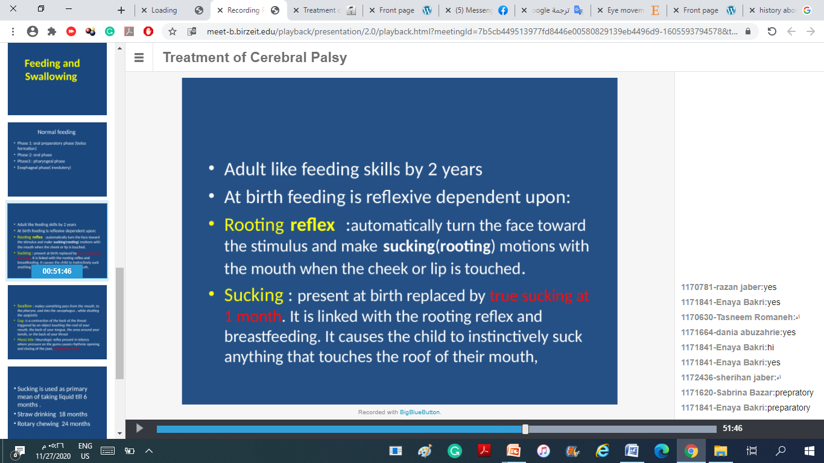

Slide 64
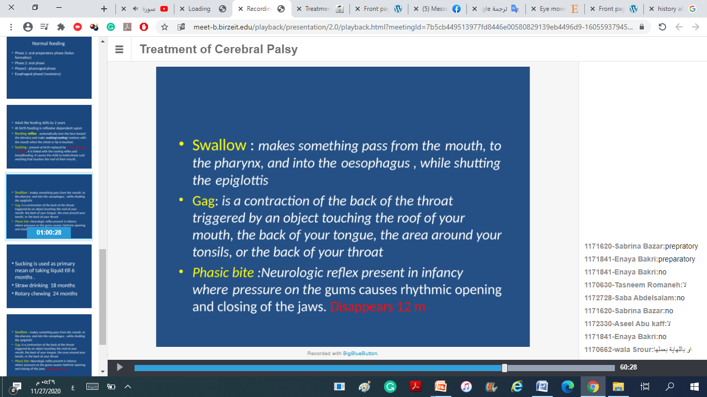

Slide 65
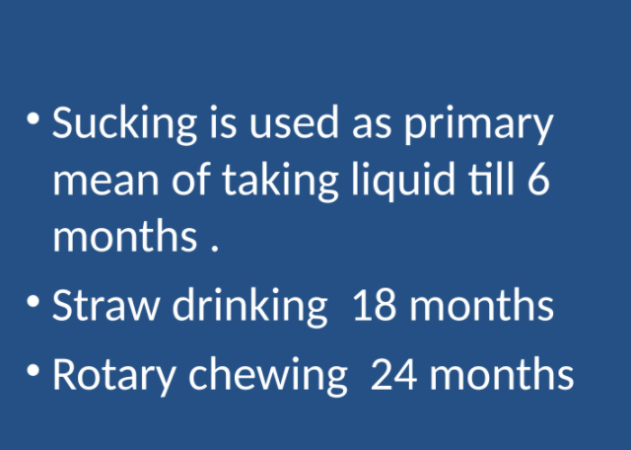

Slide 66
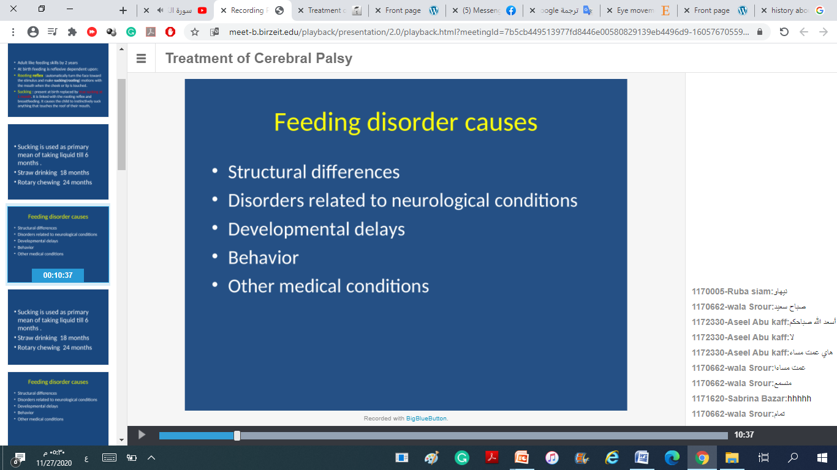

Slide 67
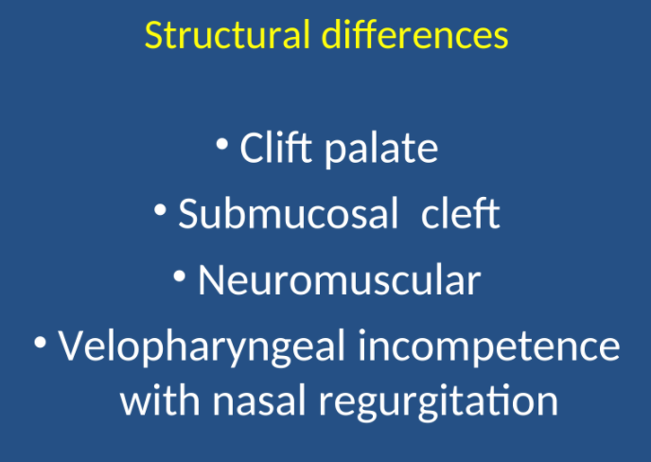

Slide 68
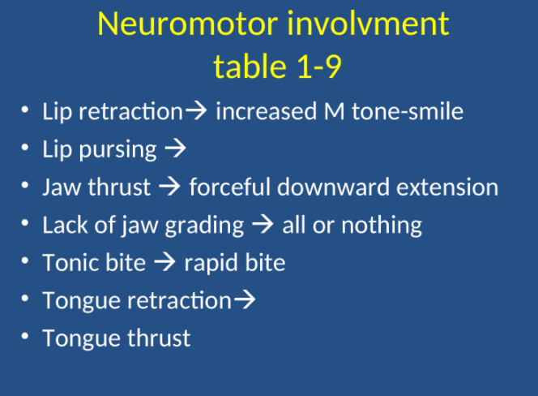

Slide 69
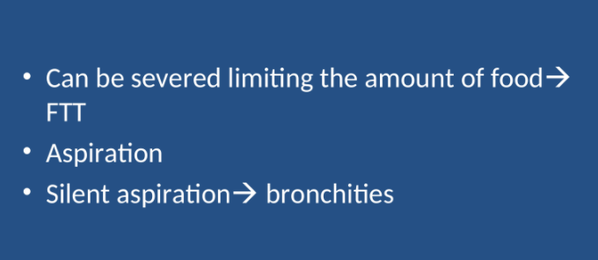

Slide 70
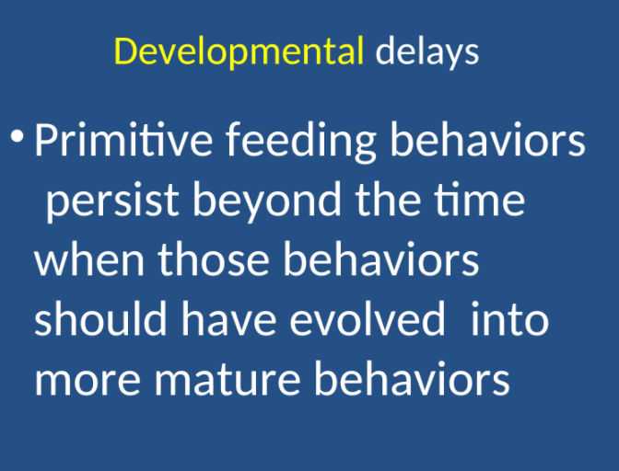

Slide 71
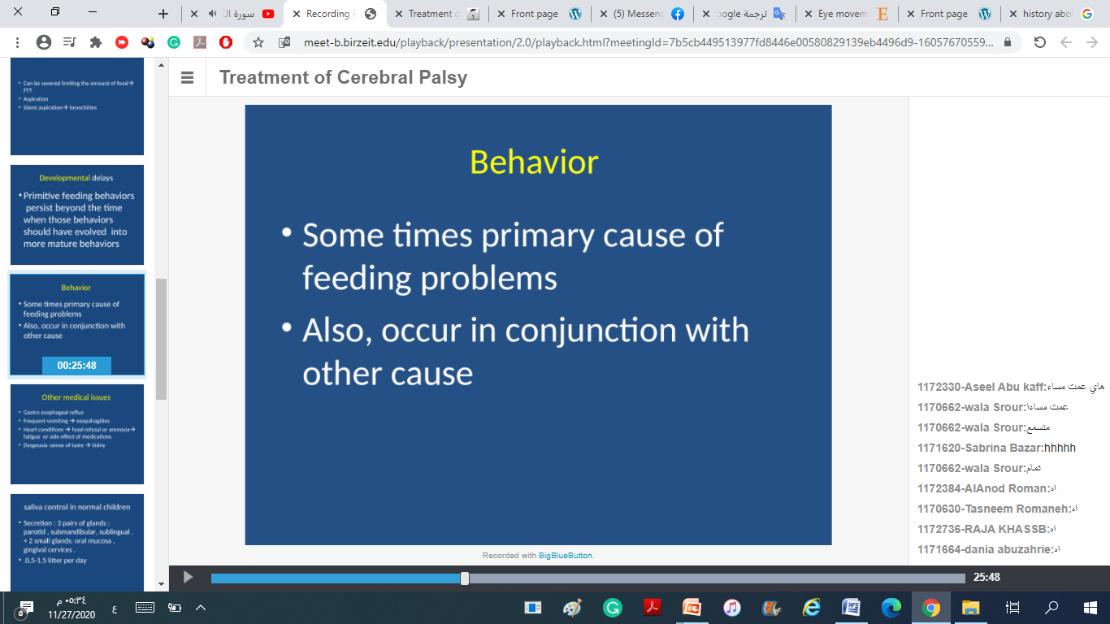

Slide 72


Slide 73


Slide 74


Slide 75


Slide 76


Slide 77


Slide 78


Slide 79


Slide 80


Slide 81


Slide 82


Slide 83


Slide 84


Slide 85


Slide 86


