Slide 1
Pharmacokinetics of Drug Absorption
Most pharmacokinetic models assume first-order absorption unless an assumption of zero-order absorption improves the model significantly or has been verified experimentally.
The rate of change in the amount of drug in the body, dD_{B}/dt, is dependent on the relative rates of drug absorption and elimination.
The net rate of drug accumulation in the body at any time is equal to the rate of drug absorption less the rate of drug elimination.

Slide 2

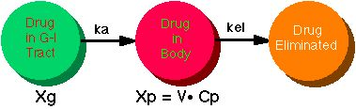
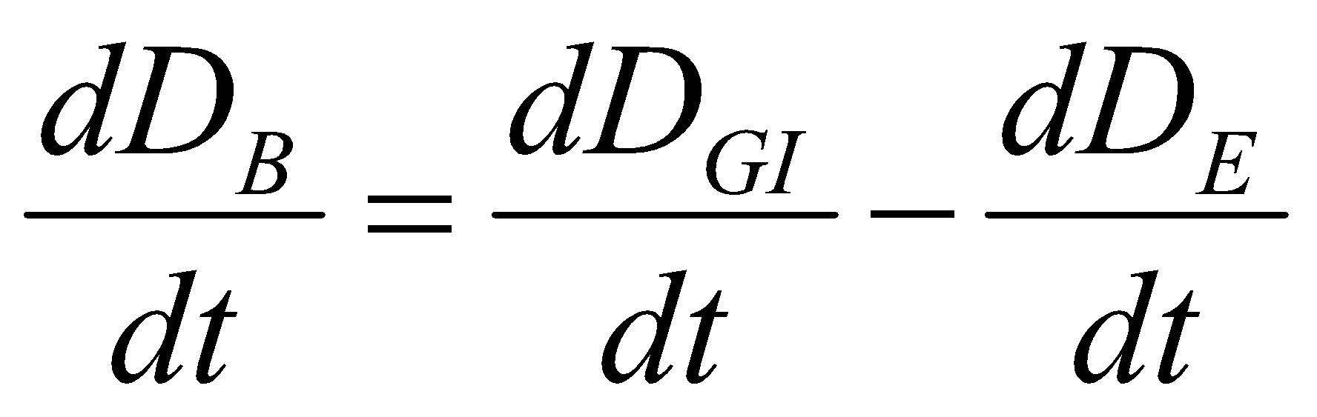
Pharmacokinetics of Drug Absorption
Where:
D_{GI} is amount of drug in the gastrointestinal tract. D_{E} is amount of drug eliminated.

Slide 3
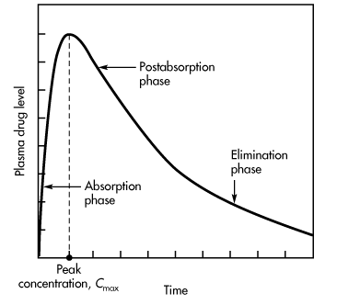
The drug absorption and elimination phases of the curve are shown:
During the absorption phase of a plasma level–time curve , the rate of drug absorption is greater than the rate of drug elimination.
Plasma level–time curve for a drug given in a single oral dose.

Slide 4
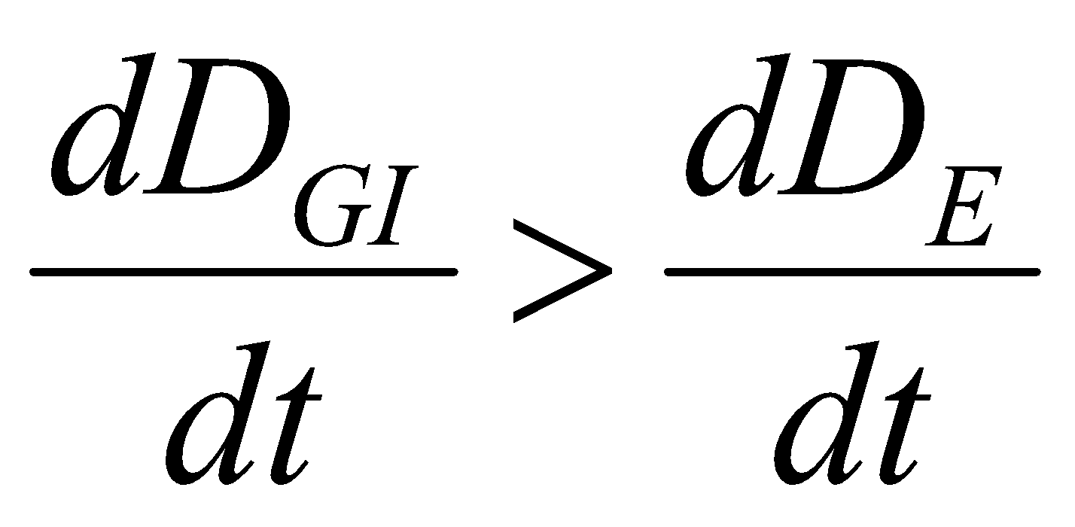
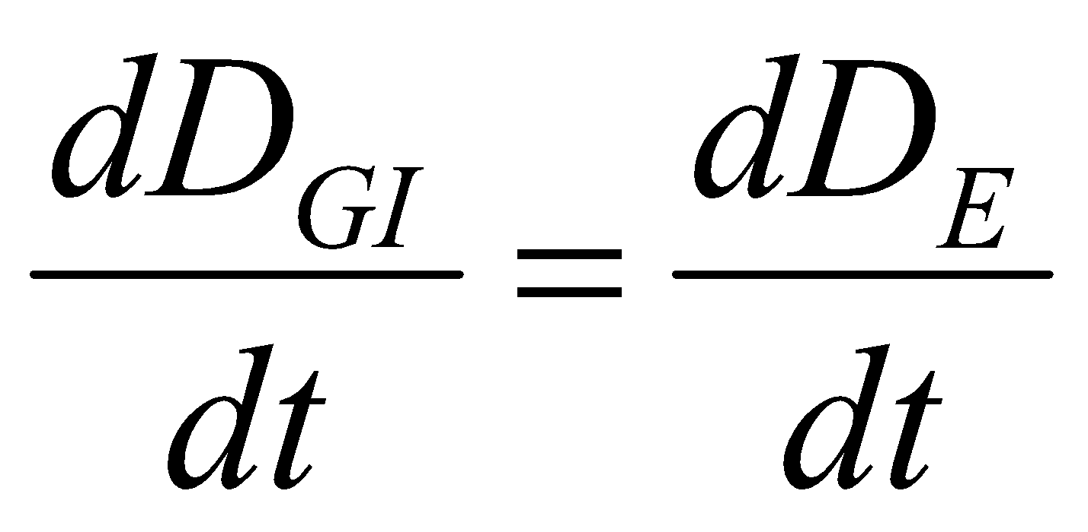
Pharmacokinetics of Drug Absorption
Note that during the absorption phase, elimination occurs whenever drug is present in the plasma, even though absorption predominates.
At the peak drug concentration in the plasma, the rate of drug absorption just equals the rate of drug elimination, and there is no net change in the amount of drug in the body.

Slide 5
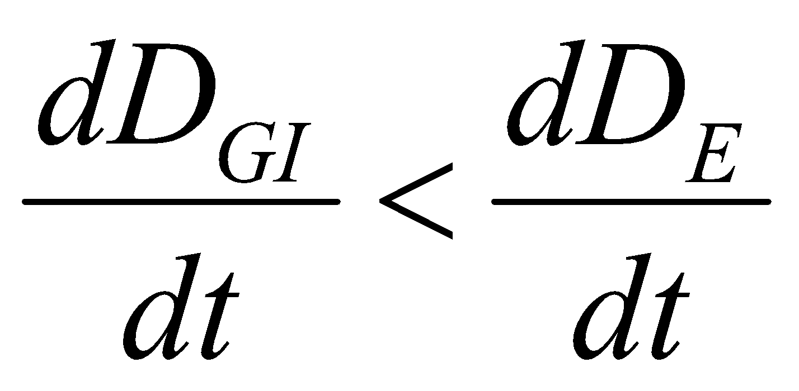
Pharmacokinetics of Drug Absorption
Immediately after the time of peak drug absorption, some drug may still be at the absorption site (ie, in the GI tract or other site of administration).
The rate of drug elimination at this time is faster than the rate of absorption (the postabsorption phase ).
When the drug at the absorption site becomes depleted, the rate of drug absorption approaches zero, or
dD_{GI}/dt = 0.

Slide 6
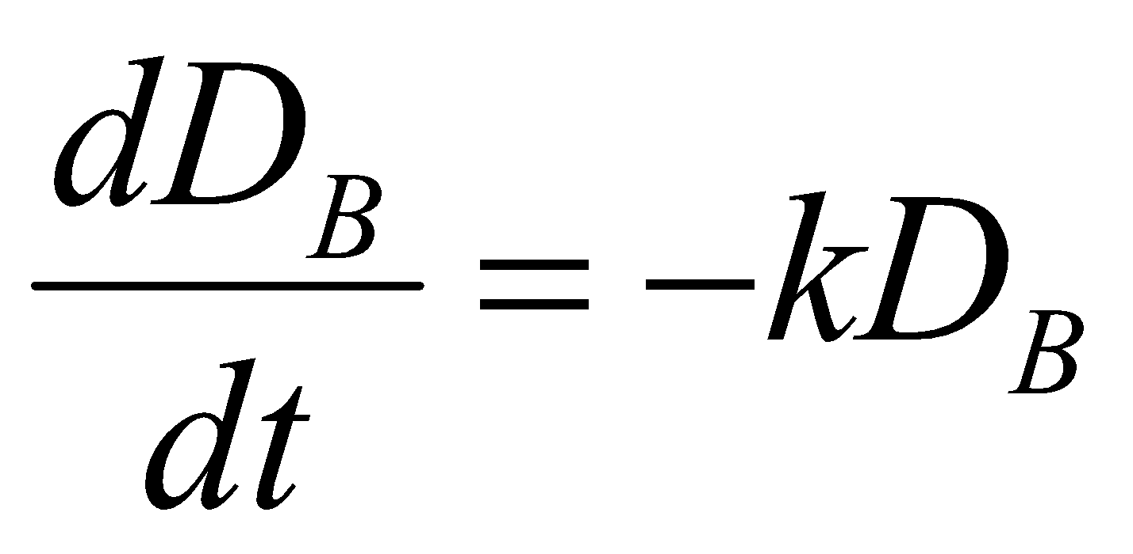
Pharmacokinetics of Drug Absorption
The plasma level–time curve (now the elimination phase) then represents only the elimination of drug from the body, usually a first-order process.
During the elimination phase the rate of change in the amount of drug in the body is described as a first-order process,
where:
k is the first-order elimination rate constant.

Slide 7
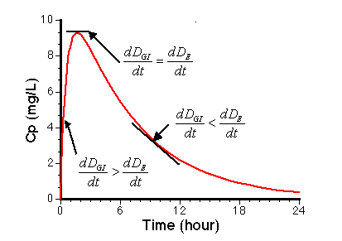
Pharmacokinetics of Drug Absorption
Linear Plot of Cp versus Time after Oral Administration

Slide 8

Zero-Order Absorption Model
Zero-order drug absorption from the dosing site into the plasma usually occurs when either the drug is absorbed by a saturable process or a zero-order controlled-release delivery system is used.
The pharmacokinetic model assuming zero-order absorption is described here.
In this model, drug in the gastrointestinal tract, D_{GI}, is absorbed systemically at a constant rate, k₀.
One-compartment pharmacokinetic model for zero-order drug absorption and first-order drug elimination

Slide 9
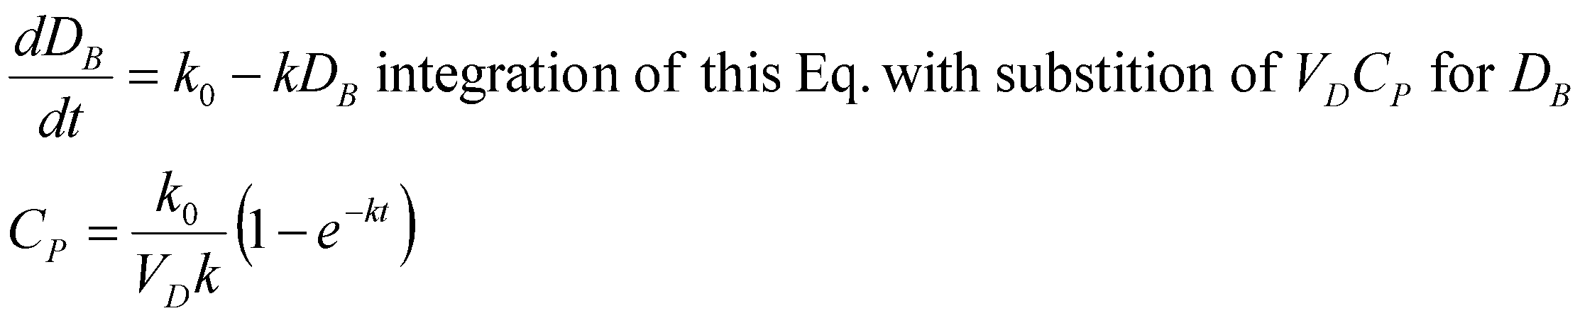
Drug is simultaneously and immediately eliminated from the body by a first-order rate process defined by a first-order rate constant, k. This model is analogous to that of the administration of a drug by intravenous infusion.
The rate of first-order elimination at any time is equal to D_{B} k. The rate of input is simply k₀. Therefore, the net change per unit time in the body can be expressed as:

Slide 10
First-Order Absorption Model
Absorption is usually assumed to be a first-order process.
This model assumes a first-order input across the gut wall and first-order elimination from the body.
This model applies mostly to the oral absorption of drugs in solution or rapidly dissolving dosage (immediate release) forms such as tablets, capsules, and suppositories and drugs given by IM or SC aqueous injections.

Slide 11
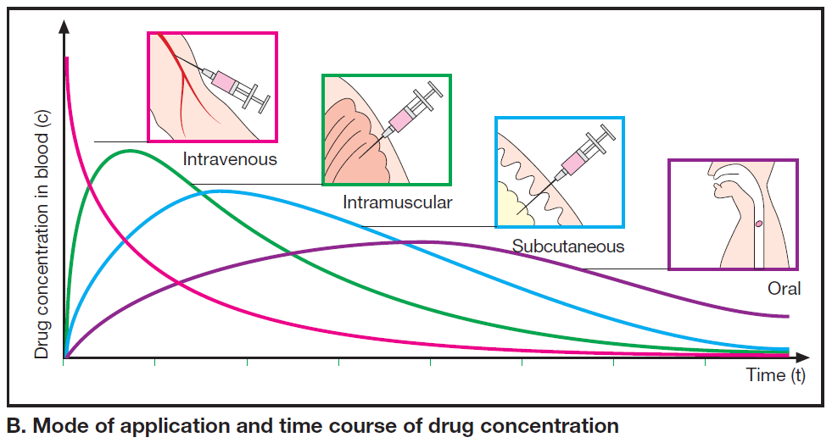

Slide 12

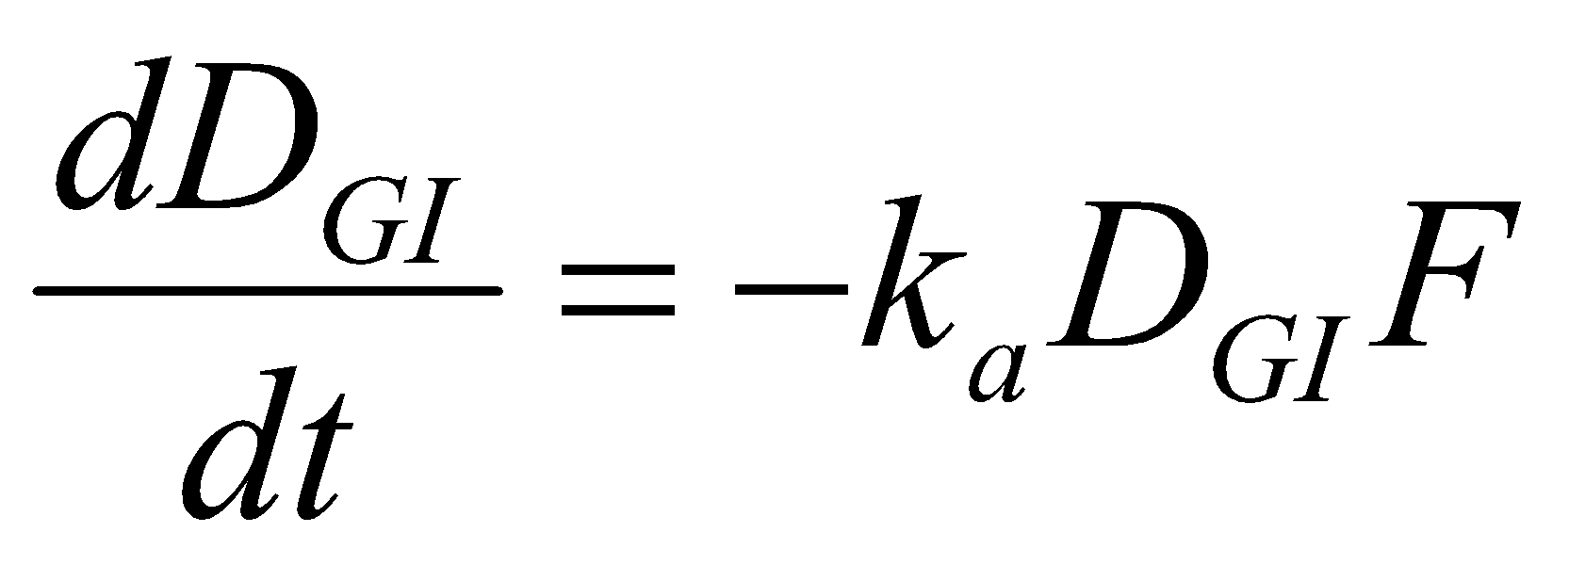
First-Order Absorption Model
The rate of disappearance of drug from the gastrointestinal tract is described by:
One-compartment pharmacokinetic model for first-order drug absorption and first-order elimination.
where :
k_{a} is the first-order absorption rate constant from the GI tract.
F is the fraction absorbed.
D_{GI} is the amount of drug in solution in the GI tract at any time t.

Slide 13
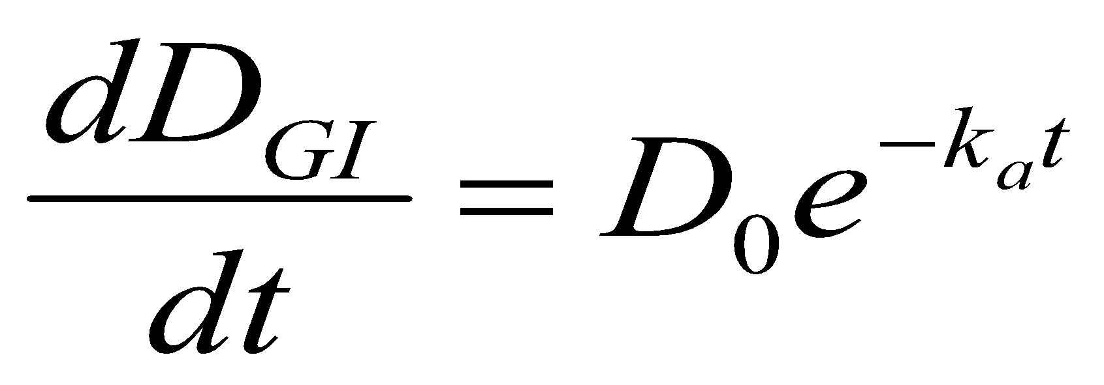
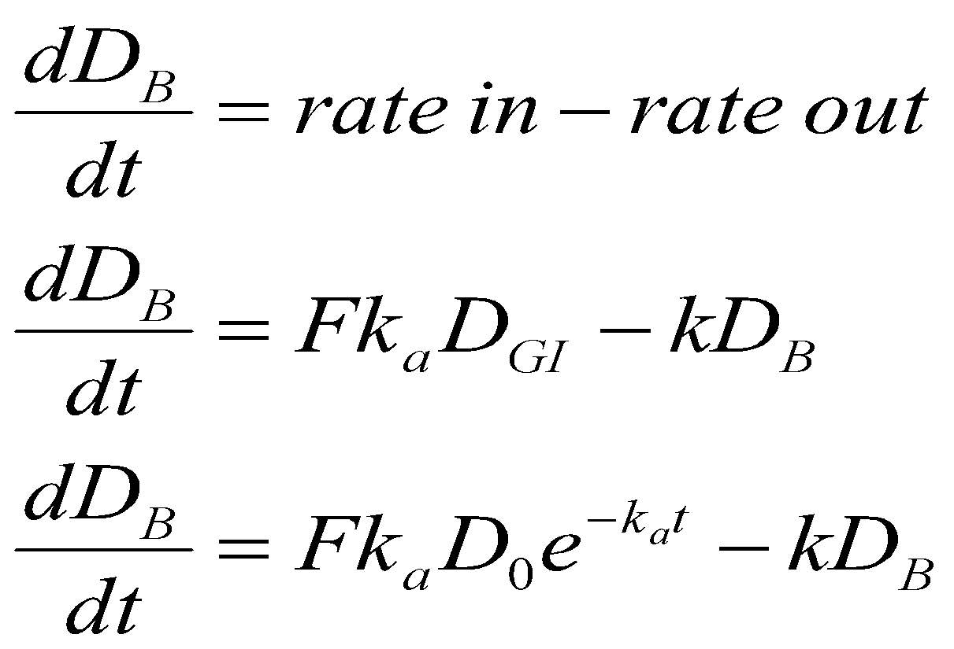
First-Order Absorption Model
Integration of the previous equation gives:
The rate of drug change in the body, dD_{B}/dt, is:

Slide 14
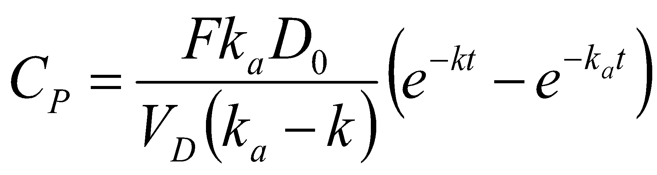
First-Order Absorption Model
The value of F may vary from 1 for a fully absorbed drug to 0 for a drug that is completely unabsorbed.
This equation can be integrated to give the general oral absorption equation for calculation of the drug concentration (C_{p}) in the plasma at any time t,

Slide 15
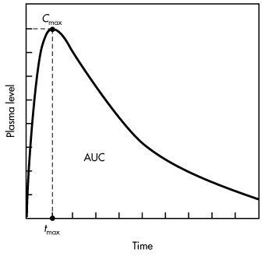
First-Order Absorption Model
A typical plot of the concentration of drug in the body after a single oral dose is presented.
Typical plasma level–time curve for a drug given in a single oral close.

Slide 16
First-Order Absorption Model
The maximum plasma concentration after oral dosing is C_{max}, and the time needed to reach maximum concentration is t_{max}.
The t_{max} is independent of dose and is dependent on the rate constants for absorption (k_{a}) and elimination (k).
At C_{max}, sometimes called peak concentration, the rate of drug absorbed is equal to the rate of drug eliminated. Therefore, the net rate of concentration change is equal to zero.

Slide 17
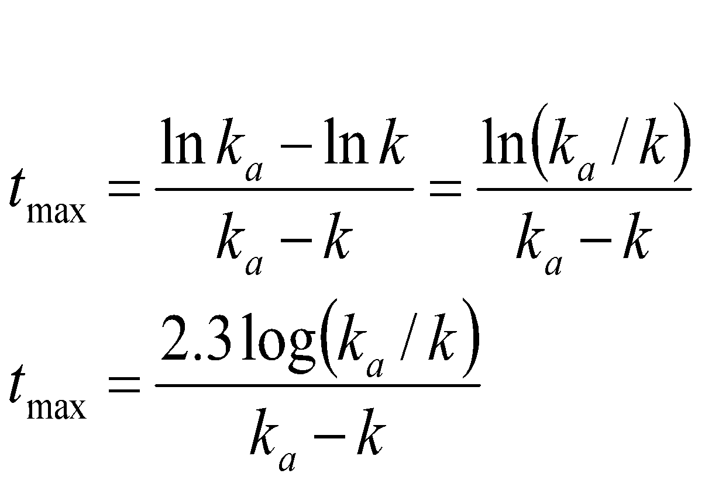
First-Order Absorption Model
At C_{max}, the rate of concentration change can be obtained by:

Slide 18
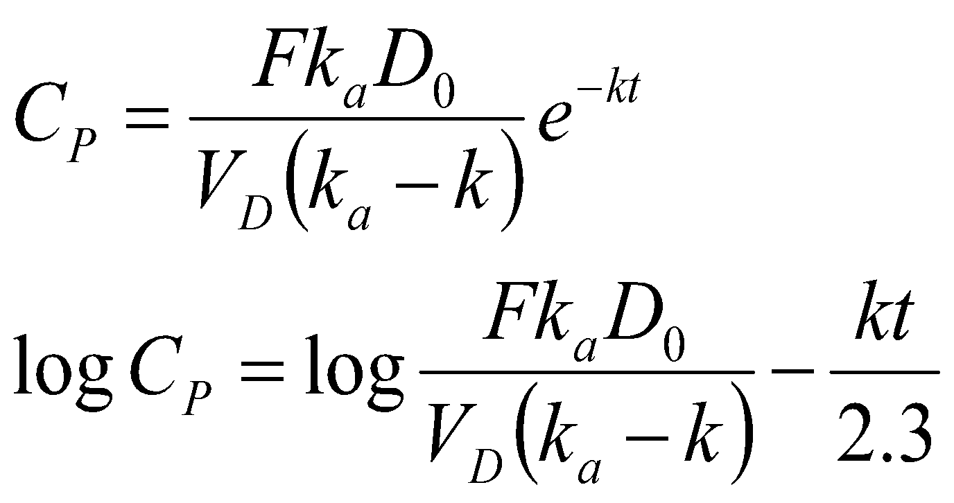
First-Order Absorption Model
The first-order elimination rate constant may be determined from the elimination phase of the plasma level–time curve.
At later time intervals, when drug absorption has been completed, ie, e^{–kat} ≈ 0, Equation reduces to:

Slide 19
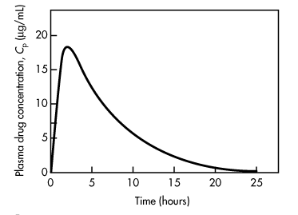
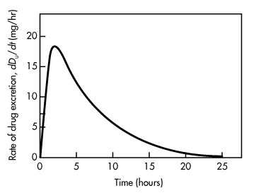
First-Order Absorption Model
Plasma drug concentration versus time
single oral dose.
Rate of urinary drug excretion versus time
single oral dose.

Slide 20
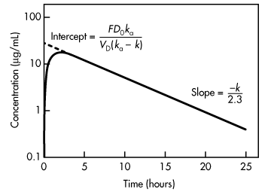
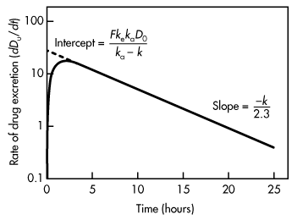
First-Order Absorption Model
plotting log C_{p} versus time will yield a straight line with a slope of –k/2.3
Plasma drug concentration versus time
single oral dose.
Rate of urinary drug excretion versus time
single oral dose.

Slide 21
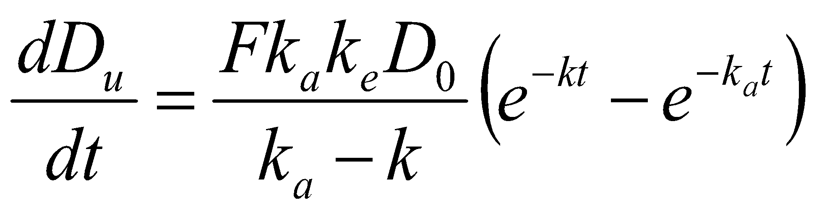
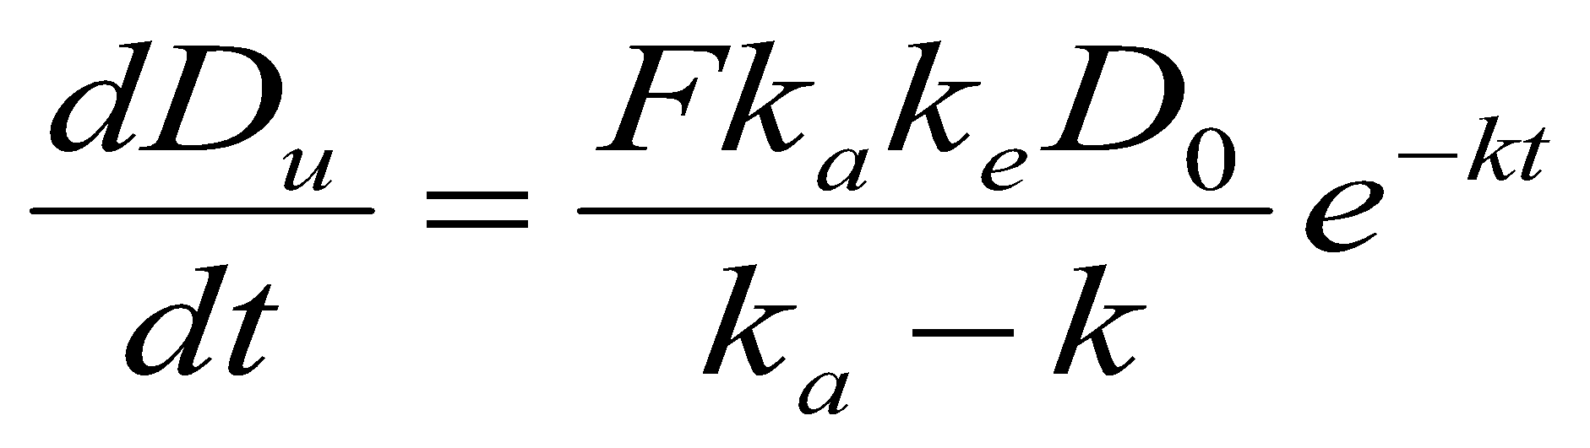
First-Order Absorption Model
urinary drug excretion data may also be used for calculation of the first-order elimination rate constant.
The rate of drug excretion after a single oral dose of drug is given by:
After drug absorption is virtually complete, –e^{–k}_{a}^{t} approaches zero, and Equation reduces to

Slide 22
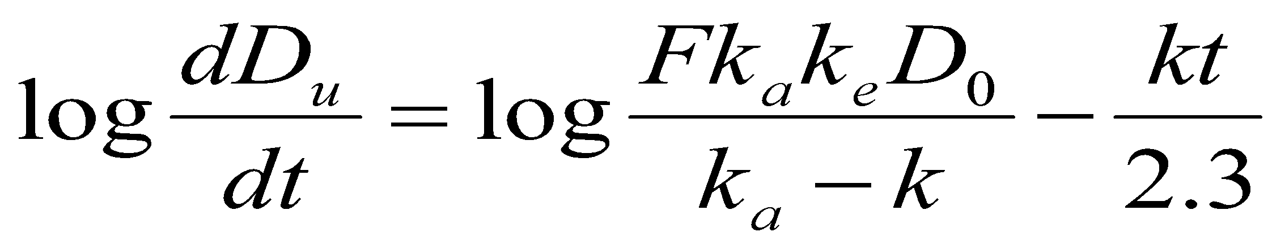
First-Order Absorption Model
Taking the natural logarithm of previous eq.
When log (dD_{u}/dt) is plotted against time, a graph of a straight line is obtained with a slope of –k/2.3.
Because the rate of urinary drug excretion, dD_{u}/dt, cannot be determined directly for any given time point, an average rate of urinary drug excretion is obtained, and this value is plotted against the midpoint of the collection period for each urine sample.

Slide 23
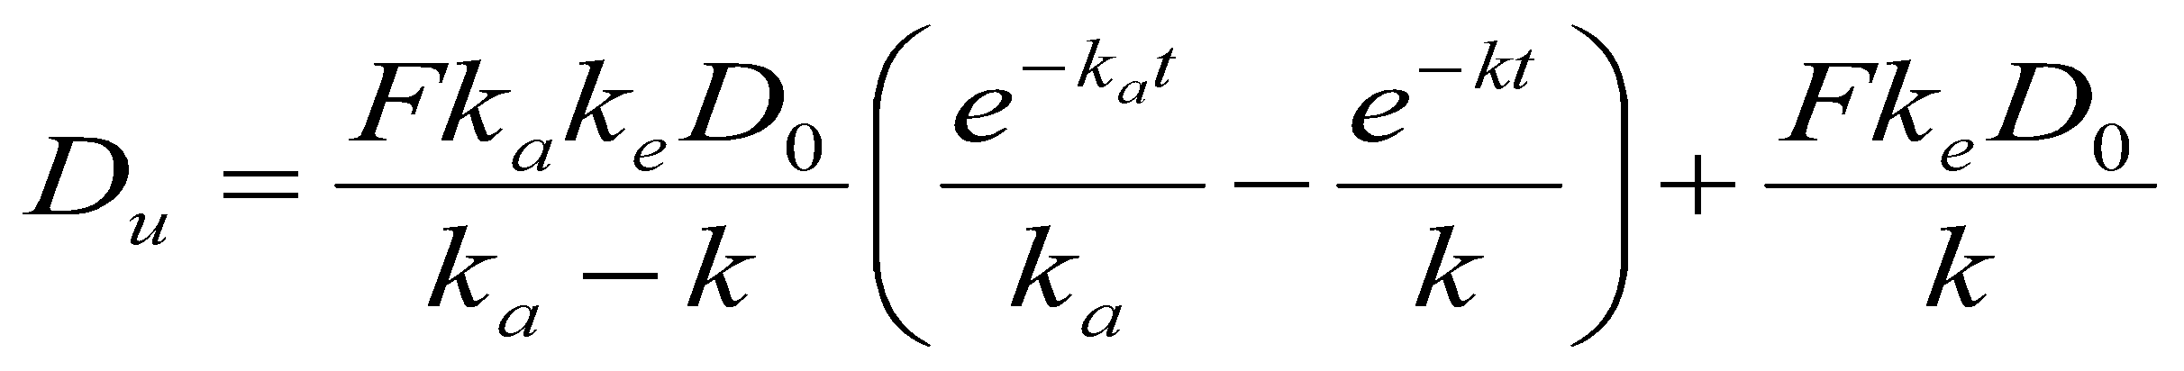
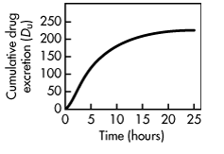
First-Order Absorption Model
To obtain the cumulative drug excretion in the urine
A plot of D_{u} versus time will give the urinary drug excretion curve:
Cumulative urinary drug excretion versus time single oral dose.

Slide 24
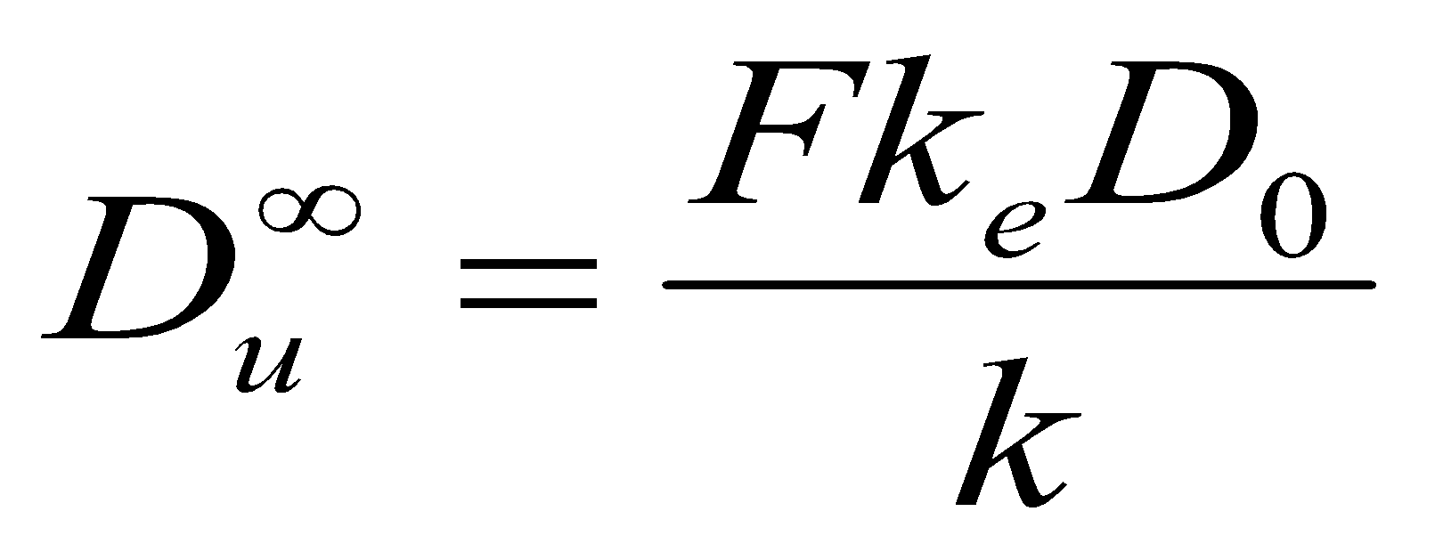
First-Order Absorption Model
When all of the drug has been excreted, at t = ∞. Equ. reduces to:
where: D ∞_{u} is the maximum amount of active or parent drug excreted.

Slide 25
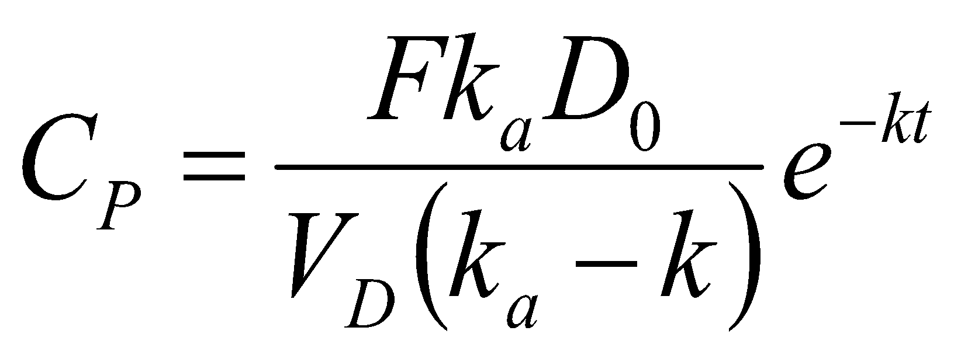
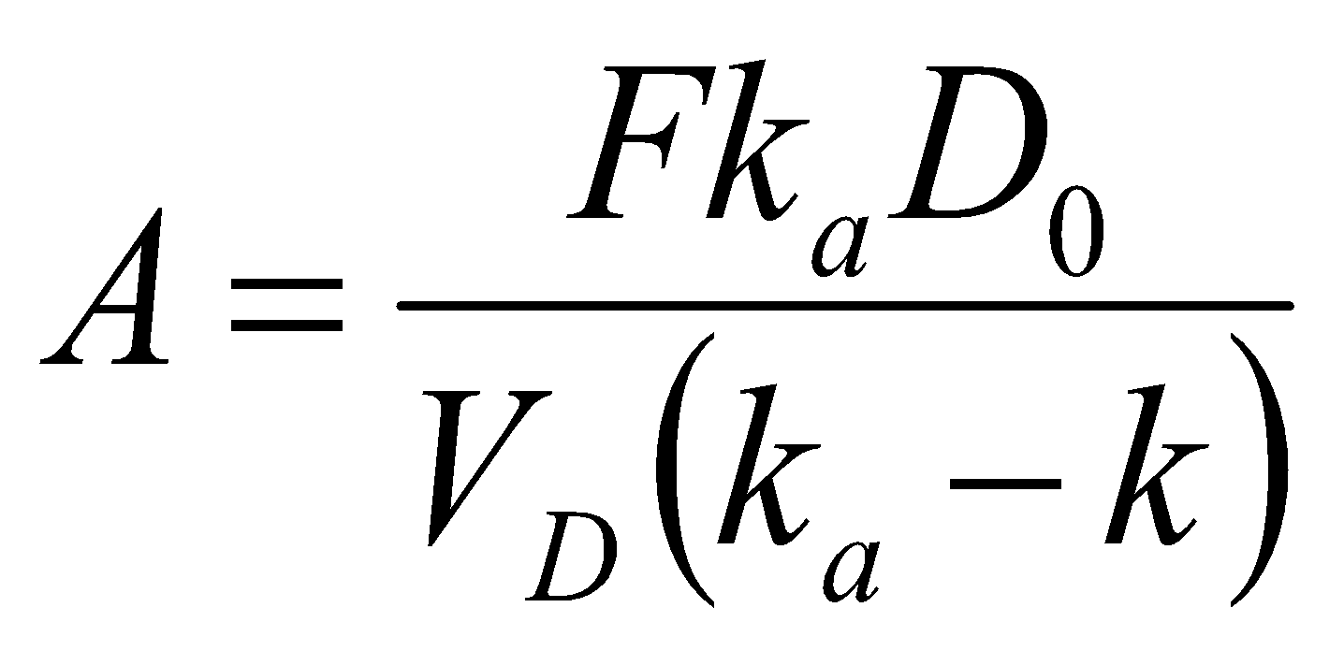
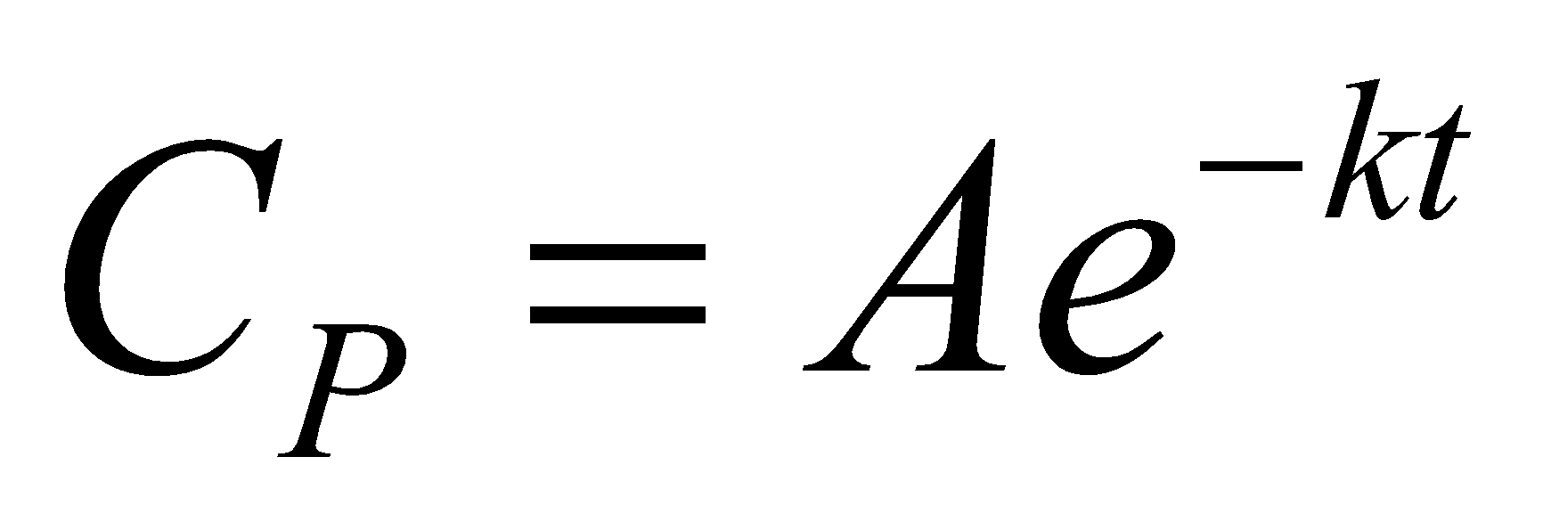
Determination of Absorption Rate Constants from Oral Absorption Data
Method of Residuals
When this is the case, drug absorption is virtually complete:
The intercept of the y axis:
Where A is a constant. Thus, Equ. Becomes:
This equation represents first-order drug elimination.

Slide 26
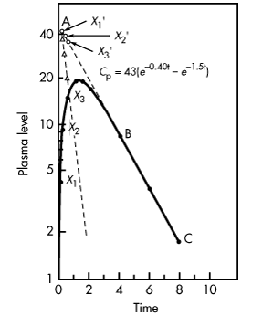
Method of Residuals
The value of k_{a} is obtained by the following procedure:
Plot the drug concentration versus time on semilog paper.
Obtain the slope of the terminal phase (line BC, ) by extrapolation.
Take any points on the upper part of line BC (eg, x'₁, x'₂, x'₃, . . .) and drop vertically to obtain corresponding points on the curve (eg, x ₁, x ₂, x ₃,.)

Slide 27
Method of Residuals
Read the concentration values at x ₁ and x'₁, x ₂ and x'₂, x ₃ and x'₃, and so on. Plot the values of the differences at the corresponding time points Δ₁, Δ₂, Δ₃, . . . . A straight line will be obtained with a slope of –k _{a}/2.3.

Slide 28
Method of Residuals
When using the method of residuals, a minimum of three points should be used to define the straight line.
Data points occurring shortly after t_{max} may not be accurate, because drug absorption is still continuing at that time. Because this portion of the curve represents the postabsorption phase, only data points from the elimination phase should be used to define the rate of drug absorption as a first-order process.

Slide 29
Method of Residuals
If drug absorption begins immediately after oral administration, the residual lines obtained will intersect on the y axis at point A.
The value of this y intercept, A, represents a hybrid constant composed of k_{a}, k, V_{D}, and FD₀. The value of A has no direct physiologic meaning.

Slide 30
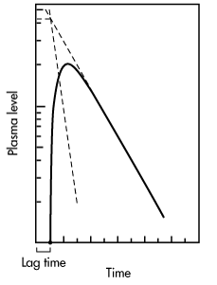
Lag Time
In some individuals, absorption of drug after a single oral dose does not start immediately, due to such physiologic factors as stomach-emptying time and intestinal motility.
The time delay prior to the commencement of first-order drug absorption is known as lag time.

Slide 31
Lag Time
The lag time for a drug may be observed if the two residual lines obtained by feathering the oral absorption plasma level–time curve intersect at a point greater than t = 0 on the x axis.
The time at the point of intersection
on the x axis is the lag time.
The lag time, t₀, represents the beginning of drug absorption and should not be confused with the pharmacologic term onset time, which represents latency, eg, the time required for the drug to reach minimum effective concentration.

Slide 32
Flip-Flop of k_{a} and k
In a few cases, the elimination rate constant k obtained from oral absorption data does not agree with that obtained after intravenous bolus injection.
For example, the k obtained after an intravenous bolus injection of a bronchodilator was 1.72 hr^{–1}, whereas the k calculated after oral administration was 0.7 hr^{–1}. When k_{a} was obtained by the method of residuals, the rather surprising result was that the k_{a} was 1.72 hr^{–1}.

Slide 33
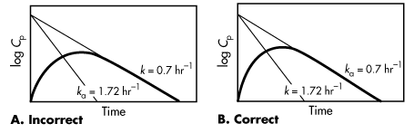
Flip-Flop of k_{a} and k
Flip-flop of k _{a} and k. Because k > k _{a}

Slide 34
Flip-Flop of k_{a} and k
Most of the drugs observed to have flip-flop characteristics are drugs with fast elimination (ie, k > k_{a}).
For drugs that have a large elimination rate constant (k > 0.69 hr^{–1}), the chance for flip-flop of k_{a} and k is much greater.
Drugs with a large k are usually considered to be unsuitable for an oral drug product due to their large elimination rate constant, corresponding to a very short elimination half-life.
An extended-release drug product may slow the absorption of a drug, such that the k _{a} is smaller than the k and producing a flip-flop situation.

Slide 35
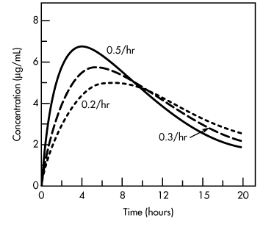
If the values for k_{a} and k are reversed, then the same t_{max} is obtained, but the C_{max} and AUC are different.
If the elimination rate constant is kept at 0.1 hr^{–1} and the k_{a} changes from 0.2 to 0.6 hr^{–1} (absorption rate increases), then the t_{max} becomes shorter (from 6.93 to 3.58 hr), the C_{max} increases (from 5.00 to 6.99 μg/mL), but the AUC remains constant (100 μg hr/mL).
Effect of a change in the absorption rate constant, k_{a}, on the plasma drug concentration-versus-time curve.
Dose of drug is 100 mg, V _{D} is 10 L, and k is 0.1 hr^{–1}.

Slide 36
Effect of k_{a} and k on C_{max}, t_{max}, and AUC
Changes in k_{a} and k may affect t_{max}, C_{max}, and AUC as shown:
Absorption Rate Constant k_{a} (hr^{–1}) | Elimination Rate Constant k (hr^{–1}) | t _{max} (hr) | C _{max} (μg/mL) | AUC (μg hr/mL)
0.1 | 0.2 | 6.93 | 2.50 | 50
0.2 | 0.1 | 6.93 | 5.00 | 100
0.3 | 0.1 | 5.49 | 5.77 | 100
0.4 | 0.1 | 4.62 | 6.29 | 100
0.5 | 0.1 | 4.02 | 6.69 | 100
0.6 | 0.1 | 3.58 | 6.99 | 100
0.3 | 0.1 | 5.49 | 5.77 | 100
0.3 | 0.2 | 4.05 | 4.44 | 50
0.3 | 0.3 | 3.33 | 3.68 | 33.3
0.3 | 0.4 | 2.88 | 3.16 | 25
0.3 | 0.5 | 2.55 | 2.79 | 20

Slide 37
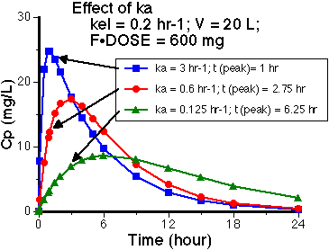
Notice that with higher values of ka the peak plasma
concentrations are higher and earlier.

Slide 38
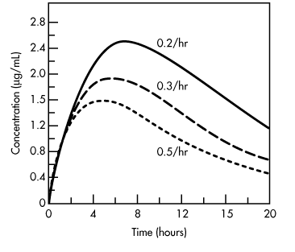
Effect of k_{a} and k on C_{max}, t_{max}, and AUC
In contrast, when the absorption rate constant is kept at 0.3 hr^{–1} and k changes from 0.1 to 0.5 hr^{–1} (elimination rate increases), then the t_{max} decreases (from 5.49 to 2.55 hr), the C_{max} decreases (from 5.77 to 2.79 μg/mL), and the AUC decreases (from 100 to 20 μg hr/mL).
Effect of a change in the elimination rate constant, k, on the plasma drug concentration-versus-time curve.
Dose of drug is 100 mg, V _{D} is 10 L, and k _{a} is 0.1 hr– ¹.

Slide 39
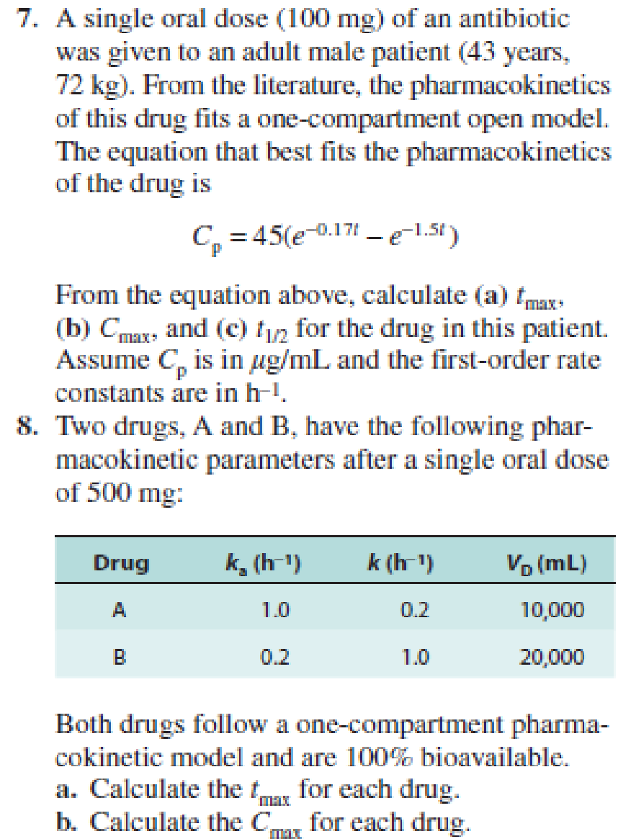

Slide 40
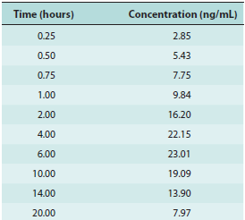
Homework (submit next lecture)
Plasma samples from a patient were collected after an oral bolus dose of 10 mg of a new benzodiazepine solution as follows:
a. Determine the elimination constant of the drug.
b. Determine k a by feathering.
c. Determine the equation that describes the plasma drug concentration of the new benzodiazepine.
d. the elimination half-life, t 1/2;
e. the t max, or time of peak drug concentration.
f. the volume of distribution of the drug.

