Slide 1
Thermodynamics ENME 333
Chapter 4
First Law For a Control Volume
Afif Akel Hasan
Mechanical & Mechatronics Engineering Department

Slide 2
Outline
Mass conservation
First law for a C.V.
SSSF process
USUF process

Slide 3


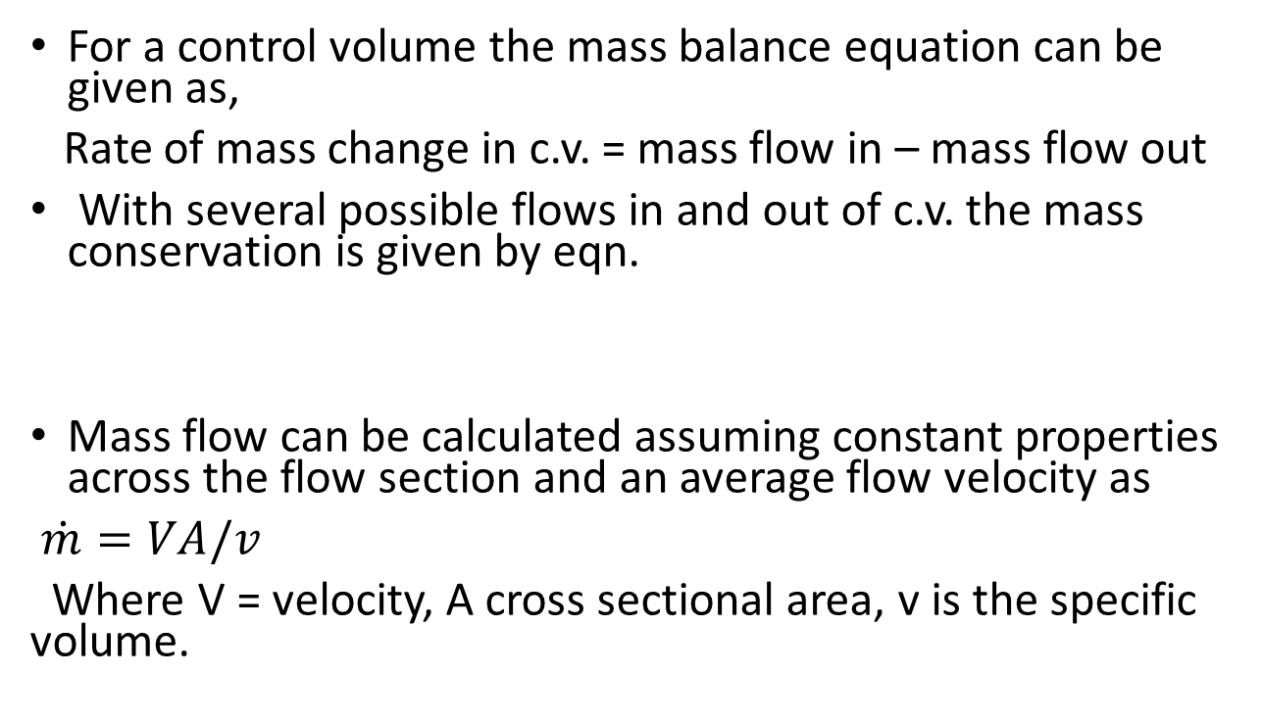
Mass conservation
For a control volume the mass balance equation can be given as,
Rate of mass change in c.v. = mass flow in – mass flow out
With several possible flows in and out of c.v. the mass conservation is given by eqn.
Mass flow can be calculated assuming constant properties across the flow section and an average flow velocity as
$\dot{m}=VA/v$
Where V = velocity, A cross sectional area, v is the specific volume.

Slide 4
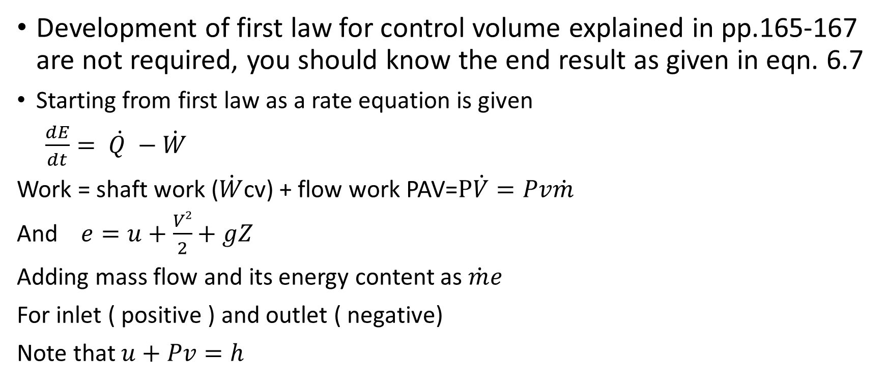
The first law for a control volume
Development of first law for control volume explained in pp.165-167 are not required, you should know the end result as given in eqn. 6.7
Starting from first law as a rate equation is given
$\frac{dE}{dt}= \dot{Q }−\dot{W}$
Work = shaft work ($\dot{W}$cv) + flow work PAV=$P\dot{V}=Pv\dot{m}$
And $e=u+\frac{V2}{2}+gZ$
Adding mass flow and its energy content as $\dot{m}e$
For inlet ( positive ) and outlet ( negative)
Note that $u+Pv=h$

Slide 5

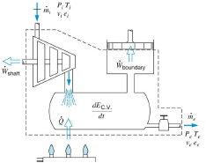
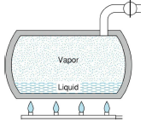

The first law for a control volume
First law becomes as ;
$$\frac{dEcv}{dt}=\dot{Q}cv−\dot{W}cv+\sum_{in}{\dot{m}\left(hi+\frac{Vi2}{2}+gZi\right)−\sum_{out}{\dot{m}( he+\frac{Ve2}{2}+gZe)}}$$

Slide 6
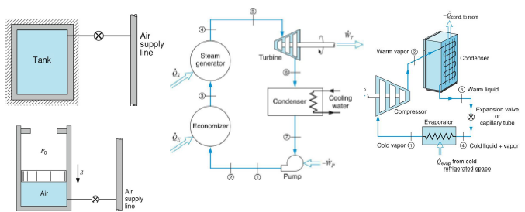
Examples of CV

Slide 7
The Steady – State, Steady – Flow process SSSF
The SSSF model is suitable for the long-term operation of devices such as turbines, compressors, nozzles, boilers etc.. ,
This model excludes the transient start-up and shut down periods of such devices.
Main assumptions in simplifying SSSF model are:
  State of mass at each point in the control volume does not vary with time.
  Mass flux and the state of this mass at each area of flow does not vary with time.

Slide 8

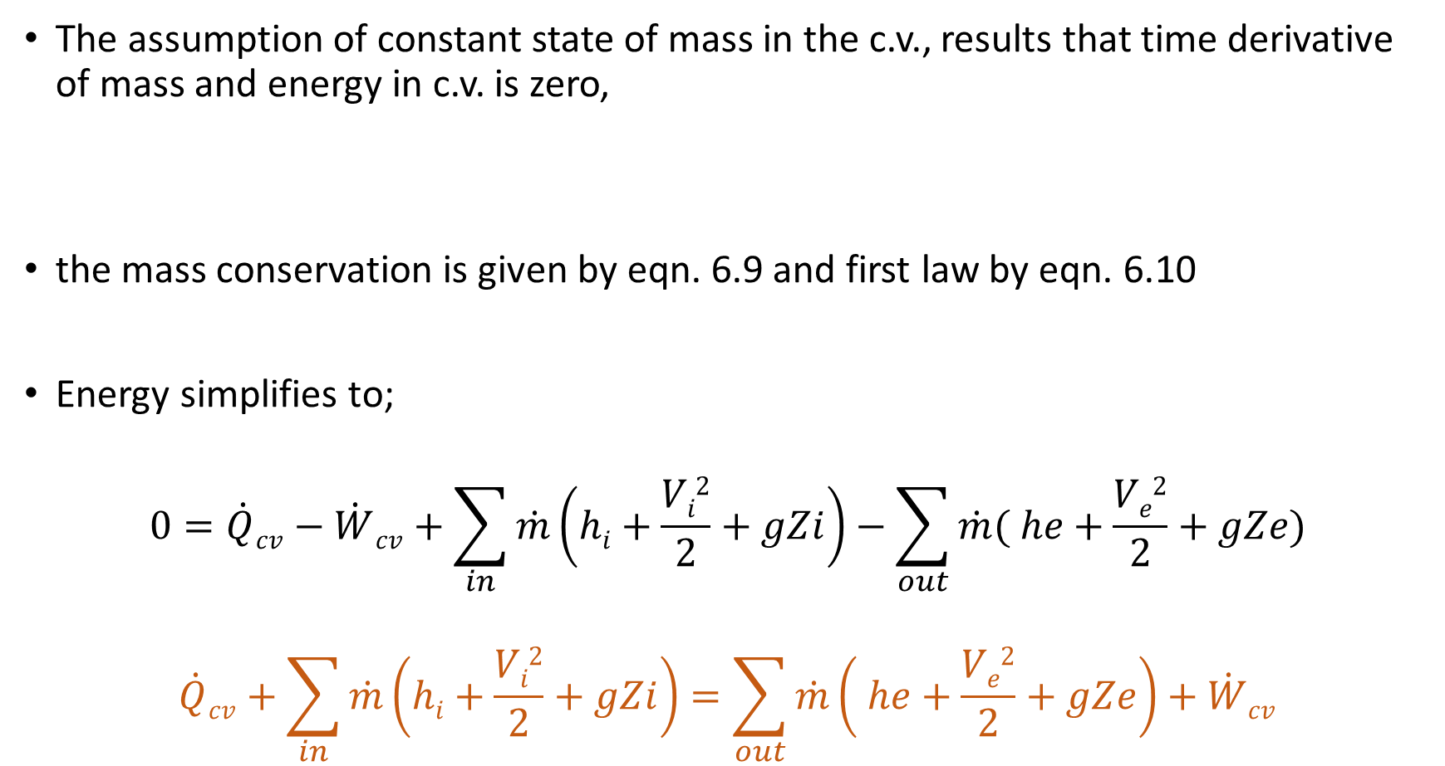
SSSF
The assumption of constant state of mass in the c.v., results that time derivative of mass and energy in c.v. is zero,
the mass conservation is given by eqn. 6.9 and first law by eqn. 6.10
Energy simplifies to;
$$0=\dot{Q}cv−\dot{W}cv+\sum_{in}{\dot{m}\left(hi+\frac{Vi2}{2}+gZi\right)−\sum_{out}{\dot{m}( he+\frac{Ve2}{2}+gZe)}}$$
$$\dot{Q}cv+\sum_{in}{\dot{m}\left(hi+\frac{Vi2}{2}+gZi\right)=\sum_{out}{\dot{m}\left( he+\frac{Ve2}{2}+gZe\right)+\dot{W}cv}}$$

Slide 9
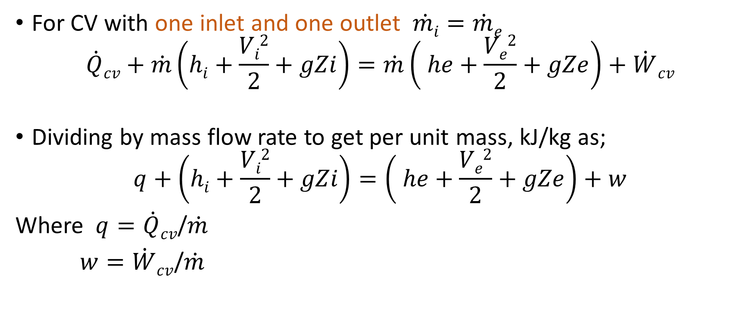
Per unit mass
For CV with one inlet and one outlet $\dot{mi}=\dot{m}e$
$$\dot{Q}cv+\dot{m}\left(hi+\frac{Vi2}{2}+gZi\right)=\dot{m}\left( he+\frac{Ve2}{2}+gZe\right)+\dot{W}cv$$
Dividing by mass flow rate to get per unit mass, kJ/kg as;
$$q+\left(hi+\frac{Vi2}{2}+gZi\right)=\left( he+\frac{Ve2}{2}+gZe\right)+w$$
Where $q=\dot{Q}cv$/$\dot{m}$
$w=\dot{W}cv$/$\dot{m}$

Slide 10
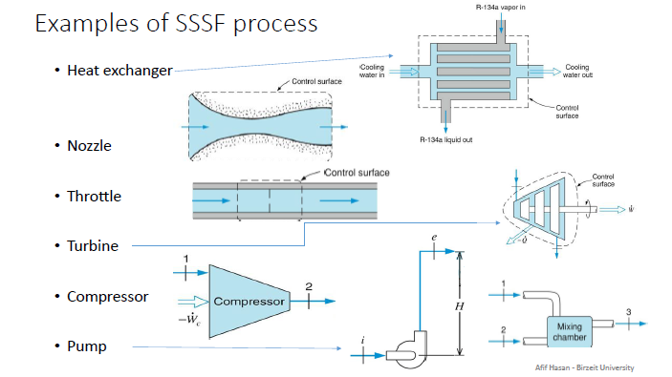

Slide 11
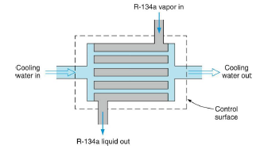
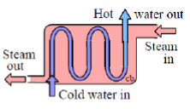
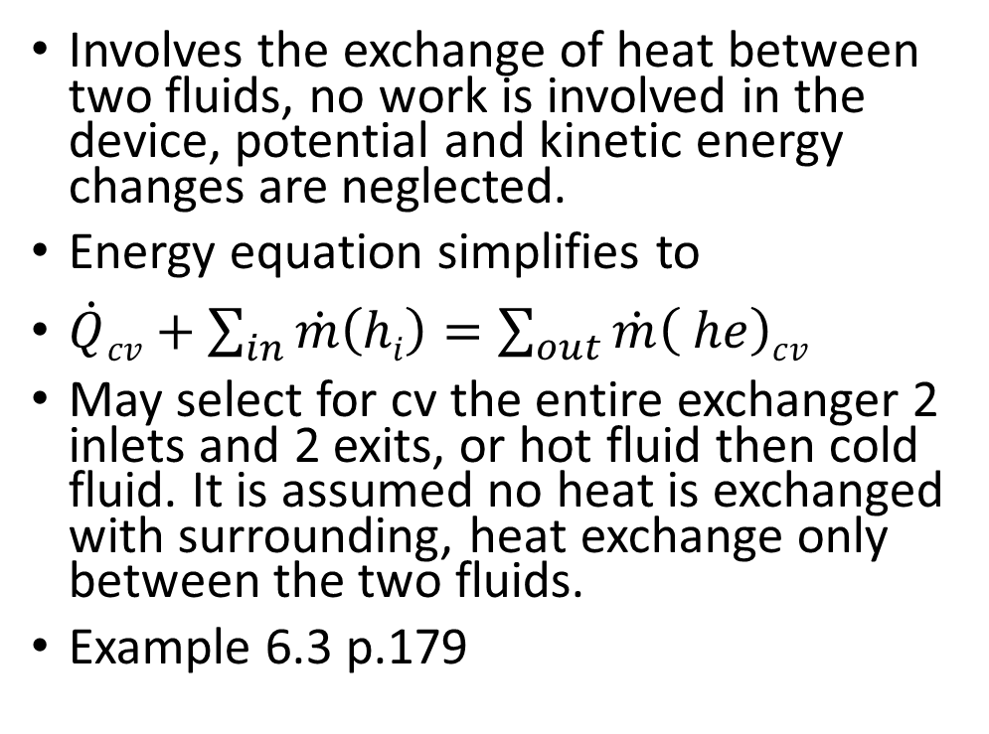
Heat exchanger
Involves the exchange of heat between two fluids, no work is involved in the device, potential and kinetic energy changes are neglected.
Energy equation simplifies to
$\dot{Q}cv+\sum_{in}{\dot{m}\left(hi\right)=\sum_{out}{\dot{m}\left( he\right)cv}}$
May select for cv the entire exchanger 2 inlets and 2 exits, or hot fluid then cold fluid. It is assumed no heat is exchanged with surrounding, heat exchange only between the two fluids.
Example 6.3 p.179

Slide 12

Heat exchanger
May select for cv the entire exchanger 2 inlets and 2 exits
Mass balance;
  $\sum_{in}{\dot{m}}=\sum_{out}{\dot{m}}$
  First law, Q=0;
  $$\sum_{in}{\dot{mi}hi}=\sum_{out}{\dot{m}ehe}$$

Slide 13
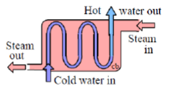
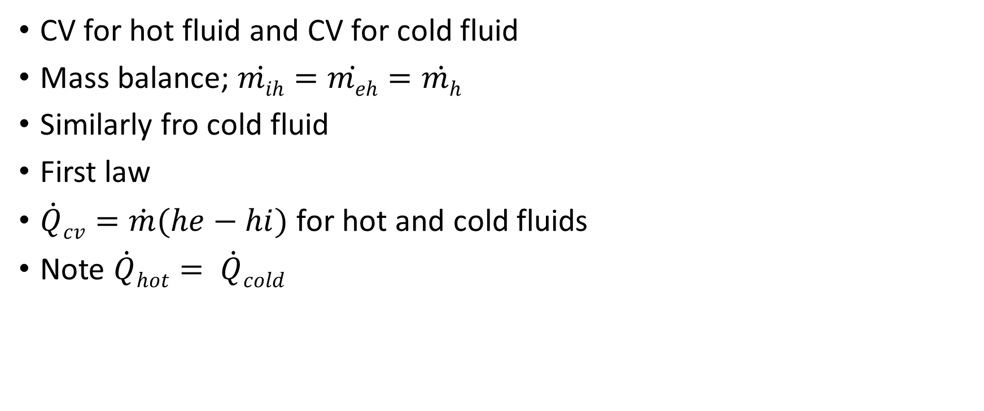
Heat exchanger
CV for hot fluid and CV for cold fluid
Mass balance; $\dot{mih}=\dot{meh}=\dot{mh}$
Similarly fro cold fluid
First law
$\dot{Q}cv=\dot{m}(he−hi)$ for hot and cold fluids
Note $\dot{Q}hot= \dot{Q}cold$

Slide 14
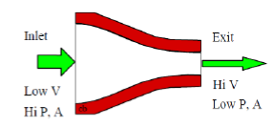
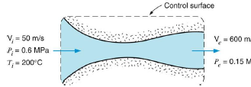
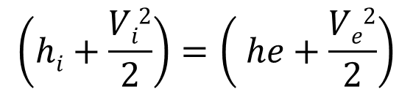
Nozzle
A SSSF device whose purpose is to increase the velocity of the fluid.
Nozzle has only one inlet and one outlet and hence first law per unit mass is used.
Nozzle involves no work, and often it is assumed adiabatic or no heat transfer, no change in PE
Simplifies to;
$$\left(hi+\frac{Vi2}{2}\right)=\left( he+\frac{Ve2}{2}\right)$$

Slide 15
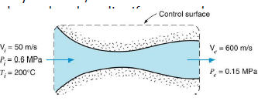
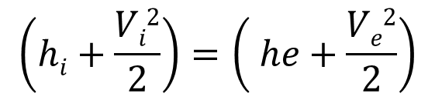
Example 6.4 ( 4.4)
Steam at 0.6 MPa , 200ºC enters an insulated nozzle with velocity of 50 m/s. It leaves at 0.15 MPa and velocity of 600m/s. Determine the final temperature if the steam is superheated and quality if saturated.
CV: nozzle , SSSF, steam tables.
Wcv=0, Qcv=0 insulated
Neglect PE, first law;
Given Vi=50 , Ve=600 , hi=2850.1, solve for he
he= 2671.4 kJ/kg The two properties (he, Pe.) Since he is less than hg at 0.15 MPa, In saturation region , solve for quality x=0.99
$$\left(hi+\frac{Vi2}{2}\right)=\left( he+\frac{Ve2}{2}\right)$$

Slide 16
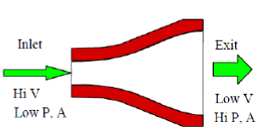
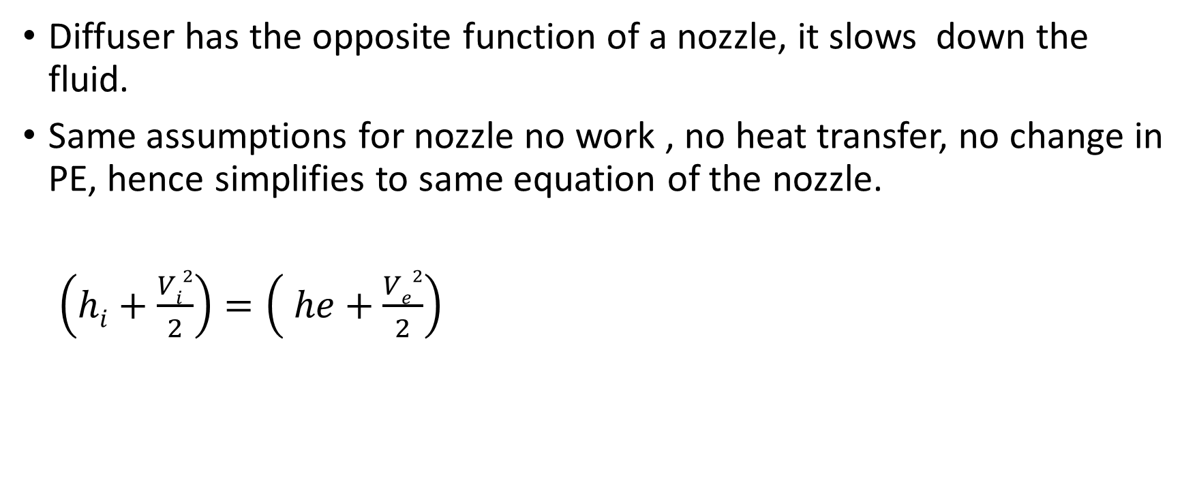
Diffuser
Diffuser has the opposite function of a nozzle, it slows down the fluid.
Same assumptions for nozzle no work , no heat transfer, no change in PE, hence simplifies to same equation of the nozzle.
$\left(hi+\frac{Vi2}{2}\right)=\left( he+\frac{Ve2}{2}\right)$

Slide 17

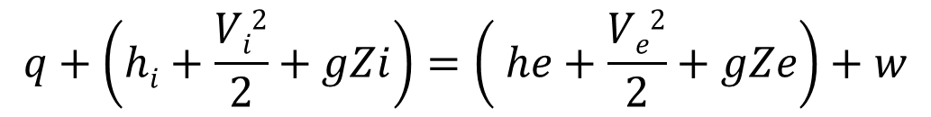

Throttle
A throttling process occurs when a fluid flowing in a line encounters a restriction in the flow passage, an example is the throttling in the refrigeration cycle or the flow across a valve.
No work is involved in the throttling process, only one inlet and exit, process is assumed adiabatic and no change in potential and kinetic energies this leads to simplifying first law to one of constant enthalpy.
Throttling is a constant enthalpy process.
$$q+\left(hi+\frac{Vi2}{2}+gZi\right)=\left( he+\frac{Ve2}{2}+gZe\right)+w$$
$$\left(hi\right)=\left( he\right)$$

Slide 18
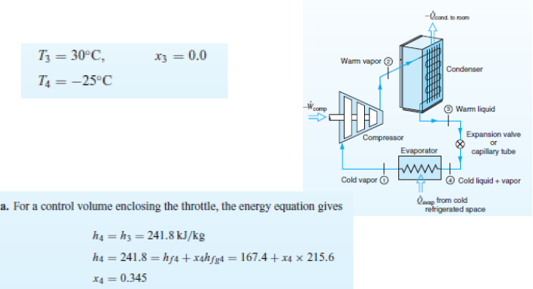

Slide 19
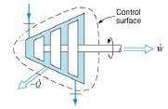

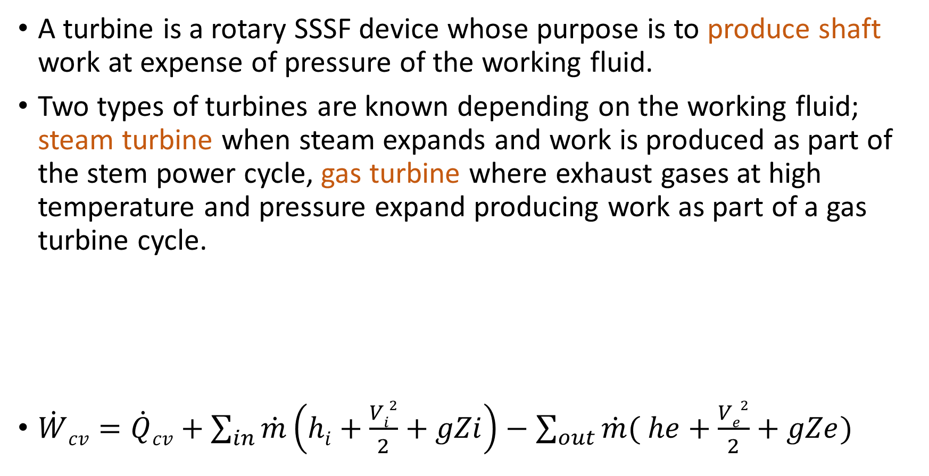
Turbine
A turbine is a rotary SSSF device whose purpose is to produce shaft work at expense of pressure of the working fluid.
Two types of turbines are known depending on the working fluid; steam turbine when steam expands and work is produced as part of the stem power cycle, gas turbine where exhaust gases at high temperature and pressure expand producing work as part of a gas turbine cycle.
$\dot{W}cv=\dot{Q}cv+\sum_{in}{\dot{m}\left(hi+\frac{Vi2}{2}+gZi\right)−\sum_{out}{\dot{m}( he+\frac{Ve2}{2}+gZe)}}$

Slide 20
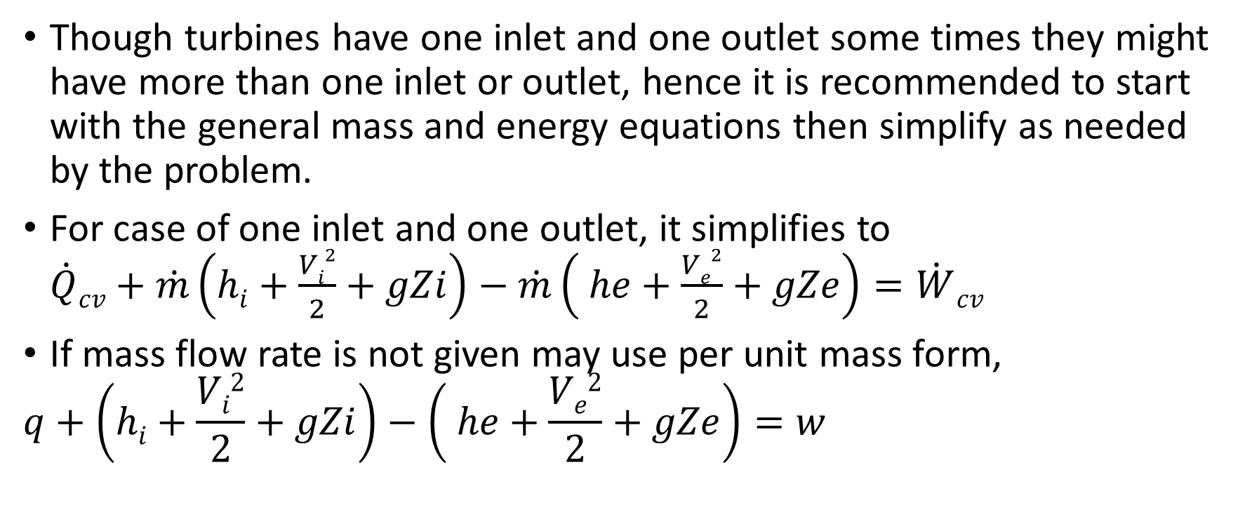
Turbine
Though turbines have one inlet and one outlet some times they might have more than one inlet or outlet, hence it is recommended to start with the general mass and energy equations then simplify as needed by the problem.
For case of one inlet and one outlet, it simplifies to $\dot{Q}cv+\dot{m}\left(hi+\frac{Vi2}{2}+gZi\right)−\dot{m}\left( he+\frac{Ve2}{2}+gZe\right)=\dot{W}cv$
If mass flow rate is not given may use per unit mass form,
$$q+\left(hi+\frac{Vi2}{2}+gZi\right)−\left( he+\frac{Ve2}{2}+gZe\right)=w$$

Slide 21
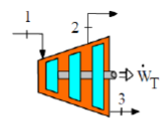
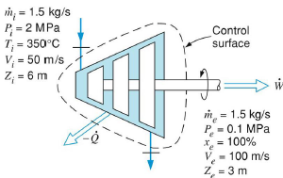
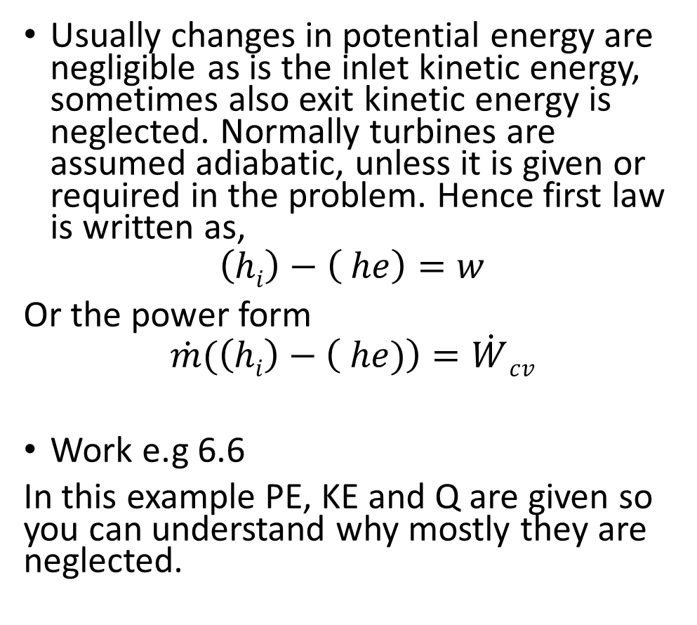
Turbine
Usually changes in potential energy are negligible as is the inlet kinetic energy, sometimes also exit kinetic energy is neglected. Normally turbines are assumed adiabatic, unless it is given or required in the problem. Hence first law is written as,
$$\left(hi\right)−\left( he\right)=w$$
Or the power form
$$\dot{m}(\left(hi\right)−\left( he)\right)=\dot{W}cv$$
Work e.g 6.6
In this example PE, KE and Q are given so you can understand why mostly they are neglected.

Slide 22
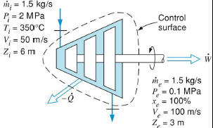
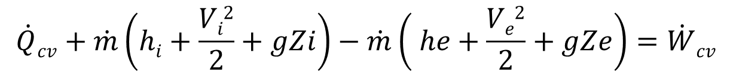
Example 6.6
Mass flow rate into steam turbine 1.5kg/s , heat transfer from turbine 8.5kW.given inlet and exit conditions calculate turbine output power.
CV; turbine, SSSF, steam tables.
KE in = 1.25 kJ/kg, KE out =5.0
PE in =0.059 kJ/kg, PE out = 0.029kJ/kg
Compare with hi=3137kJ/kg and
  he =2675.5 kJ.kg then changes in PE and
  KE are negligible.
  In general if velocity is below 20 m/s , K.E is ignored.
$$\dot{Q}cv+\dot{m}\left(hi+\frac{Vi2}{2}+gZi\right)−\dot{m}\left( he+\frac{Ve2}{2}+gZe\right)=\dot{W}cv$$

Slide 23
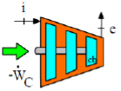
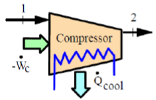
Compressor & pump
The purpose of a compress is to increase the pressure of a gas, while for the pump is to increase the pressure of a liquid.
First law can be applied per unit mass when mass flow rate is not known other wise use power form of equation.
Usually changes in potential and kinetic energies are neglected. Compressors and pumps are assumed adiabatic unless otherwise noted, such cooled compressors or when heat exchange is given or required to be calculated.

Slide 24
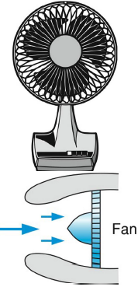
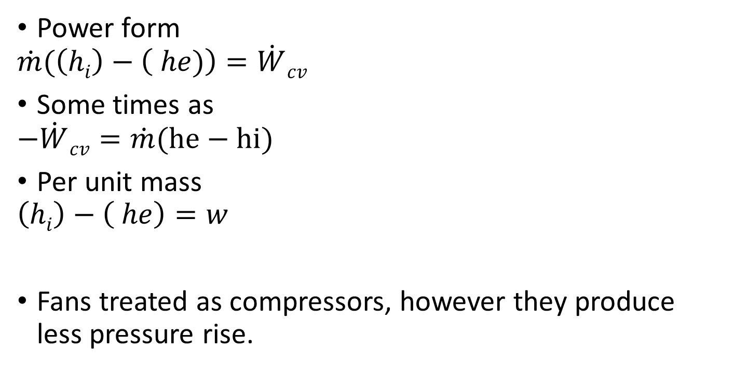
Compressor
Power form
$$\dot{m}(\left(hi\right)−\left( he)\right)=\dot{W}cv$$
Some times as
$$−\dot{W}cv=\dot{m}(he−hi)$$
Per unit mass
$$\left(hi\right)−\left( he\right)=w$$
Fans treated as compressors, however they produce less pressure rise.

Slide 25
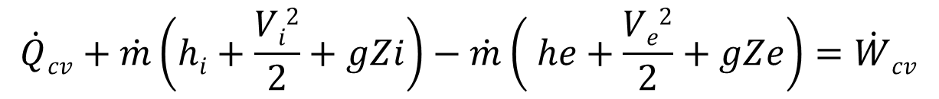
$$q+\left(hi+\frac{Vi2}{2}+gZi\right)=\left( he+\frac{Ve2}{2}+gZe\right)+w$$
$$\dot{Q}cv+\dot{m}\left(hi+\frac{Vi2}{2}+gZi\right)−\dot{m}\left( he+\frac{Ve2}{2}+gZe\right)=\dot{W}cv$$

Slide 26
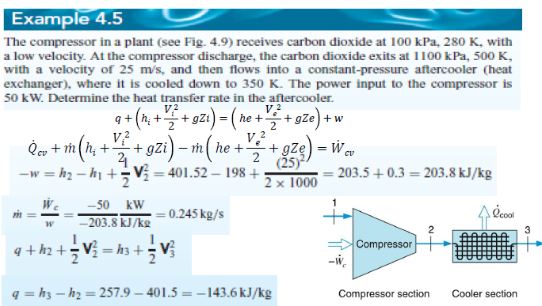

Slide 27
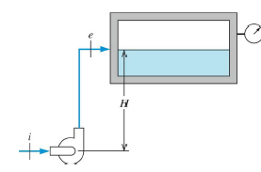
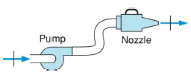
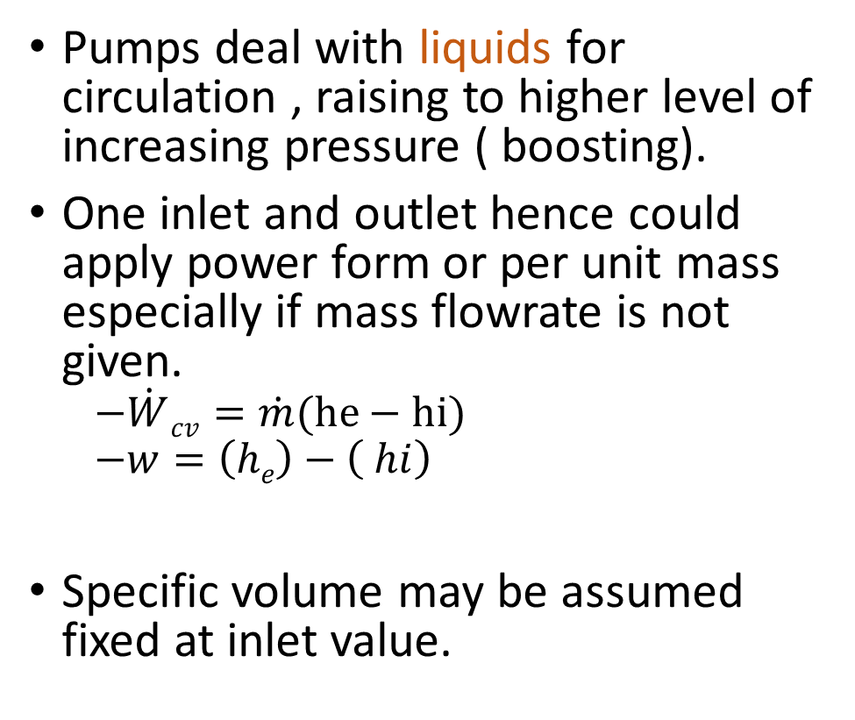
Pumps
Pumps deal with liquids for circulation , raising to higher level of increasing pressure ( boosting).
One inlet and outlet hence could apply power form or per unit mass especially if mass flowrate is not given.
  $$−\dot{W}cv=\dot{m}(he−hi)$$
  $$−w=\left(he\right)−\left( hi\right)$$
Specific volume may be assumed fixed at inlet value.

Slide 28
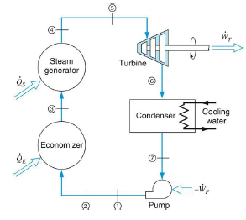
Power plant
SSSF system
One inlet /outlet CV
May analyze per unit mass then calculate as power by multiplying by mass flow rate.
Analyze each component in the cycle
If required net power is calculate and efficiency.

Slide 29
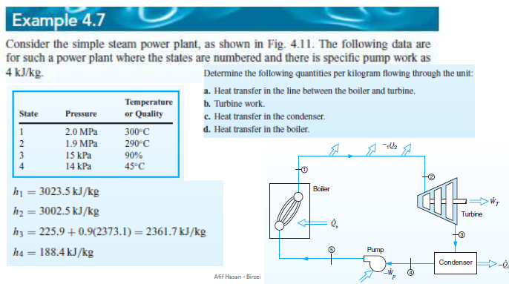

Slide 30
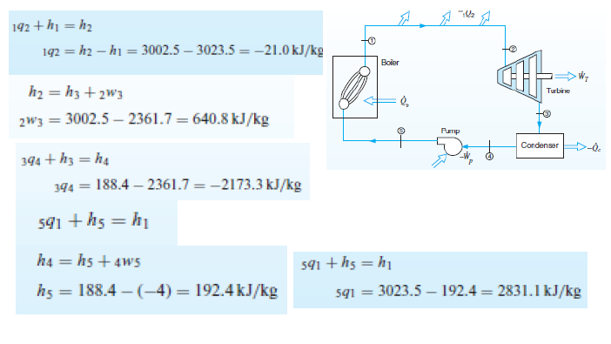

Slide 31
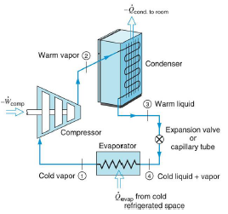
Refrigeration cycle
SSSF system
One inlet /outlet CV
May analyze per unit mass then calculate as power by multiplying by mass flow rate.
Analyze each component in the cycle
If required net power is calculate and COP.

Slide 32
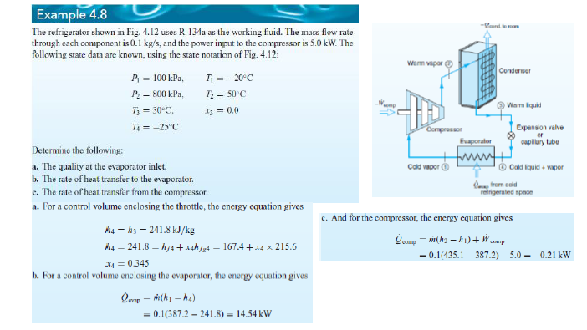

Slide 33
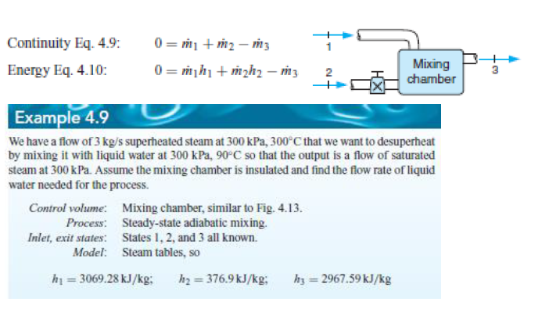

Slide 34
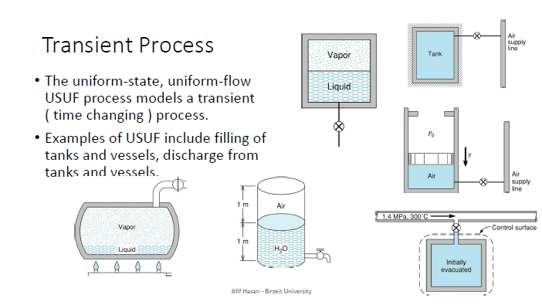

Slide 35
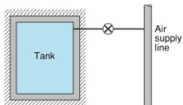
USUF
Main assumptions of USUF are
  State of the mass within the c.v. may change with time, but at any instant of time the state is uniform throughout the entire c.v.
  State of the mass crossing the areas of flow on the control surface is constant with time although the mass flow rates may change with time.
Since changes are taking place with time the total change in the c.v. from some initial state 1 to some final state 2 is obtained by integrating the relevant rate equation. Conditions at inlet are donated by subscript i and at the outlet by subscript e.

Slide 36
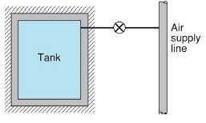



USUF
$\int_{1}^{2}{dmcv=mcv2−mcv1}$
$\int{\dot{m}dt=m}$
Carrying out the integration over the mass conservation results in the mass conservation equation for the USUF model as
$$mcv2−mcv1=\sum{mi−\sum{me}}$$

Slide 37

USUF
$\frac{dEcv}{dt}=\dot{Q}cv−\dot{W}cv+\sum_{in}{\dot{m}\left(hi+\frac{Vi2}{2}+gZi\right)−\sum_{out}{\dot{m}( he+\frac{Ve2}{2}+gZe)}}$
$\int_{1}^{2}{dEcv=Ecv2−Ecv1=\left(E2−E1\right)cv}$
$\int{\dot{(Q}cv−\dot{W}cv})dt=Qcv−Wcv$
$\int{\dot{(\sum_{in}{\dot{m}\left(hi+\frac{Vi2}{2}+gZi\right)−\sum_{out}{\dot{m}\left( he+\frac{Ve2}{2}+gZe\right)})dt}}}$
$$=\sum_{in}{mi\left(hi+\frac{Vi2}{2}+gZi\right)−\sum_{out}{me ( he+\frac{Ve2}{2}+gZe)}}$$
for the first law of thermodynamics
$\left(E2−E1\right)cv$= $Qcv−Wcv$ +$\sum_{in}{mi\left(hi+\frac{Vi2}{2}+gZi\right)−\sum_{out}{me ( he+\frac{Ve2}{2}+gZe)}}$

Slide 38


$$mcv2−mcv1=\sum{mi−\sum{me}}$$

Slide 39


USUF
Example 6.12 p.167 note the trial and error solution required for the last example.

Slide 40


Slide 41


Slide 42


Slide 43


Slide 44


Slide 45
End of chapter 6 First law for CV

