Slide 1
Lecture 10
NUTD 343
Dr. Emilia Rappocciolo

Slide 2
Staphylococcal gastroenteritis
Can be caused by the toxin alone and therefore it is difficult to diagnose either intoxication or illness. Gastroenteritis does not require to be specific.
Staphylococcus aureus can be associated with both animals and humans.
The two most important sources to foods are nasal carriers and individuals whose hands and arms are inflicted with boils and carbuncles, who are permitted to handle foods.
Can cause mastitis in cows and milk or cheese produced from contaminated animals is likely to contain the toxin and cause disease.
Staphylococci may be expected to exist, at least in low numbers, in any or all food products that are of animal origin or in those that are handled directly by humans, unless heat-processing steps are applied to effect their destruction

Slide 3
characteristics
Gram positive cocci, mesophiles. Can grow at temperatures as low as 6.7 °C. Range: between 7 and 45 °C.
Produce enterotoxins (SEs) between 10 and 45 °C.
Grows well in NaCl 7-10%. Some strains can grow in 20% NaCl (pH and aw affect salt tolerance).
Optimum pH 6-7, but can grow at pH 4 or 9.8.
Unique in its ability to grow at low aw. As low as 0.83

Slide 4
Enterotoxins and virulence factors
More than 20 different SE identified. µg range is enough to cause vomiting and diarrhea within 4 hors of ingestion.
The toxins are very powerful and can cause death. In particular TSST (toxic shock syndrome toxin) can cause toxic shock and death within a very short time.
SEA, SEB, SEC, SED most commonly associated with food poisoning. Heat resistant. Superantigens
Other virulence factors: adhesins, collagenases, protein A, coagulases, hemolysins, leukocidins.
Lactobacilli in fermented food can outcompete S. aureus and it is possible that metabolic products of lactobacilli might deactivate toxins (at least in part)

Slide 5
disease
The symptoms of staphylococcal food poisoning usually develop within 4 hours of the ingestion of contaminated food.
Symptoms—nausea, vomiting, abdominal cramps (which are usually quite severe), diarrhea, sweating, headache, prostration, and sometimes a fall in body temperature—generally lasting from 24 to 48 hours, and the mortality rate is very low or nil.
The usual treatment for healthy persons consists of bed rest and maintenance of fluid balance.
Proof of staphylococcal food poisoning is established by recovering enterotoxigenic staphylococci from leftover food and from the stool cultures of victims.
The minimum quantity of enterotoxin needed to cause illness in humans is about 20 ng .This value is derived from an outbreak of staphylococcal gastroenteritis traced to 2% chocolate milk. From 12 cartons of milk, SEA was found at levels from 94 to 184 ng per carton, with a mean of 144 ng. The attack rate was associated with the quantity of milk consumed and somewhat with age; those aged 5–9 years were more sensitive than those aged 10–19 years.

Slide 6
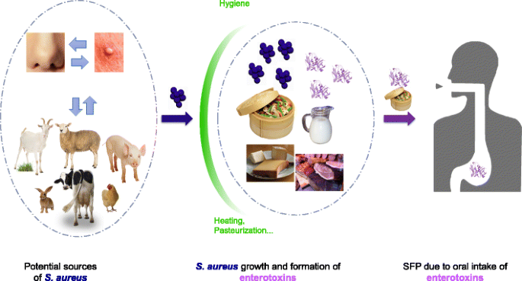
disease

Slide 7
prevention
When susceptible foods are produced with low numbers of staphylococci, they will remain free of enterotoxins and other food-poisoning hazards if kept either at or below 4.4◦C or above 60◦C until consumed.
For the years 1961–1972, over 700 foodborne-disease outbreaks were investigated and out of 16 factors that contributed to the outbreaks, the 5 most frequently involved were the following:
1. inadequate refrigeration;
2. preparing foods far in advance of planned service;
3. infected persons’ practicing poor personal hygiene;
4. inadequate cooking or heat processing;
5. holding food in warming devices at bacterial growth temperatures.

Slide 8
Clostridium botulinum
Botulism results from Consumption of food containing the potent toxin A. it is a neurotoxin which produces both neurological symptoms and some gastric symptoms.
Unless prompt treatment is administered, it is fatal
Infant botulism occurs from ingestion of spores that germinate, grow, and produce toxins in the GI tract
In the US, the average number of outbreaks is about 16/year
55 cases of botulism/year are estimated in the US with 9 death (16%)
Many outbreaks occur from foods prepared at home

Slide 9
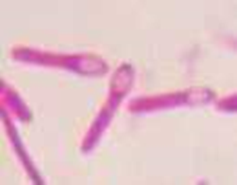
characteristics
C. botulinum: Gram-positive rods, many are motile, obligate anaerobes form single terminal spores
Spores do not germinate in the presence of nitrite (250 ppm)
Spores are highly heat resistant (killed at 115°C), cells are killed at moderate heat (pasteurization)
Toxins form during growth
Strains can either be proteolytic or nonproteolytic

Slide 10
Growth and toxins
C. botulinum strains are divided into 7 types, on the basis of the type of toxin produced:
Toxin types: A, B, C, D, E, F, G
A, B, E, and F are associated with human foodborne intoxications
Type A strains are proteolytic (optimum growth 35°C), Range: 10 -48°C
Type E strains are nonproteolytic (optimal growth 30°C), Range 3-45°C
Optimum growth facilitates optimum toxin production
conditions that prevent cell growth adversely affect spore germination
Growth is inhibited at: pH 4.6, Aw 0.93, 5.5% NaCl

Slide 11
habitat
Spores of C. botulinum are widely distributed in soil, sewage, mud sediments of marshes, and lakes
Intestinal contents of animals and fish
Fruits and vegetables can be contaminated with spores from soil
Fish from water and sediments
Types A and B spores are more prevalent in soil, sewage, and fecal matters of animals
Type E spores are generally found in marine environments
Type A spores are predominant in the western US
Type B spores are predominant in the eastern US and different parts of the world

Slide 12
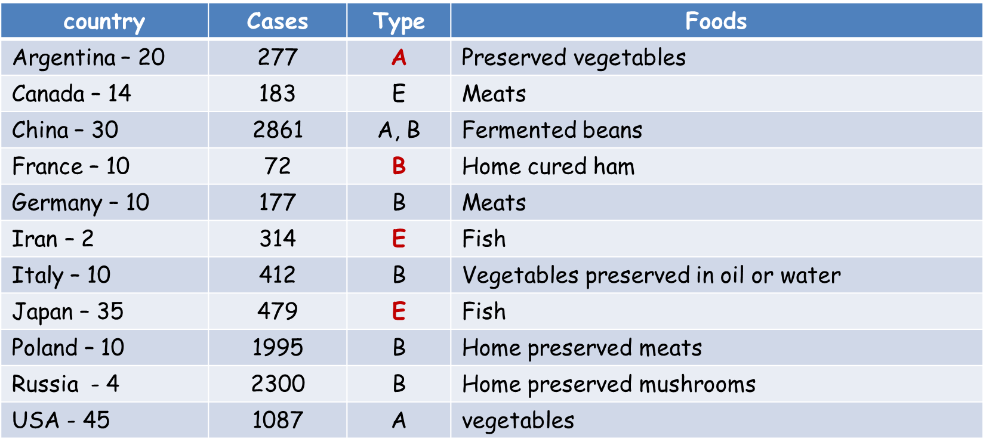
Botulism incidence

Slide 13
Toxins and toxin production
The botulinum neurotoxin consists of subunits A and B
The toxin is inactive.
Bacterial or stomach protease converts inactive toxin to the active form
Botulinum neurotoxin produced by nonproteolytic strains is activated by host protease trypsin in the intestine
Botulinum neurotoxin produced by proteolytic strain is activated by bacterial protease
Toxins associated with food intoxication in humans (types A, B, E, and F) are extremely potent, small amount of toxin produce symptoms and death.

Slide 14
Toxins and toxin production
After ingestion: toxin is absorbed in the upper intestine and spreads via blood to the peripheral nerves
B subunit (heavy chain) binds to receptor (sialic acid glycoprotein) on nerve cells
It facilitates entrance of subunit A (light chain) into the nerve cells
The A subunit cleaves synaptobrevin protein which controls the release of neurotransmitter acetylcholine in the neuromuscular junction
Interfere with the flow of nerve impulses causing irreversible paralysis of all involuntary muscles
Toxin is heat labile- destroyed in contaminated food by high uniform heat, 90°C for 15 min or boiling for 5 min, radiation can also destroy the toxin.
Cell growth is necessary for toxin production.
At optimum growth temp., toxins are produced in large amounts

Slide 15
disease
Botulism: Rare but sometimes a deadly disease
Victims require years to recover
There are 3 types of botulism:
Foodborne botulism
Infant botulism
Wound botulism

Slide 16
Foodborne botulism
Caused by ingestion of toxin formed in food
The toxin is absorbed in the intestine, spreads to peripheral nerves, and blocks transmission of nerve impulse
Toxins are highly potent, very small amount (1 ng/kg) result in severe symptoms and death
Neurological symptoms develop in a relative short time and include:
blurred or double vision, difficulty in swallowing, breathing, speaking, dryness of the mouth
paralysis of different involuntary muscles which spreads to the diaphragm, lungs, and heart
Death results from respiratory failure

Slide 17
Foodborne botulism
Associated with temperature abuse.
Outbreaks of botulism have been linked to garlic conserved in oil (refrigeration and acidification made it safe to eat) and carrot juice kept at room temperature.
Treatment: antitoxin (heptavalent antibodies obtained by horse serum)

Slide 18
Wound and infant botulism
Wound botulism: dust carrying spores can deposit in wound
Infant botulism: Spores ingested by infants, germinate in the intestine and produce toxin. Generally affects infants less than 1 year old.
Both types A and B have been identified in infant botulism cases
Symptoms
general weakness
inability to suck and control the head
loss of reflexes, and constipation.
Honey , corn syrup and dirt have been linked as sources of C. botulinum spores in infant botulism. Older individuals are protected by the intestinal flora.

Slide 19
Food association
Spores are found in contaminated food and survive during processing, germinate and outgrow when product is abused (temperature and time).
Largest number of outbreaks are associated with low acid fruits and vegetables (green beans, corn, spinach, asparagus, pepper, and mushrooms) and fruits (figs and peaches). Types A and B were associated with vegetables.
High incidence with improperly cooked and smoked fish and fish eggs. Type E associated with fish
The most common cause of outbreaks is improper home canning of contaminated products.
The occurrence of botulism from meat, poultry, and dairy products is low because they are heated and eaten quickly

Slide 20
Food association
Growth of proteolytic strains in meats, and low-acid, high-protein vegetables produce strong odors and gas
Growth of non-proteolytic strains in meat, fish, and other high-protein foods, do not produce spoilage
Because a small amount of toxin is enough to cause disease, it is better not to consume a suspected food

Slide 21
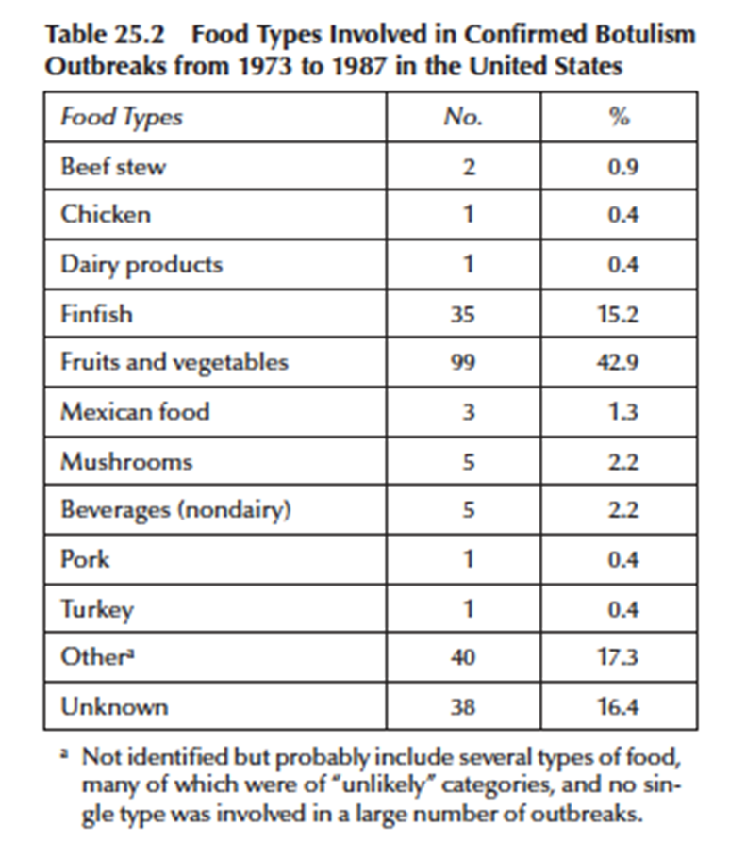

Slide 22
prevention
Use proper temperature and time in home canning of low-acid products
Commercial processors use the 13 D concept Directions:
D value: time required to inactivate 90% of the population at a given temperature
Proper and uniform cooking of foods (fish) at high temperatures
Foods cooked at temperatures where spores survive should be stored at low temperatures (at 3°C or below)
Storage of food refrigerated (4-5°C), should not be prolonged unless storage is accompanied with nitrites, low pH, low Aw, NaCl
Suspected foods should be properly heated prior to consumption but it is better not to eat them
Even tasting a small amount of a suspected food without giving high and uniform heat treatment can be dangerous

