Slide 1
Exp #8 Integrating REST API into Android
SLIDES BY: Tarek Zidan and Mohamad Balawi

Slide 2
What is REST and HTTP?
REST (Representational State Transfer):
Is an architecture and for communication.
Focuses on creating scalable, stateless APIs where each resource is uniquely identified by URIs and can be manipulated using standard methods like GET, POST, PUT, DELETE.
HTTP (Hypertext Transfer Protocol):
An implementation of the REST architecture.
The modern standard for the internet.

Slide 3

How does a browser execute a request?
The browser requires the following information to be able to execute a request:
The protocol (example: HTTP, FTP, ...).
IP address & port (example: 165.123.84.56:8621).
The path inside the host (example: /courses/computer/ENCS256)
The user arranges that information in the following order:
Protocol://IP:port/path
https://ritaj.birzeit.edu:443/courses
https://ritaj.birzeit.edu
Pop Question: My job is translating domain names into a specific IP address so that the initiating client can load the requested Internet resources. Who am I?
Domain Name System (DNS)

Slide 4
How does Android execute a request?
It needs the same information as the browser.
Has native and external libraries that are capable of doing HTTP requests.
We will be using “java.net.HttpURLConnection”.
connectionAsyncTask.execute("https://ritaj.birzeit.edu");

Slide 5
HTTP requests are time-consuming
We know that HTTP requests are sent through network of routers and switches and servers.
The response is received in about 0.2 – 3.0 seconds.
If we send a request directly in the main thread, then the UI will freeze until we receive a response. A UI freeze of a 0.2 – 3.0 seconds is catastrophic for the user experience.
Q: How do we solve such issue?
A: By executing the HTTP request in another thread.
Q: How to do that in Android?
A: By extending AsyncTask abstract class.

Slide 6
AsyncTask
By extending this class we can execute a piece of code in new thread.
We will consider 3 methods that we will override from AsyncTask class.
onPreExecute(): Executed before creating the child thread (للتمهيد لبدء التواصل).
doInBackground(String... Params): This is the child thread’s code.
onPostExecute(String s): Executed after the end of the child thread (للاخبار أن التواصل انتهى)

Slide 7
AsyncTask
When we extend AsyncTask, we need to specify 3 types:
android.os.AsyncTask <Params, Progress, Result>
Params: the type of parameters sent to the task upon execution.
Progress: is the type of progress units published during the background computation.
Result: the type of the result of the background computation.

Slide 8
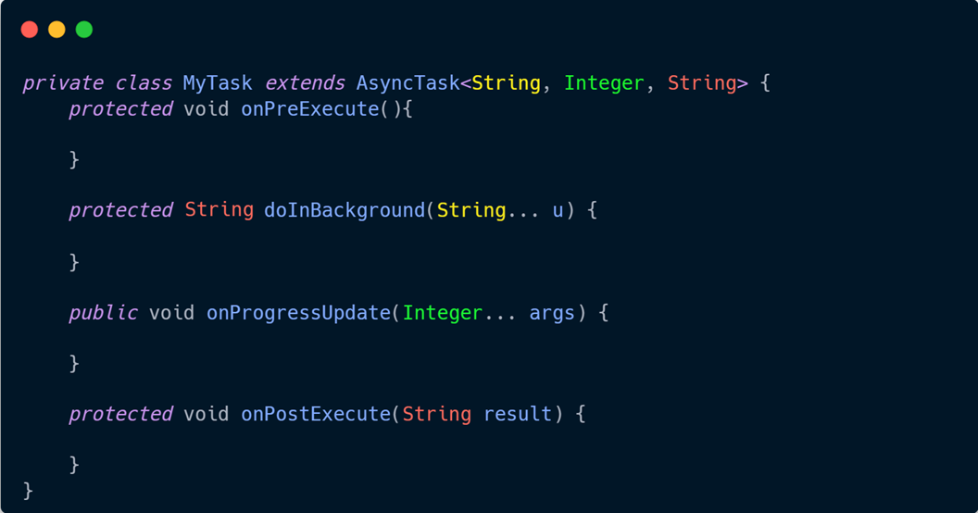

Slide 9
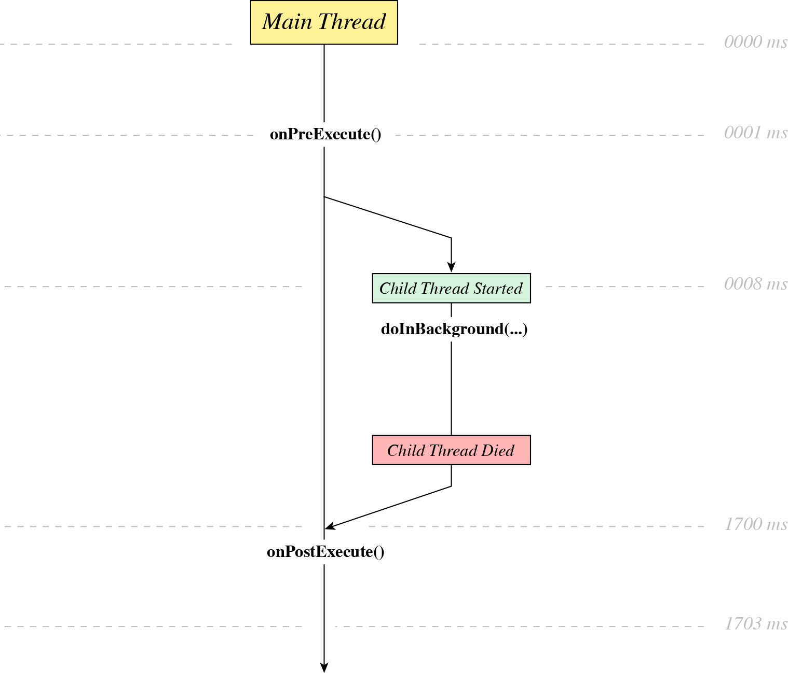
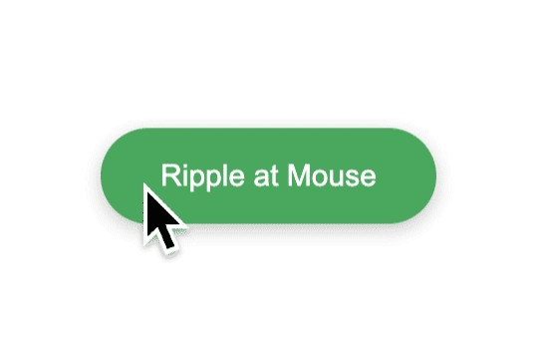


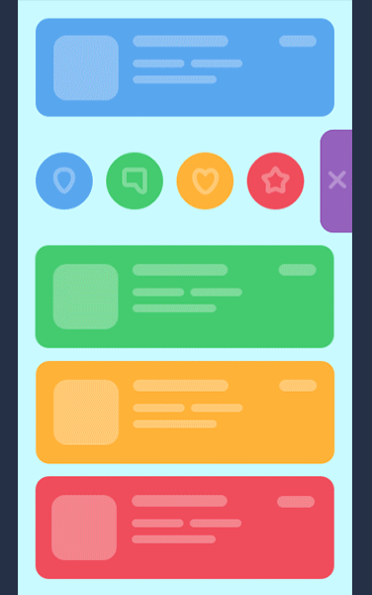

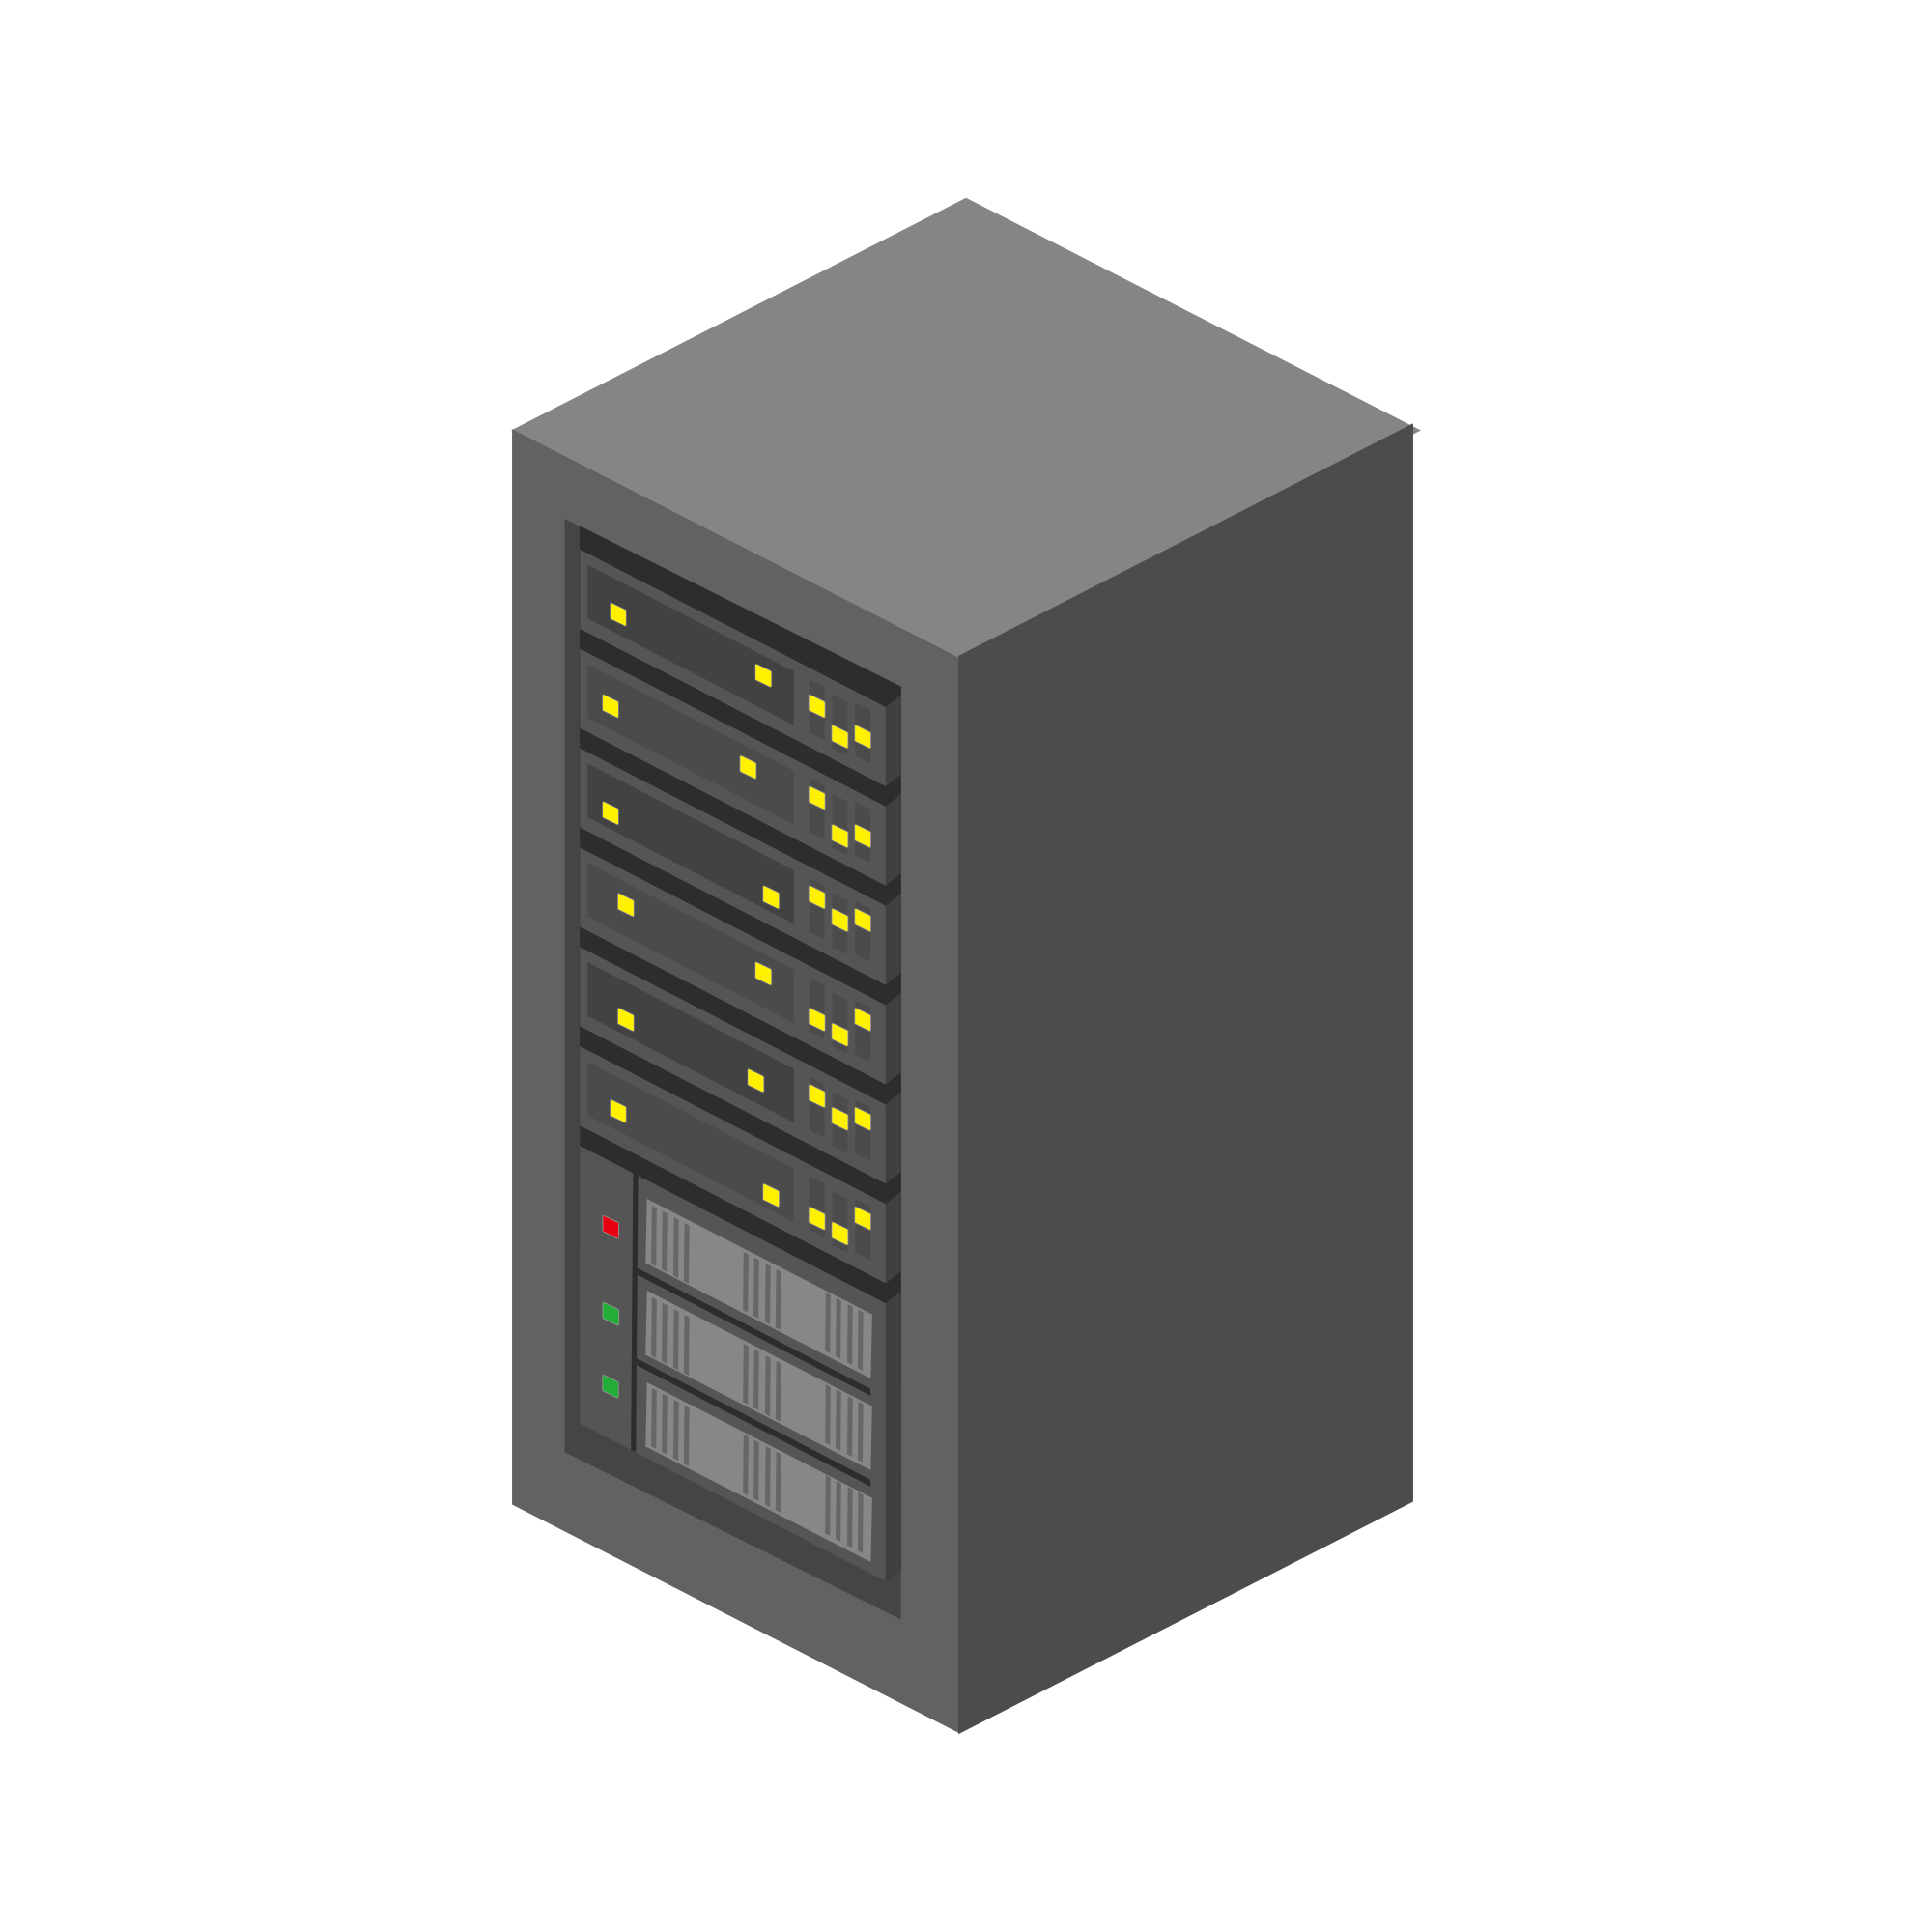

Execution Timeline

Slide 10
JSON
[
{
"id": 1,
"name": "Alice",
"age": 20.5
},
{
"id": 2,
"name": "Bob",
"age": 22.0
}
]
JSON (JavaScript Object Notation) is a lightweight data interchange format used to transmit and store structured data in a human-readable format, commonly used in web development and APIs.

Slide 11
JSON vs XML
JSON
XML
Human-readable due to minimalistic syntax.
Parsing is simpler and faster, as it's native to JavaScript.
Key-value pair, often resembling JavaScript objects and arrays
Often less readable due to tags and closing elements.
Parsing can be relatively complex.
Tag-based hierarchical structure.
{
"person": {
"name": "Alice",
"age": 25
}
}
<person>
<name>Alice</name>
<age>25</age>
</person>

Slide 12
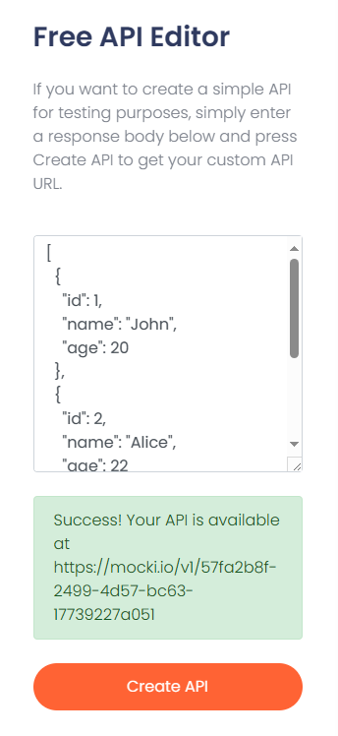
Create your own API
Go to mocki.io
Paste the following JSON object into the textarea and click “Create API”:
[
{"id": 1, "name": "Ahmad", "age": 27},
{"id": 2, "name": "Fatima", "age": 21},
{"id": 3, "name": "Tareq", "age": 24}
]
Copy the resulting URL and use it in your android application.

Slide 13
Internet permission
Since we will be doing HTTP request which requires internet connection, we need to add internet access permission to the Manifest File before the application tag
<uses-permission android:name="android.permission.INTERNET" />

Slide 14
Student (Java class)

Slide 15
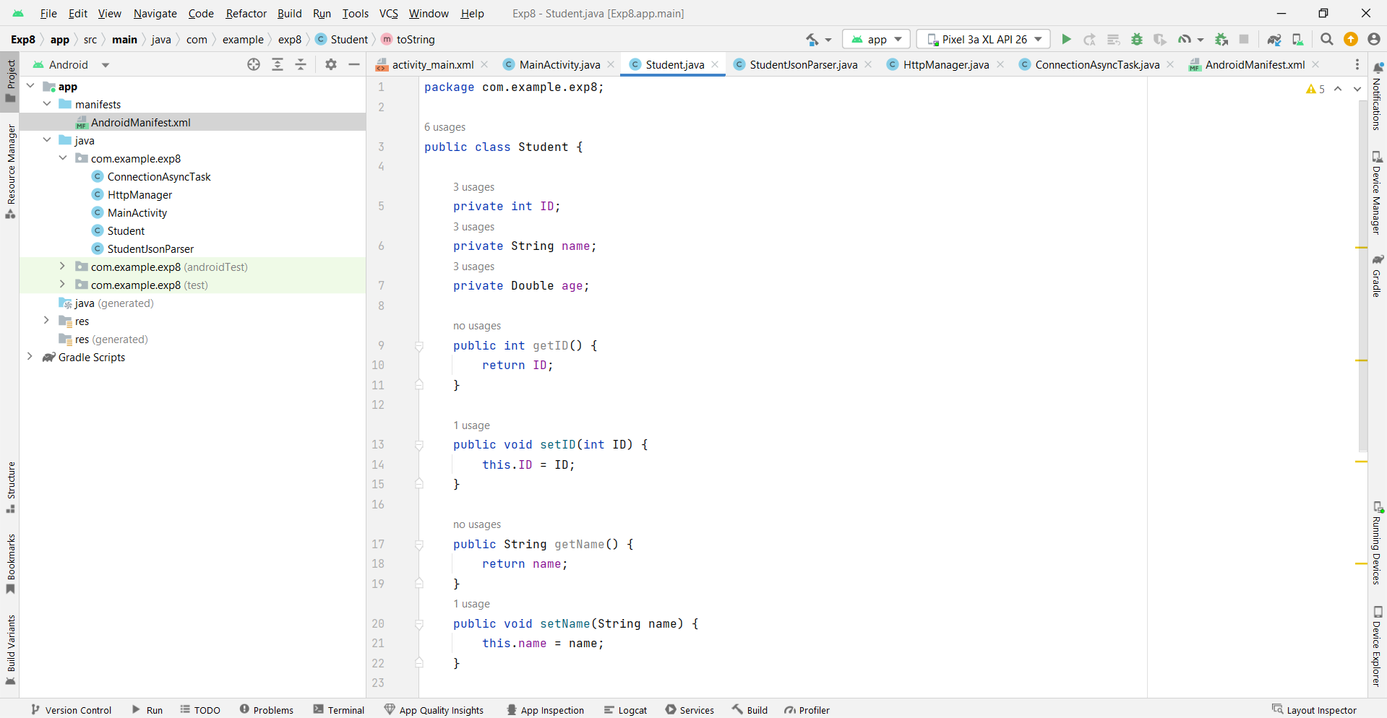

Slide 16
StudentJsonParser (Java class)
StudentJsonParser class is designed to help us understand how data in JSON format, typically received from REST API responses, can be transformed into objects that can work within Android.
The method getObjectFromJson converts a JSON array of student information into a list of Student objects, which makes the data easier to manage and display in the app.
In the context of REST APIs, this class demonstrates a standard step in Android development: parsing JSON data to work with structured objects.

Slide 17
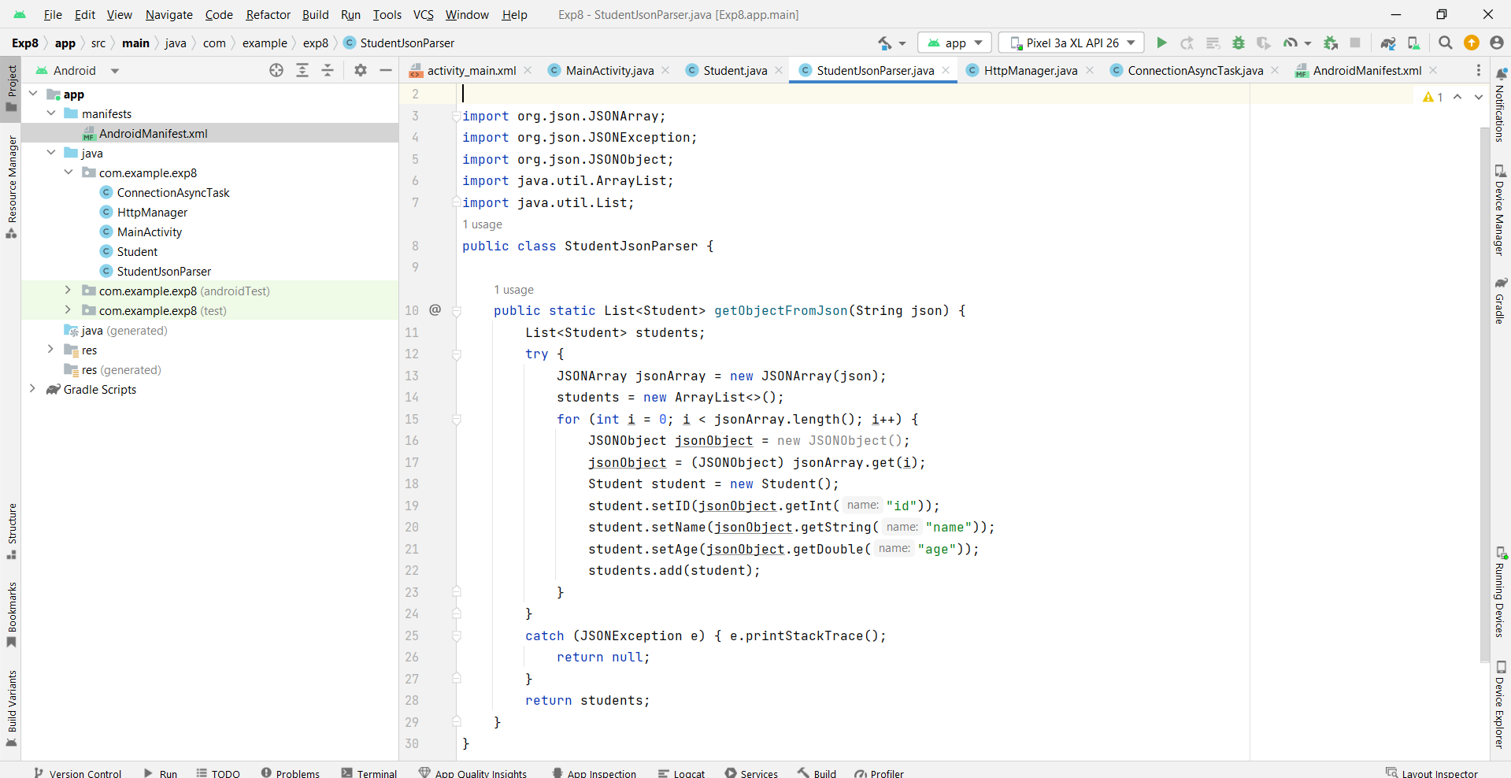

Slide 18
HttpManager (Java class)
The HttpManager class is designed to handle HTTP requests, specifically GET requests, to fetch data from a given URL.
The method getData takes a URL as input and connects to it using HttpURLConnection. It reads the response from the server line by line and stores it in a StringBuilder.
When retrieved from a REST API, this data is usually in JSON format, making it suitable for parsing with the StudentJsonParser class we discussed.
This class demonstrates how to establish network connections in Android, read server responses, and handle exceptions. It’s an essential part of working with REST APIs because it enables the app to communicate with web services and retrieve data, which can then be parsed and displayed.

Slide 19
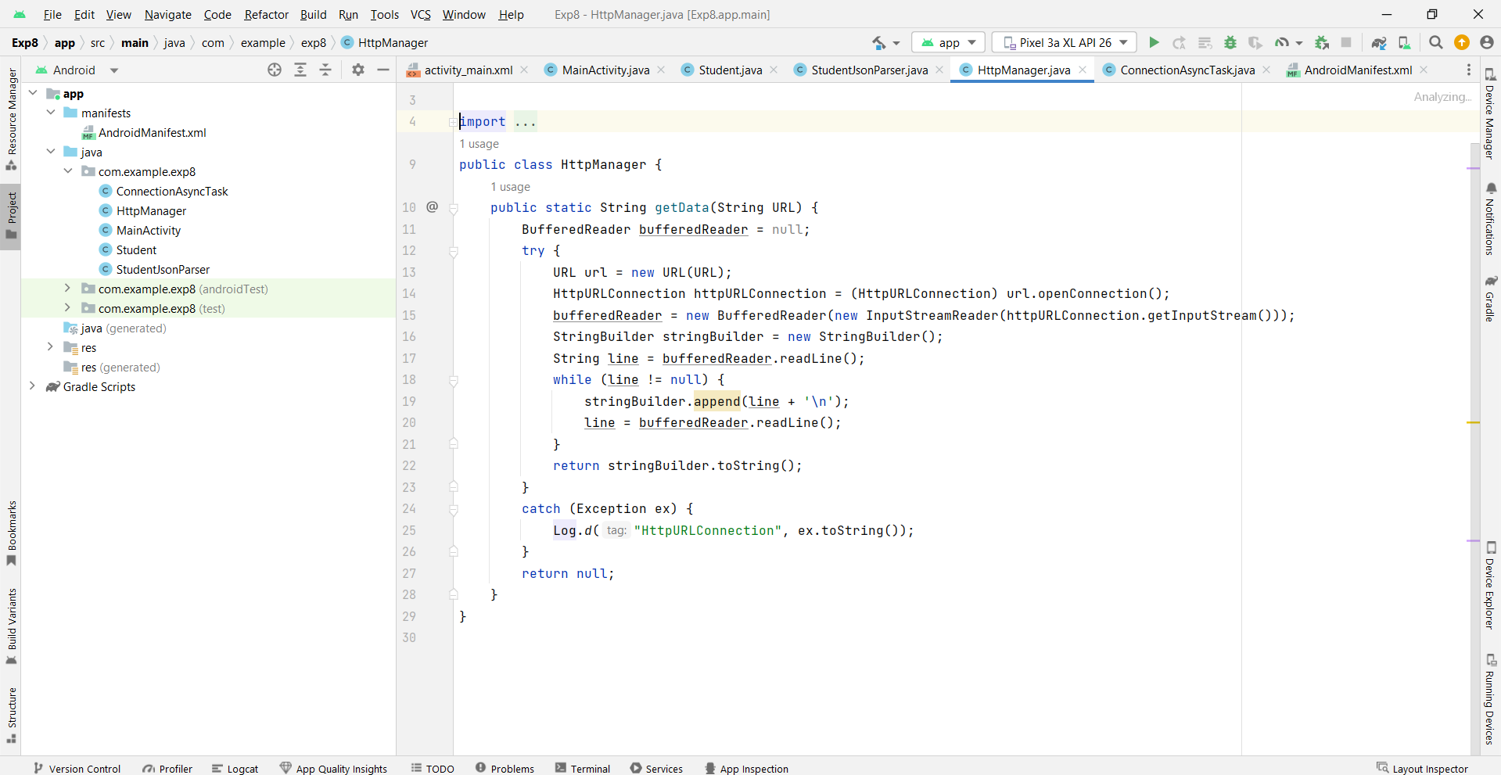

Slide 20
ConnectionAsyncTask (Java class) 1
The ConnectionAsyncTask class is an example of using AsyncTask in Android to perform a network operation in the background.
This class is responsible for fetching data from a URL (using the HttpManager class) and then parsing it to display on the app’s UI.

Slide 21
ConnectionAsyncTask (Java class) 2
Class Properties and Constructor
This property refers to the activity that creates the task, allowing updates to the UI directly from the task.
The constructor takes an Activity as a parameter, typically the main activity, to access UI components like buttons and progress indicators.
2. onPreExecute()
This method runs on the main (UI) thread before the background task starts.
It sets the button text to "connecting" and displays a loading indicator (e.g., a progress bar) by calling methods in MainActivity. These UI changes inform the user that a network operation is in progress.

Slide 22
ConnectionAsyncTask (Java class) 3
3. doInBackground(String... params)
This is where the main task happens, running in a background thread to avoid blocking the UI.
It calls HttpManager.getData with a URL passed in params[0] to retrieve data from the specified API.
The fetched data, typically in JSON format, is returned and passed to onPostExecute.
4. onPostExecute(String s)
This method is called after the background task completes and executes on the main thread.
First, it hides the progress indicator and updates the button text to "connected" to show the user that the task is done.
The StudentJsonParser.getObjectFromJson(s) method is then called to parse the JSON response (s) into a list of Student objects.
Finally, it calls fillStudents on the MainActivity, passing in the parsed list of students to display them in the UI.

Slide 23
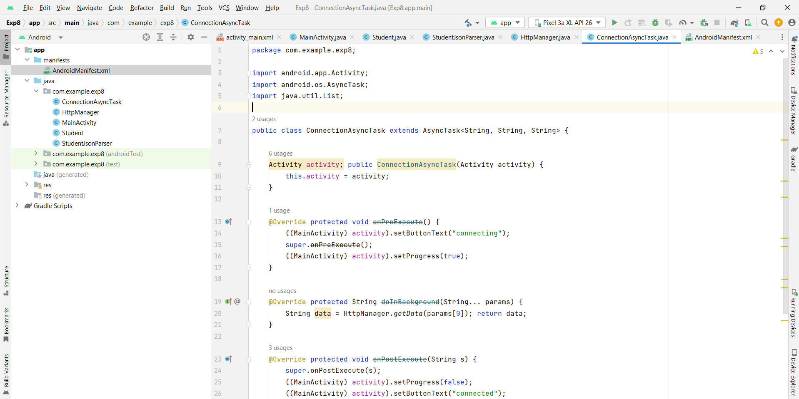

Slide 24
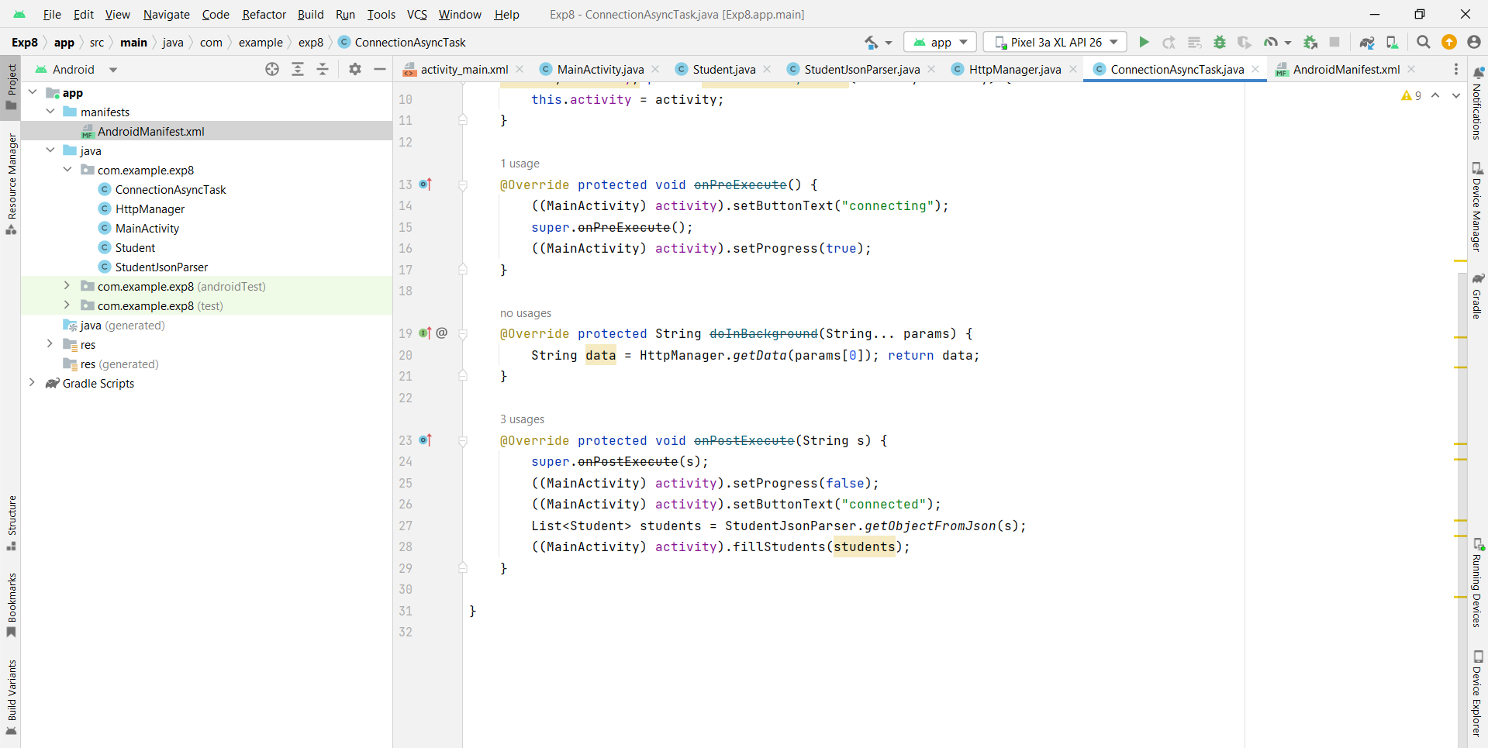

Slide 25
MainActivity (Activity) - Design

Slide 26
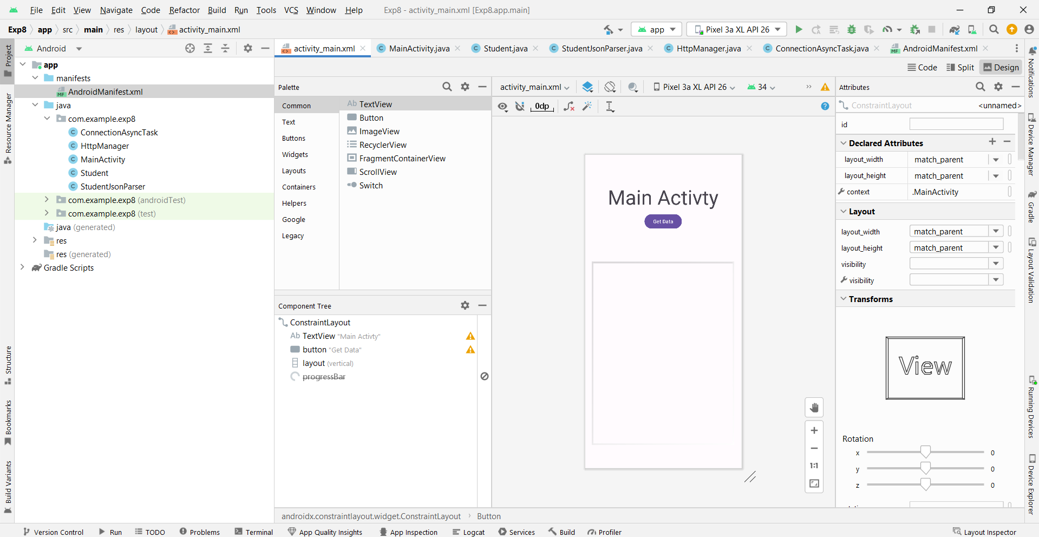

Slide 27
If the XML code in the lab manual did not work, just copy-paste this one
<?xml version="1.0" encoding="utf-8"?> <androidx.constraintlayout.widget.ConstraintLayout xmlns:android="http://schemas.android.com/apk/res/android" xmlns:app="http://schemas.android.com/apk/res-auto" xmlns:tools="http://schemas.android.com/tools" android:layout_width="match_parent" android:layout_height="match_parent" tools:context=".MainActivity"> <TextView android:layout_width="wrap_content" android:layout_height="wrap_content" android:text="Main Activty" android:textAppearance="@style/Base.TextAppearance.AppCompat.Display3" app:layout_constraintBottom_toBottomOf="parent" app:layout_constraintLeft_toLeftOf="parent" app:layout_constraintRight_toRightOf="parent" app:layout_constraintTop_toTopOf="parent" app:layout_constraintVertical_bias="0.1" /> <Button android:id="@+id/button" android:layout_width="wrap_content" android:layout_height="wrap_content" android:layout_marginStart="8dp" android:layout_marginTop="160dp" android:layout_marginEnd="8dp" android:text="Get Data" app:layout_constraintEnd_toEndOf="parent" app:layout_constraintStart_toStartOf="parent" app:layout_constraintTop_toTopOf="parent" /> <LinearLayout android:id="@+id/layout" android:layout_width="395dp" android:layout_height="507dp" android:layout_marginStart="8dp" android:layout_marginTop="32dp" android:layout_marginEnd="8dp" android:layout_marginBottom="8dp" android:background="@android:drawable/gallery_thumb" android:orientation="vertical" app:layout_constraintBottom_toBottomOf="parent" app:layout_constraintEnd_toEndOf="parent" app:layout_constraintStart_toStartOf="parent" app:layout_constraintTop_toBottomOf="@+id/button"> </LinearLayout> <ProgressBar android:id="@+id/progressBar" style="?android:attr/progressBarStyle" android:layout_width="wrap_content" android:layout_height="wrap_content" android:layout_marginStart="8dp" android:layout_marginTop="8dp" android:layout_marginEnd="8dp" android:layout_marginBottom="8dp" android:visibility="gone" app:layout_constraintBottom_toBottomOf="parent" app:layout_constraintEnd_toEndOf="parent" app:layout_constraintStart_toStartOf="parent" app:layout_constraintTop_toTopOf="parent" app:layout_constraintVertical_bias="0.62" /> </androidx.constraintlayout.widget.ConstraintLayout>

Slide 28
MainActivity (Activity) – Java API URL: https://mocki.io/v1/05381484-2632-4323-8aa9-ca0ea8619242

Slide 29
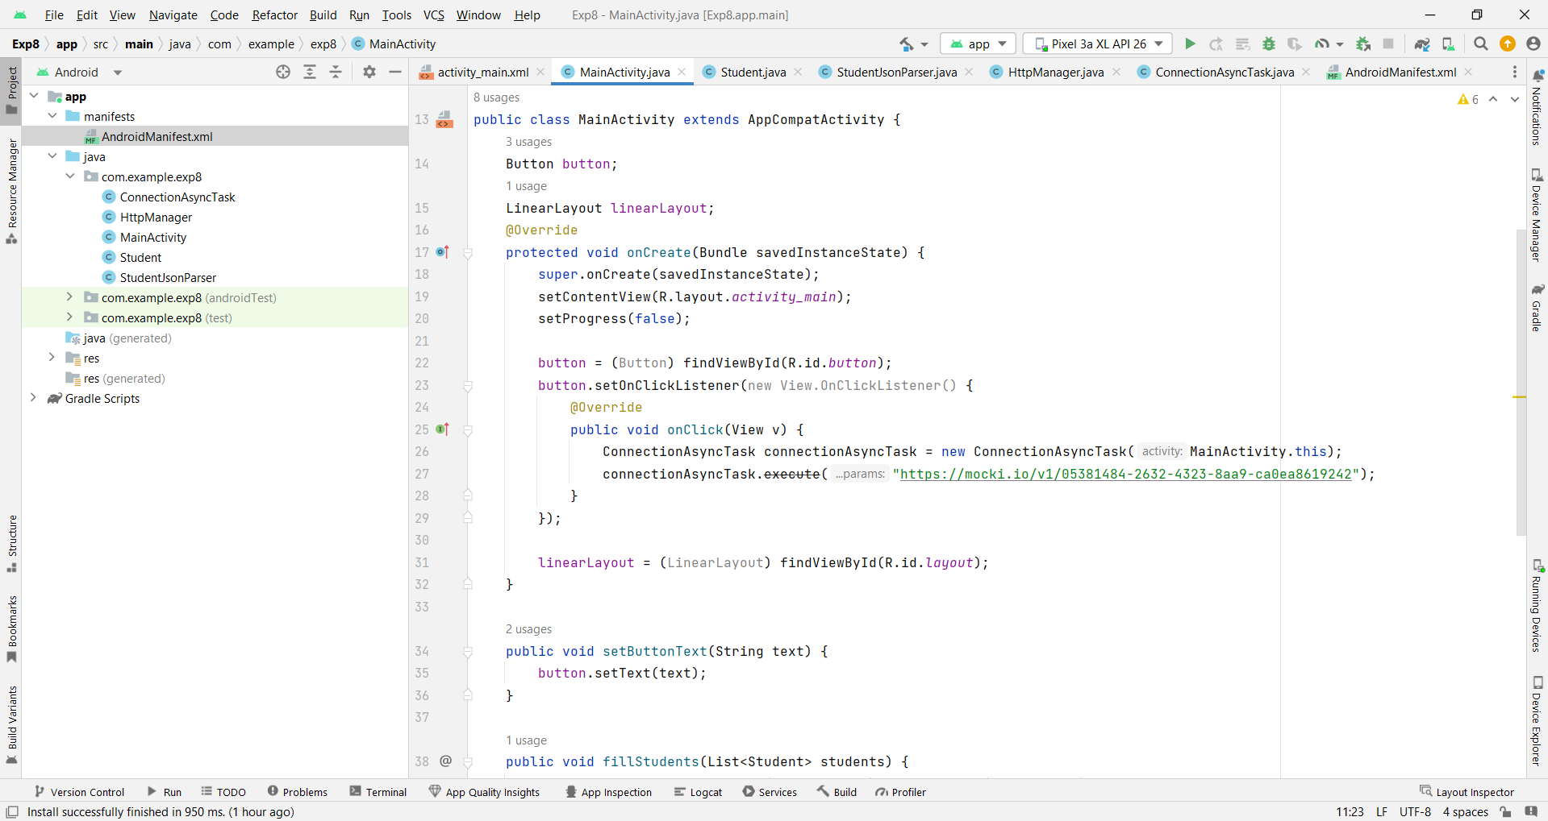

Slide 30
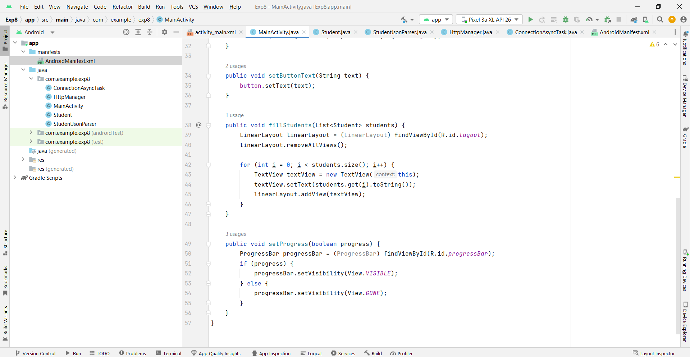

Slide 31
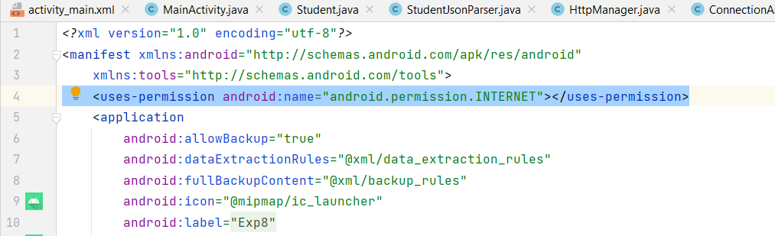

Students always forget me

