Slide 1
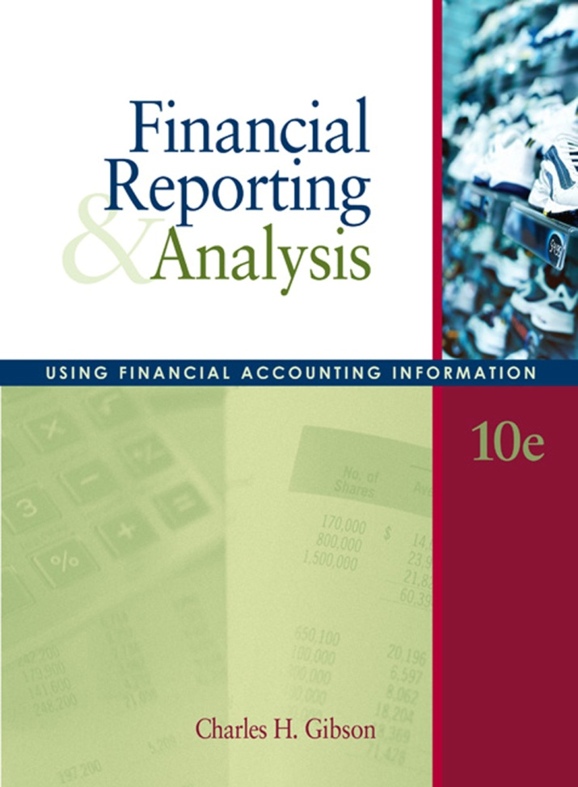
Chapter 9
For the Investor
COPYRIGHT ©2007 Thomson South-Western, a part of the Thomson Corporation. Thomson, the Star logo, and South-Western are trademarks used herein under license.

Slide 2

Financial Leverage
The use of financing with a fixed charge (such as interest) is termed financial leverage.
Financial leverage is successful if the firm earns more on the borrowed funds than it pays to use them.
It is not successful if the firm earns less on the borrowed funds than it pays to use them.
Using financial leverage results in a fixed financing charge that can materially affect the earnings available to the common shareholders

Slide 3
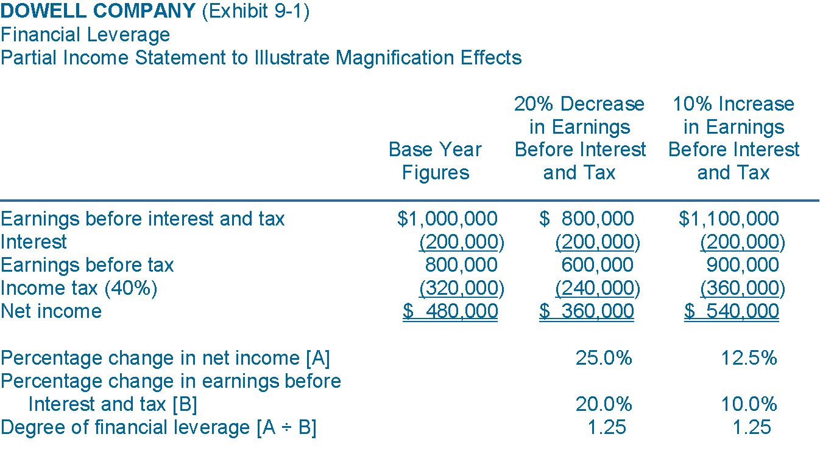
Definition of Financial Leverage and Magnification Effects
Net income increase [A] is greater than change in EBIT [B] due to the fixed nature of interest expense

Slide 4
Financial Leverage
Exhibit 9-1 illustrates financial leverage and its magnification effects. The statement illustrates the effect of leverage on the return to the common stockholder.
If EBIT increases by 10% from $1,000,000 to $1,100,000, the net income rises by 12.5%. This magnification is caused by the fixed nature of interest expense. While earnings available to pay interest rise, interest remains the same, thus leaving more for the residual owners.

Slide 5
Financial Leverage
If financial leverage is used, a rise in EBIT will cause an even greater rise in net income, and a decrease in EBIT will cause an even greater decrease in net income.
When EBIT declined 20%, net income dropped from $480,000 to $360,000—a decline of $120,000, or 25%, based on the original $480,000. The use of financial leverage is only successful if the rate of earnings on borrowed funds exceeds the fixed charges

Slide 6
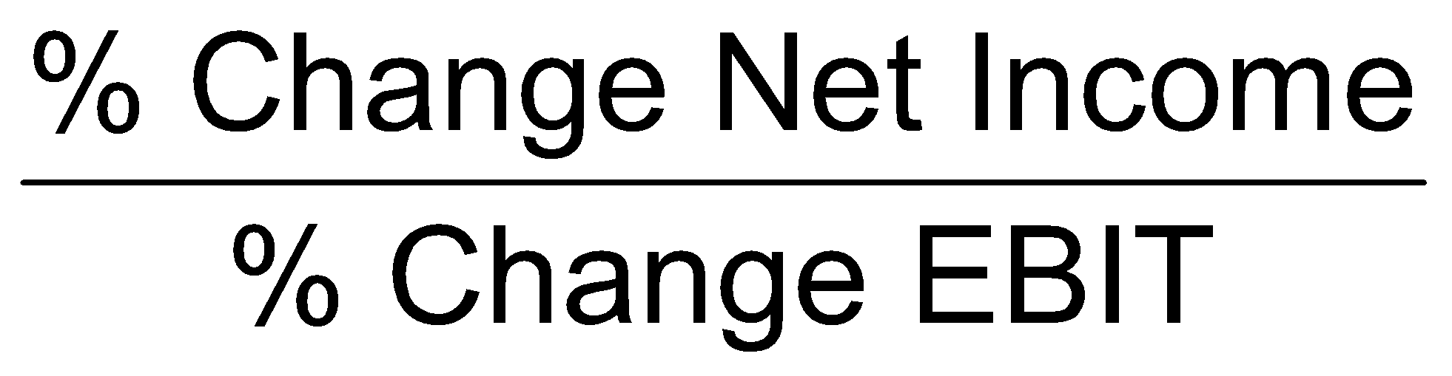
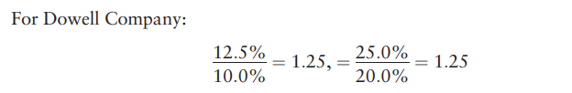
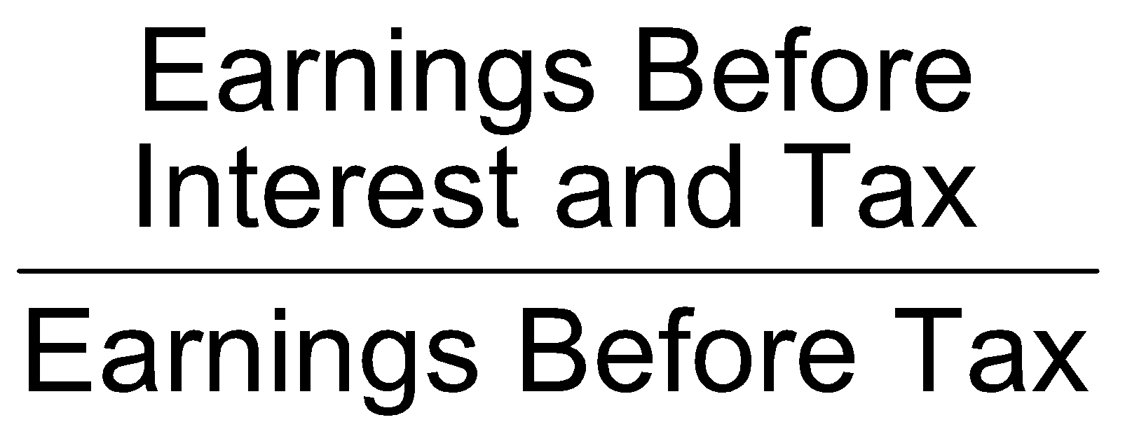
Computation of the Degree of Financial Leverage
The degree of financial leverage is the multiplication factor by which the net income changes in respect to changes in EBIT
A more simple formula for degree of financial leverage

Slide 7
Computation of the Degree of Financial Leverage
The degree of financial leverage is 1.25. From a base EBIT of $1,000,000, any change in EBIT will be accompanied by 1.25 times that change in net income. If net income before interest and tax rises 4%, earnings to the stockholder will rise 5%. If net income before interest and tax falls 8%, earnings to the stockholder will decline 10%

Slide 8
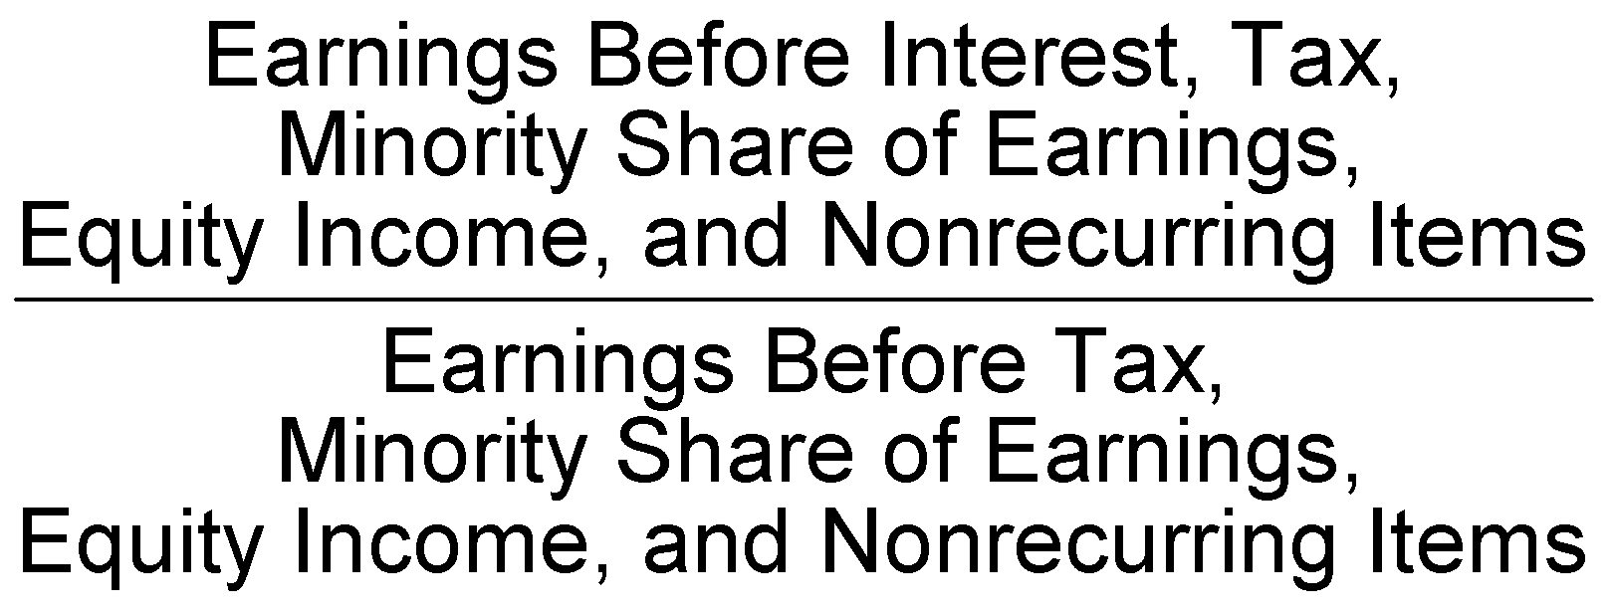
Computation of the Degree of Financial Leverage (cont’d)
Degree of financial leverage calculations should exclude
  Minority share of earnings
  Equity income
  Nonrecurring items
The all-inclusive formula for degree of financial leverage

Slide 9
Things important in financial leverage
Two things are important in looking at financial leverage as part of financial analysis:
How high is the degree of financial leverage? This is a type of risk (or opportunity) measurement from the viewpoint of the stockholder. The higher the degree of financial leverage, the greater the multiplication factor.
Second, does the financial leverage work for or against the owners?

Slide 10
Earnings per Share
Required disclosure for corporate income statements
Pertains only to common stock
Per-share amounts are disclosed for
  Income from recurring items
  Discontinued operations
  Net income

Slide 11
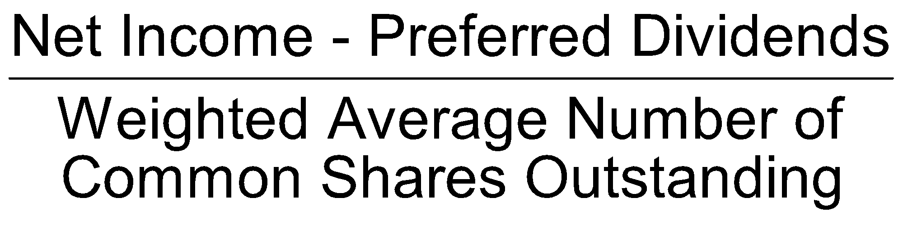
Basic Earnings per Share
Earnings pertain to an entire fiscal period
Average common shares outstanding is used for parity of information

Slide 12
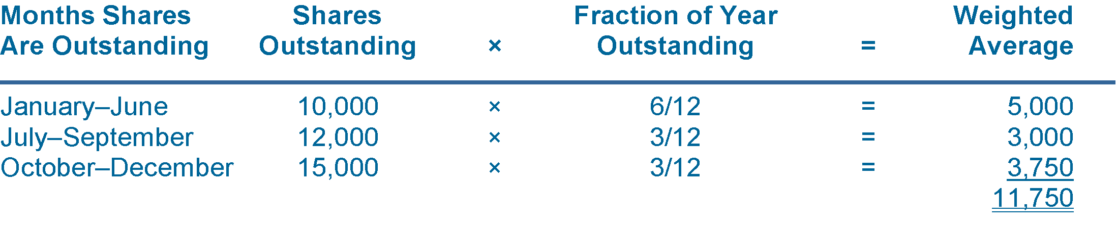
Weighted Average Common Outstanding
Assume that a corporation had 10,000 shares of common stock outstanding at the beginning of the year. On July 1, it issued 2,000 shares, and on October 1, it issued another 3,000 shares. The weighted average number of shares outstanding would be computed as follows
Stock dividends and stock splits
  Retroactive recognition to all comparative data

Slide 13
Weighted Average Common Outstanding
Stock dividends and stock splits do not provide the firm with more funds; they only change the number of outstanding shares.
Earnings per share should be related to the outstanding common stock after the stock dividend or stock split.
In the weighted average common shares illustration, if we assume that a 2-for-1 stock split took place on December 31, the denominator of the earnings per share computation becomes 23,500 (11,750 × 2). The denominator of prior years’ earnings per share computations would also be doubled. If we assume that net income is $100,000 and preferred dividends total $10,000 in this illustration, then the earnings per common share would be $3.83 [($100,000 − $10,000)/23,500]

Slide 14
Earnings Per Share and Capital Structure
Simple capital structure
Complex capital structure contains potentially dilutive securities:
  Options, rights, warrants
  Convertible debt
  Convertible preferred equity
  Contingent shares

Slide 15
Earnings Per Share and Capital Structure
Simple capital structure
Complex capital structure contains potentially dilutive securities:
  Options, rights, warrants
  Convertible debt
  Convertible preferred equity
  Contingent shares

Slide 16
Earnings Per Share and Capital Structure
Earnings per share data must be presented for:
  basic earnings per share and
  (2) diluted earnings per share.
Basic earnings per share are a presentation based on the outstanding common shares and those securities that are in substance equivalent to common shares and have a dilative effect. Convertible bond, convertible preferred stock, stock options, and warrants are examples of common stock equivalents.
Diluted earnings per share presentation is a pro forma presentation which affects the dilution of earnings per share that would have occurred if all contingent issuances of common stock that would individually reduce earnings per share had taken place at the beginning of the period

Slide 17
Earnings Per Share and Capital Structure
Example: Suppose Company ABC has the following structure of shares and dilutive securities at the end of a fiscal year:
  Weighted average Common shares outstanding: 800,000
  Convertible preferred shares: 10,000, convertible into 5 shares of common stock each and paying dividend of $10 per share
  Convertible Debt: $20,000 of 5% bonds convertible into 5,000 shares
  Stock Options outstanding at the beginning of the year: 10,000 with the exercise price of $45 (Average market price of company shares during the year was $55 per share)
  Net Income before preferred dividend=$2,000,000, tax rate 25%

Slide 18
Earnings Per Share and Capital Structure
Particulars ($) | Basic EPS | Diluted EPS
Net income | 2,000,000 | 2,000,000
Less:Preferred Dividend | 100,000 | -
Add:After tax cost of interest (20,000*0.05*(1-0.25)) | - | 750
Numerator | 1,900,000 | 2,000,750
Weighted average number of common shares outstanding | 800,000 | 800,000
Additional shares issued if preferred shares converted | - | 50,000
Additional shares issued if debt converted | - | 5,000
Additional shares issued If options exercised | - | 1,818
Denominator | 800,000 | 856,818
EPS | 2.38 | 2.34

Slide 19

Price/Earnings Ratio
Measures the relationship between the market price of a share of common stock and that stock’s current earnings per share
  Use of diluted earnings per share gives more conservative price/earnings ratio

Slide 20
Price/Earnings Ratio (cont’d)
Compare with
  Industry competitors
  Industry average
  Exchange (e.g., NYSE) average
Interpretation
  High-growth-potential firms have higher P/E ratios
  P/E ratio is a function of the market

Slide 21
Price/Earnings Ratio (cont’d)
Investors view the P/E ratio as a gauge of future earning power of the firm.
Companies with high-growth opportunities generally have high P/E ratios;
firms with low-growth tend to have lower P/E ratios.
However, investors may be wrong in their estimates of growth potential. One fundamental of investing is to be wiser than the market. An example would be buying a stock that has a relatively low P/E ratio when the prospects for the company are much better than reflected in the P/E ratio.

Slide 22

Dividend Payout
Measures the portion of current earnings per common share being paid out in dividends
A stable dividend policy is developed by consideration of recurring earnings
Lower payout typically found in
  New firms
  Growing firms and firms perceived as growth firms

Slide 23
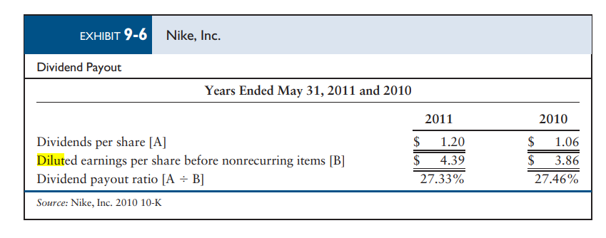
Dividend Payout

Slide 24
Dividend Payout
The dividend payout ratio has a problem as investors may assume that dividend payout implies that earnings per share represent cash. Under accrual accounting, earnings per share do not represent a cash pool.
Most firms hesitate to decrease dividends since this tends to have adverse effects on the market price of the company’s stock. No rule of thumb exists for a correct payout ratio.
Some stockholders prefer high dividends; others prefer to have the firm reinvest the earnings in hopes of higher capital gains. In the latter case, the payout ratio would be a relatively smaller percentage

Slide 25

Dividend Yield
Indicates the relationship between the dividends per common share and the market price per common share
The yield is a function of
  The firm’s dividend policy
  Market price

Slide 26
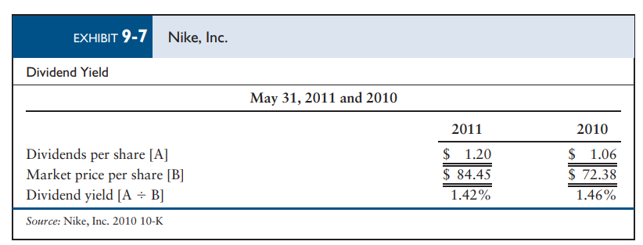
Dividend Yield

Slide 27
Dividend Yield
Since total earnings from securities include both dividends and price appreciation, no rule of thumb exists for dividend yield.
If the firm successfully invests the money not distributed as dividends, the price should rise and the dividend yield is likely to be low.
Investors that want current income prefer a high dividend yield

Slide 28
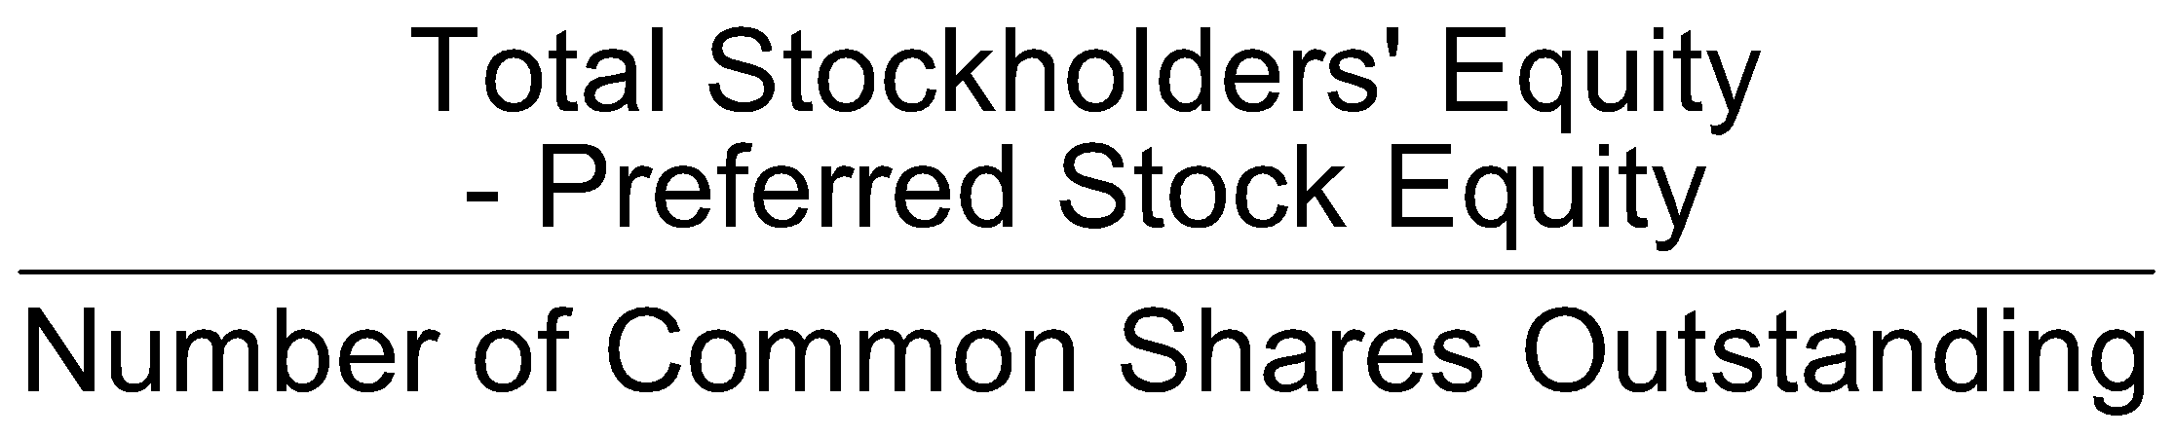
Book Value per Share
Indicates the amount of stockholders’ equity that relates to each share of outstanding common stock
Preferred equity should be measured at liquidation value, if available. If this value cannot be found, the book figure that relates to preferred stock may be used instead.
Market value vis-à-vis book value
  Book value reflects past unrecovered asset costs
  Market value reflects the potential of the firm

Slide 29
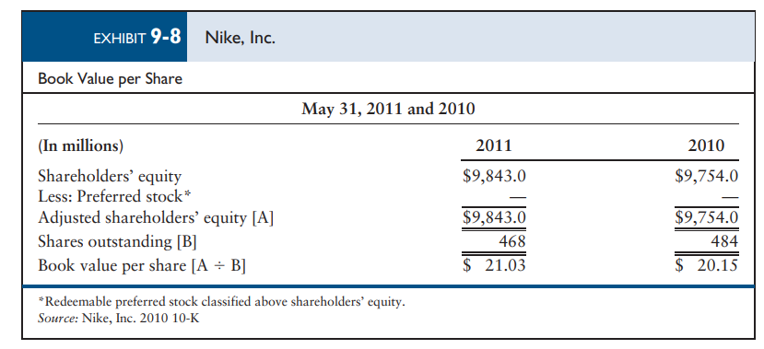
Book Value per Share

