Slide 1
Chapter Thirteen
Retailing and Wholesaling

Slide 2
Retailing and Wholesaling
Topic Outline
Retailing
Retailer Marketing Decisions
Retailing Trends and Developments
Wholesaling

Slide 3
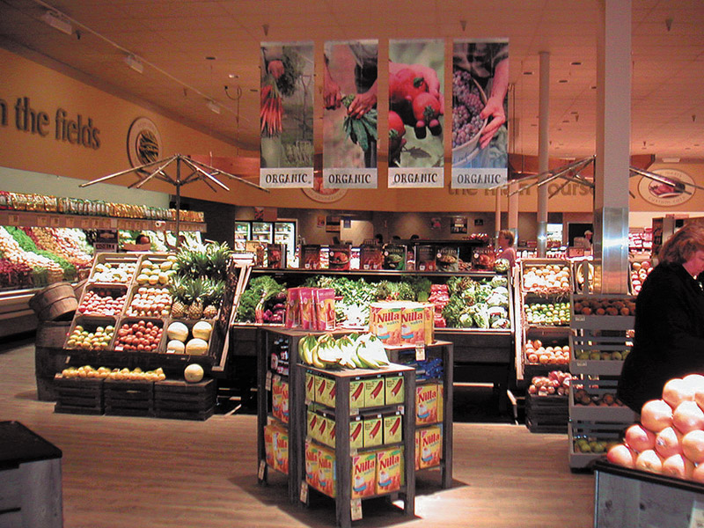
Retailing
Retailing includes all the activities in selling products or services directly to final consumers for their personal, non-business use
Retailers are businesses whose sales come primarily from retailing

Slide 4
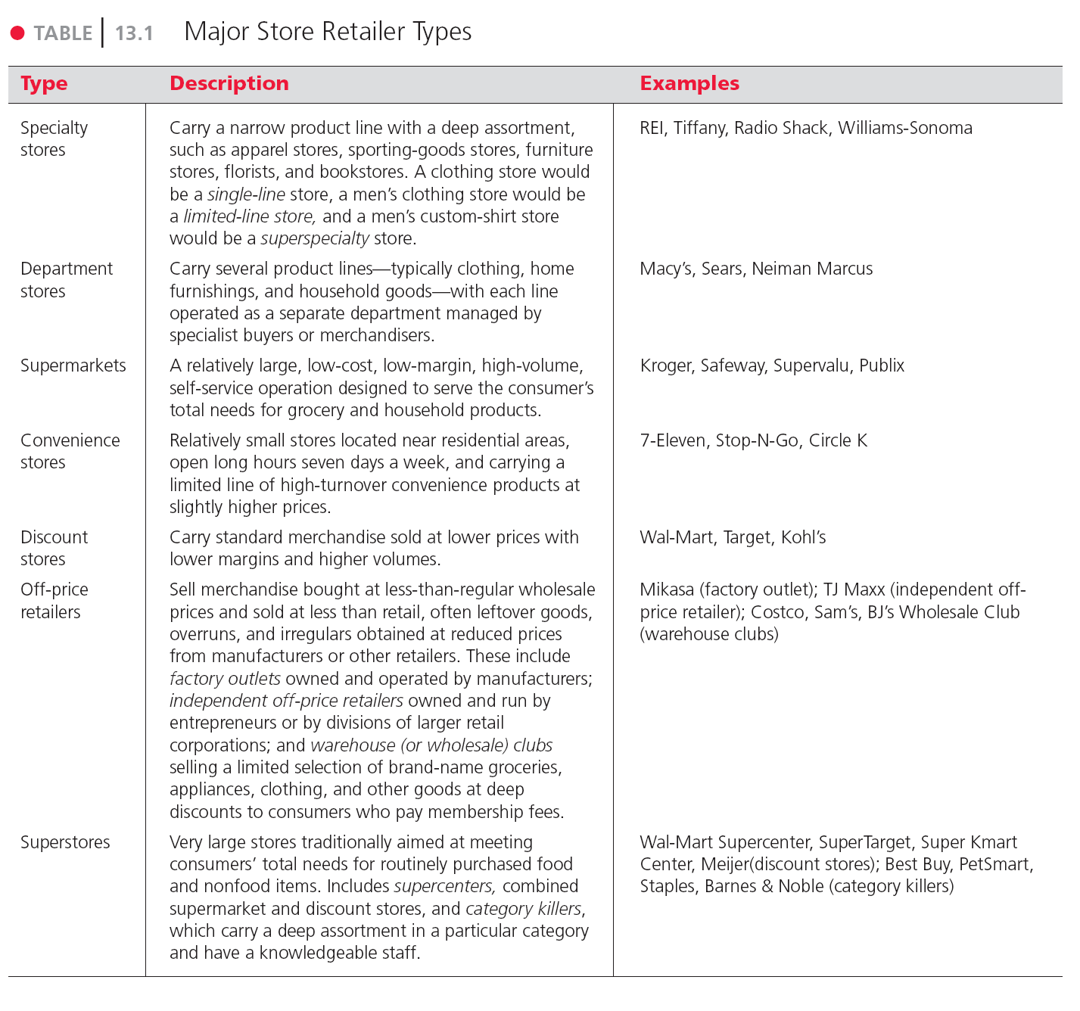
Table 13.1
Major Store Retailer Types

Slide 5
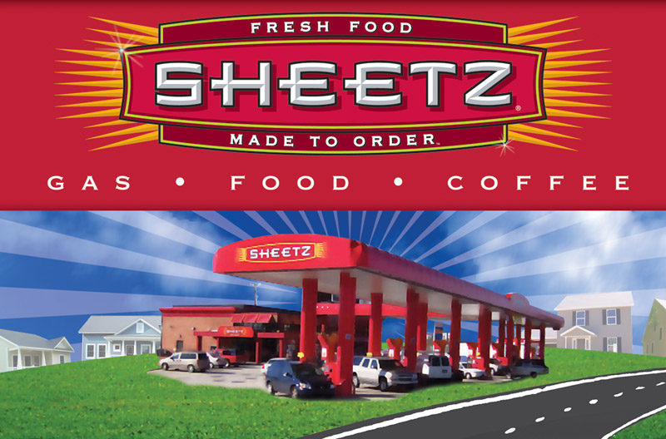
Retailing
Types of Retailers
Amount of service
Self-service
Limited service
Full service
Notes:
Self-service retailers serve customers who are willing to perform their own locate-compare-select process to save money. They include: Wal-Mart and Supermarkets.
Limited service retailers provide more sales assistance because they carry more shopping goods about which customers need more information. Examples include Sears and JC Penney.
Full-service retailers assist customers in every phase of the shopping process, resulting in higher costs that are passed on to the customer as higher prices. Includes department stores and specialty stores

Slide 6
Retailing
Product Line
Notes:
Note to Instructor
Discussion Question
What are examples of these types of stores?
It might be difficult, depending on their geographic region, to find examples of superstores. Ask them where they would rather shop for a computer, a department store like Wal-Mart or a category killer like Best Buy? Why?

Slide 7
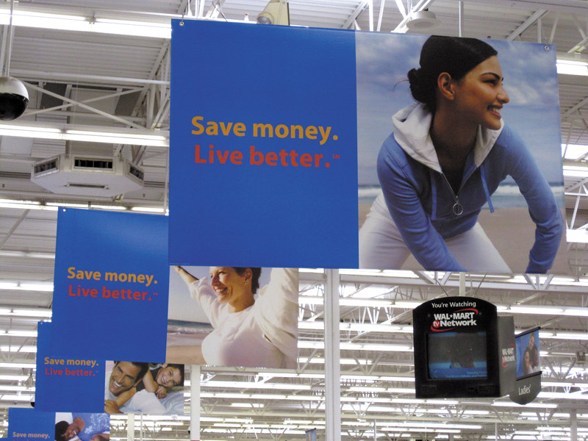

Retailing
Types of Retailers
Relative Prices
Notes:
Note to Instructor
Discount stores sell standard merchandise at lower prices by accepting lower margins and selling higher volume.
Independent off-price retailers either are owned and run by entrepreneurs or are divisions of larger retail corporations.
Off-price retailers buy at less-than-regular wholesale prices and charge customers less than retail.
Factory outlets are producer-operated stores. The link on this slide is to a Premium Factory Outlet mall. Students are probably familiar with these types of shopping locations.
Warehouse clubs are large warehouse-like facilities with few frills and offer ultra-low prices.

Slide 8
Retailing
Types of Retailers
Organizational Approach

Slide 9
Retailing
Types of Retailers
Organizational Approach
Corporate Chains are two or more outlets that are commonly owned and controlled
Size allows them to buy in large quantities at lower prices and gain promotional economies
  Sears
  CVS

Slide 10
Retailing
Types of Retailers
Organizational Approach
Voluntary chains are wholesale-sponsored groups of independent retailers that engage in group buying and common merchandising
IGA
Western Auto

Slide 11
Retailing
Types of Retailers
Organizational Approach
Retailer cooperatives is a group of independent retailers that band together to set up a joint-owned, central wholesale operation and conduct joint merchandising and promotion effort
Ace Hardware
Associated Grocers
Notes:
Note to Instructor
This link is to the homepage for Ace Hardware. Students are likely to be familiar with the brand but not know that many stores are individually owned and operated (although they might know this phrase). You can view the site for information specific to owners.

Slide 12
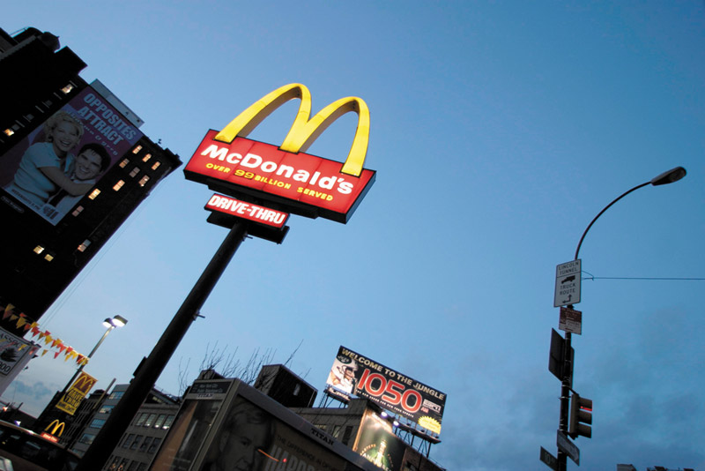
Retailing
Types of Retailers
Organizational Approach
Franchise organizations are based on some unique product or service; on a method of doing business; or on the trade name, good will, or patent that the franchisor has developed

Slide 13
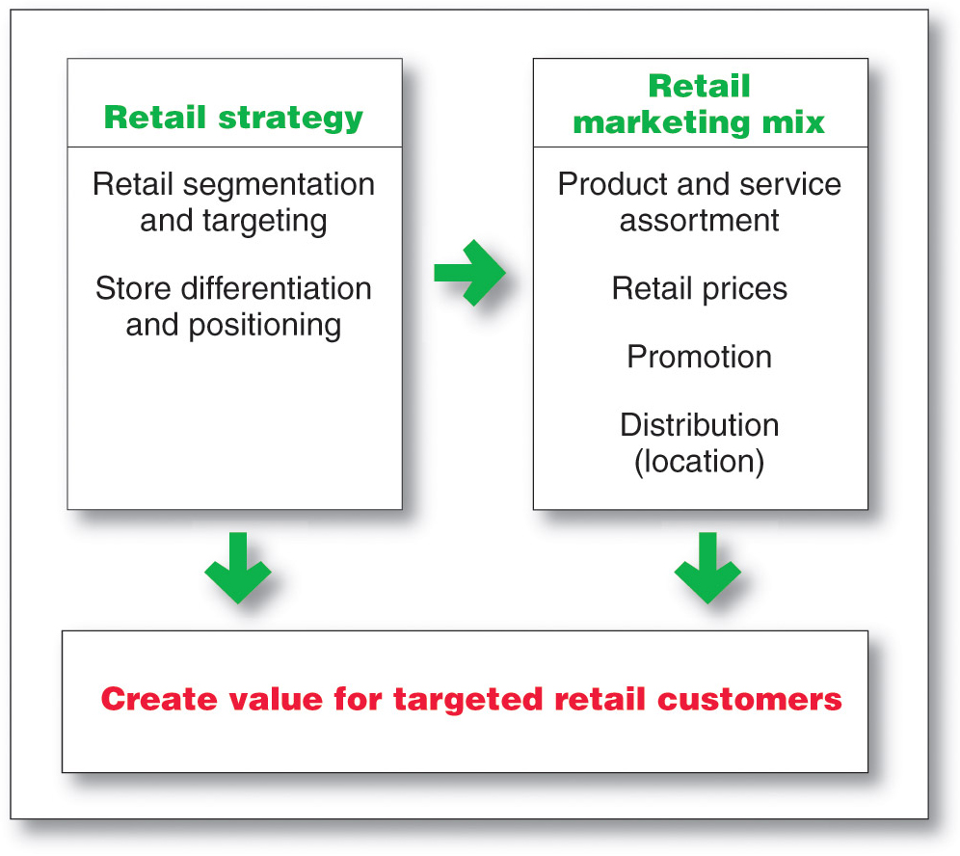
Retailing
Retailer Marketing Decisions

Slide 14
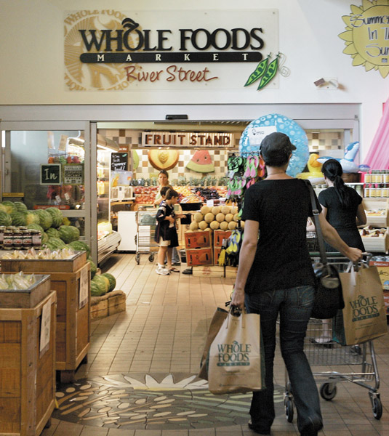
Retailing
Retailer Marketing Decisions
Segmentation targeting, differentiation, and positioning involves the definition and profile of the market so the other retail marketing decisions can be made
Notes:
Note to Instructor
This is a good time to visit the Web site for Trader Joe’s. Ask the students who they target and how they position their business. You can also ask students how this is different than Whole Foods which is discussed in the text.

Slide 15

Retailing
Retailer Marketing Decisions
Product Assortment and Service
Product assortment and service decisions include:
Product assortment
Services mix
Store atmosphere
Notes:
Note to Instructor
Product assortment should differentiate the retailer while matching target shoppers’ expectations. Offers merchandise that no other competitor carries:
Private or national brands
Merchandising events
Highly targeted product assortment
Services mix should also serve to differentiate the retailer from the competition with customer support.
Store atmosphere is the physical layout that makes moving around the store hard or easy.

Slide 16

Retailing
Retailer Marketing Decisions
Price Decision
Price policy must fit the target market and positioning, product and service assortment, and competition
High markup on lower volume
Low markup on higher volume

Slide 17
Retailing
Retailer Marketing Decisions
Price Decision
High-low pricing involves charging higher prices on an everyday basis, coupled with frequent sales and other price promotions
Everyday low price (EDLP) involves charging constant, everyday low prices with few sales or discounts
Notes:
Note to Instructor
Discussion Question
Why would a retailer engage in high-low pricing?
In most cases it is to increase store traffic, clear out unsold merchandise, create a low price image, or attract customers who will buy other goods at full price.

Slide 18
Retailing
Retailer Marketing Decisions
Promotion Decision
Notes:
Note to Instructor
Ask students for examples of retailers that advertise heavily. They might even be able to mention a local retailer whose ads they seem to constantly see on television. Local furniture stores and car dealers invest heavily on local television.

Slide 19
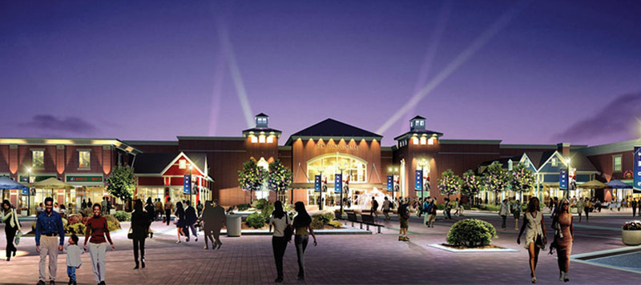
Retailing
Retailer Marketing Decisions - Place Decision
Central business districts are located in cities and include department and specialty stores, banks, and movie theaters
Shopping center is a group of retail businesses planned, developed, owned, and managed as a unit
Notes:
Note to Instructor
Central business districts are declining. Students might even be able to cite examples in their home town where shopping centers are being built but central business districts are failing to thrive. Shopping centers can be:
Regional shopping centers
Community shopping centers
Neighborhood shopping centers
Power center
Lifestyle centers

Slide 20
Retailing
Retailing Trends and Developments
New Retail Forms and Shortening Retail Life Cycles
Wheel-of-retailing concept states that many new types of retailing forms begin as low-margin, low-price, low-status operations, and challenge established retailers. As they succeed they upgrade their facilities and offer more services, increasing their costs and forcing them to increase prices, eventually becoming the retailers they replaced.

Slide 21
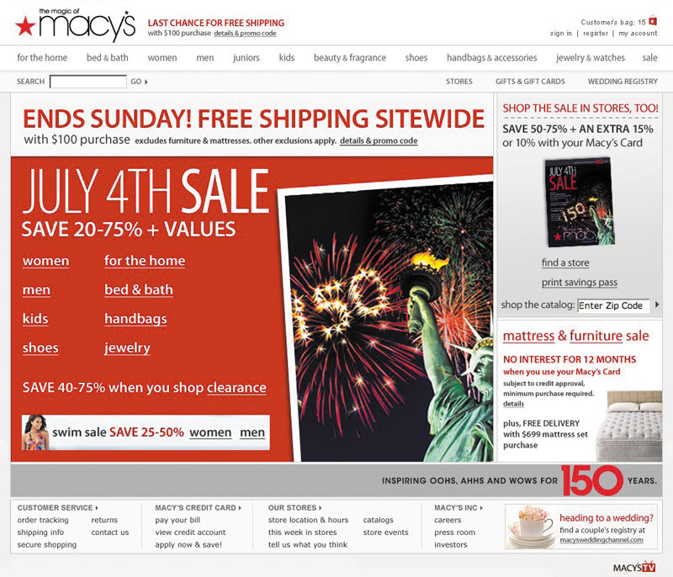
Retailing
Retailing Trends and Developments
New Retail Forms and Shortening Retail Life Cycles
s
Growth of non-store retailing includes:
Mail order
Television
Phone
Online
Notes:
Note to Instructor
Discussion Question
What percent of your purchases are online? Why is it low for some types of products?
It might be surprising to see that for certain categories it is very high but for others it remains low. You can ask why they differ by category. It might include shipping costs, need to try the product, size, impulse purchase, etc.

Slide 22
Retailing
Retailing Trends and Developments
New Retail Forms and Shortening Retail Life Cycles
Retail convergence involves the merging of consumers, producers, prices, and retailers, creating greater competition for retailers and greater difficulty differentiating offerings

Slide 23
Retailing
The Future of Retailing
New Retail Forms and Shortening Retail Life Cycles
The rise of megaretailers involves the rise of mass merchandisers and specialty superstores, the formation of vertical marketing systems, and a rash of retail mergers and acquisitions
Superior information systems
Buying power
Large selection

Slide 24
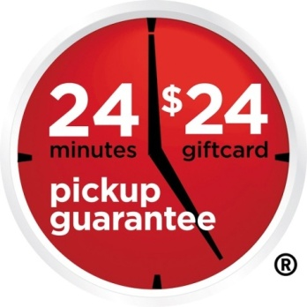
Retailing
Retailing Trends and Developments
New Retail Forms and Shortening Retail Life Cycles
Growing importance of retail technology provides better forecasts, inventory control, electronic ordering, transfer of information, scanning, online transaction processing, improved merchandise handling systems, and the ability to connect with customers

Slide 25
Wholesaling
Wholesaling includes all activities involved in selling goods and services to those buying for resale or business use

Slide 26
Wholesaling
Wholesaling
Selling and promoting involves the wholesaler’s sales force helping the manufacturer reach many smaller customers at lower cost
Buying assortment building involves the selection of items and building of assortments needed by their customers, saving the customers work

Slide 27
Wholesaling
Wholesaling
Bulk breaking involves the wholesaler buying in larger quantity and breaking into smaller lots for its customers
Warehousing involves the wholesaler holding inventory, reducing its customers’ inventory cost and risk

Slide 28
Wholesaling
Wholesaling
Transportation involves the wholesaler providing quick delivery due to its proximity to the buyer
Financing involves the wholesaler providing credit and financing suppliers by ordering earlier and paying on time

Slide 29
Wholesaling
Wholesaling
Risk bearing involves the wholesaler absorbing risk by taking title and bearing the cost of theft, damage, spoilage, and obsolescence
Market information involves the wholesaler providing information to suppliers and customers about competitors, new products, and price developments

Slide 30
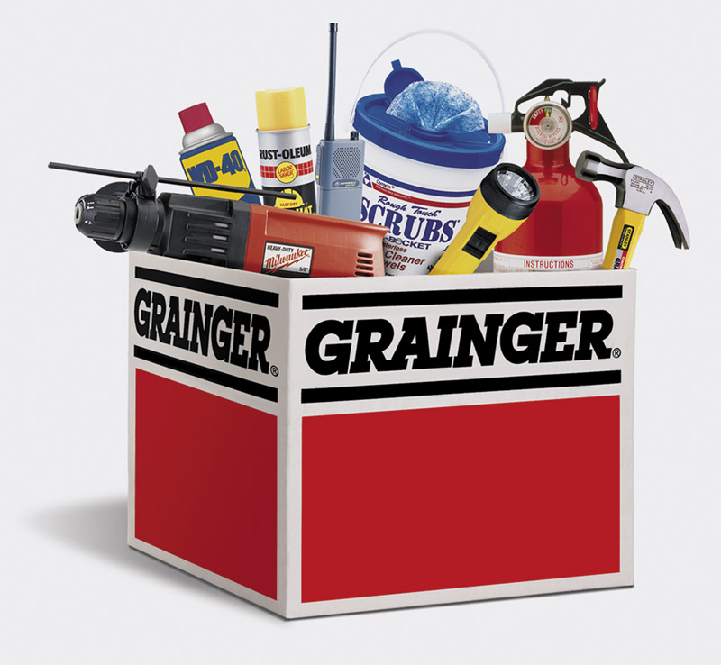
Wholesaling
Wholesaling
Management services and advice involves wholesalers helping retailers train their sales clerks, improve store layouts, and set up accounting and inventory control systems

Slide 31
Wholesaling
Types of Wholesalers

Slide 32
Wholesaling
Types of Wholesalers
Merchant wholesalers is the largest group of wholesalers and include:
Full-service wholesalers who provide a full set of services
Limited service wholesalers who provide few services and specialized functions

Slide 33
Wholesaling
Types of Wholesalers
Brokers and agents do not take title, perform a few functions, and specialize by product line or customer type
Brokers bring buyers and sellers together and assist in negotiations
Agents represent buyers or sellers

Slide 34
Wholesaling
Types of Wholesalers
Manufacturers’ sales branches and offices is a form of wholesaling by sellers or buyers themselves rather than through independent wholesalers

Slide 35
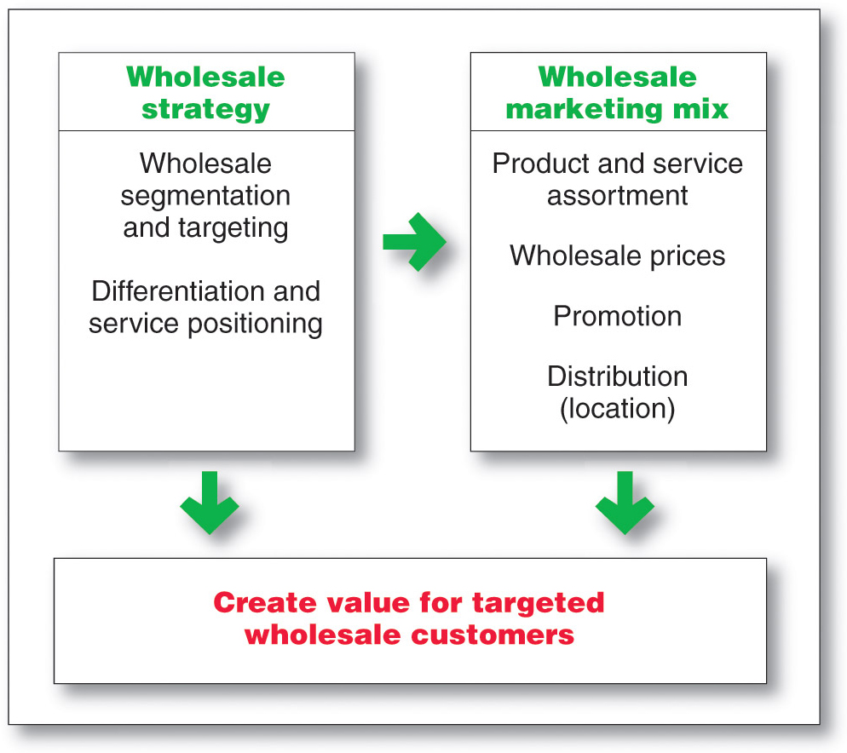
Wholesaling
Wholesaler Marketing Decisions

Slide 36
Wholesaling
Wholesaler Marketing Decisions
Target market and positioning decisions
Size of customer
Type of customer
Need for service

Slide 37

Wholesaling
Wholesaler Marketing Decisions
Marketing mix decisions
Product
Price
Promotion
Place

Slide 38
Wholesaling
Trends in Wholesaling
Challenges
Resistance to price increases
Fewer suppliers
Changing customer needs
Adding value by increasing efficiency and effectiveness

Slide 39
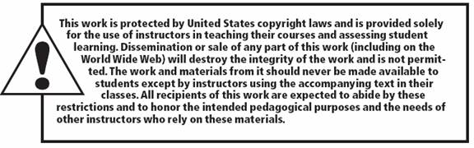
All rights reserved. No part of this publication may be reproduced, stored in a retrieval system, or transmitted, in any form or by any means, electronic, mechanical, photocopying, recording, or otherwise, without the prior written permission of the publisher. Printed in the United States of America.
Copyright © 2012 Pearson Education, Inc.
Publishing as Prentice Hall

