Slide 1
Relational Algebra
Chapter 4

Slide 2
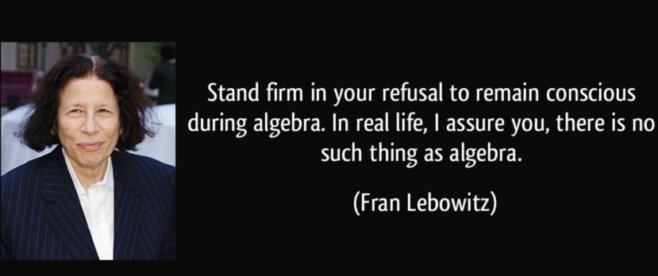
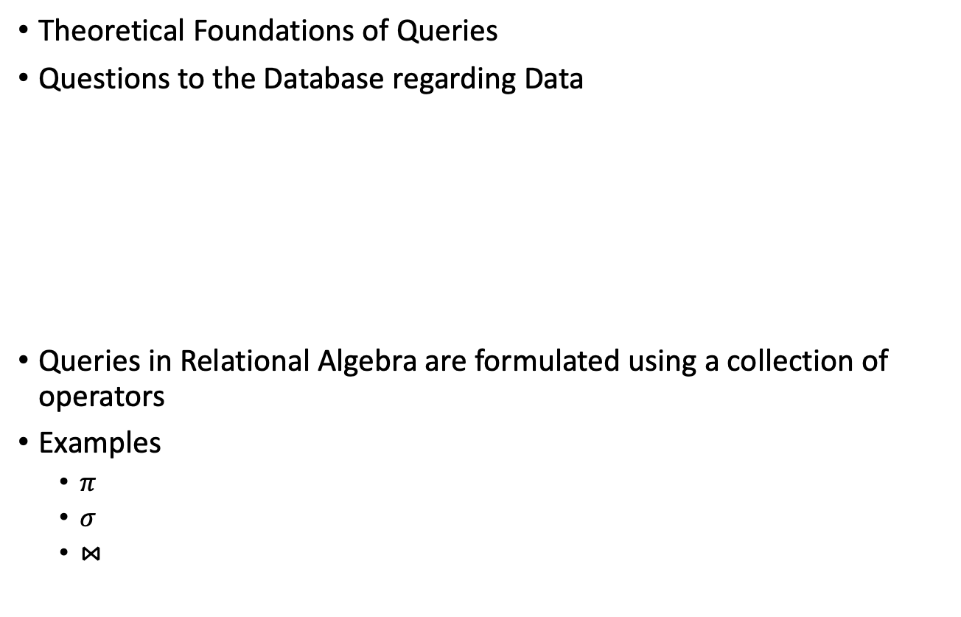
What is it?
Theoretical Foundations of Queries
Questions to the Database regarding Data
Queries in Relational Algebra are formulated using a collection of operators
Examples
  $π$
  $σ$
  $⋈$

Slide 3
Introduction and Schemas
Assumptions
Sailors
Boats
Sid | Sname | Rating | Age
22 | Dustin | 7 | 45
31 | Lubber | 8 | 55
58 | Rusty | 10 | 35
32 | Andy | 8 | 25
Bid | Bname | color
101 | Interlake | Blue
102 | Interlake | red
103 | Clipper | Green
104 | Marine | red
Reserves
Sid | Bid | Day
22 | 101 | 10/10/96
58 | 103 | 11/12/96

Slide 4
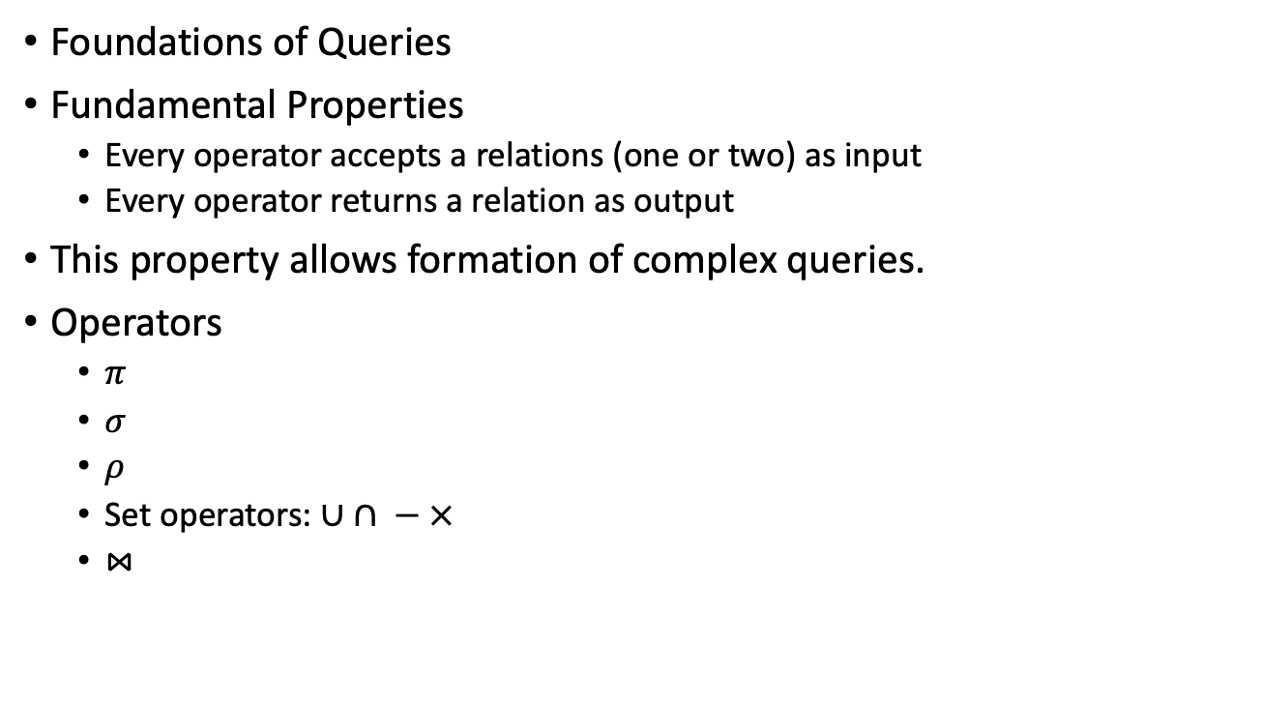
Relational Algebra
Foundations of Queries
Fundamental Properties
  Every operator accepts a relations (one or two) as input
  Every operator returns a relation as output
This property allows formation of complex queries.
Operators
  $π$
  $σ$
  $ρ$
  Set operators: $∪ ∩ − ×$
  $⋈$

Slide 5


Select Operator $(σ)$
Formal notation
$R^{′}=\begin{matrix}σ \\ conditions\end{matrix}\left(R\right)$
Works on the horizontal dimension (tuples)
Sid | Sname | Rating | Age
22 | Dustin | 7 | 45
31 | Lubber | 8 | 55
58 | Rusty | 10 | 35
32 | Andy | 8 | 25
17 | Popeye | 10 | 40

Slide 6

Examples on Selection
$R^{′}=\begin{matrix}σ \\ Sailors.age>40\end{matrix}\left(Sailors\right)$
Sid | Sname | Rating | Age
22 | Dustin | 7 | 45
31 | Lubber | 8 | 55
58 | Rusty | 10 | 35
32 | Andy | 8 | 25
Sid | Sname | Rating | Age
22 | Dustin | 7 | 45
31 | Lubber | 8 | 55

Slide 7
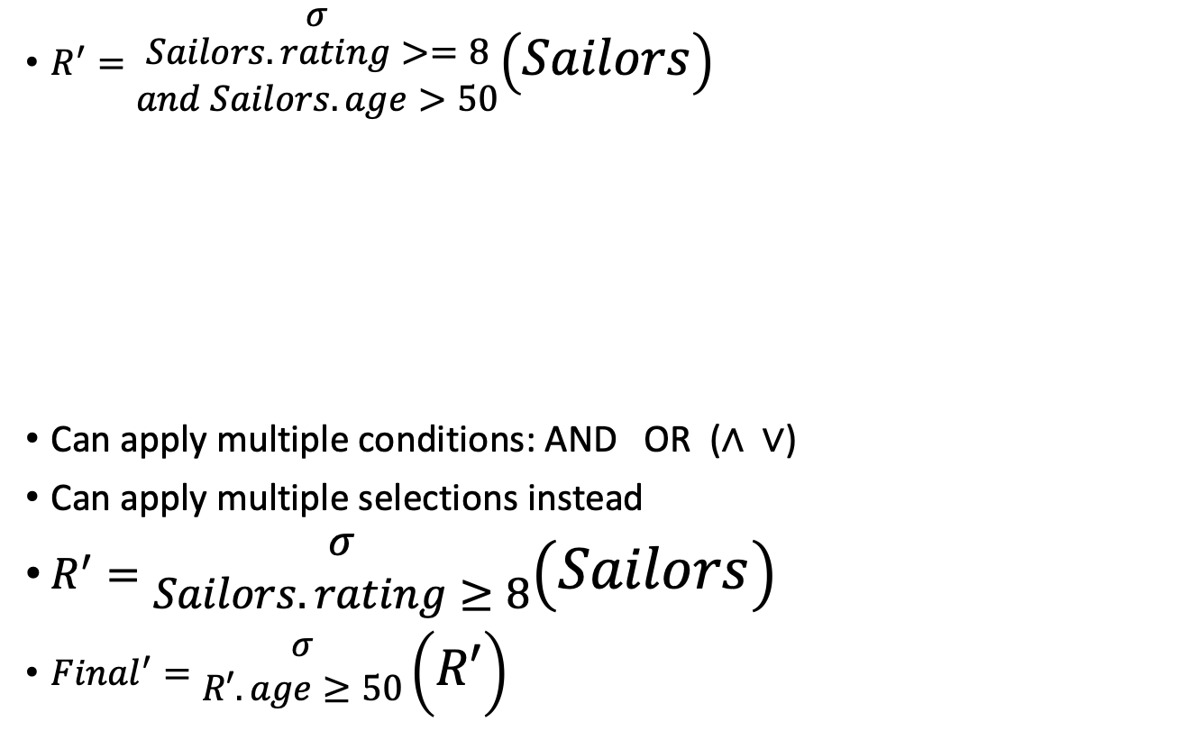
Examples on Selection (2)
$R^{′}=\begin{matrix}σ \\ \begin{aligned}Sailors.rating>=8 \\ and Sailors.age>50\end{aligned}\end{matrix}\left(Sailors\right)$
Can apply multiple conditions: AND OR ($∧ ∨$)
Can apply multiple selections instead
$R^{′}=\begin{matrix}σ \\ Sailors.rating≥8\end{matrix}\left(Sailors\right)$
${Final}^{′}=\begin{matrix}σ \\ R′.age≥50\end{matrix}\left(R′\right)$
Sid | Sname | Rating | Age
22 | Dustin | 7 | 45
31 | Lubber | 8 | 55
58 | Rusty | 10 | 35
32 | Andy | 8 | 25
Sid | Sname | Rating | Age
31 | Lubber | 8 | 55

Slide 8
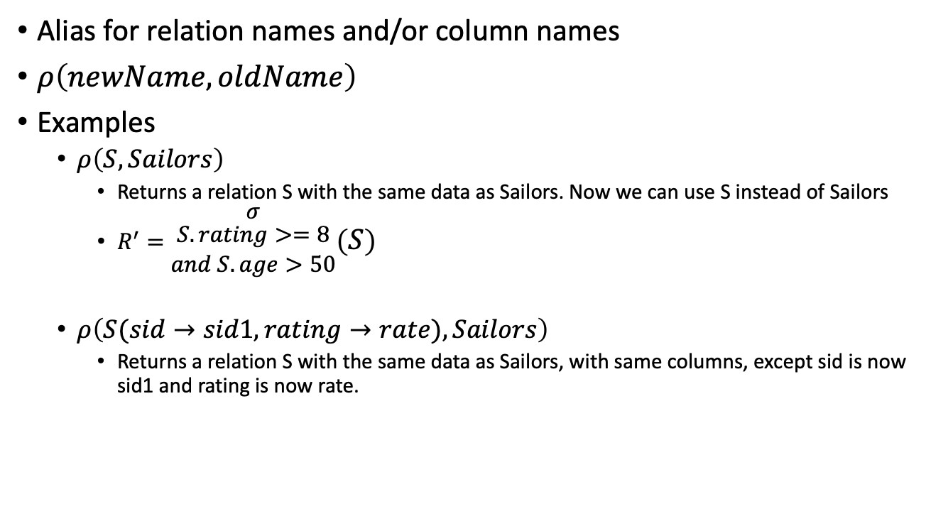

Rename Operator ($ρ$)
Alias for relation names and/or column names
$ρ\left(newName, oldName\right)$
Examples
  $ρ\left(S,Sailors\right)$
    Returns a relation S with the same data as Sailors. Now we can use S instead of Sailors
    $R^{′}=\begin{matrix}σ \\ \begin{aligned}S.rating>=8 \\ and S.age>50\end{aligned}\end{matrix}\left(S\right)$
  $ρ\left(S(sid→sid1,rating→rate),Sailors\right)$
    Returns a relation S with the same data as Sailors, with same columns, except sid is now sid1 and rating is now rate.

Slide 9


Project Operator ($\prod{R}$)
Formal notation
$R^{′}=\prod_{columns}{\left(R\right)}$
Works on the vertical dimension (attributes)
Will only show unique values.
Sid | Sname | Rating | Age
22 | Dustin | 7 | 45
31 | Lubber | 8 | 55
58 | Rusty | 10 | 35
32 | Andy | 8 | 25

Slide 10
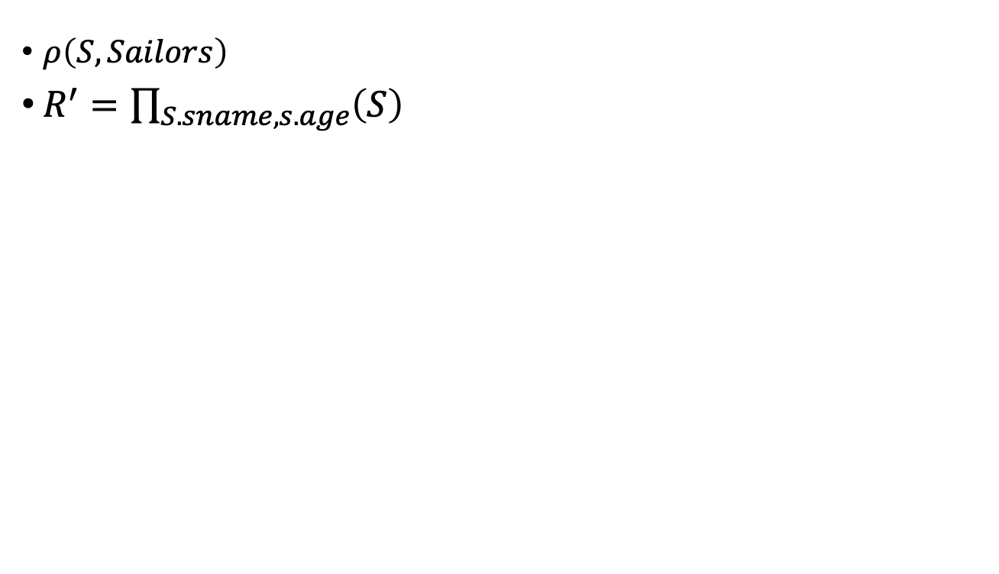
Examples on Projection
Sid | Sname | Rating | Age
22 | Dustin | 7 | 45
31 | Lubber | 8 | 55
58 | Rusty | 10 | 35
32 | Andy | 8 | 25
$ρ\left(S,Sailors\right)$
$R^{′}=\prod_{S.sname,s.age}{\left(S\right)}$
Sname | Age
Dustin | 45
Lubber | 55
Rusty | 35
Andy | 25

Slide 11
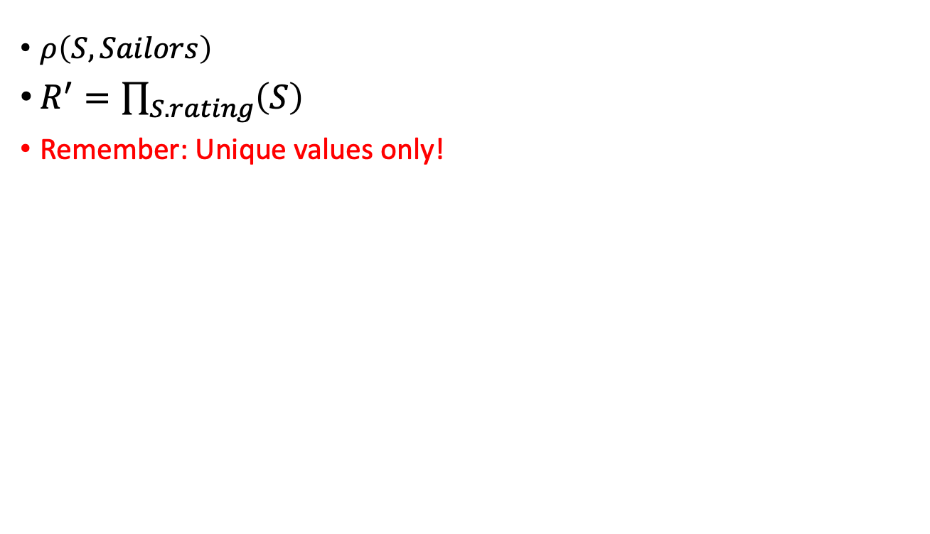
Examples on Projection(2)
Sid | Sname | Rating | Age
22 | Dustin | 7 | 45
31 | Lubber | 8 | 55
58 | Rusty | 10 | 35
32 | Andy | 8 | 25
$ρ\left(S,Sailors\right)$
$R^{′}=\prod_{S.rating}{\left(S\right)}$
Remember: Unique values only!
Rating
7
8
10

Slide 12
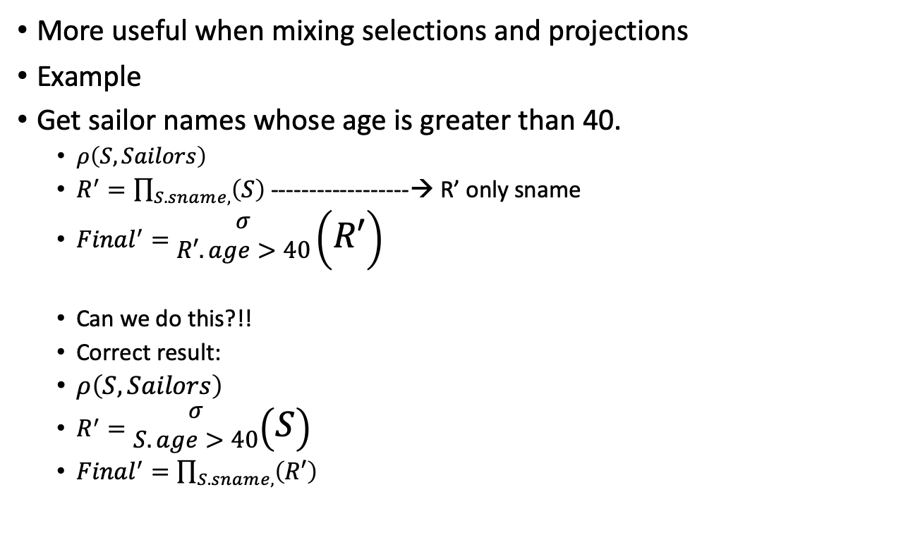
Mixing Operators
More useful when mixing selections and projections
Example
Get sailor names whose age is greater than 40.
  $ρ\left(S,Sailors\right)$
  $R^{′}=\prod_{S.sname,}{\left(S\right)}$ ------------------→ R’ only sname
  ${Final}^{′}=\begin{matrix}σ \\ R′.age>40\end{matrix}\left(R′\right)$
  Can we do this?!!
  Correct result:
  $ρ\left(S,Sailors\right)$
  $R^{′}=\begin{matrix}σ \\ S.age>40\end{matrix}\left(S\right)$
  ${Final}^{′}=\prod_{S.sname,}{\left(R′\right)}$

Slide 13
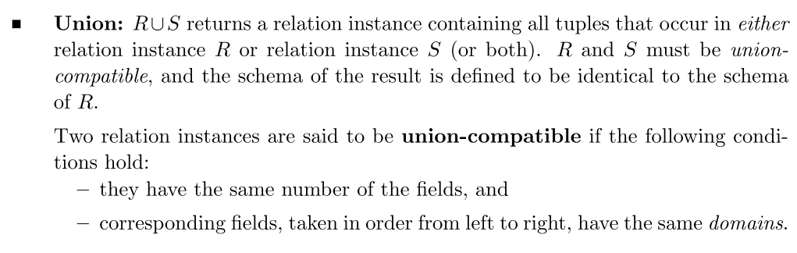
Set Operations: Union

Slide 14
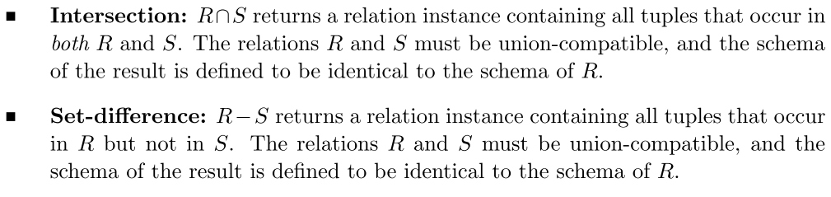
Set Operations: Intersection and Set Difference

Slide 15


Examples on Set Operators
Sid | Sname | Rating | Age
28 | yuppy | 9 | 35
31 | Lubber | 8 | 55
44 | guppy | 5 | 35
58 | Rusty | 10 | 35
Sid | Sname | Rating | Age
22 | Dustin | 7 | 45
31 | Lubber | 8 | 55
58 | Rusty | 10 | 35
Sid | Sname | Rating | Age
22 | Dustin | 7 | 45
28 | yuppy | 9 | 35
31 | Lubber | 8 | 55
44 | guppy | 5 | 35
58 | Rusty | 10 | 35
$$=$$

Slide 16

Examples on Set Operators (2)
Sid | Sname | Rating | Age
28 | yuppy | 9 | 35
31 | Lubber | 8 | 55
44 | guppy | 5 | 35
58 | Rusty | 10 | 35
Sid | Sname | Rating | Age
22 | Dustin | 7 | 45
31 | Lubber | 8 | 55
58 | Rusty | 10 | 35
Sid | Sname | Rating | Age
31 | Lubber | 8 | 55
58 | Rusty | 10 | 35
$$=$$

Slide 17

Examples on Set Operators (3)
Sid | Sname | Rating | Age
28 | yuppy | 9 | 35
31 | Lubber | 8 | 55
44 | guppy | 5 | 35
58 | Rusty | 10 | 35
Sid | Sname | Rating | Age
22 | Dustin | 7 | 45
31 | Lubber | 8 | 55
58 | Rusty | 10 | 35
$$−$$
$$=$$
Sid | Sname | Rating | Age
22 | Dustin | 7 | 45

Slide 18
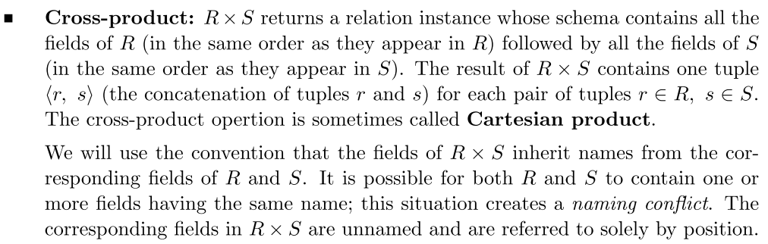
Cross Product:

Slide 19
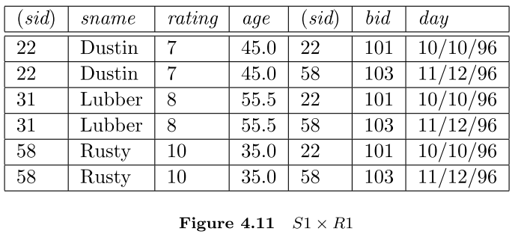


Example:
Sid | Sname | Rating | Age
22 | Dustin | 7 | 45
31 | Lubber | 8 | 55
58 | Rusty | 10 | 35
Sid | Bid | Day
22 | 101 | 10/10/96
58 | 103 | 11/12/96
$$×$$
$$=$$

Slide 20

Condition Join
The most general version of the join operation accepts a join condition c and a pair of relation instances as arguments, and returns a relation instance

Slide 21

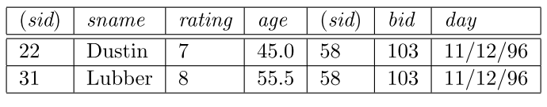
Condition Join Example

Slide 22
Equijoin
A common special case of the join operation R S is when the join condition consists solely of equalities of the form R.name1 = S.name2, that is, equalities between two ﬁelds in R and S.
The schema of the result of an equijoin contains the ﬁelds of R (with the same names and domains as in R) followed by the ﬁelds of S that do not appear in the join conditions.

Slide 23

Natural Join
A further special case of the join operation R S is an equijoin in which equalities are speciﬁed on all ﬁelds having the same name in R and S.
In this case, we can simply omit the join condition.

Slide 24

Examples
Find the names of Sailors who have reserved boat id = 103
Find the names of Sailors who reserved a red boat
Find the color of boats reserved by lubber
${\text{∏}}_{\text{s}\text{ailo}\text{rs}\text{.}\text{sname}}$ (${\text{σ}}_{\text{r}\text{eserves}\text{.}\text{bid}\text{ = }\text{103}}$ (Reserves) ⨝ Sailors)

Slide 25



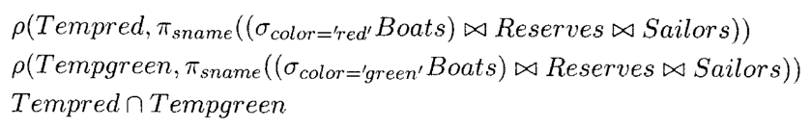
Examples (2)
Find the names of sailors who have reserved at least one boat
Find the names of Sailors who reserved a red boat or a green boat
Find the names of Sailors who reserved a red AND a green boat

Slide 26

Examples (3)
Find the sids of sailors with age over 20 who have not reserved a red boat

Slide 27
Examples (4)
Find the sids of sailors who reserved at least two different boats
Reserves
Sid | Bid | Day
22 | 101 | 10/10/96
58 | 103 | 11/12/96
22 | 107 | 1/2/98

Slide 28




Examples (4)
Find the sids of sailors who reserved at least two different boats
$$ρ\left(R,Reserves\right)$$
$$R×R′$$
$$ρ\left(R′,Reserves\right)$$
Sid | Bid | Day
22 | 101 | 10/10/96
58 | 103 | 11/12/96
22 | 107 | 1/2/98
Sid | Bid | Day
22 | 101 | 10/10/96
58 | 103 | 11/12/96
22 | 107 | 1/2/98
$$×$$

Slide 29
Examples (4)
Find the sids of sailors who reserved at least two different boats
Sid | Bid | Day | Sid’ | Bid’ | Day’
22 | 101 | 10/10/96 | 22 | 101 | 10/10/96
22 | 101 | 10/10/96 | 58 | 103 | 11/12/96
22 | 101 | 10/10/96 | 22 | 107 | 1/2/98
58 | 103 | 11/12/96 | 22 | 101 | 10/10/96
58 | 103 | 11/12/96 | 58 | 103 | 11/12/96
58 | 103 | 11/12/96 | 22 | 107 | 1/2/98
22 | 107 | 1/2/98 | 22 | 101 | 10/10/96
22 | 107 | 1/2/98 | 58 | 103 | 11/12/96
22 | 107 | 1/2/98 | 22 | 107 | 1/2/98
Now Select only rows where Rsid=R’sid

Slide 30
Examples (4)
Find the sids of sailors who reserved at least two different boats
Sid | Bid | Day | Sid’ | Bid’ | Day’
22 | 101 | 10/10/96 | 22 | 101 | 10/10/96
22 | 101 | 10/10/96 | 58 | 103 | 11/12/96
22 | 101 | 10/10/96 | 22 | 107 | 1/2/98
58 | 103 | 11/12/96 | 22 | 101 | 10/10/96
58 | 103 | 11/12/96 | 58 | 103 | 11/12/96
58 | 103 | 11/12/96 | 22 | 107 | 1/2/98
22 | 107 | 1/2/98 | 22 | 101 | 10/10/96
22 | 107 | 1/2/98 | 58 | 103 | 11/12/96
22 | 107 | 1/2/98 | 22 | 107 | 1/2/98
Now Select only rows where Rsid=R’sid

Slide 31
Examples (4)
Selecting rows where Rsid=R’sid is not enough so we need to make sure Rbid is not the same as R’bid.. However, (Sid =22) is redundant!!
So rather we need to make sure Rbid <R’bid or Rbid>R’bid
Sid | Bid | Day | Sid’ | Bid’ | Day’
22 | 101 | 10/10/96 | 22 | 101 | 10/10/96
22 | 101 | 10/10/96 | 58 | 103 | 11/12/96
22 | 101 | 10/10/96 | 22 | 107 | 1/2/98
58 | 103 | 11/12/96 | 22 | 101 | 10/10/96
58 | 103 | 11/12/96 | 58 | 103 | 11/12/96
58 | 103 | 11/12/96 | 22 | 107 | 1/2/98
22 | 107 | 1/2/98 | 22 | 101 | 10/10/96
22 | 107 | 1/2/98 | 58 | 103 | 11/12/96
22 | 107 | 1/2/98 | 22 | 107 | 1/2/98

Slide 32
Schemas
Sailors
Boats
Sid | Sname | Rating | Age
22 | Dustin | 7 | 45
31 | Lubber | 8 | 55
58 | Rusty | 10 | 35
32 | Andy | 8 | 25
Bid | Bname | color
101 | Interlake | Blue
102 | Interlake | red
103 | Clipper | Green
104 | Marine | red
Reserves
Sid | Bid | Day
22 | 101 | 10/10/96
58 | 103 | 11/12/96

