Slide 1
Management of the patient with oropharyngeal swallowing disorders

Slide 2
Treatment planning
The clinician should consider the following when deciding on swallowing treatment:
Diagnosis
Prognosis
Reaction to compensatory strategies
Severity
Ability o follow commands
Respiratory function
Availability of support
Patient motivation

Slide 3
Oral Versus Non-oral feeding
The clinician should determine if the patient should be fed orally, or placed on nasogastric tube, gastrostomy or jejunostomy.
Usually the recommendation of the type of food delivery depends on:
    Time taken to swallow ( oral and pharyngeal transit times)
    Aspiration

Slide 4
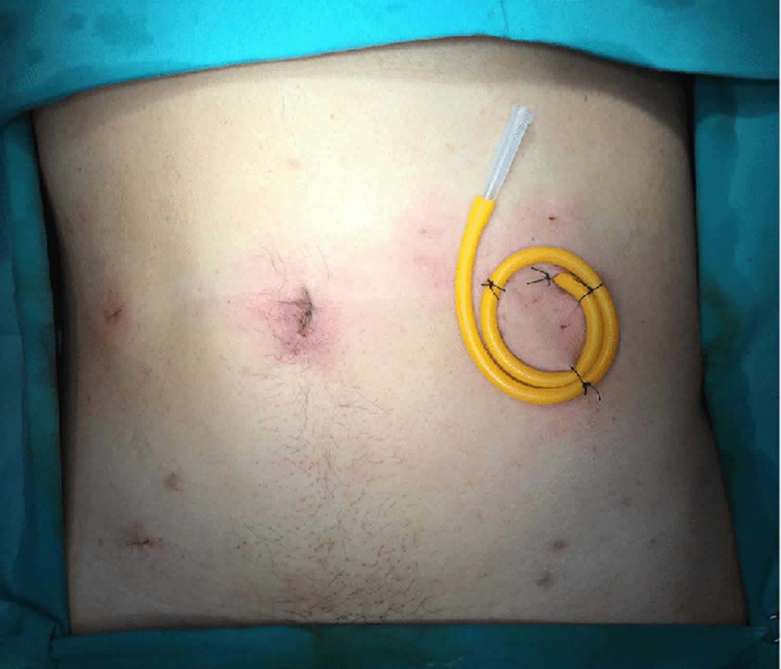
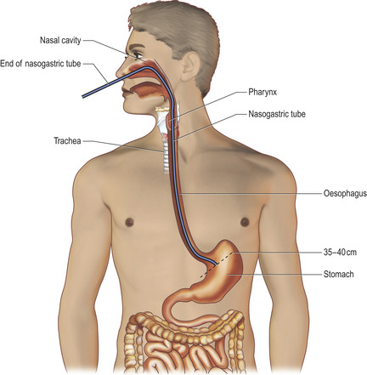
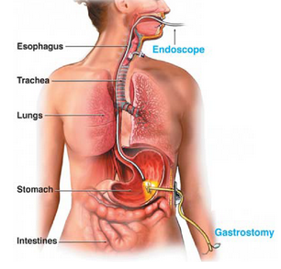
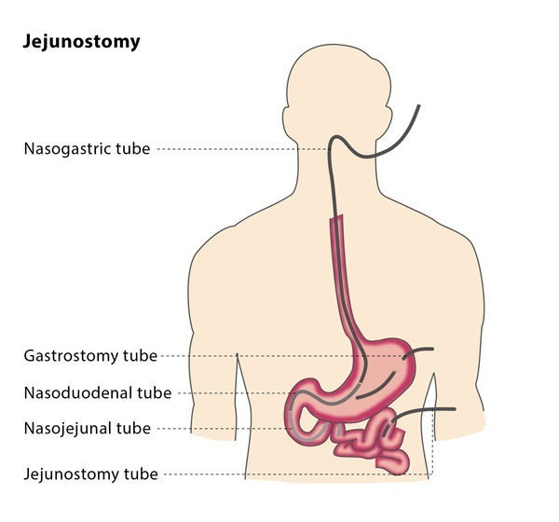

Slide 5
Compensatory treatment procedures
When do we introduce them ?
These are strategies that control the flow of food and eliminate the patient symptoms but do not change the physiology of the patient’s swallow.
Types of compensatory strategies:
      Postural techniques
      Oral sensory awareness
      Modifying volume and speed of food presentation
      Changing fod consistency or viscosity
      Introducing intraoral prosthetics

Slide 6
Postural techniques

Slide 7
Postural techniques
Postural techniques redirect food flow and change pharyngeal directions in a systematic way
During the diagnostic procedure:
    the clinician must choose the postural technique that best fits the physiologic/anatomic swallowing disorder identifies earlier in the radiographic study
    Next, the client is asked to use these postural changes while swallowing the same type of food that exhibited residue or aspiration ( why?)
Do you think that these techniques are used permanently or temporarily and why ?

Slide 8
Chin-down posture
Involves touching the neck to the chin.
Physiologic changes:
    The tongue base and epiglottis are pushed closer to the posterior pharyngeal wall
    Airway entrance is narrowed
    Vallecular space is widened
Helpful in patients with
    Delayed pharyngeal triggering
    Reduced tongue base retraction ( residue in vallecula)
    Reduced airway entrance closure
    https://www.youtube.com/watch?v=kWkhwzQKy88

Slide 9
Chin-up posture
Used to drain food from oral cavity using gravity
Helpful in patients with
    Reduced tongue control ( inefficient oral transit / bolus propulsion)

Slide 10
Head rotation
Physiologic changes:
    twists the pharynx and closes the damaged side of the pharynx so the food flows in the normal side
    Basically we eliminate damaged side from the bolus path
Helpful in patients with
    Unilateral pharyngeal wall impairment ( residue on one side of pharynx)
    Unilateral vocal fold weakness ( how? )
    https://www.youtube.com/watch?v=K071UnqO2IA

Slide 11
Chin down and head rotation ( to weak side)
Physiologic changes:
    Puts epiglottis in a more protective position
    Narrows laryngeal entrance
    Increases vocal fold closure
Helpful in patients with
    Reduced laryngeal closure ( aspiration during swallow).

Slide 12
Head tilt
Physiologic changes:
    Head is tilted to better side to use gravity to drain food down the stronger side
Helpful in patients with
    Unilateral oral impairment and unilateral pharyngeal impairment on same side ( residue in mouth and pharynx on same side)
    https://www.youtube.com/watch?v=T60HannQGeQ

Slide 13
Lying down
Physiologic changes:
    Gravity will hold the bolus against pharyngeal wall
Helpful in patients with
    Bilateral reduction in pharyngeal wall contraction
    Reduced laryngeal elevation ( aspiration after swallow).
Things to consider:
    Straw drinking
    Grastoesophageal reflux

Slide 14
Postural techniques
If the postural technique is successful and the patient is able to eat with them, the patient may or may be not given additional therapy
The patient will be rescheduled for a re-assessed after 3-4 weeks, while he exercises eating with the required posture.

Slide 15
Techniques to improve oral sensory awareness

Slide 16
Techniques to improve oral sensory awareness
These are useful for patients with :
    Apraxia
    Tactile agnosia for food
    Delayed onset of oral swallow
    Reduced oral sensation
    Delayed pharyngeal triggering

Slide 17
Techniques to improve oral sensory awareness
These can either be compensatory or therapy techniques
These techniques involve providing preliminary sensory stimulus prior to the initiation of swallow, which alerts central nervous system.

Slide 18
Techniques to improve oral sensory awareness
These techniques include :
    Increasing downward pressure of spoon when presenting food
    Presenting a sour bolus
    Presenting a cold bolus
    Presenting a bolus that requires chewing
    Presenting larger volume bolus
    Thermal tactile stimulation

Slide 19
oral sensory stimulation to improve pharyngeal trigger
Thermal-tactile stimulation
    Vertically rubbing anterior faucial arches with a 00 laryngeal mirror that has been placed in crushed ice before presenting the bolus
    This will heighten oral awareness by providing alternating sensory stimulus to the cortex and brain stem.
Suck-swallow
    Uses increased vertical tongue-jaw sucking movement with the lips closed
    Facilitates triggering of the pharyngeal swallow

Slide 20
Modifying volume and speed of food presentation

Slide 21
Modifying volume and speed of food presentation
E.g., larger bolus enhances pharyngeal triggering
Patients with weakened laryngeal swallow might need to take smaller boluses at a slower rate

Slide 22
Food consistency changes
This should be the last compensatory strategy to be examind
Usually appropriate for patients who:
    Have movement disorders
    Cannot follow directions
    Oral sensory procedures cannot be done for them

Slide 23
Liquids
Disorders that liquids are appropriate with:
Oral tongue dysfunction
Reduced tongue base retraction
Reduced pharyngeal wall retraction
Reduced laryngeal elevation
Reduced crico-pharngeal opening

Slide 24
Thickened liquids
Disorders that thickened liquids are appropriate with:
Oral tongue dysfunction
Delayed pharyngeal swallow

Slide 25
Puree and thick food
Disorders that thick food / puree are appropriate with:
Delayed pharyngeal swallow
Reduced laryngeal closure at the entrance
reduced laryngeal closure throughout

Slide 26
Intraoral prosthetics

Slide 27
Intraoral prosthetics
Oral cancer patients
Patients with hypoglossal paralysis
Velo-pharngeal deficits

Slide 28
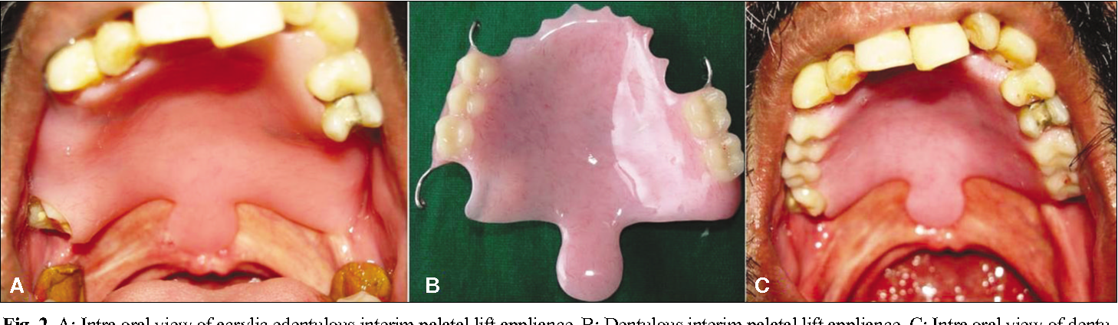
Intraoral prosthetics
Palatal lift Prosthesis: used with patients with palatal paralysis

Slide 29
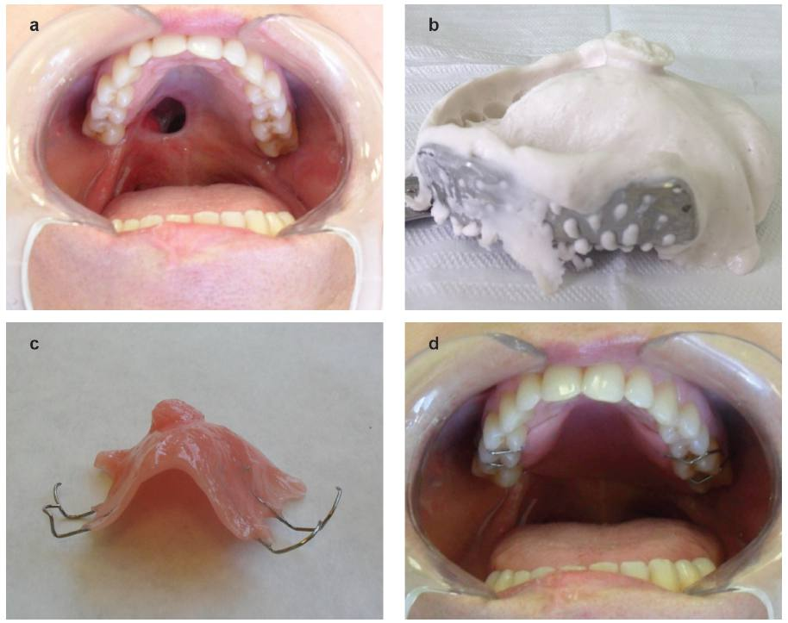
Intraoral prosthetics
Palatal obturator: used with patients with significant resection of soft palate

Slide 30
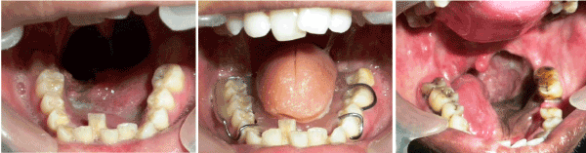
Intraoral prosthetics
Palatal augmentation / reshaping prosthesis: used with patients with significant tongue resections or bilateral tongue paralysis

