Slide 1
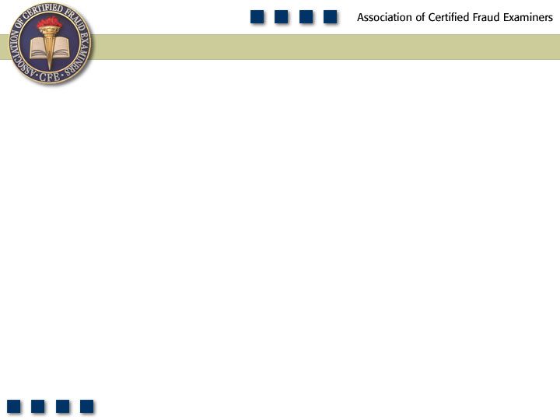
Chapter 10
Corruption

Slide 2

Pop Quiz
What are the two principle schemes involving bribery?

Slide 3
Learning Objectives
Define corruption.
Identify the four categories of corruption.
Define bribery.
Compare and contrast bribery, extortion, and illegal gratuities.
Identify the two categories of bribery schemes.
Understand kickback schemes and how they are committed.
Understand bid-rigging schemes and explain how they are categorized.

Slide 4
Learning Objectives
Describe the types of abuses that are committed at each stage of the competitive bidding process.
Be familiar with the controls and techniques that can be used to prevent and detect bribery.
Define conflicts of interest.
Differentiate conflicts of interest from bribery schemes and billing schemes.
List and understand the two major categories of conflicts of interest.
Be familiar with proactive audit tests that can be used to detect corruption schemes.

Slide 5
Corruption
Conflicts of
Interest
Bribery
Illegal
Gratuities
Economic
Extortion
Purchase
Schemes
Invoice
Kickbacks
Sales
Schemes
Bid Rigging
Other
Other

Slide 6
Frequency of Types of Occupational Fraud and Abuse

Slide 7
Median Loss of Types of Occupational Fraud and Abuse

Slide 8
Frequency of Corruption Schemes

Slide 9
Bribery
Offering, giving, receiving, or soliciting any thing of value to influence an official act
Buys influence of the recipient
Commercial bribery
Kickbacks
Bid-rigging schemes

Slide 10
Kickback Schemes
Involve submission of invoices for goods and services that are either overpriced or completely fictitious
Involve collusion between employees and vendors
Almost always attack the purchasing function of the victim company

Slide 11
Kickback Schemes
Diverting business to vendors
Vendor pays the kickbacks to ensure a steady stream of business from the purchasing company
No incentive to provide quality merchandise or low price
Almost always leads to overpaying for goods or services

Slide 12
Overbilling Schemes
Employees with approval authority
Vendor submits inflated invoices to the victim company
Overstates the cost of actual goods or services or reflects fictitious sales
Ability to authorize purchases is key to the scheme

Slide 13
Overbilling Schemes
Employees lacking approval authority
Circumvent purchasing controls
May prepare false vouchers to make it appear that the invoice is legitimate
May forge an approval signature or have access to a restricted password in a computerized system
Difficult to detect since the victim company is being attacked from two directions

Slide 14
Other Kickback Schemes
Discounts are given in exchange for bribes
Slush funds
Other side of the transaction
Funds can be paid from other accounts or paid as “consulting fees”

Slide 15
Detecting Kickbacks
Normal controls may not detect kickback schemes
Look for price inflation
Monitor trends in cost of goods sold and services purchased
Often start small but increase over time

Slide 16
Detecting Kickbacks
Look for excessive quantities purchased
Investigate inventory shortages
Look for inferior goods purchased
Compare actual amounts to budgeted amounts

Slide 17
Preventing Kickbacks
Assign an employee independent of the purchasing department to routinely review buying patterns
Make sure that all contracts have a “right to audit” clause
Establish written policies prohibiting employees from soliciting or accepting any gift or favor from a customer or supplier
Expressly forbid any employee from engaging in any transaction, on behalf of the company, in which he or she has an undisclosed personal interest
Implement an ethics policy that clearly explains what improper behavior is and provides grounds for termination if an employee accepts a bribe or kickback

Slide 18
Bid-Rigging Schemes
All bidders are expected to be on an even playing field – bidding on the same specifications
The more power a person has over the bidding process, the more influence he or she can exert over the selection of the winning bid
Potential targets include:
Buyers
Contracting officials
Engineers and technical representatives
Quality or produce assurance representatives
Subcontractor liaison employees

Slide 19
Pre-Solicitation Phase
Need recognition schemes
Employee of the purchasing company convinces the company that a particular project is necessary
Has the specifications tailored to the strengths of a particular supplier
Trends indicating a need recognition scheme is occurring
Higher requirements for stock and inventory levels
Writing off large numbers of surplus items to scrap
Defining a need that can only be met by a certain supplier
Failure to develop a satisfactory list of backup suppliers

Slide 20
Specification Schemes
Specifications include a list of the elements, materials, dimensions, and other relevant requirements
Set the specifications to a particular vendor’s capabilities
Use“prequalification” procedures to eliminate certain vendors
Sole-source or noncompetitive procurement justifications
Deliberately writes vague specifications requiring amendments at a later date
Bid splitting
Gives a vendor the right to see the specifications before his competitors get the specs

Slide 21
The Solicitation Phase
Restricting the pool of vendors from which to choose
Bid pooling
Fictitious suppliers
Restricting the time for submitting bids
Soliciting bids in obscure publications
Publicizing the bid during holiday periods

Slide 22
The Submission Phase
Fraud in the sealed bid process
Last bid submitted is the one that is awarded the contract
Winning bidder finds out what the other competitors are bidding
Winning bidder may see the other competitors’ bids before submitting his bid
Gets help on preparing the bid

Slide 23
Detecting Bid-Rigging Schemes
Look for:
Unusual bidding patterns
Low bids followed by change orders
A very large unexplained price difference among bidders
Contractors who bid last and repeatedly receive the contract
A predictable rotation of bidders
Losing bidders who become subcontractors
Vendors with the same address and phone number
Fewer bidders than expected for the project
Projects that have been split into smaller ones

Slide 24
Something of Value
Cash
Promises of future employment
Promise of ownership in the supplier’s firm
Gifts
Liquor and meals
Free travel and accommodations
Cars and other merchandise
Payment of credit card bills
Loans on very favorable terms
Transfers of property

Slide 25
Other Corruption Schemes
Illegal gratuities
Given to reward a decision rather than influence it
Decision made to benefit a person or company but is not influenced by any sort of payment
May influence future decisions
Economic extortion
“Pay up or else”
Employee demands payment from a vendor in order to make a decision in the vendor’s favor

Slide 26
Conflicts of Interest
Employee, manager, or executive has an undisclosed economic or personal interest in a transaction that adversely affects the company
Victim organization is unaware of the employee’s divided loyalties
Distinguished from bribery–in conflicts of interest, the fraudster approves the invoice because of his own hidden interest in the vendor
Purchasing schemes
Sales schemes

Slide 27
Purchasing Schemes
Overbilling schemes
Bill originates from a real company in which the fraudster has an undisclosed economic or personal interest
Fraudster uses influence to ensure the victim company does business with this particular vendor
Does not negotiate in good faith or attempt to get the best price for the employer
Turnaround sales
The employee knows that the company is seeking to purchase a particular asset and purchases it himself
Turns around and sells it to the company at an inflated price

Slide 28
Sales Schemes
Underbillings
Goods are sold below fair market value to a customer in which the perpetrator has a hidden interest
Writing off sales
Purchases are made from the victim company and credit memos are later issued

Slide 29
Other Conflict of Interest Schemes
Business diversions
Siphoning off clients of the victim company to the employee’s own business
Resource diversions
Diverting funds and other resources for the development of the employee’s own company
Financial disclosures
Inadequate disclosures of related-party transactions to the company

Slide 30
Preventing and Detecting Conflicts of Interest
Implement, communicate, and enforce an ethics policy that addresses conflicts of interest offenses
Require employees to complete an annual disclosure statement
Establish an anonymous reporting mechanism to receive tips and complaints
Compare vendor address and telephone files to employee address and telephone files for matches

