Slide 1
Best Practices in Mobile App UI Design and Interaction
Samer Zein, (Ph.D.)

Slide 2
Introduction
The difference of a good and bad app usually boils to the quality of user interaction
A good UX separates successful mobile apps from unsuccessful ones
Today, mobile users expect a lot from an app:
  fast loading time,
  ease of use and delight during interaction.
If you want your app to be successful, you have to consider UX to be not just a minor aspect of design, but an essential component of product strategy.
Refs: https://www.smashingmagazine.com/2018/02/comprehensive-guide-to-mobile-app-design/

Slide 3
Mobile app Usability Heuristics
Usability heuristics are guidelines or principles that help evaluate the user interface design of software or applications.
When it comes to mobile apps, there are several sets of usability heuristics commonly referenced.
One of the most well-known sets is Nielsen's 10 Usability Heuristics for User Interface Design. While these heuristics were not specifically tailored for mobile apps, they are widely applicable and can be adapted for mobile design considerations.

Slide 4
Mobile app Usability Heuristics..1
Visibility of system status: The system should always keep users informed about what is going on, through appropriate feedback within a reasonable timeframe.
Match between system and the real world: The system should speak the users' language, with words, phrases, and concepts familiar to the user, rather than system-oriented terms. Follow real-world conventions, making information appear in a natural and logical order.
User control and freedom: Users often choose system functions by mistake and will need a clearly marked "emergency exit" to leave the unwanted state without having to go through an extended dialogue. Support undo and redo.

Slide 5
Mobile app Usability Heuristics..2
Consistency and standards: Users should not have to wonder whether different words, situations, or actions mean the same thing. Follow platform conventions.
Error prevention: Even better than good error messages is a careful design that prevents a problem from occurring in the first place. Either eliminate error-prone conditions or check for them and present users with a confirmation option before they commit to the action.
Recognition rather than recall: Minimize the user's memory load by making objects, actions, and options visible. The user should not have to remember information from one part of the dialogue to another. Instructions for use of the system should be visible or easily retrievable whenever appropriate.

Slide 6
Usability Heuristics …3
Flexibility and efficiency of use: Accelerators—unseen by the novice user—may often speed up the interaction for the expert user such that the system can cater to both inexperienced and experienced users. Allow users to tailor frequent actions.
Aesthetic and minimalist design: Dialogues should not contain information that is irrelevant or rarely needed. Every extra unit of information in a dialogue competes with the relevant units of information and diminishes their relative visibility.
Help users recognize, diagnose, and recover from errors: Error messages should be expressed in plain language (no codes), precisely indicate the problem, and constructively suggest a solution.
Help and documentation: Even though it is better if the system can be used without documentation, it may be necessary to provide help and documentation. Any such information should be easy to search, focused on the user's task, list concrete steps to be carried out, and not be too large.

Slide 7
Minimize Cognitive Load
Cognitive load refers here to the amount of brain power required to use the app.
The human brain has a limited amount of processing power, and when an app provides too much information at once.
it might overwhelm the user and make them abandon the task.

Slide 8
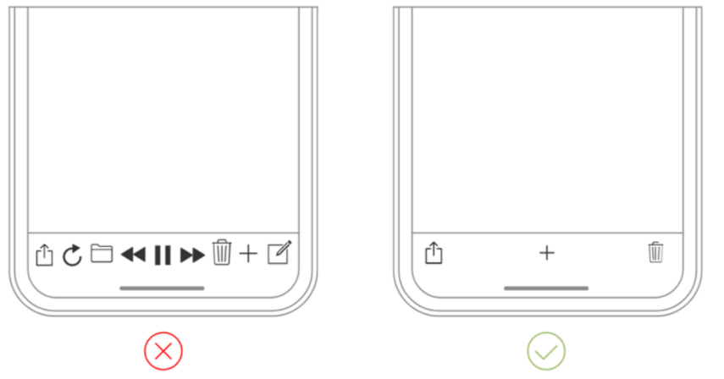
DECLUTTERING
Clutter is one of the worst enemies of good design.
By cluttering your interface, you overload users with too much information: Every added button, image and icon makes the screen more complicated.
Clutter is terrible on desktop, but it’s far worse on mobile.
It’s essential to get rid of anything in a mobile design that isn’t absolutely necessary because reducing clutter will improve comprehension.
  Keep content to a minimum (present the user with only what they need to know).
  Keep interface elements to a minimum. A simple design will keep the user at ease with the product.

Slide 9
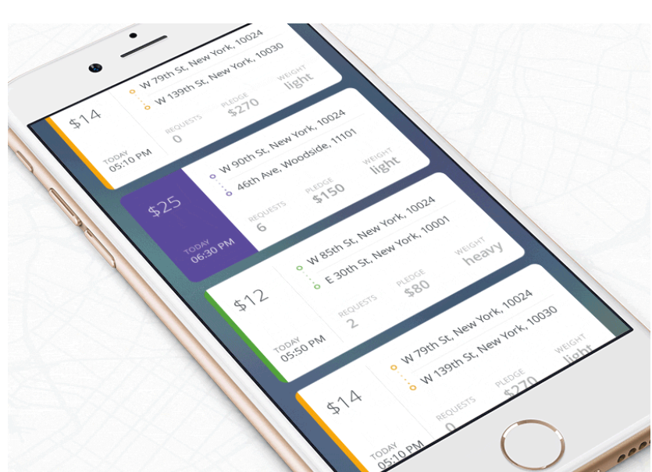
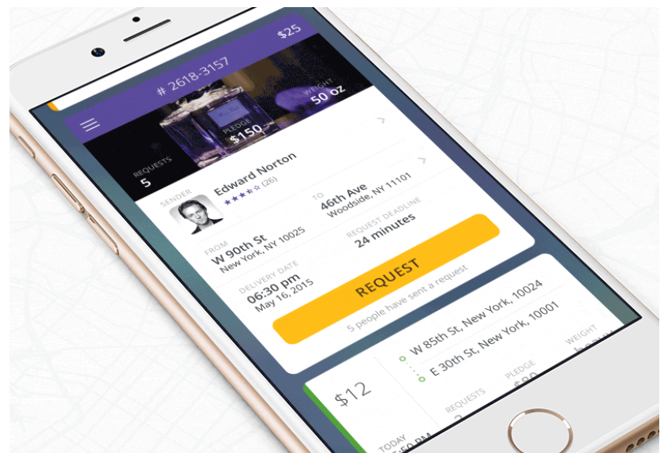
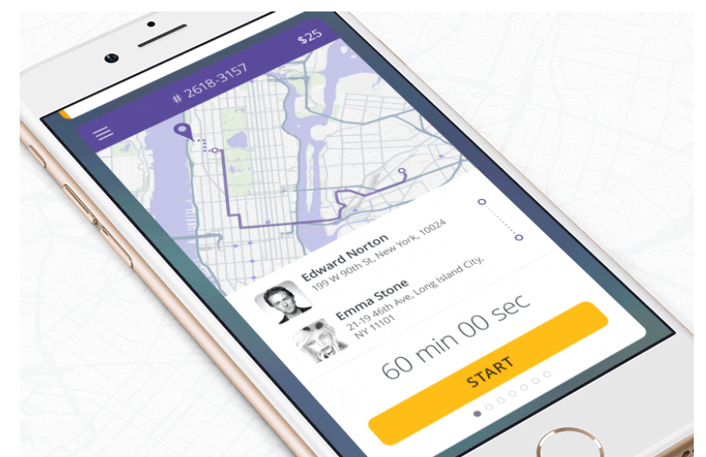
DECluttering..2
Use the technique of progressive disclosure to show more options.

Slide 10
OFFLOAD TASKS
Look for anything in the design that requires user effort (this might be entering data, making a decision, etc.), and look for alternatives.
For example, in some cases you can reuse previously entered data instead of asking the user to type more, or use already available information to set a smart default.

Slide 11
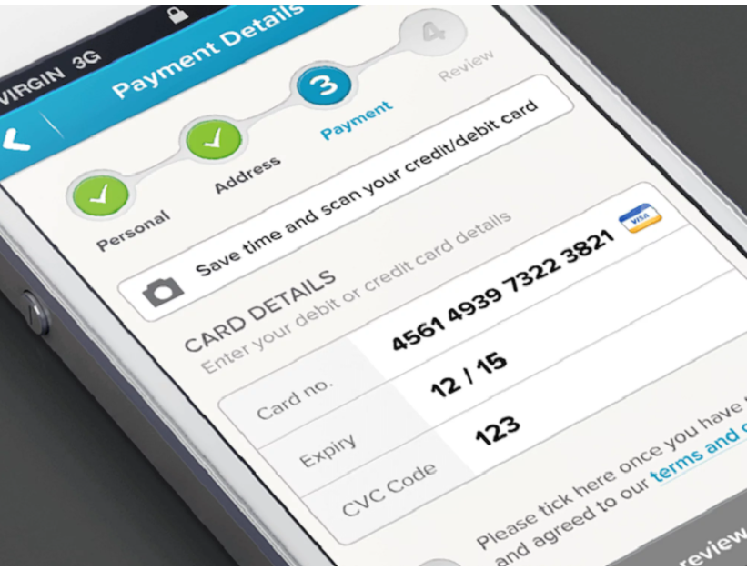
BREAK TASKS INTO BITE-SIZED CHUNKS
If a task contains a lot of steps and actions required from the user’s side, it’s better to divide such tasks into a number of subtasks.
This principle is extremely important in mobile design because you don’t want to create too much complexity for the user at one time.

Slide 12
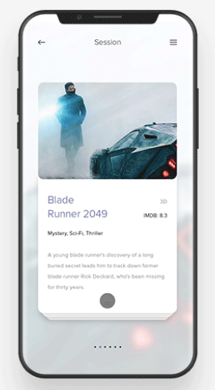
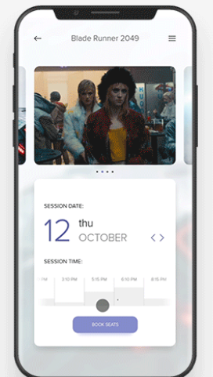
Chunking can also help to connect two different activities (such as browsing and purchasing).

Slide 13
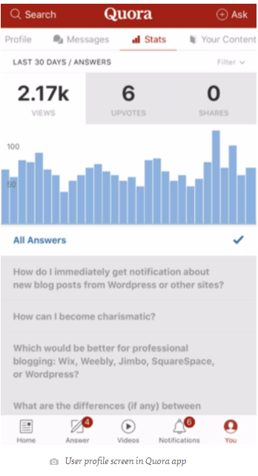
USE FAMILIAR SCREENS
Familiar screens are screens that users see in many apps.
Screens such as “Gettings started,” “What’s new” and “Search results” have become de facto standards for mobile apps.
They don’t require additional explanation because users are already familiar with them.
This allows users to use prior experience to interact with the app, with no learning curve.

Slide 14
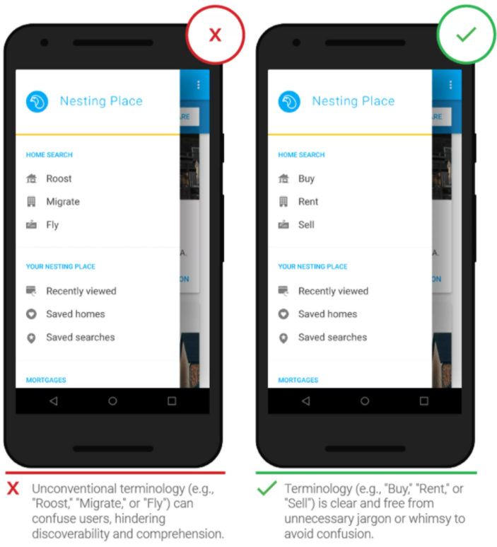
Avoid Jargon
Clear communication should always be a top priority in any mobile app.
Use what you know about your target audience to determine whether certain words or phrases are appropriate.

Slide 15
KEEP INTERACTIVE ELEMENTS FAMILIAR AND PREDICTABLE
Predictability is a fundamental principle of UX design.
When things work in the way users predict, they feel a stronger sense of control.
Unlike on desktop, where users can use hover effects to understand whether something is interactive or not, on mobile, users can check interactivity only by tapping on an element. That’s why, with buttons and other interactive elements, it’s essential to think about how the design communicates affordance.
THE “BACK” BUTTON SHOULD WORK PROPERLY
  Prevent situations when tapping the “back” button in a multi-step process would take users all the way back to the home screen.

Slide 16
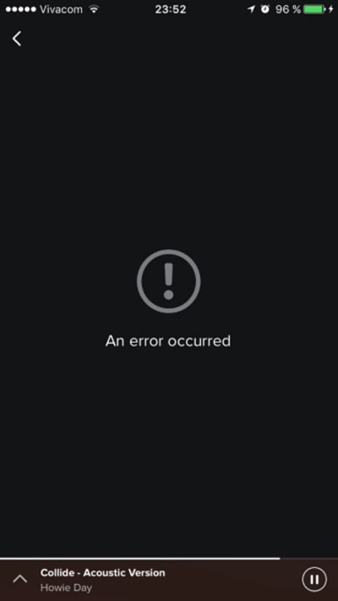
MEANINGFUL ERROR MESSAGES
Whatever the cause, these errors and how they are handled have a huge impact on the UX.
Bad error handling paired with useless error messages can fill users with frustration and could be the reason why users abandon your app.

Slide 17
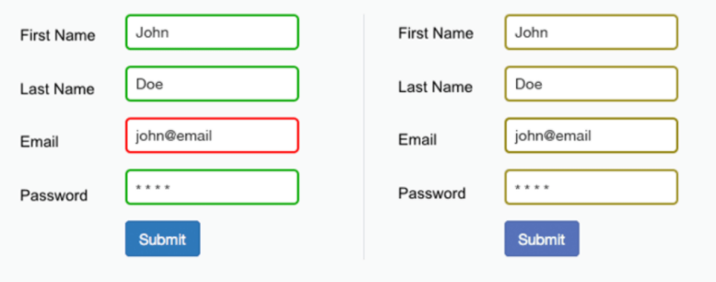
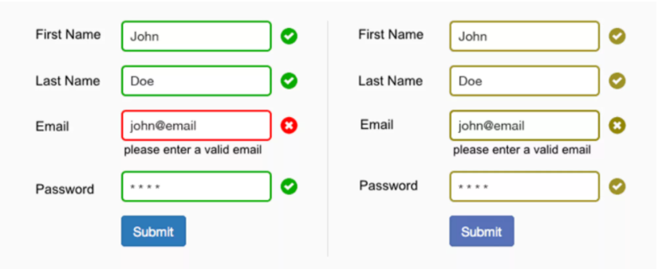
BE AWARE OF COLOR-BLINDNESS
4.5% of the global population experience color-blindness
(that’s 1 in 12 men and 1 in 200 women),
4% suffer from low vision (1 in 30 people), and 0.6% are blind (1 in 188 people).
It’s easy to forget that we’re designing for this group of users because most designers don’t experience such problems.

Slide 18
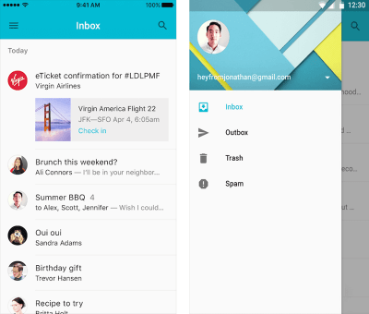
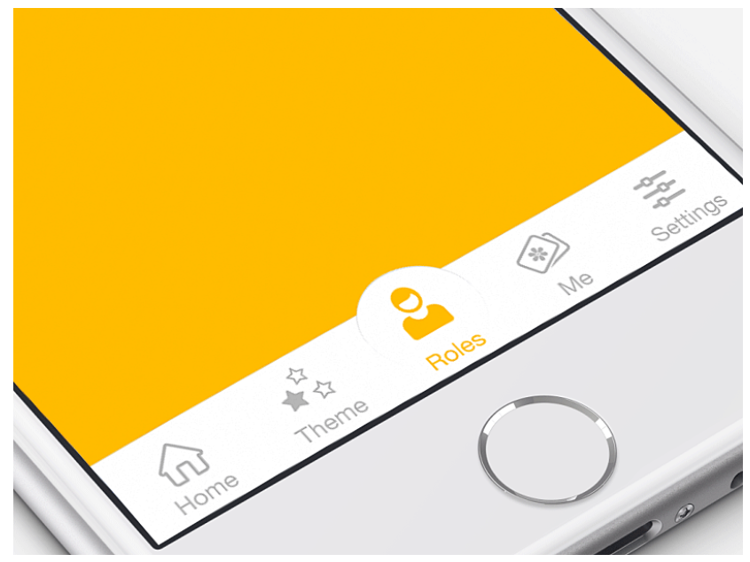
USE STANDARD NAVIGATION COMPONENTS
It’s better to use standard navigation patterns, such as the tab bar (for iOS) and the navigation drawer (for Android).
The majority of users are familiar with both navigation patterns and will intuitively know how to get around your app.

Slide 19
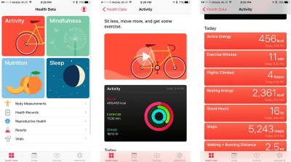
COMMUNICATE CURRENT LOCATION

Slide 20
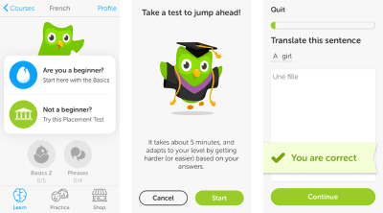
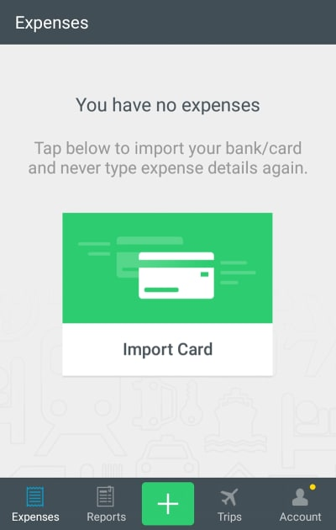
Focus On The First-Time Experience
The first-time experience is a make or break part of mobile apps. You only get one shot at a first impression. And if you fail, there’s a huge probability that users won’t launch your app again.
AVOID SIGN-IN WALLS
DESIGN A GOOD ONBOARDING EXPERIENCE

Slide 21
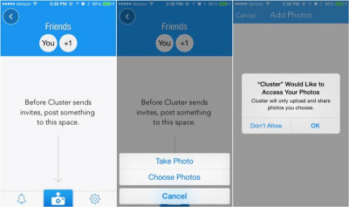
Don’t Ask For Set-Up Information Up Front
A mandatory set-up phase creates friction and can lead to abandonment of the app. When users launch an app, they expect it to just work.
Try to infer what you need from the system.
AVOID ASKING FOR PERMISSIONS RIGHT AT THE START

Slide 22
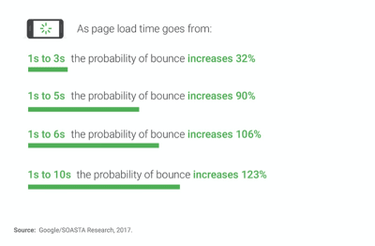
Make Your App Appear Fast And Responsive

Slide 23
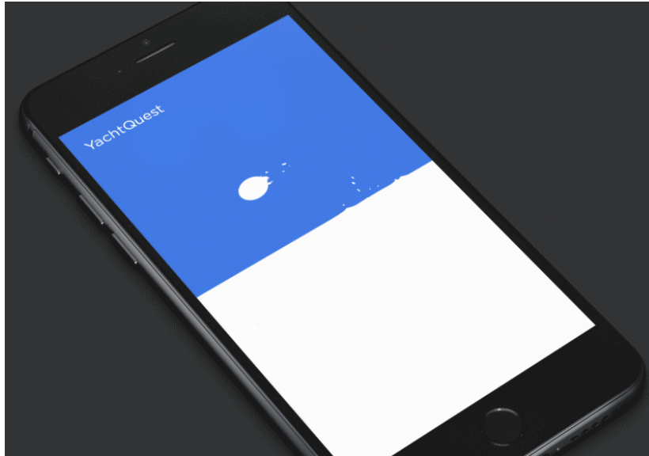
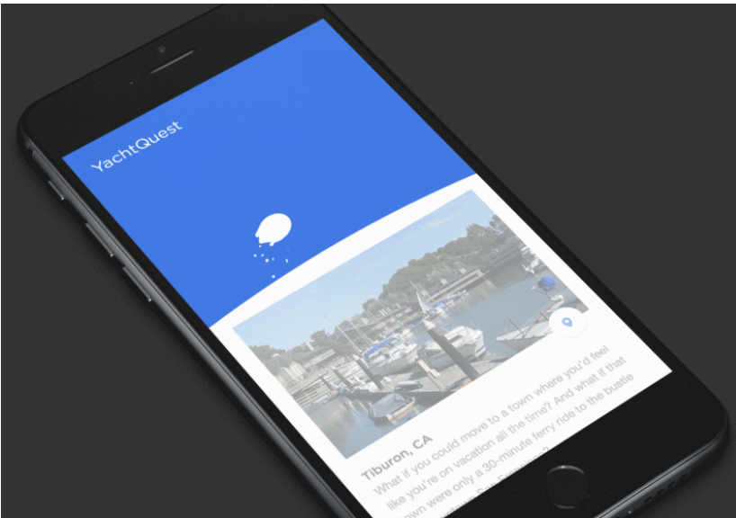
OFFER A VISUAL DISTRACTION when loading data

Slide 24
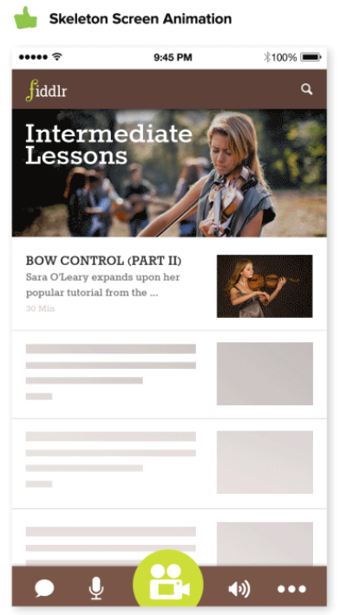
Skeleton Screens
Skeleton screens (i.e. temporary information containers) are essentially a blank version of a page into which information is gradually loaded.

Slide 25
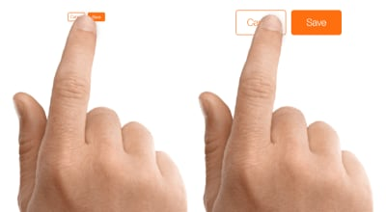
DESIGN FOR FINGERS, NOT CURSORS

Slide 26
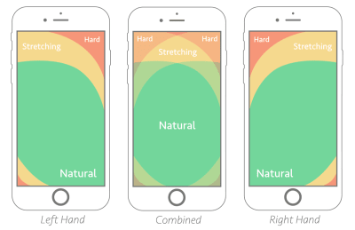
CONSIDER THUMB ZONE

Slide 27
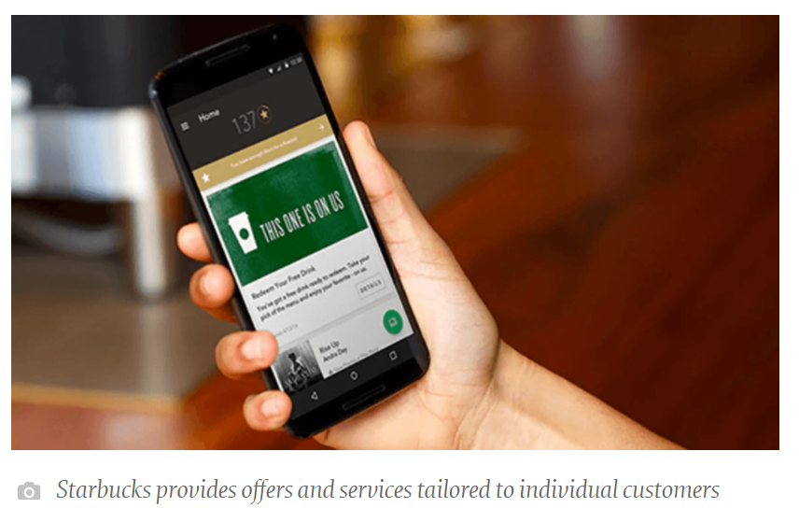
PERSONALIZED EXPERIENCE
There are countless ways to improve the mobile UX by incorporating personalization.
It’s possible to offer personalized content depending on the user’s location, their past searches and their past purchases.

Slide 28
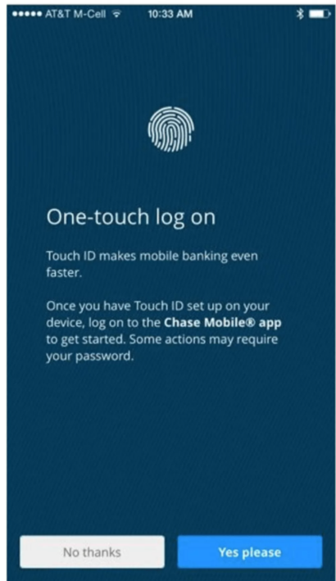
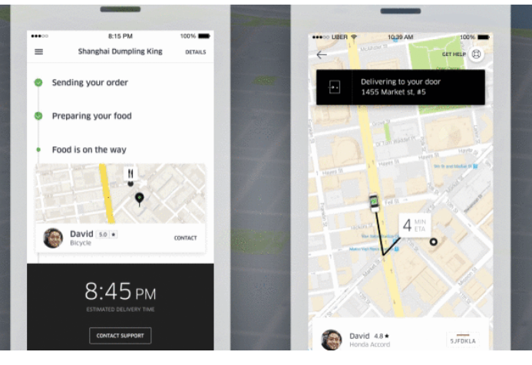
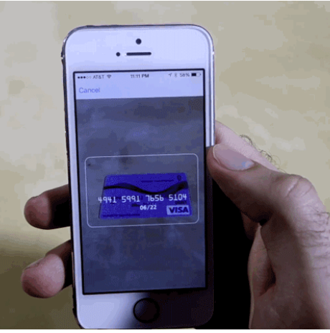
TAKE ADVANTAGE OF THE DEVICE’S CAPABILITIES

