Slide 1
Chapter Seventeen
Direct and Online Marketing: Building Direct Customer Relationships

Slide 2
Direct and Online Marketing: Building Direct Customer Relationships
Topic Outline
The New Direct-Marketing Model
Growth and Benefits of Direct Marketing
Customer Databases and Direct Marketing
Forms of Direct Marketing
Online Marketing
Setting up an Online Marketing Presence
Public Policy Issues in Direct Marketing

Slide 3
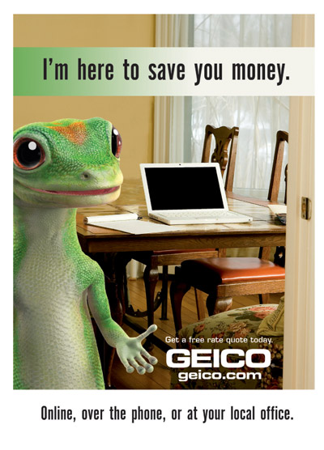

The New Direct Marketing Model
Direct marketing
A marketing channel without intermediaries
An element of the promotion mix
Fastest-growing form of marketing
Notes:
Note to Instructor
This Web link is for the DMA association—this would be an interesting site to explore with the students as it addresses many key issues in the industry. Of particular interest is the “marketing news” and the “advocacy” areas that can be viewed right on the homepage.

Slide 4
Growth and Benefits of Direct Marketing
Benefits to Buyers
Convenience
Ready access to many products
Access to comparative information about companies, products, and competitors
Interactive and immediate
Notes:
Note to Instructor
Discussion Question
When do you find direct mail to be a beneficial as a consumer?
Students might mention favorite retailers that email them coupons every week OR coupons they get in the mail. Victoria’s secret will often come up as a favorite among the female students.

Slide 5
Growth and Benefits of Direct Marketing
Benefits to Sellers
Tool to build customer relationships
Low-cost, efficient, fast alternative to reach markets
Flexible
Access to buyers not reachable through other channels

Slide 6

Customer Databases and Direct Marketing
Customer Database
Customer database is an organized collection of comprehensive data about individual customers or prospects, including geographic, demographic, psychographic, and behavioral data
Notes:
Note to Instructor
You can ask students how and why marketers use the databases. They should realize the following uses:
Locate good and potential customers
Generate sales leads
Learn about customers
Develop strong long-term relationships

Slide 7
Forms of Direct Marketing

Slide 8
Forms of Direct Marketing
Direct-mail marketing involves an offer, announcement, reminder, or other item to a person at a particular address
Personalized
Easy-to-measure results
Costs more than mass media
Provides better results than mass media

Slide 9
Forms of Direct Marketing
Catalog direct marketing involves printed and Web-based catalogs

Slide 10
Forms of Direct Marketing
Telephone direct marketing involves using the telephone to sell directly to consumers and business customers
Outbound telephone marketing sells directly to consumers and businesses
Inbound telephone marketing uses toll-free numbers to receive orders from television and print ads, direct mail, and catalogs
Notes:
Note to Instructor
Discussion Question
What are the benefits and challenges of telephone direct marketing?
They should be able to identify the following:
Benefits
Purchasing convenience
Increased product service and information
Challenges
Unsolicited outbound telephone marketing
Do-Not-Call Registry

Slide 11
Forms of Direct Marketing
Direct-response television
Direct-response television (DRTV) marketing involves 60- to 120-second advertisements that describe products or give customers a toll-free number or Web site to purchase and 30-minute infomercials such as home shopping channels
Less expensive than other forms of promotion and easier to track results
Notes:
Note to Instructor
Students have often purchased from these late night television ads. Ask what they have purchased and their satisfaction with the products?

Slide 12
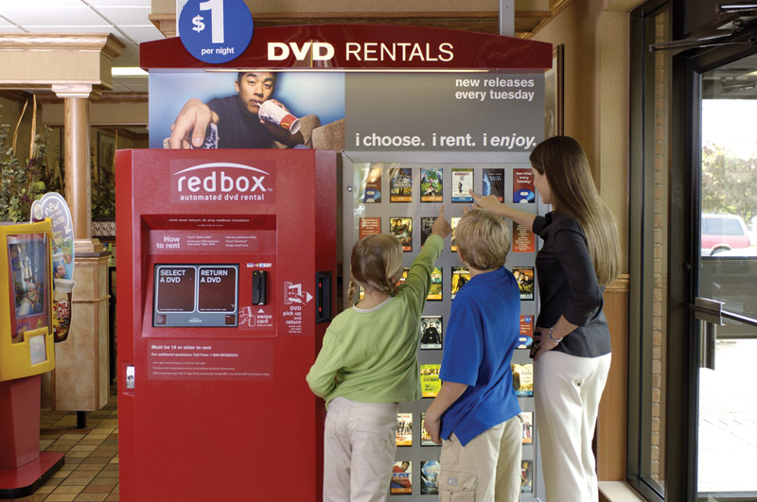
Forms of Direct Marketing
Kiosk marketing
Digital direct marketing technologies
  Mobile phone marketing
  Podcasts
  Vodcasts
  Interactive TV
Notes:
Note to Instructor
At first students might be unsure as to what kiosk marketing involves. It involves placing information and ordering machines in stores, airports, trade shows, and other locations.
Students might have used kiosk marketing—ask them if they have used the in-store machines from Kodak or Fuji for making prints in stores.

Slide 13

Forms of Direct Marketing
Mobile phone marketing includes:
  Ring-tone giveaways
  Mobile games
  Ad-supported content
  Contests and sweepstakes
Notes:
Note to Instructor
Marketers are expecting to see growth in this area over the next few years. This Web link is for an interesting site called Mobile Marketing Watch. By linking to the site you can see some of the major events within the industry. Mobile is exciting to marketers because they can delivered personalized messages to the user while they are out and about—perhaps even in the store.

Slide 14
Forms of Direct Marketing
Podcasts and vodcast involve the downloading of audio and video files via the Internet to a handheld device such as a PDA or iPod and listening to them at the consumer’s convenience
Interactive TV (ITV) lets viewers interact with television programming and advertising using their remote controls and provides marketers with an interactive and involving means to reach targeted audiences

Slide 15
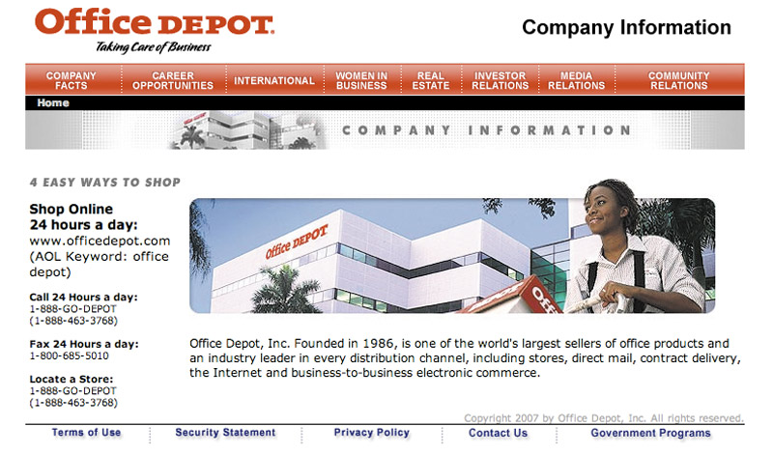
Online Marketing
Marketing and the Internet
Internet is a vast public Web of computer networks that connects users of all types around the world to each other and to a large information repository

Slide 16
Online Marketing
Online Marketing Domains

Slide 17
Online Marketing
Online Marketing Domains
Business to consumer (B2C) involves selling goods and services online to final consumers
Business to business (B2B) involves selling goods and services, providing information online to businesses, and building customer relationships

Slide 18
Online Marketing
Online Marketing Domains
Consumer to consumer (C2C) occurs on the Web between interested parties over a wide range of products and subjects
Blogs
  Offer fresh, original, and inexpensive ways to reach fragmented audiences
  Difficult to control
Notes:
Note to Instructor
Students might be aware of how marketers can use these sites. The text gives an example of Nescafe placing an ad on a blogging site. Students may be familiar with ads on Facebook and the types of companies who advertise on this site. Blogs are good for marketers as they provide fresh, original, personal, and cost efficient methods to reach consumers. For this reason “word of Web” is joining “word of mouth” as a buying influence.

Slide 19
Online Marketing
Online Marketing Domains
Consumer to business (C2B) involves consumers communicating with companies to send suggestions and questions via company Web sites

Slide 20
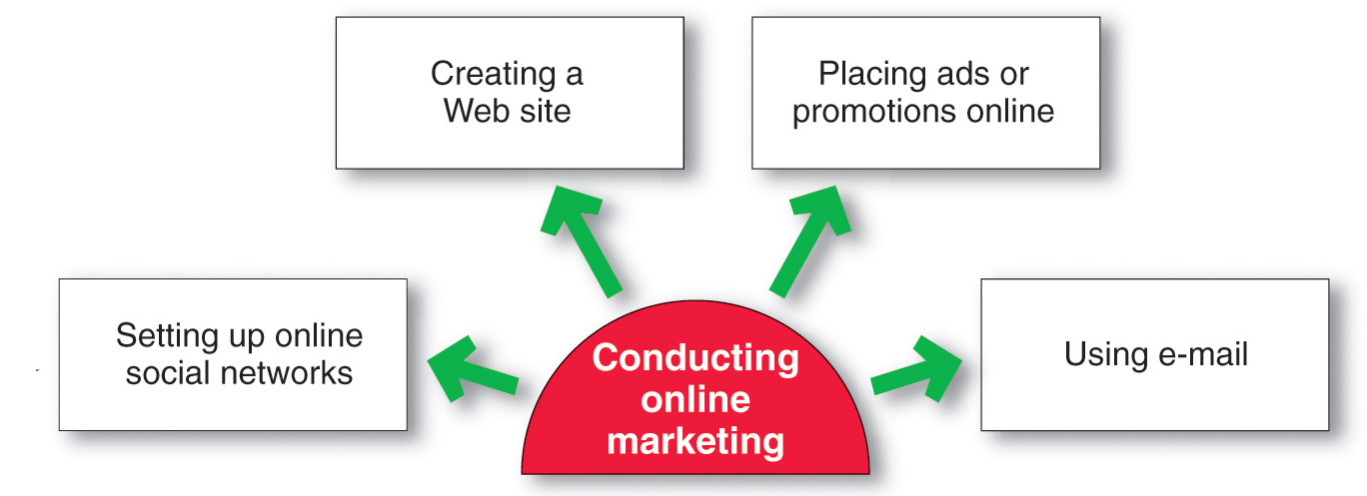
Online Marketing
Setting Up an Online Presence
Creating a Web site requires designing an attractive site and developing ways to get consumers to visit the site, remain on the site, and return to the site

Slide 21
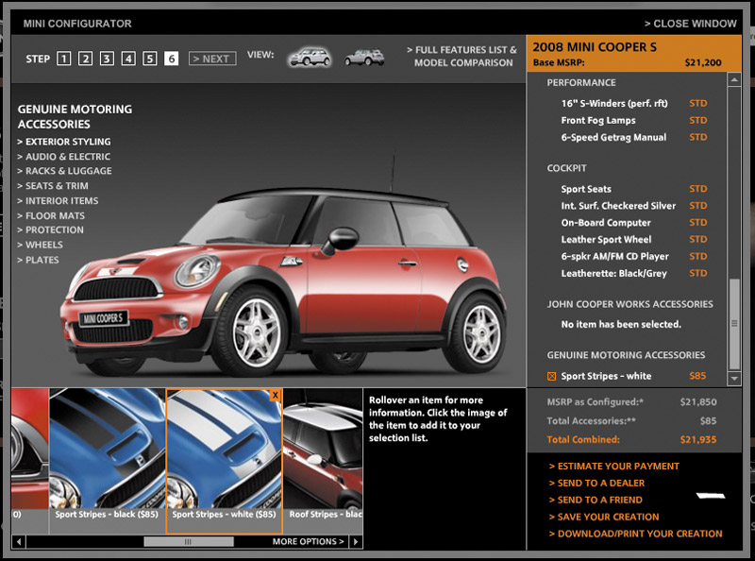

Online Marketing
Setting Up an Online Presence
Types of sites
Corporate Web site
Marketing Web site
Notes:
Note to Instructor
This link takes you to the MINI-USA site. Ask the students to evaluate the site. This will provide a nice preview for the 7Cs which follows in a few slides.

Slide 22
Online Marketing
Setting Up an Online Presence
Corporate Web site is designed to build customer goodwill and to supplement other channels, rather than to sell the company’s products directly to:
Provide information
Create excitement
Build relationships

Slide 23
Online Marketing
Setting Up an Online Presence
Marketing Web site is designed to engage consumers in interaction that will move them closer to a direct purchase or other marketing outcome

Slide 24

Online Marketing
Designing Effective Web Sites
To attract visitors, companies must:
Promote an offline promotion and online links
Create value and excitement
Constantly update the site
Make the site useful
Notes:
Note to Instructor
This is a great Web link to the annual Webby awards. These are awards for the best on the Web. Before class the you should review the sites and find one or two to show the students. Students will comment on whether they believe the site is a winner.

Slide 25
Online Marketing
Designing Effective Web Sites
The Seven C’s
Notes:
Note to Instructor
Context is the site’s layout.
Content is the site’s pictures, sound, and video.
Community is the site’s means to enable user-to-user communication.
Customization is the site’s ability to tailor itself to different users or to allow users to personalize the site.
Communication is the way the site enables user-to-user, user-to-site, or two-way communication.
Connection is the degree that the site is lined to other sites.
Commerce is the site’s capabilities to enable commercial transactions.
Change—To keep customers coming back, the site needs to constantly change.

Slide 26
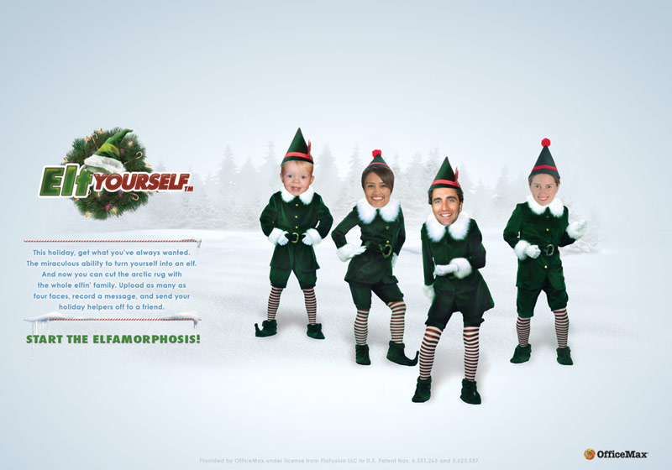
Online Marketing
Placing Ads and Promotions Online
Forms of online advertising
  Display ads
  Search-related
  ads
  Online classifieds

Slide 27

Online Marketing
Placing Ads and Promotions Online
Banners are banner-shaped ads found on a Web site
Interstitials are ads that appear between screen changes
Pop-ups are ads that suddenly appear in a new window in front of the window being viewed
Rich media ads incorporate animation, video, sound, and interactivity
Notes:
Note to Instructor
This Web link is to boston.com. Professors might have other sites they know with many different types of ads. Visit the site and have students locate examples of these types of ads.

Slide 28
Online Marketing
Placing Ads and Promotions Online
Search-related ads are ads in which text-based ads and links appear alongside search engine results on sites such as Google and Yahoo! and are effective in linking consumers to other forms of online promotion

Slide 29
Online Marketing
Placing Ads and Promotions Online
Content sponsorships provide companies with name exposure through the sponsorship of special content such as news or financial information
Viral marketing is the Internet version of word-of-mouth marketing and involves the creation of a Web site, e-mail message, or other marketing event that customers pass along to friends

Slide 30
Online Marketing
Creating or Participating in Social Networks (Web Communities)
Social Networks (Web communities) allow members to congregate online and exchange views on issues of common interest
  Facebook

Slide 31
Online Marketing
Using E-mail
Marketers are developing enriched messages that include animation, interactivity, and personal messages with streaming audio and video to compete with the cluttered e-mail environment

Slide 32
Online Marketing
Using E-mail
Spam is unsolicited, unwanted commercial e-mail messages
Permission-based marketing allows users to opt in or opt out of e-mail marketing

Slide 33
Public Policy Issues in Direct Marketing
Irritation, Unfairness, Deception, and Fraud
Irritation includes annoying and offending customers
Unfairness includes taking unfair advantage of impulsive or less-sophisticated buyers
Deception includes “heat merchants” who design mailers and write copy designed to mislead consumers
Fraud includes identity theft and financial scams

Slide 34
Public Policy Issues in Direct Marketing
Invasion of Privacy
The concern is that marketers may know too much about consumers and use this information to take unfair advantage
Sale of databases
Microsoft

Slide 35

Public Policy Issues in Direct Marketing
A Need for Action
Can Spam
California Online Privacy Protection Act (OPPA)
Children’s Online Privacy Protection Act (COPPA)
TRUSTe
Notes:
Note to Instructor
Discussion Question
What must marketers consider when designing a site for children?
This Web link is for the Bratz site, which you can visit for an illustration. COPPA requires Web sites to post privacy policies and notify parents about the information they are gathering from children under the age of 13.

Slide 36
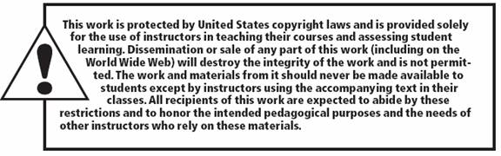
All rights reserved. No part of this publication may be reproduced, stored in a retrieval system, or transmitted, in any form or by any means, electronic, mechanical, photocopying, recording, or otherwise, without the prior written permission of the publisher. Printed in the United States of America.
Copyright © 2012 Pearson Education, Inc.
Publishing as Prentice Hall
Notes:
D

