Slide 1
Lecture 9
NUTD 343
Dr. Emilia Rappocciolo

Slide 2
listeriosis
Genus Listeria Gram positive, non-spore former, non-acid fast staining, catalase positive, lactic acid producer.
6 species . L. monocytogenes is the human pathogens. There are 13 serovars of which serovar 1/2 a and 1/2 b are predominant in Europe. Serovar 4b is predominant in the US.
Psychrotrophic: grows between 1-44 °C. optimum temperature 30-37 °C. Rapid growth between 7-10 °C. Temperature abuse (between 4 and 60 °C) even for a short time can induce rapid growth.
Produces β hemolysis on sheep blood agar
Causes severe disease in infants, old, immunocompromised individuals, new born babies, foetuses, pregnant women (mortality 30-40%). Infectious dose varies with host status.
US: zero tolerance in ready to eat products; Canada, some EU countries 108 cells/25 gr of food is the limit.

Slide 3
listeriosis
Regulatory agencies procedures to reduce the number of foodborne listeriosis cases were based on:
Identification of the type of foods mostly involved in listeriosis
Food processing steps that can contaminate ready-to-eat foods
Groups of people most susceptible to the disease
educating susceptible consumer groups about food choices, eating habits, and sanitary practices in food preparation.
As a result, in developed countries, the number of listeriosis cases has dropped; in the US 1600 cases with 255 fatalities/year (16%)

Slide 4
characteristics
Sensitive to pasteurization temperature (71.7 °C for 15 seconds or 62.8°C for 30 minutes)
Acid tolerant, essential for survival in stomach acid due to the presence of glutamate decarboxylase (GAD) enzyme system
Glutamine is abundant in food; the enzyme - GAD- is activated by the acid in the stomach to convert glutamine to glutamate with the release of ammonia which neutralize the acid

Slide 5
habitat
L. monocytogenes is a saprophyte, isolated from many environmental samples:
soil, sewage, water, dead vegetation.
intestinal contents of domesticated animals and birds
Humans can carry it in the intestine without symptoms and may harbor it in the gall bladder
uncooked meat, milk, egg, sea foods, fish, leafy vegetables and tubers (potatoes and radishes)
Heat-processed foods, as pasteurized milk and dairy products, and ready-to-eat meat preparations can be contaminated with L. monocytogenes.

Slide 6
Disease and symptoms
Listeria monocytogenes causes two forms of diseases:
Febrile gastroenteritis: associated with healthy individuals, the infectious dose is 108 to 1010 cells
symptoms appear 1-7 d after ingestion
mild flu-like symptoms, slight fever, abdominal cramps, diarrhea
They subside in a few days
the individual sheds L. monocytogenes in the feces.
The disease is mild in healthy individuals

Slide 7
Disease and symptoms
Invasive Systemic Disease - immunosuppressed, pregnant women, unborn fetuses, infants, elderly, cancer pts taking chemotherapy
The infective dose is 100–1000 cells
L. monocytogenes survives inside macrophage, transported to liver, spleen, lymph nodes the CNS causing meningitis
In pregnant women it can cross the placenta and infect the fetus causing abortion and stillbirth (dead birth)
Symptoms include:
bacteremia, fever, headache, meningitis, liver abscess, high fatality rate among fetuses, newborn infants, and immunocompromised

Slide 8
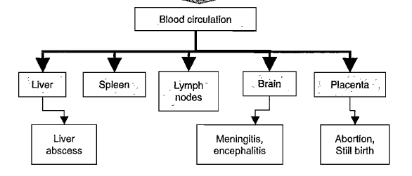

Slide 9
Foods association
Foodborne listeriosis in humans is mainly sporadic
Outbreaks were reported from the consumption of contaminated coleslaw, pasteurized milk, raw milk and dairy products, soft cheeses, meat pates, turkey sausages, cold cut meats, improperly cooked chicken
Fruits and vegetables, including celery and cantaloupes, are involved in recent fatal outbreaks in the United States.

Slide 10
Prevention and control
L. monocytogenes is ubiquitous- it is impossible to have foods free of this pathogen
Effectiveness of regulatory procedures
current stringent zero tolerance
consumer education to reduce foodborne listeriosis by:
Thorough cooking raw foods of animal origin
thorough washing raw vegetables and fruits before eating
keeping uncooked meats separate from vegetables, cooked foods, and ready-to-eat foods
not consuming raw milk or foods made with raw milk
washing hands, knives, and cutting boards after handling uncooked foods

