Slide 1
Organizational Behavior 15th Ed
Chapter 6
Robbins and Judge
Perception and
Individual Decision-Making

Slide 2
Chapter 6 Learning Objectives
After studying this chapter you should be able to:
Define perception and explain the factors that influence it.
Explain attribution theory and list the three determinants of attribution.
Identify the shortcuts individuals use in making judgments about others.
Explain the link between perception and decision-making.
Apply the rational model of decision-making and contrast it with bounded rationality and intuition.
List and explain the common decision biases or errors.
Explain how individual differences and organizational constraints affect decision-making.
Contrast the three ethical decision-criteria.
Define creativity and discuss the three-component model of creativity.

Slide 3
Define perception and explain the factors that influence it
LO 1
Perception is a process by which individuals organize and interpret their sensory impressions in order to give meaning to their environment.
It is important to the study of OB because peoples’ behaviors are based on their perception of what reality is, not on reality itself.

Slide 4
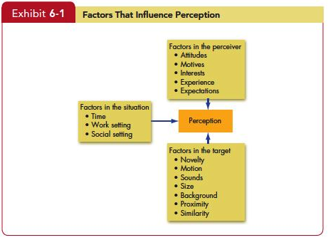
Define perception and explain the factors that influence it
LO 1

Slide 5
Explain attribution theory and list the three determinants of attribution
LO 2
Attribution theory suggests that when we observe an individual’s behavior, we attempt to determine whether it was internally or externally caused.
Determination depends on three factors:
Distinctiveness
Consensus
Consistency

Slide 6
Explain attribution theory and list the three determinants of attribution
LO 2
Clarification of the differences between internal and external causation:
Internally caused - those that are believed to be under the personal control of the individual.
Externally caused - resulting from outside causes.

Slide 7
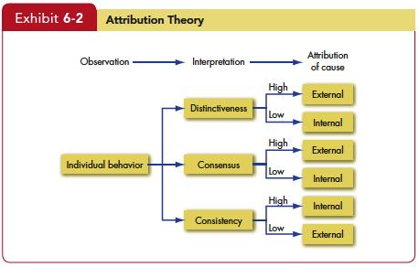
Explain attribution theory and list the three determinants of attribution
LO 2

Slide 8
Explain attribution theory and list the three determinants of attribution
LO 2
Fundamental Attribution Error
We have a tendency to underestimate the influence of external factors and overestimate the influence of internal or personal factors.
Self-serving Bias
Individuals attribute their own successes to internal factors.

Slide 9
Identify the shortcuts individuals use in making judgments about others
LO 3
Selective Perception
Any characteristic that makes a person, object, or event stand out will increase the probability that it will be perceived.
Since we can’t observe everything going on about us, we engage in selective perception.
A classic example:
Dearborn and Simon

Slide 10
Identify the shortcuts individuals use in making judgments about others
LO 3
Halo Effect
The halo effect occurs when we draw a general impression on the basis of a single characteristic.
The reality of the halo effect was confirmed in a classic study.

Slide 11
Identify the shortcuts individuals use in making judgments about others
LO 3
Contrast Effects
We do not evaluate a person in isolation.
Our reaction to one person is influenced by other persons we have recently encountered.
For example, an interview situation in which one sees a pool of job applicants can distort perception.
Distortions in any given candidate’s evaluation can occur as a result of his or her place in the interview schedule.

Slide 12
Identify the shortcuts individuals use in making judgments about others
LO 3
Stereotyping
Judging someone on the basis of our perception of the group to which he or she belongs.
This is a means of simplifying a complex world, and it permits us to maintain consistency.
From a perceptual standpoint, if people expect to see these stereotypes, that is what they will perceive.

Slide 13
Identify the shortcuts individuals use in making judgments about others
LO 3
Applications of Shortcuts in Organizations
Employment Interview
Evidence indicates that interviewers make perceptual judgments that are often inaccurate.
Agreement among interviewers is often poor.

Slide 14
Identify the shortcuts individuals use in making judgments about others
LO 3
Applications of Shortcuts in Organizations
Performance Expectations
Evidence demonstrates that people will attempt to validate their perceptions of reality, even when those perceptions are faulty.
Self-fulfilling prophecy or Pygmalion effect characterizes the fact that people’s expectations determine their behavior. Expectations become reality.

Slide 15
Identify the shortcuts individuals use in making judgments about others
LO 3
Performance Evaluation
An employee’s performance appraisal is very much dependent on the perceptual process.
Many jobs are evaluated in subjective terms. Subjective measures are, by definition, judgmental.
What the evaluator perceives to be good or bad employee characteristics or behaviors will significantly influence the outcome of the appraisal.

Slide 16
Explain the link between perception and decision-making
LO 4
Top managers determine goals, products to offer, how to finance operations, or locate a new plant.
Middle- and lower-level managers determine production schedules, select employees, and decide about pay raises.
Non-managerial employees make decisions to come to work on any given day, the effort to put forward at work, and to comply with requests made by the boss.

Slide 17
Explain the link between perception and decision-making
LO 4
Empowering non-managerial employees with job-related decision-making which is usually reserved for managers.
Decision-making occurs as a reaction to a problem.
Every decision requires interpretation and evaluation of information.
Alternatives will be developed, and the strengths and weaknesses of each will need to be evaluated.

Slide 18
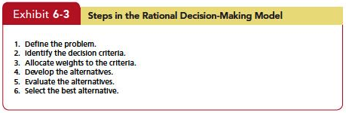
Apply the rational model of decision-making and contrast it with bounded rationality and intuition
LO 5

Slide 19
Apply the rational model of decision-making and contrast it with bounded rationality and intuition
LO 5
Assumptions of the Rational Model
The decision maker has complete information,
And is able to identify all the relevant options in an unbiased manner, and
Chooses the option with the highest utility.
Most decisions in the real world don’t follow the rational model.

Slide 20
Apply the rational model of decision-making and contrast it with bounded rationality and intuition
LO 5
Bounded Rationality
Most people respond to a complex problem by reducing the problem to a level at which it can be readily understood.
Individuals operate within the confines of bounded rationality. They construct simplified models that extract the essential features.

Slide 21
Apply the rational model of decision-making and contrast it with bounded rationality and intuition
LO 5
How does bounded rationality work?
Once a problem is identified, the search for criteria and options begins.
Identify a limited list made up of the more conspicuous choices, which are easy to find, tend to be highly visible, and they will represent familiar criteria and previously tried-and-true solutions.
Once this limited set of options is identified, the decision maker will begin reviewing it.

Slide 22
Apply the rational model of decision-making and contrast it with bounded rationality and intuition
LO 5
To use the rational model in the real world, you need to gather a great deal of information about all the options, compute applicable weights, and then calculate values across a huge number of criteria.

Slide 23
Apply the rational model of decision-making and contrast it with bounded rationality and intuition
LO 5
Intuition
Intuition occurs outside conscious thought; it relies on holistic associations, or links between disparate pieces of information; it’s fast; and it’s affectively charged, meaning it usually engages the emotions.
The key is neither to abandon nor rely solely on intuition but to supplement it with evidence and good judgment.

Slide 24
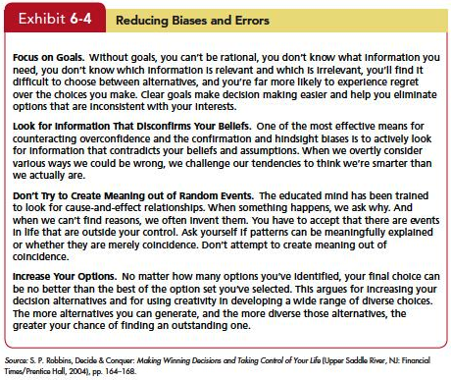
List and explain the common decision biases or errors
LO 6

Slide 25
List and explain the common decision biases or errors
LO 6
Overconfidence Bias
Individuals whose intellectual and interpersonal abilities are weakest are most likely to overestimate their performance and ability.
Anchoring Bias
Fixating on initial information as a starting point and failing to adequately adjust for subsequent information.

Slide 26
List and explain the common decision biases or errors
LO 6
Confirmation Bias
Type of selective perception.
Seek out information that reaffirms past choices, and discount information that contradicts past judgments.
Availability Bias
Tendency for people to base judgments on information that is readily available.

Slide 27
List and explain the common decision biases or errors
LO 6
Escalation of Commitment
Staying with a decision even when there is clear evidence that it’s wrong.
Randomness Error
Decision-making becomes impaired when we try to create meaning out of random events.

Slide 28
List and explain the common decision biases or errors
LO 6
Risk Aversion
Risk-averse employees will stick with the established way of doing their jobs, rather than taking a chance on innovative or creative methods.
Hindsight Bias
Tendency to believe falsely that one has accurately predicted the outcome of an event, after that outcome is actually known.

Slide 29
Explain how individual differences and organizational constraints affect decision-making
LO 7
Personality
Conscientiousness
Achievement–Striving
Dutifulness

Slide 30
Explain how individual differences and organizational constraints affect decision-making
LO 7
Gender
Mental Ability
Cultural Differences

Slide 31
Explain how individual differences and organizational constraints affect decision-making
LO 7
Performance Evaluations
Reward Systems
Formal Regulations
System Imposed Time Constraints
Historical Precedents

Slide 32
Contrast the three ethical decision-criteria
LO 8
Utilitarian criterion—decisions are made solely on the basis of their outcomes or consequences.
Focus on rights—calls on individuals to make decisions consistent with fundamental liberties and privileges as set forth in documents such as the Bill of Rights.
Impose and enforce rules fairly and impartially to ensure justice or an equitable distribution of benefits and costs.

Slide 33
Define creativity and discuss the three-component model of creativity
LO 9
Expertise
Creativity
Creative Thinking Skills
Intrinsic Task Motivation

Slide 34
Summary and Implications for Managers
LO 9
Perception
How do employees perceive the manager?
How do employees perceive their jobs?
How do employees perceive opportunity at the company?
Do employees distort reality?

Slide 35
Summary and Implications for Managers
LO 9
Individual Decision-making
Analyze the situation
Be aware of biases
Combine rational and intuition
Enhance creativity

Slide 36

All rights reserved. No part of this publication may be reproduced, stored in a retrieval system, or transmitted, in any form or by any means, electronic, mechanical, photocopying, recording, or otherwise, without the prior written permission of the publisher. Printed in the United States of America.
Copyright © 2013 Pearson Education, Inc. publishing as Prentice Hall
Notes:
All rights reserved. No part of this publication may be reproduced, stored in a retrieval system, or transmitted, in any form or by any means, electronic, mechanical, photocopying, recording, or otherwise, without the prior written permission of the publisher. Printed in the United States of America.

