Slide 1
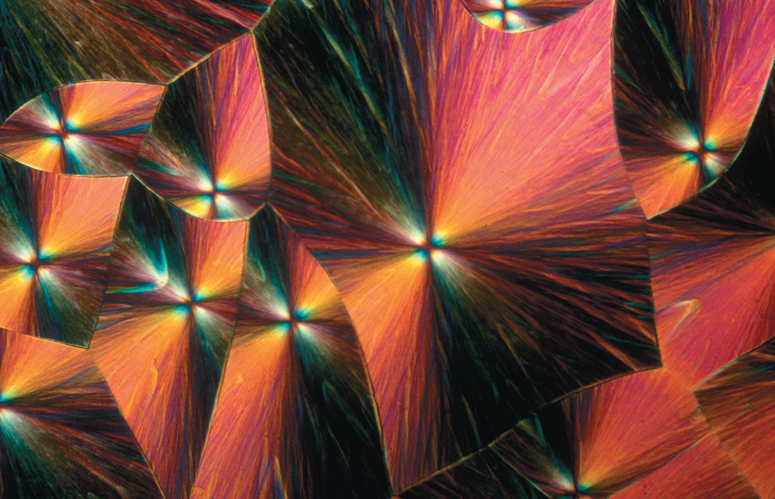
Chapter 3
An Introduction to Organic Compounds
Nomenclature, Physical Properties, and Representation of Structure
Paula Yurkanis Bruice
University of California,
Santa Barbara

Slide 2
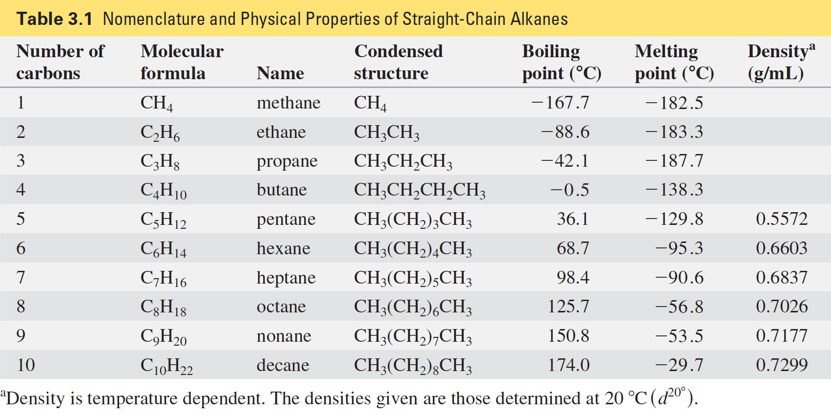
Alkanes are Hydrocarbons that contain only single Bonds general Molecular Formula: C_{n}H_{2n+2}

Slide 3
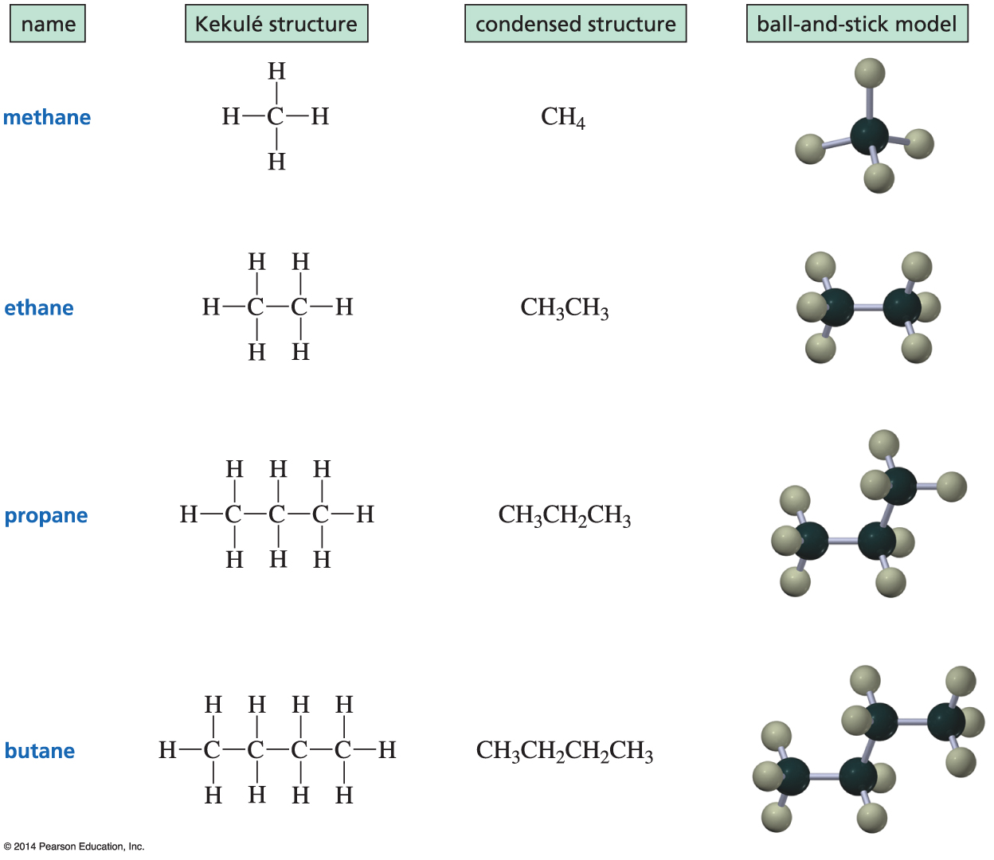
Nomenclature of Alkanes

Slide 4
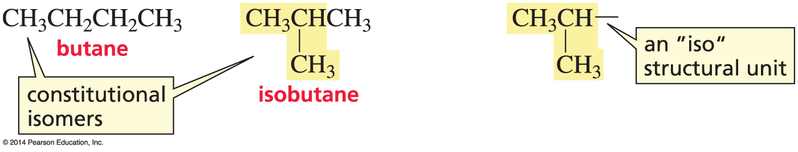
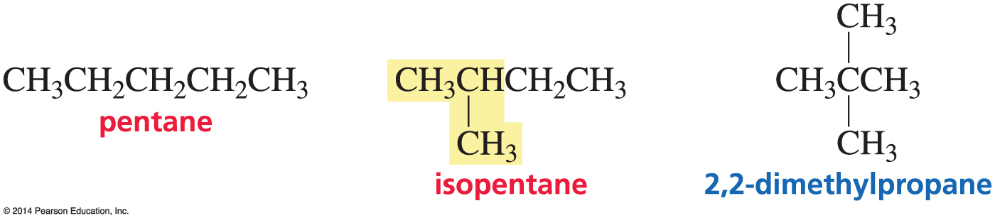
Nomenclature of Alkanes
C₄H₈ can be arranged in two ways:
C₅H₁₀ can be arranged in three ways:
These are constitutional isomers:
the same molecular formula but the atoms are linked differently.

Slide 5
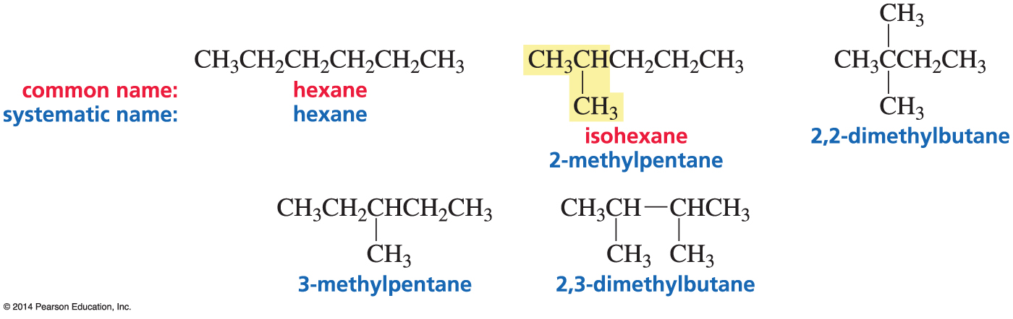
Nomenclature of Alkanes
C₆H₁₄ can be arranged in five ways:

Slide 6
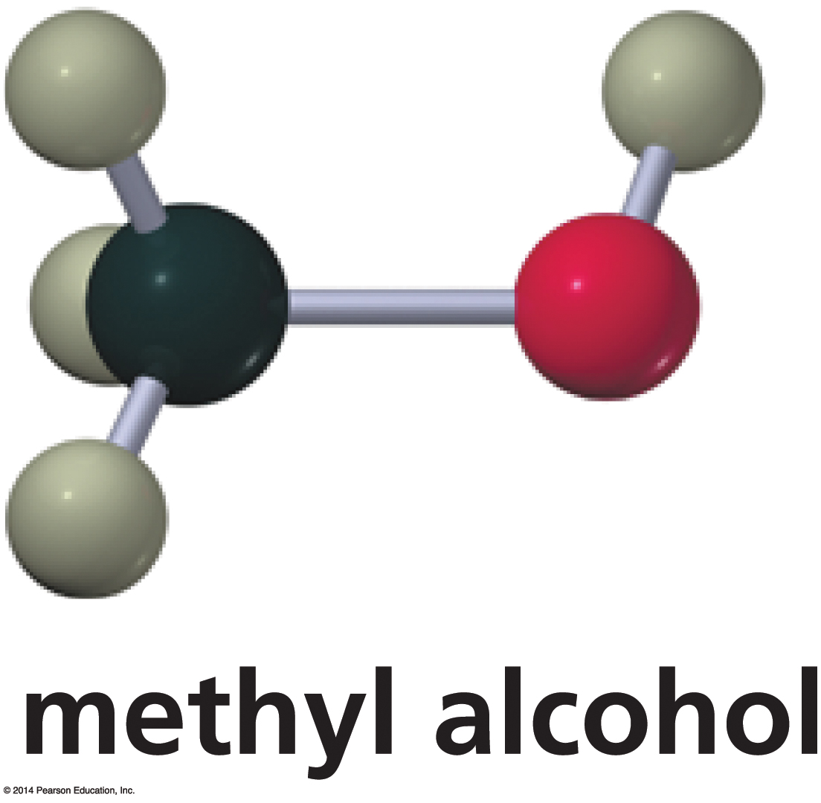
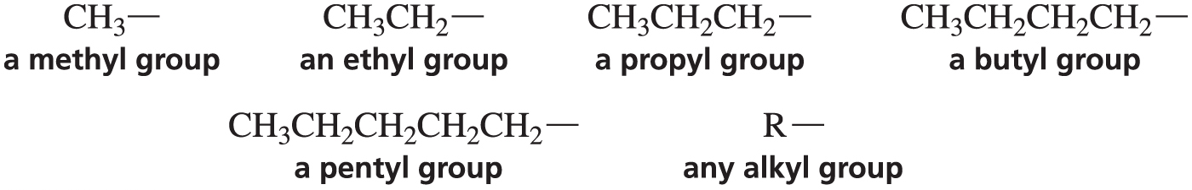
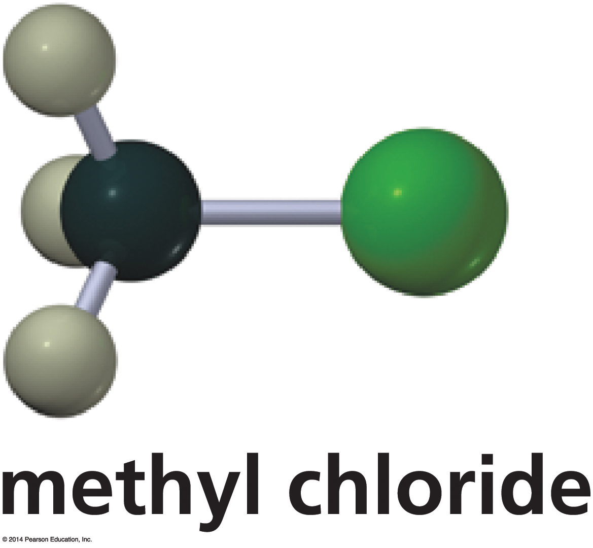
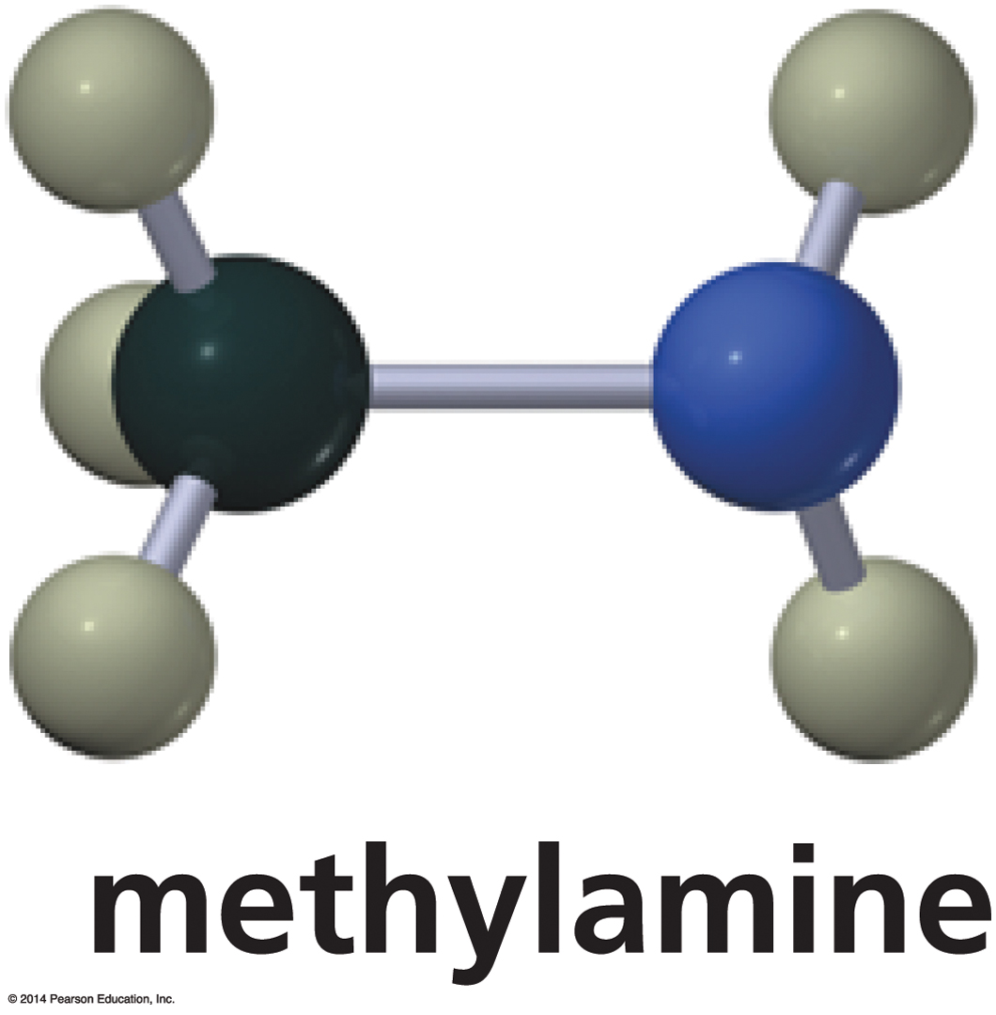
Alkyl Substituents
Removing a hydrogen from an alkane results in an alkyl substituent.
Replace “ane” of alkane with “yl.”

Slide 7
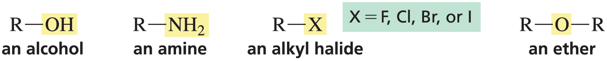
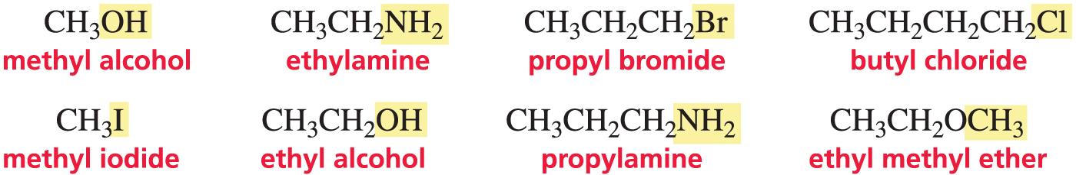
Common Names

Slide 8
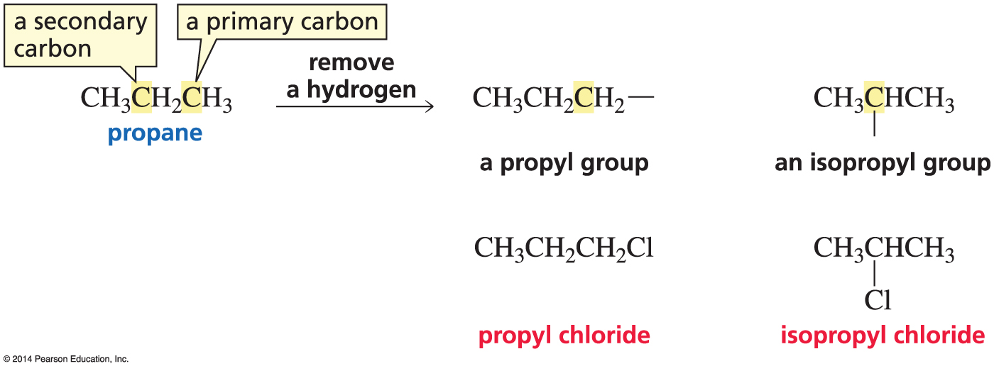
Propyl and Isopropyl

Slide 9
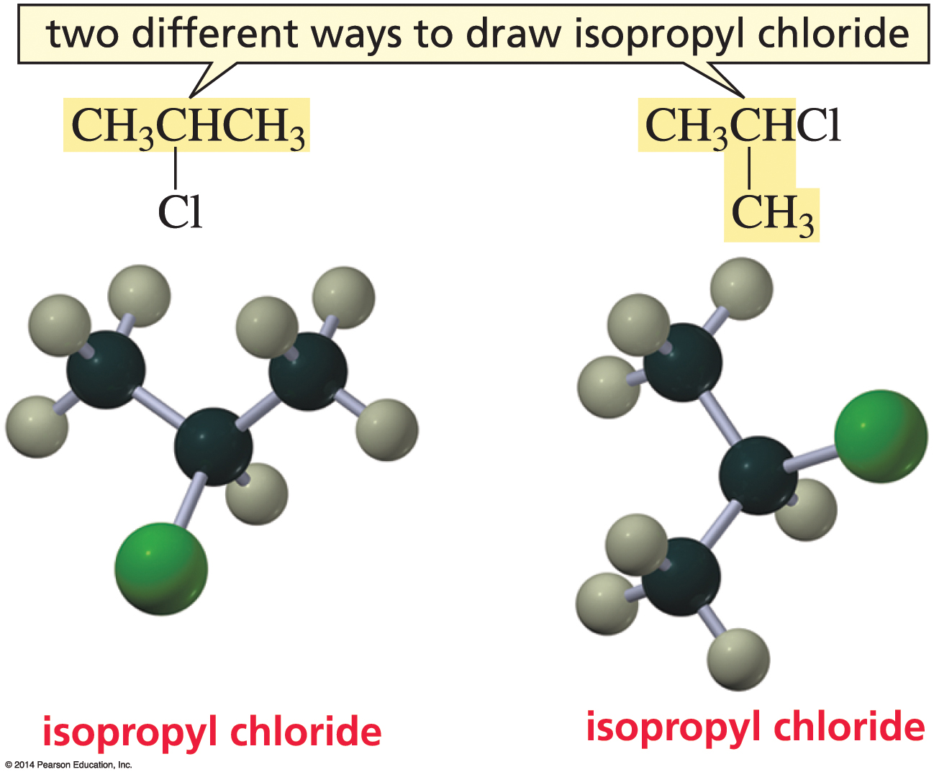
Two ways to draw Isopropyl Chloride

Slide 10
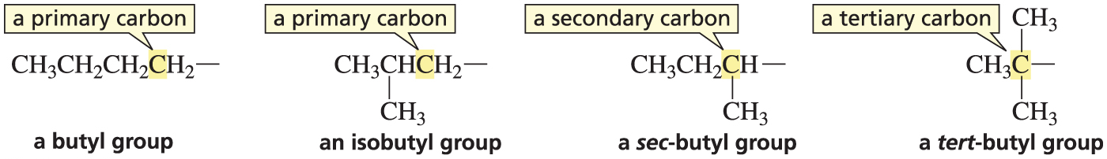
There are four Butyl Groups

Slide 11
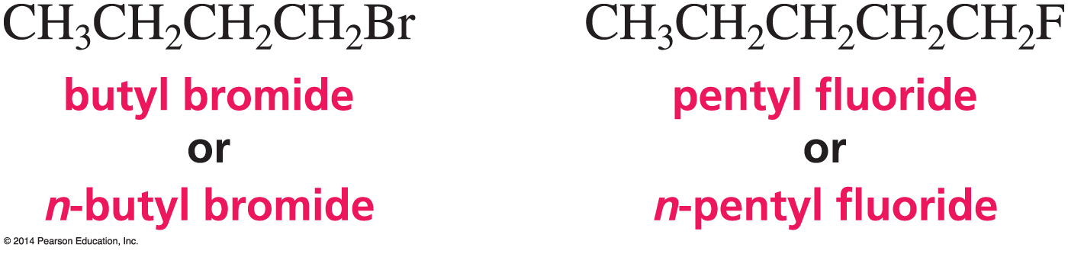
n = An Unbranched Chain
Common names sometimes use “n” to indicate an straight-chain alkane.

Slide 12
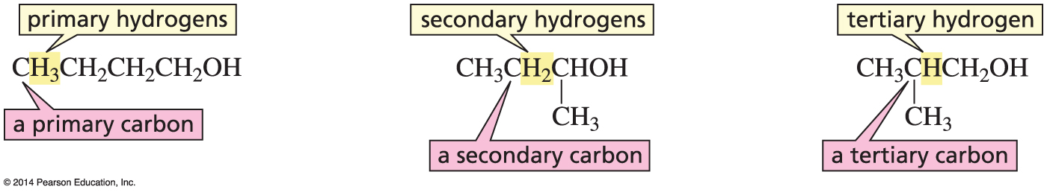
Primary, Secondary, and Tertiary Carbons
A primary carbon is bonded to one carbon.
A secondary carbon is bonded to two carbons.
A tertiary carbon is bonded to three carbons.
Primary hydrogens are attached to primary carbons.
Secondary hydrogens are attached to secondary carbons.
Tertiary hydrogens are attached to tertiary carbons.

Slide 13
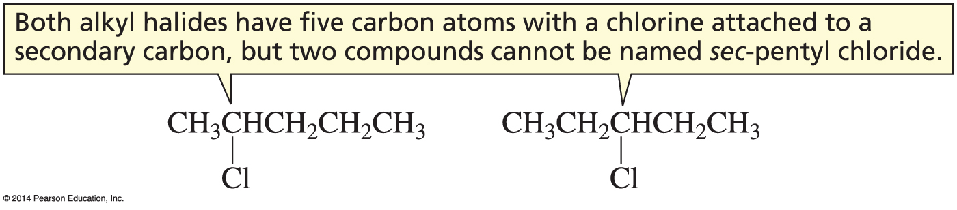
sec-Pentyl is not a good Name
A name must specify only one compound.

Slide 14
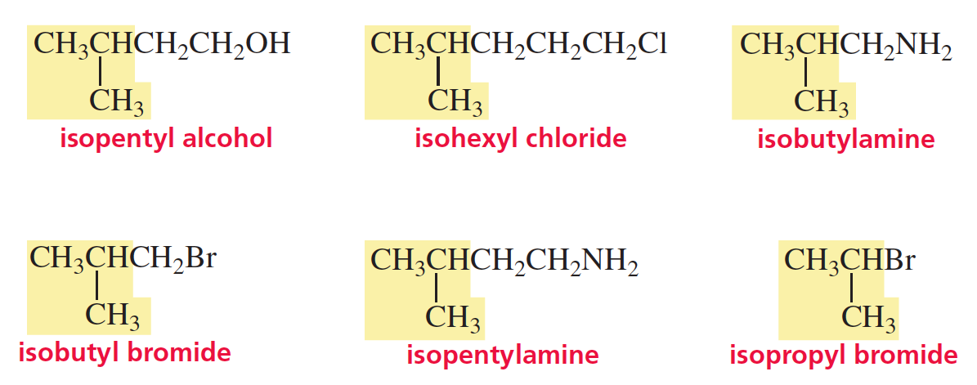
“Iso”
Iso is at one end, and the substituent is at the other end.

Slide 15
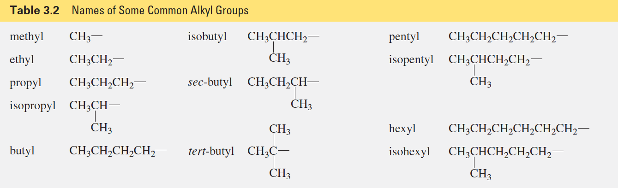
Alkyl Group Names

Slide 16
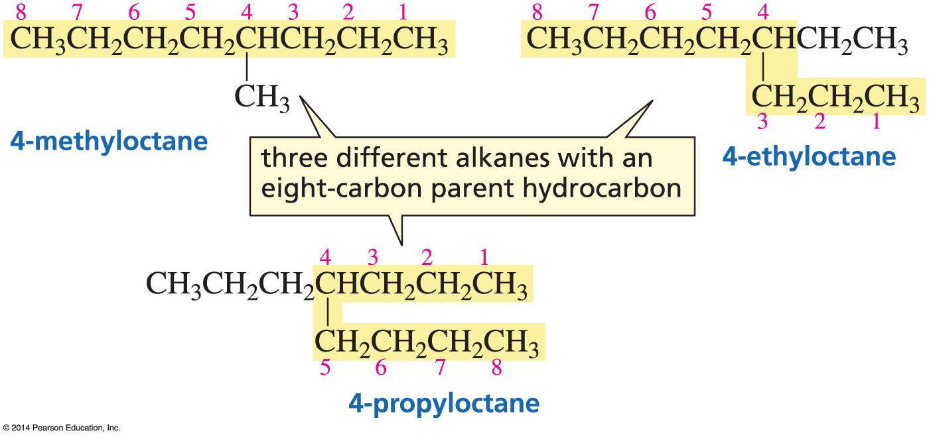
Alkanes Systematic Nomenclature
First identify the longest continuous chain
(this is called the parent hydrocarbon)

Slide 17
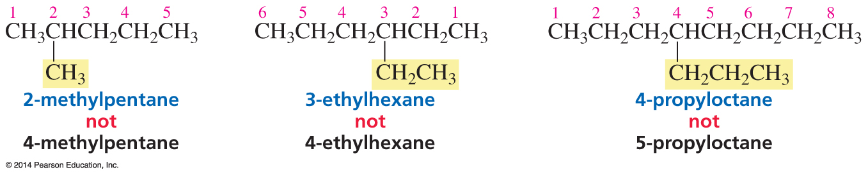
Add the Name of the Substituent
Number the chain in the direction that gives the substituent as low a number as possible.

Slide 18
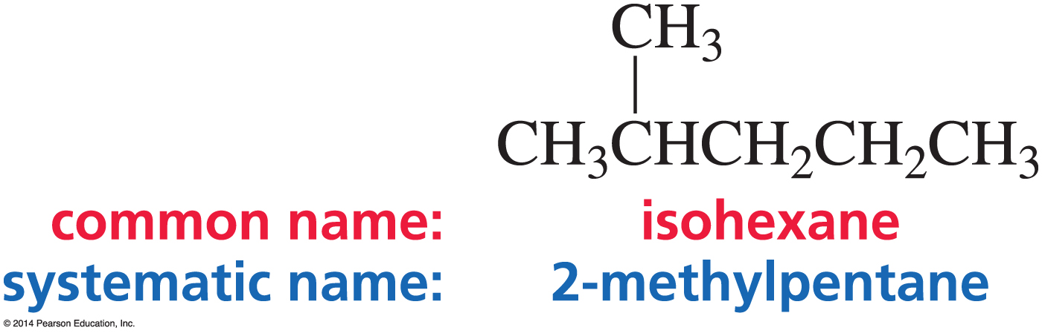
Common versus Systematic Nomenclature
Common names never have numbers.
Only systematic names can have numbers.

Slide 19
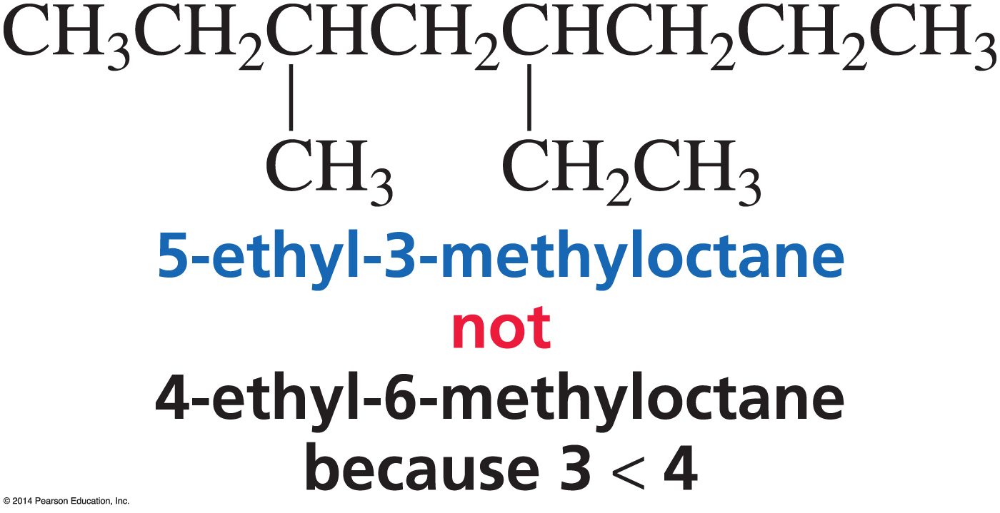
List Substituents in Alphabetical Order
The correct name is the one that contains the lowest of the possible numbers.

Slide 20
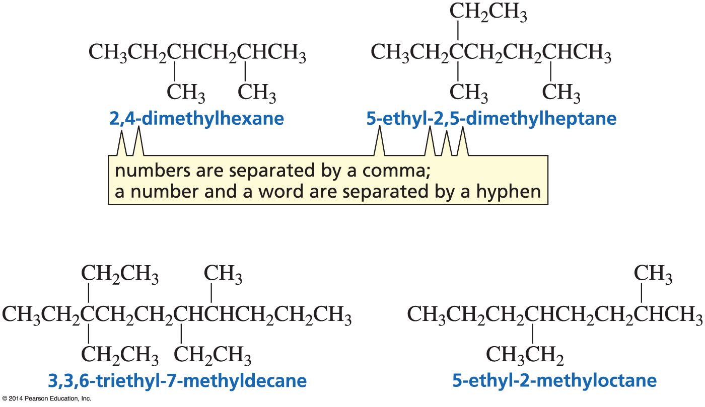
Multiple Substituents
Chain is numbered in the direction that puts the lowest number in the name.
Substituents are listed in alphabetical order (di- and tri- are not alphabetized).

Slide 21
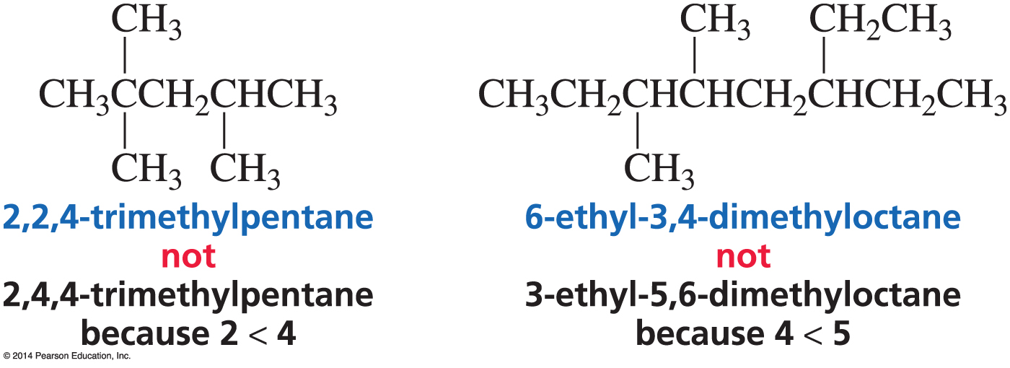
When both have the
same Lowest Number
When both names have the same lowest number, go for the next lowest number.

Slide 22
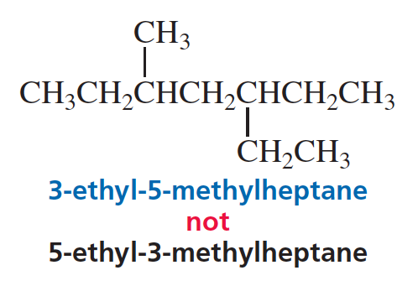
When both have the same Number
When the same numbers are obtained in both directions, the first group listed gets the lower number.

Slide 23
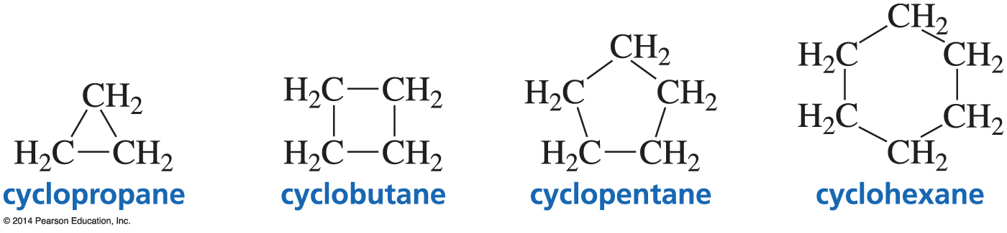
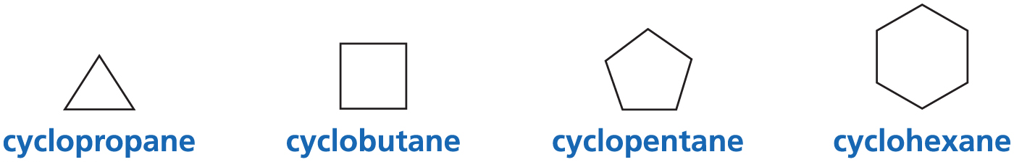
Cycloalkanes
Skeletal structures do not show Cs and Hs bonded to Cs.

Slide 24
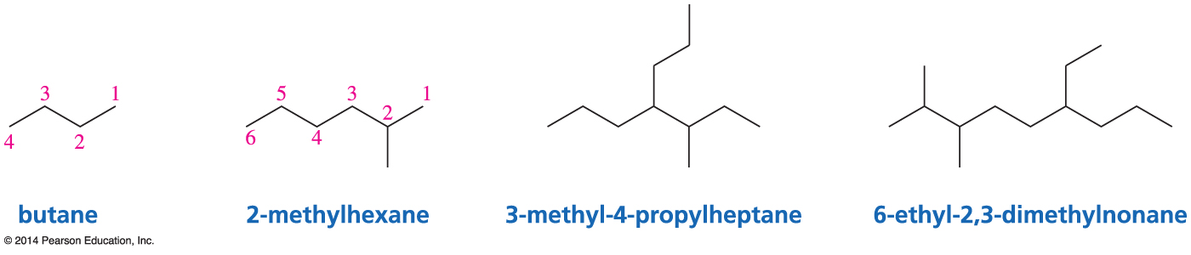
Skeletal Structures

Slide 25
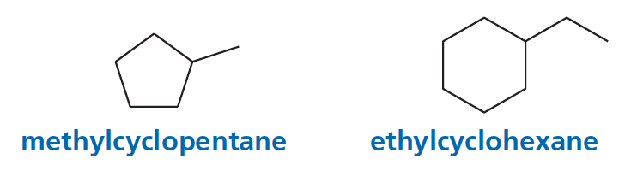
Mono-Substituted Cycloalkanes
A number is not needed

Slide 26
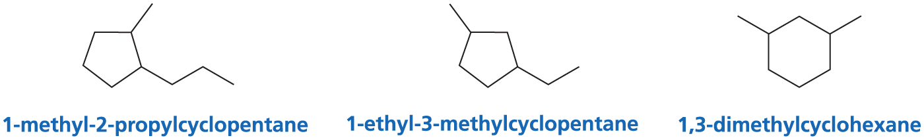
Di-Substituted Cycloalkanes
Substituents are stated in alphabetical order.
#1 goes to first-listed substituent.

Slide 27
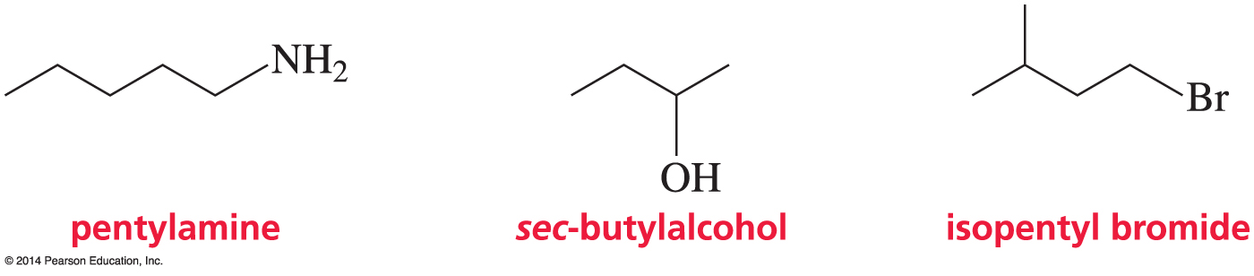
Skeletal Structures

Slide 28
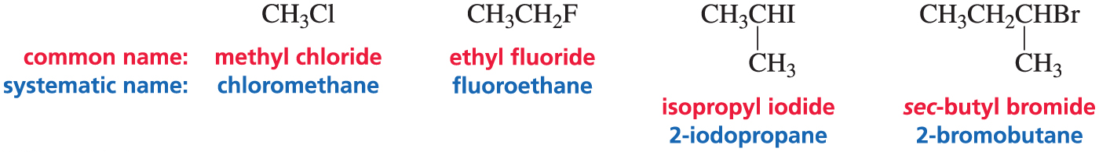
Nomenclature of Akyl Halides
Numbers are used only for systematic names.
Common names never have numbers.

Slide 29
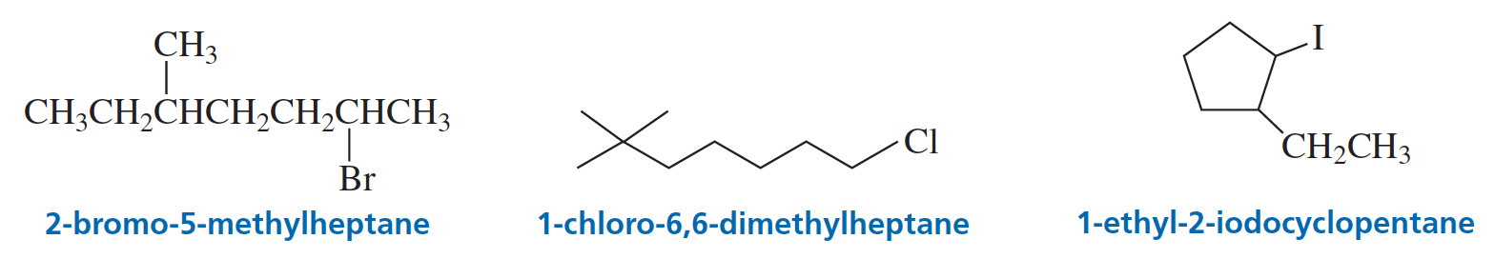
Nomenclature of Alkyl Halides

Slide 30
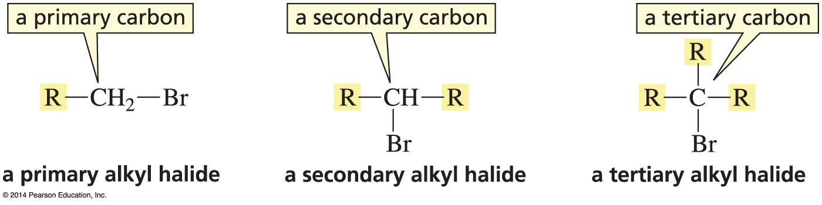
Classification of Alkyl Halides
Primary = Halogen is on a primary carbon.
Secondary = Halogen is on a secondary carbon.
Tertiary = Halogen is on a tertiary carbon.

Slide 31
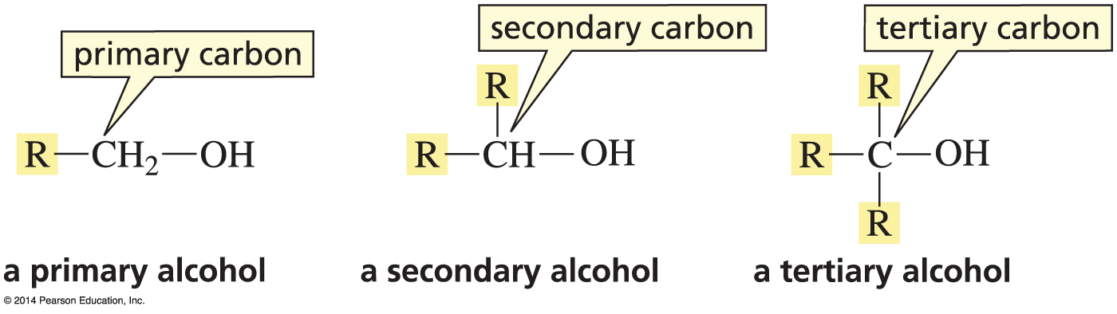
Classification of Alcohols
Primary alcohol = OH is on a primary carbon.
Secondary alcohol = OH is on a secondary carbon.
Tertiary alcohol = OH in on a tertiary carbon.

Slide 32
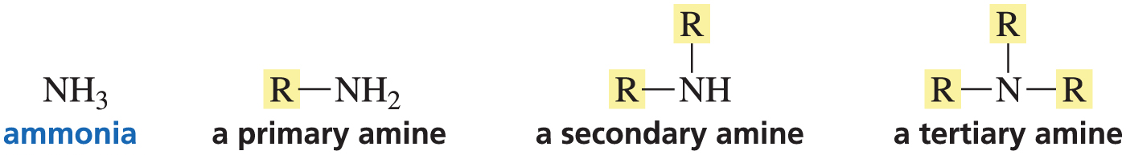
Classification of Amines
The classification depends on how many groups
are bonded to N.
  Primary amine = one group bonded to N
  Secondary amine = two groups bonded N
  Tertiary amine = three groups bonded N

Slide 33
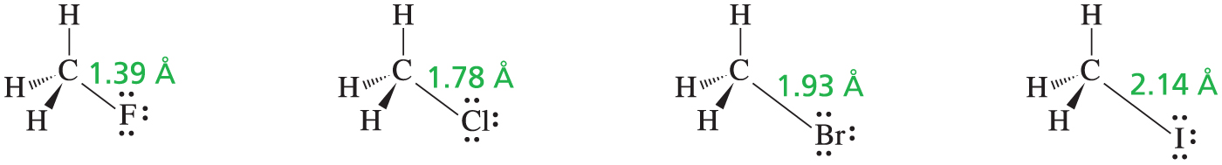
The Structure of an Alkyl Halide
The C—X bond of an alkyl halide becomes longer and weaker as the size of the halogen increases.

Slide 34
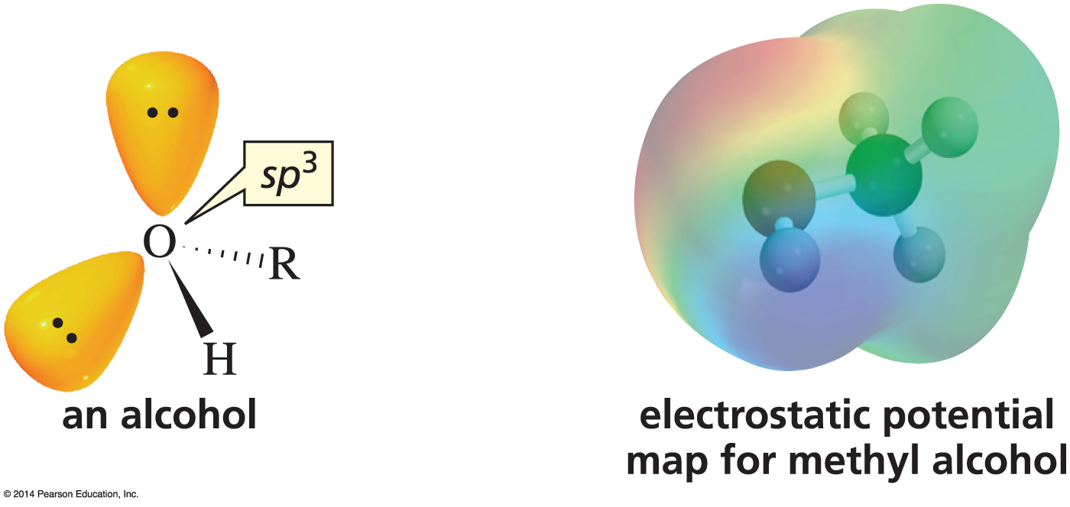
The Structure of an Alcohol
Resembles the Structure of Water
An alcohol is structurally like water with one H replaced by an R.

Slide 35
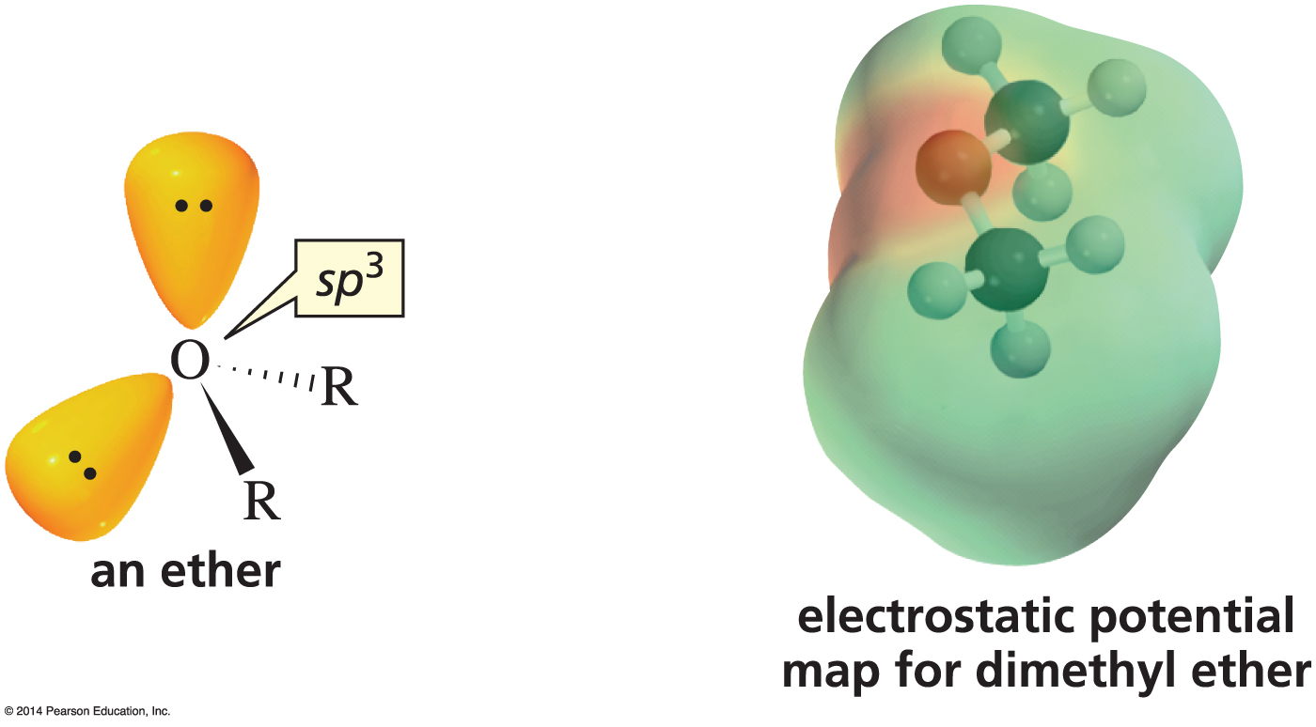
The Structure of an Alcohol
Resembles the Structure of Water
An ether is structurally like water with both Hs replaced by Rs.

Slide 36
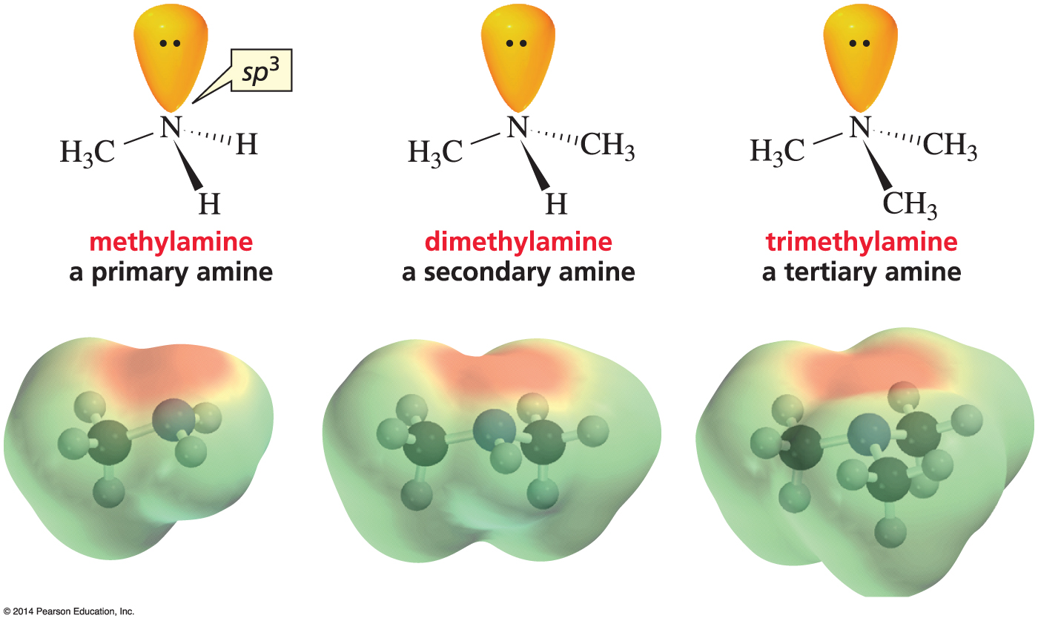
Structures of Amines

Slide 37
Boiling Points
The greater the attractive forces between molecules, the higher the boiling point.
attractive forces
van der Waals forces
dipole–dipole interactions
hydrogen bonds

Slide 38
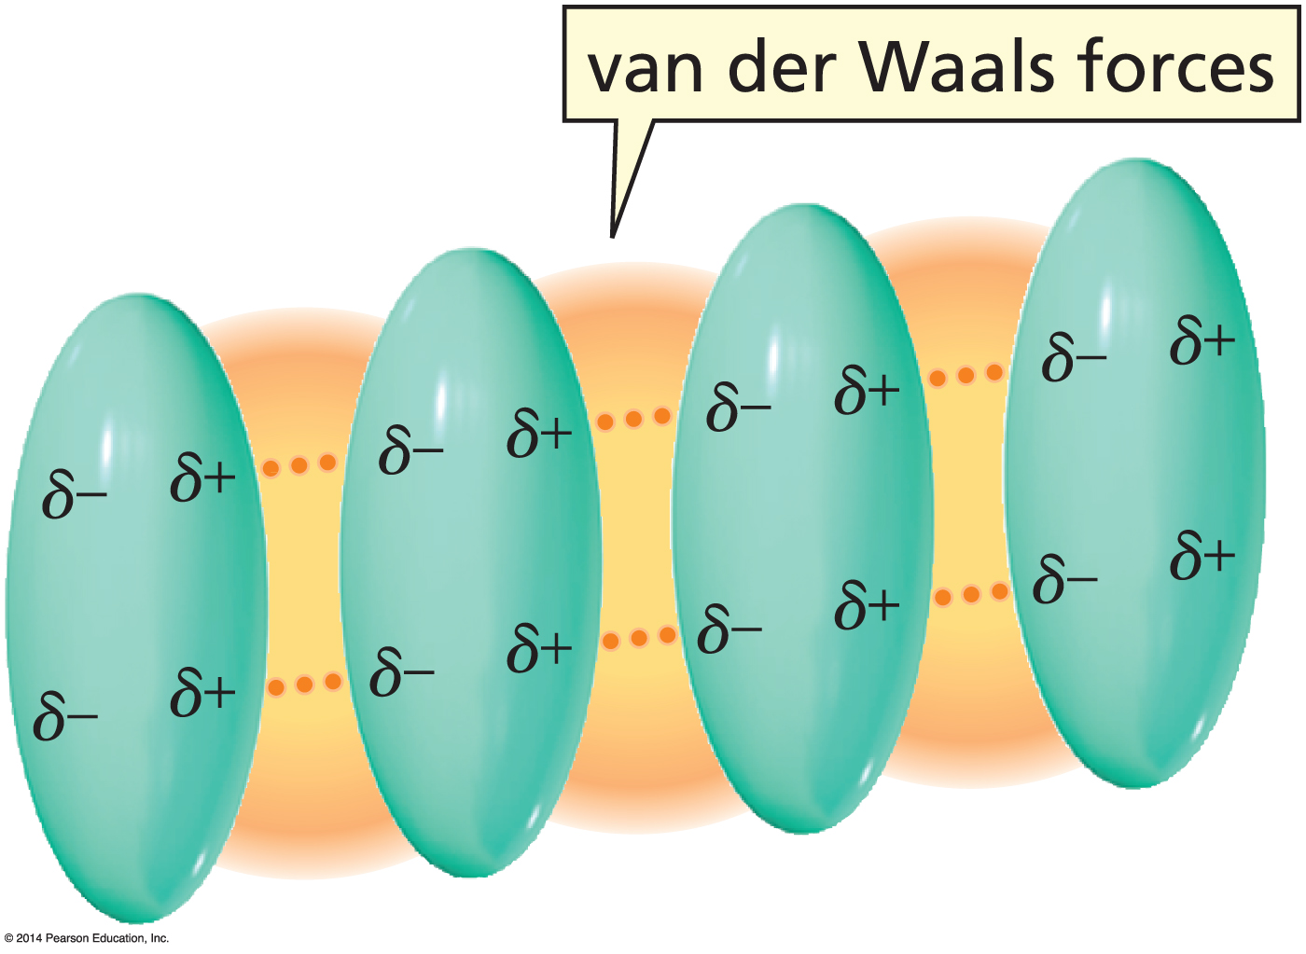
Boiling Points
Methane –167.7 °C
Ethane –88.6 °C
Propane –42.1 °C
Butane –0.5 °C
Pentane 36.1 °C
Hexane 68.7 °C
Heptane 98.4 °C
Octane 125.7 °C
induced dipole-induced dipole
interactions
van der Waals forces
The greater the surface area of the molecule, the higher the boiling point

Slide 39
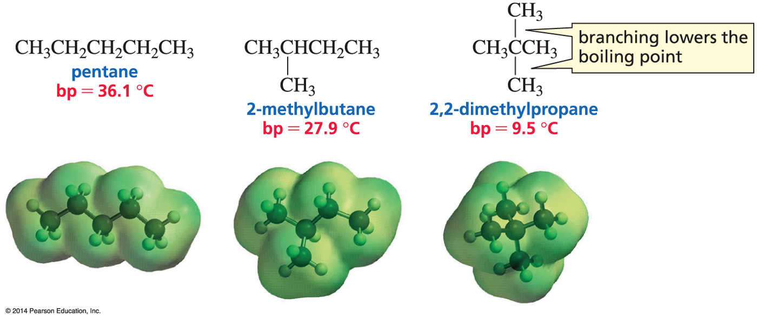
Branching Lowers the Boiling Point
“cigar”
“tennis ball”

Slide 40
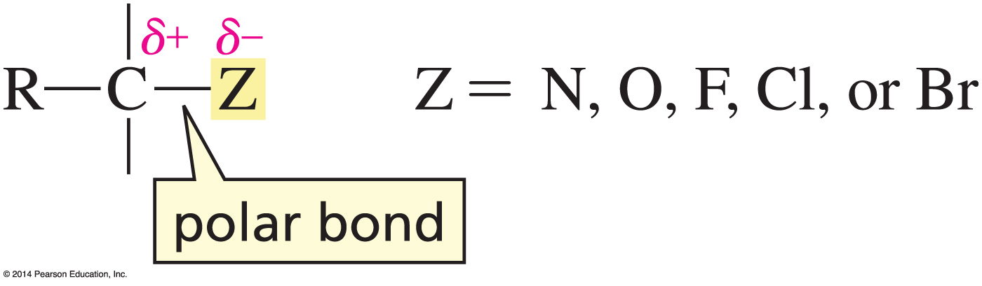
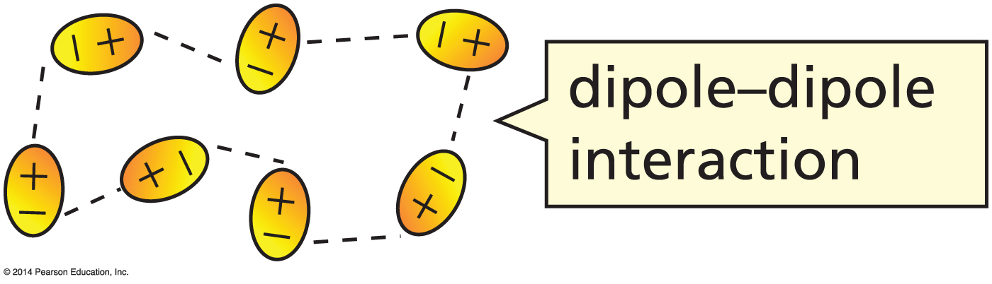
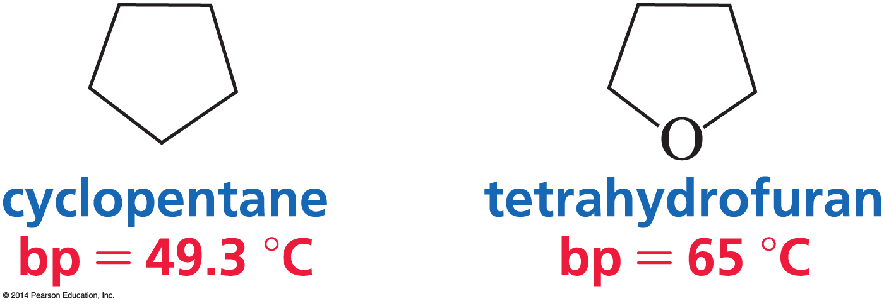
Dipole–Dipole Interactions
Dipole–dipole interactions are
stronger than van der Waals forces.
Van der Waals
Van der Waals
dipole–dipole

Slide 41
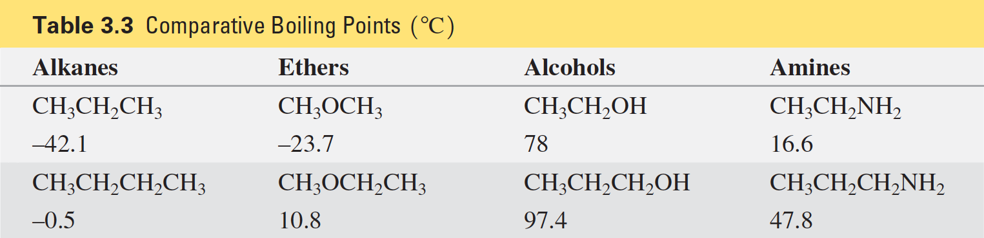
Comparative Boiling Points

Slide 42
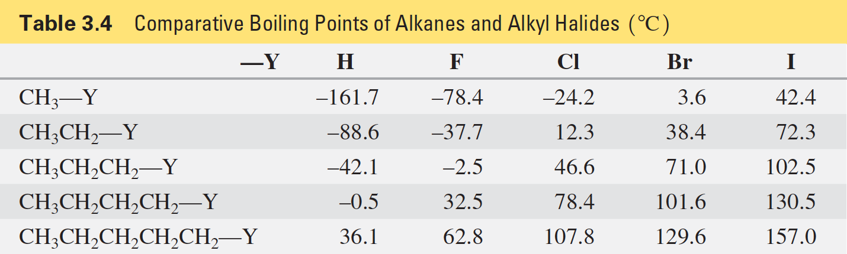
Comparative Boiling Points
The larger the halogen, the more polarizable it is.

Slide 43
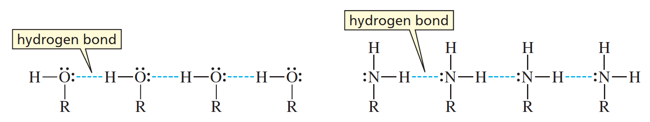
Hydrogen Bonds in H₂O and NH₃
CH₄ –167.7 °C
no hydrogen bonds
H₂O 100 °C
hydrogen bonds
Hydrogen bonds are stronger than other dipole–dipole interactions.

Slide 44

Hydrogen Bonds in Water

Slide 45

Hydrogen Bonds in Proteins

Slide 46

Hydrogen Bonds in DNA

Slide 47

Compounds with Similar Shapes and Properties
often have Similar Physiological Activities
Drugs bind to their receptors by van der Waals interactions,
dipole-dipole interactions, and hydrogen bonding.

Slide 48
Solubility
like dissolves like
Polar compounds dissolve in polar solvents (H₂O).
Nonpolar compounds dissolve in nonpolar solvents (hexane).

Slide 49

Solvation
Solvation is the interaction between solute molecules and solvent molecules.

Slide 50

An Oxygen can Drag
Three Carbons into Water

Slide 51

Solubilities of Alkyl Halides

Slide 52

A Cell Membrane

Slide 53

Rotation Occurs About
Single Bonds

Slide 54


Staggered and Eclipsed Conformers of Ethane

Slide 55


Rotation Can Occur About the
Three Carbon—Carbon Bonds in Butane

Slide 56


Rotation About C-2—C-3 in Butane
Steric strain is repulsion between the electron clouds of atoms or groups.

Slide 57

Zigzag Arrangement

Slide 58

Bond Angles in Planar Cyclic Alkanes

Slide 59

Angle Strain
tetrahedral bond angle = 109.5°
bond angle < 109.5°
Angle strain results from poor orbital–orbital overlap because bonds have to deviate from the ideal (109.5°) bond angle.

Slide 60

Cyclopropane

Slide 61

Cyclobutane
Molecules twist out of a planar arrangement to minimize angle strain and the number of eclipsed hydrogens.

Slide 62

Cyclopentane
Molecules twist out of a planar arrangement to minimize angle strain and the number of eclipsed hydrogens.

Slide 63

Chair Conformer of Cyclohexane
The chair conformer of cyclohexane is completely free of strain.
All bond angles are 111° and all adjacent bonds are staggered.

Slide 64



Drawing the Chair Conformer
Notice that each equatorial bond is parallel to two ring bonds.

Slide 65



Axial and Equatorial Bonds

Slide 66

Ring Flip
Cyclohexane interconverts between two stable chair conformers.

Slide 67


Conformers of Cyclohexane

Slide 68

Conformers of Monosubstituted Cyclohexanes

Slide 69


A Substituent is More Stable in an Equatorial Position

Slide 70

1,3-Diaxial Interactions

Slide 71

Comparing Gauche and
1,3-Diaxial Interactions
Gauche is 0.87 kcal/mole
less sable than anti.
Axial is 1.74 (2 × 0.87) kcal/mol
less sable than equatorial.

Slide 72

The larger the substituent, the more the quatorial-substituted conformer will be favored.

Slide 73

The Only Difference Between Starch and Cotton
is an Equatorial Bond versus an Axial Bond

Slide 74

Cis and Trans Isomers of Cyclohexanes

Slide 75


Each Isomer has
Two Chair Conformers

Slide 76

cis-1-tert-butyl-3-methylcyclohexane

Slide 77

trans-1-tert-butyl-3-methylcyclohexane

Slide 78

Rings can be Trans Fused or Cis Fused

Slide 79


The Steroid Ring System

