Slide 1
Architecture Design
Samer Zein, PhD

Slide 2
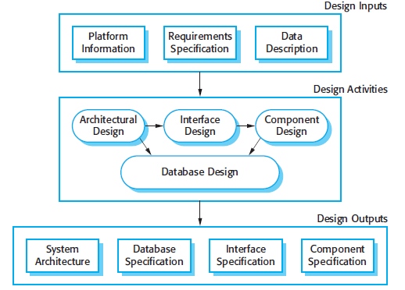
RECAP: Architecture design is first stage in software design process

Slide 3
Introduction
It is the critical link between design and
requirements engineering,
identifies the main structural components in a system.
and the relationships between them.
The output of the architectural design process is
an architectural model that describes how the system is organized as a set of communicating components.

Slide 4
Introduction..1
Architecture design is a creative process and depends on:
  Type of system being developed
  Technology being used
  Experience and background of system architect/team lead

Slide 5
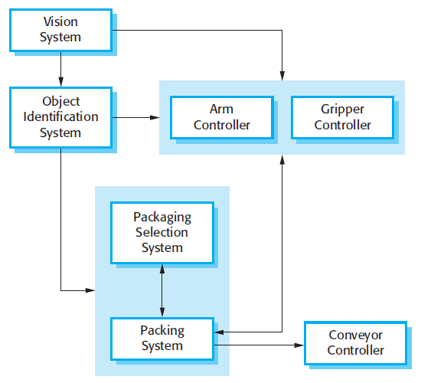
Architecture of Packing Robot System

Slide 6
Introduction..2
Software Architecture affects:
  Performance
  Robustness
  Distribution
  And Maintainability

Slide 7
Advantages of Documenting Software Architecture
Stakeholder communications
  Focus of discussion
System Analysis
  Early stage of development.
Large-scale reuse:
  Usually software products with similar requirements can be designed using similar software architecture.

Slide 8
Software Architecture Using Block-Diagrams
System architectures are often modeled using simple block diagrams.
Each box in the diagram represents a component.
Boxes within boxes indicate that the component has been decomposed to sub-components.
Arrows mean that data and or control signals are passed from component to component in the direction of the arrows

Slide 9
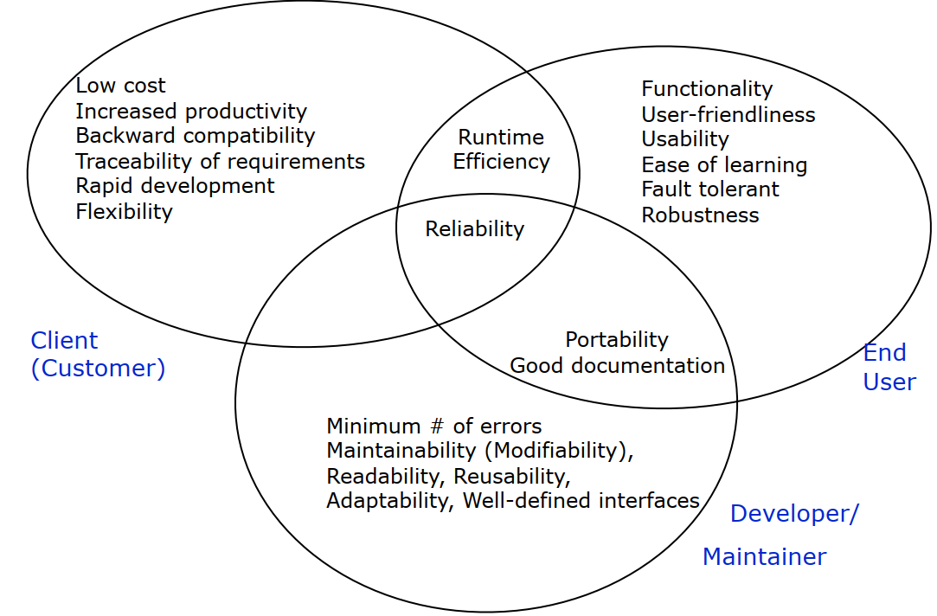
Stakeholders have different Design Goals (OR
Issues of Concerns)

Slide 10
Some Design Trade-offs for a developer
Functionality vs Usability
Robustness vs Cost
Performance vs Cost
Portability vs Efficiency
Rapid Development vs Functionality & Complexity
Reusability vs Cost
Backward Compatibility vs Readability

Slide 11
Architectural Design Decisions..2
Performance: localize critical components such as data storage.
Security: a layered architecture should be used with critical aspects protected at inner most components.
Safety: have safety-related operation located at single component.
Availability: redundant components
Maintainability: loosely-coupled components

Slide 12
Architectural Views
It is impossible to represent all relevant information about a system’s architecture in a single architectural model.
4+1 View Model of Software Architecture:
  Logical view: class diagram
  Process view: runtime interaction of components
  Development view: distribution of components on development teams
  Physical view: how components are distributed on physical hardware machines

Slide 13
Detailed Design of Software Architecture Using UML
There are differing views about whether or not software architects should use the UML for architectural description
  Some prefer UML
  Lots DON’T,
“I don’t find the UML to be useful during the design process itself and prefer informal notations that are quicker to write and which can be easily drawn on a whiteboard. The UML is of most value when you are documenting an architecture in detail or using model-driven development”. Somerville

Slide 14
Subsystems and Components
Components are depicted as rectangles with the component icon in the upper right corner.
Dependencies among components can be depicted with dashed stick arrows.
In UML, components can represent both logical and physical components.
A logical component corresponds to a subsystem that has no explicit run-time equivalent, for example, individual business components that are composed together into a single run-time application logic layer.
A physical component corresponds to a subsystem that as an explicit run-time equivalent, for example, a database server.

Slide 15
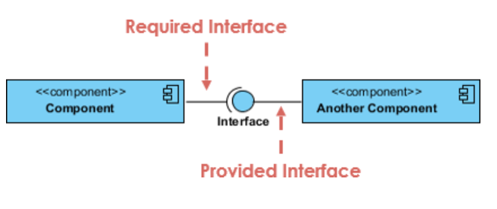
Required/provided interfaces

Slide 16
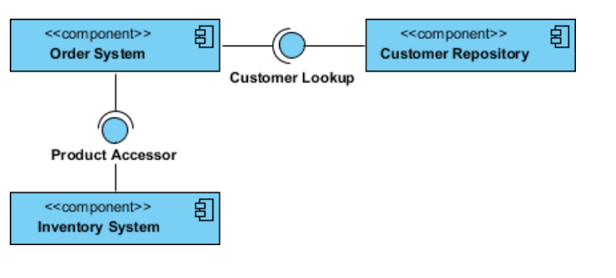
Required/provided interfaces..2

Slide 17
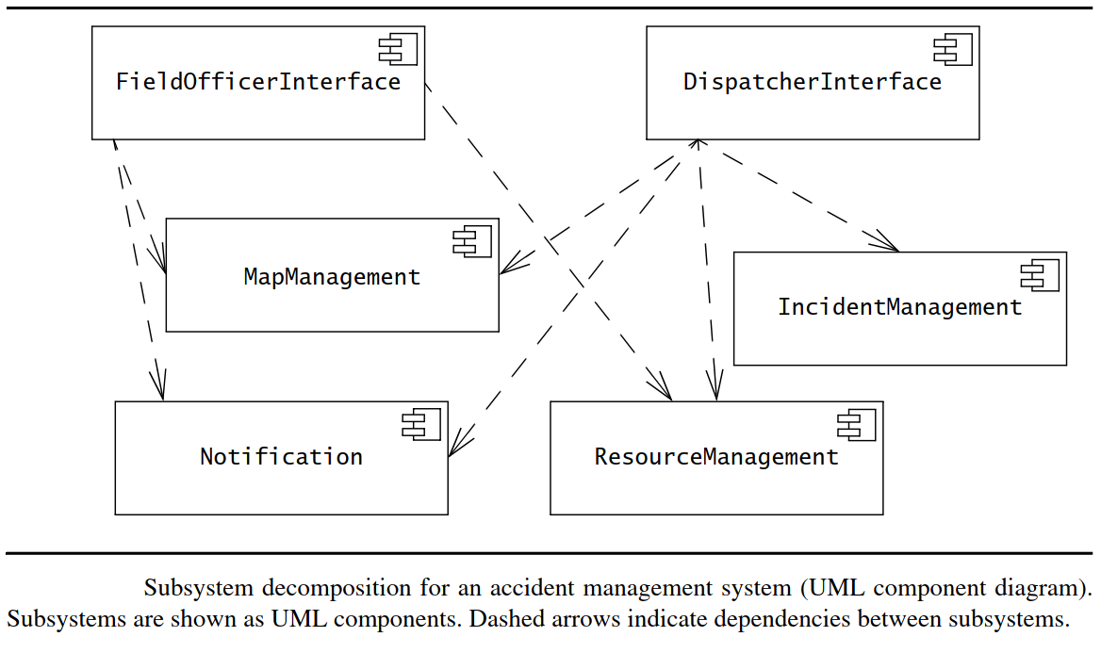

Slide 18
Services and Subsystem Interfaces
A subsystem is characterized by the services it provides to other subsystems.
A service is a set of related operations that share a common purpose.
The set of operations of a subsystem that are available to other subsystems form the subsystem interface.
The subsystem interface includes the name of the operations, their parameters, their types, and their return values

Slide 19
Coupling and Cohesion as design goals
When writing a subsystem interface, one should strive to minimize the amount of information provided about the implementation.
For example, a subsystem interface should not refer to internal data structures, such as linked lists, arrays, or hash tables.
This allows us to minimize the impact of change when we revise the implementation of a subsystem

Slide 20
Coupling
Coupling is the number of dependencies between two subsystems.
If two subsystems are loosely coupled, they are relatively independent, so modifications to one of the subsystems will have little impact on the other.

Slide 21
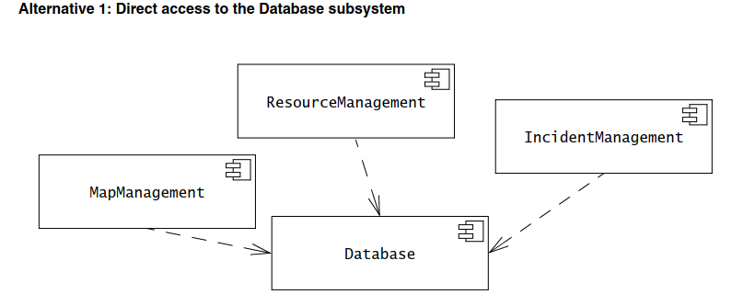
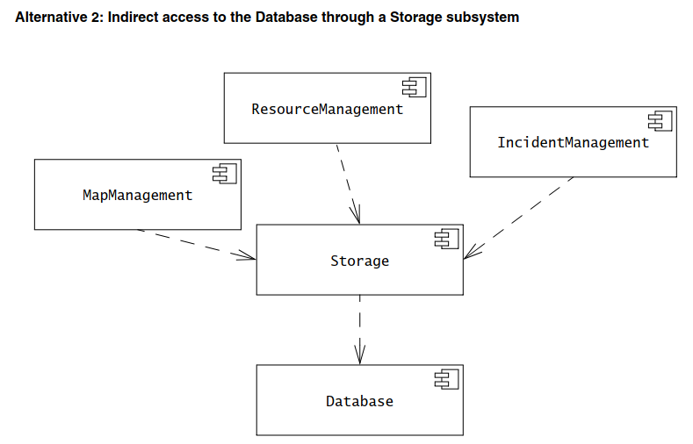

Slide 22
Cohesion
Cohesion is the number of dependencies within a subsystem.
If a subsystem contains many objects that are related to each other and perform similar tasks, its cohesion is high.

Slide 23
Why high cohesion?
increases the clarity and ease of comprehension of the design
simplifies maintenance and future enhancements
often supports low coupling
supports increased reuse
a highly cohesive (i.e. a highly related functionality)
  component can be re-used for the same specific purpose!

Slide 24
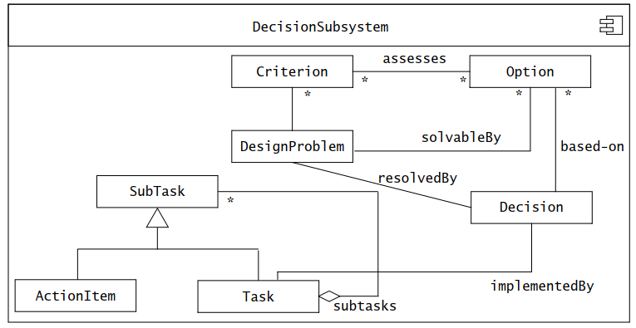
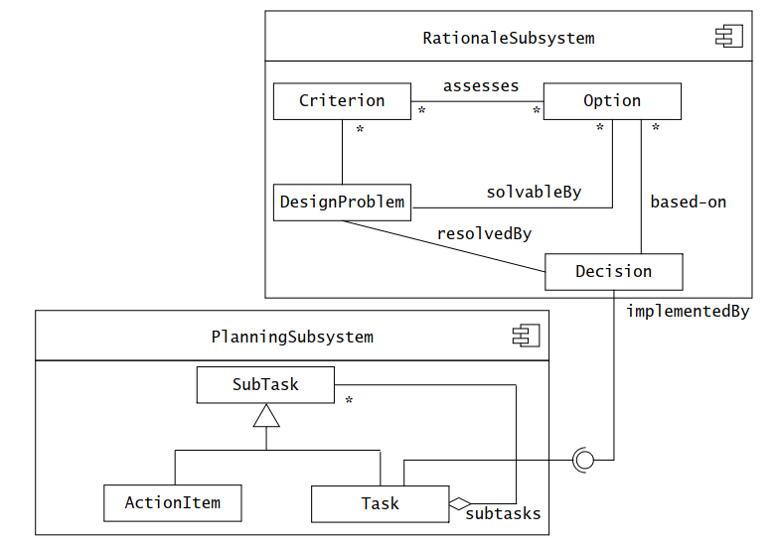

Slide 25
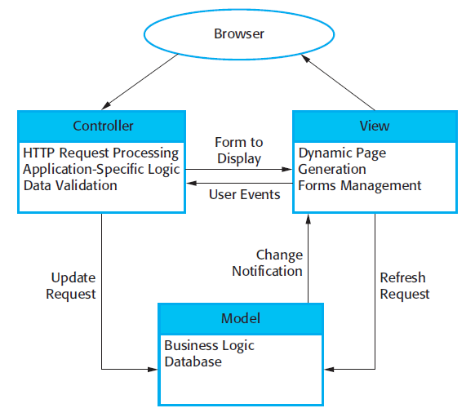
Architectural Patterns: MCV

Slide 26
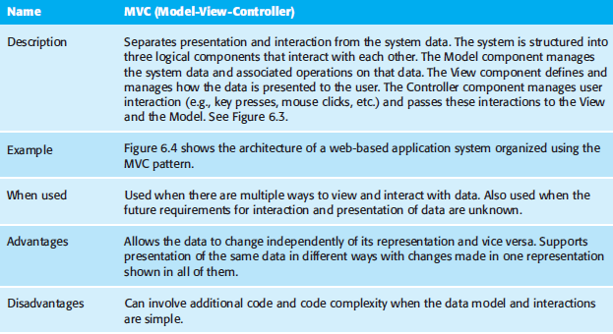
The Model-View-Controller Pattern

Slide 27
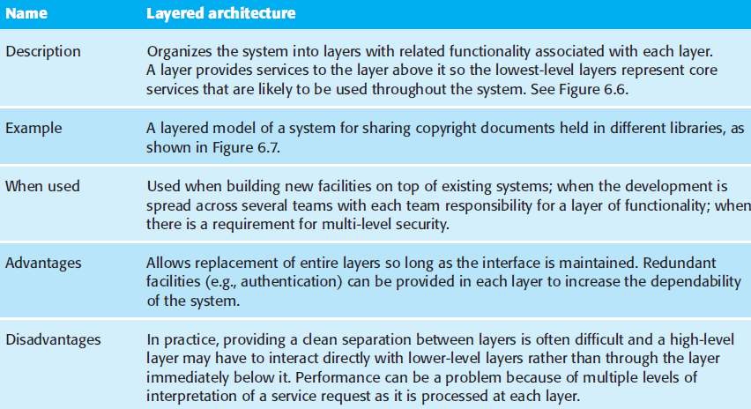
Architectural Patterns: Layered Architecture

