Slide 1
Electrical Machines Fundamentals
ENEE4303
aabdo@birzeit.edu Electrical Machine Fundamentals ENEE 4303

Slide 2
Course Organization
Grading:
First Exam 20 % - 30 %
Second exam 20 % - 30 %
Final Exam 40 %
Class Work 0% - 20 %
------------
100 %
aabdo@birzeit.edu Electrical Machine Fundamentals ENEE 4303

Slide 3
Introduction to Machinery Principles
Electric Machines → mechanical energy to electric energy or vice versa
Mechanical energy → Electric energy : GENERATOR
Electric energy → mechanical energy : MOTOR
Almost all practical motors and generators convert energy from one form to
another through the action of a magnetic field.
Only machines using magnetic fields to perform such conversions will be
considered in this course.
aabdo@birzeit.edu Electrical Machine Fundamentals ENEE 4303

Slide 4
Introduction to Machinery Principles
When we talk about machines, another related device is the transformer. A transformer is a device that converts ac electric energy at one voltage level to ac electric energy at another voltage level.
Transformers are usually studied together with generators and motors because they operate on the same principle, the difference is just in the action of a magnetic field to accomplish the change in voltage level.
aabdo@birzeit.edu Electrical Machine Fundamentals ENEE 4303

Slide 5
Introduction to Machinery Principles
Why are electric motors and generators so common?
Electric power is a clean and efficient energy source that is easy to transmit over long distances and easy to control.
An electric motor does not require constant ventilation and fuel the way that an internal-combustion engine does, so the motor is very well suited for use in environments where the pollutants associated with combustion are not desirable.
aabdo@birzeit.edu Electrical Machine Fundamentals ENEE 4303

Slide 6
Introduction to Machinery Principles
Rotational Motion, Newton’s Law and Power Relationship
Almost all electric machines rotate about an axis, called the shaft of the machines. It is important to have a basic understanding of rotational motion.
Angular Position Ө - is the angle at which it is oriented, measured from some arbitrary reference point. Its measurement units are in radians (rad) or in degrees. It is similar to the linear concept of distance along a line.
Conventional notation: +ve value for counterclockwise
-ve value for clockwise rotation
Angular Velocity ω - Angular velocity (or speed) is the rate of change in angular position with respect to time.
aabdo@birzeit.edu Electrical Machine Fundamentals ENEE 4303

Slide 7
Introduction to Machinery Principles
Similar to the concept of standard velocity where:
(m/sec)
where:
r – distance traverse by the body
t – time taken to travel the distance r
For a rotating body, angular velocity is formulated as:
(rad/s)
where:
θ - Angular position/ angular distance traversed by the rotating body
t – time taken for the rotating body to traverse the specified distance,
aabdo@birzeit.edu Electrical Machine Fundamentals ENEE 4303

Slide 8

Introduction to Machinery Principles
The following symbols are used in out text book to describe angular velocity:
wm : angular velocity expressed in radians per second
fm : angular velocity expressed in revolutions per second
nm : angular velocity expressed in revolutions per minute
These measures of shaft speed are related to each other by the following
equations:
Angular acceleration, α - is defined as the rate of change in angular velocity with respect to time. Its formulation is as shown:
aabdo@birzeit.edu Electrical Machine Fundamentals ENEE 4303

Slide 9
Introduction to Machinery Principles
Torque (Twisting Force) τ
The torque on an object is define as the product of the force applied on the object and the smallest distance between the line of the action of force and the axis of rotation.
aabdo@birzeit.edu Electrical Machine Fundamentals ENEE 4303

Slide 10
Introduction to Machinery Principles
Newton’s Law of Rotation
( N or kg.m/sec^2)
where:
F – net force applied
m – mass of object
a – resultant acceleration of object
Applying these concept for rotating bodies,
(Nm)
where:
τ - Torque
J – moment of inertia
α - angular acceleration
aabdo@birzeit.edu Electrical Machine Fundamentals ENEE 4303

Slide 11
Introduction to Machinery Principles
Work (W)
Is defined as the application of Force through a distance.
- For linear motion
( Joules OR foot-pounds)
Assuming that the direction of F is collinear (in the same direction) with the direction of motion.
If F (force) is constant then:
- For rotational motion
if τ is constant, then (Joules)
aabdo@birzeit.edu Electrical Machine Fundamentals ENEE 4303

Slide 12


Introduction to Machinery Principles
Power (P)
Is defined as rate of doing work. Hence,
(Watt) OR (Joules/s) OR
hours power (1 hp = 746 watt )
OR foot-pounds/s
Assuming that force is constant and collinear with the direction of motion, power is given by
Applying this for rotating bodies,
This equation can describe the mechanical power on the shaft of a motor or generator.
aabdo@birzeit.edu Electrical Machine Fundamentals ENEE 4303

Slide 13
Introduction to Machinery Principles
Magnetic Field
magnetic fields are the fundamental mechanism by which energy is converted from one form to another in motors, generators, and transformers.
Basic principles:
A current-carrying wire produces a magnetic field in the area around it.
A time-changing magnetic field induces a voltage in a coil of wire if it passes through that coil. (This is the basis of transformer action.)
A current-carrying wire in the presence of a magnetic field has a force induced on it. (This is the basis of motor action.)
A moving wire in the presence of a magnetic field has a voltage induced in it. (This is the basis of generator action.)
aabdo@birzeit.edu Electrical Machine Fundamentals ENEE 4303

Slide 14
Introduction to Machinery Principles
Production of a Magnetic Field
Ampere’s Law – the basic law governing the production of a magnetic field by a current:
Where,
H is the magnetic field intensity produced by the current I_{net}
dl is a differential element of length along the path of integration.
H is measured in Ampere-turns per meter.
To better understanding the previous equation consider the following example:
aabdo@birzeit.edu Electrical Machine Fundamentals ENEE 4303

Slide 15
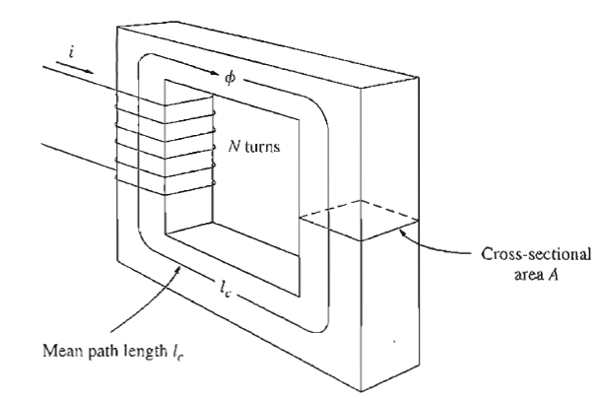
Introduction to Machinery Principles
Production of a Magnetic Field
Consider a current carrying conductor is wrapped around a ferromagnetic core
Applying Ampere’s law, the total amount of magnetic field induced will be proportional to the amount of current flowing through the conductor wound with N turns around the ferromagnetic material as shown. Since the core is made of ferromagnetic material, it is assumed that a majority of the magnetic field will be confined to the core.
aabdo@birzeit.edu Electrical Machine Fundamentals ENEE 4303

Slide 16
Introduction to Machinery Principles
The path of integration in Ampere’s law is the mean path length of the core, l_{c}
The current passing within the path of integration I_{net} is then Ni,
Since the coil of wires cuts the path of integration N times while carrying the current i. Hence Ampere’s Law becomes,
Production of a Magnetic Field
(Ampere turns per meter)
aabdo@birzeit.edu Electrical Machine Fundamentals ENEE 4303

Slide 17
Introduction to Machinery Principles
Production of a Magnetic Field
Magnetic field intensity H is known as the effort required to induce a magnetic field.
The strength of the magnetic field flux produced in the core also depends on the material of the core. Thus,
B = magnetic flux density (webers per square meter, Tesla (T))
µ= magnetic permeability of material (Henrys per meter)
H = magnetic field intensity (ampere-turns per meter)
aabdo@birzeit.edu Electrical Machine Fundamentals ENEE 4303

Slide 18
Introduction to Machinery Principles
Production of a Magnetic Field
The constant μ may be further expanded to include relative permeability which can be defined as below:
where:
μo – permeability of free space 4π x 10⁻⁷ H/m (Henry/meter)
Note:
permeability of air = permeability of free space.
steels used in modern machines have μ_{r} of 2000 to 6000.
aabdo@birzeit.edu Electrical Machine Fundamentals ENEE 4303

Slide 19
Introduction to Machinery Principles
In a core such as in the figure,
Now, to measure the total flux (Φ ) flowing in the ferromagnetic core, consideration has to be made in terms of its cross sectional area (CSA). Therefore,
Where: A – cross sectional area throughout the core
aabdo@birzeit.edu Electrical Machine Fundamentals ENEE 4303

Slide 20
Introduction to Machinery Principles
Assuming that the flux density in the ferromagnetic core is constant throughout hence constant A, the equation simplifies to be:
Taking into account past derivation of B,
weber
aabdo@birzeit.edu Electrical Machine Fundamentals ENEE 4303

Slide 21


Introduction to Machinery Principles
Magnetic Circuit
The current in a coil of wire wrapped around a core produces a magnetic flux in the core. This is in some sense analogous to a voltage in an electric circuit producing a current flow.
The analogy is as follows:
Electric Circuit Magnetic Circuit
F is denoted as magnetomotive force (mmf) which is similar to Electromotive force in an electrical circuit (emf).
aabdo@birzeit.edu Electrical Machine Fundamentals ENEE 4303

Slide 22
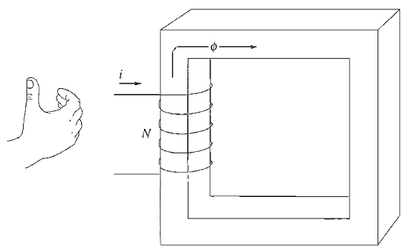

Introduction to Machinery Principles
Magnetic Circuit
The polarity of the mmf will determine the direction of flux. To easily determine the direction of flux, the ‘right hand curl’ rule is utilised:
1) The direction of the curled fingers determines the current flow.
2) The resulting thumb direction will show the magnetic flux flow.
aabdo@birzeit.edu Electrical Machine Fundamentals ENEE 4303

Slide 23
Introduction to Machinery Principles
Magnetic Circuit
The element of R in the magnetic circuit analogy is similar in concept to the electrical resistance.
It is basically the measure of material resistance to the flow of magnetic flux.
Reluctance in this analogy obeys the rule of electrical resistance
(Series and Parallel Rules).
Reluctance is measured in Ampere-turns per weber.
Series Reluctance,
R_{eq} = R₁ + R₂ + R₃ + ….
Parallel Reluctance,
aabdo@birzeit.edu Electrical Machine Fundamentals ENEE 4303

Slide 24
Introduction to Machinery Principles
Magnetic Circuit
The inverse of electrical resistance is conductance (G) which is a measure of conductivity of a material.
Hence the inverse of reluctance is known as permeance, P where it represents the degree at which the material permits the flow of magnetic flux.
Also
aabdo@birzeit.edu Electrical Machine Fundamentals ENEE 4303

Slide 25
Introduction to Machinery Principles
Inaccuracy in the magnetic circuit approach
By using the magnetic circuit approach, it simplifies calculations related to the magnetic field in a ferromagnetic material, however, this approach has inaccuracy.
Possible reason of inaccuracy is due to:
1) Assumes that all flux are confined within the core, but in reality a small fraction of the flux escapes from the core into the surrounding low-permeability air, and this flux is called leakage flux.
2) Assumes a certain mean path length and cross sectional area (CSA) of the core is not accurate especially at the corners.
3) In ferromagnetic materials, the permeability varies with the amount of flux already in the material. The material permeability is not constant hence there is an existence of non-linearity of permeability.
4) For ferromagnetic core which has air gaps, there are fringing effects that should be taken into account as shown:
aabdo@birzeit.edu Electrical Machine Fundamentals ENEE 4303

Slide 26
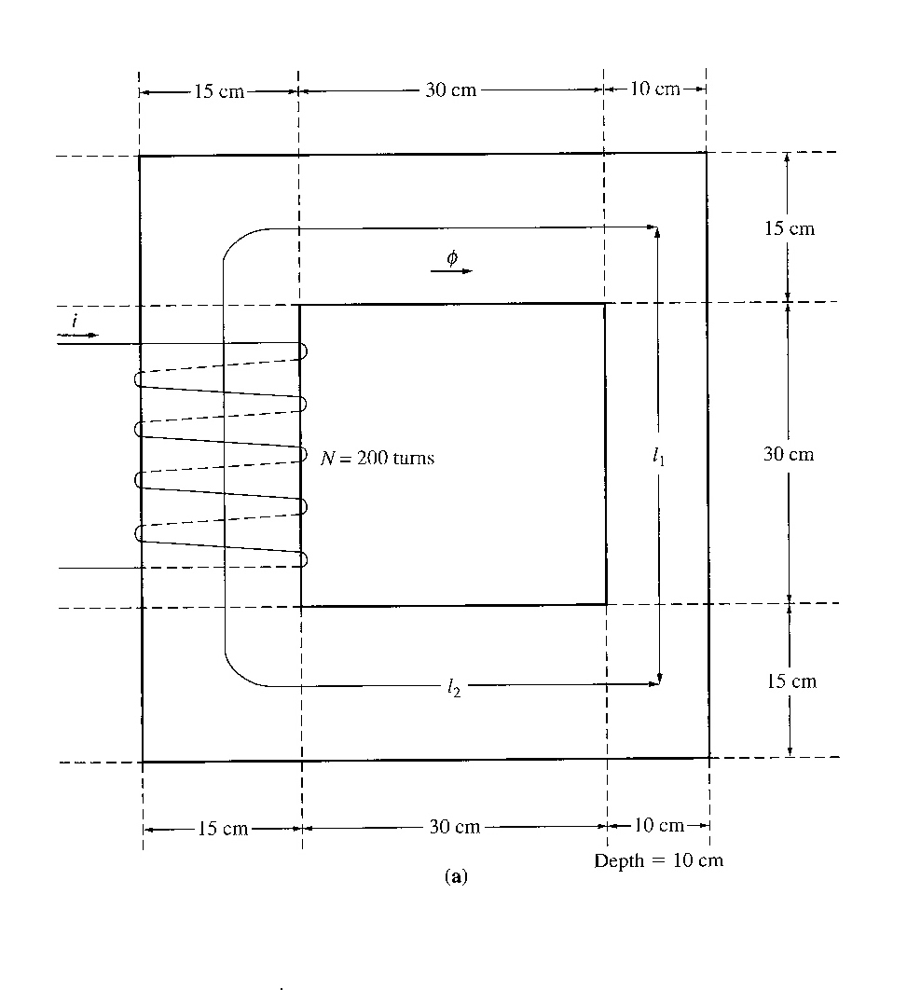
Introduction to Machinery Principles
Example 1-1
A ferromagnetic core is shown. Three sides of this core are of uniform width, while the fourth side is somewhat thinner. The depth of the core (into the page) is 10cm, and the other dimensions are shown in the figure. There is a 200 turn coil wrapped around the left side of the core.
Assuming relative permeability μ_{r} of 2500, how much flux will be produced by a 1 A input current?
aabdo@birzeit.edu Electrical Machine Fundamentals ENEE 4303

Slide 27
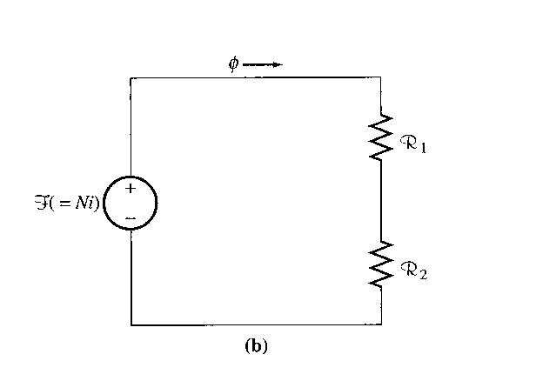
Introduction to Machinery Principles
Example 1-1
Solution:
3 sides of the core have the same csa, while the 4th side has a different area. Thus the core can be divided into 2 regions:
(1) the single thinner side
(2) the other 3 sides taken together
The magnetic circuit corresponding to this core:
Solve Examples 1-1, 1-2, 1-3 in the book
aabdo@birzeit.edu Electrical Machine Fundamentals ENEE 4303

Slide 28
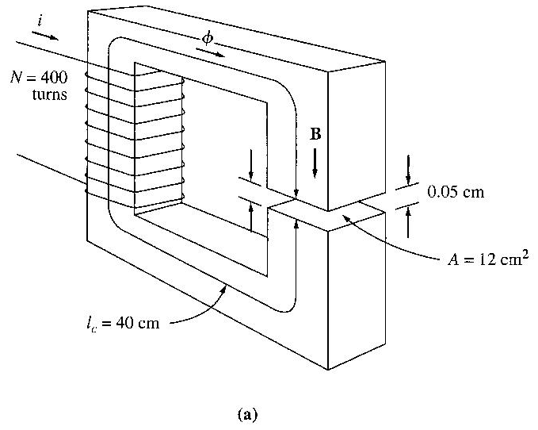
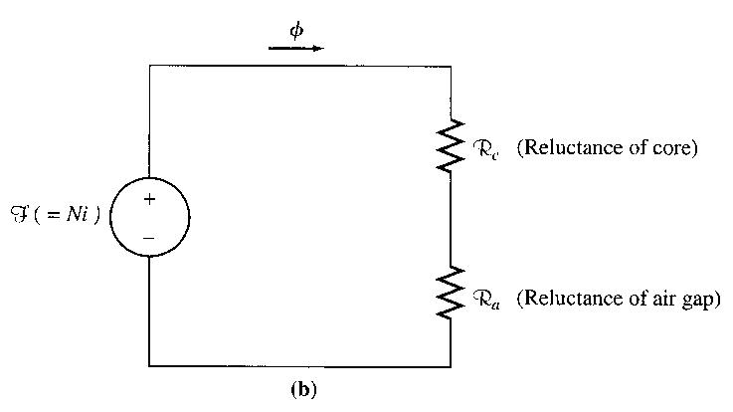
Introduction to Machinery Principles
Example 1-2
Figure shows a ferromagnetic core whose mean path length is 40cm. There is a small gap of 0.05cm in the structure of the otherwise whole core. The csa of the core is 12cm², the relative permeability of the core is 4000, and the coil of wire on the core has 400 turns. Assume that fringing in the air gap increases the effective csa of the gap by 5%. Given this information, find
  the total reluctance of the flux path (iron plus air gap)
  the current required to produce a flux density of 0.5T in the air gap.
Solution:
The magnetic circuit corresponding to this core is shown below:
aabdo@birzeit.edu Electrical Machine Fundamentals ENEE 4303

Slide 29
Introduction to Machinery Principles
Magnetic Behaviour of Ferromagnetic Materials
For magnetic materials, a much larger value of B is produced in these materials than in free space.
Therefore, the permeability of magnetic materials is much higher than µo.
However, the permeability is not linear anymore but does depend on the current over a wide range.
The concept of magnetic permeability corresponds to the ability of the material to permit the flow of magnetic flux through it.
In electrical machines and electromechanical devices a somewhat linear relationship between B and I is desired, which is normally approached by limiting the current.
aabdo@birzeit.edu Electrical Machine Fundamentals ENEE 4303

Slide 30
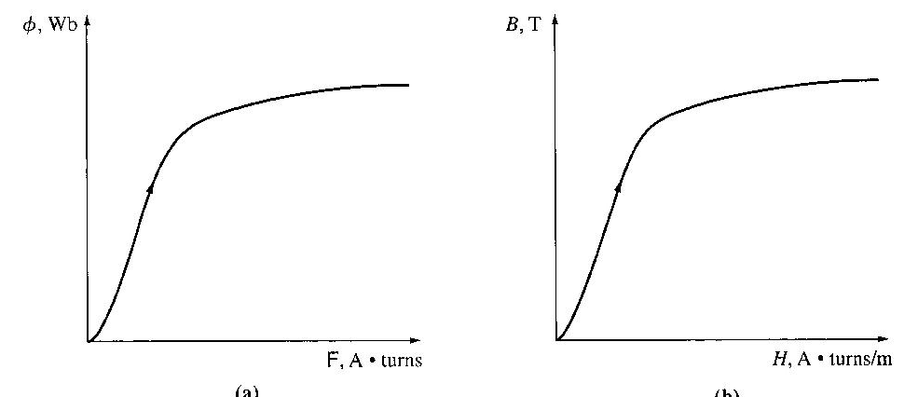
Introduction to Machinery Principles
Look at the magnetization curve and B-H curve.
Note: The curve corresponds to an increase of DC current flow through a coil wrapped around the ferromagnetic core
Saturation region
When the flux produced in the core is plotted versus the mmf producing it. This plot is called a saturation curve or a magnetization curve.
A small increase in the mmf produces a huge increase in the resulting flux. After a certain point, further increases in the mmf produce relatively smaller increases in the flux. Finally, there will be no change at all as you increase mmf further.
knee
unsaturated region
aabdo@birzeit.edu Electrical Machine Fundamentals ENEE 4303

Slide 31
Introduction to Machinery Principles
Advantage of using a ferromagnetic material for cores in electric machines and transformers is that one gets more flux for a given mmf than with air (free space).
If the resulting flux has to be proportional to the mmf, then the core must be operated in the unsaturated region.
Generators and motors depend on magnetic flux to produce voltage and torque, so they need as much flux as possible. So, they operate near the knee of the magnetization curve (flux not linearly related to the mmf). This non-linearity as a result gives peculiar behaviours to machines.
As magnetizing intensity H increased, the relative permeability first increases and then starts to drop off.
aabdo@birzeit.edu Electrical Machine Fundamentals ENEE 4303

Slide 32
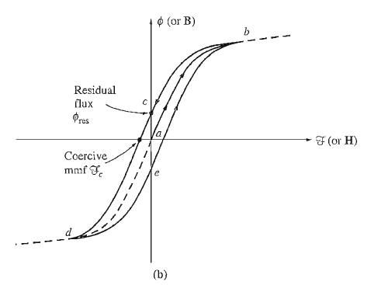
Introduction to Machinery Principles
Energy Losses in Ferromagnetic Core
Hysteresis losses
Notice that the amount of flux present in the core depends not only on the amount of current applied to the windings of the core, but also on the previous history of the flux in the core.
This dependence on the preceding flux history and the resulting failure to retrace flux paths is called hysteresis.
aabdo@birzeit.edu Electrical Machine Fundamentals ENEE 4303

Slide 33
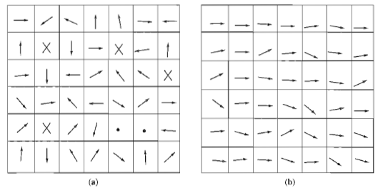
Introduction to Machinery Principles
(a) Magnetic domains oriented randomly. (b) Magnetic domains lined up in the presence of an external magnetic field.
The hysteresis loss in an iron core is the energy required to accomplish the reorientation of domains during each cycle of the alternating current applied to the core. It is proportional to hysteresis loop and cause heat in the core.
aabdo@birzeit.edu Electrical Machine Fundamentals ENEE 4303

Slide 34
Introduction to Machinery Principles
FARADAY’S LAW – Induced Voltage from a Time-Changing Magnetic Field
It is the basis of transformer operation.
Faraday's law states that if a flux passes through a turn of a coil of wire, a voltage will be induced in the turn of wire that is directly proportional to the rate of change in the flux with respect to time.
- If there is N number of turns in the coil with the same amount of flux flowing through it, hence:
where:
N – number of turns of wire in coil.
aabdo@birzeit.edu Electrical Machine Fundamentals ENEE 4303

Slide 35
Introduction to Machinery Principles
Note the negative sign at the previous equations which is in accordance to Lenz’ Law which states:
‘The direction of the build-up voltage in the coil is as such that if the coils were short circuited, it would produce current that would cause a flux opposing the original flux change.’
aabdo@birzeit.edu Electrical Machine Fundamentals ENEE 4303

Slide 36
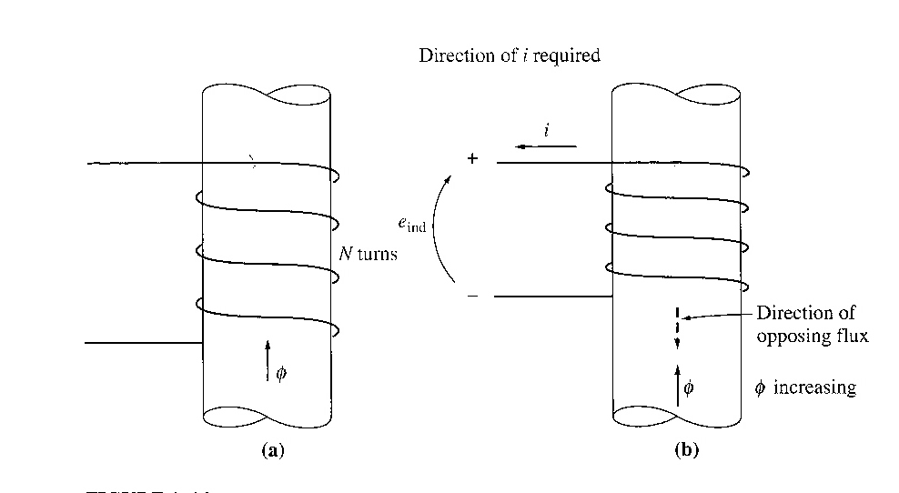
Introduction to Machinery Principles
If the flux shown is increasing in strength, then the voltage built up in the coil will tend to establish a flux that will oppose the increase.
A current flowing as shown in the figure would produce a flux opposing the increase.
So, the voltage on the coil must be built up with the polarity required to drive the current through the external circuit. So, -e_{ind}
aabdo@birzeit.edu Electrical Machine Fundamentals ENEE 4303

Slide 37
Introduction to Machinery Principles
In calculations we can omit the minus because it indicates only the physical consideration.
If there was a leakage flux out of the core, then each turn might have a slightly different flux.
Now consider the induced voltage in the ith turn of the coil,
Since there is N number of turns, the equation above may be rewritten into,
aabdo@birzeit.edu Electrical Machine Fundamentals ENEE 4303

Slide 38
Introduction to Machinery Principles
Flux linkage - λ
The equation above may be rewritten into,
where λ (flux linkage) is defined as:
Faraday’s law is the fundamental property of magnetic fields involved in transformer operation.
Lenz’s Law in transformers is used to predict the polarity of the voltages induced in transformer windings.
(Weber-turns)
aabdo@birzeit.edu Electrical Machine Fundamentals ENEE 4303

Slide 39
Introduction to Machinery Principles
Eddy current: the time changing flux also induces a voltage in the core, which causes eddy currents to flow within the core.
these currents pass through the core (resistive core) causing energy loss called eddy current losses.
aabdo@birzeit.edu Electrical Machine Fundamentals ENEE 4303

Slide 40
Introduction to Machinery Principles
Production of Induced Force on a Wire (motor action principle)
A current carrying wire present in a uniform magnetic field of flux density B, would produce a force on the conductor/wire.
Dependent upon the direction of the surrounding magnetic field, the force induced is given by:
where:
i – represents the current flow in the conductor
l – length of wire, with direction of l defined to be in the direction of current flow
B – magnetic field density vector
aabdo@birzeit.edu Electrical Machine Fundamentals ENEE 4303

Slide 41
Introduction to Machinery Principles
The direction of the force is given by the right-hand rule.
The induced force formula shown earlier is true if the current carrying conductor is perpendicular to the direction of the magnetic field. If the current carrying conductor is positioned at an angle to the magnetic field, the formula is modified to be as follows:
Where: θ - angle between the conductor and the direction of the magnetic field.
aabdo@birzeit.edu Electrical Machine Fundamentals ENEE 4303

Slide 42
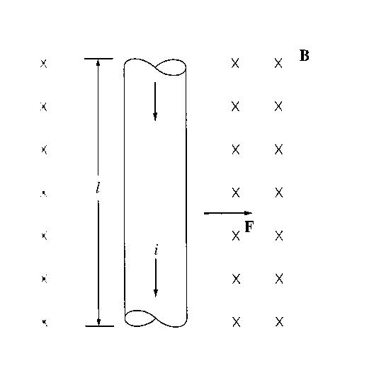
Introduction to Machinery Principles
Example 1-6
The figure shows a wire carrying a current in the presence of a magnetic field. The magnetic flux density is 0.25T, directed into the page. If the wire is 1m long and carries 0.5A of current in the direction from the top of the page to the bottom, what are the magnitude and direction of the force induced on the wire?
aabdo@birzeit.edu Electrical Machine Fundamentals ENEE 4303

Slide 43
Introduction to Machinery Principles
Solution
Direction of F is given by the right hand rule ➔ to the right
= (0.5A)(1.0)m(0.25T) sin 90º
= 0.125 N
Therefore F=0.125 N directed to the right
aabdo@birzeit.edu Electrical Machine Fundamentals ENEE 4303

Slide 44
Introduction to Machinery Principles
Production of Induced voltage on a conductor (Generator action principle)
If a conductor moves or ‘cuts’ through a magnetic field, voltage will be induced between the terminals of the conductor.
The magnitude of the induced voltage is dependent upon the velocity of the wire assuming that the magnetic field is constant. This can be summarised in terms of formulation as shown:
e_{ind} = (v x B) l
where:
v – velocity of the wire
B – magnetic field density
l – length of the wire in the magnetic field
Note: The value of l (length) is dependent upon the angle at which the wire cuts through the magnetic field. Hence a more complete formula will be as follows:
e_{ind} = (v x B)l cosѳ
where:
θ - smallest angle between the conductor and the direction of (v x B)
aabdo@birzeit.edu Electrical Machine Fundamentals ENEE 4303

Slide 45
Introduction to Machinery Principles
The induction of voltages in a wire moving in a magnetic field is fundamental to the operation of all types of generators.
Example 1.8
The figure shows a conductor moving with a velocity of 5m/s to the right in the presence of a magnetic field. The flux density is 0.5T into the page, and the wire is 1m length, oriented as shown. What are the magnitude and polarity of the resulting induced voltage?
aabdo@birzeit.edu Electrical Machine Fundamentals ENEE 4303

Slide 46
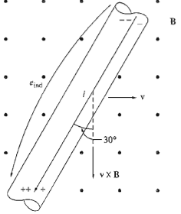
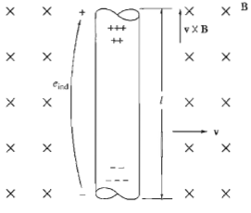
Introduction to Machinery Principles
Solution:
direction of vxB is up and voltage polarity is as shown since positive voltage polarity is in the direction of vxB
e_{ind} = (v x B) l= (vBsin 90º) l cos 0º
= 5( m/s)(0.5T) (1.0m)=2.5V
Induced voltage is 2.5V, positive at top of wire
Positive voltage polarity is in the direction of vxB
aabdo@birzeit.edu Electrical Machine Fundamentals ENEE 4303

Slide 47
Introduction to Machinery Principles
The Linear DC Machine
Linear DC machine is the simplest form of DC machine which is easy to understand, and it operates according to the same principles and exhibits the same behaviour as motors and generators. Consider the following:
rails
Battery
Bar of conductor
Equations needed to understand linear DC machines are as follows:
Production of Force on a current carrying conductor in presence of magnetic field
aabdo@birzeit.edu Electrical Machine Fundamentals ENEE 4303

Slide 48
Introduction to Machinery Principles
Voltage induced on a current carrying conductor moving in a magnetic field
e_{ind} = (v x B) l
Kirchoff’s voltage law
Newton’s Law for motion
F_{net} = ma
aabdo@birzeit.edu Electrical Machine Fundamentals ENEE 4303

Slide 49
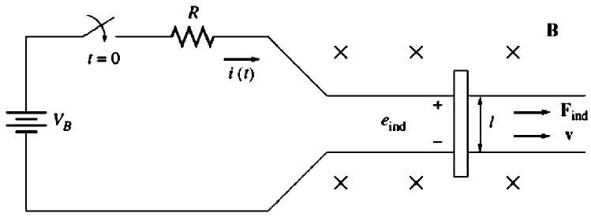
Introduction to Machinery Principles
Starting the Linear DC Machine
To start the machine, the switch is closed.
Current will flow in the circuit and the equation can be derived from Kirchoff’s law:
At this moment, e_{ind} is 0 due to no movement of the wire (the bar is at rest).
aabdo@birzeit.edu Electrical Machine Fundamentals ENEE 4303

Slide 50
Introduction to Machinery Principles
As the current flows down through the bar, a force will be induced on the bar.
Direction of movement: Right
When the bar starts to move, its velocity will increase, and a voltage appears across the bar.
Direction of induced potential: positive upwards
aabdo@birzeit.edu Electrical Machine Fundamentals ENEE 4303

Slide 51
Introduction to Machinery Principles
The voltage now reduces the current flowing in the bar, since by Kirchhoff's voltage law
Eventually; the bar will reach a constant steady-state speed where the net force on the bar is zero. This occurs when e_{ind} has risen all the way up to equal V_{B}. This is given by:
aabdo@birzeit.edu Electrical Machine Fundamentals ENEE 4303

Slide 52
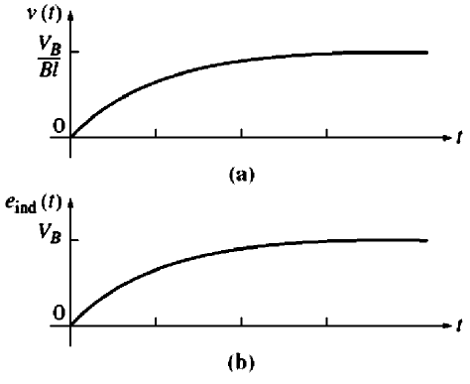
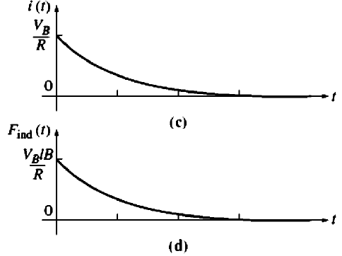
Introduction to Machinery Principles
Summarization of the starting of linear DC machine is sketched in the figures below:
aabdo@birzeit.edu Electrical Machine Fundamentals ENEE 4303

Slide 53
Introduction to Machinery Principles
To summarize, at starting, the linear dc machine behaves as follows:
Closing the switch produces a current flow i = V_{B} /R.
The current flow produces a force on the bar given by F = ilB.
The bar accelerates to the right, producing an induced voltage e_{ind} as it speeds up.
This induced voltage reduces the current flow
The induced force is thus decreased (F = i↓lB) until eventually F =0. At that point
e_{ind} = V_{B} ,i= 0, and the bar moves at a constant no- load speed v_{ss}= V_{B} /BI.
aabdo@birzeit.edu Electrical Machine Fundamentals ENEE 4303
53

Slide 54
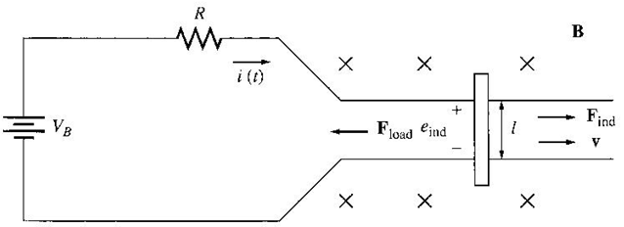
Introduction to Machinery Principles
The Linear DC Machine as a Motor
Assume the linear machine is initially running at the no-load steady state condition.
What happen when an external load is applied? See figure below:
A force F_{load} is applied to the bar opposing the direction of motion. Since the bar was initially at steady state, application of the force F_{load} will result in a net force on the bar in the direction opposite the direction of motion.
aabdo@birzeit.edu Electrical Machine Fundamentals ENEE 4303

Slide 55
Introduction to Machinery Principles
The Linear DC Machine as a Motor
Thus, the bar will slow down (the resulting acceleration a = F_{net}/m is negative). As soon as that happen, the induced voltage on the bar drops
(e_{ind} = v↓ Bl).
When the induced voltage drops, the current flow in the bar will rise
Thus, the induced force will rise too.
(F_{ind}↑ = i↑ lB)
Final result → the induced force will rise until it is equal and opposite to the load force, and the bar again travels in steady state condition, but at a lower speed.
aabdo@birzeit.edu Electrical Machine Fundamentals ENEE 4303

Slide 56
Introduction to Machinery Principles
The Linear DC Machine as a Motor
Now, there is an induced force in the direction of motion and power is being converted from electrical to mechanical form to keep the bar moving.
The power converted is
P_{conv} = e_{ind} I = F_{ind} v
→ An amount of electric power equal to e_{ind} I is consumed and is replaced by the mechanical power F_{ind} v → MOTOR
The power converted in a real rotating motor is:
P_{conv} = τ_{ind} ω
aabdo@birzeit.edu Electrical Machine Fundamentals ENEE 4303

Slide 57
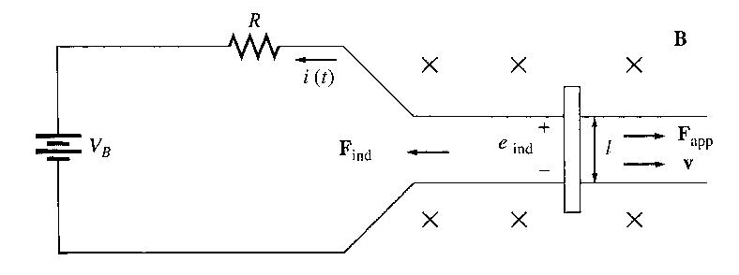
Introduction to Machinery Principles
The Linear DC Machine as a Generator
Assume the linear machine is operating under no-load steady-state condition. A force in the direction of motion is applied.
The applied force will cause the bar to accelerate in the direction of motion, and the velocity v will increase.
So; e_{ind} = v ↑ Bl will increase and will be larger than V_{B}.
When e_{ind} > V_{B} the current reverses direction.
Since the current now flows up through the bar, it induces a force in the bar (F_{ind} = ilB to the left). This induced force opposes the applied force on the bar.
aabdo@birzeit.edu Electrical Machine Fundamentals ENEE 4303

Slide 58
Introduction to Machinery Principles
The Linear DC Machine as a Generator
End result → the induced force will be equal and opposite to the applied force, and the bar will move at a higher speed than before. The linear machine is now converting
mechanical power (F_{ind}v) to electrical power (e_{ind} i) → GENERATOR
The amount of power converted : P_{conv} = τ_{ind} ω
NOTE:
  The same machine acts as both motor and generator. The only difference is whether the externally applied force is in the direction of motion (generator) or opposite to the direction of motion (motor).
  The machine was a generator when it moved rapidly and a motor when it moved more slowly. But, whether it was a motor or a generator, it always moved in the same direction.
  Electrically, e_{ind} > V_{B} → Generator
  e_{ind} < V_{B} → Motor
aabdo@birzeit.edu Electrical Machine Fundamentals ENEE 4303

Slide 59
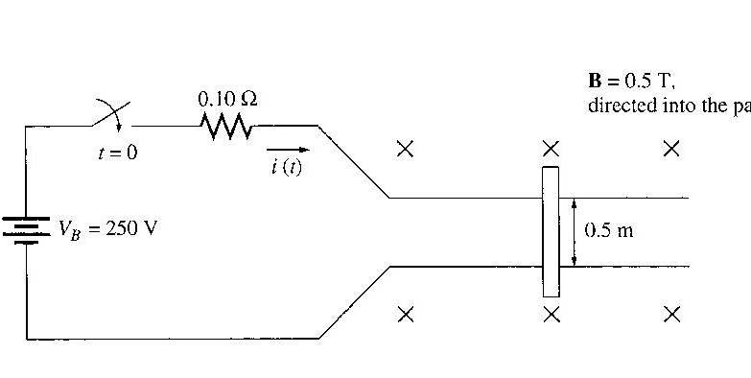
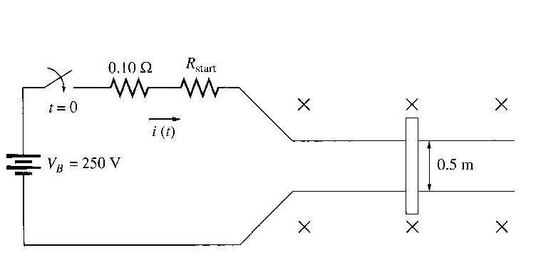
Introduction to Machinery Principles
Starting problems with the Linear Machine
This machine is supplied by a 250V dc source and internal resistance R is 0.1 ohm.
At starting, the speed of the bar is zero, e_{ind} = 0. The current flow at start is:
This current is very high (10x in excess of the rated current).
How to prevent? → insert an extra resistance into the circuit during starting to limit current flow until e_{ind} builds up enough to limit it, as shown here:
aabdo@birzeit.edu Electrical Machine Fundamentals ENEE 4303

Slide 60
Introduction to Machinery Principles
Solve Example 1-10 in text book
Homework:
1.6, 1.17, 1.21, and 1.22.
aabdo@birzeit.edu Electrical Machine Fundamentals ENEE 4303

