Slide 1

Name: Baha Rabee
Student No. :1202135
Course name :Fundamentals of nursing “Lab”
Subject name :COVID -19
Supervised By : Maram Jaghama

Slide 2
Contents:
Definition of COVID-19
Sings and Symptoms
Causes
Diagnosis
Treatment
Care plan as a nurse
Sources

Slide 3
Coronavirus
Coronavirus disease (COVID-19) is an infectious disease caued by a newly discovered coronavirus.
The novel coronavirus infection (COVID‐19) is a global public health emergency. Since the first case of COVID‐19 pneumonia was reported in Wuhan, Hubei Province, China, in December 2019, the infection has spread rapidly to the rest of China and beyond. As of 1st March 2020, a total of 85 406 confirmed cases of COVID‐19 infection have been reported, together with 39 597 recovered and discharged patients and 2933 deaths.

Slide 4
Most people infected with the COVID-19 virus will experience mild to moderate respiratory illness and recover without requiring special treatment. Older people, and those with underlying medical problems like cardiovascular disease, diabetes, chronic respiratory disease, and cancer are more likely to develop serious illness.
The COVID-19 virus spreads primarily through droplets of saliva or discharge from the nose when an infected person coughs or sneezes.

Slide 5
It spreads the same way other coronaviruses do, mainly through person-to-person contact. Infections range from mild to deadly.
It’s normal for a virus to change, or mutate, as it infects people. A Chinese study of 103 COVID-19 cases suggests the virus that causes it has done just that. They found two strains, which they named L and S. The S type is older, but the L type was more common in early stages of the outbreak. They think one may cause more cases of the disease than the other, but they’re still working on what it all means.

Slide 6
We also know that pregnant women are more susceptible to viral diseases. Over and above the impact of COVID‐19 infection on a pregnant woman, there are concerns relating to the potential effect on fetal and neonatal outcome; therefore, pregnant women constitute a group that requires special attention in relation to prevention, diagnosis and management. In this Opinion, we review the clinical manifestation, neonatal outcome and risk of vertical transmission of COVID‐19 infection during pregnancy.

Slide 7
Symptoms of COVID-19
The main symptoms include:
Fever
Coughing
Shortness of breath
Trouble breathing
Fatigue
Chills, sometimes with shaking

Slide 8
Body aches
Headache
Sore throat
Congestion/runny nose
Loss of smell or taste
Nausea
Diarrhea
The virus can lead to pneumonia, respiratory failure, heart problems, liver problems, and death. Many COVID-19 complications may be caused by a condition known as cytokine release syndrome or a cytokine storm. This is when an infection triggers your immune system to flood your bloodstream with inflammatory proteins called cytokines. They can kill tissue and damage your organs.

Slide 9
If you’re infected, symptoms can show up in as few as 2 days or as many as 14. It varies from person to person.
Some people who are hospitalized for COVID-19 have also have dangerous blood clots, including in their legs, lungs, and arteries

Slide 10
Distinguish between Corona virus, the bad cold, and others
Symptoms of COVID-19 can be similar to a bad cold or the flu. Your doctor will suspect COVID-19 if:
You have a fever and a cough.
You have been exposed to people who have it within the last 14 days.

Slide 11
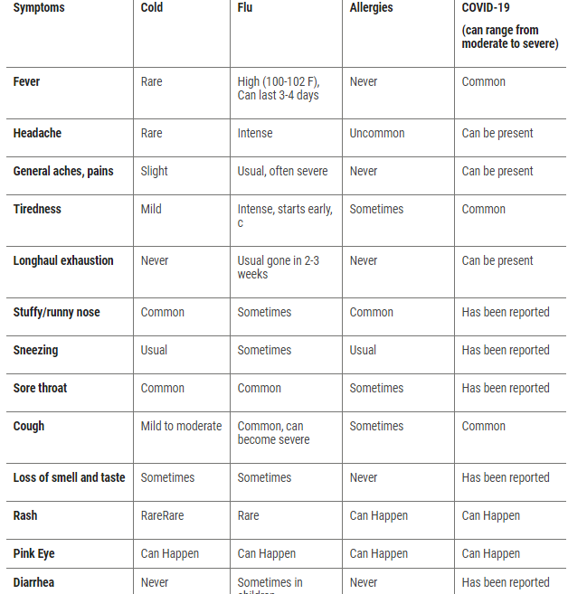

Slide 12
Coronavirus Treatment
There’s no specific treatment for COVID-19. People who get a mild case need care to ease their symptoms, like rest, fluids, and fever control. Take over-the-counter medicine for a sore throat, body aches, and fever. But don't give aspirin to children or teens younger than 19.
You might have heard that you shouldn't take ibuprofen to treat COVID-19 symptoms. But the National Institutes of Health says people who have the virus can use nonsteroidal anti-inflammatory drugs (NSAIDs) or acetaminophen as usual.
People with severe symptoms need to be cared for in the hospital.

Slide 13
Many clinical trials are under way to explore treatments used for other conditions that could fight COVID-19 and to develop new ones.
For instance, trials are under way for tocilizumab, another medication used to treat autoimmune conditions. And the FDA is also allowing clinical trials and hospital use of blood plasma from people who’ve had COVID-19 and recovered to help others build immunity. You’ll hear this called convalescent plasma. Currently, evidence of its effectiveness is limited.

Slide 14
Coronavirus Vaccine
On Dec. 11, 2020, the FDA granted an emergency use authorization (EUA) in the U.S. for the Pfizer-BioNTech COVID-19 vaccine for people 16 years of age and older. Within a week, that agency also granted an EUA to a vaccine developed by Moderna.
The British government approved and began to give the Pfizer vaccine on Dec. 8, 2020. Vaccines developed in China and Russia are now also being given in several other countries.
These vaccines were developed at an unprecedented speed, with testing in humans starting in March 2020. The FDA says that no corners were cut to allow for approval and that these vaccines are safe to take.Two people in the U.K. who received the Pfizer vaccine had severe allergic reactions. For that reason, people with a history of severe allergies are advised not to get the Pfizer vaccine now.

Slide 15
Example of care plan
This patient is exposed to suffocation and insufficient oxygen supply in the blood, thus he will be at risk of stroke due to insufficient oxygen to the brain.
INTERVENTIONS | RATIONALES
placing the patient on a ventilator. | When a ventilator is placed for the patient, breathing returns to normal, the oxygen level in the blood returns to normal, and oxygen reaches all members of the body.

Slide 16
Risk for infection related to a sudden increase in his body temperature (The high temperature of the patient’s body leads to his loss).
INTERVENTIONS | RATIONALES
Getting rid of excess clothing and blankets, encouraging the intake of fluids and giving fever-reducing medications. | Giving the patient a fever reducer, it cools the body and reduces the infection, so the temperature returns to its normal range.

Slide 17
Risk for a high level of adrenaline in the blood, which increases the heart rate related to a great anxiety and fear of the disease.
INTERVENTIONS | RATIONALES
Recalling touch and whispering of the ear, reminding the patient that he is not alone and encouraging him. | Then the patient feels relaxed, and adrenaline will return to normal.

Slide 18


Slide 19
Sources
Webmd :
https://www.webmd.com/lung/coronavirus?fbclid=IwAR2_YlLKeRttJuTWhCtQFGbpisaguqU1u8WIKYb5upAoF3-v0keTX4Rc06I
Nurseslab:
https://nurseslabs.com/?fbclid=IwAR2YGA3-uXm3lftlM1Wyu3jccbNGTDoK_8_EkQG1re53BfDzev
FCjucf-1E
https://www.who.int/health-topics/coronavirus#tab=tab_1

