Slide 1
Respiratory Function

Slide 2
Lung Functions
Gas exchange
Moves O₂ into blood
Removes CO₂ from blood
Barrier immunity
Regulates vasoconstricting substances
Bradykinin
Angiotensin II
Heparin

Slide 3
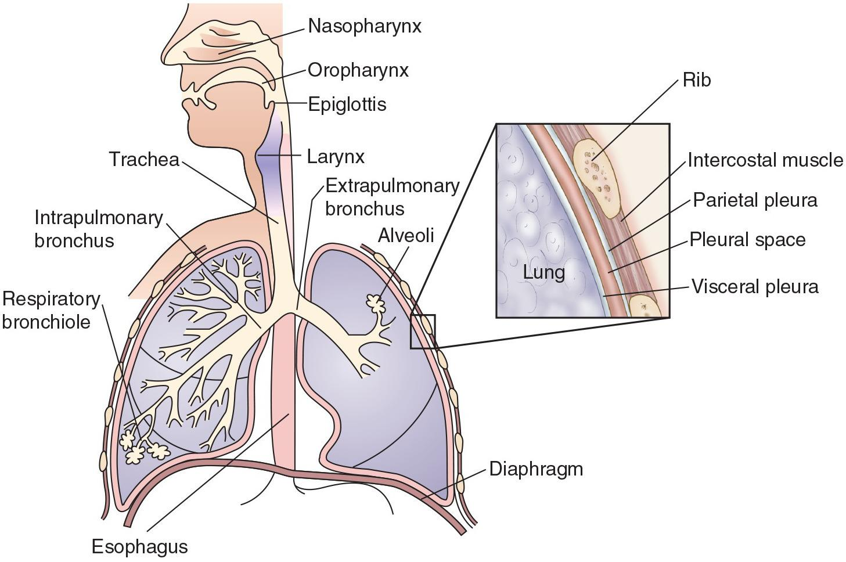
Respiratory System Structures

Slide 4
Conducting Airways
Move air into the lungs
Warm and humidify air
Trap inhaled particles

Slide 5
Respiratory Airways
Bronchioles
Alveoli
Gas is exchanged with the blood.

Slide 6
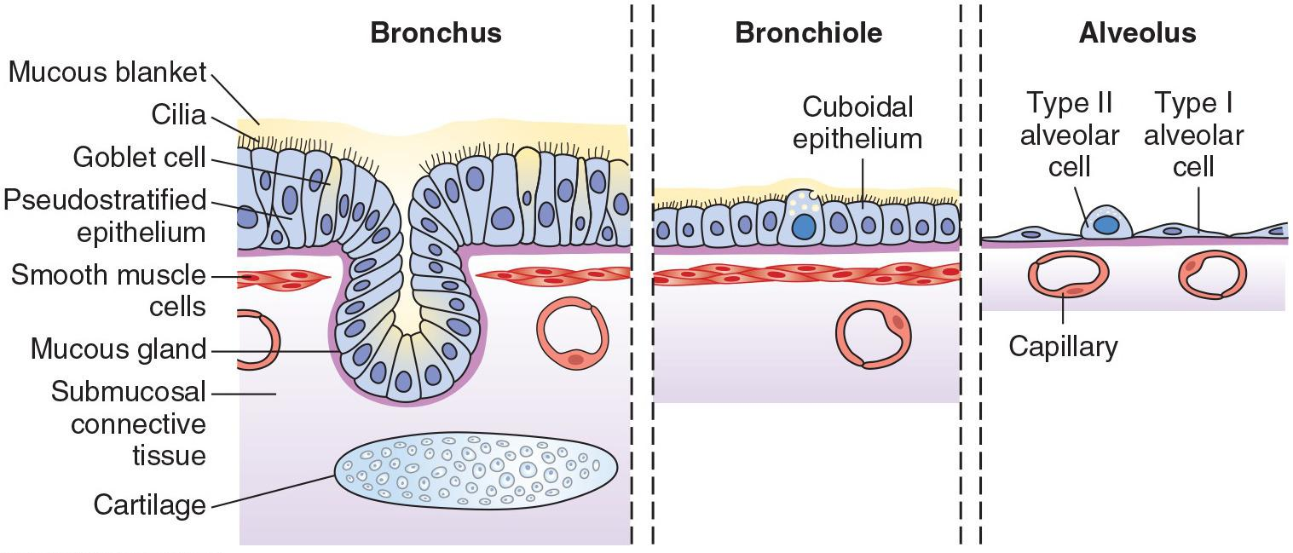
Structure of Airway Walls

Slide 7
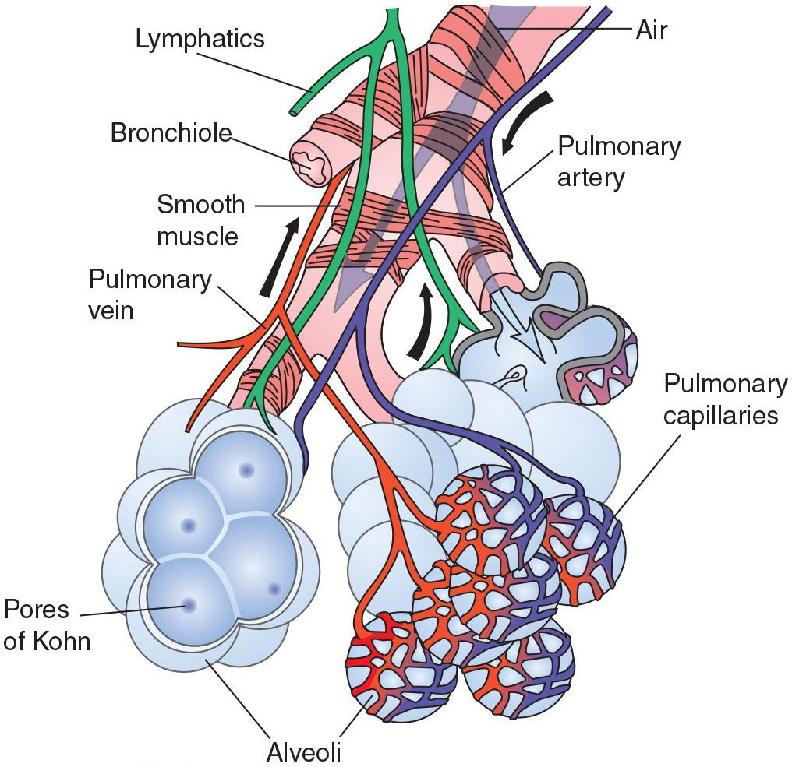
Respiratory Airways (cont.)

Slide 8
Question
Which serous membrane lines the thoracic cavity?
Viscera pleura
Parietal pleura
Visceral mediastinum
Parietal mediastinum

Slide 9
Answer
B. Parietal pleura
Rationale: The organs and walls of the thoracic and abdominal cavities are covered with serous membranes. Visceral membranes cover the organ; parietal membranes line the cavity walls. The two membranes and the space between them allow for ease of movement.
The thoracic cavity is lined by parietal pleura; the lungs are covered by visceral pleura.

Slide 10
Introduction
The primary function of the respiratory system is gas exchange, with oxygen from the air being transferred to the blood and carbon dioxide from the blood being eliminated into the atmosphere.

Slide 11
Introduction
Functionally, the respiratory system can be divided into two parts: the conducting airways (nasopharynx, oropharynx, larynx, trachea, and bronchi and bronchioles), through which air moves as it passes between the atmosphere and the lungs, and the respiratory airways of the lungs (terminal bronchioles and alveoli), where gas exchange takes place.

Slide 12
Introduction
There are two types of alveolar cells: type I and type II.
Type I alveolar cells provide the surface area for the gas exchange function of the lung.
Type II alveolar cells secrete surface -active surfactants that serve to decrease alveolar surface tension and mediate the immune destruction of pathogens that have entered the lung.

Slide 13
Introduction
The lungs are provided with a dual blood supply:
the pulmonary circulation, which provides for the gas exchange function of the lungs; and
the bronchial circulation, which supplies blood to the conducting airways and supporting structures of the lung.

Slide 14
Breathing Innervation
Innervation of the lungs occurs by way of the sympathetic and parasympathetic divisions of the autonomic nervous system.
Parasympathetic innervation produces airway constriction and an increase in respiratory secretions; whereas sympathetic innervation produces bronchodilation and a decrease in respiratory tract secretions.

Slide 15
Breathing
Breathing involves the movement of atmospheric air into and out of the alveolar structures in the lungs.
It requires a system of open airways and alternating pressure changes resulting from the action of the respiratory muscles in changing the volume of the chest cage.

Slide 16
Lung Compliance
Lung compliance or ease with which the lungs can be inflated reflects the elastic forces of the lung tissue and the surface tension in the alveoli.
Surfactant molecules, produced by type II alveolar cells, reduce the surface tension in the lungs, thereby increasing lung compliance and ease of inflation.

Slide 17
Compliance
How easily lungs can be inflated depends on:
Elastin and collagen fibers
Water content
Surface tension

Slide 18
Scenario
A man’s lungs were damaged during a fire, and he developed severe respiratory distress.
The doctor said smoke inhalation had caused an inflammation of his alveoli and destroyed some of his surfactant.
Questions:
What happened to his lung compliance?
Why was he given positive-pressure ventilation?

Slide 19
Airway Resistance
Airway resistance refers to the impediment to flow that the air encounters as it moves through the airways. It varies with airway radius and lung volume, being greatest in the bronchi with medium-sized radii and lowest in the bronchioles with their smaller radii.
Airway resistance decreases as the lungs expand and pull the airways open during inspiration and it increases as the lungs deflate during expiration.

Slide 20
Lung Volumes
Lung volumes reflect the amount of air that is exchanged during normal and forced breathing.
The minute volume (tidal volume [TV] multiplied by the respiratory rate) is determined by the metabolic needs of the body.
MV is normally between 5-8 L/min.

Slide 21
Lung Volumes
The efficiency of breathing is determined by matching the TV and respiratory rate in a manner that provides an optimal minute volume while minimizing the work of breathing.
Persons with stiff and noncompliant lungs usually find it easier to keep their TV low and breathe at a more rapid rate, whereas those with increased airway resistance usually find it less difficult to inflate their lungs and increase their TV, while breathing at a slower rate.

Slide 22
Lung Volumes
Tidal volume (TV)
Inspiratory reserve volume (IRV)
Expiratory reserve volume (ERV)
Residual volume (RV)

Slide 23
Lung Capacities
Vital capacity
Inspiratory capacity
Functional residual capacity
Total lung capacity

Slide 24
Dynamic Lung Function
Maximum voluntary ventilation
Forced vital capacity (FVC)
Forced expiratory volume (FEV)
FEV_{1.0}
Minute volume

Slide 25
Ventilation and Perfusion
The primary function of the lungs, which is gas exchange, requires matching of ventilation and perfusion so that equal amounts of air and blood enter the respiratory portion of the lungs.

Slide 26
Ventilation and Perfusion
Scenario:
An inhaled peanut blocks a left primary bronchus.
Questions:
How will the composition of the air in the two lungs differ?
Which lung should receive more blood?

Slide 27
Dead Space
Dead air space refers to areas of the lungs that are ventilated but not perfused.
The anatomic dead air space represents the volume of air that moves through the conducting airways, but does not participate in air exchange.
The physiologic dead space is the total volume of dead air space, including the anatomic dead space and dead space associated with ventilated but unperfused alveoli.

Slide 28
Shunt
Shunt refers to blood that moves from the left to the right side of the circulation without being oxygenated.
In an anatomic shunt, blood moves directly from the venous to the arterial side of the circulation without moving through the lungs.
In a physiologic shunt, there is an absence of ventilation in a perfused portion of the lung.

Slide 29
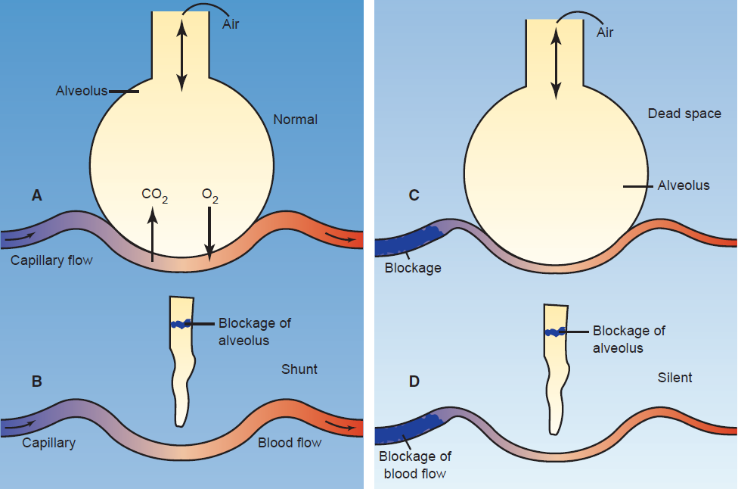
V/Q Mismatch

Slide 30
Gas Diffusion
Diffusion or movement of gases across the alveolar–capillary membranes of the lung is influenced by the:
(1) difference in the partial pressures of the gas on either side of the membrane;
(2) surface area available for diffusion;
(3) diffusion characteristics of the gas; and
(4) thickness of the alveolar-capillary membrane.

Slide 31
Gas Diffusion
Although the lungs are responsible for the exchange of gases with the environment, it is the blood that transports oxygen from the lungs to the tissues and returns carbon dioxide to the lungs.
Most of the oxygen (97% to 99%) in the blood is carried in chemical combination with hemoglobin in red blood cells, with the remaining 1% to 3% being carried in the plasma as a dissolved gas.

Slide 32
Oxygen Dissociation Curve
The oxygen dissociation curve is S shaped with a plateau area, above which an increase in dissolved oxygen (PO2) has minimal or no effect on hemoglobin saturation.
This insures adequate hemoglobin saturation over a wide range of dissolved oxygen values.

Slide 33
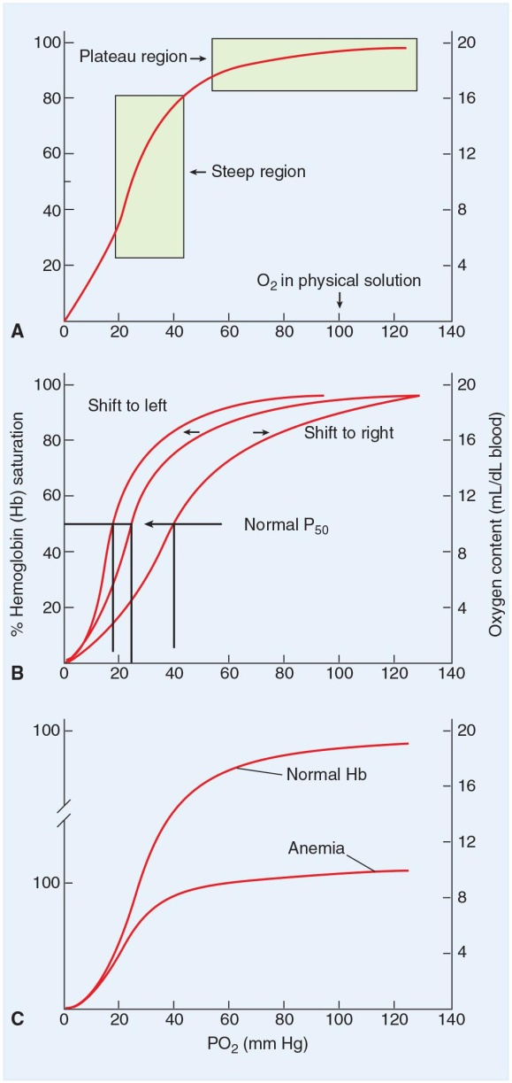
Oxygen Capacity (cont.)

Slide 34
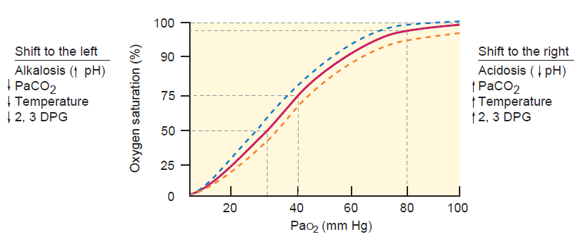
Oxyhemoglobin Dissociation Curve

Slide 35
Oxygen Content
The oxygen content or amount of oxygen that is carried in the blood is equal to amount of oxygen that is carried bound to hemoglobin plus the dissolved form.
Since each gram of hemoglobin carries approximately 1.34 mL oxygen, it is the hemoglobin content of the blood rather than the hemoglobin saturation that determines the amount of oxygen that the blood can carry.

Slide 36
CO2
Carbon dioxide is transported in the blood:
(1) as the dissolved gas (10%),
(2) attached to hemoglobin (30%), and
(3) as bicarbonate (60%).
The reversible action of carbon dioxide with water to form bicarbonate is catalyzed by the enzyme carbonic anhydrase within red cells and is the major pathway for generation of bicarbonate.

Slide 37
Question
True or false?
The relationship between PCO₂ and pH is direct.

Slide 38
Answer
False
Rationale: The relationship is indirect. As PCO₂ levels rise, the amount of carbonic acid in the blood increases, making the pH more acidic (decreasing it).

Slide 39
Breathing
Pulmonary ventilation or the act of breathing involves movement of the diaphragm, intercostal muscles, and other respiratory muscles.
These muscles are controlled by neurons of respiratory centers in the pons and medulla with input from higher brain centers and peripheral receptors.

Slide 40
Control of Breathing
Control of breathing has both automatic and voluntary components .
The automatic regulation of ventilation is controlled by two types of receptors: chemoreceptors, which monitor blood levels of carbon dioxide, oxygen, and pH; and lung receptors, which monitor the status of breathing in terms of airway resistance and lung expansion.
Voluntary respiratory control is needed for integrating breathing and actions such as speaking, blowing, and singing. These acts, which are initiated by the motor and premotor cortex, cause temporary suspension of automatic breathing.

Slide 41
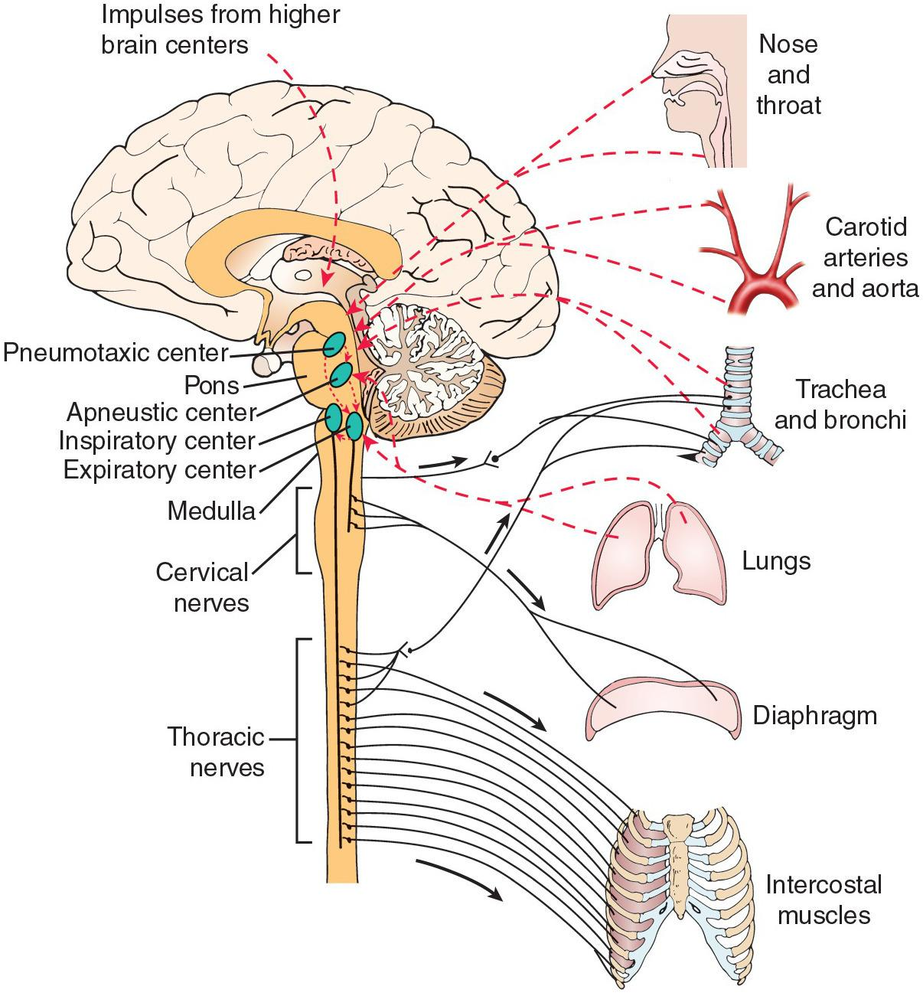
Respiratory Center Control

Slide 42
Chemoreceptors can adjust respiration rate
Central chemoreceptors
Measure PCO₂ and pH in cerebrospinal fluid
Increase respiration when PCO₂ increases or pH decreases
Peripheral chemoreceptors
Measure PO₂ in arterial blood
Increase respiration when PO₂ less than 60 mm Hg

Slide 43
Scenario
You are caring for a COPD client.
He has chronically high PCO₂.
He is being given low-flow oxygen and complains all the time that he “needs more air,” so you turn up his oxygen.
Question:
When you check on him later, he is unconscious and not breathing. What happened?

Slide 44
Cough
The cough reflex protects the lungs from the accumulation of secretions and from the entry of irritating and destructive substances; it is one of the primary defense mechanisms of the respiratory tract.

Slide 45
Dyspnea
Dyspnea is a subjective sensation of difficulty in breathing that is seen in cardiac, pulmonary, and neuromuscular disorders.
It can present as air hunger brought about by inadequate ventilation, labored or difficulty breathing due to weakened respiratory muscles, or chest tightness that occurs with bronchoconstriction.

