Slide 1
Where to find Ideas

Slide 2
Agenda
Play games
Brainstorming Techniques
  Game fest
  Mind Mapping
  Affinity Diagram
Paper prototyping
Shazam session
Sharing output
  Traditional design document
  One page design document

Slide 3
Play games
The best way to start is to play games. However you can’t play these games for fun, you need to play them as a homework.
You should gain insight into what the game developers are doing and how they are holding your attention, directing you from one place to another, and providing you with the information you need to be successful.
You should play different types of games (Recall game types)

Slide 4
Questions to be answered while playing
What is the main goal of this game?
What type of tutorial or instructions did I receive prior to playing the game?
What type of feedback am I receiving during this game?
What activities am I doing in the game that are of value?
What rewards do I receive for accomplishing the tasks of the game?
What rewards are expected? What are unexpected?
How many levels are in the game
What is the game teaching me?
Are there both single player and multiplayer modes? Are they the same or different?

Slide 5
Brain storming
A cross functional team is the best to have different idea regardless the technique that is used.
  Subject Matter expert
  Instructional designer
  Developer
  Artists
  Many others
You should keep the following in mind when brain storming about an interactive learning experience.
  The business and learning goals should be written down so everyone can continually refer to them .
  Interactivity is the key for ILE.

Slide 6
Brain Storming - continue
  Balance “ fun” with learning outcome
  Choose your technique to begin brainstorming.

Slide 7
Game fest
An efficient way to generate a lot of ideas
Each player has fifteen to twenty minutes to play a game in which he/she is randomly assigned.
After this each player should write down a major idea to include in ILE.
Then the players will switch games and play a new game for fifteen to twenty again and write down a new major idea again.
If major ideas are already taken, the players then can write refinements or smaller ideas on a sticky notes and add them besides the major ideas.
This method is effective if the individuals working on the ILE are not overly familiar with games.

Slide 8
Mind Mapping
To display thoughts visually for examination and to create connections among items.
You can place the learning outcome in the middle and diagram actions, activities or tasks that are required to help a person to learn the intended outcome.
Consider using different colors to represent different information and connection.
The goal is to bring together ideas for the ILE in one visual image and then to drill down into the areas map that make sense for the development of game, gamification or simulation.

Slide 9
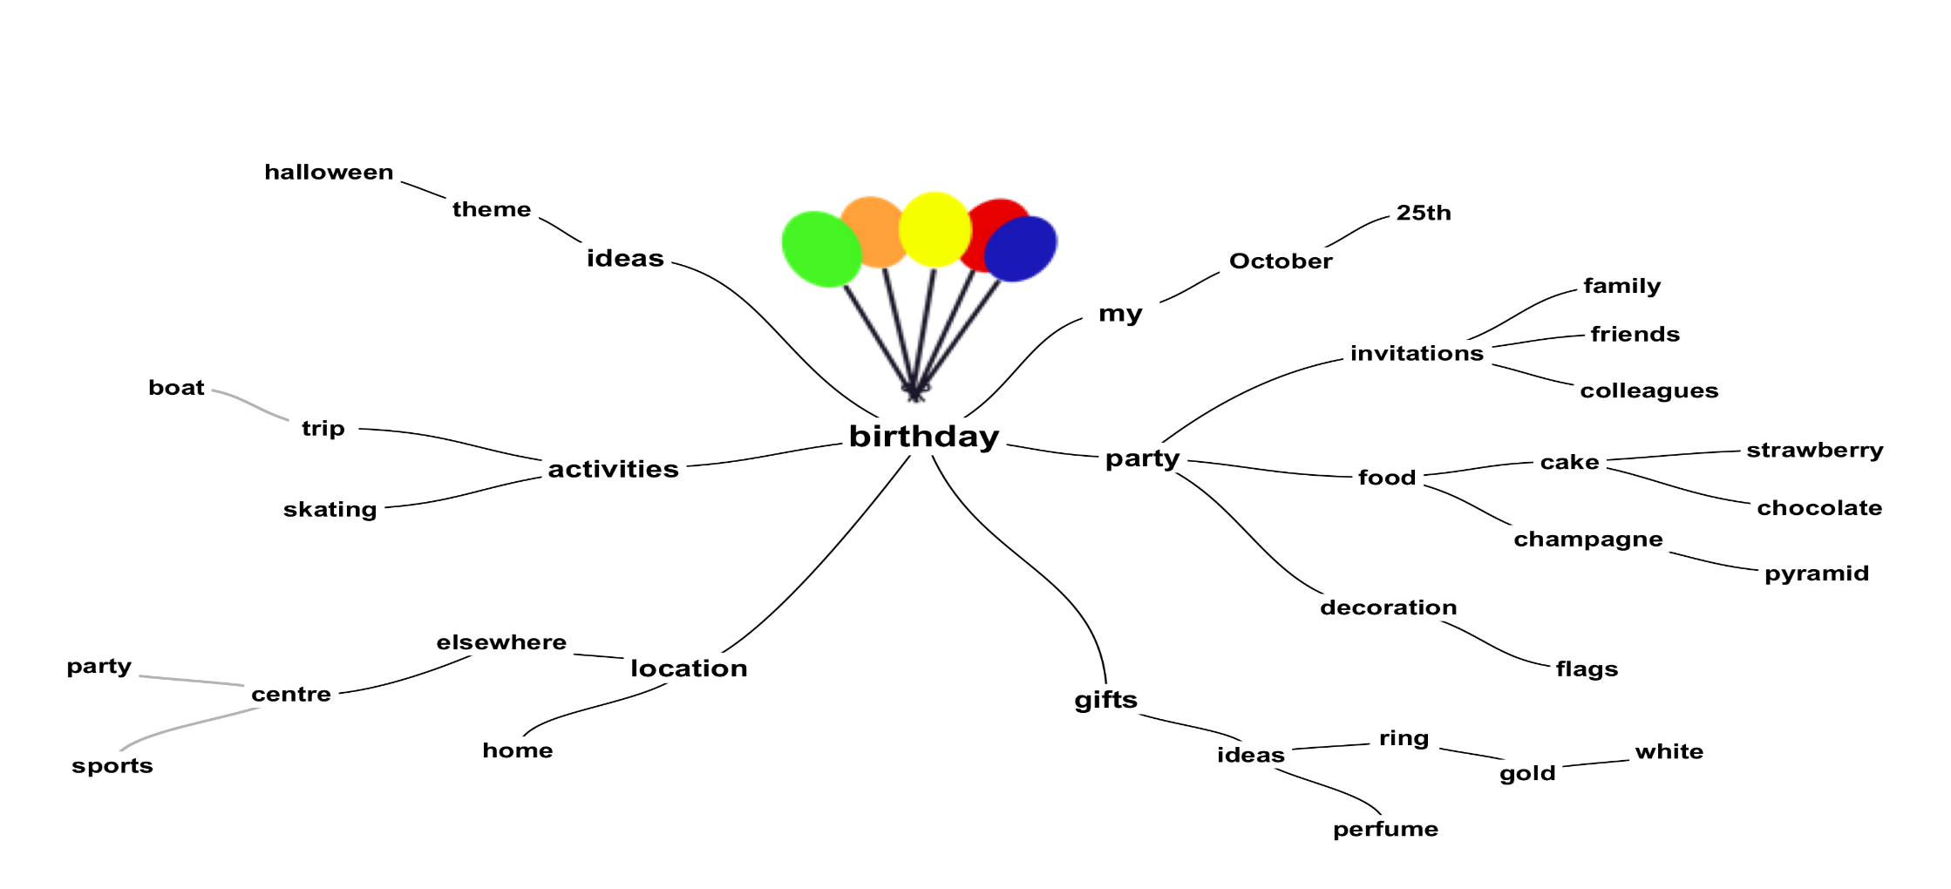
Mind Mapping

Slide 10
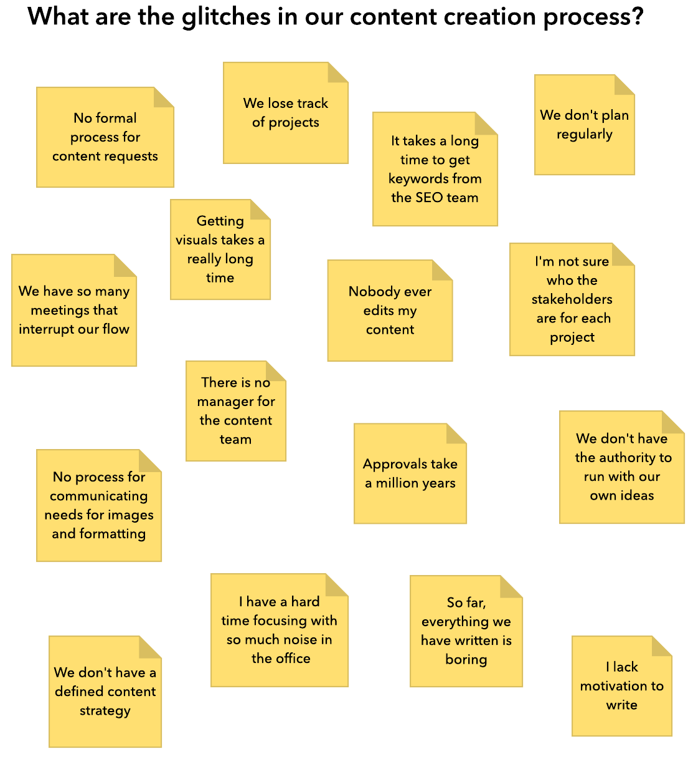
Affinity Diagram
The team members generate ideas, write them on sticky notes and finally place them on a white board or other surface.
Look carefully at the ideas that receive a large number of notes and have strong relationship.

Slide 11
Paper prototyping
To avoid miscues in early stage a paper prototype is created.
It is so flexible and there is no expectation of permanence and focusing should be done on interactions and activities not the aesthetics.
This paper should works as follows:
  Write up a player interaction with ILE.(player walkthrough)
  Write the rules.
  spend extra times documenting the scoring and points process.
  Design a paper environment that mimic the environment(s) for the ILE.
  You can create also a paper characters or none player characters.
  Play the game and observe what happening and deal with problems once with the designer team and another from external team.

Slide 12
Play testing
Here’s what to assess as you prototype and play test:
  is the game achieving the learning objective defined for it?
  Is the game “fun”?
  Is the game balanced in terms of difficulty?
  Are the rules clear?
  Are the rules logical and well aligned with the learning objective?
  Is the game goal clear to players?
  Are the game aesthetics compelling and engaging?
  Who should my player tester be?

Slide 13
Shazam session
Acronym containing the initials of the first letters of the names of six ancient heroes.
Over a week long period for the purpose of rapidly designing, prototyping and playtesting for ILE. This process will occur (Reading activity in the class).
  Preparation
  Day One
  Day Two
  Day Three
  Day Four
  Day Five

Slide 14
Sharing output
There is a high demand to articulate the design, goals and outcomes to an audience outside the project team.
This is done by two types of design documents

Slide 15
Traditional Document
Overview of concept
Outcome
Instructional objective
Description of characters
Environment
Description of game play
Reward Structure
Look and feel of game
Technical description
Timeline

Slide 16
One page document
People are not tending to read long design document which written by the design team and never looked again.
Easier to comprehend and more simple.
Can be viewed quickly by the outsiders who don’t need to take a depth view of all formal information regard the game.

