Slide 1
Lipids part 2

Slide 2
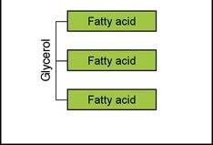
Fat digestion
Triacylglycerols must be hydrolyzed to fatty acids and monoacylglycerols before they can be absorbed
lipids are hydrophobic but digestive enzymes are hydrophilic
Fat digestion starts off slowly in the mouth

Slide 3
Mouth
Enzyme (lingual lipase) released by salivary glands at the base of the tongue
Important for infants: Lingual lipase efficiently digests the short- and medium-chain fatty acids found in milk
In adults: plays a minor role

Slide 4
stomach
Gastric lipase
Strong muscle contractions of the stomach propel its contents toward the pyloric sphincter
the stomach grinds swallowed food to smaller pieces and mixes the chyme
Disperses the fat into small droplets
Expose the fat for attack by the gastric lipase enzyme
Gastric lipase enzyme activated by the acidic environment of the stomach
Overall, little fat digestion takes place in the stomach
Chyme ( a mass of partially digested food and digestive secretions that is formed in the stomach and intestine during digestion)

Slide 5
Intestine/ Duodenum
Fat enters the small intestine
The hormone cholecystokinin (CCK) is released
CCK sends a signal to the gallbladder to release bile
Bile: Produced in the Liver and is stored in the gallbladder
Contains bile salts, phospholipids and sterols and is secreted into the duodenum.
Bile acids are made up of cholesterol and pairs with amino acids
Bile acids have a hydrophilic and a hydrophobic component
Bile acts as an emulsifier

Slide 6
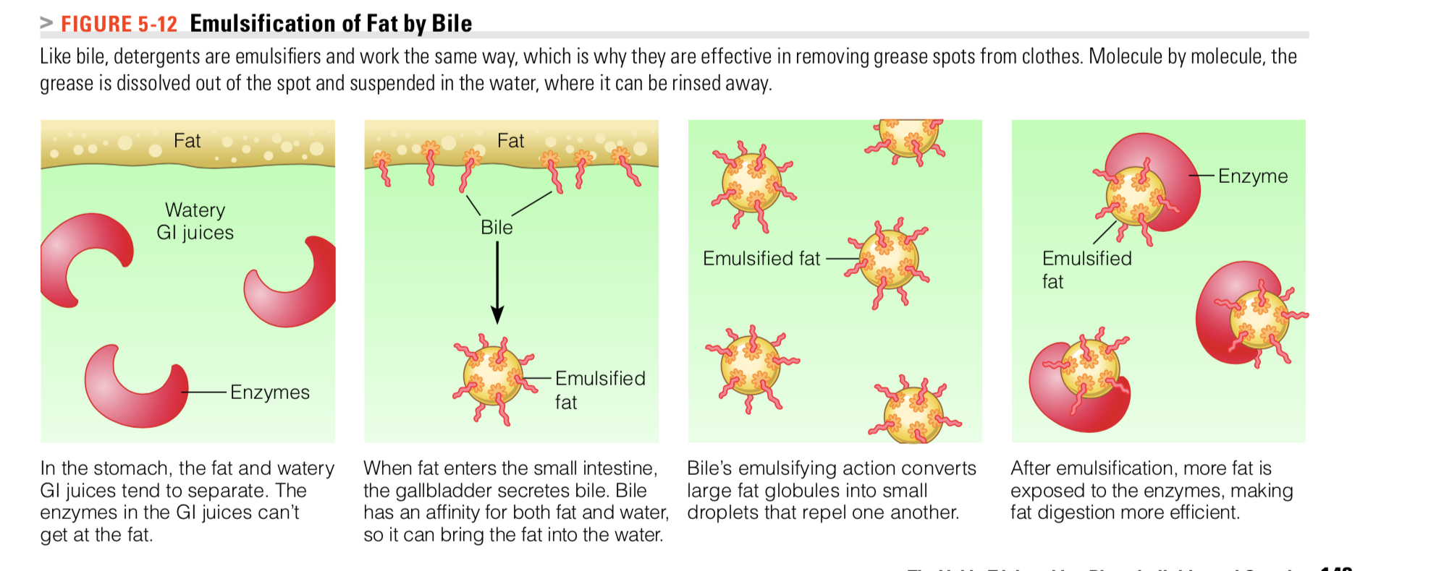
Lipid-bile salt complexes called micelles are formed

Slide 7
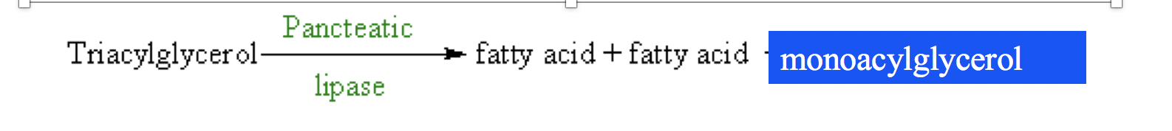
INTESTINE
Bile salt micelles break up fat droplets
Fat breaking enzyme: Mostly pancreatic lipase and some intestinal lipase
Pancreatic lipase : splits off one fatty acid at a time from the triglyceride molecule, working from the outside in until two free fatty acids and a monoglyceride remain
The end products of digestion—mostly monoglycerides with free fatty acids and little glycerol—are absorbed into intestinal cells.

Slide 8
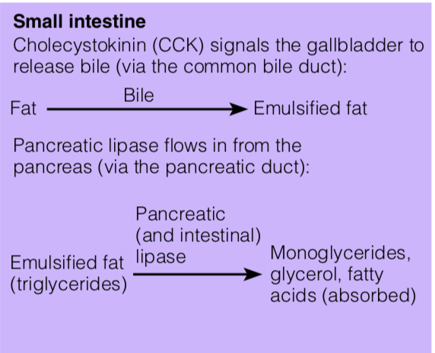
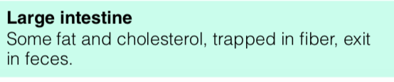
Intestine
The digestion of phospholipids is similar with the end products being two free fatty acids and a phospholipid fragment.
Cholesterol does not undergo digestion; it is absorbed as is.

Slide 9
Absorption
Small molecules (glycerol and short- and medium-chain fatty acids) can diffuse easily into the intestinal cells and are absorbed directly into the bloodstream
monoglycerides, fatty acids, cholesterol, lysophospholipids, and other dietary lipids diffuse from the mixed micelles into the enterocytes of the small intestine
Once inside the intestinal cells, the monoglycerides and long-chain fatty acids combine to reform triglycerides

Slide 10
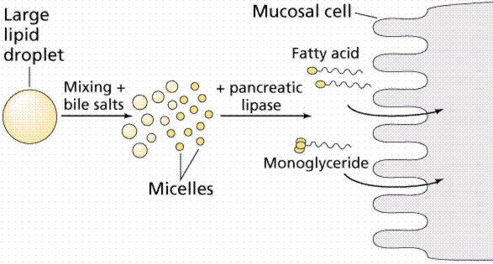
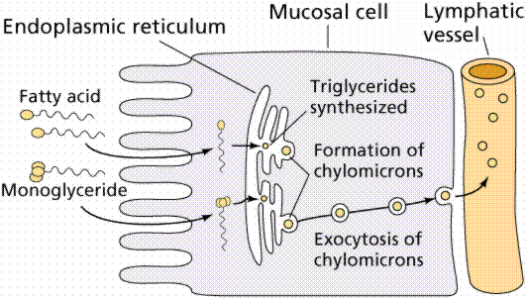
Lipid absorption
Lumen of small intestine
Purves et al., Life: The Science of Biology, 4th Edition by Sinauer Associates and WH Freeman

Slide 11
Absorption
The reformed triglycerides, along with phospholipids and cholesterol are packed in protein to form chylomicrons
The intestinal cells then release the chylomicrons into the lymphatic system
The chylomicron travel in the lymphatic system and enter the bloodstream
The blood carries these lipids to the rest of the body for use or storage

Slide 12
Lipid Transport
Free fatty acids make up only about 2% of total plasma lipid and are transported in the blood
The remaining 98% of lipids circulate in the body , in plasma and blood HOW?
given that blood and most of the body is an aqueous environment and lipids are hydrophobic molecules ?
The remainder of lipid in the plasma is carried as lipoprotein complexes (lipid + protein = lipoprotein)

Slide 13
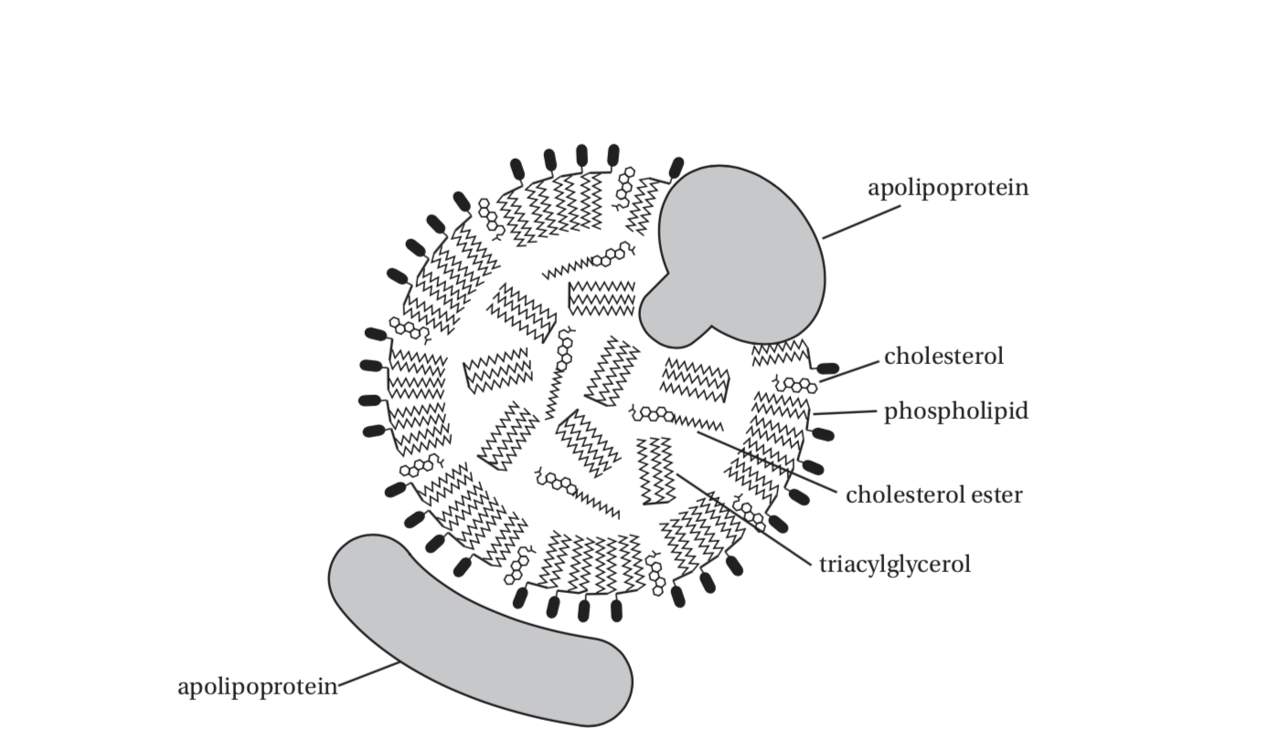
Lipid transport- lipoproteins
They consist of a core of neutral lipid (triacylglycerol and cholesterol esters) surrounded by a single surface layer of polar lipid (phospholipid and cholesterol)

Slide 14
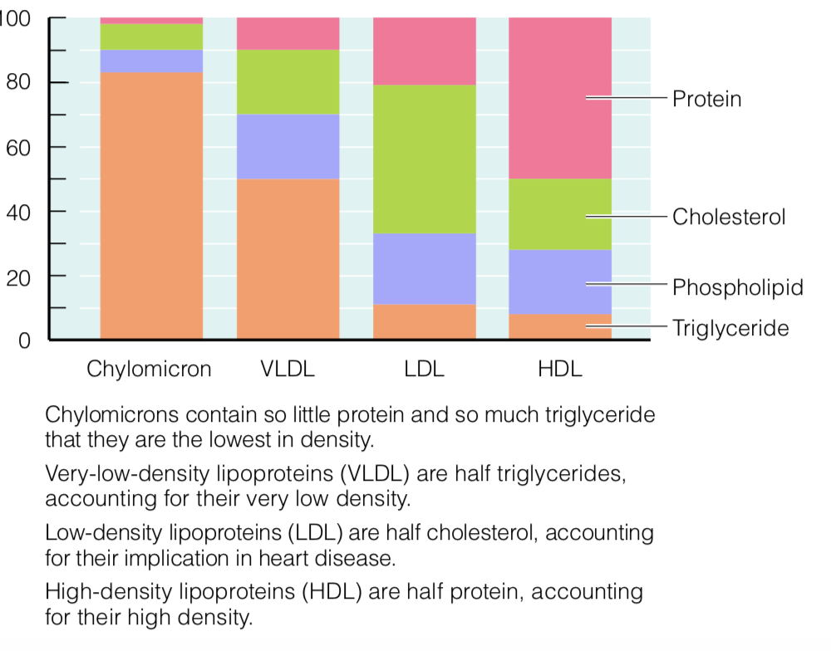
4 classes of lipoprotein
Identified according to their density
Each type contains different kinds and amounts of lipids and proteins
The more lipids, the less dense
The LESS lipids, the more dense because it will have more protein

Slide 15
Lipoproteins
Chylomicrons: vehicles for lipid transport
Intestinal epithelial cells synthesize triglycerides, cholesteryl esters, phospholipids, free cholesterol, and apoproteins, and package them into chylomicrons

Slide 16
Lipoproteins
Chylomicrons
The largest and least dense of the lipoproteins
Function: Transport diet-derived lipids (mostly triglycerides)
From small intestine → rest of body
Cells all over the body remove triglycerides from the chylomicrons as they pass by, so the chylomicrons get smaller and smaller
Chylomicrons are abundant in the blood after eating food but are scarce in fasting blood
The fat soluble vitamins (A, D, E, and K) are delivered to the liver as part of the chylomicron remnant

Slide 17
Lipoproteins
VLDL (Very-Low-Density Lipoproteins)
The liver synthesizes lipids
The lipids made in the liver and those collected from chylomicron remnants are packaged with proteins as a VLDL (very-low-density lipoprotein) and shipped to other parts of the body.
As the VLDL travel through the body, cells remove triglycerides
As VLDL molecules lose triglycerides, the VLDL shrink and the proportion of lipids shifts. Cholesterol becomes the predominant lipid, and the lipoprotein becomes smaller and more dense
The VLDL becomes an LDL (low-density lipoprotein)

Slide 18
Lipoproteins
LDL (Low-Density Lipoproteins)
High cholesterol but few triglycerides
The LDL circulate throughout the body delivering cholesterol to the cells of all tissues—muscles (including the heart muscle), fat stores, the mammary glands, and blood vessels

Slide 19
HDL (High-Density Lipoproteins)
The liver makes HDL (high-density lipoprotein) to remove cholesterol from the cells and carry it back to the liver for recycling or disposal
By efficiently clearing cholesterol, HDL lowers the risk of heart disease

Slide 20
Lipoproteins summary
Lipoprotein | Source | Function
Chylomicron | Intestine | Transport dietary TG to tissues
Very Low density lipoprotein (VLDL) | Liver | Transport endogenous TG to tissues
Low-density lipoprotein (LDL) | Plasma VLDL’s | Transport cholesterol to tissues
High density Lipoprotein (HDL) | Liver and intestine | Reverse cholesterol transport

Slide 21
Levels of LDL and total plasma cholesterol are determined by an interaction of genetic factors and dietary characteristics
High intakes of saturated fatty acids are associated with raised LDL-cholesterol
Exact mechanism not 100% clear
BUT High intakes of saturated fatty acids appear to decrease the removal of plasma LDL by LDL-receptors
mono- and polyunsaturated fatty acids are associated with increased LDL receptor activity
When excess LDL molecules remain in circulation, LDL gets oxidized, triggering an immune response leading to fatty streaks build up in artery walls

Slide 22
Plant sterols are very poorly absorbed and interfere with the absorption of cholesterol
Consumption can lower plasma total and LDL-cholesterol concentrations

Slide 23
Fat catabolism
triglycerides that are needed for energy are split into glycerol and fatty acids by lipoprotein lipase and are released into the bloodstream to be picked up by cells.
The catabolism of fatty acids increases when carbohydrate intake is inadequate

Slide 24
Biosynthesis of fatty acids
Most newly absorbed fatty acids recombine with glycerol to form triglycerides that end up stored in adipose tissue
Saturated and monounsaturated fatty acids can be synthesized in the body from carbohydrate and protein in a process called lipogenesis
Insulin stimulates the biosynthesis of fatty acids.
Lipogenesis is reduced during energy restriction or when the diet is high in fat

Slide 25
fat provides more than twice as much energy (9 calories) as carbohydrate or protein (4 calories), making it an extremely efficient storage form of energy
Each pound of body fat provides 3500 calories
The blood lipid profile reveals the concentrations of various lipids in the blood, notably triglycerides and cholesterol, and their lipoprotein carriers (VLDL, LDL, and HDL)

Slide 26
recommendations FOR fat INTAKE
DRI and Dietary Guidelines suggest a diet that provides 20 to 35 percent of the daily energy intake from fat
less than 10 percent of daily energy intake from saturated fat
As little trans fat as possible
For several decades, previous guidelines advised less than 300 milligrams of cholesterol, but the 2015 Dietary Guidelines found no evidence to support this recommendation

Slide 27
Fats in foods
Found in Milk
Meat
Oils
Other “fat free” groups
Fruits : except for olives, avocado, coconut
Vegetables: except for fried, creamed, served with cheese
Grains : except for cereals, waffles ...

Slide 28
Milk
Full-fat
Reduced fat
Fat free
Predominately saturated fats
Full-fat products have more cholesterol than in the lower-fat options.
Selecting fermented milk products, such as yogurt, may also help to lower blood cholesterol. These foods increase the population and activity of bacteria in the colon that use cholesterol.

Slide 29
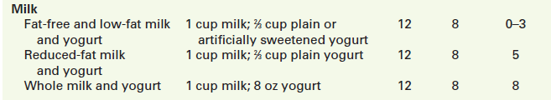

Slide 30
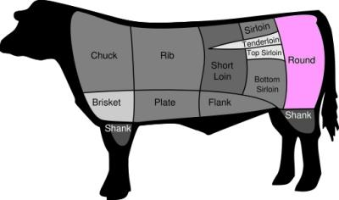

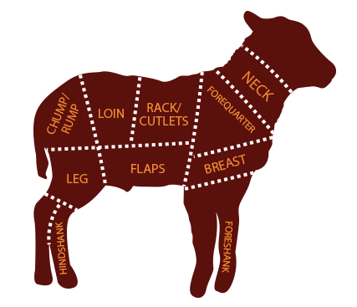
Meats- solid fats
Solid fats deliver an abundance of saturated fatty acids
Fat content varies among different cuts of meat.
The leanest cuts are:
– beef loin and round
– veal and lamb from the loin or leg

Slide 31
Fat trimmed from meat, are easy to see
Others—such as the fat that “marbles” a steak or is hidden in foods such as cheese—are less apparent and can be present in foods in surprisingly high amounts

Slide 32
Shellfish are very low in fat but have considerable cholesterol.
Processed meats, such as sausage and hot dogs, may provide more fat calories than protein calories.

Slide 33
Nuts have many healthy attributes; they contain plant protein, fiber, vitamin E, selenium, magnesium, zinc, phosphorus potassium
Their high fat content of 13 to 20 g/oz comes mostly from monounsaturated fats and polyunsaturated fats

Slide 34
Fats and oils
butter; shortening (as in fried foods and baked goods); and hard margarines
Allowances are small : usually 5 to 7 teaspoons/ day for adults , depending on their total calorie needs.
Include:
– vegetable oils like canola, corn, and olive
– oil-rich foods such as margarine and mayonnaise – avocado and nuts

