Slide 1
Chapter 15: Lipids and Lipoproteins
By Raffick A. R. Bowen, Amar A. Sethi, G. Russell Warnick, Alan T. Remaley

Slide 2
Lipid Chemistry
Roles of Lipids (Fats)
Rich source of energy & efficient way for body to store calories
Integral part of cell membranes and structure
Fatty Acids
Linear chains of carbon-hydrogen bonds terminating in carboxyl group
Triglycerides
3 fatty acid molecules attached to 1 molecule of glycerol by ester bonds

Slide 3
Lipid Chemistry (cont’d)
Phospholipids
Similar to triglycerides, except with only 2 esterified fatty acids
Third position on glycerol backbone contains phospholipid head group.
Types of head groups: choline, inositol, serine, ethanolamine, all of which are hydrophilic in nature
Cholesterol
An unsaturated steroid alcohol containing 4 rings & single side chain tail
Synthesized almost exclusively by animals; not readily catabolized by most cells, not a source of fuel

Slide 4
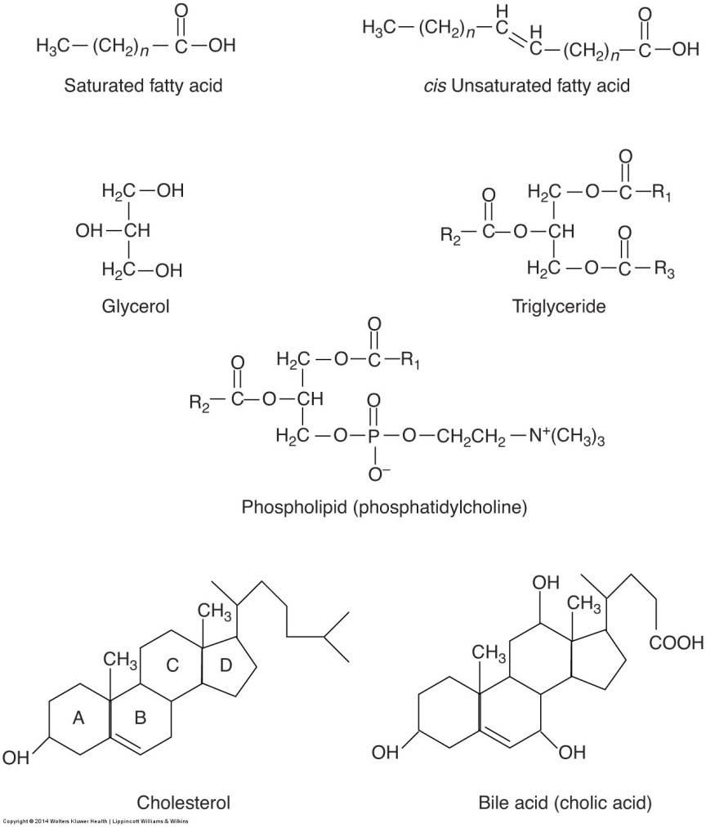
Lipid Chemistry (cont’d)
Chemical structures of lipids

Slide 5
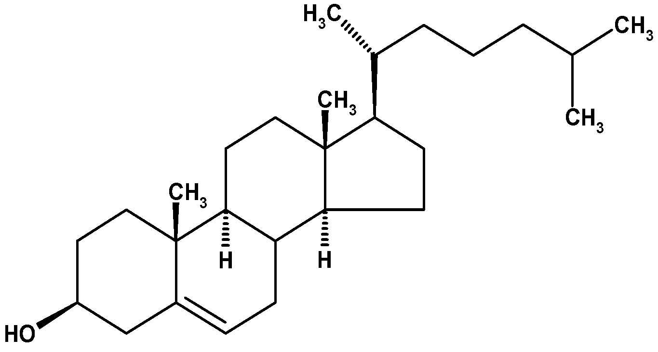
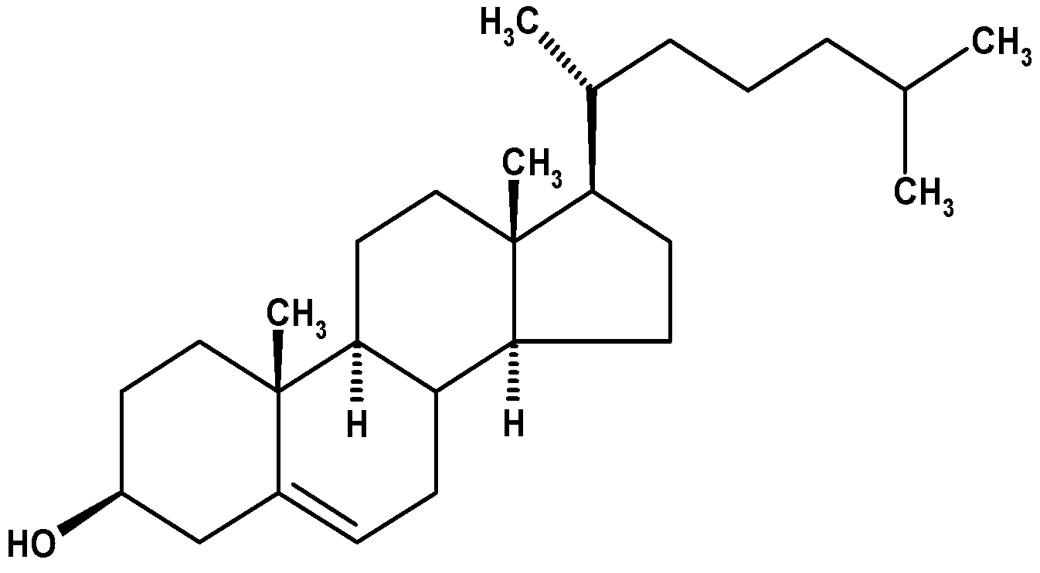
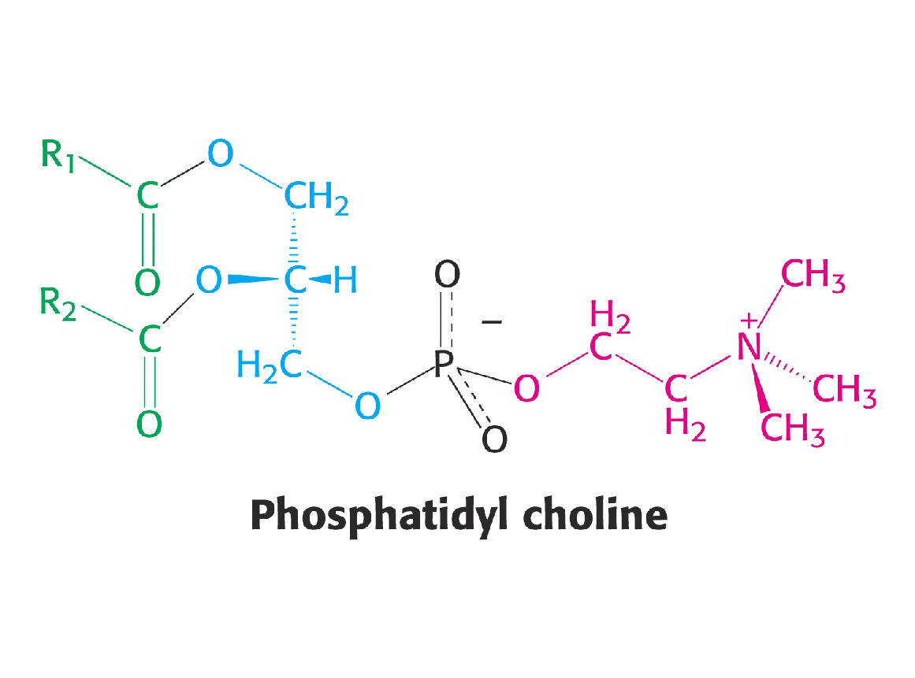
Mark the hydrophobic and hydrophilic parts on these molecules
HO
FA

Slide 6
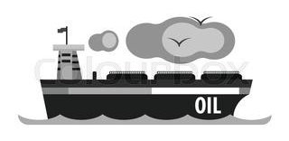
Lipoproteins
Liporproteins are the body’s “petroleum industry”> like oil tankers
Chylomicrons: ferry their cargo dietary TG, throughout the circulatory system and finally docking at the liver
Largest & least dense; diameters as large as 1,200 nm
Produced by intestine; deliver dietary lipids to hepatic & peripheral cells

Slide 7

Lipoproteins
TG
VLDLs: like tanker trucks
Produced by liver; major carriers of endogenous triglycerides
Redistribute dietary & hepatic synthesized TG to peripheral cells for energy needs or storage as fat
LDLs: rich in cholesterol, like nearly empty tankers that just delivered TG to peripheral cells and liver after their main cargo TG have been off-loaded
HDLs: clean up crew, gathering up excess cholesterol for transport back to liver

Slide 8
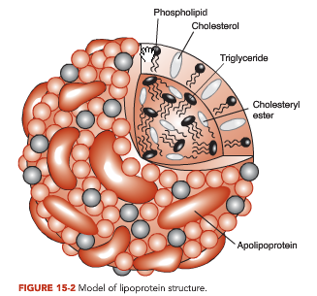
General Lipoprotein Structure
Lipoproteins are spherical in shape, 10-1200 nm
Composed of lipids & apolipoproteins; deliver fuel to peripheral cells
Size correlated with lipid contents
Core of TG and CE
Surface of phospholipids and some cholesterol
Apolipoproteins (regulators of LP metabolism)
Notes:
Cholesteryl ester, a dietary lipid, is an ester of cholesterol. The ester bond is formed between the carboxylate group of a fatty acid and the hydroxyl group of cholesterol. Cholesteryl esters have a lower solubility in water due to their increased hydrophobicity. They are hydrolyzed by pancreatic enzymes, cholesterol esterase, to produce cholesterol and free fatty acids.^{[1]} They are associated withatherosclerosis.^{[2]}

Slide 9
Apolipoproteins
Located on surface of lipoprotein particles
Functions
Maintain structural integrity of lipoproteins
Ligands for interaction with LP receptors that determine disposition of individual particles
Activators & inhibitors of various enzymes involved in LP and plasma lipid metabolism
Amphipathic helix on the surface
hydrophobic part binds to lipids, hydrophilic residues facing the aqueous surface

Slide 10
The 4 classes of lipoproteins (all contain characteristic amounts of TG, Cholesterol, cholesteryl esters, phospholipids and apolipoproteins)
Class | Average Diameter (nm) | Source, function | Major apolipoproteins
CM | 500 | Intestine. transport of dietary TAG | A, B48, C(I,II,III), E
VLDL | 43 | Liver. Transport of endogenously synthesized TAG | B100, C(I,II,III), E
LDL | 22 | Delivers cholesterol to peripheral tissues | B100
HDL | 8 | Liver. Removes used cholesterol from tissues and takes it to liver. | A, C(I,II,III), D, E
Increasing density

Slide 11
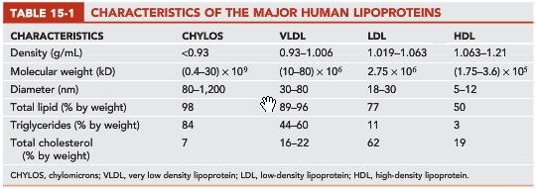

Slide 12
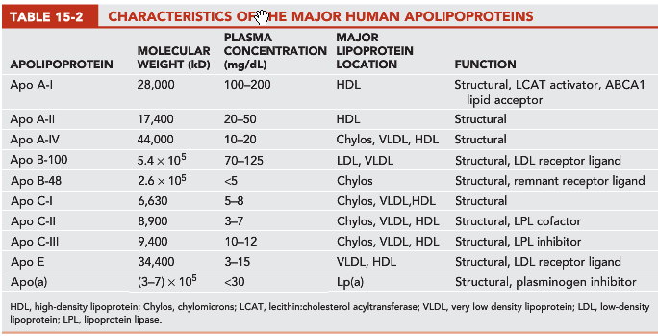

Slide 13
Type Association Function
B48 Chylomicron Carry cholesterol esters
Lacks LDL receptor
binding domain
B100 VLDL, IDL, LDL Binds LDL receptor
C-II Chylo, VLDL, IDL, HDL Activates Lipoprotein lipase (LPL)
C-III Chylo, VLDL, IDL, HDL Inhibits LPL
E Chylo, remnant, VLDL, IDL Binds LDL-receptor related protein (LRP)
HDL
A-1 HDL LCAT activator
(lecithin:cholesterol acyltransferase)

Slide 14
Chylomicrons
Chylos contain apo B-48
Largest and least dense of lipoprotein particles
Diameter up to 1200 nm
Primary function of Chylos: delivery of dietary lipids to hepatic & peripheral cells
Can scatter light, and accounts for the turbidity or milky appearance of postprandial plasma
Chylos are so light, readily float to the top of plasma when stored for hours at 4°C
Produced by intestine & packaged with absorbed lipids & apolipoproteins
In circulation, TG & cholesteryl esters in chylos are rapidly hydrolyzed by lipases, & converted to chylos remnant particles, recognized by liver

Slide 15
Very low density lipoproteins (VLDL)
Produced primarily by liver
Contain apo B-100 (main lipoprotein), apo E and apo Cs
Rich in TG
Major carriers of endogenous TG from liver to peripheral tissues for energy & storage
Light & contribute to turbidity observed in fasting hyperlipidemic plasma, but do not form a creamy top layer
Excess dietary intake of carbohydrate, saturated fatty acids, and trans fatty acids enhances the hepatic synthesis of triglycerides, which in turn increases VLDL production

Slide 16
Intermediate density lipoproteins (IDL)
Also called VLDL remnants
Normally exist transiently during conversion of VLDL to LDL
Not typically present in normal plasma
Efficient conversion of VLDL to IDL 🡪 do not accumulate in the plasma after an overnight fast
TG & cholesterol content is intermediate between those of VLDL and LDL
Type III hyperlipoproteinemia (TIIIHL), a rare inborn error of metabolism, shows elevated levels of IDLs in plasma. Due to abnormal form of apo E that delays clearance of IDL> risk of peripheral vascular disease & coronary artery disease

Slide 17
Low density lipoproteins (LDL)
Primarily contain apo B-100 & is more cholesterol rich than other apo B-containing lipoproteins
Form as a consequence of lipoplysis of VLDL
Because of their small size, they infiltrate into extracellular space of vessel wall & are taken up macrophages > transform into foam cells > fatty streaks, early precursor of atherosclerosis
Can be separated into 8 subclasses
Smaller LDLs are denser and contain more TG than CE. More atherogenic

Slide 18
Lipoprotein (a)
Lp(a) particles are LDL-like particles
Contain apo (a) linked to apo B-100 by a disulfide bond
Heterogeneous in size and density (contain differing number of repeating peptide sequences, called kringles, in the apo (a) portion of the molecule)
Larger than LDL and has a higher lipid content and a slightly lower density
Elevated levels of Lp(a) increases risk of premature CHD and stroke.
Measuring Lp(a) is useful in patients with a strong family history of CHD, particularly in absence of other known risk factors
Question: What is a possible mechanism for the induction of clots by Lp(a) through its kringles domain?

Slide 19
High density lipoproteins (HDL)
Smallest and most dense lipoprotein particle
Synthesized by liver and intestine
Exists as disk shaped (more active in extracting lipids) or spherical (core is filled with lipids)
Reverse cholesterol transport
Antiatherogenic
It is highly heterogeneous and has 13-14 different subfractions
Two major types of spherical HDL
HDL₂ (1.063 to 1.125 g/mL) larger in size, less dense, and richer in lipid and may be more efficient in the delivery of lipids to the liver
HDL₃ (1.125 to 1.21 g/mL)

Slide 20
Lipoprotein X
Abnormal lipoprotein that exists in patients with biliary cirrhosis or cholestasis and in particular mutations in LCAT, the enzyme that esterifies cholesterol
Different from other lipoproteins in the endogenous pathway due to the lack of apo B-100.
Contains phospholipids and non-esterified cholesterol (~90% by weight) and albumin and apo C (<10% by weight)
Mainly removed by the reticuloendothelial system of the liver and the spleen.
Lipoprotein X is typically included in the LDL-C value as calculated by the Friedewald equation:
LDL = TotalChol - (Triglyceride / 5) – HDL (all in mg/dL)
Notes:
The term cholestasis originally derives from the Greek and literally means “a standing still of bile.” This disruption of bile flow can occur on a cellular level in the hepatocyte, at the level of the intrahepatic biliary ductules, or from an extrahepatic mechanical obstruction of the bile ducts. Commonly, bile flow is only partially disrupted, giving rise to anicteric cholestasis, or cholestasis without jaundice. Cholestasis is defined, therefore, both clinically and biochemically, with varying degrees of jaundice, pruritus, and elevated levels of conjugated bilirubin, alkaline phosphatase, γ-glutamyl transpeptidase, 5'-nucleotidase, bile acids, and cholesterol. A conventional categorization of cholestatic liver diseases has divided these factors into intrahepatic and extrahepatic causes (Box 1). This chapter discusses the different types of intrahepatic cholestatic liver disease.

Slide 21
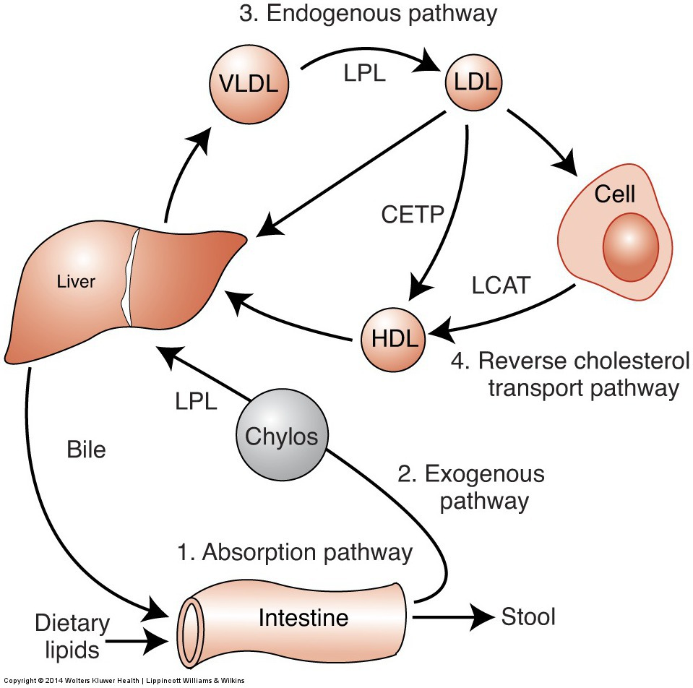
Lipoprotein Physiology and Metabolism
Four Major Pathways Involved in Lipoprotein Metabolism
Net result of these 1-3 pathways is the transport of dietary lipid and cholesterol to peripheral cells
When peripheral cells in the vessel wall accumulate too much cholesterol, this can lead to atherosclerosis
The Reverse cholesterol transport which is mediated via HDL, where excess cholesterol in peripheral cells is transported back to liver, where it is excreted into the bile as free cholesterol and converted to bile acids

Slide 22
Peripheral cells are prone to accumulating cholesterol because:
They also synthesize their own cholesterol
Unlike liver, they do not have enzymatic pathways to catabolize it
Cholesterol is relatively water insoluble and cannot readily diffuse away from its site of deposition or synthesis

Slide 23
There are several genetic defects in the genes that encode for proteins in the forward and reverse cholesterol transport pathways
Most individuals with CAD, do not have a clear, single, genetic defect but instead have multiple genetic variations or gene polymorphisms that most likely interact with various lifestyle habits such as exercise, diet, and smoking, leading to a predisposition for disease

Slide 24
(1) Lipid absorption
Pancreatic lipase cleaves off fatty acids 🡪 converting dietary lipids into more polar compounds with amphipathic properties
Amphipathic lipids form micelles in intestinal lumen
TG 🡪 monoglycerides and diglycerides; cholesteryl esters 🡪 free cholesterol; and phospholipids 🡪 lysophospholipids
Absorption of some of these lipids may occur via a passive transfer process or facilitated by specific transporters (NPC1L-1 transporter for cholesterol)
Short-chain free fatty acids (<10 C), can readily pass directly into the portal circulation and are carried by albumin to the liver
The absorbed long-chain fatty acids, monoglycerides, and diglycerides are esterified in intestinal cells to form triglycerides and cholesteryl esters, & packaged into CMs, along with apo B-48
Triglyceride absorption is efficient; greater than 90% of dietary triglycerides are taken up by the intestine.
In contrast, only about half of the 500 mg of cholesterol in the typical diet is absorbed each day
Notes:
lysophospholipid (plural lysophospholipids)
(organic chemistry) Any derivative of a phospholipid in which one or both acyl derivatives have been removed by hydrolysis

Slide 25
(2) Exogenous pathway
Newly synthesized CMs in the intestine are initially secreted into lacteals and enter the circulation
CMs interact with proteoglycans on capillaries that promote LPL (lipoprotein lipase) which hydrolyzes TG on CMs 🡪 Free fatty acids and glycerol are taken up by cells
A key protein in TG metabolism is the Apo C-II (in VLDL) & activates LPL
Hormone-sensitive Lipase in adipose cells releases free fatty acids from TG in case of energy needs
Epinephrine, glucagon & cortisol play a key role in lipolysis and TG mobilization
Insulin prevents lipolysis
Chylomicron remnants are rapidly taken up by the liver through interaction of apo E with the LDL receptor and LDL-receptor related protein (LRP)
Remnants are broken down in the lysosome to release free fatty acids, free cholesterol, and amino acids.
Some cholesterol is converted to bile acids (both excreted into bile0
Not all of the excreted cholesterol and bile salt exit the body (reabsorbed in the intestine).

Slide 26
Chylomicron assembly
Fatty acids, 2-MAG
lumen
Fatty acids, 2-MAG
Protein
ATP
ADP
intestinal
epithelium
Triacylglycerol
Apolipoproteins
Chylomicrons
Triacylglycerol
Chylomicrons
lymphatics

Slide 27
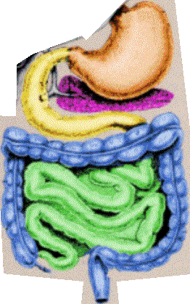
Chylomicrons are released from the intestine into the lymphatics, bypassing the liver
Lungs
Lymphatics
(thoracic duct)
Liver
Portal vein
Systemic circulation

Slide 28
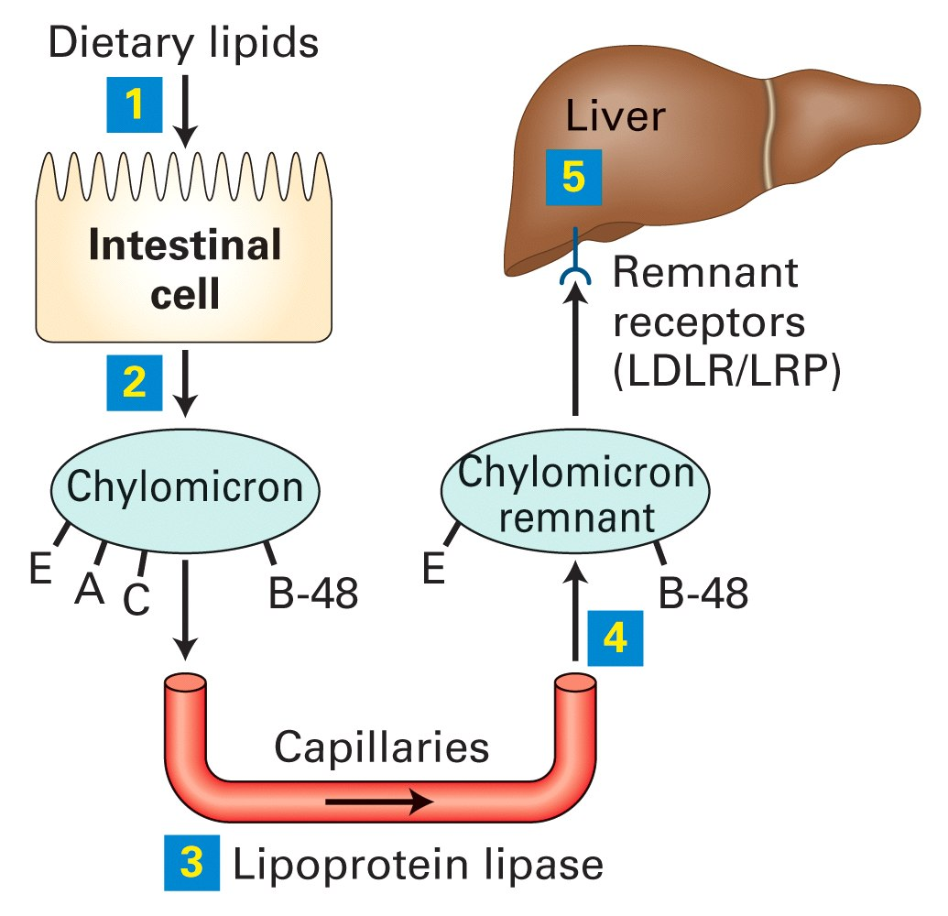

Slide 29
(3) Endogenous pathway
Most TG in liver and packaged into VLDL are derived from diet
Normally, small fractions of TG are synthesized from dietary carbohydrates
VLDL once secreted into circulation undergo a lipolytic process similar to that of CMs
VLDL loses core lipids, causing dissociation & transfer of apolipoproteins & phospholipids to other lipoprotein particles.
During this, VLDL is converted to VLDL remnants (IDL), which can be further transformed by lipolysis into LDL.
Half of VLDL is converted to LDL; remainder is taken up as VLDL remnants by liver remnant receptors.

Slide 30
Free cholesterol derived from LDL is used for membrane biosynthesis and excess fraction is converted by acyl-CoA:cholesterol acyltransferase (ACAT) into cholesteryl esters and stored in intracellular lipid droplets
Cellular cholesterol biosynthesis is controlled by a complex mechanism involving availability of cholesterol delivered by LDL receptor
LDLR, and many cholesterol biosynthetic enzymes (e.g. HMG-CoA reductase) are downregulated by increased cellular cholesterol levels

Slide 31
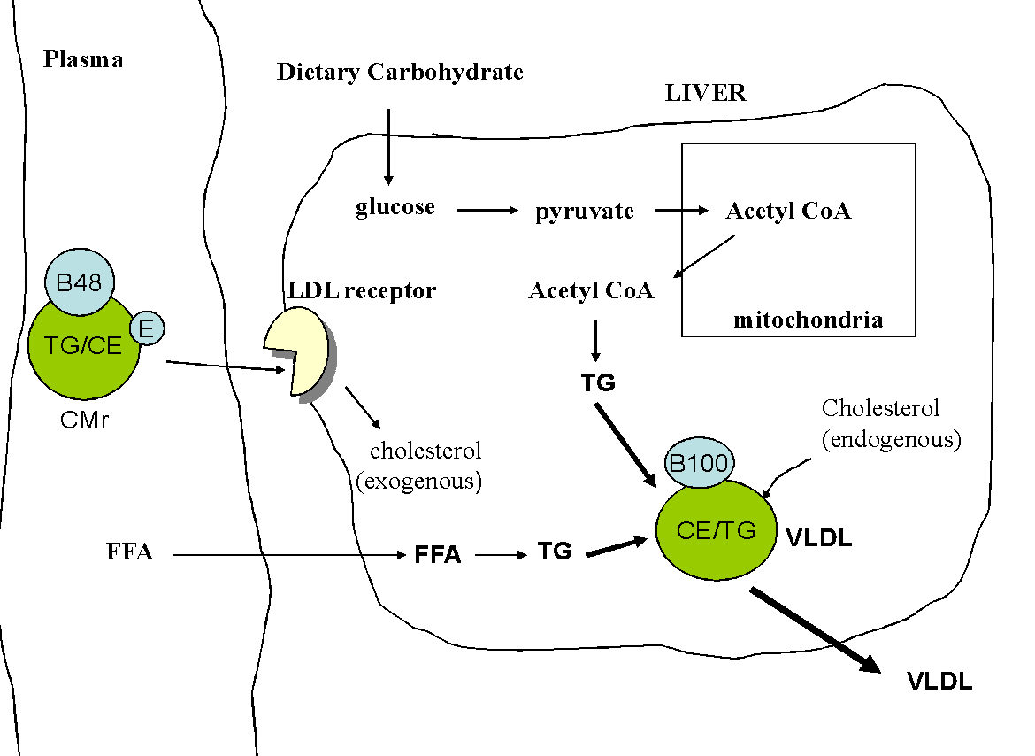
VLDL Assembly
Notes:
.

Slide 32
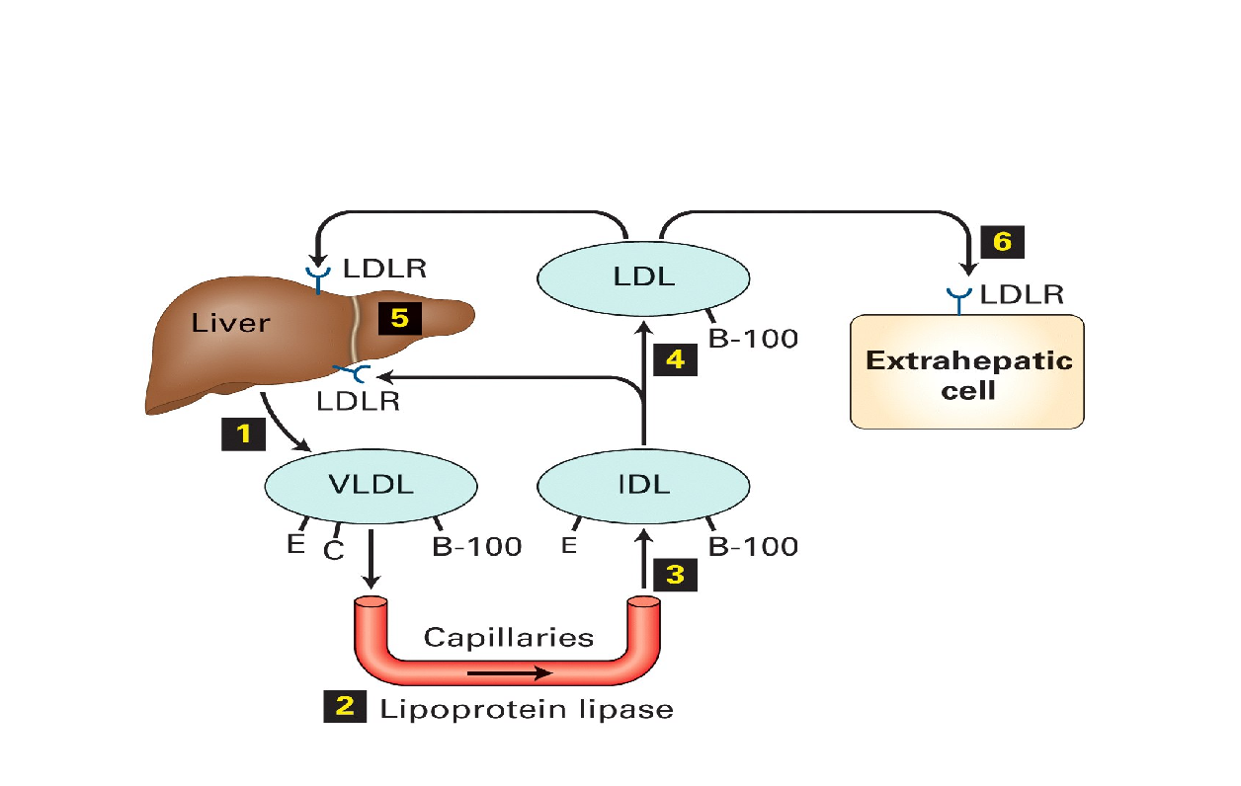
Endogenous Lipid Transport

Slide 33
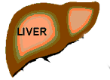
B100
Tissues
VLDL
B100
Lipoprotein
lipase
LDL
Some LDL taken up
by liver (LDL receptors)
E
CII
Having lost TAG to tissues LDL contains a large proportion of cholesterol/cholesteryl esters
Capillary wall
(endothelial surface)
Some LDL taken up by
other tissues (LDL receptors).
LDL delivers cholesterol and
TAG to the extra hepatic tissues.
E
CII
HDL

Slide 34
Regulation of Lipoprotein Lipase
Fed state
LPL synthesis and activity (adipocytes)
LPL synthesis and activity (skeletal and heart muscle)
Fasted/ exercise state
LPL synthesis and activity (adipocytes)
LPL synthesis and activity (muscle)
Lactating -
Mammary gland
LPL activity
The K_{m} for muscle LPL is lower than that of LPL in adipose

Slide 35
Function of LDL receptor
Endocytosis of LDL and other LP
Release free cholesterol into liver
Incorporate into plasma membrane
Inhibit formation of new LDL receptors
Inhibit cholesterol synthesis
Promote ACAT activity (FC 🡪 CE)
Regulated by SREBP
Monitors free cholesterol

Slide 36
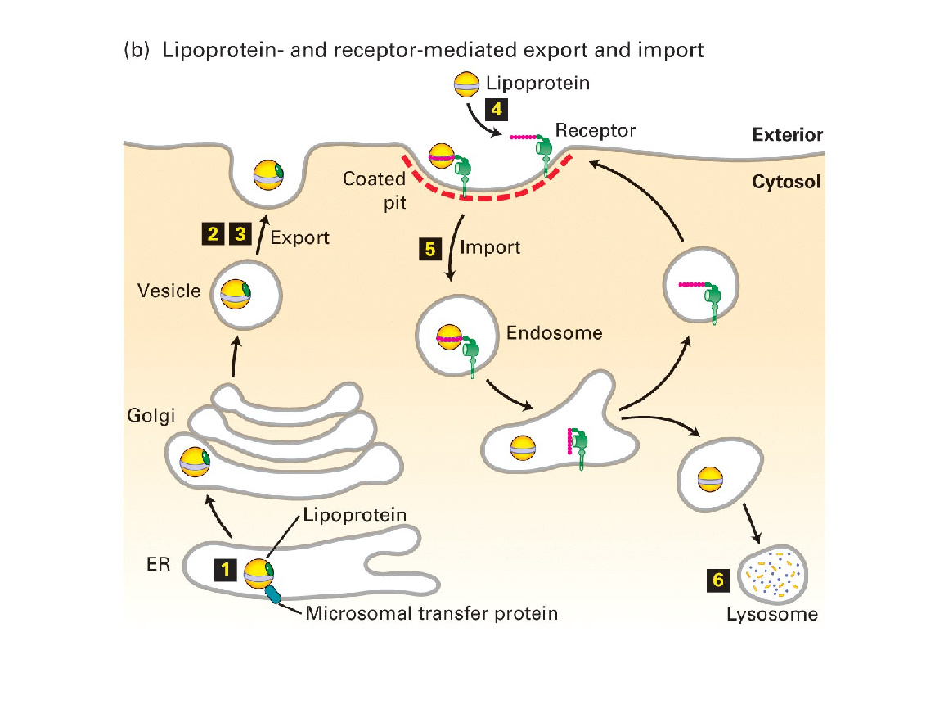

Slide 37
Familial Hypercholesterolemia
Incidence of FH is 1:500
Patients heterozygotes for FH, have half the normal number of LDL receptors
FH lowers the hepatic uptake of LDL and increases hepatic cholesterol synthesis
LDL accumulates in plasma and often leads to CHD by mid-adulthood in heterozygotes and even earlier for homozygotes
Notes:
Discussed later on slide

Slide 38
(4) Reverse cholesterol transport pathway
HDL maintains equilibrium of cholesterol in peripheral cells by reverse transport to liver
HDL acts like a sink for the small amount of cholesterol that can diffuse away from cells
Once chol is bound to HDL it is trapped by converting it via LCAT to chol ester producing HDL₃
Chol esters increase the capacity of the surface of HDL₃ to absorb more chol along with apo C-I, C-II, C-III and E and phospholipids from CMs and VLDL & is converted to HDL₂
HDL₂ delivers chol to liver via scavenger receptor type BI (SR-BI)
Approx. half of chol on HDL is returned to liver via LDL receptor after being transferred from HDL to LDL via the Chol ester transfer protein (CETP)
Another pathway that mediates transfer of Chol from cells via HDL involves the ABCA1 transporter
ABCA1 mutation 🡪 Tangier disease, a disorder associated with low HDL and a predisposition to premature CHD

Slide 39
CETP exchanges cholesterol esters in HDLs for triglycerides in B100 LPs
VLDL
CE
CETP
FFA
LPL
TG
IDL
Liver
(LDLR)
TG
CETP
HDL
CE
FFA
TG
LPL
CETP
Liver
(LDLR)
CE
LDL

Slide 40
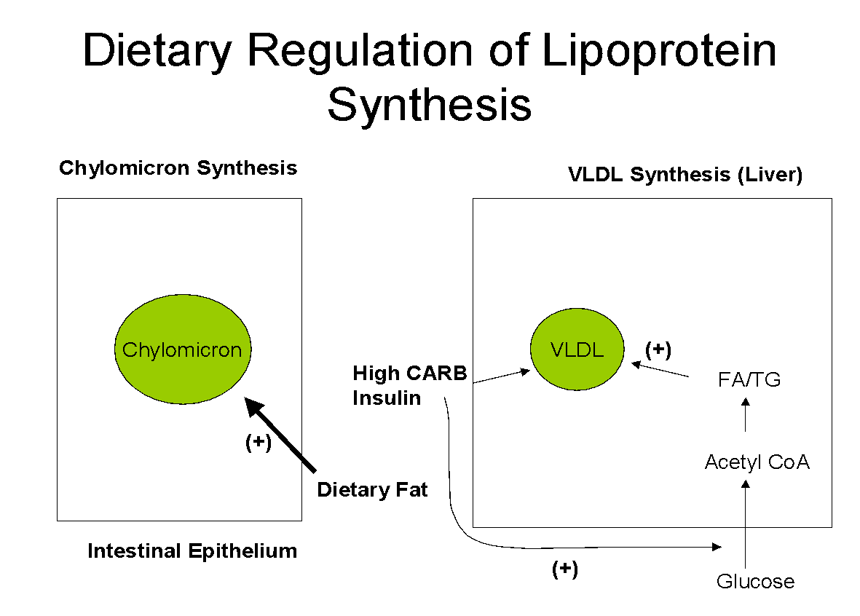

Slide 41
Postprandial Changes in Plasma Lipid Metabolism
Fat storage via LPL
Exchange of cholesterol for VLDL TG in HDL (CETP)
LCAT activity = esterification of free cholesterol (HDL)
These postprandial changes are beneficial in maintaining whole body homeostasis of glycerides and cholesterol

Slide 42
Fat accumulation in adipose: High I/G (Fed)
Capillary endothelium
B48
(+)
CII
insulin
TG/CE
LPL
CIII
FFA-albumin (oxidation)
Glucagon
chylomicron
FFA
Glucose
glut4
(+)
Insulin
regulated
glucose
transport
CoA
G3P
Fatty acyl CoA
Triglycerides
adipose
Notes:
Fed state: High adipose LPL. Increased glucose transport into adipocyte.

Slide 43
Lipid and Lipoprotein Population Distributions
Women have, on average, higher HDL cholesterol levels but lower total cholesterol & triglyceride levels than men.
After menopause, no difference in total cholesterol
Total & LDL cholesterol & triglyceride levels all increase with age, in both men & women.
Total & LDL cholesterol & triglycerides are much lower in young children than adults.
At puberty, boys’ HDL cholesterol drops 20% to adult male levels, but girls’ does not change.
Lower rates of LDL cholesterol & heart disease in Asians (food and lifestyle differences)

Slide 44
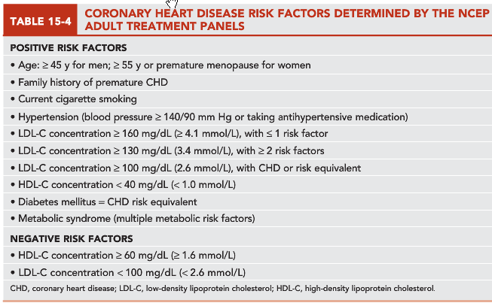
NCEP: National cholesterol education program in USA

Slide 45
Diagnosis and Treatment of Lipid Disorders (Dyslipidemias)
Dyslipidemias - diseases associated with abnormal blood lipid concentrations
Arteriosclerosis
Single leading cause of death & disability in U.S.
Caused by lipids, in form of esterified cholesterol, being deposited in artery walls, resulting in fatty streaks
Fatty streaks develop into plaques that can block blood flow.
When plaque develops in arteries of the arms or legs 🡪 peripheral vascular disease (PVD); when it develops in the heart 🡪 coronary artery disease (CAD); when it develops in the vessels of the brain 🡪 cerebrovascular disease (CVD)
Plaque formation involves repeated cycles of cell injury, followed by infiltration and cell proliferation to repair the site. LDL is believed to play a central role in initiating and promoting plaque formation. It is deposited into the subendothelial space where it is taken up by various cells, including macrophages

Slide 46
Diagnosis and Treatment of Lipid Disorders (Dyslipidemias)
Arteriosclerosis drugs/therapy
HDL increasing drugs (fibric acid derivatives and niacin-containing compounds; Cholesteryl esters transfer proteins (CETP) inhibitors)
Bile acid sequestrants (cholestyramine, colesevelam, and colestipol) work by sequestering cholesterol in the gut so that it is not absorbed 🡪 enhancing conversion of cholesterol into bile acids in the liver, reduces hepatic cholesterol content. Interfere with absorption of fat-soluble nutrients
Ezetimibe inhibits cholesterol absorption by inhibiting the Niemann-Pick C1-Like 1 (NPC1-L1) transporter in the intestine without impacting the absorption of fat-soluble nutrients.
HMG-CoA reductase inhibitors (lovastatin, simvastatin, pravastatin, etc.) block intracellular cholesterol synthesis 🡪 increasing LDLR expression 🡪 removal of LDL from circulation.
Fish oils (omega-3) lower TG and increase HDL

Slide 47
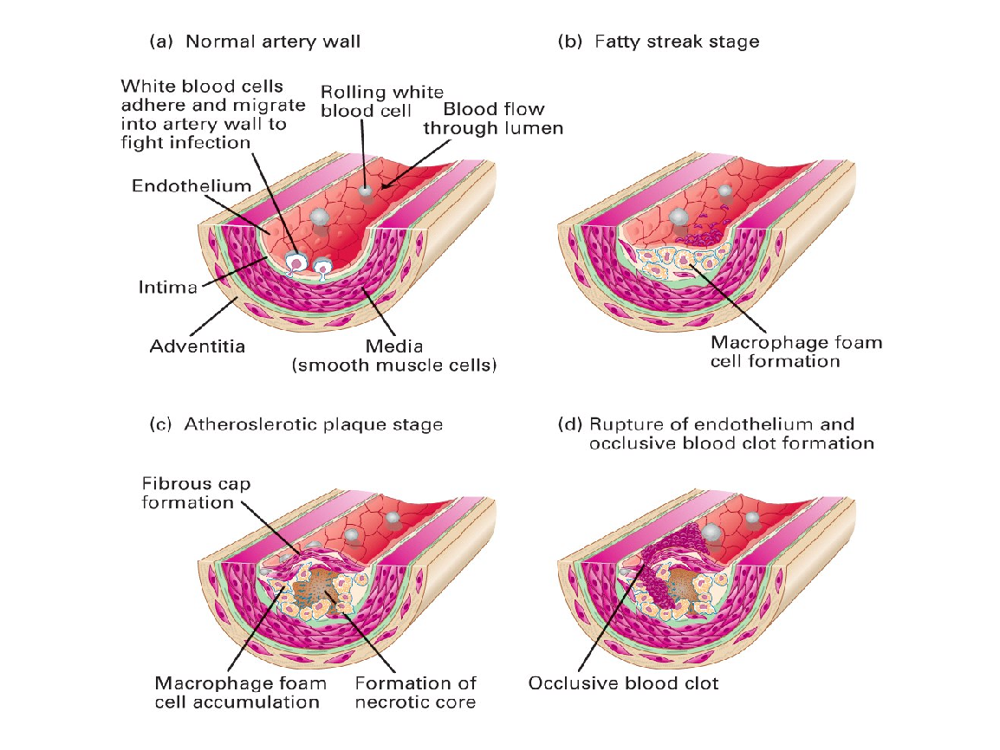

Slide 48
Effect of Exercise
Increases LPL activity in muscle.
Reduces TGL from the particle.
Reduction in weight
Increases HDL

Slide 49
Effect of diet
Vegetarian diet – Cholesterol intake less
Reduced Carbohydrate – VLDL TG Reduced
Reduced Fat – Reduces CM TG
Unsaturated fats (Mono and Poly)- Reduction in Plasma cholesterol
Fiber – decreases cholesterol absorption

Slide 50
Diagnosis and Treatment of Lipid Disorders (Dyslipidemias)
Hyperlipoproteinemia
Diseases associated with elevated lipoprotein levels
Caused by malfunctions in the synthesis, transport, or catabolism of lipoproteins.
Includes hypercholesterolemia, hypertriglyceridemia, & combined hyperlipidemia

Slide 51
Diagnosis and Treatment of Lipid Disorders (Dyslipidemias)
Hypercholesterolemia
Lipid abnormality most closely linked to heart disease
Familial hypercholesterolemia (FH): genetic abnormality predisposing people to elevated cholesterol levels
Homozygotes: rare (1:1 million); first heart attack in teens
Treated by LDL pheresis (similar to dialysis) blood is periodically drawn from the patient, processed to remove LDL, and returned to the patient.
Heterozygotes: more common (1:500)
Treatment with HMG-CoA reductase inhibitors

Slide 52
Diagnosis and Treatment of Lipid Disorders (Dyslipidemias)
Hypertriglyceridemia
Elevated triglyceride: high, 200–500 mg/dL; very high, >500 mg/dL
Due to either genetic abnormalities or hormonal abnormalities
Genetic abnormalities - familial hypertriglyceridemia (FTG)
Hormonal abnormalities (associated with the pancreas, adrenal gland, and pituitary or of diabetes mellitus or nephrosis)
Severe hypertriglyceridemia (>500 mg/dL) is usually not associated with high risk of CHD, but it is a potentially life-threatening abnormality because it can cause acute and recurrent pancreatitis
Can cause eruptive xanthomas
Severe hypertriglyceridemia is caused by a deficiency of LPL or by a deficiency in apo C-II which is a necessary cofactor for LPL activity
Treatment of HTG consists of dietary modifications, fish oil and or TG lowering drugs (primarily Fibric acid derivatives)
Notes:
Diabetes mellitus leads to increased shunting of glucose into the pentose pathway, causing increased fatty acid synthesis. Renal failure depresses the removal of large-molecular-weight constituents like triglycerides, causing increased serum levels. Hypertriglyceridemia is generally a result of an imbalance between synthesis and clear-ance of VLDL in the circulation.12

Slide 53
Management of Hypetriglyceridemia
Nonpharmacotherapy
Nonpharmacologic management of hypertriglyceridemia is generally the initial treatment for patients with this condition. This primarily involves lifestyle modifications such as diet, exercise, weight reduction, smoking cessation, and limiting alcohol intake.
Pharmacotherapy
Fibric acid derivatives (eg, gemfibrozil, fenofibrate)
Niacin
Omega-3 fatty acids (eg, omega-3-acid ethyl esters)
HMG-CoA reductase inhibitors (eg, atorvastatin, simvastatin)

Slide 54
Management of Hypetriglyceridemia
Surgical option
In general, surgical intervention is not necessary to treat hypertriglyceridemia.
Plasmapheresis
It can be used in the setting of severe hypertriglyceridemia to reduce triglycerides in the acute setting.
Ileal bypass
Surgery has been shown to improve all lipid parameters but should be reserved for severe hypertriglyceridemia refractory to all treatment.

Slide 55
Diagnosis and Treatment of Lipid Disorders (Dyslipidemias)
Combined Hyperlipoproteinemia (CH)
Elevated levels of serum total cholesterol & triglycerides
Increased risk for coronary heart disease (CHD)
Genetic forms
Familial CH: some in family have only elevated cholesterol, others only elevated triglycerides, others both
Familial dysbetalipoproteinemia: very rare
Lp(a) Elevation
Increased risk of CHD & cerebrovascular disease
Most LDL-lowering drugs have no effect on Lp(a) concentration, even when LDL-C is significantly lowered.
The two drugs shown to have some effect are niacin and estrogen replacement in postmenopausal women.

Slide 56
Non-HDL Cholesterol
Reflects total cholesterol minus HDL-C
LDL, VLDL, IDL, Lp(a)
Elevated non-HDL-C associated with increased risk. of CVD (even if the LDL-C levels are normal).
On average, non–HDL-C levels are approximately 30 mg/dL higher than LDL-C levels.

Slide 57
Diagnosis and Treatment of Lipid Disorders (Dyslipidemias) (cont’d)
Hypolipoproteinemia
Low levels of lipoproteins
Two forms: hypoalphalipoproteinemia (low HDL) & hypobetalipoproteinemia (low LDL)
Hypoalphalipoproteinemia
Isolated decrease in circulating HDL (concentration <40 mg/dL), without presence of hypertriglyceridemia
Alpha denotes region in which HDL migrates on agarose electrophoresis.
Associated with several defects, often genetic, most of which are linked to increased risk of premature CHD
Tangier disease is an extreme form of hypoalphalipoproteinemia

Slide 58
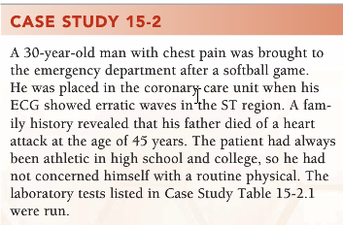
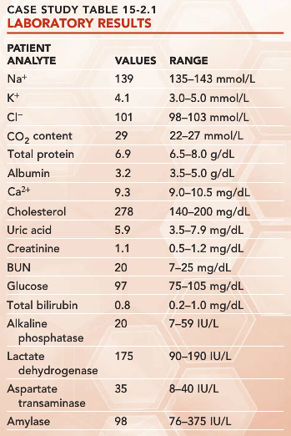
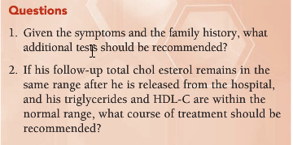
Cardiac enzyme CK and CK isoenzyme and LDH and LDH isoenzyme would be useful. Fasting total chol, TG, and HDL-C and LDL-C as well.
LDL-C can be calculated >190 mg/dL (Total chol = 280 mg/dL and normal TG and HDL-C), which is extremely elevated. Treatment should start with diet change before leaving the hospital. After a few weeks, if no improvement occurs, the physician should start him on medication. The patient has a family history of CHD, and, presumably, the patient has now been diagnosed with CHD. Therefore, the goal would be to reduce LDL-C values to <100 mg/dL.

Slide 59
Lipid and Lipoprotein Analyses
Lipid Measurement
Lipids & lipoproteins are important measures of CHD risk.
Cholesterol Measurement
Hexane extraction after hydrolysis with alcoholic KOH, followed by reaction with Liebermann-Burchard color reagent (old)
Current reference method GC-MS
Coupled enzymatic reactions
Triglyceride Measurement
Useful in detecting metabolic disorders & CVD risk
Reference method GC-MS

Slide 60
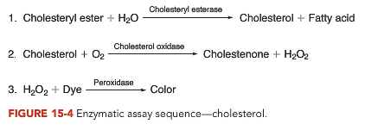
Cholesterol measurement
Specimen: serum or plasma
Fasting: at least 12 hrs, preferred for chol & required for TG
Method: enzymatic methods

Slide 61
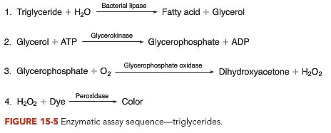
Triglyceride measurement
Used in estimation of LDL-C
Current methods will measure also endogenous serum glycerol (10 to 20 mg/dL overestimation of triglycerides)

Slide 62
Lipid and Lipoprotein Analyses (cont’d)
Lipoprotein Methods
Measure physical properties: density, size, charge, apolipoprotein
Methods: ultracentrifugation, electrophoretic separation, chemical precipitation, chromatographic, immunochemical
HDL Methods
In past, 2-step separation by chemical precipitation was used.
Now, 3-step process: ultracentrifugation to remove VLDL, heparin manganese precipitation to remove LDL, & analysis of supernatant cholesterol by Abell-Kendall assay

Slide 63
Lipid and Lipoprotein Analyses (cont’d)
LDL Methods
Beta-quantification: most common; combines ultracentrifugation & chemical precipitation
Friedwald calculation: bypasses centrifugation; commonly used in routine & sometimes research labs
Compact Analyzers
Mobile point-of-care testing systems
Can measure cholesterol, triglycerides, HDL cholesterol, & glucose from a finger stick sample

Slide 64
Lipid and Lipoprotein Analyses (cont’d)
Apolipoprotein Methods
Apo B is measured directly in serum by immunoassay.
Apo A-I is measured by separation & analysis of HDL cholesterol.
Lp(a) is commonly measured by various immunoassays.
Phospholipid Measurement
Can be measured by an enzymatic reaction sequence
Fatty Acid Measurement
Commonly analyzed by gas-liquid chromatography

Slide 65
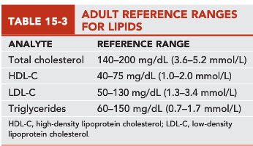

Slide 66
Calculations
Total chol (chol) = VLDL-C + LDL-C + HDL-C
Friedewald Equation:
LDL-C (mg/dL)= [Total chol] – [HDL-C] – [TG]/5
LDL-C (mmol/L) = [Total chol] – [HDL-C] – [TG]/2.2
Other formulas uses a factor of 0.16*[TG] as an approx of VLDL

Slide 67
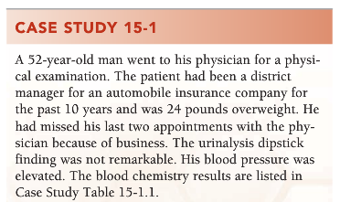
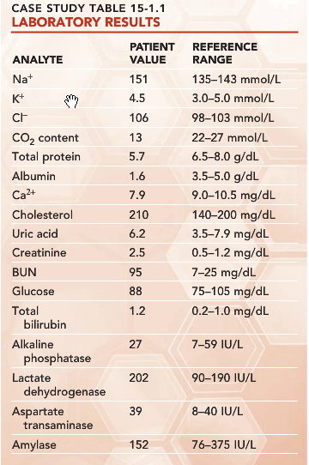
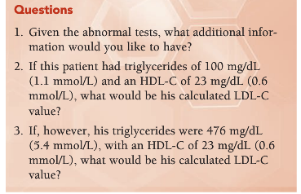
Triglyceride and HDL cholesterol values
The estimated LDL cholesterol, 167 mg/dL (4.3 mmol/L), is considered high.
The LDL cholesterol concentration could not be estimated because the triglycerides were >400 mg/dL (4.5 mmol/L). Lipoproteins would need to be measured in a specialty laboratory following ultracentrifugation.

Slide 68
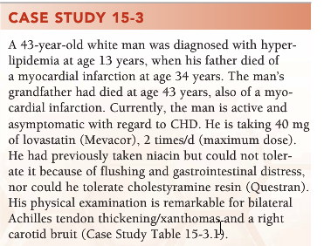
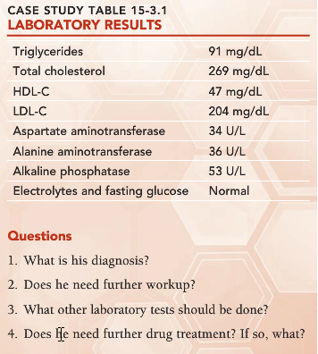
FH heterozygote
Yes, the patient needs an exercise stress test and carotid ultrasound to evaluate his current risk.
Lp(a), homocysteine
Yes, further therapy could include a more potent statin or combination drug therapy or a retrial of niacin to further lower his LDL cholesterol; however, his liver function tests would need careful monitoring. Other options are low-dose aspirin and vitamin E.

Slide 69
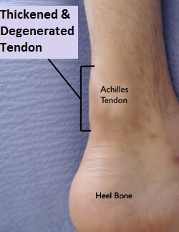
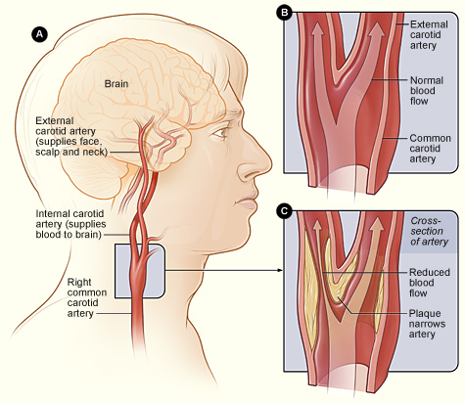

Slide 70
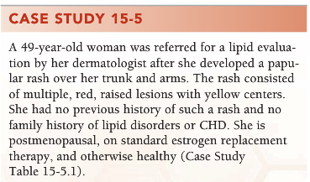
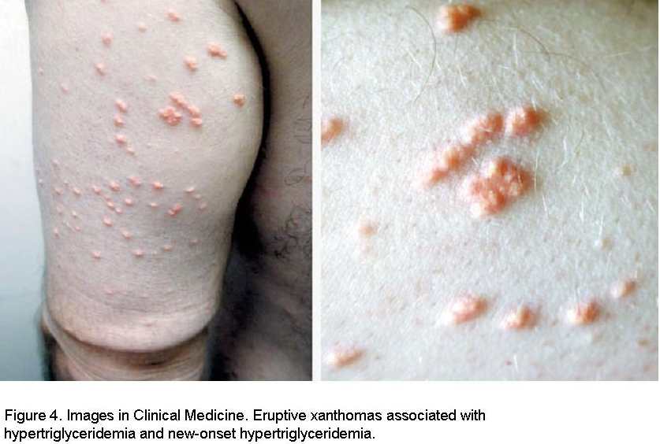
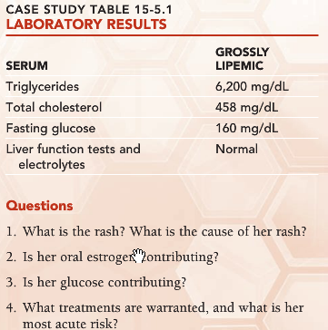
Eruptive xanthomas; triglycerides
Yes
Yes, she has diabetes mellitus.
Cessation of estrogen replacement therapy, with consideration of transdermal estrogen therapy, triglyceride-lowering diet and medication, hypoglycemic medication. Most acute risk is pancreatitis.

